Slide 1

Chapter 5
Consumers and Incentives
ECON 003
UC Riverside · Summer 2026
Notes:
TITLE
- Chapter 5. The title image is the same market stall as Chapter 4 — deliberate. Last
week we watched the market from the outside; today we walk up to the stall and stand
behind one buyer's eyes.
- One sentence of framing before you move on: "Chapter 4 drew the demand curve and asked
you to believe it. Today we build it out of a person."

Slide 2



Where We Left Off
Chapter 4 handed you the demand curve as a fact.
Chapter 5 builds it out of one person making one decision.
CHAPTER 3 GAVE YOU THE
TOOL
CHAPTER 4 GAVE YOU THE
PICTURE
CHAPTER 5 JOINS
THEM UP
Optimisation. Compare
marginal
benefit with marginal cost and
stop where they meet.
Two curves crossing. Demand
sloped down.
A buyer with tastes, prices and
a budget. Her choices ARE the
demand curve.
Notes:
WHERE WE LEFT OFF
- The through-line of the course so far: Ch3 = the method (optimise at the margin),
Ch4 = the picture (two curves), Ch5 = the person behind the picture.
- Say out loud: "In Chapter 4 I asked you to accept that the demand curve slopes down.
I owe you a derivation. That is what today is."
- The Ch4 egg question was answered last week. Do not re-open it.

Slide 3
Today's Roadmap
01
The Buyer's Problem
Three ingredients: what you like, what it costs, what you have
02
Putting It All Together
Marginal benefit per dollar — the rule that picks the best bundle
03
From the Problem to the Demand Curve
Change one price, redo the problem, and the curve appears
04
Consumer Surplus
What buyers get out of a market over and above what they pay
05
Demand Elasticities
Putting a number on 'how responsive' — and why it decides revenue
Notes:
ROADMAP
- Parts 1-4 are one continuous argument: a buyer, a rule, a curve, a measure of what
she gains. Part 5 is a separate tool bolted on — say so, so nobody expects elasticity
to fall out of the sweater table.
- If you are running long, Part 5 is where the hour will bite. It is also the part the
exam leans on hardest. Protect it.

Slide 4
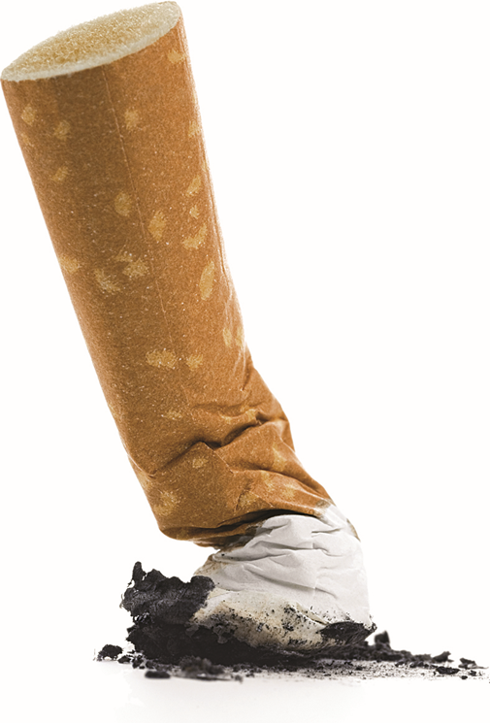


A Question to Carry Through the Hour
Would a smoker give up the habit for $100 a month?
THE INSTINCT
HOLD ONTO IT
"No. Addiction isn't a budgeting
problem — money won't fix it."
"Or maybe yes, if they're broke
enough."
Both are guesses. Neither puts a
number on anything.
We come back to this in Part 4,
once you can put $100 into a
budget constraint and read off
what it buys.
There is a real experiment behind
it, and the answer is a number.
The habit, priced
Image: Acemoglu, Laibson & List, Microeconomics 3e
Notes:
CARRIED QUESTION — the chapter's cliffhanger
- ANNOUNCE THE PARKING. An unresolved question reads as forgetting; an announced one
reads as structure. Same device as the brown-egg question in Chapter 4, and say so —
"you have seen me do this before, and I did come back to the eggs."
- Take two or three answers, do not adjudicate them, move on.
- This is Pearson's own Evidence-Based Economics opener for the chapter.
- Resolution is on the smoking-trial slide in Part 4, and then in sweaters and jeans
on the slide after it.

Slide 5
PART 1
The Buyer's Problem
Notes:
PART 1 — 5.1
Three ingredients. Nothing here is hard; the payoff is that all of consumer theory is
built from exactly these three and nothing else.

Slide 6


The Buyer’s Problem
Every purchase you have made answered the same three questions.
Economists call the three together the buyer's problem.
WHAT DO YOU
LIKE?
HOW MUCH DOES IT
COST?
HOW MUCH MONEY DO YOU
HAVE?
Prices. Set by the market in Chapter 4.
Your budget constraint.
Tastes and preferences.
Taken as given and read off your choices.
Drop any one of the three and the theory gives nonsense — a private jet, or the cheapest thing on the
shelf.
Notes:
THE BUYER'S PROBLEM — three parts
- Pearson's point, worth making concretely: each ingredient alone gives an absurd answer.
Only tastes -> you buy an island. Only prices -> you buy whatever is cheapest,
whether or not you want it. Only budget -> you know what you can spend and nothing
about what to spend it on.
- Ask the room: "which of the three is doing the work when you pick between two coffee
places that charge the same?" (tastes) "And when you pick between two identical
coffees at different prices?" (prices)
- All three get formalised in the next few slides. Tastes become marginal benefit,
prices become the slope of a line, budget becomes the line itself.

Slide 7
What You Like: Your Choices Give You Away
We do not need to ask what you value. We watch what you buy.
THE $50 JEANS
WHAT WE ACTUALLY LEARN
You spend birthday money on a $50 pair of jeans at the mall.
We now know more than "you like jeans."
Of everything in that mall you could have had for $50 — shoes, dinner, headphones, you favored a pair of jeans over all of them.
So: what do your buying decisions signal about you as a consumer?
Two working assumptions: you want the biggest bang for your buck, and what you buy shows what
you like.
Notes:
TASTES AND PREFERENCES
- The move here is subtle and students miss it. The choice does not just rank jeans
above nothing; it ranks jeans above EVERY other $50 bundle available at that moment.
That is a lot of information from one receipt.
- Pearson's live-classroom prompt, converted to posed-then-pause since we record:
"What do your buying decisions signal about you as a consumer?" Pause three or four
seconds before answering.
- Worth naming the term revealed preference even though ALL does not use it as a heading.
Students meet it again in upper division.
- Do NOT moralise about anyone's tastes. The theory is deliberately silent on whether
the jeans were a good idea.

Slide 8

Assumptions
PRICES
BUDGET
1. Prices are posted, not negotiated.
2. You can buy as much as you want
without pushing the price up.
You are one buyer among millions —
too small to move the market you met
last week.
1. No saving, no borrowing. Money not
spent is simply lost.
2. We draw a straight line, but you buy
whole units — two sweaters, not 2.4.
Notes:
THE ASSUMPTIONS
- Flag these deliberately. Students who later ask "but what if I could save?" are asking
a good question, and the honest answer is "we assumed that away on purpose, and
Chapter 15 puts it back."
- Assumption 2 on prices is the price-taking assumption from Chapter 4's perfectly
competitive market. Point back at it explicitly — it is the same idea wearing a
different hat.
- The whole-units point matters for the sweater table shortly: the optimum is 6 sweaters
and 3 jeans, not a fraction of either.

Slide 9
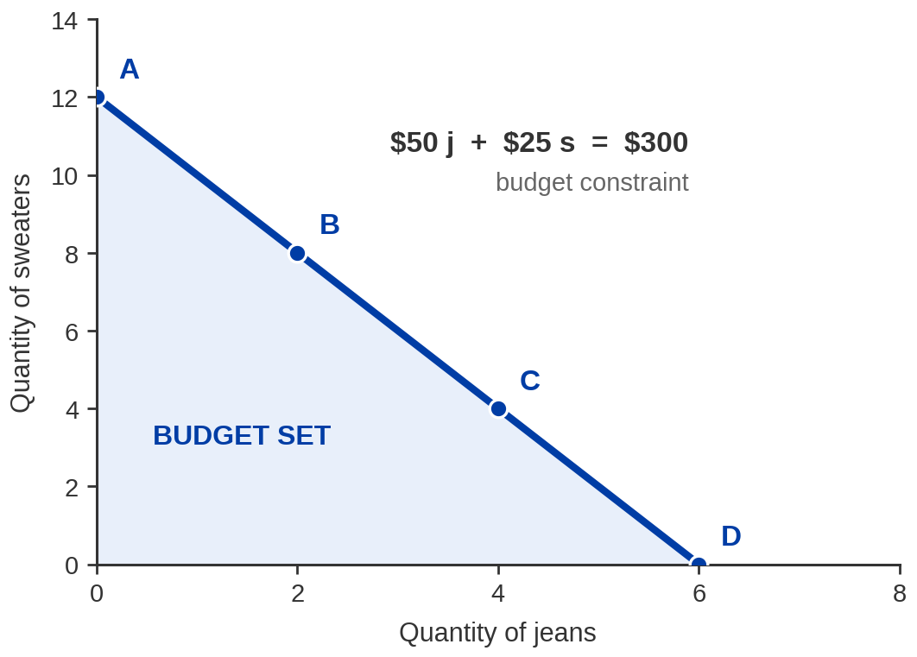
Exhibit 5.1 — The Budget Set and the Budget Constraint
FOUR BUNDLES ON THE LINE
Bundle | Sweaters | Jeans
A | 12 | 0
B | 8 | 2
C | 4 | 4
D | 0 | 6
$300 to spend.
Sweaters $25 · Jeans $50.
This is not a demand curve. It plots one good against another — and the prices are hidden in the
slope.
Notes:
EXHIBIT 5.1 — READ THESE NUMBERS, DO NOT RECONSTRUCT THEM
Budget $300. Sweaters $25 each. Jeans $50 a pair.
All sweaters -> 12. All jeans -> 6. Line: $50j + $25s = $300.
- Build it at the endpoints, out loud: "If you spend the lot on jeans at $50, how many?
Six. All on sweaters at $25? Twelve. Now join them."
- ASK FIRST, before explaining: "is this a demand curve?" It is not, and the reason is
worth the pause — a demand curve plots ONE good against ITS price; this plots two
goods against each other. Prices appear only in the slope.
- Vocabulary: the LINE is the budget constraint; the filled triangle including the line
is the budget set.
- Bundles A-D all cost exactly $300. Check one live: B is 8 x $25 + 2 x $50 = $300.

Slide 10
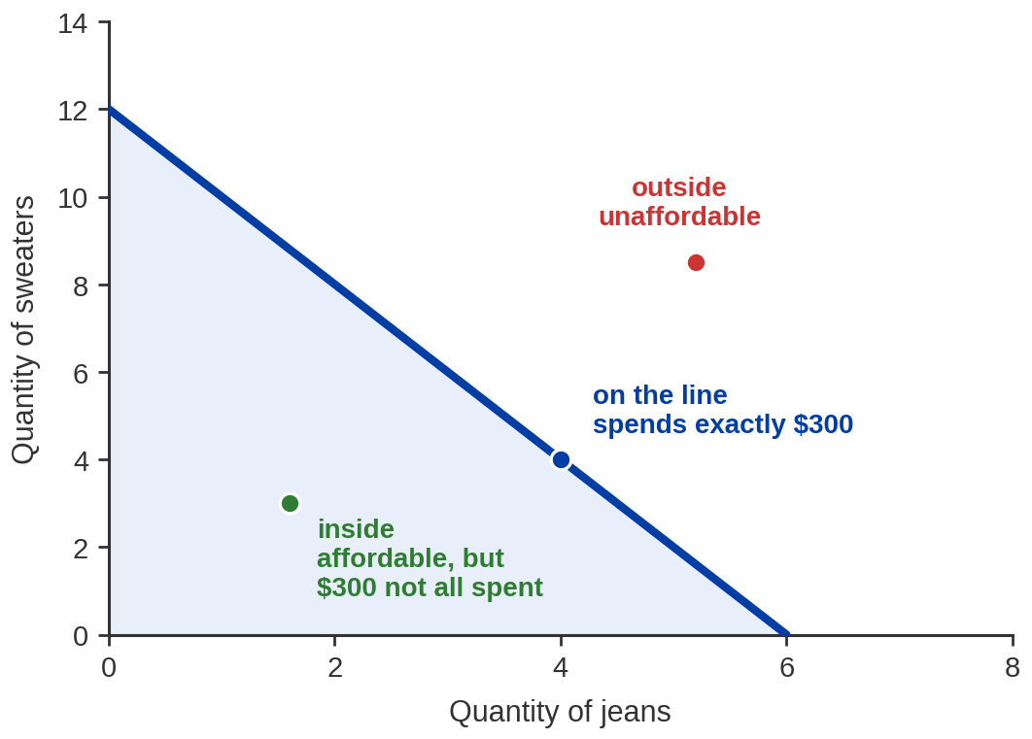
One Line, Three Regions
ON THE LINE
Spends exactly $300. These are the
bundles worth arguing about.
INSIDE
Affordable, but leaves money unspent —
and unspent money is wasted here.
OUTSIDE
Unaffordable. No borrowing, so these
bundles simply do not exist for you.
An optimizing buyer always ends up ON the line. Inside is leaving money on the table; outside is
impossible.
Notes:
THREE REGIONS
- The reason inside-the-line is wasteful is our no-saving assumption. Say it plainly:
"In this model there is nothing else to do with a dollar. Saving it is throwing it
away." A student who objects is right about the world and wrong about the model.
- This is why we can search for the best bundle ON the line rather than anywhere in
the triangle. That shrinks the problem enormously and it is worth flagging as a
method point, not just a fact.
- Why does the line slope down? Because more of one thing means less of the other at
fixed prices and fixed income. The slope IS the trade-off, which is the next slide.

Slide 11
The Slope Is an Opportunity Cost
slope of the budget constraint = − P(jeans) / P(sweaters) = − $50 / $25 = − 2
MOVING RIGHT ALONG THE LINE
MOVING LEFT ALONG THE LINE
One more pair of jeans costs you
TWO sweaters. That is the opportunity
cost of a pair of jeans.
One more sweater costs you HALF a
pair of jeans. Same trade, read the
other way round.
Opportunity cost is measured in units of goods of A per unit of good B you give up (e.g. sweater per pair of jeans), or a price ratio. Jeans cost twice what sweaters cost, so jeans cost two sweaters.
Chapter 3 told you every choice has an opportunity cost.
Notes:
SLOPE = OPPORTUNITY COST — read these exactly
P(jeans) = $50. P(sweaters) = $25. Slope = −50/25 = −2.
One pair of jeans "costs" 2 sweaters. One sweater "costs" 1/2 a pair of jeans.
- This is the single most reusable idea in Part 1. Opportunity cost, which in Chapter 3
was a sentence, is now a measurable number on a diagram.
- Pearson works this at points D and A. The answer is the same at every point on a
straight line, and saying so pre-empts the obvious question.
- Push once: "what would have to change for the trade-off to change?" Only the price
RATIO. Doubling both prices does not change the slope — it moves the whole line in.
That distinction is the pivot-versus-shift slide later, so plant it here.

Slide 12
PART 2
Putting It All Together
Notes:
PART 2 — 5.2
The budget constraint says what you CAN buy. Now we work out which of those bundles
you WILL buy. The answer is a rule, and the rule is the whole chapter.

Slide 13


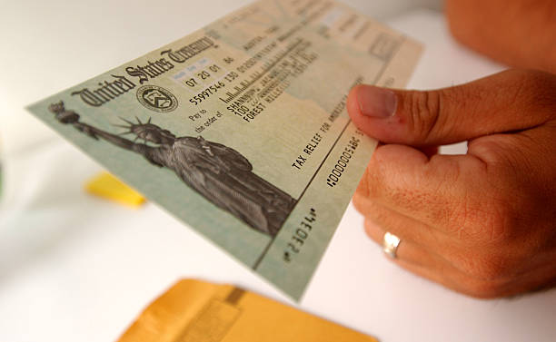
Somebody Offers You a $100,000 Car
MONDAY
TUESDAY
A billionaire offers to buy you a
Jaguar — a $100,000 car.
Do you accept?
He hasn't got time to go to the
dealership, so he offers you a
$100,000 check instead.
Do you go and buy the car?
Almost everyone says yes on Monday and no on Tuesday.
Same $100,000 either way — so the difference is not the money.
Given the cash you buy something else, because something else delivers more benefit per dollar. That is the rule.
Notes:
THE JAGUAR — Pearson's set-up for the equilibrium condition
- Run it as two separate questions with a real pause between them. Nearly every hand
goes up on Monday; nearly none on Tuesday.
- Then the payoff question: "if you would take a car worth $100,000, why won't you buy
the same car with $100,000?" Guide them, do not tell them.
- The answer: there exist other things worth more to you per dollar. Free car = the car
or nothing. Cash = the car or ANYTHING. The choice set changed, not the money.
- Pearson's aside, and it is a fair one: if a student says "because of the tax bill on
a gifted car," acknowledge that they are right in reality and ask them to set it
aside — it is not the point being made.
- This slide exists to make "benefit per dollar" feel inevitable before you write it down.

Slide 14
Exhibit 5.2 — Your Buyer's Problem, with $300
Qty | Sweaters $25 Total benefit | Marginal benefit | MB per $ (÷ $25) | Jeans $50 Total benefit | Marginal benefit | MB per $ (÷ $50)
0 | 0 | — | — | 0 | — | —
1 | 100 | 100 | 4.00 | 160 | 160 | 3.20
2 | 185 | 85 | 3.40 | 310 | 150 | 3.00
3 | 260 | 75 | 3.00 | 410 | 100 | 2.00
4 | 325 | 65 | 2.60 | 490 | 80 | 1.60
5 | 385 | 60 | 2.40 | 520 | 30 | 0.60
6 | 435 | 50 | 2.00 | 530 | 10 | 0.20
7 | 480 | 45 | 1.80 | 533 | 3 | 0.06
8 | 520 | 40 | 1.60 | 535 | 2 | 0.04
To find the optimum: STEP 1 – Difference to get marginal benefits.
STEP 2 – Divide by goods price to get MB per $ for each goods.
The optimum is 6 sweaters and 3 jeans: 6 × $25 + 3 × $50 = $300, for $435 + $410 = $845 of
benefit.
Notes:
EXHIBIT 5.2 — READ THESE, AND NOTE ONE CORRECTION
Optimum: 6 sweaters + 3 jeans. Cost 6 x $25 + 3 x $50 = $300 exactly.
Total benefit 435 + 410 = $845. MB per dollar equal at 2.00 on both sides.
- CORRECTION TO THE PUBLISHER'S TABLE. Pearson prints total benefit for the 6th sweater
as 425. That contradicts their own marginal-benefit column: 385 + 50 = 435, and the
7th (480) only follows from 435 + 45. Their own notes then quote the optimum as $845
of total benefit, which requires 435, not 425. We print 435. If a student is reading
along in the book and queries it, tell them the book's marginal column is right and
the one total-benefit cell is a typo — and that catching it is exactly the right
instinct.
- Do not walk the whole table. Point at the two MB-per-dollar columns and say "these
two columns are the entire decision. Everything else is scaffolding."
- The jeans marginal benefits collapse fast after the third pair (100 -> 80 -> 30 -> 10).
That is what stops you buying more jeans, and it is not an accident of the numbers —
it is diminishing marginal benefit, next slide.

Slide 15

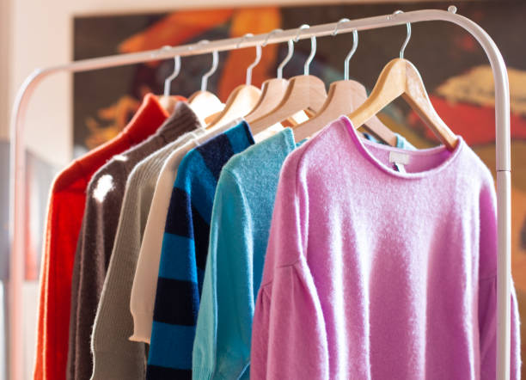
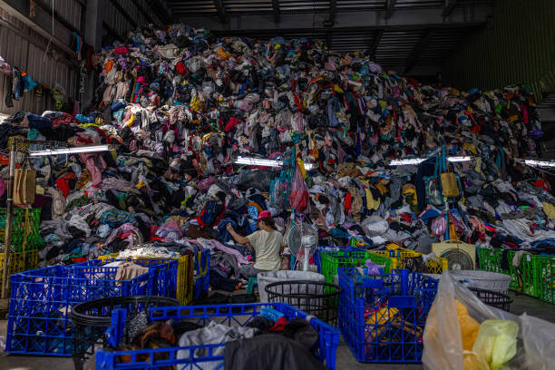
Diminishing Marginal Benefit
Diminishing marginal benefit — each additional unit of the same good
is worth less to you than the one before it.
THE FIRST ONE
THE FIFTH ONE
PUSH FAR ENOUGH
The first sweater is worth 100
to you. It fills the biggest
gap you had.
Worth 60. Still positive — you
would take it free — but it is
not the sweater you needed.
Marginal benefit goes to zero,
and then negative. An eighth
sweater becomes a nuisance.
Notes:
DIMINISHING MARGINAL BENEFIT
- Pearson's classroom bit, converted to posed-then-pause: "Would you like one serving of
your favourite food? A second? A third?" Ask, pause, then narrate the pattern rather
than polling the room — the recording needs the pause written in.
- Callback to Chapter 3, where this ran the same way. Students who saw it there will
recognise it; say the name of the idea so the recognition sticks.
- FORESHADOW HARD: this is the engine of the whole chapter. Because marginal benefit
falls, you eventually stop buying; and because you stop sooner when the price is
higher, the demand curve slopes down. We prove that in Part 3.
- Careful with wording: benefit falls at the MARGIN. Total benefit is still rising
(100 -> 185 -> 260). Students conflate the two constantly.

Slide 16
Marginal Benefit Per Dollar
marginal benefit per dollar = marginal benefit ÷ price
COMPARING RAW BENEFIT IS WRONG
COMPARING PER DOLLAR IS RIGHT
The 1st pair of jeans is worth 160;
the 1st sweater only 100.
So buy jeans first? No — the jeans
cost twice as much.
Jeans: 160 ÷ 50 = 3.20
Sweater: 100 ÷ 25 = 4.00
The sweater delivers more benefit
for every dollar. Buy it first.
Unify the units of benefits of different goods to the per dollar benefit.
Notes:
MARGINAL BENEFIT PER DOLLAR — read the arithmetic
1st sweater: 100 / $25 = 4.00. 1st jeans: 160 / $50 = 3.20.
So the first purchase is a sweater, even though jeans are "worth more".
- This is the single most common place students go wrong on this chapter, and it is
worth being slow. The bigger number (160) loses to the smaller one (100) because of
the denominator.
- Tie it back to Chapter 3: this is still marginal benefit vs marginal cost. We have
just divided both sides by the price so that two different goods become comparable.
- Analogy that lands: comparing 160 to 100 is comparing a 500 ml bottle to a 330 ml can
on price alone. You want the price per millilitre.

Slide 17
Working It: Buy in Order of Bang per Buck
Take the highest number in either MB-per-dollar column, buy that unit, cross it off, repeat until the $300 is gone.
Step | Buy | MB per $ | Cost | Spent so far
1 | Sweater #1 | 4.00 | $25 | $25
2 | Sweater #2 | 3.40 | $25 | $50
3 | Jeans #1 | 3.20 | $50 | $100
4 | Sweater #3 | 3.00 | $25 | $125
5 | Jeans #2 | 3.00 | $50 | $175
6 | Sweater #4 | 2.60 | $25 | $200
7 | Sweater #5 | 2.40 | $25 | $225
8 | Sweater #6 | 2.00 | $25 | $250
9 | Jeans #3 | 2.00 | $50 | $300
STEP 3: figure out which good should you spend the next dollar on – find the highest MB per $.
STEP 4: Repeat until you exhaust your budget.
The money runs out exactly as the two columns level off at 2.00 — 6 sweaters, 3 jeans.
Notes:
THE GREEDY WALK — this is the slide students should copy down
Order: S1 (4.00), S2 (3.40), J1 (3.20), then S3 and J2 tie at 3.00,
S4 (2.60), S5 (2.40), then S6 and J3 tie at 2.00. Cumulative spend hits
$300 exactly at step 9.
- Walk at least the first four steps out loud with the table on screen. After that the
pattern carries itself.
- The ties are not a nuisance, they are the answer arriving: when the two columns are
equal there is no reason to prefer either good, which is the equilibrium condition on
the next slide.
- If asked "what if the budget ran out mid-step?" — with whole units you would stop one
purchase earlier. Pearson's numbers are built so it comes out even; say that it is
built that way rather than pretending it always does.

Slide 18
The Consumer Equilibrium Condition
MB (sweaters) / P (sweaters) = MB (jeans) / P (jeans)
at the optimum: 50 / 25 = 100 / 50 = 2.00
IF THEY ARE NOT EQUAL
WHY IT SETTLES
Say sweaters give 3 per dollar and
jeans give 2.
You are leaving benefit on the table.
Shift a dollar to sweaters and you are
better off.
Buy another sweater and its marginal
benefit falls — diminishing marginal
benefit again.
The ratios move toward each other
until there is no gain left in switching.
Equilibrium: nobody has any reason left to change what they are doing.
Here: the last dollar you spent give the same benefit regardless of what goods you choose to buy.
Notes:
THE EQUILIBRIUM CONDITION — read the numbers
At 6 sweaters: MB = 50, so 50/25 = 2.00.
At 3 jeans: MB = 100, so 100/50 = 2.00. Equal. Stop.
- Pearson's worked what-if, and it is a good one: suppose MB of another sweater is $75
and of another pair of jeans is $100. Ratios are 3 and 2. Do you switch? Yes, toward
sweaters. And as you do, the sweater's marginal benefit falls below $75, pulling the
ratio back down. The incentive to switch destroys itself. That self-correction IS the
equilibrium.
- Emphasise the word EQUILIBRIUM has now appeared twice in the course with the same
meaning — no remaining incentive to change. In Ch4 it was a market; here it is one
person's shopping basket.
- This condition is examinable in exactly this form. Say so.

Slide 19
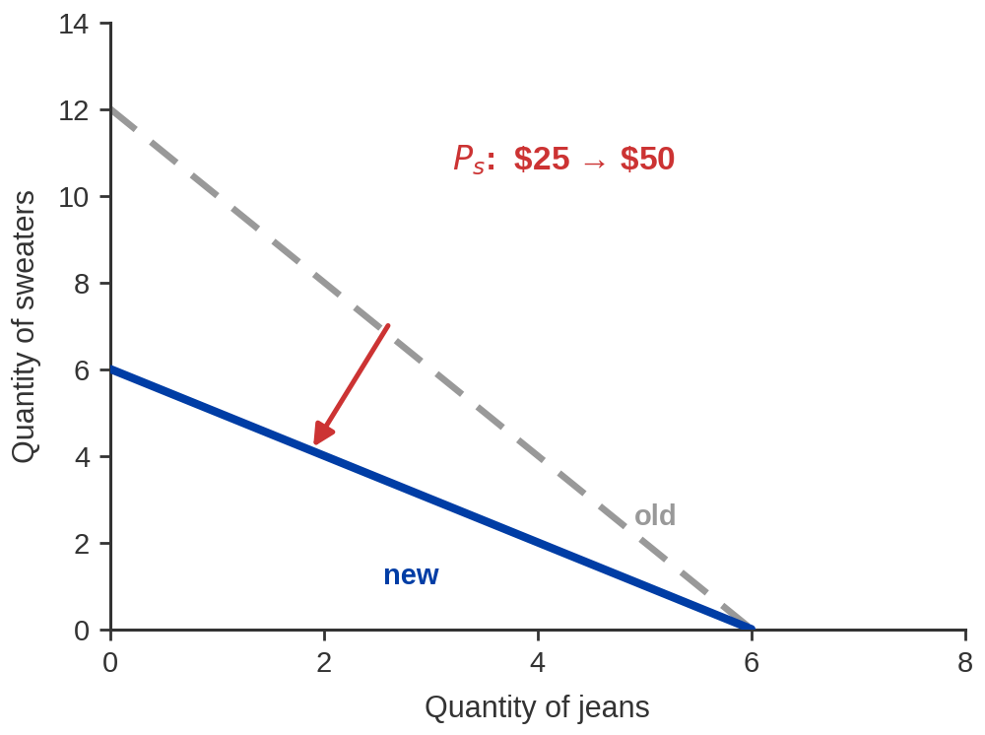
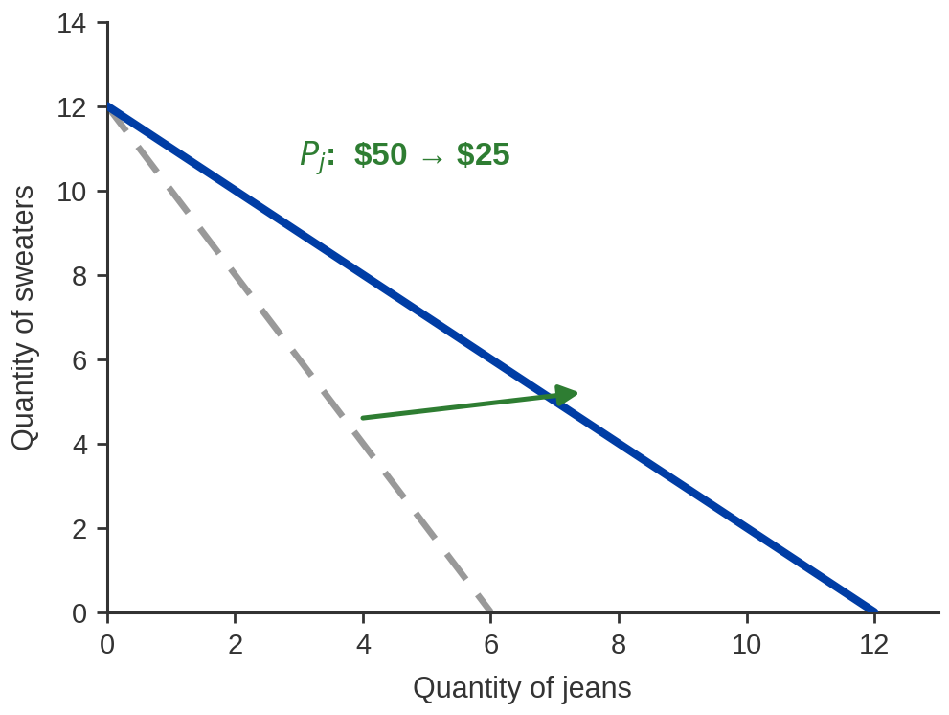
A Price Change Pivots the Line
Exhibit 5.3 — sweaters $25 → $50.
Only 6 sweaters now. Pivots on the jeans axis.
Exhibit 5.4 — jeans $50 → $25.
Now 12 pairs. Pivots on the sweater axis.
Change one price and the line swings: one intercept moves, the other is nailed down. The slope — the
trade-off — changes.
Notes:
PRICE CHANGES — pivots, both exhibits on one slide
Sweaters $25 -> $50 with $300: sweater intercept 12 -> 6. Jeans intercept unchanged at 6.
Jeans $50 -> $25 with $300: jeans intercept 6 -> 12. Sweater intercept unchanged at 12.
- Ask before revealing each: "if sweaters double in price, how many can I buy with $300?
And how many jeans?" The second half is the one they forget — the jeans intercept does
NOT move, because nothing happened to jeans.
- That is why it pivots rather than shifts, and the pivot point is always the axis of the
good whose price did not change.
- New slope means new opportunity cost. After the sweater price doubles, a pair of jeans
costs only ONE sweater instead of two. The trade-off itself has changed, not just the
amount you can buy.
- Link forward: a price change makes you re-solve the buyer's problem, which is exactly
how we get a demand curve in Part 3.

Slide 20
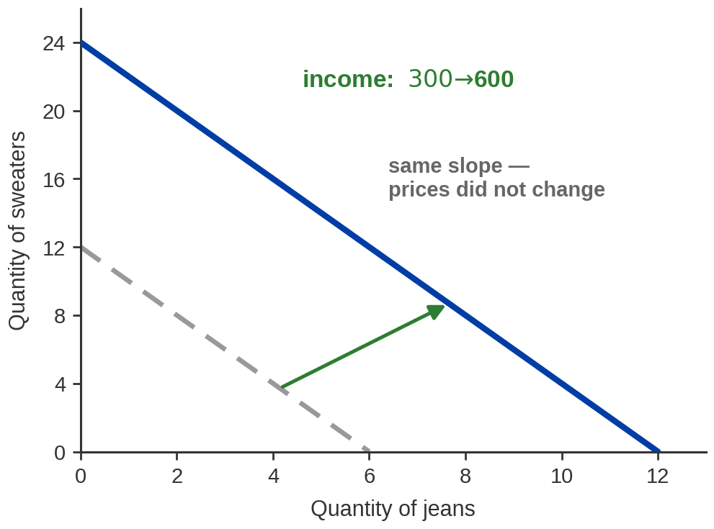
An Income Change Shifts It — Without Tilting It
WHAT CHANGED
$300 → $600. Now 24 sweaters or 12 pairs
of jeans, or anything between.
WHAT DID NOT
The slope. Prices are untouched, so a pair
of jeans still costs two sweaters. Same
trade-off, bigger set.
More income buys more of everything. It does not change what one thing costs in terms of another.
Notes:
INCOME — a parallel shift (Exhibit 5.5)
$300 -> $600 at unchanged prices: intercepts 12 -> 24 sweaters, 6 -> 12 jeans.
Slope stays at -2 because the PRICE RATIO 50/25 is unchanged.
- Get them to predict the intercepts before you show the figure. Both double; that is
what "parallel" means numerically.
- The sentence to make them repeat: prices set the SLOPE, income sets the POSITION.
- Nice test question to pose and answer: what happens if income doubles AND both prices
double? Nothing at all — the line is exactly where it started. Only relative prices
and real income matter. This surprises people and it is worth the thirty seconds.
- This slide is the mechanical setup for the $100-a-month smoking question in Part 4.
Say that explicitly: "remember this picture — the answer to our opening question is
this line moving out."

Slide 21
PART 3
From the Buyer's Problem
to the Demand Curve
Notes:
PART 3 — 5.3
The payoff. We now have everything needed to derive, rather than assert, a demand curve.
Keep the pace up: the mechanism is one idea repeated at four prices.

Slide 22
Change the Price, Redo the Whole Problem
Raise the price of jeans and every jeans-per-dollar number falls.
Redo the optimization with budget constraint as price changes.
Price of jeans | MB per $ on the 1st pair | MB per $ on the 2nd | MB per $ on the 3rd | Pairs bought
$25 | 160 ÷ 25 = 6.40 | 150 ÷ 25 = 6.00 | 100 ÷ 25 = 4.00 | 4
$50 | 160 ÷ 50 = 3.20 | 150 ÷ 50 = 3.00 | 100 ÷ 50 = 2.00 | 3
$75 | 160 ÷ 75 = 2.13 | 150 ÷ 75 = 2.00 | 100 ÷ 75 = 1.33 | 2
$100 | 160 ÷ 100 = 1.60 | 150 ÷ 100 = 1.50 | 100 ÷ 100 = 1.00 | 1
The sweater column never moved. Only jeans got dearer, and only jeans purchases fell.
Notes:
RE-SOLVING AT FOUR PRICES — read these, do not recompute live
$25 -> 4 pairs $50 -> 3 pairs
$75 -> 2 pairs $100 -> 1 pair
Budget is $300 throughout; sweaters stay at $25.
- Check one in front of them so they trust the rest. At $75: buy S1 (4.00), S2 (3.40),
S3 (3.00), S4 (2.60), S5 (2.40), then J1 (2.13), then S6 and J2 tie at 2.00. That is
6 sweaters and 2 jeans = 6 x 25 + 2 x 75 = $300. Two pairs.
- The mechanism in one sentence, and it is the sentence of the chapter: a higher price
pushes that good's benefit-per-dollar down the ranking, so it gets bought later, so
fewer units get bought before the money runs out.
- Do NOT walk all four. One worked example plus the pattern is the right dose.

Slide 23
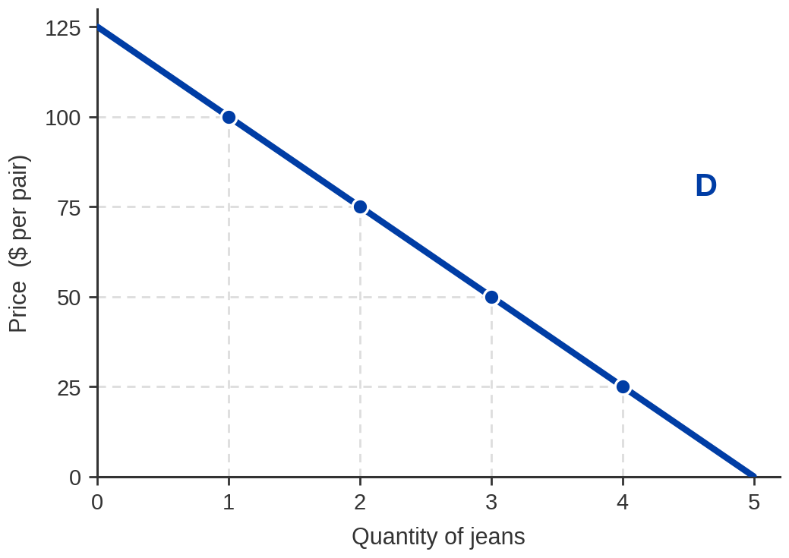

Exhibit 5.6 — Your Demand Curve for Jeans
FOUR SOLVED PROBLEMS
Price | Pairs bought
$25 | 4
$50 | 3
$75 | 2
$100 | 1
Plot the pairs. Join them.
That is a demand curve.
Every point on this curve is one full solution of the buyer's problem – under our standard set of assumptions and the alternative’s price fixed.
We can use the price of a whole bundle of goods as the alternative to make it more general.
Notes:
EXHIBIT 5.6 — the derivation lands here
Points: ($100, 1) ($75, 2) ($50, 3) ($25, 4).
- Slow down. This is the moment Chapter 4's assumption becomes Chapter 5's result.
Say the sentence: "In Chapter 4 I drew this curve and asked you to trust it. You have
just built it yourself, from tastes, prices and a budget."
- Emphasise what a point on a demand curve MEANS: not "how much she likes jeans," but
"the quantity that solves her whole optimisation problem at that price, given
everything else she could have spent the money on."
- That reading is why a demand curve shifts when income or other prices change — those
change the problem, not the price. Ties straight back to Ch4's five shifters.

Slide 24

So — Why Does the Demand Curve Slope Down?
Because marginal benefit falls, a lower price is needed to make
the next unit worth buying.
START FROM
QUANTITY
SO ASK WHAT IT
TAKES
READ IT THE OTHER
WAY
The 4th pair of jeans is worth
less to you than the 3rd. That
is diminishing marginal benefit.
For that 4th pair to clear the
Bar, its price per dollar of
benefit must improve — the
price must fall.
Which is the same as saying:
when the price falls, quantity
demanded rises. The law of
demand.
Notes:
THE PAYOFF — answering the question posed at the start of the chapter
- Pearson makes this point well and it is worth preserving exactly. Students answer
"cheaper things get bought more," which is true but is reading the curve from PRICE
to QUANTITY. Push them to read it the other way: what has to happen for you to buy
ONE MORE unit? The price has to come down. That direction is the explanation.
- Name the two channels if you want the fuller story, briefly: the substitution effect
(jeans became cheap relative to sweaters) and the income effect (your $300 now
stretches further). ALL does not develop these formally here — do not examine on them,
but strong students will ask.
- Close the loop on the Chapter 4 promise. This is the derivation owed from last week.

Slide 25
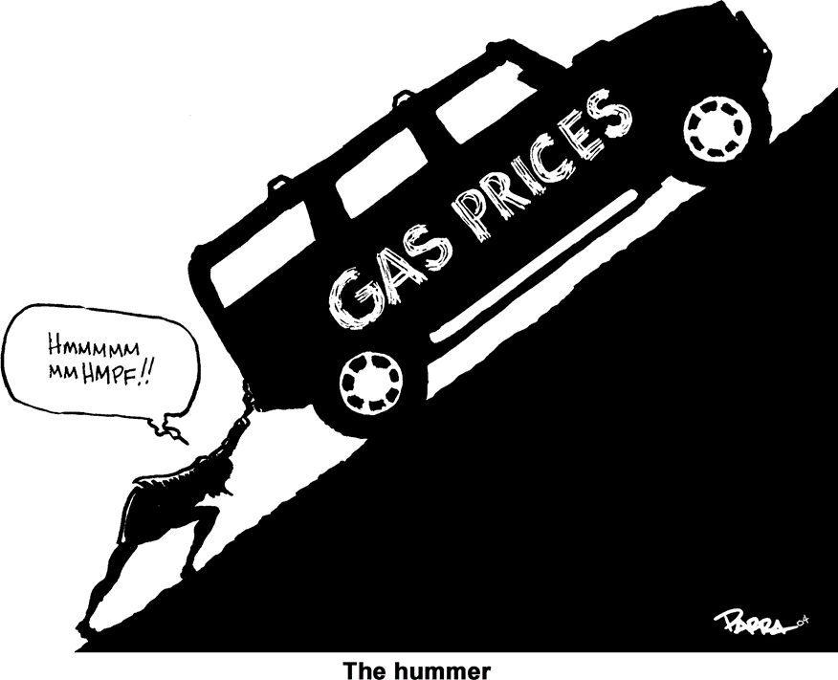

Would Rising Gas Prices Change What You Drive?
A car is a bundle with a running cost attached. Change the cost of running it and you change the bundle.
WHAT THE FUEL BILL DID
2008 — US regular peaked at $4.11 a
gallon in the week to 7 July 2008.
US Hummer sales: 54,052 in 2006 →
20,681 in 2008 → 5,487 in 2009. GM
opened a strategic review that June.
Uphill, on a full tank
Nobody's taste in cars changed in 2008. The price of running one did, and the ranking changed with it.
Image: Acemoglu, Laibson & List, Microeconomics 3e
Notes:
GAS PRICES AND VEHICLE CHOICE — read these figures, do not reconstruct
2008 peak: $4.114/gal, week ending 7 July 2008 (EIA weekly, US regular).
Hummer US: 54,052 (2006) -> 20,681 (2008) -> 5,487 (2009).
Now: $4.096 US, $5.489 California, week ending 27 July 2026 (EIA).
- THE TRAP, AND YOU MUST SAY IT: today's national average is essentially identical to
the 2008 nominal record. In REAL terms it is far lower — 2008 dollars bought a great
deal more. If you skip this, a sharp student will conclude fuel is as expensive now
as it has ever been, which is false. Phrase it as "the same number, not the same
price."
- The economics: buying an H2 was not just buying a vehicle, it was committing to a
fuel bill. NBC reported a full 32-gallon tank costing around $128 at $4 gasoline.
When the complement gets dear, demand for the good falls — which is Chapter 4's
cross-price idea, and Part 5 will put a number on it.
- Hummer production ended 24 May 2010 after the Tengzhong sale collapsed. Mention only
if asked; it is not the point.
- Do not claim gas prices alone killed the brand. The financial crisis was running at
the same time. "Contributed heavily" is the supportable claim.

Slide 26
PART 4
Consumer Surplus
Notes:
PART 4 — 5.4
What buyers get out of a market beyond what they hand over. This is the first welfare
measure in the course and it comes back in Ch7, Ch9 and Ch10.

Slide 27
Consumer Surplus
Consumer surplus — the difference between what a buyer is willing
to pay for a good and what the buyer actually pays.
WILLINGNESS TO
PAY
WHAT YOU ACTUALLY
PAY
THE GAP IS YOURS TO
KEEP
The most you would hand over
rather than go without.
The market price — the same
price for everyone, however
much they wanted it.
Trade only happens when the
gap is positive. Every purchase
you make leaves you ahead.
You should only pay for goods that give you consumer surplus.
Notes:
CONSUMER SURPLUS — the definition
- The definition is exam-critical in exactly ALL's wording. Put it on the board.
- Pearson's classroom device, converted to posed-then-pause: "What is the most you would
pay for a guaranteed A in this class?" Then: "suppose the price were $30. If you would
have paid $200, your surplus is $170. If you would have paid exactly $30, it is zero —
and you are indifferent about buying at all."
- Tie back to Chapter 3's net benefit. This IS net benefit, given a name and a shape on
a diagram. Say that; the continuity is reassuring.
- The deep point, worth twenty seconds: voluntary trade is not zero-sum. Both sides walk
away ahead, which is why Chapter 4's market produced gains rather than just moving
money around. Chapter 7 makes this the centrepiece.

Slide 28
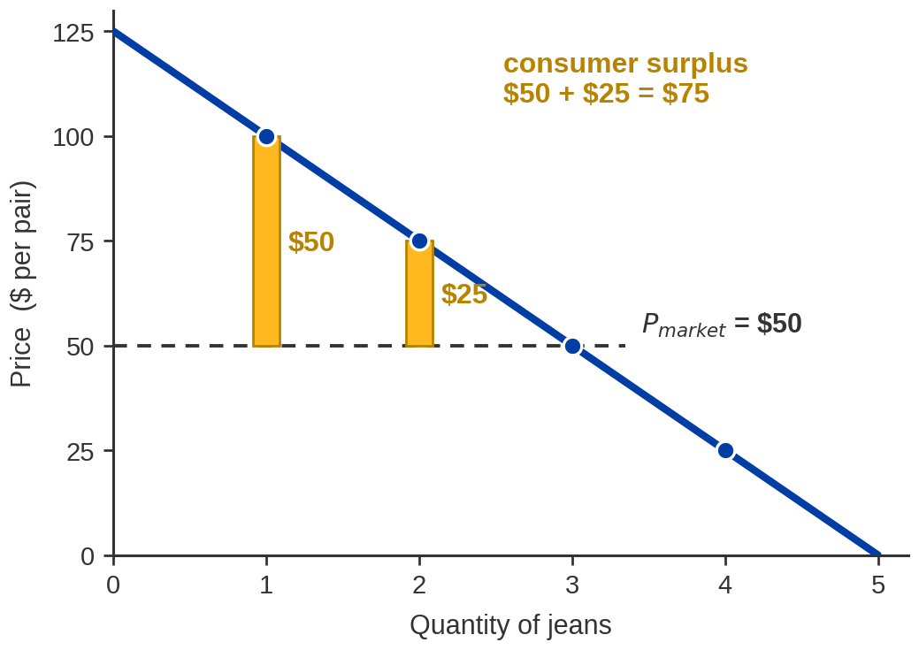
Exhibit 5.7 — Computing It for One Buyer
AT A MARKET PRICE OF $50
Pair | Worth to you | You pay | Surplus
1st | $100 | $50 | $50
2nd | $75 | $50 | $25
3rd | $50 | $50 | $0
Total consumer surplus
$50 + $25 + $0 = $75
The third pair is the marginal one: worth exactly what it costs, and adding nothing. That is why she
stops there.
Notes:
EXHIBIT 5.7 — READ THESE NUMBERS
1st pair worth $100, pays $50, surplus $50.
2nd pair worth $75, pays $50, surplus $25.
3rd pair worth $50, pays $50, surplus $0.
Total consumer surplus = $75.
- The willingness-to-pay figures ARE the points on her demand curve from Exhibit 5.6.
Say so — it is the same object being read for a different purpose.
- The third pair earning zero surplus is not a failure. It is the definition of the
marginal unit, and it explains why she buys exactly three rather than two or four.
- Common student error: adding what she PAID ($150) into the surplus. Surplus is the
gap, not the value. Head it off.

Slide 29
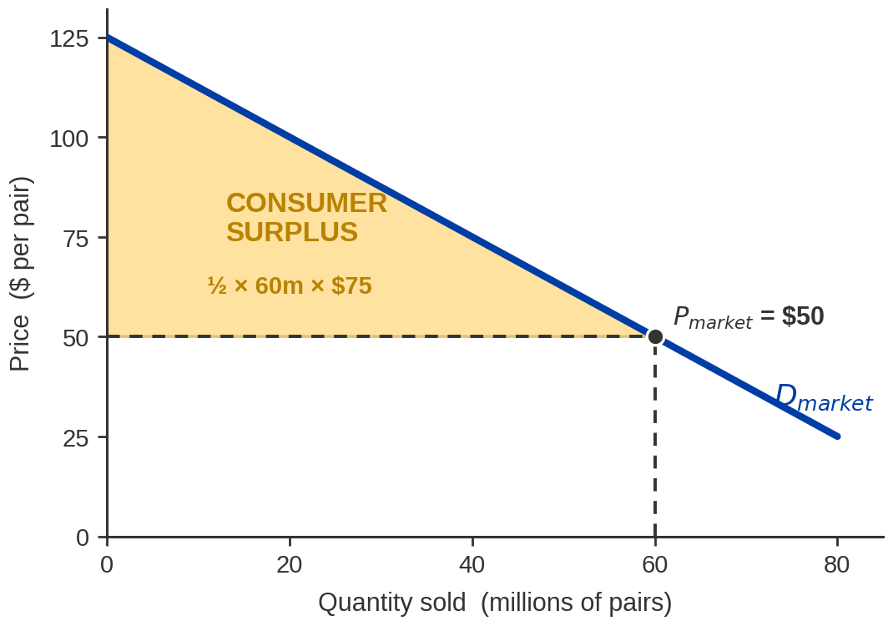
Exhibit 5.8 — Market-Wide Consumer Surplus
Add every buyer's demand
sideways and the steps smooth
into one market curve.
CS = ½ × base × height
= ½ × 60 million × $75
= $2.25 billion
It measures what the whole market's buyers gained by being able to trade.
Notes:
EXHIBIT 5.8 — READ THESE NUMBERS
Market demand runs from ($125, 0) to ($25, 80 million): P = 125 - 1.25Q.
At P = $50, quantity is 60 million. Height of the triangle = 125 - 50 = $75.
CS = 1/2 x 60,000,000 x 75 = $2.25 billion.
- The triangle formula only works because the curve is a straight line. Say the caveat
once; with a curved demand it is still the area, just not a triangle.
- Base is a QUANTITY (60 million pairs), height is a PRICE ($75). Multiply and you get
dollars. Students who lose the units get answers that are wrong by millions — make
them say the units out loud.
- Height is the vertical gap from the market price to the choke price ($125), NOT the
price itself. This is the most common arithmetic slip on this topic.

Slide 30
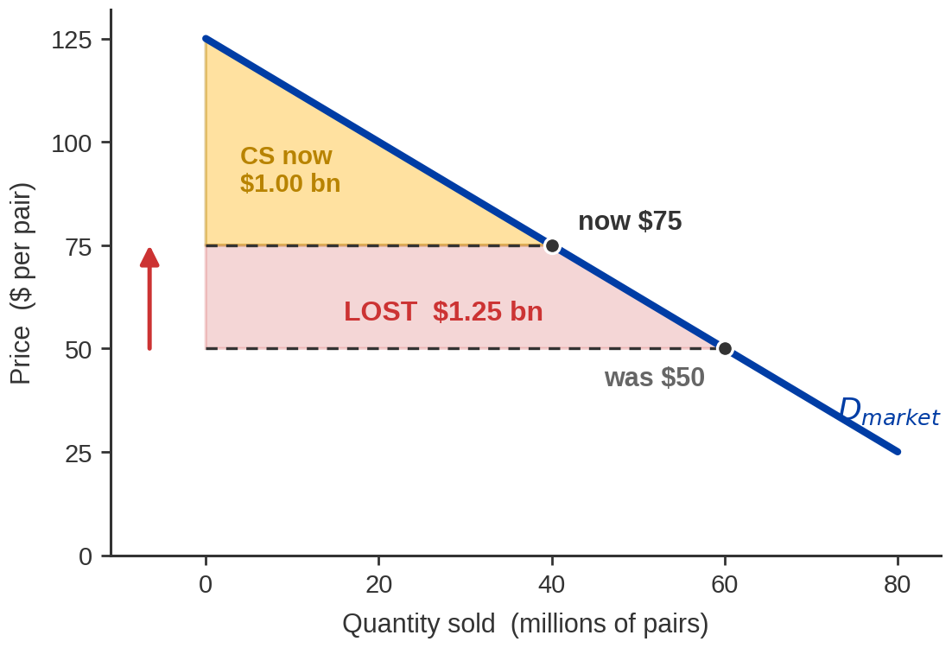
Exhibit 5.9 — What a Price Rise Takes Away
PRICE $50 → $75
Quantity 60m → 40m
CS $2.25 bn → $1.00 bn
Lost $1.25 billion
WHERE IT WENT
Part goes to sellers as higher
revenue. Part is simply gone —
buyers priced out of trades
they valued.
Price up, surplus down; price down, surplus up. This is how we will judge taxes, ceilings and
monopolies later.
Notes:
EXHIBIT 5.9 — READ THESE NUMBERS
At $50: Q = 60m, CS = 1/2 x 60m x 75 = $2.25 bn.
At $75: Q = 40m, CS = 1/2 x 40m x 50 = $1.00 bn.
Consumer surplus lost = $1.25 bn.
- Do the second triangle in front of them; it takes fifteen seconds and it proves the
method rather than the answer.
- The honest nuance, and worth including: the $1.25 bn is not destroyed wealth. Roughly
$1.00 bn of it transfers to sellers as extra revenue on the 40m units still sold; the
remainder is genuinely lost, because 20 million trades that both sides wanted no longer
happen. We name that remainder DEADWEIGHT LOSS in Chapter 10. Plant the term, do not
develop it.
- This is the analytical engine for the price-ceiling work in Ch4 and for taxation in
Ch10. Flag the forward link so it does not look like a detour.

Slide 31
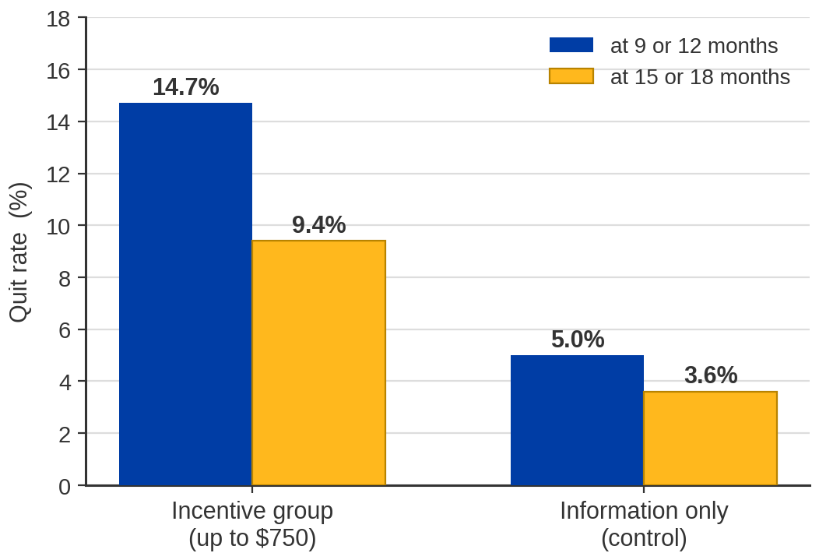
Evidence: Would a Smoker Quit for Cash?
THE EXPERIMENT
878 General Electric employees,
randomly assigned. One group offered
up to $750 for quitting and staying
quit; the other got information only.
THE CATCH
Roughly three times the quit rate —
but nine in ten still smoking, and the
gap narrows once the money stops.
Incentives move behaviour in the direction theory predicts. They do not move it as far as anyone
hoped.
Notes:
THE SMOKING TRIAL — READ THESE NUMBERS EXACTLY
Volpp et al., NEJM 360:699-709 (12 Feb 2009). N = 878 GE employees.
Incentive: $100 for completing a programme + $250 for confirmed cessation within
6 months + $400 for a further 6 months abstinent = $750 maximum.
Quit rate at 9 or 12 months: 14.7% incentive vs 5.0% control.
Quit rate at 15 or 18 months: 9.4% incentive vs 3.6% control.
- TWO CORRECTIONS TO THE TEXTBOOK'S FRAMING, both worth making:
1. The chapter asks "would a smoker quit for $100 A MONTH?" The trial paid a ONE-OFF
bundle of up to $750 over about eighteen months, not a monthly stipend. Use the
$750 figure. If you keep the $100/month framing as the intuition, say plainly that
it is the textbook's simplification.
2. Pearson's bar chart reads about 16% versus 4.5%. The published figures are 14.7%
and 5.0%. Our chart uses the published ones, and also shows the later follow-up.
- The economics is the point, and it survives the corrections: the incentive group is
roughly three times as likely to quit. Money changes behaviour even for an addictive
good — which is exactly what a budget-constraint model predicts.
- Be straight about the size of the effect. Roughly 85% of the incentive group did NOT
quit, and the gap shrinks over time. A later, much larger pragmatic trial (Halpern
et al., NEJM 2018) found sustained quit rates in the low single digits across every
arm. "Incentives work, and the base rate is brutal" is the honest summary.
- SENSITIVE TOPIC. Keep it analytical. Some students in the room will be smokers or will
have family who are; the framing is about how incentives operate, not about anyone's
choices.

Slide 32

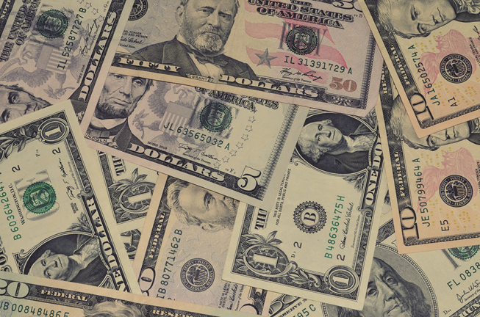
So Which One Would Actually Make You Quit?
Take a second and answer honestly before we look at what the money does.
What quitting costs you
What quitting pays you
Incentives only work on people for whom the second picture outweighs the first — and the trial says
that is a minority.
Image: Acemoglu, Laibson & List, Microeconomics 3e
Notes:
WHICH WOULD MAKE YOU QUIT? — a posed question, so actually pause
- THE QUESTION IS ON THE SLIDE. Ask it, then stop talking for three or four seconds.
The lecture is recorded, so the silence has to be deliberate or it does not exist.
- Do not take a show of hands on smoking. Ask them to answer it in their own head. This
is a room of undergraduates and the question is personal.
- The economics: the left-hand picture is the cost of the habit, which is already in
their budget constraint. The right-hand picture is an increase in income. The whole
chapter says a rise in income shifts the constraint out — the question is whether the
new bundle is worth more than what is given up.
- PEARSON'S CAVEAT, and keep it: after the incentives stop, many people who quit for the
cash start again. The Volpp gap narrows from 14.7 vs 5.0 at 9-12 months to 9.4 vs 3.6
at 15-18. An incentive that is switched off is an income change that is switched off.
- Land the honest version: money moves behaviour in the direction the model predicts,
by less than anyone hoped, and not permanently. That is a real finding, not a
disappointing one.
- SENSITIVE TOPIC. Analytical register throughout.

Slide 33
Your Buyer's Problem, with $400
Quantity | Sweaters $25 Total Benefits (A) | Sweaters $25 Marginal Benefits (B) | Sweaters $25 Marginal Benefits per Dollar Spent = (B)/$25 | Jeans $50 Total Benefits (C) | Jeans $50 Marginal Benefits (D) | Jeans $50 Marginal Benefits per Dollar Spent = (D)/$50
0 | 0 | Blank | Blank | 0 | Blank | Blank
1 | 100 | 100 | 4 | 160 | 160 | 3.2
2 | 185 | 85 | 3.4 | 310 | 150 | 3
3 | 260 | 75 | 3 | 410 | 100 | 2
4 | 325 | 65 | 2.6 | 490 | 80 | 1.6
5 | 385 | 60 | 2.4 | 520 | 30 | 0.6
6 | 425 | 50 | 2 | 530 | 10 | 0.2
7 | 480 | 45 | 1.8 | 533 | 3 | 0.06
8 | 520 | 40 | 1.6 | 535 | 2 | 0.04
Notes:
CLOSING THE CARRIED QUESTION — read these
$300 -> 6 sweaters + 3 jeans, total benefit 435 + 410 = $845.
$400 -> 8 sweaters + 4 jeans, total benefit 520 + 490 = $1,010.
The extra $100 buys 2 more sweaters and 1 more pair of jeans.
- Continue the greedy walk from the earlier slide: after step 9 you have $100 left.
Next best is sweater #7 at 1.80 ($25), then sweater #8 and jeans #4 tie at 1.60
($25 + $50). That is exactly $100. Eight sweaters, four jeans.
- The rhetorical move that makes the chapter land: an abstract question — "would you
quit for $100?" — has been converted into a concrete comparison a person can actually
make. That is what the model is FOR. Say it.
- Pearson's addendum is good and worth keeping: income really rises by more than $100,
because the cigarette spending stops too. At a California average around $11-12 a pack,
a pack-a-day habit is far more than $100 a month on its own.
- This is the pay-off of the question posed at the top of the hour. Mark it as such —
"that is the question I parked, and that is the answer."

Slide 34
The Answer, in Sweaters and Jeans
An extra $100 a month is not a taste change and not a price change.
It is income — so the budget line shifts out, and the bundle gets bigger.
WITH $300
WITH $400
SO THE REAL
QUESTION IS
6 sweaters and 3 pairs of
jeans.
Total benefit $845.
8 sweaters and 4 pairs of
jeans.
Total benefit $1,010.
Is smoking worth two sweaters
and a pair of jeans to you?
That is a question you can
actually answer.
And it undercounts: quitting also frees whatever you were spending on cigarettes, so income rises by
more than $100.
Notes:
CLOSING THE CARRIED QUESTION — read these
$300 -> 6 sweaters + 3 jeans, total benefit 435 + 410 = $845.
$400 -> 8 sweaters + 4 jeans, total benefit 520 + 490 = $1,010.
The extra $100 buys 2 more sweaters and 1 more pair of jeans.
- Continue the greedy walk from the earlier slide: after step 9 you have $100 left.
Next best is sweater #7 at 1.80 ($25), then sweater #8 and jeans #4 tie at 1.60
($25 + $50). That is exactly $100. Eight sweaters, four jeans.
- The rhetorical move that makes the chapter land: an abstract question — "would you
quit for $100?" — has been converted into a concrete comparison a person can actually
make. That is what the model is FOR. Say it.
- Pearson's addendum is good and worth keeping: income really rises by more than $100,
because the cigarette spending stops too. At a California average around $11-12 a pack,
a pack-a-day habit is far more than $100 a month on its own.
- This is the pay-off of the question posed at the top of the hour. Mark it as such —
"that is the question I parked, and that is the answer."

Slide 35
PART 5
Demand Elasticities
Notes:
PART 5 — 5.5
A separate tool. Everything so far said WHICH WAY quantity moves; elasticity says HOW
MUCH. This is the most examinable part of the chapter and the most mechanical — budget
time for the three practice calculations.

Slide 36

Two Questions That Need a Number
AT THE AIRPORT AND THE THEATRE
AT YOUR GIG
Why is a plane ticket bought the day
before so expensive — and a Broadway
seat bought that afternoon so cheap?
Same last-minute buyer. Opposite
pricing.
Your band gets the whole cover charge
at a bar. You want more money.
Raise the cover and lose some of the
crowd, or cut it and pack the room?
Both answers hinge on the same missing number: how much does quantity move when
price moves?
"Quantity falls when price rises" is true and useless here. We need to know by how much.
Notes:
TWO OPENING QUESTIONS FOR PART 5
- Take answers on the band question and do NOT resolve it. Both answers are reasoned
correctly and only one can be right; that tension is the motivation for the whole
section. Say that explicitly.
- Steer them toward the real variable: it depends who is coming. Friends and family who
will turn up regardless (inelastic) versus strangers with other options on a Friday
night (elastic).
- Airline/theatre resolution comes at the end of Part 5. Park it out loud, same as the
smoking question.
- The law of demand gives DIRECTION. Every decision anyone actually makes needs
MAGNITUDE. That is the sentence to open the section with.

Slide 37
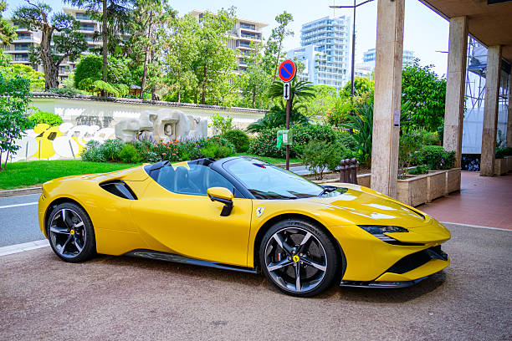
Elasticity
Elasticity — a measure of how sensitive one variable
is to changes in another.
PRICE ELASTICITY OF
DEMAND
CROSS-PRICE
ELASTICITY
INCOME ELASTICITY
How much does demand
change
when INCOME changes?
How much does quantity
demanded change when the
good's OWN price changes?
How much does demand for one
good change when the price of
ANOTHER good changes?
These are Chapter 4's demand shifters again.
Notes:
ELASTICITY — the three measures
- Frame it as a return visit, not new material: Chapter 4 listed what shifts demand.
Three of those shifters now get a measuring stick. Students find this much less
intimidating when it is framed as measurement rather than as a new concept.
- All three are ratios of PERCENTAGE changes. That is what makes them unit-free and
therefore comparable across goods — you can compare the elasticity of demand for
gasoline with that for haircuts, which you could never do with slopes.
- Say the unit-free point now; it is the answer to "why not just use the slope?", which
is the next slide but one.

Slide 38
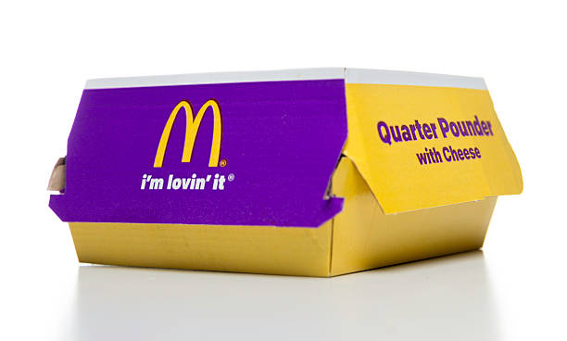
Price Elasticity of Demand
E(D) = percentage change in quantity demanded ÷ percentage change in price
MINUS SIGN
Demand curves slope down, so E(D)
is always negative. By convention we
quote the ABSOLUTE VALUE and
compare its size to 1.
|E(D)| > 1 elastic · |E(D)| < 1 inelastic · |E(D)| = 1 unit elastic
Percentages on both sides. That is what lets you compare gasoline with concert tickets.
Notes:
PRICE ELASTICITY — the formula
- The Quarter Pounder mnemonic is Pearson's and students genuinely remember it. Q over P.
Use it; it costs ten seconds and prevents the single most common formula inversion.
- The sign convention is a real source of confusion in exams. State the rule you will
enforce: we report the absolute value unless a question asks for the signed number.
Cross-price and income elasticities are the opposite — there the SIGN carries the
meaning. Flag that contrast now so it is not a surprise later.
- Worked warm-up if there is time: price up 10%, quantity down 20% -> |E| = 2, elastic.
Price up 10%, quantity down 5% -> |E| = 0.5, inelastic.

Slide 39

Five Elasticities
PERFECTLY
INELASTIC
|E| = 0
INELASTIC
|E| < 1
UNIT
ELASTIC
|E| = 1
ELASTIC
|E| > 1
PERFECTLY
ELASTIC
|E| = ∞
Insulin sits near the left of this strip — no close substitute, so quantity barely responds. Ketchup sits near the right — dozens of near-identical alternatives on the same shelf.
The two ends are theoretical limits. Everything you will meet in practice lives between them.
Notes:
THE FIVE CATEGORIES
- Perfectly inelastic: quantity does not move at all, whatever the price. Perfectly
elastic: any price rise at all and quantity goes to zero.
- Both extremes are idealisations, with one important exception you should flag: the
demand curve facing a SINGLE firm in perfect competition is perfectly elastic. That
arrives in Chapter 7, and it is the reason this extreme is worth teaching rather than
dismissing.
- Insulin and ketchup are Pearson's own examples for the two ends of the practical range,
and they work because the mechanism is obvious in both — substitutes, or the absence
of them. That is the first determinant, three slides from here.

Slide 40
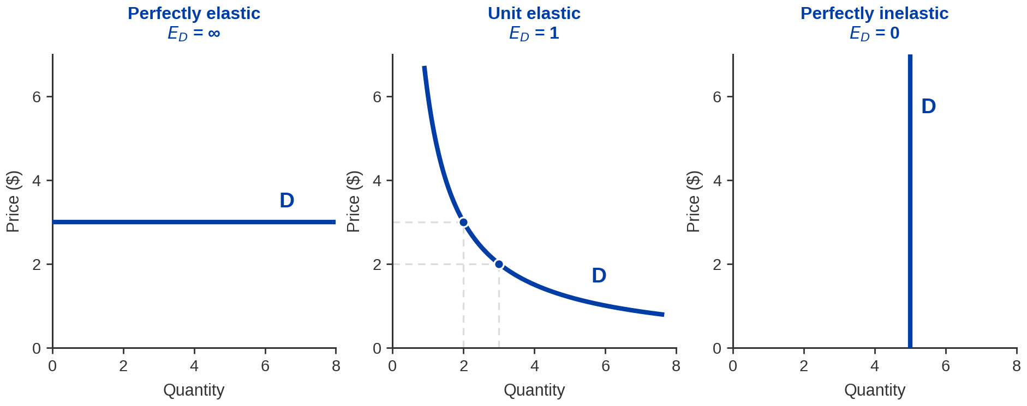
Exhibit 5.12 — The Three Extreme Cases
A flat curve means any price rise loses every buyer. A vertical one means the price is irrelevant to
quantity.
Notes:
EXHIBIT 5.12 — the limiting shapes
- Left, perfectly elastic (horizontal): buyers will take any quantity at $3 and nothing
at all above it. The single competitive firm's demand curve, coming in Chapter 7.
- Middle, unit elastic: a rectangular hyperbola, so price times quantity is constant
everywhere along it. Check it on the two marked points: 2 x $3 = $6 and 3 x $2 = $6.
Total revenue never changes, which is exactly what unit elastic means. That check is
the best thirty seconds on this slide.
- Right, perfectly inelastic (vertical): quantity is 5 regardless of price.
- Then say the caveat plainly: these are teaching devices. Real demand curves are none
of these three, and the middle one is the only one that is even approximately met in
practice.

Slide 41
Exhibit 5.13 — Some Estimated Price Elasticities
Good | |Price elasticity| | Reads as
Olive oil | 1.92 | elastic
Peanut butter | 1.73 | elastic
Ketchup | 1.36 | elastic
Wine | 1.00 | unit elastic
Laundry detergent | 0.81 | inelastic
Shampoo | 0.79 | inelastic
Potato chips | 0.45 | inelastic
Cigarettes | 0.40 | inelastic
Notes:
EXHIBIT 5.13 — teach the ordering, flag the numbers
- The PATTERN is the lesson and it is completely sound: goods with close substitutes on
the same shelf (olive oil, peanut butter, ketchup) come out elastic; habitual or
small-budget-share goods (potato chips, cigarettes) come out inelastic.
- HONESTY FLAG, and say some version of this out loud. The textbook does not identify
the studies these come from, and the category mix suggests supermarket scanner data
that may be decades old. I could not trace them to a published source. Treat them as
illustrative of the ordering, not as current measurements. If a student asks "is olive
oil really 1.92 today?", the correct answer is "I don't know, and neither does the
table."
- CIGARETTES AT 0.40 IS NOW GENUINELY CONTESTED and it is the one number worth
qualifying on the record. The conventional estimate is around 0.4, and Pesko et al.
(NBER WP 22296) support roughly 0.38 on their preferred price measure. But DeCicca,
Kenkel & Lovenheim's review in the Journal of Economic Literature (60(3), 2022) argues
that standard methods OVERSTATE cigarette price responsiveness, and the GAO used a
plausible range of 0.2 to 0.9 in 2025. Safe classroom phrasing: "textbooks conventionally
cite about 0.4; recent work suggests it may be smaller, with credible estimates spanning
roughly 0.2 to 0.9."
- Cigarettes being inelastic is the reason tobacco taxes raise a lot of revenue while
changing consumption relatively little. That link matters for the practice problem at
the end of the hour.

Slide 42
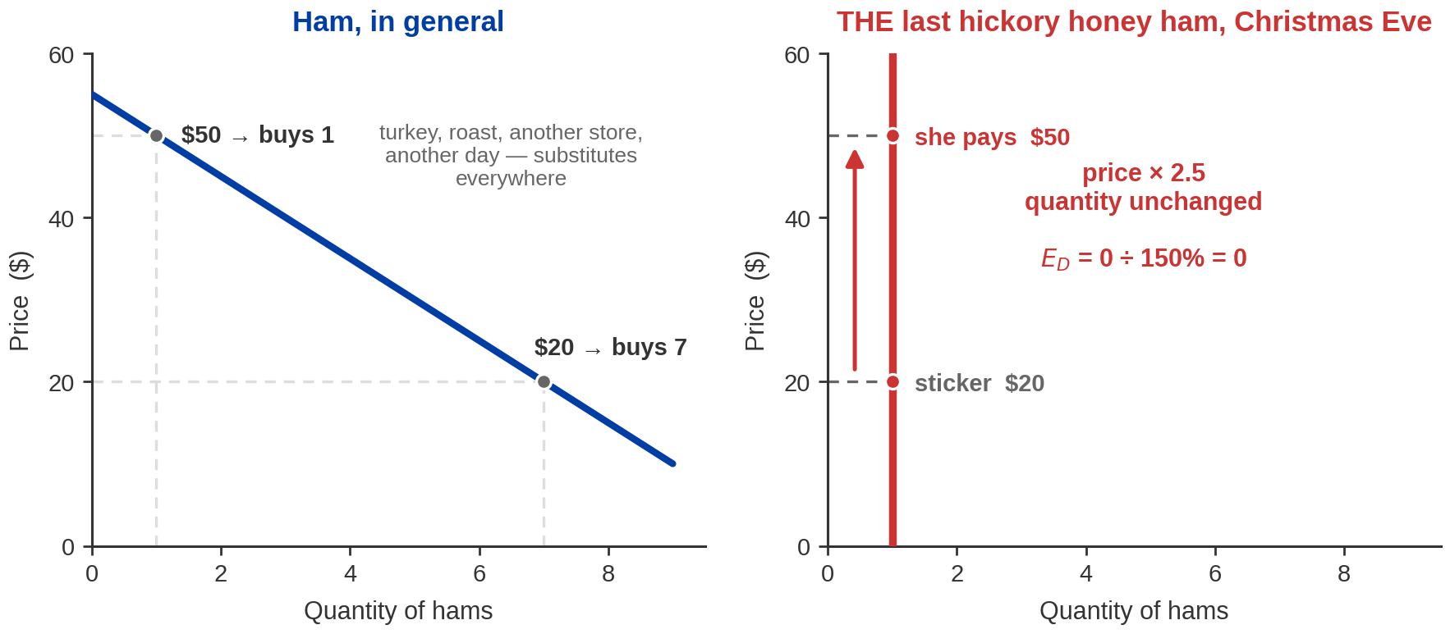
Elasticity, Measured on Mrs Krank
Elasticity — a measure of how sensitive one variable is to changes in another.
Price × 2.5, quantity unchanged: E(D) = 0% ÷ 150% = 0. Perfectly inelastic.
Elasticity is not about how much she likes ham. It is about whether she has anywhere else to go — and
tonight she does not.
Notes:
CLIP PAGE 2 — the definition, delivered through her story
Deck's own numbers, NOT the film's: sticker $20, she pays $50.
Price rises 150%. Quantity stays at 1, so the quantity change is 0%.
E(D) = 0% / 150% = 0 — PERFECTLY INELASTIC.
- DO NOT ATTRIBUTE THE PRICES TO THE FILM. I could not source what the ham actually
costs on screen, so the deck uses round numbers that make the arithmetic close. Say
"suppose the sticker said $20 and she pays $50" — that is honest and it is enough.
- ASK FIRST, before you advance past the picture: "the price more than doubled. How much
less ham did she buy?" The answer is none, and hearing themselves say "none" is what
makes the zero land.
- Then give the definition. This is the formal ALL definition and it is examinable in
this wording: elasticity measures how sensitive one variable is to changes in another.
Here the two variables are quantity demanded and price.
- THE LEFT PANEL IS DOING REAL WORK — do not skip it. Ham in general has substitutes
everywhere: turkey, a roast, another store, or simply next week. Demand slopes down
normally. It is only the conjunction of THIS ham, THIS store, TONIGHT that removes
every substitute and stands the curve up vertical.
- That is the whole mechanism of the chapter's most important determinant, and she
demonstrates it in ninety seconds: elasticity is about substitutes, not about
intensity of wanting.
- Worth saying plainly, because students get this backwards: an inelastic buyer is not a
buyer who wants something more. She is a buyer with nowhere else to go. That is also
exactly why the seller can raise the price on her.
- FORWARD LINK: hold this picture. In the last clip of the chapter it is a person on the
other side of a negotiation who has nowhere else to go, and the same logic decides who
pays what.

Slide 43
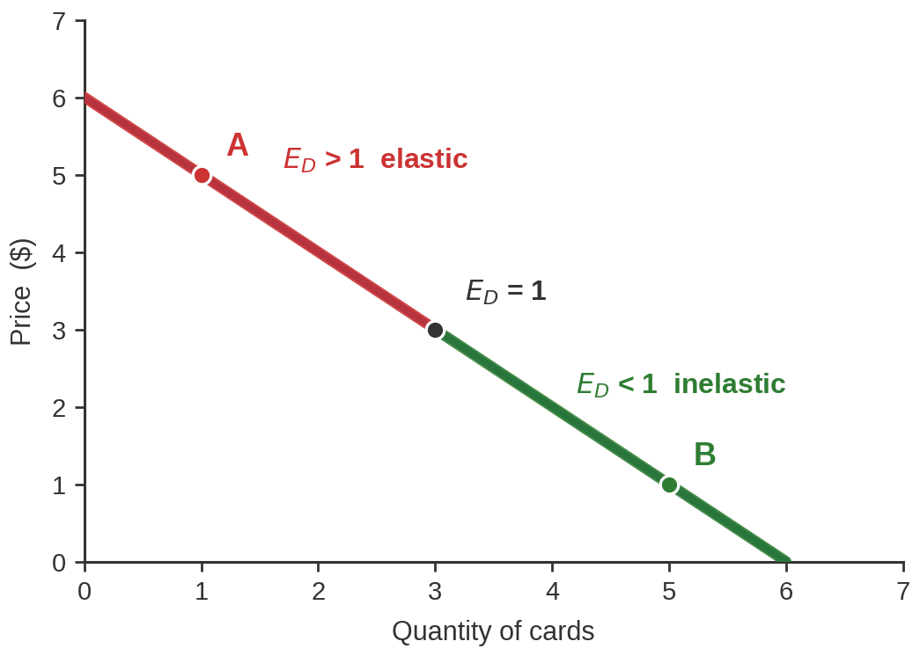
Exhibit 5.11 — Slope Is Not Elasticity
This is one straight line, so the
slope is the same everywhere.
But the elasticity is different at
every single point.
WHY
Slope compares changes in units.
Elasticity compares changes in
percentages — and a $1 move is a
huge percentage of $1 and a tiny
one of $5.
High on the curve, demand is elastic. Low down, it is inelastic. Exactly halfway, it is unit elastic.
Notes:
EXHIBIT 5.11 — the slope/elasticity distinction
Demand: P = 6 - Q. Point A (Q=1, P=$5): elastic. Midpoint (Q=3, P=$3): |E| = 1.
Point B (Q=5, P=$1): inelastic.
- This is the conceptual heart of the elasticity section and it is worth being slow.
Students assume steep = inelastic and flat = elastic. On a single straight line that
is simply false, because the slope never changes and the elasticity always does.
- The intuition to give them: at point A the price is $5 and the quantity is 1. A $1 cut
is a 20% price cut but a 100% quantity increase — huge response. At point B the price
is $1 and quantity is 5; a $1 cut is a 100% price cut for a 20% quantity rise — feeble
response.
- The midpoint of a linear demand curve is ALWAYS unit elastic. That is a fact worth
memorising and it is exam bait.
- Steep-vs-flat comparisons only work between two curves compared at the SAME point.
Say that, because it rescues the intuition rather than destroying it.

Slide 44
The Arc (Midpoint) Formula
arc E(D) = ΔQ ÷ average Q /(ΔP ÷ average P)
THE PROBLEM IT FIXES
HOW IT FIXES IT
$8 → $4 is a 50% cut.
$4 → $8 is a 100% rise.
Same two prices, two different
percentages — so two different
elasticities for one stretch of curve.
Divide by the AVERAGE of the two
prices and the AVERAGE of the two
quantities.
Now it does not matter which end you
start from. One stretch, one number.
Use the arc formula whenever a question gives you two points. Use the point formula only for
small changes.
Direction-free by construction. That is the whole reason it exists.
Notes:
ARC ELASTICITY — why it exists
- Demonstrate the problem before giving the fix. $8 to $4 is a 50% fall; $4 to $8 is a
100% rise. Same stretch of curve, two answers. That is intolerable for a measure, so
we average the base.
- Mechanically: divide the change by the MIDPOINT rather than by the starting value.
Some books call it the midpoint formula; same thing, and students will meet both names.
- Pearson also gives a shortcut version. Teach the full form — it is what an exam will
ask for and the shortcut only saves a few seconds.
- Three worked examples follow. Do the first one fully on the board, then let them try
the second before you reveal it.

Slide 45
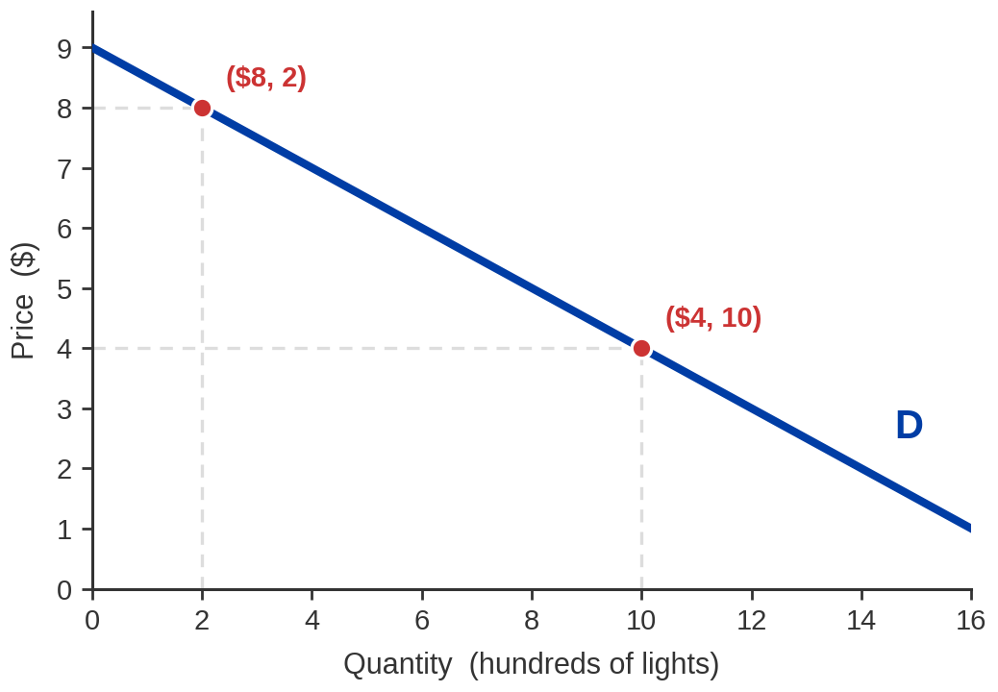
Practice 1 — Price Falls from $8 to $4
SET IT OUT
Quantity at $8
200 lights
Quantity at $4
1,000 lights
ΔQ ÷ average Q
800 ÷ 600 = 1.333
ΔP ÷ average P
−4 ÷ 6 = −0.667
|arc E(D)| = 1.333 ÷ 0.667 = 2.0 —
elastic
Averages in both denominators. Start from either end and the answer is the same.
Notes:
PRACTICE 1 — READ THESE NUMBERS
Demand for solar-powered lights: P = 9 - 0.5Q, with Q in hundreds.
At $8, Q = 2 (200 lights). At $4, Q = 10 (1,000 lights).
Delta Q = 8; average Q = (2 + 10)/2 = 6; 8/6 = 1.3333
Delta P = -4; average P = (8 + 4)/2 = 6; -4/6 = -0.6667
|arc E| = 1.3333 / 0.6667 = 2.0 -> ELASTIC.
- Do this one fully on the board. Emphasise writing the averages down as a separate step
— that is where the arithmetic goes wrong.
- Sanity check to teach as a habit: quantity multiplied by five while price halved.
Quantity moved far more than price in proportion, so we expect a number well above 1.
It is 2. Getting 0.5 means the fraction is upside down.

Slide 46
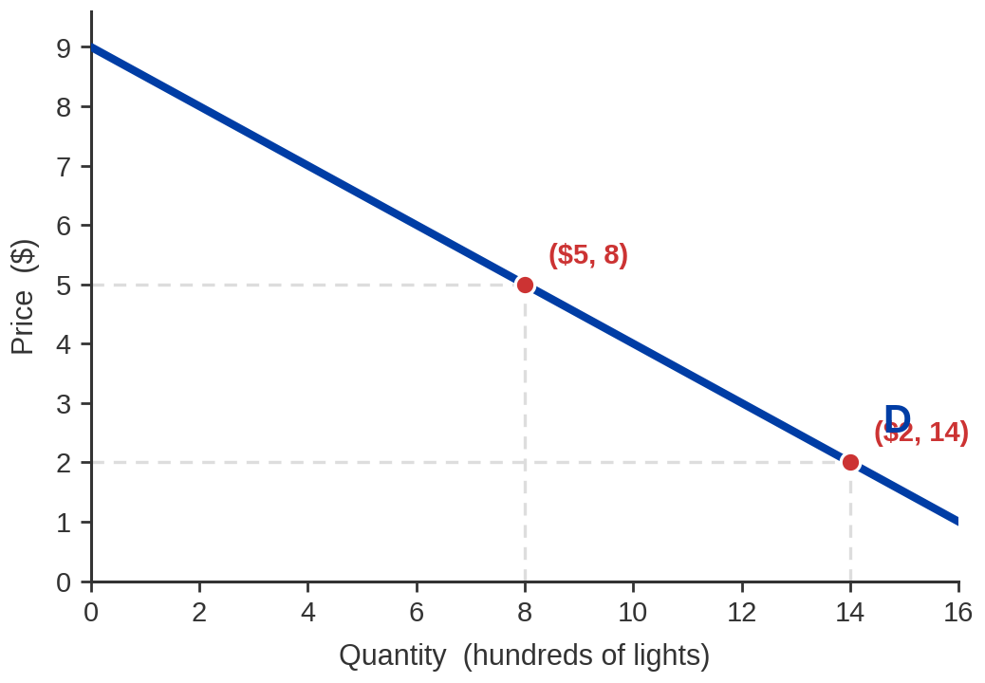
Practice 2 — Price Falls from $5 to $2
SET IT OUT
Quantity at $5
800 lights
Quantity at $2
1,400 lights
ΔQ ÷ average Q
600 ÷ 1,100 = 0.545
ΔP ÷ average P
−3 ÷ 3.5 = −0.857
|arc E(D)| = 0.545 ÷ 0.857 = 0.64 —
inelastic
Averages in both denominators. Start from either end and the answer is the same.
Notes:
PRACTICE 2 — READ THESE NUMBERS
At $5, Q = 8 (800 lights). At $2, Q = 14 (1,400 lights).
Delta Q = 6; average Q = 11; 6/11 = 0.5455
Delta P = -3; average P = 3.5; -3/3.5 = -0.8571
|arc E| = 0.5455 / 0.8571 = 0.636 -> INELASTIC.
- THE POINT OF THIS ONE: it is the same demand curve as Practice 1, and the answer has
crossed from elastic to inelastic. Say that out loud — it is Exhibit 5.11 showing up
in arithmetic rather than in a picture.
- We are lower down the curve now, where prices are small and quantities large, so a
given dollar change is a big percentage of price and a small percentage of quantity.

Slide 47
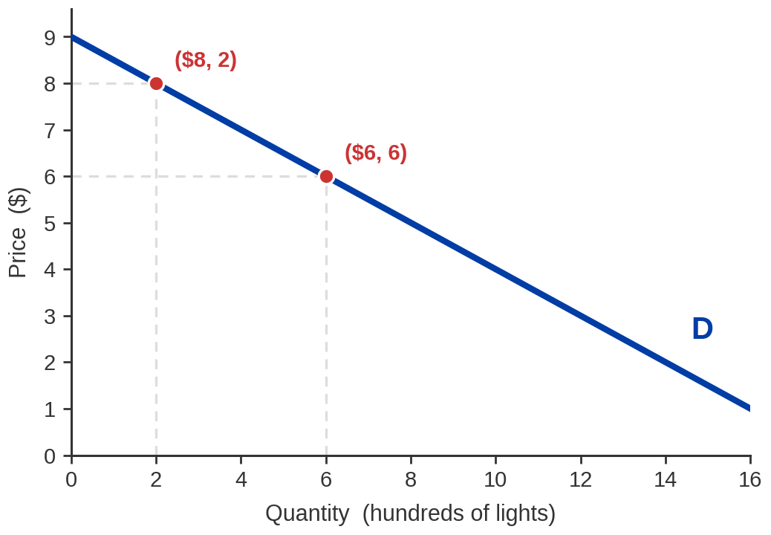
Practice 3 — Price Rises from $6 to $8
SET IT OUT
Quantity at $6
600 lights
Quantity at $8
200 lights
ΔQ ÷ average Q
−400 ÷ 400 = −1.000
ΔP ÷ average P
2 ÷ 7 = 0.286
|arc E(D)| = 1.000 ÷ 0.286 = 3.5 —
strongly elastic
Averages in both denominators. Start from either end and the answer is the same.
Notes:
PRACTICE 3 — READ THESE NUMBERS
At $6, Q = 6 (600 lights). At $8, Q = 2 (200 lights).
Delta Q = -4; average Q = 4; -4/4 = -1.000
Delta P = 2; average P = 7; 2/7 = 0.286
|arc E| = 1.000 / 0.286 = 3.5 -> STRONGLY ELASTIC.
- NOTE ON THE PUBLISHER'S DECK, and it is worth telling students who read along: the
Pearson slide carrying this answer still has the heading from the previous question
("price decreases from $5 to $2"). The worked figures underneath are for $6 to $8.
We have corrected the heading. Their arithmetic is fine; the label is not.
- This is a price RISE, so quantity falls and the numerator is negative while the
denominator is positive. The ratio is negative before we take the absolute value —
which is the normal case, not a special one.
- We are high on the curve here, so the strongly elastic answer is exactly what
Exhibit 5.11 predicted.

Slide 48
Total Revenue: Why Anyone Cares
total revenue = price × quantity
A PRICE RISE PULLS BOTH WAYS
ELASTICITY SAYS WHICH WINS
Every unit sold now earns more — revenue up.
But fewer units are sold — revenue down.
It is a race between a percentage gain in price and a percentage loss in quantity.
Elasticity is precisely the ratio of those two percentages.
Notes:
TOTAL REVENUE — the practical payoff
- Set it up as a tug of war and let them feel that the answer is not obvious. Both
effects are real and they point in opposite directions.
- Elasticity resolves it because it IS the ratio of the two percentage changes. If
quantity moves proportionally more than price (elastic), the quantity effect wins.
If less (inelastic), the price effect wins.
- Note for accuracy: revenue is the seller's, but the elasticity is the BUYERS'. This
is a fact about the demand side that determines an outcome on the supply side. Students
find that connection genuinely interesting.
- Revenue is not profit. We say nothing about costs until Chapter 6. Flag it before
somebody assumes raising price always makes a firm better off.

Slide 49
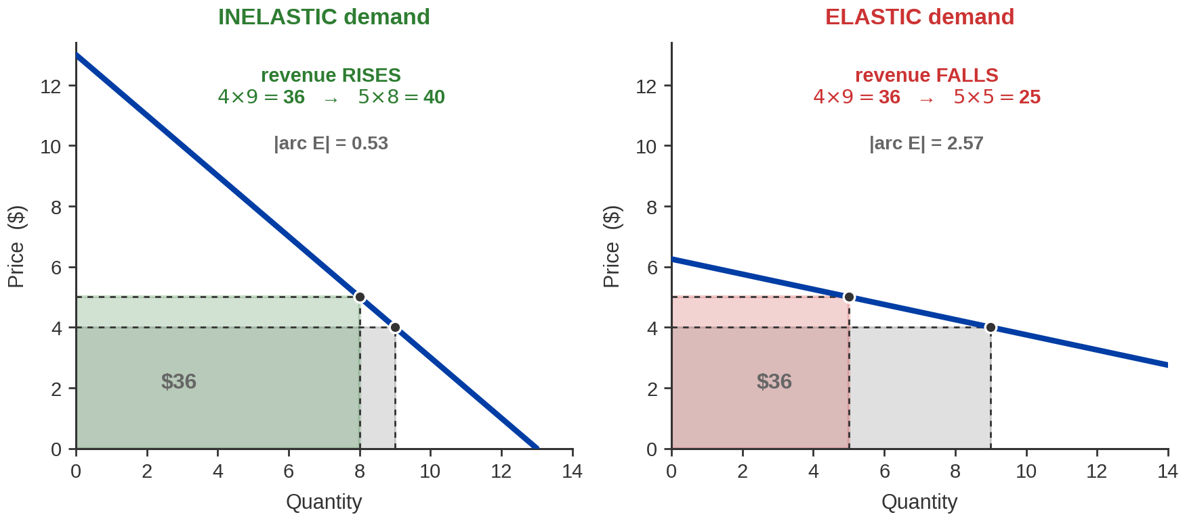
The Same $1 Rise on Two Different Curves
Identical price rise, opposite revenue result. The only thing that differs is how far quantity moved.
Notes:
TWO REVENUE PANELS — read these numbers
Both curves pass through ($4, 9), so both start at revenue $36.
INELASTIC (|arc E| = 0.53): $4 -> $5 takes quantity 9 -> 8. Revenue 36 -> 40. UP.
ELASTIC (|arc E| = 2.57): $4 -> $5 takes quantity 9 -> 5. Revenue 36 -> 25. DOWN.
- The shaded rectangles ARE the revenue. Point at the areas rather than reciting the
multiplication; the geometry is what makes it stick.
- Deliberately constructed so the starting point is identical. The only difference in the
whole picture is how far quantity moved, and the revenue result reverses. That is the
cleanest demonstration of why elasticity matters that exists.
- Ask before revealing the second panel: "same price rise — what happens to revenue this
time?" Someone will say "up" from momentum. That mistake is the lesson.

Slide 50
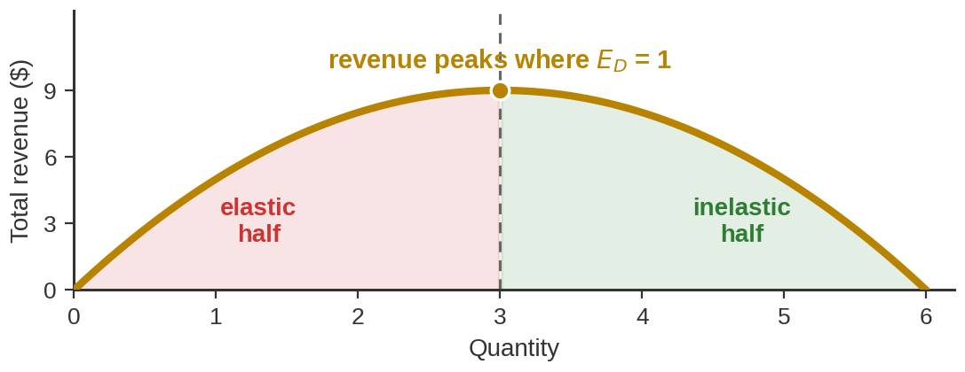
The Total-Revenue Rule
If demand is… | Value | Raise the price | Cut the price
Elastic | |E| > 1 | revenue FALLS | revenue RISES
Unit elastic | |E| = 1 | no change | no change
Inelastic | |E| < 1 | revenue RISES | revenue FALLS
IN REVERSE
Raise price, revenue up? Demand is inelastic.
AND THE PEAK
Revenue is highest at |E| = 1 — the midpoint.
Notes:
THE TOTAL-REVENUE RULE
- This table is examinable in exactly this form. Tell them to copy it.
- Do not let them memorise it blind — regenerate it in ten seconds from the tug of war
on the previous slide. Elastic means quantity is the bigger mover, so quantity wins,
so revenue goes the OPPOSITE way to price.
- The revenue peak at |E| = 1 is worth the small graph. It is why a firm that keeps
raising price eventually loses money even on an initially inelastic good — it walks
itself up the curve into the elastic region.
- Reverse inference, and this is the practical version Pearson emphasises: an owner who
raises price and sees revenue rise has just measured that demand is inelastic. Insulin
behaves that way; ketchup does not.

Slide 51


So: Should Your Band Raise the Cover Charge?
It depends on who is coming through the door.
FRIENDS AND FAMILY
STRANGERS ON A FRIDAY NIGHT
They came to see YOU. No substitute
exists — nobody else is your band.
Demand is inelastic. RAISE the cover;
revenue goes up.
They came for a night out. Four other
bars are within walking distance.
Demand is elastic. CUT the cover and
pack the room.
Notes:
ANSWERING THE BAND QUESTION
- Return to the split you got at the start of Part 5. The satisfying resolution is that
neither camp was wrong — they were answering different questions, because they pictured
different crowds.
- The determinant doing all the work is CLOSENESS OF SUBSTITUTES, which is the next slide.
Set it up here.
- Real-world extension if there is a minute: this is why venues price differently on a
Tuesday and a Saturday, and why a band with a devoted following can charge more than
its objective quality would justify. The audience composition changes, so the elasticity
changes.

Slide 52

What Makes Demand Elastic? Three Things
CLOSENESS OF
SUBSTITUTES
SHARE OF THE
BUDGET
TIME TO ADJUST
Gas doubles tomorrow and you
still drive to work.
Give it two years and you have
changed car, job or route.
Demand gets more elastic with
time.
The big one. If a near-identical
alternative sits on the same
shelf, buyers leave the moment
your price moves.
Ketchup: elastic.
Insulin: not.
A 10% rise on a $2 coffee is
twenty cents — you barely
notice.
A 10% rise on rent is real money, and you will move.
Notes:
THREE DETERMINANTS
- SUBSTITUTES is the one that explains most real cases. It also explains why market
definition matters so much: demand for "Coca-Cola" is far more elastic than demand
for "soft drinks," which is more elastic than demand for "beverages." Narrow the
category and you multiply the substitutes.
- BUDGET SHARE: the mechanism is attention as much as arithmetic. Nobody researches the
price of salt.
- TIME is the one students underrate and the one that matters most for policy. Short-run
gasoline demand is famously inelastic; long-run demand is far more elastic, because
eventually people buy different cars — which is the Hummer story from Part 3, and worth
naming as such.
- Pull it together: if an exam question says "in the short run," it is signalling
inelastic. If it says "over several years," elastic. That is a free mark.

Slide 53
Cross-Price Elasticity of Demand
E(cross) = % change in quantity demanded of good 1 ÷ % change in the price of good 2
Sign | What it means
Negative | Complements
Zero | Unrelated
Positive | Substitutes
Exhibit 5.14 — examples | E(cross)
Meat and fish | 1.6
Clothing and entertainment | 0.6
Whole milk and low-fat milk | 0.5
Meat and potatoes | −0.2
Food and entertainment | −0.7
Here the SIGN is the point, not the size. Positive means buyers switch between them; negative
means they are used together.
Chapter 4 told you substitutes and complements exist. This tells you which is which, and how
strongly.
Notes:
CROSS-PRICE ELASTICITY
- The contrast with own-price elasticity is the thing to hammer: there we ignored the
sign because it was always negative. Here the sign IS the answer.
- Positive: the price of one goes up and you buy more of the other -> substitutes
(Pepsi and Coke). Negative: price up, you buy less of the other -> complements
(printers and ink; petrol and large cars, which is exactly the Hummer mechanism).
- Magnitude measures the strength of the relationship. A cross-price elasticity of 0.05
is close to no relationship at all.
- Same source caution as Exhibit 5.13: the table's provenance is not given in the text.
Teach the signs, not the decimals. "Meat and fish at 1.6" is a strong substitute
relationship; whether it is 1.6 or 1.4 today is not something this table can tell you.
- Practical use: this is the number competition authorities argue about when deciding
whether two firms are actually in the same market.

Slide 54
Income Elasticity of Demand
E(income) = % change in quantity demanded ÷ % change in income
Value | Type of good
Less than 0 | Inferior
Between 0 and 1 | Normal — a necessity
Greater than 1 | Normal — a luxury
Exhibit 5.15 — selected | E(income)
Foreign vacation | 2.10
Healthcare | 1.18
Housing | 1.00
Gasoline | 0.48
Electricity | 0.23
Rice | −0.44
Public transit | −0.75
Chapter 4's normal and inferior goods, now with a dividing line at zero — and a second one at 1.
Notes:
INCOME ELASTICITY
- Two thresholds, not one, and students routinely miss the second. Zero separates
inferior from normal. ONE separates necessities from luxuries WITHIN the normal goods.
- "Luxury" here is a technical term meaning demand rises faster than income. It carries
no judgement — healthcare comes out as a luxury on this table, which surprises people
and is worth ten seconds.
- CAVEAT WORTH MAKING, on public transit at -0.75. That is a defensible figure for BUS
travel, but it does not generalise: rail transit income elasticities are typically
POSITIVE, and Paulley et al. report figures as high as 2 for some rail services, which
would make rail a luxury good. Litman's VTPI review is the accessible source. The
aggregate label "public transit" is hiding two goods that behave in opposite ways —
a nice teaching moment about what aggregation costs you.
- Same provenance caution as the previous two exhibits. Teach the categories.
- Practical hook: this is what a firm uses to forecast. In a recession, sellers of
high-income-elasticity goods (foreign holidays) get hit hardest; sellers of inferior
goods can actually grow.

Slide 55


Back to the Airport and the Theatre
THE LAST-MINUTE FLYER
THE LAST-MINUTE THEATREGOER
Booking two days out usually means a
funeral, a deal, a deadline. There is no
substitute for BEING THERE ON TUESDAY.
Demand is inelastic → the airline
raises the fare.
A 2024 study of 917 million fares put
the 0–6-days-out premium at about 59%
above the cheapest booking window.
Wants a nice evening. A different show,
a cinema, a restaurant — all substitute
perfectly.
Demand is elastic → the seat gets
discounted rather than wasted.
TKTS day-of-show seats were 30–50% off
when this was checked in August 2026.
Notes:
RESOLVING THE OPENING QUESTION OF PART 5 — read these
Last-minute airfare premium: about +59% for 0-6 days out versus the 74-21 day
window (CheapAir study of 917 million fares; 2024 edition — date it on the slide).
TKTS day-of-show Broadway discounts: roughly 30-50% off.
- The whole answer is substitutes, which is the first determinant. The business traveller
has none; the theatregoer has a city full of them.
- ONE HONEST QUALIFICATION and it is worth making. The shows that reach the TKTS booth
are, by selection, the ones with unsold inventory. Genuine hits use dynamic and premium
pricing and never appear there — Broadway grossed a record $1.91 billion in 2025-26 at
an average ticket of about $131. So the correct claim is that UNSOLD last-minute seats
are cheap, not that Broadway is cheap. That selection point is itself good economics.
- Second qualification, if a student has been booking flights: the fare curve is U-shaped,
not monotonic. Expedia's 2026 analysis finds the cheapest window is 15-30 days out, so
booking VERY early is also expensive. "Book as early as possible" is wrong advice.
- Do not claim airlines are softening last-minute fares. I found no evidence for it.

Slide 56

Letting the Data Speak: Should McDonald's Care?
Three questions a burger chain asks — one for each elasticity.
OWN PRICE
CROSS PRICE
INCOME
Put 30¢ on a burger. Do we make
more money or less?
Price elasticity of demand
decides it.
Burger King cuts the Whopper price. How many of our customers walk?
Cross-price elasticity.
A recession arrives. Do we sell
fewer burgers — or more, as
people trade down?
Income elasticity.
The category elasticity for food away from home is about 0.81 — but a single BRAND faces far
more elastic demand.
Notes:
LETTING THE DATA SPEAK — the three elasticities in one business
- Structure the slide as one question per elasticity. It is the cleanest summary of
Part 5 available and it takes thirty seconds.
- THE ONE REAL INSIGHT, and it is the answer to Pearson's question: category demand and
brand demand are completely different animals. Demand for "fast food" as a category is
inelastic — Andreyeva et al.'s review of 160 studies puts food away from home at about
0.81. Demand for MCDONALD'S specifically is far more elastic, because Burger King and
Wendy's are close substitutes. Same determinant as always: substitutes.
- DO NOT quote a brand-level number for McDonald's. I could not find a credible published
estimate, and inventing one would be exactly the failure mode this deck is meant to
avoid. State the direction, not a figure.
- On price levels, if it comes up: McDonald's published a national average of $5.29 for
a Big Mac and $5.39 for a Quarter Pounder in 2024, up about 20% on 2019. Current 2026
figures are franchisee-set and vary by store; the delivery-app prices circulating
online carry a platform markup, so do not quote them as counter prices.
- The income question is the interesting one: fast food may be an inferior good in a
downturn, as diners trade down from casual restaurants. Pose it; do not assert it.

Slide 57
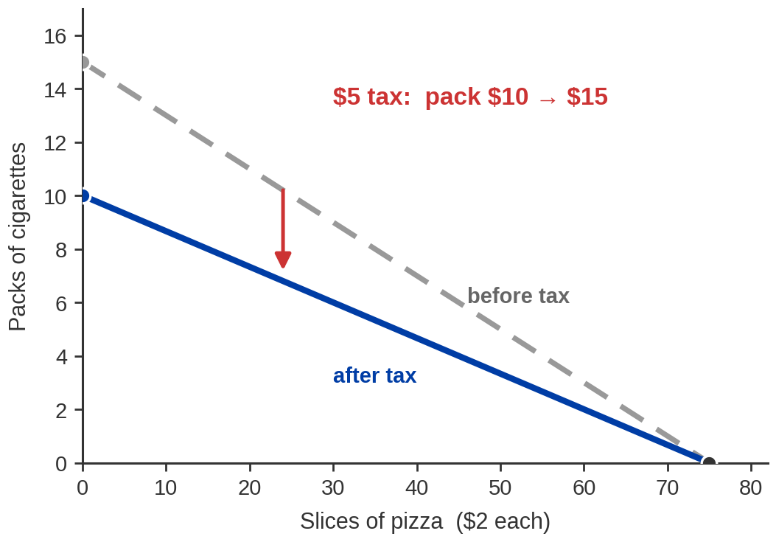
Practice:
Greta has $150 to spend on cigarettes and pizza. A pack costs $10; a slice costs $2.
FOUR QUESTIONS
a. Draw Greta's budget constraint.
b. What is her opportunity cost of
one pack of cigarettes?
c. Government adds a $5 tax per
pack. Draw the new constraint.
d. What is her opportunity cost now?
e. Will she smoke more or less —
and which elasticity tells you?
Notes:
PRACTICE PROBLEM — set-up
Budget $150. Cigarettes $10/pack, pizza $2/slice.
Intercepts: 15 packs, or 75 slices.
After a $5 tax the pack is $15: intercepts 10 packs, still 75 slices.
- Give them two or three minutes on (a) and (b) before showing anything. The figure on
this slide already shows both constraints, so if you want them to work cold, talk over
it or advance quickly.
- (a) is a pivot, not a shift — only the cigarette price changed. Callback to the
pivot/shift slide in Part 2; if they get this wrong, that is the slide to revisit.
- The answers are on the next slide, including one place where the publisher's own
answer key is wrong.

Slide 58
Practice: The Answers
B. BEFORE THE TAX
D. AFTER THE TAX
$10 pack ÷ $2 slice = 5
One pack costs her five slices of
pizza. That is the slope of the line.
$15 pack ÷ $2 slice = 7.5
One pack now costs seven and a half
slices. Smoking got dearer in pizza.
e. She smokes less. The measure that tells you HOW MUCH less is the PRICE ELASTICITY
OF DEMAND.
And because cigarette demand is inelastic, "less" means a little less — which is why the tax raises
revenue.
Notes:
PRACTICE ANSWERS — read these
b. Opportunity cost before tax = $10 / $2 = 5 slices per pack.
d. Opportunity cost after tax = $15 / $2 = 7.5 slices per pack.
e. Less. PRICE elasticity of demand tells you how much less.
- PUBLISHER ERROR, AND THIS ONE MATTERS. Pearson's instructor notes answer (e) with
"income elasticity would tell us Greta's specific demand response to an increase in the
price of cigarettes." That is self-contradicting — a response to a PRICE change is
measured by PRICE elasticity. Correct it explicitly; a student revising from the
publisher's slides will otherwise learn it wrong.
- Reinforce the pivot: the pizza intercept stays at 75 because nothing happened to pizza.
Only the cigarette intercept moves, 15 -> 10.
- Bring the whole hour together here. Cigarette demand is inelastic (Exhibit 5.13, with
the caveat we gave), so a tax cuts consumption only modestly while raising a lot of
revenue. That is simultaneously the argument FOR tobacco taxes as a revenue source and
the argument AGAINST them as a quitting device — and it is worth saying that the same
number supports both.
- REALITY CHECK worth 20 seconds: Pearson's $5 tax is close to accurate for California.
State excise is $2.87 a pack, federal is $1.01, and with sales tax the total is roughly
$4.85-$4.90. The $10 pack is low — California retail runs nearer $11-12.

Slide 59

The Whole Chapter, in One Negotiation
A price gets set between Drama and the realtor. Which one it lands nearer is decided by who has somewhere else to go.
BUDGET CONSTRAINT
Drama names a budget and then exceeds it. He ends up in its unaffordable zone.
WHO IS INELASTIC HERE?
Drama is. He wants THIS apartment, and he wants it bad.
SELLER'S MARKET OR BUYER'S?
The realtor doesn’t even flinch as they tries to haggle.
The inelastic side of a bargain pays for the privilege. Mrs Krank paid it for a ham; Drama pays it for a
higher quote.
Notes:
CLIP PAGE 2 — the analysis, and the chapter's closing synthesis
Deck's own round numbers, NOT the film's:
his stated budget $2,400
her walk-away $2,600 (below this she rents to someone else)
his true maximum $3,400 (above this he walks)
the deal $3,200
Bargaining range = $2,600 to $3,400, worth $800. The deal at $3,200 leaves him
$200 of it and her $600.
- DO NOT QUOTE FIGURES FROM THE FILM. I could not source the rent on screen, so these
are the deck's numbers, chosen so the arithmetic closes. Say so if anyone asks.
- WALK THE LADDER BOTTOM TO TOP. Below $2,600 she says no. Above $3,400 he says no.
Everything between is a deal both would accept rather than walk — that shaded band is
the whole negotiation, and where inside it the price lands is what they are arguing
about.
- FOUR CONCEPTS, IN THIS ORDER:
1. BUDGET CONSTRAINT. He states a budget and then agrees above it, which tells you the
stated number was a bargaining position, not the constraint. The real constraint is
his true maximum. Good moment to note that Part 1's budget line is what a person can
afford, not what they announce.
2. WILLINGNESS TO PAY. His true maximum IS his willingness to pay, straight out of
Part 4. The gap between it and the price he pays is his consumer surplus — here only
$200, because he got squeezed.
3. ELASTICITY, AND WHO HAS IT. He has spent the afternoon on this apartment and wants
THIS one. Few substitutes, inelastic demand. She has a queue of other renters, so
her side is elastic. The inelastic side gives up more of the range.
4. SELLER'S VS BUYER'S MARKET. Many buyers per unit is a seller's market and the price
runs toward the buyer's maximum. Flip it — many empty units, few renters — and the
same diagram sends the price toward the seller's walk-away instead. Ask them to
describe what the ladder looks like in a buyer's market; that is the best test of
whether the picture landed.
- CALL BACK TO THE HAM EXPLICITLY. Mrs Krank had no substitute for one night and paid
well over sticker. He has no substitute he is willing to consider and pays well over
his stated budget. Same mechanism, completely different setting — which is the point of
teaching a mechanism rather than a story.
- CAREFUL WITH ONE THING: a two-person haggle is not the perfectly competitive market of
Chapter 4, where nobody negotiates and the price is posted. Say that out loud. What
carries over is the LOGIC of elasticity and outside options, not the model. A student
who notices the difference has understood both chapters.
- If the room is still with you, the one-line closer: in Chapter 4 the market set the
price and nobody was in charge. Here two people set it, and the one with somewhere else
to go won.

Slide 60
Chapter 5: The Full Picture
 | What it says | Key terms | Where you saw it
The buyer's problem | Tastes, prices and a budget. Nothing else is needed to explain a purchase | budget set, budget constraint, revealed preference | Sweaters and jeans on $300
The optimum | Buy in order of marginal benefit per dollar; stop when the ratios are equal | diminishing marginal benefit, consumer equilibrium | 6 sweaters, 3 pairs of jeans
Moving the line | A price change pivots the constraint; an income change shifts it | pivot, parallel shift, opportunity cost | Sweaters at $50; income at $600
The demand curve | Re-solve the problem at each price and the curve appears — it is not assumed | law of demand, individual and market demand | Jeans at $25, $50, $75, $100
Consumer surplus | What buyers keep: willingness to pay minus what they actually pay | consumer surplus, willingness to pay | $75 for one buyer, $2.25 bn for the market
Elasticity | How much quantity responds — and therefore what a price change does to revenue | price, cross-price and income elasticity, arc formula, total-revenue rule | Solar lights, the band's cover charge, Greta's tax
Chapter 4 gave you the curve. Chapter 5 gave you the person behind it — and a number for how hard she
pushes back.
Notes:
THE FULL PICTURE
- Nothing on this slide is new. It is the hour re-indexed so students can see the shape
of what they just did.
- If you are short of time, read only the first column aloud and let them read the rest.
- The closing line is the one to say deliberately. It is the bridge from last week and
the setup for Chapter 6, which does the identical job on the seller's side.

Slide 61
KEY TAKEAWAYS
Chapter 5: Consumers and Incentives
The buyer's problem is only three things: what you like, what it costs, what you have
Buy in order of marginal benefit per dollar, and stop when the ratios are equal
Re-solve that problem at every price and the demand curve is derived, not assumed
Consumer surplus is the gap between what you would have paid and what you did pay
Elasticity turns "quantity responds" into a number — and that number decides revenue
Notes:
KEY TAKEAWAYS
- Five lines, one per part of the lecture. Read them; do not gloss them.
- SET UP CHAPTER 6 in one sentence: we have just built the demand curve out of a buyer
optimising at the margin. Next time we do exactly the same thing on the other side of
the market and build the supply curve out of a seller. Same tool, mirrored.
- If you want a hook to leave them with: ask which of the three elasticities they would
most want to know if they ran a business, and why. It is the kind of question that
makes the tool feel like a tool rather than a formula.

