Slide 1

Chapter 6
Sellers and Incentives
ECON 003
UC Riverside · Summer 2026
Notes:
Title.
Chapter 6, Sellers and Incentives. This is Chapter 5 seen from the other side of the
counter, and the picture says so: it is the same market stall from the Chapter 4 title
slide, reframed onto the SELLER. Same transaction, other side of it.
Say at the top: everything in Chapter 5 built the demand curve from a buyer's problem.
Today we build the supply curve from a seller's problem, and by the end of the hour we
will have both halves of the diagram we have been drawing since Chapter 4 derived from
scratch.
One firm runs through the whole hour — a McDonald's franchise. The textbook runs the same
argument on a cheese factory with different numbers; the logic is identical, and the
bridging figures are in these notes wherever they matter.

Slide 2



Where We Left Off
In Chapter 5 you built the demand curve out of one buyer's problem.
Today you build the supply curve out of one seller's problem.
THE BUYER'S
PROBLEM
THE SELLER'S
PROBLEM
SAME MACHINERY
Optimise at the margin. Keep
going while the next unit adds
more than it costs. Stop when
they are equal.
A budget line, a bang-per-buck rule, and
a quantity for every price. Stack those
up and you have a demand curve.
A production function, a cost curve,
and a quantity for every price. Stack
those up and you get a supply curve.
Chapter 4 asked you to trust the supply curve. Today you build it.
Notes:
Recap and framing.
One sentence of recap, no more: in Chapter 5 the demand curve stopped being an assertion
and became a result. Today the supply curve gets the same treatment.
Point at the middle card. The parallel is exact and worth naming out loud, because
students who see Chapter 6 as a fresh pile of definitions will drown in the vocabulary.
It is the same optimisation problem with the signs flipped.

Slide 3




Today's Roadmap
1. Perfect
competition
2. The seller's
problem
3. To the
supply curve
4. Producer
surplus
5. Short run to
long run
Notes:
Roadmap.
Six sections, and they are not six separate topics. Parts 2, 3 and 4 are one continuous
argument — production, then costs, then the quantity the firm picks at each price, which
IS the supply curve, and then what the firm gains from trading at the market price.
Parts 5 and 6 change the time horizon and let the number of firms move. That is where the
chapter's punchline lives.
Announce the carried question here as well as on the next slide, so it is heard twice.

Slide 4
PART 1
Sellers in a Perfectly
Competitive Market
Notes:
Section divider — Part 1, Pearson section 6.1.
Short section, and it is scaffolding rather than content: it defines the market structure
every diagram today assumes. Tell them that explicitly, so they know it is a set of
assumptions and not a description of the world.

Slide 5

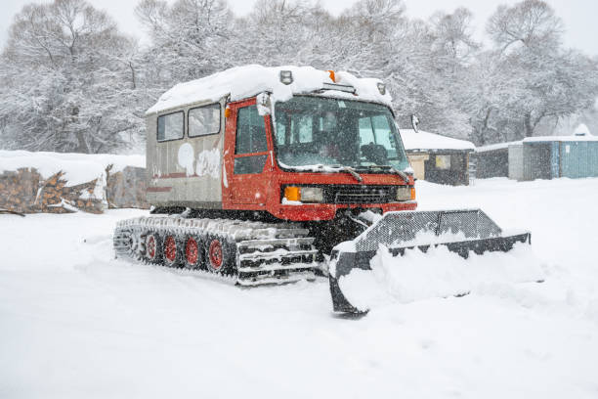
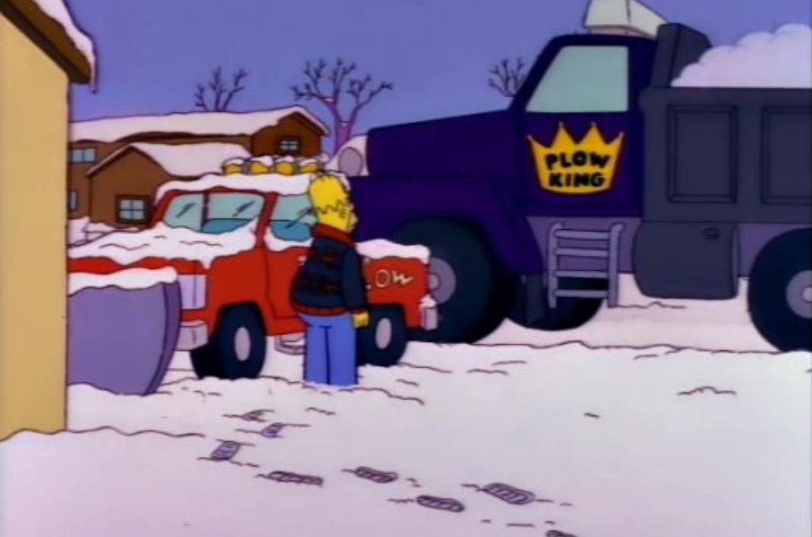
Competitive Market Review
A perfectly competitive market: many small buyers and sellers, an
identical product, and free entry and exit.
NOBODY IS BIG
ENOUGH
THE PRODUCT IS
IDENTICAL
ANYONE CAN COME AND
GO
So many buyers and sellers that no
single one of them can move the
market price by anything they do.
One seller's unit is a perfect
substitute for another's.
No license, no patent, no barrier.
This is a benchmark, not a description. Very few real markets satisfy all three.
Notes:
The three conditions.
Get the honesty in early: this is a benchmark. Almost nothing satisfies all three
perfectly. It earns its place because it is the case where the answer is cleanest, and
because the further a real market sits from it, the more of Chapters 12 to 14 you need.
Closest real examples worth naming: commodity grain, foreign exchange at the retail level,
and a lot of online resale of identical goods.
A fair objection a student may raise, and you should welcome it: McDonald's is a BRAND, so
is it really in a perfectly competitive market? No — not perfectly. But the market for a
fast, hot, cheap lunch near campus is close enough that no single restaurant sets the going
price, and that is the assumption doing the work today. Say so rather than pretend.
The third condition is doing the heavy lifting. Conditions one and two set up Parts 2 to 4;
condition three is the whole of Part 6.

Slide 6

Price Takers — Quantity Is Your Only Lever
A price taker treats the market price as given. It is a fact about the world,
not a decision the firm gets to make.
WHAT THE FIRM DECIDES
WHAT HAPPENS IF IT TRIES
Only ONE thing: how much to produce. Price is
handed to it by the market and it takes that number
as given.
Charge a bit more and you sell nothing — every buyer
goes to an identical seller. Charge a bit less and you
have thrown money away for no reason, because you
could have sold everything at the market price.
Notes:
Price taking.
This is the single most load-bearing assumption in the chapter, and the one students
quietly stop believing by week ten. Say it plainly: for the next four weeks the firm
chooses a QUANTITY and nothing else.
The asymmetry in the second card is worth spelling out at the board. Raising the price
loses you every customer; cutting it is simply pointless. So there is exactly one price you
would ever post.
Chapter 4's Breaking Bad clip, if they saw it, is the counterexample — a seller who can
move the price. That is a price maker, and it is Chapter 12.

Slide 7
Identical Goods — and Why That Matters
If nobody can tell one seller's unit from another's, nobody can charge
more than anybody else.
Notes:
Identical goods.
Ask the room for a product where they genuinely cannot tell the brands apart. Petrol, table
salt, unbranded flour, generic paracetamol, a kilowatt-hour. Then ask for one where they
obviously can, and notice how hard the seller worked to make that true.
The economics: if two firms really sell the same thing, the only competition left is price,
and price competition in this model runs all the way down to the cost curve. That is not a
side observation — it IS the result of the chapter, arriving early.
Line worth landing, and it is the kicker: almost every marketing budget in the world exists
to get a firm out of this chapter. Which tells you the chapter's conclusion is not one firms
enjoy.

Slide 8

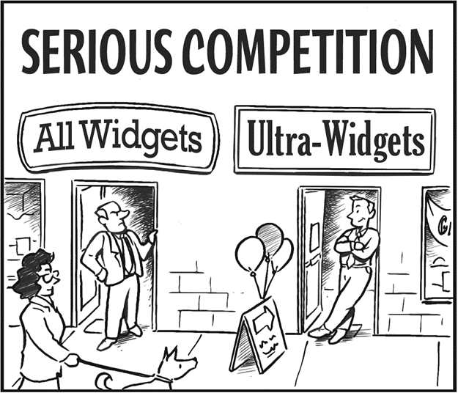
Free Entry and Free Exit
Nothing legal or technical stops a new firm setting up — or stops one leaving.
ENTRY FOLLOWS PROFIT
Profit is a signal, and in this model everybody can see it and
anybody can act on it.
EXIT FOLLOWS LOSS
Firms losing money leave. Both movements push the market back
toward the same place — which is what Part 6 is about.
Image: Acemoglu, Laibson & List, Microeconomics 3e
Notes:
Free entry and exit. Flag this one hard.
This is the condition that answers the question posed on slide 4, and it is the one
students forget when they try to answer it. Everything in Part 6 comes from here — and so
does the Simpsons clip at the end of the hour.
The cartoon: a rival has opened directly across the street selling the same thing under a
slightly shinier name. That is entry, and nothing stopped it. Play it lightly and move on.
Counterexamples worth naming for contrast, because they are what the rest of the course is
about: a taxi medallion, a pharmaceutical patent, a banking licence, a broadcast spectrum
allocation. Each is a barrier to entry, and each is why the industry behind it does not
behave the way today's model says it should.
Do not develop the mechanism now. One sentence and move on — the payoff is forty minutes
away and it is better if they have to wait for it.

Slide 9
PART 2
The Seller's Problem
Notes:
Section divider — Part 2, Pearson section 6.2.
The long one, and it is worth saying so. Three questions, answered in order, and the third
cannot be answered until the first two are.
We open it with a film clip rather than a definition, because the clip contains the whole
section in ninety seconds and students will have the shape of it before the vocabulary
arrives.
Warn them the vocabulary comes thick and fast — six kinds of cost in about fifteen minutes.
Tell them the cost table is the slide to photograph.

Slide 10


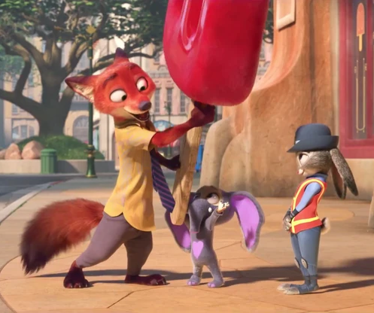
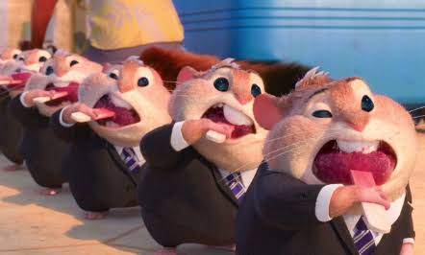
What Nick Built
Three decisions — and they are the three this whole section is about.
1. PRODUCTION
2. COSTS
3. REVENUE
One jumbo-pop in, dozens of small
ones out. Melt, re-freeze, add a stick.
That is a production function.
One Jumbo-pop turns into hundreds of Pawpsicles. Plus the stick and the melted syrup.
A queue of hamsters outside
a bank.
Notes:
Clip page 2 of 2. This is the page students photograph.
Ask FIRST, before you show the bar: "why is that a good business?" Pause. Take answers. The
one you are steering toward is not "because he's clever" but "because the price is far above
what it costs him to make one more."
Then the diagram. Read the numbers as illustrative and say so — the film gives no figures.
Top bar: it costs about 20 cents to make one more Pawpsicle and he sells it for around two
dollars. That gap is the margin, and it is enormous.
Two forces make it wide, and both are on the slide:
- COSTS are low, because the production step is trivial once you own the big popsicle.
- DEMAND is high and unresponsive, because the customers are hot, they are already
queuing, and there is no second stall. A buyer with no alternative does not haggle.
Now the sentence that sets up the whole hour: a wide margin is not a permanent fact about
Pawpsicles. It is a fact about how many people are selling them. Nothing in that scene stops
anyone else buying a big popsicle and standing on the next corner — which is the bottom bar.
Do NOT use this clip for supply elasticity. What the scene shows is inelastic DEMAND — a
captive queue — and the two elasticities are exactly what students confuse. Using it here
would make that worse.
Leave the bottom bar hanging. It is answered by the Simpsons clip in Part 6, and the
callback is the best moment in the lecture.

Slide 11
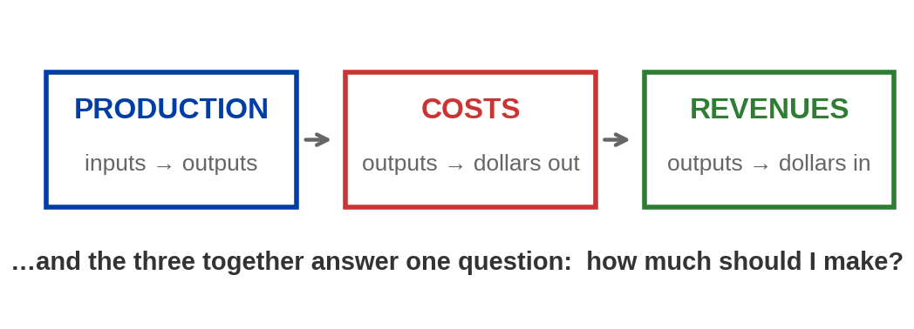
Seller’s Problem
The seller's goal is to maximize profit. Getting there means answering
three questions, in order.
Notes:
The structure of the whole section — the Pawpsicle scene, formalised.
Production, costs, revenues. Say the order matters: costs are derived from the production
function, and the profit-maximising quantity is derived from costs and revenue together. A
student who memorises the cost definitions without the production function behind them will
not be able to explain why ATC is U-shaped.
The fourth box — how much to make — is deliberately not on the diagram. It is the OUTPUT of
the other three, and it arrives on the profit-maximisation slide.
Point back at the clip: Nick answered all three in ninety seconds without naming any of
them.

Slide 12
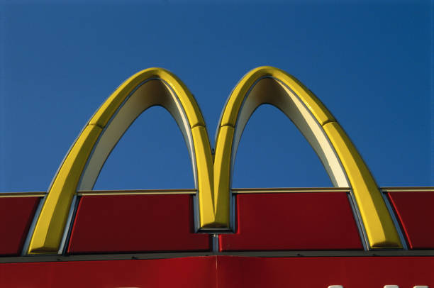
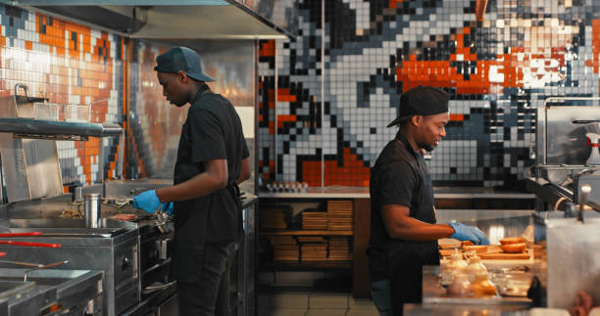
Starting a McDonald’s Franchise
CAPITAL INVESTMENT
TIME
Six to twelve months of training
before you are even considered
for a restaurant, and an
agreement that usually runs
twenty years.
A $45,000 franchise fee, and $1.47 to $2.73
million for equipment, seating, signage and
opening stock. At least $750,000 of it has to
be your own money, not borrowed.
McDonald's 2025 Franchise Disclosure Document, Items 5 and 7; mcdonalds.com/us/en-us/us-franchising (costs, process and FAQ pages), retrieved 9 August 2026.
Notes:
The decision that carries the rest of the hour. Spend two minutes here.
READ THESE OUT: a $45,000 franchise fee. A total initial investment of $1.47 to $2.73
million. At least $750,000 of it in non-borrowed personal funds. Six to twelve months of
training. A twenty-year agreement.
THE SECOND CARD IS THE IMPORTANT ONE and it is easy to skip. The franchisee does NOT buy
the land or the building. McDonald's acquires the site, builds the restaurant, and issues
the operator a lease. That is why the initial investment looks small for a restaurant — the
real capital is on McDonald's balance sheet, and it comes back as rent. We meet that rent in
twenty minutes.
If a student says "$2.7 million seems cheap for a restaurant" — they are right, and that is
the answer. Say so; it is a good catch.
One sourcing note worth making out loud if you like, because it teaches something: McDonald's
own franchising-costs page says $750,000 of non-borrowed funds, while its consumer FAQ page
still says $500,000. Both were live in August 2026. Use $750,000 — the dedicated page — and
tell them that checking two pages of the same company's site is normal work.
From here on, "the firm" means this restaurant. Every table, every curve, every decision.

Slide 13


Question 1: How Do You Make It?
Production is the process that turns inputs into outputs. Physical capital
is any good — machine, building, fryer — used to do it.
INPUTS
THE TECHNOLOGY
OUTPUT
Labor, capital, land, raw
materials.
The recipe: how much output
a given bundle of inputs
yields.
What comes out and gets
sold. Meals served.
How do you make a burger? Beef, a bun, a grill, and somebody who knows how.
Notes:
Production, and the vocabulary of inputs.
Physical capital is worth defining carefully, because students hear "capital" and think
money. In this chapter capital means the grill, not the loan that bought it.
Everything today holds the technology fixed. If the recipe improves — a faster fryer, a
better rota — the whole cost structure moves, and that is a different question.
Keep this brisk. It is a naming slide, and the table two slides on is where the work
happens.

Slide 14

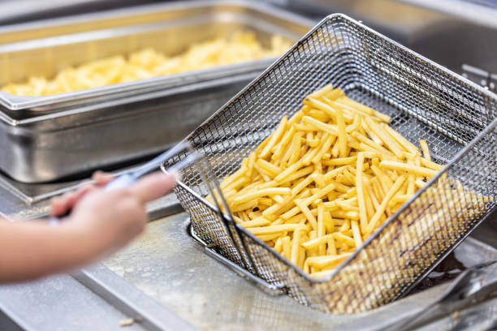
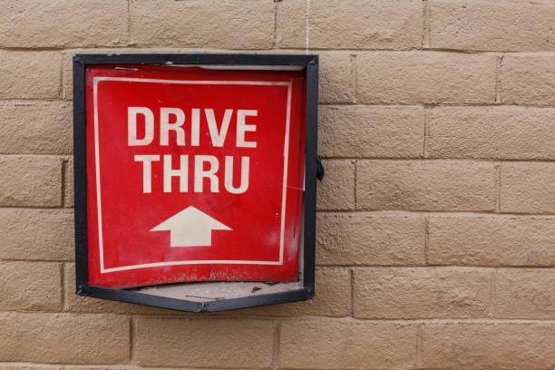
Short Run and Long Run
The short run is any period in which at least one input cannot be
changed. The long run is the period in which all of them can.
SHORT RUN — THE KITCHEN IS FIXED
LONG RUN — NOTHING IS FIXED
Serving lunch today, you are stuck with the grills
and the floor space you already have.
Given enough time you can add a second
drive-through lane, take the unit next door, or close
the restaurant entirely.
Notes:
Short run and long run — and the definition students get wrong.
The single most common error in this chapter: treating the short run as "a few months" and
the long run as "a few years". They are not calendar periods. The short run is whatever
stretch of time leaves something fixed.
Concrete contrast worth saying: for a food truck the long run might be six weeks. For a
nuclear power station it is a decade. Same definition, wildly different clock times.
Standard exam trap: "is rent a fixed cost?" On a signed lease in the short run, yes. Over a
horizon long enough not to renew, no. The answer is always "over what period?"
Parts 2 to 4 are entirely short run. Part 5 switches. Say so now, because when the cost
curves change shape in Part 5 students will think they have been contradicted.
Setting up the next slide: because the kitchen is fixed, the only way to serve more meals
today is to put more people in the same kitchen. Hold that thought — it is the whole reason
marginal product eventually falls.

Slide 15
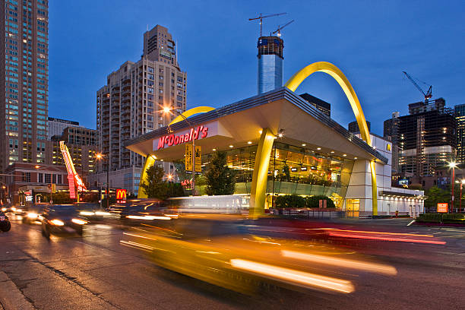
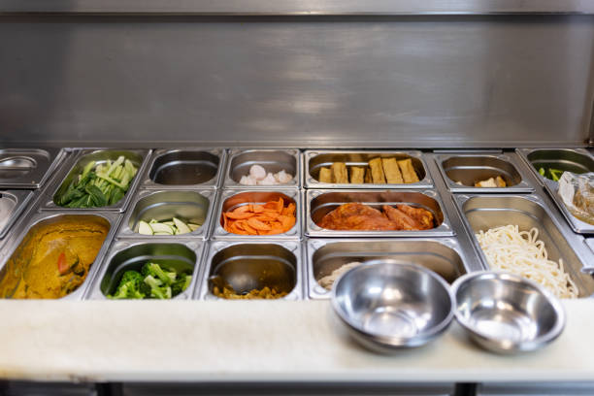


Fixed and Variable Factors
FIXED FACTOR OF PRODUCTION
VARIABLE FACTOR OF PRODUCTION
An input that cannot be changed in the short run, and
that stays the same no matter how much you
produce. The building. The fryers.
An input you can change within the period, and that
moves with the level of output. Crew hours, beef,
buns, power.
Notes:
Fixed and variable factors. A naming slide — the one idea worth dwelling on is
in the band.
The SAME input is fixed or variable depending on the run. That is what the band is doing
there.
Standard exam trap: "is rent a fixed cost?" On a signed lease in the short run, yes. Over a
horizon long enough not to renew, no. The answer is always "over what period?"
Setting up the next slide: because the kitchen is fixed, the only way to serve more meals
today is to put more people in the same kitchen. Hold that thought — it is the whole reason
marginal product eventually falls.

Slide 16
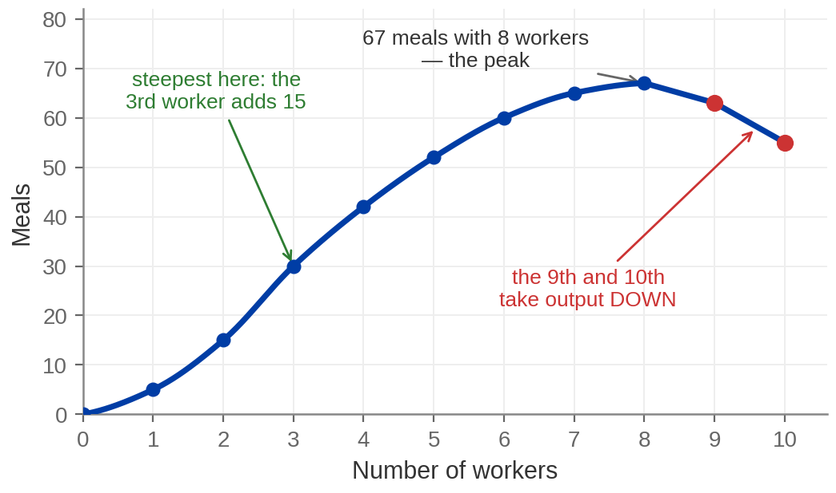
Production at McDonald's
Workers | Meals | Marginal product
0 | 0 | —
1 | 5 | +5
2 | 15 | +10
3 | 30 | +15
4 | 42 | +12
5 | 52 | +10
6 | 60 | +8
7 | 65 | +5
8 | 67 | +2
9 | 63 | −4
10 | 55 | −8
One kitchen, one set of grills, and workers added one at a time.
Notes:
The production table and the production function. Same data, two views.
READ THESE OUT: the 3rd worker adds 15 meals, the most of any worker. Output peaks at 67
meals an hour with 8 workers. The 9th worker takes output DOWN by 4, and the 10th by 8.
Everything is held constant except the number of workers — same kitchen, same grills. That
is what makes this the SHORT run.
The link to make explicit: the SLOPE of the curve on the right is marginal product. Steep
slope means a big marginal product; flattening means it is falling; the peak is where
marginal product hits zero; past the peak it is negative.
Say that sentence carefully, because the same relationship appears twice more today — total
cost and marginal cost, total revenue and marginal revenue. Marginal is always the slope of
total.
Ask: how many workers would this restaurant ever hire? Never more than 8, at any wage above
zero. Get that from the room rather than telling them.
BRIDGE TO THE TEXTBOOK: Acemoglu runs this identical argument on a cheese factory. Their
table peaks at 1,934 boxes a day with 38 workers and the 39th takes it down by 100. Same
shape, same three lessons, bigger numbers. If a student is revising from the book, tell them
to map worker 3 here onto worker 4 there — the peak of marginal product.

Slide 17
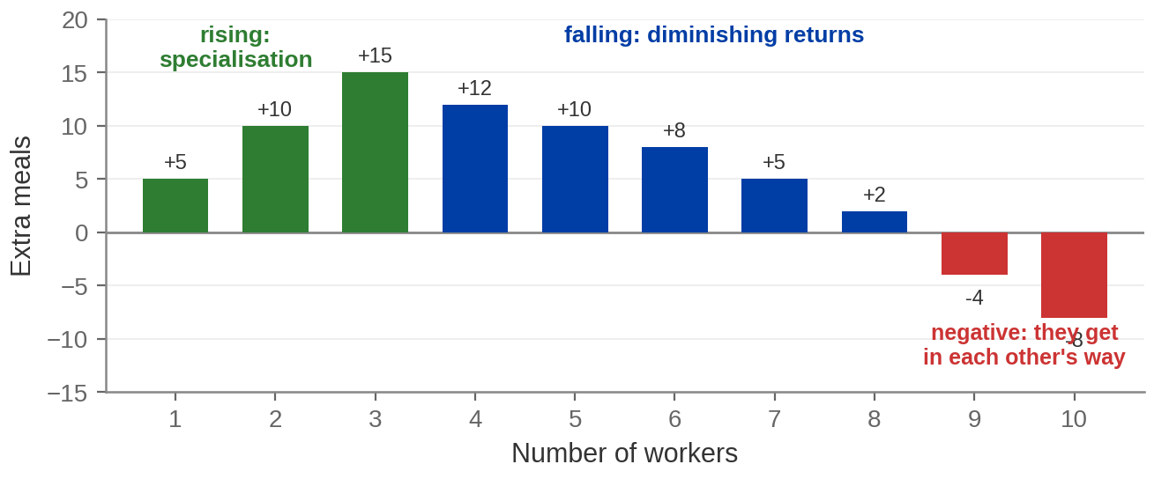
Marginal Product: Rise, Fall, Negative
Marginal product = the change in total output from adding one more worker.
Notes:
Marginal product — the conceptual heart of the production section.
THE NUMBERS: +5, +10, +15, then +12, +10, +8, +5, +2, then −4 and −8.
Walk the three colours, but get the WHY from the room before you reveal the cards. Ask why
the 4th worker adds less than the 3rd. The answer is on the tip of most tongues and it lands
better if a student says it.
The phrase to protect them from is "workers get worse". They do not. Every worker is
identical by assumption. What falls is the amount of kitchen each of them has to work with.
The word EVENTUALLY in the law of diminishing returns matters. It does not say the first
worker is the most productive — here the third is. It says the fall must come at some point.
Head off the confusion now and again in Part 5: diminishing returns is a SHORT-RUN idea and
needs a fixed input. Diseconomies of scale, later, is a LONG-RUN idea where nothing is
fixed. Different concepts, different diagrams.
OPTIONAL 60-SECOND CLIP, if the room wants intuition rather than arithmetic: the Witcher
scene where Geralt calls off Ciri's training — more hours today will yield smaller and
smaller gains, so rest is worth more than the next repetition. Two caveats if you use it:
her skill is not a fixed factor in the way a kitchen is, and the scene is closer to fatigue
than to diminishing returns proper. Play it as an analogy, then come straight back to the
table, which is the examinable version.

Slide 18

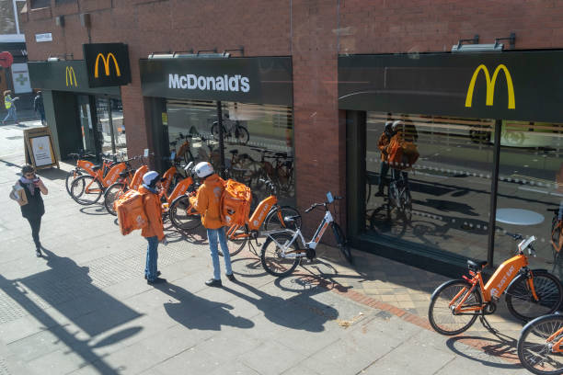
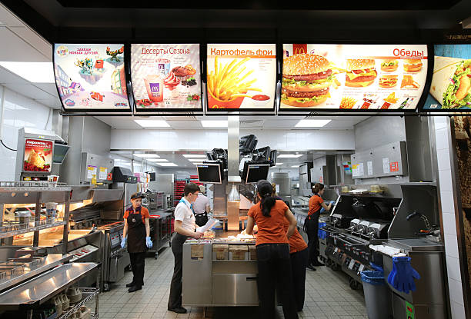
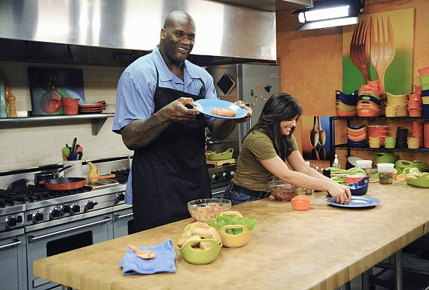
Three Things This Table Says
1. IT RISES AT FIRST —
SPECIALISATION
2. THEN IT FALLS —
DIMINISHING RETURNS
3. IT CAN GO
NEGATIVE
One person doing everything wastes
time switching tasks. Two can split the
work and each get good at half of it.
That is why workers 2 and 3 each add
more than the one before.
At some point each extra worker
adds less than the one before. Not
because he is worse, but because
the kitchen he works in is fixed
and there is less of it to go round.
Keep adding people to the same
kitchen and eventually they get in
each other's way. The 9th worker
takes output DOWN by 4 meals.
The law of diminishing returns: with at least one input fixed, each additional unit of a variable
input eventually adds less than the one before it.
Notes:
The three lessons, stated as a law.
Diminishing returns is the one to get right, and the phrase to protect them from is "workers
get worse". They do not. The workers are identical by assumption. What falls is the kitchen
available per worker.
The word EVENTUALLY in the law matters. It does not say the first worker is the most
productive — here the third is. It says the fall must come at some point.
The negative stretch is not a curiosity. It is why no restaurant would ever roster the 9th
worker even if labour were free, and it is why the production function turns over.
Common exam confusion to head off now: diminishing returns is a SHORT-RUN idea and needs a
fixed input. Diseconomies of scale, in Part 5, is a LONG-RUN idea where nothing is fixed.
Different concepts, different diagrams. Say it now and again in Part 5.

Slide 19
Question 2: What Does It Cost?
Total cost = variable cost + fixed cost.
Which is which depends on the length of the run.
FIXED COST (FC)
VARIABLE COST (VC)
The cost of the fixed factors. The same at zero meals
as at a hundred — the rent, the fryers, the insurance,
the loan. Also called overhead. Here: $100 an hour.
The cost of the variable factors. Moves with output
— the crew on shift, the beef, the buns, the power
for the grills.
Notes:
Costs — the two primitives.
Say the fixed cost clearly: one hundred dollars an hour, and it is paid at zero output. That
is not a technicality; it is the entire shutdown argument in Part 3, and saying it now stops
the result being a surprise later.
Ask the room to sort a few items live. Beef patties — variable. The rent — fixed. The crew
on shift tonight — variable. The manager's salary — fixed, in the short run. The electricity
— mostly variable, some fixed. That last one is a good answer to accept, because real costs
are not always tidy.
BRIDGE: the textbook's cheese factory uses $200 a day of fixed cost and $72 per worker. Same
structure, different figures.

Slide 20
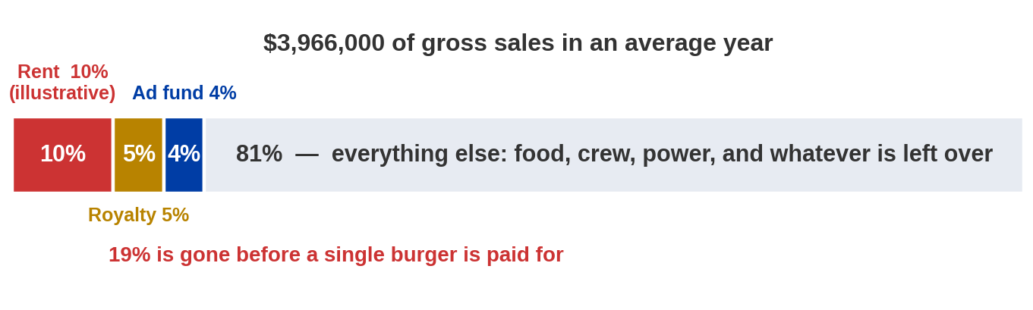
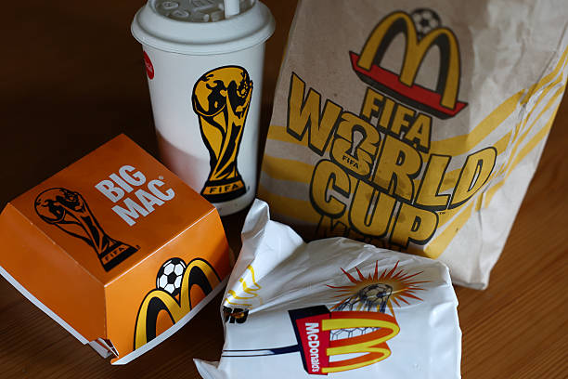
What It Actually Costs to Run One
Average annual sales and all three fees: McDonald's 2025 Franchise Disclosure Document, Items 5, 6 and 19 — 2024 sales across about 12,023 US franchised restaurants open at least a year; median $3.80m, range $914,000 to $19.7m. Rent is shown at 10% for illustration; the FDD discloses effective rents from 0.00% to 33.33% of gross sales.
Notes:
The running cost, on the real restaurant. This is the slide the cost table was
building toward.
READ THESE OUT: an average US franchised McDonald's sold $3,966,000 in 2024. The service fee
— the royalty — is 5% of gross sales for a new franchisee. The advertising contribution is
not less than 4% of gross sales. Rent to McDonald's is a percentage of gross sales too.
At $3.97 million, the royalty alone is about $198,000 a year and the ad fund about $159,000.
Rent at 10% would be another $397,000. That is roughly $754,000 gone before a single burger,
a single hour of crew, or a single kilowatt is paid for.
THE DENOMINATOR IS THE LESSON. Every one of those percentages is a share of GROSS SALES —
the top line — not of profit and not of what is left. Ask the room what happens to the
royalty in a bad month. It falls with sales, yes; but it never falls to zero while the doors
are open, and it does not care whether the month was profitable.
The second card is the subtle one and worth the time. Rent is structured as the greater of a
minimum base rent or a percentage of sales. So there is a floor you owe regardless. The
royalty has no floor. Two things that both feel like overhead, and only one of them is fixed
in the sense this chapter means.
TWO CAVEATS, and say them before a student does:
1. The 5% royalty applies to NEW franchisees, from 1 January 2024 — the first increase in
nearly thirty years. Operators who signed earlier are grandfathered at 4%.
2. The $3.97m average is across restaurants open at least a year, and the range runs from
$914,000 to $19.7 million. It is not what your store would make in year one.
WHAT I HAVE NOT PUT ON THE SLIDE, and why: McDonald's discloses gross sales and fees, but
NOT franchisee profit. Any "a McDonald's owner makes $150,000 a year" figure you find online
is somebody applying an assumed margin. We come back to that on the economic-cost slide.

Slide 21

Three Averages and a Margin
AVERAGE TOTAL
COST (ATC)
AVERAGE VARIABLE
COST (AVC)
AVERAGE FIXED
COST (AFC)
MARGINAL COST
(MC)
Total cost ÷ output.
What the average meal
costs, all in.
Variable cost ÷ output.
What the average meal
costs to actually make.
Fixed cost ÷ output.
Overhead spread over
the meals. Always falls.
Change in total cost ÷
change in output.
What the NEXT meal costs.
ATC = AVC + AFC and MC = ΔTC / ΔQ
Averages tell you how you have done overall. The margin tells you what to do next.
Notes:
The cost vocabulary. Six terms in one slide — go slowly and use the band.
The line at the bottom is the one to make them write down. Averages are backward looking;
they describe what has already happened. Marginal cost is the only one that answers a
decision, and every decision in this chapter is made with it.
ATC = AVC + AFC is worth deriving out loud rather than asserting: divide TC = VC + FC through
by Q. Ten seconds, and it stops the identity looking arbitrary.
AFC always falls, because a fixed number divided by a rising one falls. That is "spreading
the overhead", and students already have the intuition from anything they have organised — a
group order, a shared flat, a party with a fixed room hire.

Slide 22
Marginal Cost
Marginal cost is the change in total cost from producing one more unit
of output.
MC = ΔTC / ΔQ — what the NEXT meal costs, not what the average one cost
MC FALLS WHILE MP
RISES
MC RISES WHILE MP
FALLS
MC IS A MIRROR OF
MP
Early on each worker adds more meals for
the same wage, so each meal costs less.
Later each worker adds fewer meals for
the same wage, so each meal costs more.
Marginal cost is upside-down marginal
product: same story, different units.
Notes:
Marginal cost, and the identity that makes its shape obvious.
THE NUMBERS: MC bottoms at $1.00, at 50 meals. By 100 meals it is $8.00 — an eightfold climb
over the second half of the table.
The identity worth holding: marginal cost is the wage divided by marginal product. When the
denominator is at its biggest, the fraction is at its smallest. Students who hold that never
have to memorise the shape of the MC curve, because they already know the shape of marginal
product.
It works cleanly here because labour is the only variable input. Say that caveat — with two
variable inputs the relationship is messier.
Read one step off the table live: going from 70 meals to 80 adds $40 of variable cost for 10
more meals, so the marginal cost over that stretch is $4.00 a meal. That is the number the
profit-maximisation slide uses.

Slide 23
The Cost Table
Meals | VC | FC | TC | AVC | AFC | ATC | MC
0 | $0 | $100 | $100 | — | — | — | —
10 | $30 | $100 | $130 | $3.00 | $10.00 | $13.00 | $3.00
20 | $50 | $100 | $150 | $2.50 | $5.00 | $7.50 | $2.00
30 | $65 | $100 | $165 | $2.17 | $3.33 | $5.50 | $1.50
40 | $77 | $100 | $177 | $1.93 | $2.50 | $4.42 | $1.20
50 | $87 | $100 | $187 | $1.74 | $2.00 | $3.74 | $1.00
60 | $100 | $100 | $200 | $1.67 | $1.67 | $3.33 | $1.30
70 | $120 | $100 | $220 | $1.71 | $1.43 | $3.14 | $2.00
80 | $160 | $100 | $260 | $2.00 | $1.25 | $3.25 | $4.00
90 | $220 | $100 | $320 | $2.44 | $1.11 | $3.56 | $6.00
100 | $300 | $100 | $400 | $3.00 | $1.00 | $4.00 | $8.00
Notes:
The cost table. Tell them to photograph this slide.
READ THESE OUT: fixed cost is $100 at every level including zero meals. At 80 meals: VC $160,
TC $260, ATC $3.25, AVC $2.00, MC $4.00.
Walk ONE row by hand — doing one live is worth more than describing all eleven. Take 70
meals: variable cost $120, plus fixed $100, gives total cost $220. Divide by 70 meals and the
average is $3.14. The last $20 of variable cost bought the last 10 meals, so marginal cost is
$2.00 a meal.
Three numbers from this table run the rest of the hour, so point at them now:
- MINIMUM AVC is $1.67, at 60 meals. That will be the shutdown price.
- MINIMUM ATC is $3.14, at 70 meals. That will be the long-run price.
- MC is at its lowest, $1.00, at 50 meals.
One honest note if a sharp student checks: because the table steps in tens, MC does not cross
AVC and ATC exactly at a tabulated row — the crossing falls between rows. With a continuous
curve it lands exactly on the minimum, which is what the next slide draws. Say it if asked;
do not volunteer it.
BRIDGE: the textbook's cheese factory has min AVC $0.65 at 558 boxes and min ATC $0.90 at
1,019 boxes, where MC is exactly $0.90 too.

Slide 24
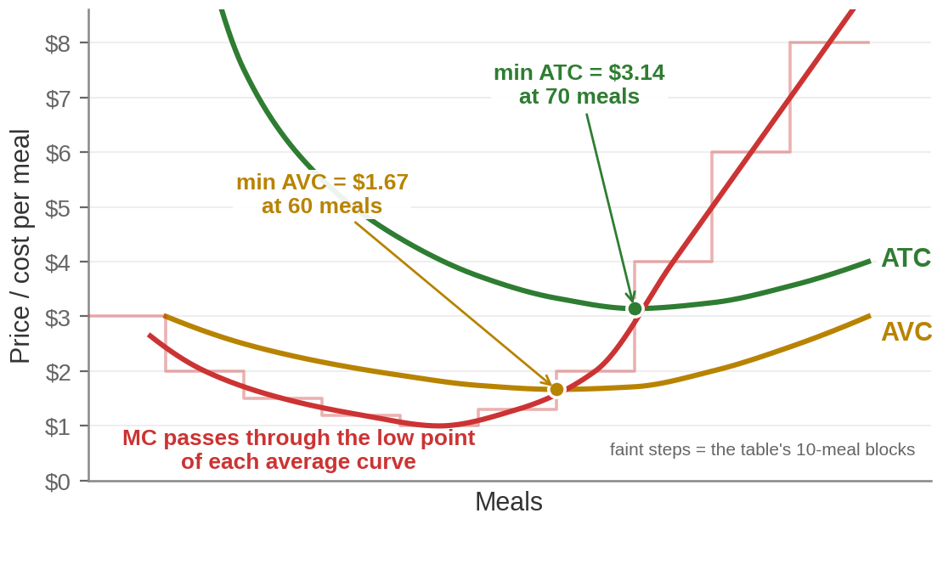
The Cost Curves
Marginal cost passes through the lowest point of each average curve. Always.
Notes:
The cost curves. The picture students will see for the next three chapters.
NUMBERS: AVC bottoms at $1.67 at 60 meals. ATC bottoms at $3.14 at 70 meals. MC bottoms at
$1.00 at 50 meals and then climbs steeply.
The result to state and then justify: MC passes through the minimum of each average curve.
The justification that works, and the next slide is built on it: if the next meal costs LESS
than the current average, it pulls the average down. If it costs MORE, it pushes the average
up. So the average is falling exactly while MC is below it and rising exactly while MC is
above it — and it must be flat where they cross.
Note the gap between ATC and AVC narrows as output rises. That gap IS average fixed cost, and
it shrinks because the overhead spreads over more meals.
If a student asks about the faint steps: the table gives marginal cost a block at a time —
the 71st to 80th meals cost $4.00 each — so the honest picture of the table is a staircase.
The smooth curve is what that staircase becomes when the blocks shrink to one meal, and it is
the curve every textbook draws. Both are on the slide, and each riser crosses an average curve
at exactly the point the curve bottoms out.
Hold on to $1.67 and $3.14. They come back as the shutdown price and the long-run price, and
by the end of the hour students should be able to say what each one means without looking.

Slide 25
The Average Follows the Margin
A margin above the average pulls it up; below, it pulls it down; equal, it is flat.
THE CLASS AVERAGE IS 85%
A PLAYER AVERAGES 30 POINTS A GAME
Somebody joins and scores 100. What happens to the average?
It rises — the new score was above it. Somebody joins and
scores 34, and it falls.
He scores 45 tonight and the average rises. He scores 12
and it falls. He scores exactly 30 and it does not move.
That last case is where MC crosses ATC.
Notes:
Why the average curves are U-shaped, in language nobody has to memorise.
This slide exists because "MC cuts ATC at its minimum" gets learned as a fact about a picture
rather than as arithmetic. Do the two examples out loud and let the room answer.
Then make the transfer explicit: marginal cost is the "next score". Average total cost is the
"average so far". While the next meal costs less than the average, the average falls. The
moment the next meal costs more, the average starts rising. So the lowest point of ATC is
exactly where the two are equal.
That is a complete proof and it takes thirty seconds. Once they have it, they never need to
memorise the shape of the cost curves again.
Push it one step if you have the room: this also tells you the U-shape of ATC is NOT caused
by fixed costs alone. AFC falls forever. What turns ATC back up is rising MC — which is
diminishing returns arriving from the production table.

Slide 26
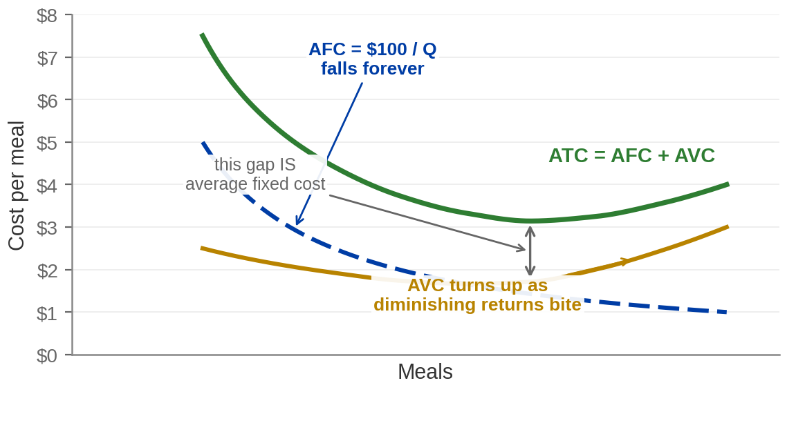
Why the Average Curves Bend
AT A MCDONALD'S
Base rent spreads over
more meals, so it falls per
meal. The 5% royalty and
4% ad fund are shares of
sales — they never spread
at all.
AFC FALLS FOREVER
ATC IS THE RACE
$100 spread over more and more meals. It never turns
up — it just flattens toward zero.
Falling AFC pulls ATC down; rising AVC pushes it up.
AVC wins in the end, and that is the U.
Notes:
Why the U-shape happens — the mechanism behind the picture.
This exists because "ATC is U-shaped" gets memorised without a cause, and then students
cannot say why the LONG-run curve in Part 5 is U-shaped for a completely different reason.
The story: two forces. Spreading the overhead pushes average cost down and never stops.
Diminishing returns pushes it up and gets stronger. At low output the first wins, at high
output the second does, and the turning point is the minimum — $3.14 at 70 meals.
Say clearly: AFC has no U in it. It falls forever. Anybody who draws a U-shaped AFC has
misunderstood.
The vertical gap between ATC and AVC is average fixed cost, and it narrows as output rises
for exactly that reason. The arrow on the figure marks it at 70 meals, where the gap is
$3.14 − $1.71 = $1.43, which is 100 ÷ 70.

Slide 27

Question 3: How much can you make?
Revenue is the money the firm brings in from selling its product.
Total revenue = price × quantity.
Marginal revenue = ΔTR / ΔQ — what the NEXT meal makes
THE FIRM DOES NOT SET
THE PRICE
SO REVENUE HAS ONE
LEVER
AND THE NEXT MEAL
ALWAYS ADDS $4
It is a price taker. The market
hands it $4 a meal and that is
the end of the negotiation.
Total revenue = $4 × however
many meals it chooses to
serve.
Sell one more, get one more
$4. Marginal revenue equals
the price.
Notes:
Revenue, and the two-panel picture.
Say the axis point before anything else, because it is where students get lost: the LEFT
panel measures the whole market, in thousands of meals. The RIGHT panel measures one
restaurant, in meals. One restaurant is a rounding error in its own market, which is exactly
why it cannot move the price.
Do the arithmetic out loud. Price $4. Sell one meal: $4. Two: $8. Three: $12. How much more
revenue from the third than the second? $4. Every time. So marginal revenue equals the price.
The horizontal line in panel (b) is simultaneously the demand curve facing this firm, its
marginal revenue curve, its average revenue curve, and the price. Four labels, one line. Say
that, because exam questions exploit it.
Flag the qualifier hard, because it is the most common error carried into Chapter 12: MR = P
is true FOR A PRICE TAKER. A firm that has to cut its price to sell more has marginal revenue
BELOW price. That is the whole of monopoly.

Slide 28
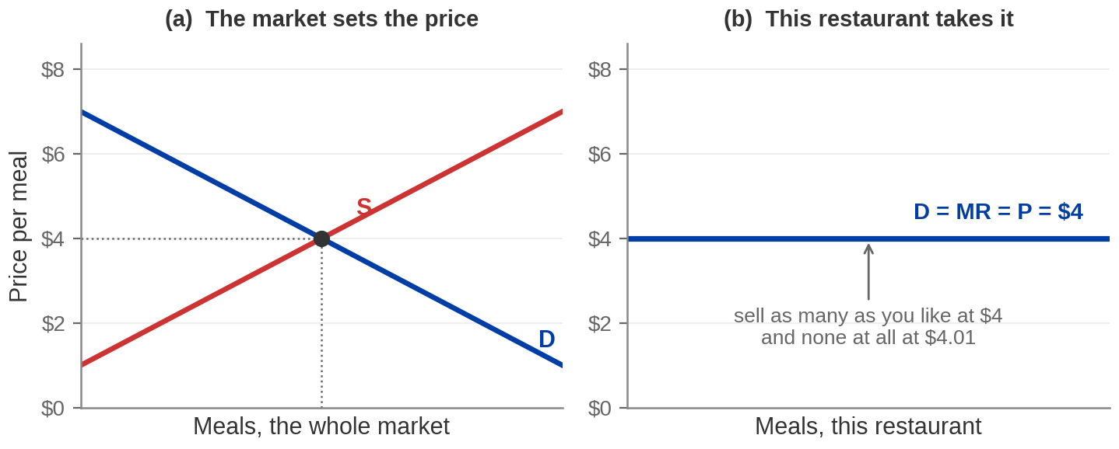
The Market and the Firm
Notes:
The two-panel picture, and the axis warning.
Say the axis point before anything else, because it is where students get lost: the LEFT
panel measures the whole market, in thousands of meals. The RIGHT panel measures one
restaurant, in meals. One restaurant is a rounding error in its own market, which is exactly
why it cannot move the price.
Left panel: ordinary supply and demand, crossing at $4.
Right panel: the demand curve FACING THIS FIRM is horizontal at $4. That is what price taking
looks like drawn. Sell as many as you like at $4; try $4.01 and sell none.
The horizontal line is simultaneously the firm's demand curve, its marginal revenue curve,
its average revenue curve and the price. Four labels, one line. Say that, because exam
questions exploit it.
Do the arithmetic out loud if you did not on the previous slide: one meal $4, two $8, three
$12 — the third adds exactly $4, same as the second. MR = P.

Slide 29


The Economic Cost of Running a McDonald's
The accountant counts the checks you write. The economist adds what
you gave up in order to write them.
Accounting Profit = TR - Explicit costs
Economic Profit = TR – (Explicit cost + Implicit cost)
EXPLICIT — THE
INVOICES
IMPLICIT — YOUR
TIME
IMPLICIT — YOUR
MONEY
Food and paper. Crew. Power.
Rent. The 5% royalty. The 4% ad
fund. Every one of them is billed,
paid, and on the tax return.
Somebody has to run the restaurant.
A US food-service manager earns
about $74,900 a year. Do the job
yourself and you have given that up.
$750,000 of your own cash,
locked in for twenty years. At the
4.65% Treasury yield that is
$35,000 a year of forgone interest.
Roughly $110,000 a year of real cost that never appears on the tax return.
Food-service manager pay: BLS Occupational Employment and Wage Statistics, May 2025 (mean annual $74,880). Ten-year Treasury constant maturity yield 4.65%, 7 August 2026, US Treasury. Cash requirement: McDonald's franchising costs page.
Notes:
The economic-cost slide, on our own restaurant. This is where the previous
slide's abstraction becomes somebody's actual decision.
READ THESE OUT: a US food-service manager earns a mean of $74,880 a year. The 10-year
Treasury yielded 4.65% on 7 August 2026. On the $750,000 of non-borrowed cash alone that is
about $35,000 a year of forgone interest; on the full $2.1 million midpoint investment it is
closer to $98,000.
Add the manager's salary and the interest on the cash and you have roughly $110,000 a year of
cost that no accountant records. On the full investment it is nearer $170,000.
The argument to make: the owner-operator is not working for free and the money is not sitting
idle by accident. Both have alternatives, and the value of the best alternative is a cost of
choosing this. That is the whole of economic profit.
THE FLAG BAND IS WORTH DWELLING ON. McDonald's Franchise Disclosure Document discloses gross
sales — and stops. It publishes no franchisee profit, no cash flow, no net income. So a
student who goes looking for "what does a McDonald's owner earn" will find only numbers that
somebody built by assuming a margin. Tell them that. Learning that a figure is not published
is a real result, and it protects them from repeating a made-up one.
Directionally, what IS on the record: McDonald's chief executive said in 2024 that franchisee
cash flows were down about 10% from their highs, with California operators under more
pressure than most. No dollar baseline was given, and do not invent one.
Callback: this is the restaurant owner from the previous slide's table, with $500 of
accounting profit and minus $200 of economic profit. Same arithmetic, real business.

Slide 30
Walking Toward the Optimum
Keep producing while the next unit brings in more than it costs. Stop
when they are equal.
IF MR > MC
IF MR < MC
IF MR = MC
The next meal earns more
than it costs. Make it. You are
leaving money on the table if
you stop.
The next meal costs more
than it earns. Do not make it
— and if you already did,
make one fewer.
Nothing left to gain in either
direction. That is the
profit-maximising quantity.
Notes:
The optimisation walk. Do this as a walk, not as a formula.
Start at a low quantity and ask: should you serve one more? At 30 meals, marginal cost is
$1.50 and the meal sells for $4. Obviously yes. Keep walking. At 80 meals the next one costs
$4.00 and earns $4.00 — and the question stops being obvious. That is the answer.
Name the callback: this is the same move as Chapter 5's "buy in order of bang per buck until
the budget runs out", and the same move as Chapter 3's optimisation in differences. Third
time they have seen it. Say so — the repetition is the point of the course.
The rule on the next slide is not a new idea. It is this walk written down.

Slide 31
The Profit-Maximizing Rule
MR = MC and, because the firm is a price taker, P = MC
STEP 1 — FIND THE
QUANTITY
STEP 2 — READ OFF ATC
THERE
STEP 3 — COMPARE P WITH
ATC
Go along until MR meets MC.
At $4 a meal, that is 80 meals
an hour.
At 80 meals, average total
cost is $3.25. That is what
each meal cost, all in.
P > ATC → profit. P < ATC → loss.
P = ATC → break even, and no
reason to be anywhere else.
Three steps. Every profit question in this course is one of them.
Notes:
The rule and the three steps. The most examinable slide in the deck — tell them
to copy it verbatim.
NUMBERS: at P = $4 the optimal quantity is 80 meals, because MC at 80 is exactly $4.00. ATC
there is $260 ÷ 80 = $3.25.
Build it as a walk before you state it as a rule. Start low and ask: should you serve one
more? At 30 meals, MC is $1.50 and the meal sells for $4. Obviously yes. Keep walking. The
question stops being obvious exactly where the two are equal.
Emphasise the ORDER. Quantity first, from MR = MC. Only THEN look at ATC. Students who go
looking for the minimum of ATC and produce there are answering a question nobody asked —
that is the long-run outcome, not the short-run decision.
Warn about P = MC: it holds only because MR = P for a price taker. The general rule is
MR = MC.
Name the callback: this is the same move as Chapter 5's "buy in order of bang per buck", and
the same move as Chapter 3's optimisation in differences. Third time. The repetition is the
point of the course.

Slide 32
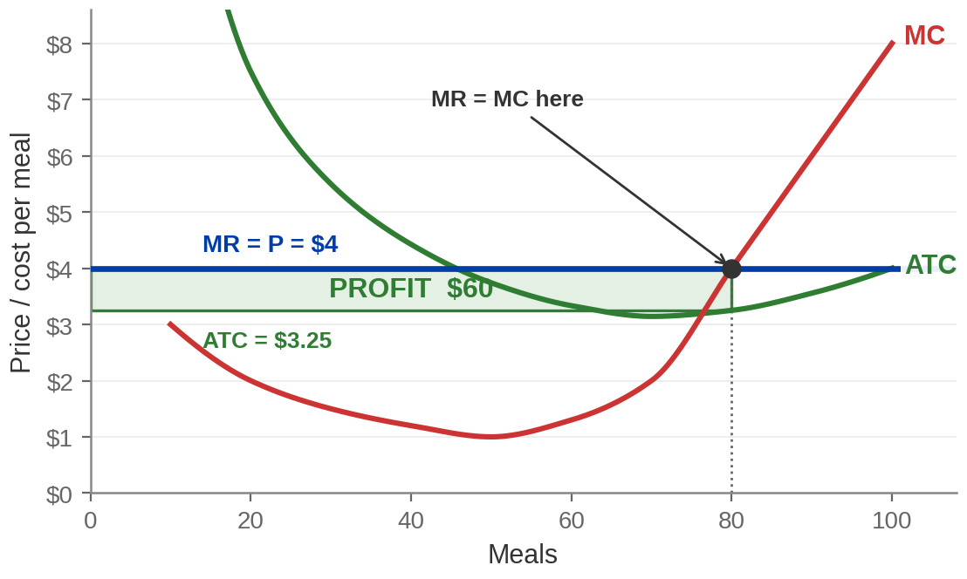
Seeing the Profit
PROFIT
Height is P − ATC = $4.00 − $3.25 = $0.75.
Width is 80 meals.
Area is the profit.
TR = 80 × $4 = $320.
TC = $260.
Profit = $60 an hour.
Profit = TR – TC = (P × Q) – (ATC × Q) = (P - ATC) × Q
Notes:
Profit as a rectangle.
NUMBERS TO READ OUT, not recall: P = $4.00. Q = 80 meals. ATC = $3.25. Total revenue
80 × $4 = $320. Total cost $260. Profit = $60 an hour.
Both routes give the same number and it is worth showing that: the rectangle is
(4.00 − 3.25) × 80 = $60, and revenue minus total cost is 320 − 260 = $60.
The habit to build: profit is ALWAYS this rectangle. Height is the vertical gap between price
and ATC AT THE CHOSEN QUANTITY; width is the quantity. It works for losses too, and in
fifteen minutes we use it for exactly that.
Common error to head off: reading the rectangle's height at the minimum of ATC rather than at
Q*. The height must be measured at 80 meals, where ATC is $3.25, not at 70 where it is $3.14.
BRIDGE: the textbook's cheese factory makes $248.25 a day at a price of $1.13 — same
rectangle, different numbers. (You may see $245 printed; that comes from rounding average
cost to $0.93 first. A student who answers $245 has done nothing wrong.)

Slide 33
How a McDonald's Actually Maximizes Profit
MR = MC is not a burger-by-burger decision. In a real restaurant it is an
hour-by-hour one.
THE MARGINAL UNIT IS A
CREW-HOUR
SO WHAT DOES THE HOUR
COST?
AND THE SAME RULE SETS
THE HOURS
Roster one more person for one
more hour. Does the extra
service that hour buys bring in
more than the hour costs?
Fast-food and counter workers average
$15.46 an hour nationally. In California the
fast-food minimum is $20.00.
Open at 5am? Staff the second
drive-thru lane? Run overnight?
Every one of them is MR = MC
asked about a smaller unit.
Wages: BLS Occupational Employment and Wage Statistics, May 2025 — fast food and counter workers, mean hourly $15.46, median $15.00. California fast-food minimum wage $20.00 since 1 April 2024 and unchanged in 2026; California general minimum $16.90 from 1 January 2026 (California DIR).
Notes:
Profit maximisation, made operational. The previous slide drew the rectangle;
this one says what the manager actually decides.
READ THESE OUT: fast-food and counter workers averaged $15.46 an hour nationally in May 2025,
median $15.00. California's fast-food minimum has been $20.00 since April 2024 and was still
$20.00 in 2026. California's general minimum is $16.90 from January 2026 — so fast food
carries a $3.10, roughly 18%, premium.
The move to make: students picture the firm choosing "how many burgers", which is not a
decision anybody makes. The restaurant serves whoever walks in. What the manager actually
chooses is how much CAPACITY to have on the floor — how many people rostered, which hours to
open, whether the second lane is staffed.
So the marginal unit is a crew-hour, and the rule is unchanged: roster the hour if the extra
service it buys is worth more than the hour costs. In California, at $20, the bar is 18%
higher than the national average — which is a live natural experiment your students can watch
from the parking lot.
Ask: what does the California wage do to the profit-maximising number of crew-hours? Fewer of
them, at any given price. And then the follow-up that makes it interesting — what does it do
to the incentive to install ordering kiosks?
ONE HONEST NOTE if a student asks what McDonald's pays: McDonald's does not set wages at
about 95% of US restaurants, because they are independently owned, and it publishes no
system-wide average. The BLS occupational figure is the defensible number. That the franchisor
does not control its franchisees' largest controllable cost is itself worth a sentence.

Slide 34
PART 3
From the Seller's Problem
to the Supply Curve
Notes:
Section divider — Part 3, Pearson section 6.3.
The payoff section. Everything so far has been machinery; here it becomes the supply curve
students have been drawing since Chapter 4.
Say the sentence when you reach the supply-curve slide: "In Chapter 4 I drew this curve and
asked you to trust it. You have just built it." Same beat as Chapter 5's demand curve.

Slide 35
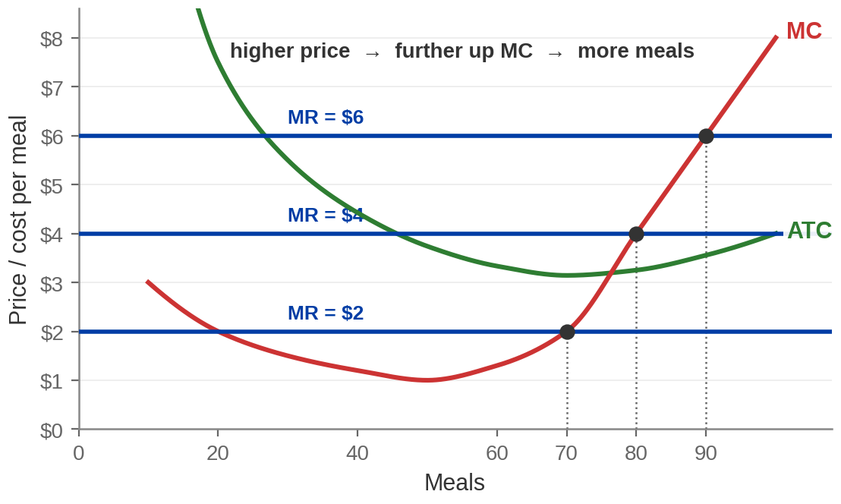
Change the Price, Redo the Problem
$2 → 70 meals. $4 → 80 meals. $6 → 90 meals. Three prices, three quantities — and every one of
them is a point on MC.
At every price, the firm produces where P = MC. So the MC curve gives quantity supplied at every price unless it shuts down.
Notes:
The moment the supply curve appears.
READ THE PAIRS: at $2 the restaurant serves 70 meals an hour. At $4, 80. At $6, 90. Each
comes from MR = MC, so each is a point ON the marginal cost curve.
The move to make explicit: we did not derive a new rule. We applied the same rule three times
at three prices. Price-quantity pairs are exactly what a supply curve IS.
So the marginal cost curve is the supply curve. Let that land — and then immediately undercut
it, because it is not true at every price, and the next fifteen minutes are about the
exception.
Ask the room directly before moving on: is there a price so low that you would serve nobody
at all? Most will say yes, and most will guess the threshold is where you start losing money.
That guess is wrong, and the fact that it is wrong is the best thing in this chapter.

Slide 36
Price Elasticity of Supply
The price elasticity of supply measures how responsive quantity
supplied is to a change in the market price.
E(S) = % change in quantity supplied ÷ % change in price
ELASTIC: Ε_S > 1
INELASTIC: Ε_S < 1
UNIT-ELASTIC: Ε_S = 1
Quantity is very responsive. A 10% price
rise brings out more than 10% extra.
Quantity barely moves. A 10% price
rise brings out less than 10% extra.
They move together. A 10% price
rise brings out exactly 10% extra.
Supply elasticity is normally POSITIVE — up with price, unlike demand.
Notes:
Elasticity of supply. Same machinery as Chapter 5, different curve — keep it
brisk.
The sign is the thing to flag. Demand elasticity is negative and we took absolute values.
Supply elasticity is naturally positive because the supply curve slopes up. A NEGATIVE supply
elasticity should make a student suspicious of their own arithmetic.
Middle panel arithmetic: price $5 to $6 is +20%, quantity 100 to 120 is +20%, so elasticity is
exactly 1. Worth knowing: ANY straight line through the origin is unit-elastic everywhere,
whatever its slope. That surprises people and it is a nice one-line result.
Use the midpoint formula from Chapter 5 for anything examinable — divide each change by the
AVERAGE of the two values, so you get the same answer in both directions.
WHAT MAKES SUPPLY ELASTIC — three determinants, worth saying even without a slide:
1. Inventory on hand. A firm sitting on stock can push it out the moment price rises.
2. How easily it can hire. If workers are available at the going wage, output scales.
3. TIME, and this is the big one. Over a day almost nothing can change; over a year you can
build a second kitchen. Supply is more elastic the longer the horizon.
That third one connects straight to Part 5 and to the oil slide at the end of this part.
Real approximations for the three extremes: perfectly inelastic is close to right for seats at
tonight's concert; perfectly elastic is close to right for one small farmer's wheat.

Slide 37
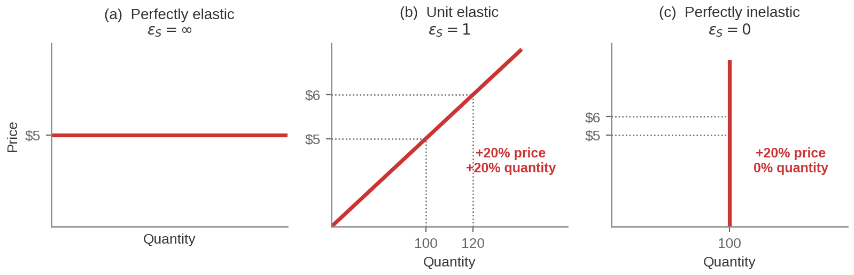
Three Extreme Cases
PERFECTLY ELASTIC
UNIT-ELASTIC
PERFECTLY INELASTIC
Any amount at $5, nothing at $4.99.
Horizontal.
+20% price, +20% quantity. A straight line
through the origin.
100 units whatever the price. Vertical — a
fixed stock, already produced.
Notes:
Three limiting cases.
Middle panel arithmetic: price $5 to $6 is +20%, quantity 100 to 120 is +20%, so elasticity
is exactly 1. Worth knowing: ANY straight line through the origin is unit-elastic everywhere,
whatever its slope. That surprises people and it is a nice one-line result.
Use the midpoint formula from Chapter 5 for anything examinable — divide each change by the
AVERAGE of the two values, so you get the same answer in both directions.
Real approximations, since the extremes never happen exactly: perfectly inelastic is close to
right for seats at tonight's concert, or a Picasso. Perfectly elastic is close to right for
one small farmer's wheat at the market price.
Contrast with Chapter 5's three extreme cases for demand if they saw them — same geometry,
opposite slope.

Slide 38
What Makes Supply Elastic?
INVENTORY ON
HAND
HOW EASILY IT CAN
HIRE
TIME — AND THIS IS THE BIG
ONE
Over a day, almost nothing can
change. Over a year, you can
build a second kitchen. Supply is
more elastic the longer the
horizon.
A firm sitting on stock can
push it out the moment the
price rises. A firm with empty
shelves has to make it first.
If workers are available at the
going wage, output scales
quickly. If the skill is scarce, it
does not.
The same market has a different supply elasticity depending on the window you ask about.
Notes:
Determinants of supply elasticity.
Time is the one that matters and the one that connects forward. Short-run supply is steep
because capital is fixed. Long-run supply is flatter because it is not. Same market, two
elasticities, and the only difference is how long you gave it.
Concrete: an oil price spike. Within a week, output barely moves. Within two years, rigs are
drilling. Within five, whole fields come online. Three elasticities for one commodity.
This card also previews the oil-patch slide at the end of this part, and Part 5's switch to
the long run.

Slide 39
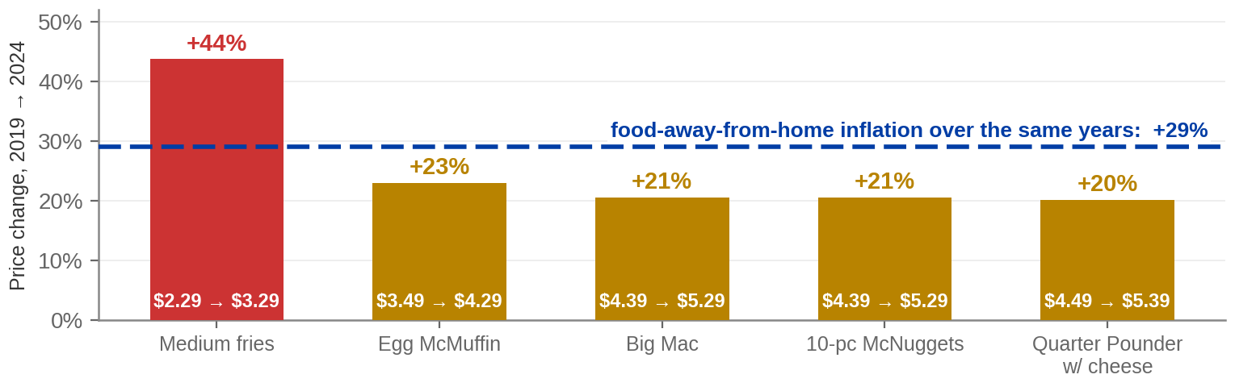
How Elastic Is McDonald's?
SUPPLY ELASTICITY — THIS CHAPTER
DEMAND ELASTICITY — CHAPTER 5
Within the hour, roster another crew member: very responsive. Within a year, McDonald's must buy a site and build, and the operator needs 6–12 months of training. The US network grew by 149 restaurants in 2025, on a base of 13,706.
In the second quarter of 2026 US comparable sales rose
0.8% — on a bigger average check, “partly offset by
negative comparable guest counts”. Prices up, visits down.
Menu prices: McDonald's USA, “McD US Pricing Myths vs Facts”, 29 May 2024, with its own 29% food-away-from-home benchmark. Comparable sales and guest counts: McDonald's Q2 2026 earnings release, 4 August 2026. Restaurant counts: McDonald's FY2025 Form 10-K. Published elasticity for food away from home: −0.81 (Andreyeva, Long & Brownell, AJPH 100(2), 2010).
Notes:
Elasticity on the real firm — and the slide exists partly to stop a confusion.
READ THESE OUT. McDonald's own 2019-to-2024 price comparison: Big Mac $4.39 to $5.29, up 21%.
Ten-piece McNuggets, the same, up 21%. Quarter Pounder with cheese, up 20%. Egg McMuffin, up
23%. Medium fries $2.29 to $3.29 — up 44%. Food-away-from-home inflation over the same years
was 29%, which is McDonald's own benchmark in the same document.
Note what that means and say it: against 29% general inflation, the real price of a Big Mac
FELL. Only the fries rose faster than the category. If you are going to run an elasticity
calculation, decide first whether you are using nominal or real prices — the sign of the
implied response can flip.
THE TWO CARDS ARE TWO DIFFERENT ELASTICITIES AND THAT IS THE POINT OF THE SLIDE.
Supply elasticity — this chapter — asks how quickly the SELLER can produce more when the
price rises. Over an hour, very quickly: roster another person. Over a year, slowly: McDonald's
has to acquire a site and build a restaurant, and the operator needs six to twelve months of
training. The US network went from 13,557 to 13,706 restaurants during 2025 — 149 net
additions, about 1.1%. That is a mature market where entry is slow and expensive.
Demand elasticity — Chapter 5 — asks what buyers do when the price rises. McDonald's own words
for the second quarter of 2026: US comparable sales up 0.8%, driven by positive check growth,
"partly offset by negative comparable guest counts". Bigger baskets, fewer visits.
Sharper still, and worth saying: management reported low-income customer traffic falling at
roughly double-digit rates through 2025 while higher-income traffic rose. Same menu, same
prices, opposite responses — elasticity differs by who is buying.
THINGS NOT TO CLAIM:
- McDonald's does not publish a guest-count percentage, only the direction. If you have seen
"US traffic fell 4.5%", that is Placer.ai mobile-location data, not McDonald's, and it
measures store visits rather than transactions. Attribute it or leave it out.
- The −0.81 elasticity is for food away from home in aggregate, from a 2010 review of older
studies. It is not a fast-food elasticity and not a 2026 one.
- McDonald's said two different things in one week in 2024: core items up 20-23%, and an
executive saying the average item cost about 40% more than 2019. Both are on the record.
Menu mix and the fries outlier reconcile them, and it is a good prompt if you want one.

Slide 40
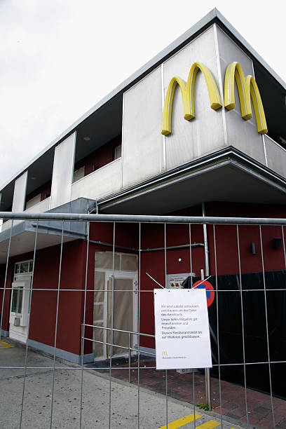
Stay Open or Shut Down: What Do You Still Pay?
STAY OPEN
SHUT DOWN
You pay your VARIABLE costs — the crew, the
beef, the power — and you pay your FIXED costs.
But you also take in revenue.
You pay no variable costs. Nobody is rostered,
nothing is bought.
You still pay every penny of your FIXED costs. And
you take in nothing.
Fixed costs are paid in BOTH columns.
AT A MCDONALD'S
Open at 4am? Run overnight? The rent is owed either way; the crew, the power and the food are not.
Notes:
The two columns. This slide is the hinge of the whole argument — do not rush it.
Build it on the board rather than just showing it. Two columns, "stay open" and "shut down",
and fill in what you pay under each.
The moment to land: fixed costs appear in BOTH columns, identically. $100 either way. A cost
that is the same under both options cannot possibly tell you which to choose. It falls out of
the comparison entirely.
What is left is variable cost against revenue. That is the whole shutdown rule, and it is now
almost trivial.
Ask: so what WOULD make you close for the night? Answer: if the takings do not even cover
what you spend to open. Producing would then lose you MORE than the $100 you were going to
lose anyway.
A concrete version that always works: a restaurant open on a dead Tuesday night. Why bother?
Because the rent is owed either way, and if the tables that do come in more than cover the
food and the crew, the evening reduces the loss.

Slide 41
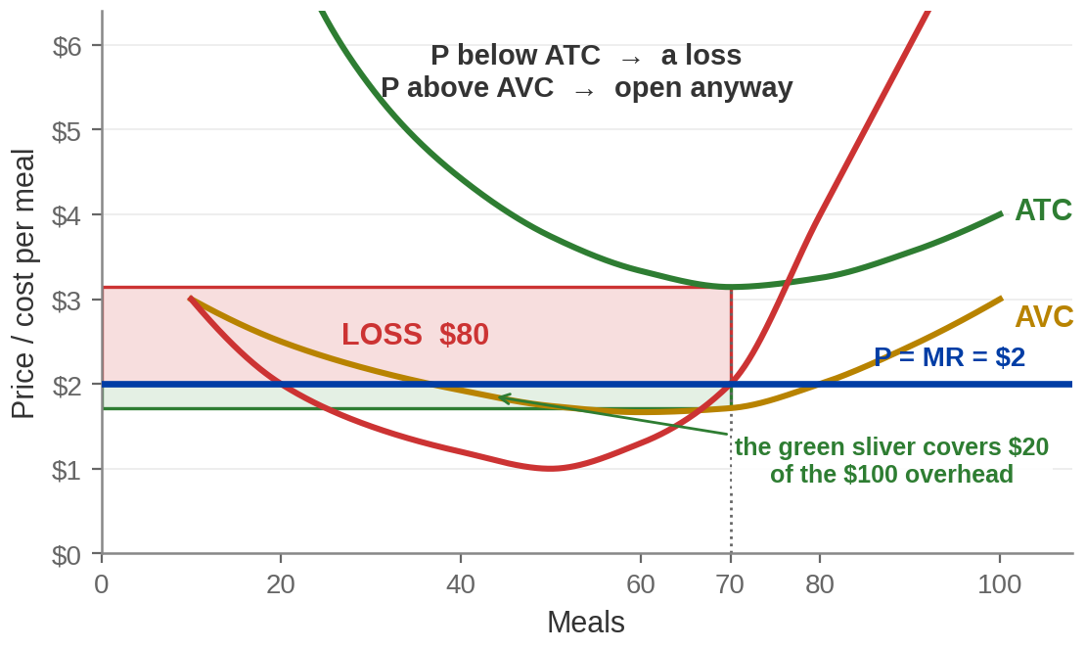
Losing Money and Still Opening the Doors
SHUT DOWN
Revenue $0.
Variable cost $0.
Fixed cost $100.
Lose the whole $100.
STAY OPEN AT $2
Revenue $140.
Variable cost $120.
Fixed cost $100.
Lose $80 — which is $20 better.
Notes:
The resolution, and the counterintuitive result of the chapter.
READ THE ARITHMETIC OUT, slowly. Price $2, so the restaurant serves 70 meals.
Revenue 70 × $2 = $140
Variable $120
Fixed $100
Total cost $220, so a LOSS of $80.
Shut down instead: no revenue, no variable cost, but still $100 of fixed cost — a loss of
$100.
$80 is better than $100. The restaurant opens, loses money, and is right to.
Say the sentence: the $140 of takings covers all $120 of variable cost and leaves $20 to put
toward the overhead. Twenty dollars of the hundred gets covered. Close, and you cover none of
it.
This is the answer to the question posed at the top of the section. Pause on it. Students find
it genuinely surprising that "I am losing money" is not by itself a reason to close.
BRIDGE: the textbook runs the same case at $0.78 a box, where the cheese factory loses $110
rather than the $200 of fixed cost it would lose shut.

Slide 42

Sunk Costs
A sunk cost has already been committed and can never be recovered. It
should not affect any decision you make from now on.
IN THE SHORT RUN, FIXED
COSTS ARE SUNK
SO THEY DROP OUT OF THE
DECISION
THIS IS NOT JUST A FIRM
PROBLEM
The lease is signed, the fryers
are bought. That money is gone
whatever you decide tonight.
Not because they do not matter —
they matter enormously — but
because they are the same under
every option.
The ticket you already bought. The
two years already spent on the
degree. The meal already paid for.
Same logic, same error.
"But I've already spent so much on it" is never, by itself, a reason to continue.
If we have a reason to stop producing, sunk cost should not be stopping us from shutting down.
Notes:
Sunk costs.
Careful with the framing. Sunk costs do not "not matter". They matter for whether you should
have got into this in the first place, and for the long-run decision to stay in the industry.
They are irrelevant to THIS period's produce-or-not question, because they are identical under
both options.
The everyday examples in the third card are worth doing — the sunk cost fallacy is the one
piece of economics students take home and use.
Best version to say out loud: you paid $60 for a concert ticket, it is pouring with rain, and
you do not want to go. The $60 is gone either way. The only live question is whether going
tonight beats staying home tonight.
If someone raises "escapable" fixed costs — a lease you could sublet, equipment you could
resell — that is a good objection, and the honest answer is that those are not fully sunk. The
pure textbook case assumes they are.

Slide 43
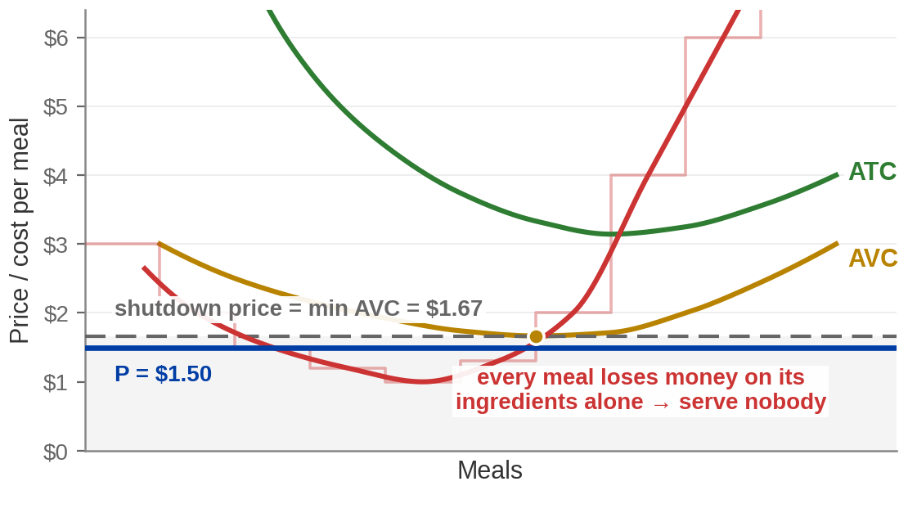
The Shutdown Rule
Shut down if P < AVC. Keep producing if P > AVC.
BELOW $1.67
Every meal loses money on its ingredients alone.
Serving makes things worse. Serve nobody.
ABOVE $1.67
Every meal contributes something toward the
overhead. Open, even at a loss.
Notes:
The shutdown rule, stated.
THE NUMBER: minimum average variable cost is $1.67, at 60 meals an hour. That is the shutdown
price. Below it, serve nobody.
Say why the threshold is MINIMUM AVC and not just AVC: the firm gets to pick its quantity, so
it shuts down only if there is NO quantity at which price covers average variable cost. The
best chance is at AVC's lowest point. If price is below even that, no quantity works.
The two mistakes to name explicitly, because both are common in exams:
- Shutting down whenever there is a loss. Wrong. Losses are survivable down to AVC.
- Comparing P with ATC to decide. Wrong curve. ATC decides whether you are PROFITABLE; AVC
decides whether you should be OPEN.
Shutdown is a SHORT-RUN decision to produce nothing this period. It is not exit. The firm
still exists, still owes its fixed costs, and reopens the moment the price recovers. Exit is
Part 6.
BRIDGE: the cheese factory's shutdown price is $0.65.

Slide 44
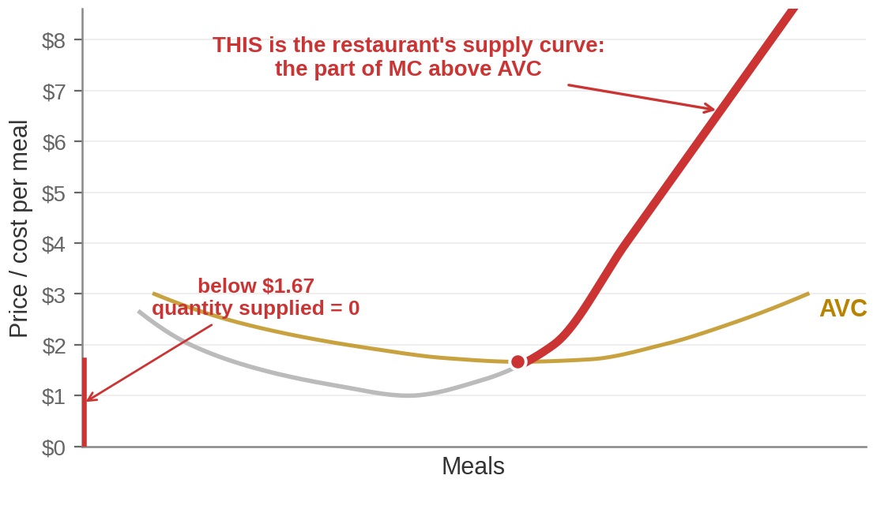
The Firm's Supply Curve
The short-run supply curve is the portion of the marginal cost curve that lies above average
variable cost.
Notes:
The answer to the question left open, and the moment the chapter pays off.
SAY THE SENTENCE: "In Chapter 4 I drew this curve and asked you to trust it. You have just
built it yourself." Same beat as the demand curve in Chapter 5.
What is on the picture: below $1.67 the quantity supplied is zero and the supply curve runs
down the vertical axis. At and above $1.67 it is the marginal cost curve. The kink is at
minimum AVC.
The market supply curve of Chapter 4 is the horizontal sum of these across all firms. One
sentence; it does not need a slide.
Worth flagging: this is the SHORT-RUN supply curve. The long-run one looks completely
different and arrives in fifteen minutes. Students who miss that will think Part 6 contradicts
this slide.

Slide 45
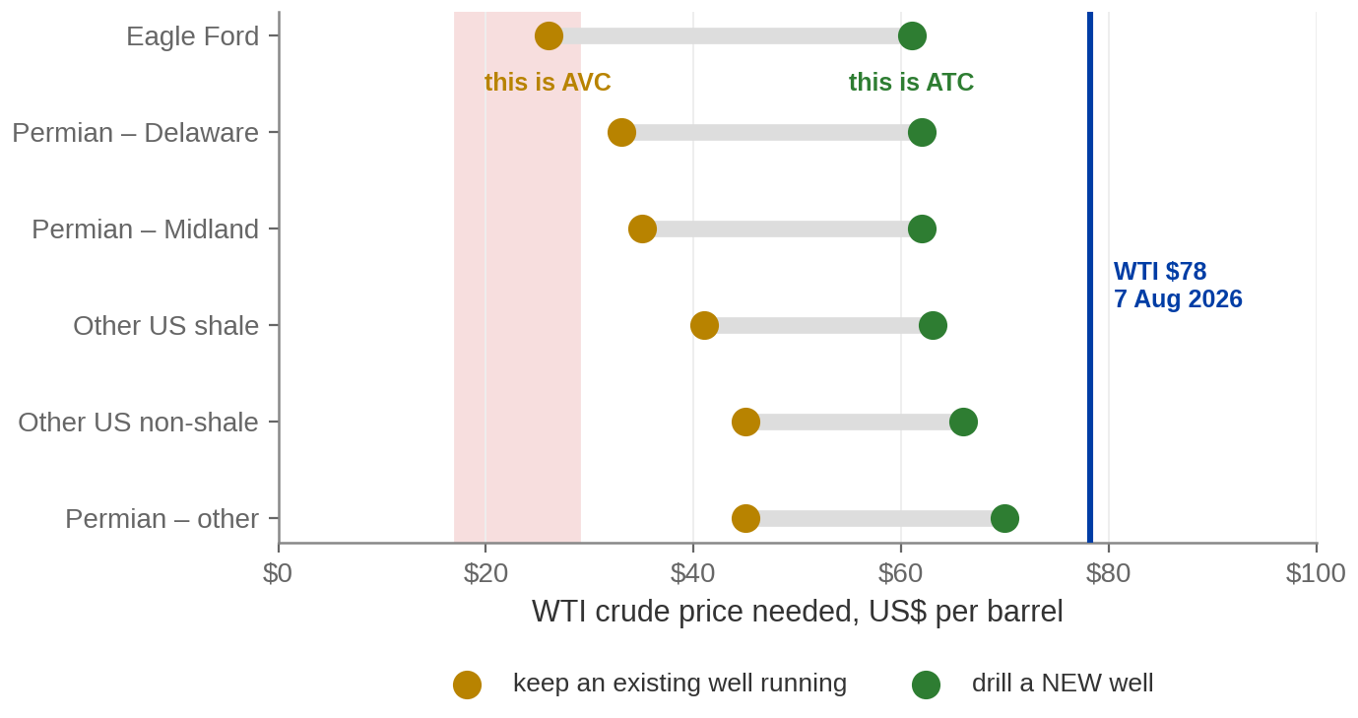
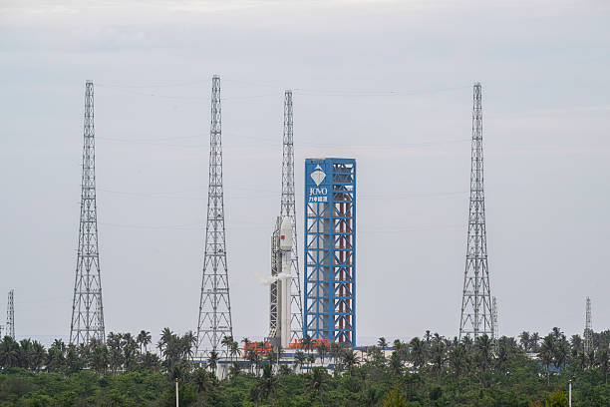
The Shutdown Rule in the Oil Patch
Existing wells keep running down to $26–$45. A NEW well needs $61–$70. The gap between them is AVC against ATC.
Dallas Fed Energy Survey special questions, fielded 12–20 March 2025, published 26 March 2025 (n = 83 and 81). The March 2026 round moved the all-respondent averages to $43 and $66. WTI spot $78.18 on 7 August 2026.
Notes:
Live slide. The best evidence in the chapter — worth the time.
READ THESE OUT. The Dallas Fed asks oil producers two separate questions, and they are
literally AVC and ATC:
- the WTI price needed to COVER OPERATING COSTS on existing wells: $26 in the Eagle Ford,
$33 and $35 in the two Permian sub-basins, up to $45. Average $41.
- the WTI price needed to PROFITABLY DRILL A NEW WELL: $61 to $70. Average $65.
Now run the shutdown rule across three episodes:
- April–May 2020. WTI $17 to $29, BELOW the operating line. North Dakota production fell
from 1.5 to 0.9 million barrels a day, of which about 0.4 million was voluntarily shut in
beyond natural decline. Producing wells fell from about 16,000 to 12,800. (EIA, 20 August
2020.)
- 2025. WTI around $60 — BETWEEN the two lines. Nothing shut down, but new drilling stalled,
and US output still hit a record near 13.8 million barrels a day because existing wells
kept running.
- Today, 7 August 2026. WTI $78, above both. Everything runs and new wells get drilled.
Same firms, same rule, three different outcomes, decided entirely by which side of which line
the price sat on.
THREE THINGS TO SAY BEFORE A STUDENT SAYS THEM:
1. The chart is the March 2025 round, because that is the most recent round publishing BOTH
questions broken out by region. The 2026 round moved the averages to $43 and $66 — the
shape is the same.
2. Shutting in a real well is not the frictionless switch of the model. Reservoir damage and
re-entry costs mean the true trigger sits below the naive AVC number.
3. These are survey responses — what firms say they need, not audited accounts.

Slide 46
PART 4
Producer Surplus
Notes:
Section divider — Part 4, Pearson section 6.4.
Short section and the exact mirror of Chapter 5's consumer surplus. Lead with that: same
diagram, same triangle, other side of the price line.
If they remember consumer surplus, this takes eight minutes.

Slide 47
Producer Surplus
Producer surplus is the difference between the price a seller actually
receives and the lowest price it would have accepted.
THE MIRROR OF CHAPTER 5
PRODUCER SURPLUS
Consumer surplus was the gap between what a
buyer WOULD have paid and what she did pay —
the area under demand, above price.
The gap between what a seller receives and what it
would have accepted — the area above supply,
below price.
The supply curve is a marginal cost curve, so "lowest acceptable price" means marginal cost.
Notes:
Producer surplus, defined.
Lead with the symmetry. Consumer surplus was under the demand curve and above the price;
producer surplus is above the supply curve and below the price. Same picture, split by the
price line.
The kicker earns its place. Students accept "willingness to accept" as a phrase without
connecting it to anything. It is marginal cost — the supply curve already tells you the
lowest price at which each meal would be offered.
Flag now what the next slide proves: producer surplus is NOT profit. They differ by the fixed
cost. If nobody asks, say it anyway — it is a favourite exam question.

Slide 48
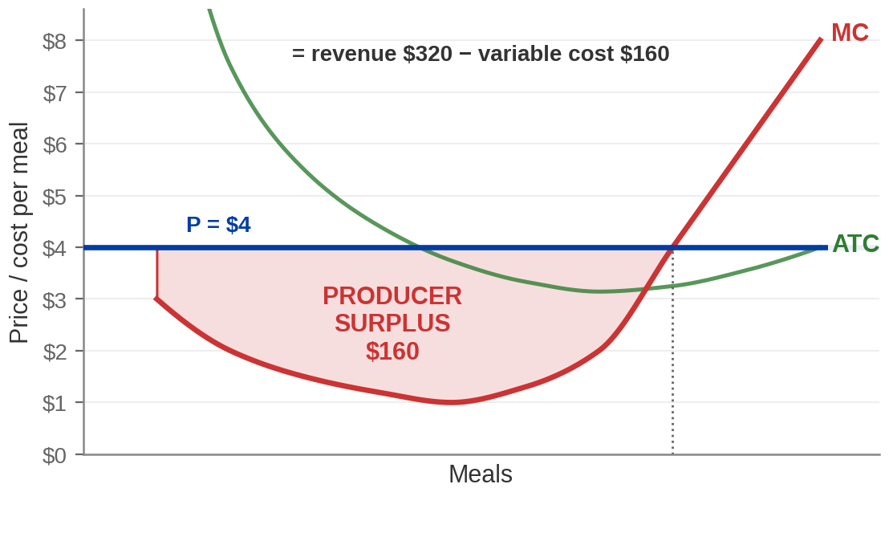
Measuring Producer Surplus
MEAL BY MEAL
The 10th meal would have been served
for $3 and earns $4. The 80th costs
exactly $4 and earns $4 — no surplus at
all.
NOT THE SAME AS PROFIT
Producer surplus $160.
Profit $60.
The gap is exactly the $100 of fixed
cost.
Notes:
Producer surplus, and the distinction that gets examined.
NUMBERS: at a price of $4 the restaurant serves 80 meals. Revenue $320, variable cost $160, so
producer surplus is $160. Profit is $60. The gap between them is $100 — exactly the fixed
cost.
Lead with the symmetry. Consumer surplus sat under the demand curve and above the price;
producer surplus sits above the supply curve and below the price. Same picture, split by the
price line.
Why the supply curve is the right lower boundary: the supply curve IS marginal cost, so it
already tells you the lowest price at which each meal would be offered. Producer surplus is
the sum, over every meal, of the gap between what it fetched and what it cost to make.
THE EXAM POINT, and it is on the slide: producer surplus is revenue minus VARIABLE cost.
Profit is revenue minus TOTAL cost. In the short run they differ by exactly the fixed cost.
Students conflate them constantly. Make them write the $160 / $60 / $100 line down.
The marginal meal carries no surplus at all — the 80th meal costs exactly $4 and sells for
exactly $4. That is true on both sides of the market and worth saying once.

Slide 49
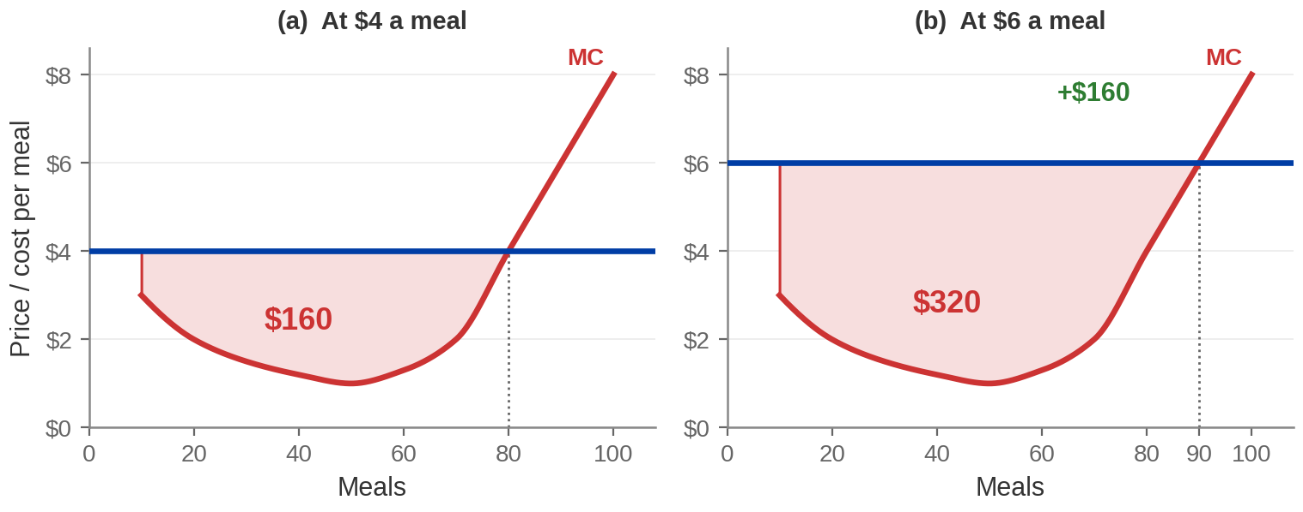
What a Price Rise Adds
$4 → $6 takes producer surplus from $160 to $320. Sellers gain $160 — and buyers lose.
Notes:
The price rise.
NUMBERS: at $4 the restaurant serves 80 meals; revenue $320, variable cost $160, so producer
surplus is $160. At $6 it serves 90; revenue $540, variable cost $220, so producer surplus is
$320. The gain is $160.
Break the gain into its two pieces, because the decomposition is the examinable part:
- most of it is extra money on meals it was already serving — 80 meals × $2 = $160 of extra
revenue on the old quantity;
- and the 10 extra meals bring in $60 while costing $60 of extra variable cost, so they add
nothing net at the margin. The marginal unit never carries surplus.
Then the honest note: this is not a free gain to the world. Buyers are paying more. Chapter
5 showed the same price rise destroying consumer surplus. Put the two together and you have
Chapter 10, where we ask whether the total went up or down.
Say explicitly: producer surplus rising is not the same as society being better off.

Slide 50
PART 5
From the Short Run
to the Long Run
Notes:
Section divider — Part 5, Pearson section 6.5.
The time horizon changes here and everything that was fixed becomes variable. Warn them before
the diagrams change shape.
In the short run you ask "how much should I make?" In the long run you ask "how big should I
be?" Two different questions, two different diagrams.

Slide 51
In the Long Run, Everything Is Variable
SHORT RUN
LONG RUN
Some factors fixed. The only way to change output is to
change labor/utilities/food— more people in the same kitchen.
That is why diminishing returns bites, and why MC
eventually rises steeply.
Nothing fixed. To change output you can change ANYTHING
— take the unit next door, add a second line, move.
The long run is a planning period: what is the right SIZE of
restaurant?
In the short run you ask "how much should I make?" In the long run you ask "how big
should I be?"
Notes:
Short run to long run.
The band is the sentence to make them write down. Two different questions, and they get two
different diagrams.
Emphasise the planning framing: the long run is not a date in the future. It is the decision
problem you face when nothing is yet committed. A firm choosing its restaurant size is "in
the long run" even though it is choosing today.
Once the kitchen is built, the firm is back in the short run with that kitchen's cost curves.
Every firm lives in the short run and plans in the long run. That is exactly what the next
diagram shows.

Slide 52
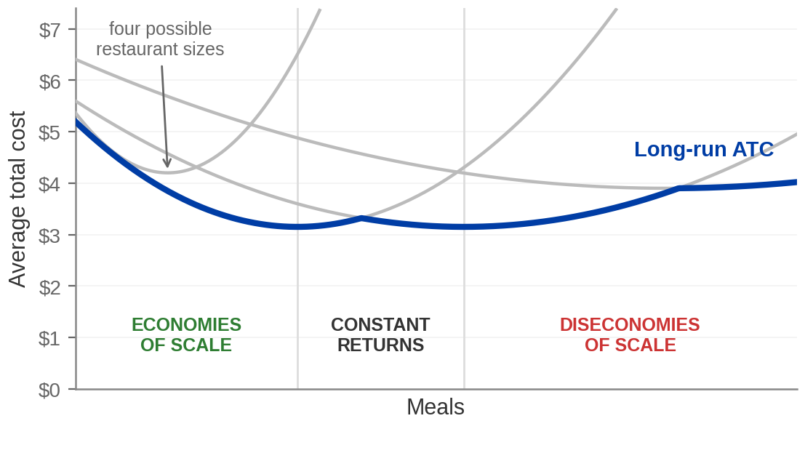
The Long-Run Average Cost Curve
Each grey curve is one possible restaurant size. The blue curve is the cheapest you can do at each
output, once you can choose the size.
Notes:
The envelope, and the three regions.
How to walk it: each grey U is the short-run ATC of one possible restaurant size. Pick a level
of output, look down the grey curves, take the lowest. Do that at every output and you trace
the blue curve. Hence "envelope" — the long-run curve is never above any short-run curve,
because in the long run you could always have chosen that size.
THE CRITICAL DISTINCTION, and say it twice because it is the most confused pair in the
chapter:
- Short-run ATC is U-shaped because of DIMINISHING RETURNS — a fixed input.
- Long-run ATC is U-shaped because of ECONOMIES then DISECONOMIES OF SCALE — and there is
nothing fixed at all. Everything scales up together and it still eventually gets worse.
Same shape, completely different cause. Exam questions live in that gap.
Concrete examples worth naming:
- Economies: a semiconductor fab. Billions before a single chip is sold, so cost per chip
falls steeply with volume. (Trade press puts a 2nm-class fab module at $25–35 billion; the
WTO put a bleeding-edge fab at "well over $20 billion" in 2023. These are estimates, not
company disclosures — attribute loosely.)
- And the one we come back to in twenty minutes: the average US ethanol plant grew from
about 34 million gallons a year in 2000 to about 96 million by 2023, while the number of
plants stopped rising.
- Diseconomies: any organisation where a decision now needs six approvals.
Note the blue curve is flat in the middle. That is constant returns, and it is why the
long-run supply curve turns out horizontal in Part 6.

Slide 53
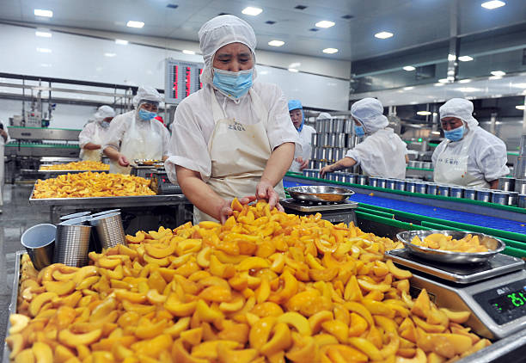
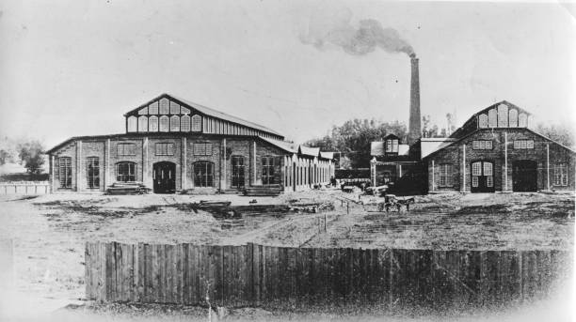
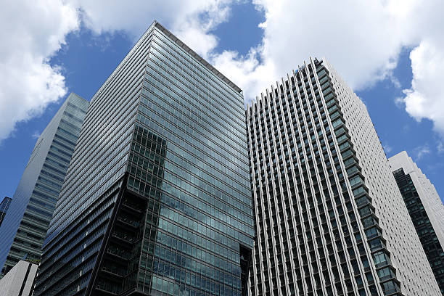
Economies, Constant Returns, Diseconomies
ECONOMIES OF
SCALE
CONSTANT RETURNS TO
SCALE
DISECONOMIES OF
SCALE
ATC FALLS as output rises. Double the
inputs, more than double the output.
Why: large set-up costs get spread, and
bigger operations specialise further.
ATC is FLAT. Double the inputs,
double the output.
Why: the gains from specialising have
all been taken, and nothing has
started going wrong yet.
ATC RISES. Double the inputs, less
than double the output.
Why: coordination. Too many layers of
management, too far between the
decision and the work.
Notes:
The three regions, named.
THE KICKER IS THE POINT, and it is the most confused pair in the chapter. Diminishing returns
needs a fixed factor and is short run. Diseconomies of scale has NO fixed factor and is long
run — everything scales up together and it still gets worse. Students merge these constantly.
Concrete examples worth naming:
- Economies: a semiconductor fab. Billions before a single chip is sold, so cost per chip
falls steeply with volume. (Trade press puts a 2nm-class fab module at $25–35 billion; the
WTO put a bleeding-edge fab at "well over $20 billion" in 2023. These are estimates, not
company disclosures — attribute loosely.)
- The one we come back to in twenty minutes: the average US ethanol plant grew from about 34
million gallons a year in 2000 to about 96 million by 2023, while the number of plants
stopped rising. Economies of scale visible in an industry we are already discussing.
- Diseconomies: any organisation where a decision now needs six approvals.
And say why the long-run supply curve in Part 6 comes out flat: the middle region. Where ATC
is flat, adding firms does not change anyone's costs.

Slide 54
Profits Are a Signal — and Everybody Can See Them
In the long run, firms can enter an industry or leave it. Nothing legal or
technical stands in the way.
THE FRANCHISE BEATS THE
TREASURY
SO MORE MCDONALD'S
OPEN
WHICH SHRINKS THE VERY
PROFIT THAT ATTRACTED
THEM
Put the $2.1 million a restaurant costs into
10-year Treasuries at 4.65% and it returns
about $98,000 a year, risk-free. Clear
more than that and the difference is
economic profit.
Anybody who can read the disclosure
document can see the same numbers.
Restaurants get built, market supply shifts
right — and a supply curve shifting right
means the price comes down.
Entry continues while there is still
an advantage over the Treasury. It
stops when there is not.
The profit is not destroyed by bad luck. It is destroyed by the response to it.
Notes:
Entry generalised — on the restaurant they have been running all hour.
THE COMPARISON IS THE POINT, and it is the economic-profit slide arriving again with real
money in it. A restaurant costs $1.47 to $2.73 million. Take the midpoint, $2.1 million. The
10-year Treasury paid 4.65% on 7 August 2026, so that same money parked in Treasuries returns
about $98,000 a year and you never get out of bed. Anything the restaurant clears ABOVE that
is economic profit — and the franchise disclosure document is a public filing, so anybody
who wants to run the comparison can.
Then the mechanism, and it is one sentence: everyone who can see the same numbers wants one.
Restaurants get built. Market supply shifts right. A supply curve shifting right means the
price comes down. And the $98,000 gap narrows.
Ask: when does the building stop? When the restaurant returns the same as the Treasury — no
better, no worse — because at that point there is nothing to move money for. That is zero
ECONOMIC profit, and it is the next slide.
ONE HONEST CAVEAT, and say it before a student does. Entry into McDonald's specifically is
not free: the franchisor picks the operators, picks the sites, and decides how many
restaurants a market gets. What IS free is entry into fast food — anybody can open a burger
restaurant, and Chick-fil-A, In-N-Out and everyone else did. The model needs free entry into
the INDUSTRY, not into one company's brand. If anything, McDonald's controlling its own
entry is why its US store count is as stable as the next-but-one slide shows.

Slide 55
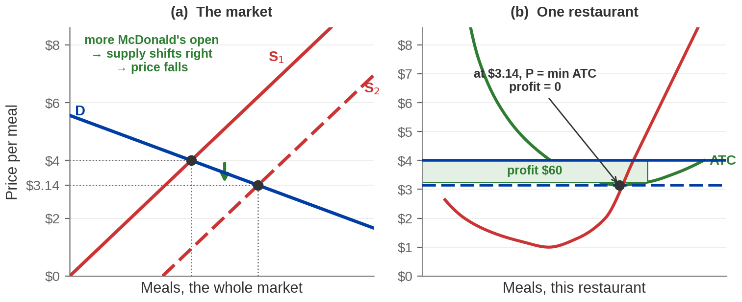
Entry Competes the Profit Away
Entry stops when P = minimum ATC = $3.14, because at that price there is nothing left to attract
anybody.
Notes:
Homer's clip, finished — the answer to the question left open in Part 1.
In Part 1 we watched entry drive a price down and said we could not yet say where it stops.
This is where.
NUMBERS: price starts at $4 with the restaurant making $60 an hour. Entry shifts market supply
right. Price falls to $3.14 — the MINIMUM of ATC — at 70 meals per restaurant. Economic profit
is then zero.
Why exactly minimum ATC, and not some other price? Because entry continues while profit is
positive, and profit is positive whenever price exceeds ATC at the chosen quantity. The only
price at which the firm can just break even is the one that touches ATC at a single point —
its minimum.
Two consequences worth saying:
- Firms end up producing at the lowest possible average cost. Nobody planned that.
- This is the strongest efficiency claim in the chapter, and Chapter 10 asks what it is
worth.
Then close the loop out loud, all three at once: Nick's margin was wide because he was the
only seller outside that bank. Homer's was wide because he was the only plough in Springfield.
Neither is a fact about popsicles or snow. Both are facts about how many people are selling —
and the ethanol subsidy is about to be the third.

Slide 56
Zero Economic Profit Is Not Zero Profit
In long-run equilibrium, price equals minimum average total cost and
economic profit is zero.
WHAT IT DOES NOT MEAN
WHAT IT DOES MEAN
It does not mean the owner is broke, working for
free, or should quit. She is being paid, and her
capital is earning its normal return.
There is nothing better available. Every alternative
use of the same time, money and space returns
exactly the same. She has no reason to move —
and neither does anyone outside.
"Zero economic profit" means "doing exactly as well as the next best thing" — which is fine.
Notes:
The single most misread result in the chapter.
Say it before they can misread it: zero economic profit does NOT mean zero income, and it does
not mean the business is failing. The owner is being paid. The capital is earning its normal
return. Those are COSTS in the economic accounting, and they have been paid in full.
What is zero is the EXCESS over the next best alternative.
Point back at the accounting-versus-economic-profit table. The restaurant owner there had $500
of accounting profit and MINUS $200 of economic profit. Zero economic profit sits between
those — a healthy accounting profit, exactly matching what she could earn elsewhere.
If a student asks why anybody bothers running a business for zero economic profit: because the
alternative also returns zero economic profit, by construction. The zero is a statement about
the comparison, not about the bank balance.

Slide 57
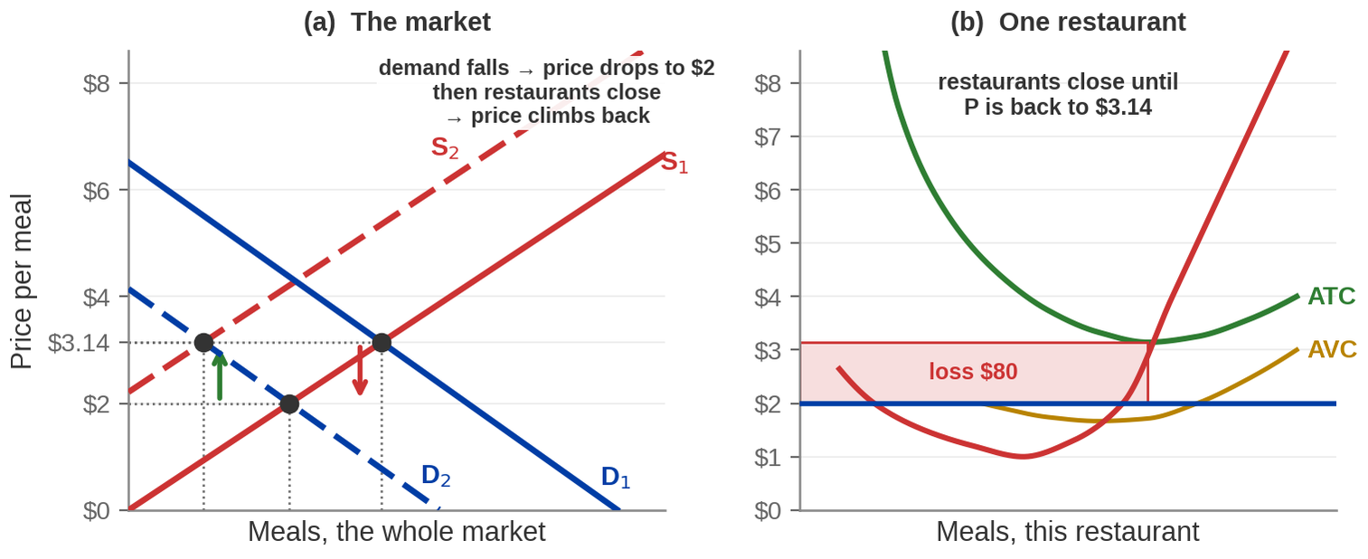
And Exit Works the Same Way
Demand falls, price drops to $2, restaurants lose money, some close — and the price climbs back
to $3.14.
Notes:
Exit — the same mechanism running backwards.
NUMBERS: start in long-run equilibrium at $3.14. Demand shifts left; price falls to $2. At $2
each restaurant serves 70 meals and loses $80 an hour — the same arithmetic as the
staying-open slide. Note it does NOT close: $2 is above minimum AVC of $1.67. It stays open
and bleeds.
Then, over the long run, some restaurants close. Market supply shifts left. Price rises back
to $3.14 and the survivors break even again.
THE TWO DISTINCTIONS, which finally separate here:
- SHUTDOWN is short run. Serve nobody this period, keep existing, keep owing the fixed
costs, reopen when price recovers. Trigger: P < AVC.
- EXIT is long run. Leave the industry, sell the fryers, owe nothing. Trigger: P < ATC
persistently.
At $2 this restaurant does neither in the short run — it serves meals at a loss. But if $2 is
the new normal, in the long run it or somebody like it closes for good.
The symmetry with entry is the point. Same signal, same response, opposite sign.

Slide 58
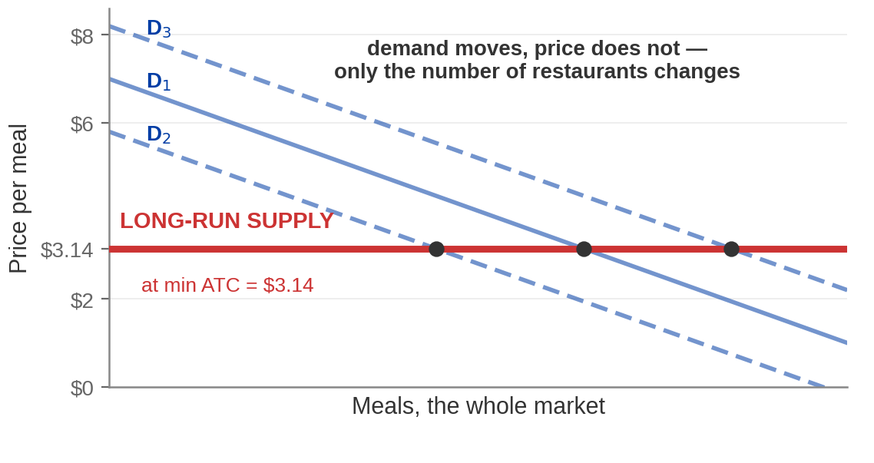
Why Long-Run Supply Is Flat
In the long run the price returns to minimum ATC whatever demand does. What changes is the
NUMBER of firms.
And $3.14 is the BOTTOM of the ATC curve — so entry pushes every restaurant to its efficient scale.
Nobody planned that.
Notes:
The horizontal long-run supply curve.
The result: demand can shift wherever it likes and the long-run price comes back to $3.14
every time. What absorbs the change is not the price — it is how many restaurants there are.
Why: any price above $3.14 attracts entry until it is competed back down; any price below
$3.14 drives exit until it is pushed back up. $3.14 is the only price that can persist.
This is the sharpest contrast in the chapter. Put the two sentences side by side:
- SHORT-run supply slopes UP. The firm moves along its own marginal cost curve.
- LONG-run supply is FLAT. The industry adds and removes firms instead.
The assumption underneath, and name it so it is not smuggled: every firm has the same cost
curves, and input prices do not change as the industry grows. Relax either and the long-run
supply curve slopes up somewhat. The flat case is what is examinable.
AND THE EFFICIENCY POINT, which is the green band and the strongest claim in the chapter.
$3.14 is not just the price entry settles at. It is the MINIMUM of the average total cost
curve — the one output at which this restaurant makes meals as cheaply as it is capable of
making them. Economists call it the efficient scale.
So in long-run equilibrium every surviving restaurant is producing at the lowest average cost
available to it, and it is selling at exactly that cost. Nobody chose this. No regulator set
the output, no manager was told to minimise average cost for the public's benefit. Each
operator was trying to make money, and entry did the rest.
Say plainly what it does NOT mean, because students over-read it: it does not mean the
outcome is fair, and it does not mean the right number of restaurants exist from society's
point of view. Chapter 10 asks that question. This is a claim about cost, not about welfare.

Slide 59
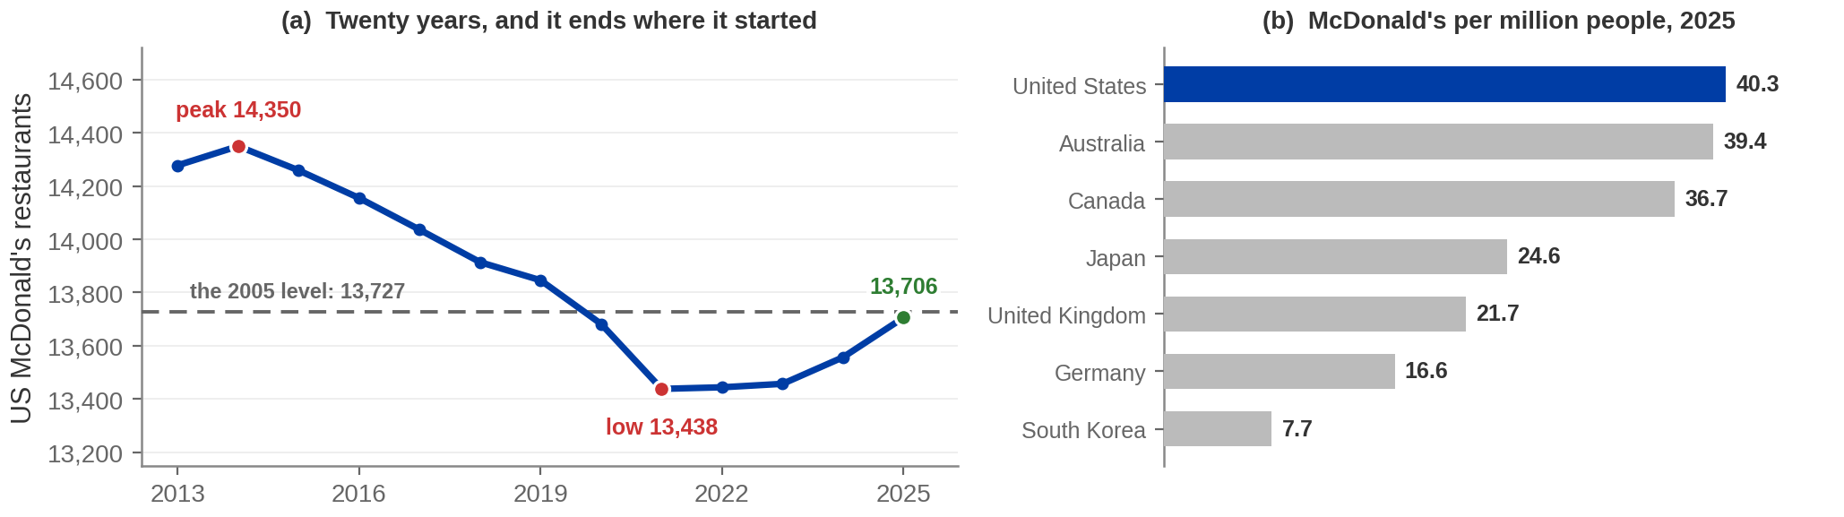
So How Many McDonald's Does America End Up With?
TWENTY YEARS, NET MINUS TWENTY-ONE
ENTRY WENT SOMEWHERE ELSE
13,727 US restaurants in 2005. 13,706 in 2025. It peaked at
14,350 in 2014 and bottomed at 13,438 in 2021 — seven
straight years of net closures.
Of ~2,600 restaurants planned worldwide for 2026, about 750
are in the US and all International Operated Markets. Over
1,800 are in licensed markets.
Nobody chose 13,706. Entry chose it — and then it stopped.
US counts: McDonald's Corp — Q4 2005 earnings release, Q4 releases 2015–2018, and Forms 10-K FY2020/FY2022/FY2024/FY2025. 2026 plan: FY2025 10-K, MD&A. Country counts: “Restaurants by Market 2025”. Populations: national statistical offices; US Census Bureau Vintage 2025 (340,003,797 at 1 Jul 2025).
Notes:
Long-run equilibrium, as a number you can look up. This is the payoff slide for
Part 5 and it is worth three minutes.
THE HEADLINE, and read it out: 13,727 US McDonald's in 2005. 13,706 in 2025. Net change over
twenty years: minus twenty-one restaurants. Out of nearly fourteen thousand.
That is what "the number of firms adjusts until economic profit is zero" looks like when you
go and count. The model does not predict a growing industry or a shrinking one. It predicts a
number that stops moving.
THE PATH MATTERS AS MUCH AS THE ENDPOINT. Point at the hump. The peak was 14,350 in 2014 —
entry overshot. Then SEVEN consecutive years of net closures, 2015 through 2021, bottoming at
13,438. Then back up to 13,706. Exit and entry, both visible, both doing what Part 5 says.
About 200 of the 2020 closures were low-volume restaurants inside Walmart stores; McDonald's
says so in its own 10-K.
PANEL (b) IS THE SECOND LESSON: the equilibrium number is not a law of nature. Same company,
same product, and the US settles at 40 restaurants per million people while Germany settles
at 17 and South Korea at 8. Ask the room why. Good answers: how often people eat out, how
cities are laid out, what the competition is, what land costs. All of those move the cost
curves or the demand curve, and the equilibrium number moves with them. Australia at 39 and
Canada at 37 are within 10% of the US, so the split is not "America is different" — it is
Anglosphere against Europe and East Asia.
THE THIRD POINT, on the second card: entry has not stopped worldwide, it has MOVED. Of about
2,600 openings planned for 2026, at most 750 are in the US and all International Operated
Markets combined; over 1,800 are in developmental licensed markets. Capital goes where the
economic profit still is. That is the chapter's mechanism operating at the level of countries.
SAY THIS OUT LOUD, because it is the difference between teaching evidence and citing it:
McDonald's has never said the US market is saturated. The words "saturation" and
"cannibalization" appear in none of its SEC filings — I checked. The plateau is a measurement;
"the industry reached long-run equilibrium" is OUR interpretation of it. The company describes
the same fact in the language of unit economics and restaurant quality. Students should see
where the data stops and the model starts.
If someone asks about other chains: Subway has about 18,800 US locations and Starbucks about
16,900, both more than McDonald's — and Subway closed 729 US stores in 2025 alone. Biggest is
not the same as settled.

Slide 60
Chapter 6: The Full Picture
 | What it says | Key terms | Where you saw it
Production | Output rises with labour, then more slowly, then falls. The kitchen is fixed in the short run. | marginal product, diminishing returns, specialisation | The 3rd worker adds 15
Costs | TC = VC + FC. The average follows the margin, so MC passes through the low point of each average curve. | FC, VC, ATC, AVC, AFC, MC | min AVC $1.67, min ATC $3.14
The rule | Produce where MR = MC, and MR = P for a price taker. Then compare P with ATC. | price taker, economic profit, implicit cost | $4 → 80 meals → $60
Supply | Short-run supply is MC above AVC. Below minimum AVC, produce nothing. | shutdown rule, sunk cost, ε_S | $2 → lose $80, not $100
Surplus | The area above supply and below price — it exceeds profit by the fixed cost. | producer surplus, willingness to accept | $160 surplus, $60 profit
The long run | Entry and exit drive price to minimum ATC, so long-run supply is flat and profit is zero. | economies of scale, free entry, long-run equilibrium | Nick, Homer, and ethanol
Chapter 5 built the demand curve. Chapter 6 built the supply curve. Chapter 4's diagram is now derived from
both sides.
Notes:
Recap. Nothing new — the hour re-indexed so students can find things.
Read the last line out. It is the real close: we have now built both curves of the supply and
demand diagram from individual optimisation problems, and neither is an assertion any more.
The right-hand column is deliberately numbers rather than exhibit references, because this
deck runs one firm the whole way through and those five figures are the spine of it.

Slide 61
KEY TAKEAWAYS
Chapter 6: Sellers and Incentives
The average follows the margin — which is why MC passes through the bottom of ATC.
Produce where MR = MC. For a price taker MR = P, so produce where P = MC.
Compare P with ATC for profit; compare P with AVC for whether to open at all.
Fixed costs are sunk in the short run. They cannot decide anything.
Free entry drives price to minimum ATC — and economic profit to zero.
Notes:
Key takeaways. Five, and the middle three are the examinable core.
If they remember only one thing, make it the third: two different curves answer two different
questions. ATC answers "am I making money?" AVC answers "should I be open?" Mixing them up is
the most costly single error in this chapter.
The last one sets up Chapter 7, which asks what happens when the conditions for perfect
competition fail.
Close on the thread: Nick's Pawpsicles, Homer's plough, and a federal ethanol subsidy are the
same story told three times. A wide margin is never a fact about the product. It is a fact
about how many people are selling it.

