Slide 1
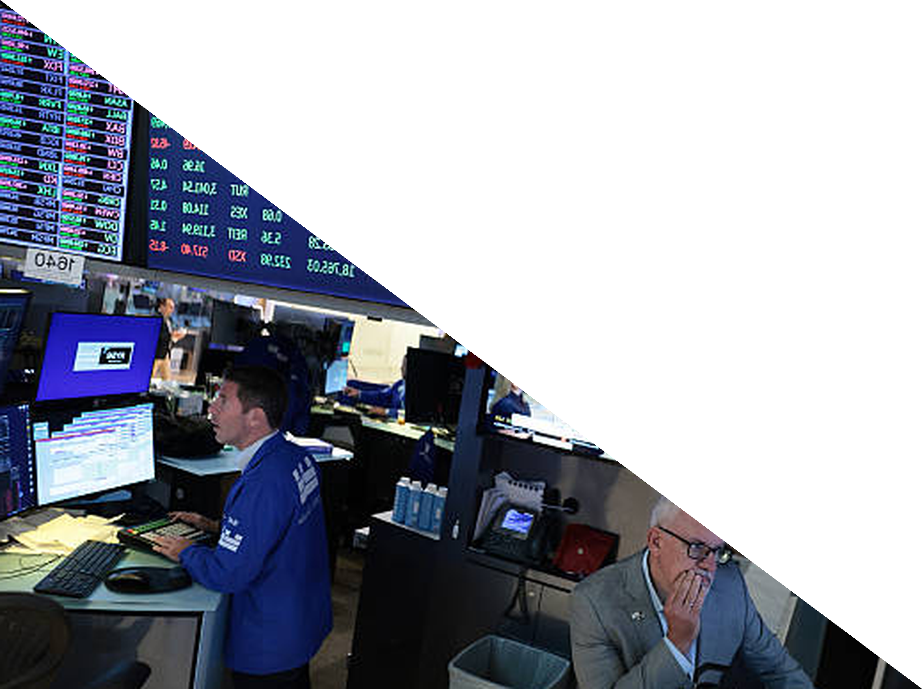
Chapter 7
Perfect Competition and the Invisible Hand
ECON 003
UC Riverside · Summer 2026
Notes:
Title.
Chapter 7. Chapters 5 and 6 built one buyer's problem and one seller's problem. Today
those two problems meet in a market, and the question is what comes out when nobody is
in charge.
No theme image on the title card yet, by instruction.
The sentence to open with: for two chapters we have watched individuals do the best they
can for themselves. Today we ask whether the result of everyone doing that is chaos or
something better than chaos - and we get to measure the answer, not just assert it.

Slide 2



Where We Left Off
Chapter 5 built the demand curve out of one buyer's problem.
Chapter 6 built the supply curve out of one seller's problem.
Today we put them in the same room.
WHAT BUYERS DO
WHAT SELLERS DO
WHAT NOBODY DOES
Spend the next dollar where it
buys the most utility. Stack those
choices and you have demand.
Produce where price equals
marginal cost. Stack those
choices and you have supply.
Coordinate any of it. No one
adds the two sides up. And
yet the market clears.
Today's question: when self-interested people trade, what does society end up with?
Notes:
Recap and framing.
Keep the recap to twenty seconds. The only thing that matters is the third card: nobody
in either of the last two chapters was trying to make the market work. Every actor was
selfish in the technical sense - maximising their own objective.
The claim of Chapter 7 is that the outcome of all that private optimisation is, under
strict conditions, the best outcome available to society as a whole. That claim is
testable, and we test it three times today: within a market, within a firm, and across
industries.
Do not oversell it. Say now, once, that the conditions are strict and that Chapter 8
onwards is largely about what happens when they fail.

Slide 3




Today's Roadmap
1. Efficiency,
measured
2. Across
industries
3. Prices as
signals
4. Equity vs
efficiency
Notes:
Roadmap.
Four parts. They escalate in scope: one market you can count on your fingers, then a whole
economy of industries, then the price system itself, then the one question the model
cannot settle for us.
Announce the carried question here and again on the next slide. It is deliberately the one
students already have an opinion about, and most rooms start out against surge pricing.
That is exactly what makes the ending land.

Slide 4
PART 1
Perfect Competition
and Efficiency
Notes:
Section divider - Part 1, Pearson section 7.1.
The job of this part is to make "efficient" a measurable word rather than a compliment.
By the end of it students should be able to compute social surplus for a small market and
say exactly how much a restriction costs.

Slide 5

One Sentence, from 1776
“It is not from the benevolence of the butcher, the brewer, or the baker, that we expect our dinner, but from their regard to their own interest.”
Adam Smith, The Wealth of Nations, 1776
Self-interested ≠ selfish
Maximum well-being ≠ fairness
We are examining how efficient markets lead to the maximum level of well-being.
Image: Acemoglu, Laibson & List, Microeconomics 3e
Notes:
Adam Smith, and the two distinctions the rest of the hour depends on.
Read the quotation out loud. It is short and it is the most quoted sentence in
economics for a reason.
Two things worth saying about it:
First, the phrase "invisible hand" appears exactly once in The Wealth of Nations, in
Book IV, and Smith used it far more cautiously than the modern slogan does. If a
student asks, that is the honest answer — he was making a narrower argument than the
phrase now carries.
Second, and this is the one to labour: Smith is not describing a moral system. He is
describing an information and incentive system. The butcher does not need to know
you, or care about you, or even know your name. The price does the communicating.
THE BAND — take both halves slowly, because both are places students go wrong.
"Self-interested is not selfish." Students arrive believing economics assumes people
are selfish and they resist the whole chapter because of it. The model needs one
thing: that people act on their own preferences consistently. It says nothing about
what those preferences contain. Someone whose utility rises when their neighbour eats
is self-interested and not selfish, and every result today goes through unchanged.
Good line: "The assumption is not that you are a bad person. The assumption is that
you are a person."
"Maximum well-being is not fairness." This is the promissory note for the last part
of the hour. What we are about to maximise is social surplus, which counts a dollar
of willingness to pay identically whoever holds it. That is a real measure and it is
not a measure of fairness. Say now that we will come back to it, so that when Part 4
says efficiency cannot settle a distributional question, it lands as something
promised rather than something conceded.
The kicker is the frame for Part 1: efficient markets, maximum well-being — and we
are about to make both of those phrases mean something you can compute.
Ask, if there is time: what would it take for a central planner to feed a city as
well as the butchers, brewers and bakers do? Hold the answer until Part 3 — it is the
coordination problem.

Slide 6

Two Numbers That Do All the Work
Reservation value — the most a buyer will pay, or the least a seller will
accept, for one unit.
Buyer's surplus = reservation value − price · Seller's surplus = price − reservation value
FOR A BUYER
FOR A SELLER
It is the value of the thing to you. Above it you walk
away; below it you buy and pocket the difference.
It is what the thing costs you to give up. Below it you
keep it; above it you sell and pocket the difference.
Notes:
Reservation values.
This is the vocabulary slide for the whole of Part 1, and it is worth being pedantic.
A reservation value is a *number in a person's head*, and it is the source of every
surplus figure we compute today. Notice that it is exactly willingness to pay from
Chapter 5 and willingness to accept from Chapter 6 — new word, old idea, and say that
explicitly so students do not think they have to learn something new.
The two formulae on the blue band are the only arithmetic in this section. Everything
else is addition.
One caution to flag: reservation values are unobservable in the real world. In the toy
market on the next slide we are handed them. In an actual market we infer them from
behaviour, which is what makes empirical demand estimation hard. Do not let students walk
away thinking these numbers are lying around.

Slide 7
Exhibit 7.1 — Seven Buyers, Seven Sellers
Buyer | Will pay | Cum. Q | Seller | Will accept | Cum. Q
Madeline | $70 | 1 | Tom | $10 | 1
Katie | $60 | 2 | Mary | $20 | 2
Sean | $50 | 3 | Jeff | $30 | 3
Dave | $40 | 4 | Phil | $40 | 4
Ian | $30 | 5 | Adam | $50 | 5
Kim | $20 | 6 | Matt | $60 | 6
Ty | $10 | 7 | Fiona | $70 | 7
One market for one used phone each. Nobody trades more than once.
Notes:
Exhibit 7.1. Tell them to photograph it — every number in the next eight
slides comes from this table.
Set it up carefully. Seven people each want to buy one phone; seven people each own one
and would sell it. Madeline values a phone at $70; Tom would part with his for $10.
Then walk the logic of the two "cumulative quantity" columns, because that is what turns
a list of people into a curve: at any price, the number of buyers willing to trade is the
number whose reservation value is at least that price, reading down; the number of
sellers is the number whose reservation value is at most that price, reading down the
other side.
One honest note: the numbers are symmetric on purpose, so the arithmetic stays clean. Real
markets are not, and nothing in the argument depends on the symmetry.
A student will notice this is not the market as they experience it — one phone each, no
haggling. Agree, and say that Chapter 4's smooth curves are what you get when you do this
with a million people instead of seven.

Slide 8
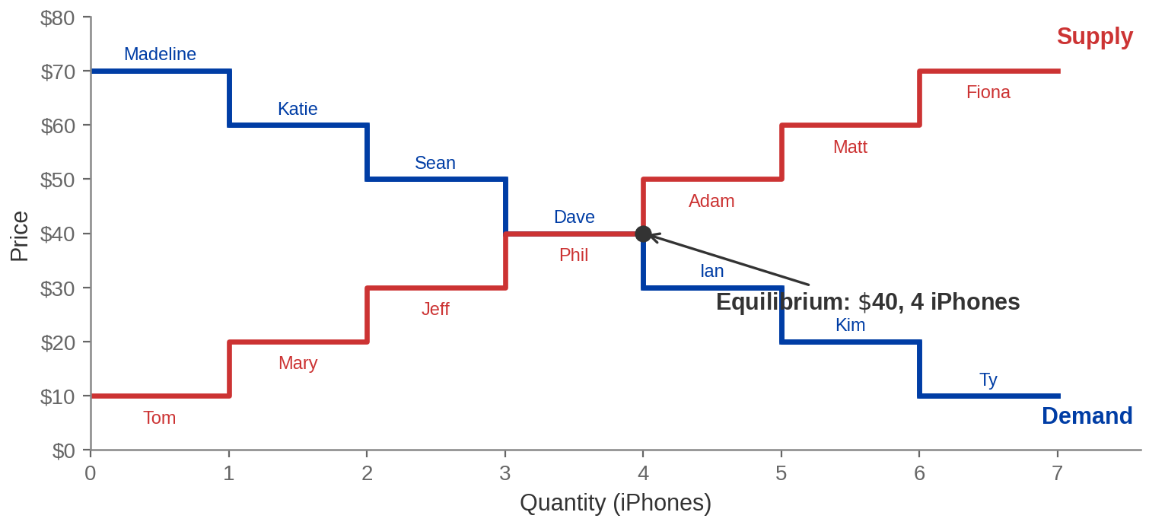
Exhibit 7.2 — The Same Table, Drawn
Every step is one person. Where the staircases cross is where the table balanced.
Notes:
Exhibit 7.2 - the staircase market.
Walk it slowly the first time. The blue staircase is the demand curve: it starts high at
Madeline's $70 and drops one step per buyer. The red staircase is supply, starting at
Tom's $10 and climbing.
The steps are the point. In Chapter 4 the curves were smooth lines and students took them
on trust. Here you can see what a demand curve IS — a queue of people sorted by how much
they value the thing. Say that out loud: a demand curve is a queue.
The curves cross at $40 and four units, exactly as the table said. Nothing new has
happened; we have just changed representation.
If you have time, the one extra sentence worth adding: add a few million more people and
the steps get small enough that the staircase looks like a line. That is all the smooth
curves in Chapter 4 ever were.

Slide 9
Consumer Surplus, at a Price of $40
Buyer | Will pay | Pays | Consumer surplus
Madeline | $70 | $40 | $30
Katie | $60 | $40 | $20
Sean | $50 | $40 | $10
Dave | $40 | $40 | $0
Ian, Kim, Ty | $30 and below | — no trade | $0
Total |  |  | $60
Consumer surplus is what buyers got for free: the gap between what a phone was worth to
them and what they paid.
Notes:
Consumer surplus, rebuilt from the table.
Do the first row out loud. Madeline would have paid $70 and paid $40, so she walks away
$30 better off than if she had not traded. That $30 is real — it is not accounting profit,
it is the value she captured.
Then Katie $20, Sean $10, Dave $0.
Two things to be explicit about:
Ian, Kim and Ty get nothing, and that is not a failure. Their reservation values are below
$40, so a trade at $40 would have made them worse off. The market correctly excluded
them.
Dave gets nothing either, but for the opposite reason — he traded, and it was exactly a
wash. Marginal buyer, zero surplus. That is what "marginal" means.
Total: $60. Write it on the board and leave it there; you need it in two slides.

Slide 10
Producer Surplus, at the Same Price
Seller | Will accept | Receives | Producer surplus
Tom | $10 | $40 | $30
Mary | $20 | $40 | $20
Jeff | $30 | $40 | $10
Phil | $40 | $40 | $0
Adam, Matt, Fiona | $50 and above | — no trade | $0
Total |  |  | $60
Producer surplus is the mirror image: the gap between what a seller received and the least
they would have accepted.
Notes:
Producer surplus - the mirror of the last slide.
Run it fast. The structure is identical and students will see it coming, which is the
point: the two sides of a market are the same problem viewed from opposite ends.
Tom's $30 is the biggest gain because Tom was the most eager seller. Fiona, who wanted
$70, sells nothing and loses nothing.
Total again $60, which is a coincidence of the symmetric numbers, not a law. Say that
explicitly — a student who leaves thinking consumer and producer surplus are always equal
has learned something false. In Chapter 4's tax and price-control diagrams they were very
much not equal.
Now you have $60 and $60 on the board.

Slide 11
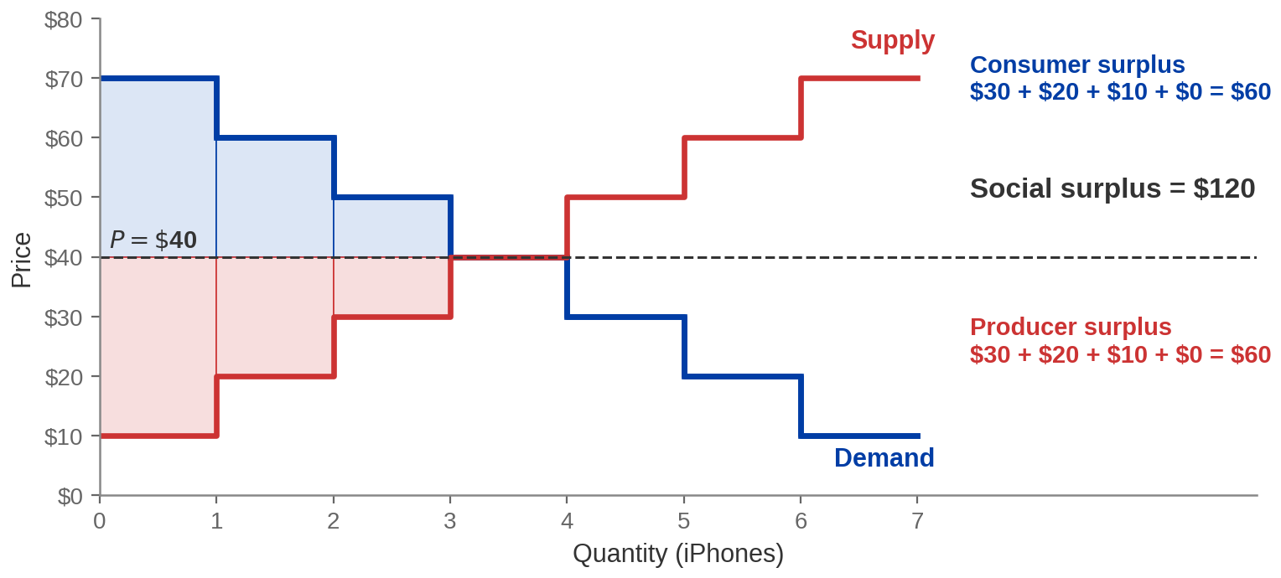
Social Surplus
Social surplus = consumer surplus + producer surplus
$60 + $60 = $120. That is the whole value this market created — now try to beat it.
Notes:
Social surplus, and the number the rest of Part 1 is measured against.
Definition first: social surplus is the total value the market created, counting everyone
in it. It does not care who got what — a dollar of surplus to Fiona counts the same as a
dollar to Madeline. Flag that now, because it is exactly the assumption Part 5 comes back
and questions.
On the figure: the blue blocks above the price line are consumer surplus, the red blocks
below it are producer surplus, and the whole shaded region is social surplus. The area
between the two staircases, up to where they cross.
Then set up the next two slides as a challenge. We have a candidate answer — $120, from
leaving the market alone. Anyone who thinks a rule would do better has to beat $120. We
will try two rules: a cap and a floor.
Numbers to have to hand: $60, $60, $120.

Slide 12
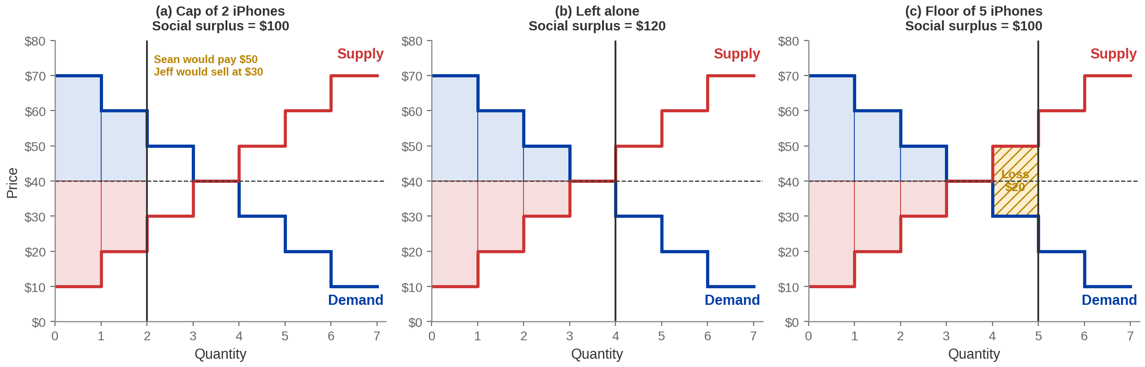
Exhibit 7.3 — Cap It, Leave It, or Force It
Too few trades wastes $20. Too many wastes $20. Left alone, the market finds the top.
Notes:
Exhibit 7.3, and the punchline of Part 1.
Three panels, and the middle one wins.
Panel (a) - the cap. Two trades, surplus $100. The market is stopped before it has
finished creating value.
Panel (b) - left alone. Four trades, surplus $120. The maximum.
Panel (c) - a floor: five trades required. Now Ian, who values a phone at $30, has to buy
one from Adam, who would only part with his for $50. That trade destroys $20 of value.
Surplus back down to $100.
The symmetry is the thing to point at. Interfering in either direction costs the same $20,
for opposite reasons: the cap blocked a trade worth making, the floor forced a trade not
worth making.
State the result plainly: the competitive equilibrium maximises social surplus. Not
"tends to", not "usually" — in this market, exactly, and you can check it by adding up
seven numbers.
Then immediately add the caveat, because it is the honest half: this result assumes the
conditions of perfect competition hold. When they do not — and Chapter 8 onwards is
mostly about when they do not — the result can fail.

Slide 13
Pareto Efficiency
An allocation is Pareto efficient when nobody can be made better off
without making somebody else worse off.
AT $40 AND FOUR PHONES
AT $20, SAY
Try it. Move a phone to Ian and you must take it
from someone who values it more. Change the
price and one side gains exactly what the other
loses. There is no free move left.
Buyers do better and sellers do worse. That is not a
Pareto improvement — it is a transfer. And with
fewer sellers willing, fewer phones trade at all.
“No free moves left” is a much weaker claim than “this outcome is fair”.
Notes:
Pareto efficiency - and the sentence that stops it being mistaken for a
moral endorsement.
Definition first, then test it on the market they already know.
The important and slightly deflating fact: Pareto efficiency is a very low bar. An
allocation in which one person owns everything and everyone else owns nothing is Pareto
efficient, because you cannot improve anyone without hurting the owner. Say that example
out loud — it is the single most useful thing on this slide, and it inoculates students
against reading "efficient" as "good".
Relation to social surplus: maximising social surplus implies Pareto efficiency here, but
the reverse does not hold in general. Do not go deeper than that in an intro course; just
be sure nobody leaves thinking the two words are synonyms.
Set up Part 5 now with one sentence: efficiency is about the size of the pie, equity is
about the slices, and this chapter's model has nothing to say about the slices.

Slide 14
What “Efficient” Does and Does Not License
IT DOES SAY
IT DOES NOT SAY
If the market is perfectly competitive and you
intervene, you will end up with less total surplus than
you started with. That is a real result and it has teeth.
That the outcome is fair, that everyone can afford
the product, or that we should never intervene.
Surplus counts dollars, not people.
So intervention cannot be justified on efficiency grounds here — but it may still be
justified on other grounds.
Efficiency is one argument. It was never meant to be the only one.
Notes:
The boundary of the result. This slide is where students most often
over-learn the chapter, so it is worth a full minute.
The publisher states this carefully and we should too: because the competitive equilibrium
is Pareto efficient, government intervention in THIS market cannot be defended by saying
it will make the pie bigger. It will not.
But three things remain wide open, and name all three:
One — the conditions. Perfect competition needs many buyers, many sellers, identical
goods, free entry, and good information. Remove any of them and the efficiency result can
break. Chapter 8 onwards.
Two — external effects. If production pollutes, private surplus and social surplus are
different numbers, and the market maximises the wrong one.
Three — distribution. Efficiency is silent on it, by construction, and Part 5 comes back
to this.
The line to say: "Efficient is a technical word with a narrow meaning. If you use it as a
compliment you will lose arguments to people who know what it means."

Slide 15
PART 2
Across Industries
Notes:
Section divider - Part 3, Pearson section 7.3.
Scale changes again. Now the question is not who produces within a market or within a
firm, but how many firms an industry should have at all — and how that gets decided when
nobody decides it.
The mechanism is entry and exit, which they met at the end of Chapter 6. This section
turns it into the resource-allocation story.

Slide 16


The Three Steps, One More Time
1. Find q where MR = MC · 2. Read ATC at that q · 3. Compare P with ATC
P > ATC
P < ATC
P = ATC
Economic profit. The industry
is paying better than the
alternatives, and outsiders
can see it.
Economic loss. Resources
here are earning less than
they would elsewhere.
Break-even. Nothing pulls
anyone in and nothing pushes
anyone out.
Economic profit is not a reward. It is a signal, and everyone can read it.
Notes:
Chapter 6's three steps, recalled. Brisk — but do not skip it, because this is
now the only slide in the deck that states the profit-maximising procedure, and the next
four exhibits all run it.
Walk the band once, pointing at each step, and say that every diagram in this section is
the same three moves in a different position.
The new emphasis is the kicker. In Chapter 6 economic profit was an outcome — the answer to
"am I making money?". In Chapter 7 it is an input: a message to everyone OUTSIDE the
industry saying resources here are earning more than they could elsewhere, come and get
some.
That reframing is the whole of this part, so say it before the diagrams arrive rather than
after.
Reminder worth stating: economic profit is measured after opportunity cost, which is why
P = ATC is a resting point rather than a crisis. The slide after the long-run diagram
comes back to this.

Slide 17
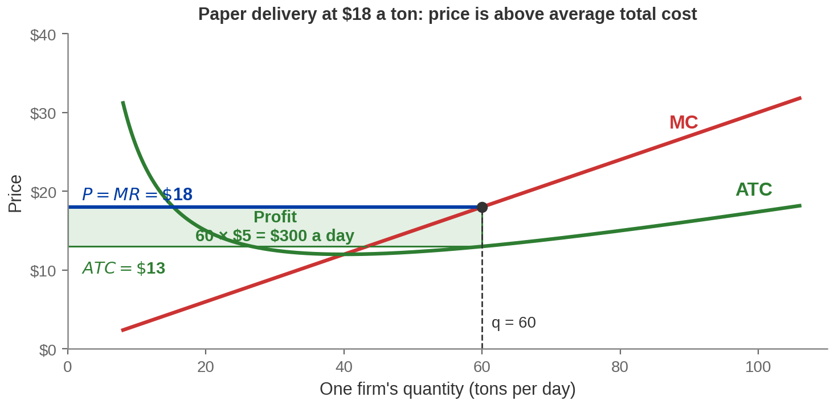
Exhibit 7.9 — Economic Profit in Paper Delivery
q = 60 tons a day · price $18 · ATC $13 · profit $300 a day, per firm
Notes:
Exhibit 7.9, redrawn as a firm in a profitable industry.
Walk the three steps on the picture so the method becomes muscle memory.
Step 1: MC crosses the $18 price line at 60 tons a day. That is the quantity.
Step 2: read up to the ATC curve at 60 — average total cost is $13.
Step 3: $18 is above $13, so there is profit: $5 a ton on 60 tons, $300 a day.
Every one of those numbers is exact. The firm's total cost is 240 + 0.15q², which gives a
minimum average total cost of $12 at 40 tons, and $13 at 60 tons.
Now the question that opens the next slide: this firm is making $300 a day. Who else can
see that, and what will they do about it?
A student may notice the profit rectangle is not at the minimum of ATC. Correct, and
important: firms maximise profit, not minimise average cost. Producing at minimum ATC
would mean giving up profitable units.

Slide 18
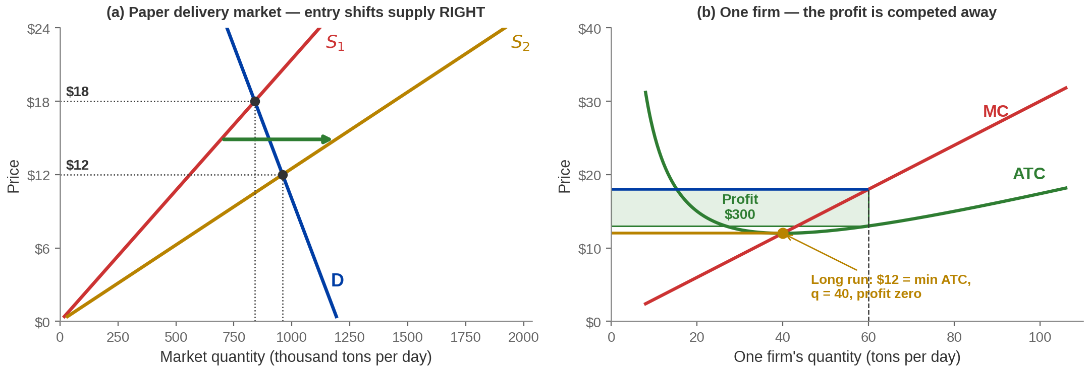
Exhibit 7.10 — Entry, and What It Does to the Price
Note for anyone comparing with the textbook figure: entry adds firms, so market supply shifts RIGHT and the price falls. Some printings of this exhibit draw the shift the other way.
Entry does not stop when the newcomers arrive. It stops when the profit does.
Notes:
Exhibit 7.10, redrawn - and one of the flags of this chapter.
Panel (a), the market: more firms means more supply at every price, so the supply curve
shifts RIGHT, from S1 to S2, and the price falls from $18 to $12.
Panel (b), the firm: as the price falls the profit rectangle shrinks. At $12 it has
vanished — price equals minimum average total cost, and the firm produces 40 tons instead
of 60.
THE ERROR: the version of Exhibit 7.10 in the publisher's slide deck draws S2 to the LEFT
of S1 on a slide titled "Firm Entry and Its Effect on the Market" — a leftward shift is
exit. The deck actually ships a corrected duplicate of the same exhibit a slide later,
with a note from its own author saying so. Teach the right one; if a student's copy shows
the arrow pointing left, that is the reason.
Numbers, if wanted: the industry goes from 14,000 firms at $18 to 24,000 firms at $12, and
market output rises from 840 to 960 thousand tons a day. Each firm shrinks while the
industry grows — that is worth one sentence, because it surprises people.

Slide 19
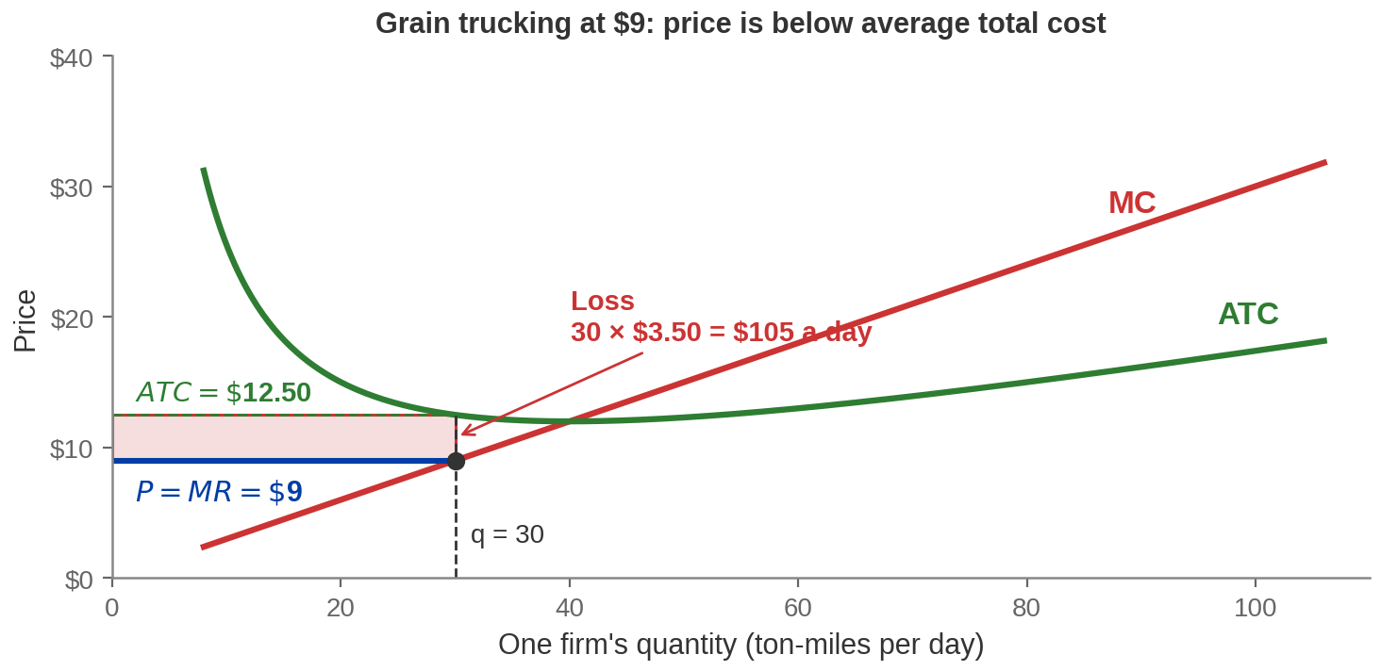
Exhibit 7.11 — And an Industry Losing Money
q = 30 ton-miles a day · price $9 · ATC $12.50 · loss $105 a day, per firm
Notes:
Exhibit 7.11 - the mirror of Exhibit 7.9.
Same three steps, opposite answer. Marginal cost meets the $9 price at 30 ton-miles;
average total cost there is $12.50; price is below cost, so the firm loses $3.50 a
ton-mile, $105 a day.
Two questions to head off:
"Why is it operating at all?" Because this is a short-run picture and, as long as price
covers average VARIABLE cost, shutting down would lose more. That is Chapter 6's shutdown
rule, and it is worth ten seconds of recall.
"Why doesn't it just produce less?" Because 30 is the loss-MINIMISING quantity. Producing
less would forgo units whose revenue exceeds their marginal cost. Students find this
counterintuitive every year.
The long-run answer is on the next slide: it does not produce less, it leaves.

Slide 20
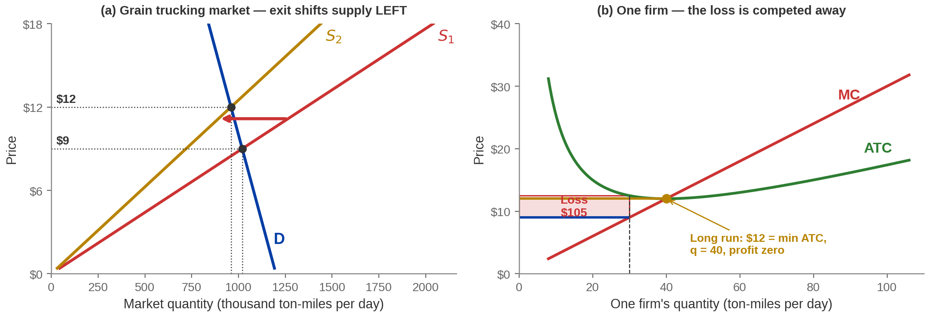
Exhibit 7.12 — Exit, and the Same Mechanism Backwards
Firms leaving is not the market breaking. It is the market moving resources somewhere they are worth
more.
Notes:
Exhibit 7.12.
Panel (a): firms leave, so supply shifts LEFT from S1 to S2 and the price RISES, from $9
to $12. Panel (b): the loss rectangle shrinks and disappears at $12.
The exit industry runs from 34,000 firms down to 24,000. Note that it lands on the same
$12 and the same 40-ton firm as the entry industry did, because both are using the same
cost technology. That is deliberate — it makes the point that the resting place is a
property of the technology, not of where you started.
The sentence that makes this Part 3 rather than Chapter 6 revision: the trucks, the
drivers and the capital that left this industry did not evaporate. They went to industries
where the return was higher — perhaps to paper delivery, where profits were attracting
entry. That is the cross-industry reallocation, and nobody organised it.
Ask: who decided that the economy needed fewer trucking firms and more paper delivery
firms? Nobody did. The prices did.

Slide 21
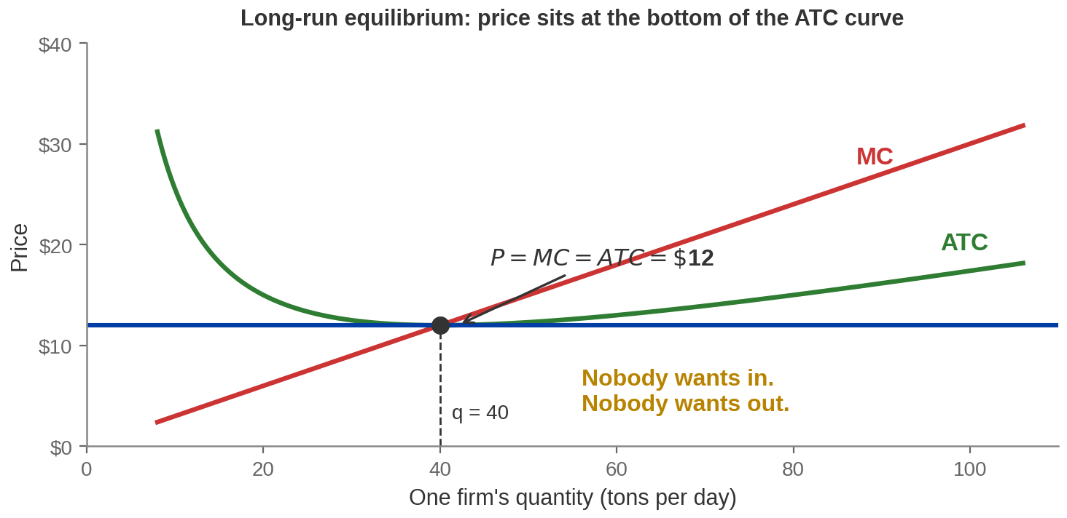
Where It Stops
Long-run equilibrium: P = MC = minimum ATC, and economic profit is zero in every
industry at once.
Notes:
The resting point.
Entry stops when profit reaches zero. Exit stops when losses reach zero. Both roads lead
to the same place: price equal to the minimum of average total cost.
Three consequences to state, because each is examinable:
One - the price ends up at the lowest average cost the technology allows. Consumers get
the good at the cheapest sustainable price. Nobody arranged that.
Two - each firm produces at the bottom of its ATC curve, which is the most cost-effective
scale. Nobody arranged that either.
Three - economic profit is zero everywhere, which means no industry is offering a better
return than any other. That is what "resources are allocated to their highest-value use"
actually means, stated as a condition you can check.
The picture is worth one more sentence: notice this is where MC crosses ATC, which
Chapter 6 established is always the minimum of ATC. Nothing new is being assumed.

Slide 22
Entry and Exit Are the Market Working
PROFITS ATTRACT
LOSSES REPEL
A profitable industry is one where resources are
earning more than they could elsewhere. Entry is
the economy noticing and responding.
A loss-making industry is one where resources are
earning less than they could elsewhere. Exit is the
same mechanism running the other way.
Free entry and free exit are what make the reallocation possible. Block either one and
the mechanism stops.
Firms closing is uncomfortable. It is also how the economy stops wasting things.
Notes:
The Part 3 summary, and a place to be honest.
The economics is clean: entry and exit move capital and labour toward their highest-value
uses, and free entry and exit are the necessary condition. Say the condition out loud —
licensing, patents, capital requirements and network effects all restrict entry, and all
of them break this result to some degree. Chapter 8 onwards.
Then the honest part, and do not skip it: "resources reallocate" is a phrase that hides
people losing jobs, towns losing employers, and skills becoming worthless. The model is
about the size of the pie. It says nothing about who bears the cost of the transition, and
the answer is usually not the people who captured the gains.
That is not a criticism of the model — it is the boundary of it, and it is the second time
today we have hit that boundary. Part 5 is where we stop working around it.

Slide 23
PART 3
Prices Guide
the Invisible Hand
Notes:
Section divider - Part 4, Pearson section 7.4.
Everything so far has run on prices without saying much about them. This part makes the
price itself the object of study: what information it carries, what happens when it is
allowed to move, and what happens when it is not.
This is also the part with the live material in it.

Slide 24
A Price Is a Message
A price is the shortest possible summary of everything anyone knows
about how scarce something is and how badly it is wanted.
TO BUYERS IT SAYS
TO SELLERS IT SAYS
TO EVERYONE ELSE IT
SAYS
Here is what this costs society
to give you. Take it only if it is
worth that much to you.
Here is what people will give
up for this. Make it only if you
can do so for less.
There is money to be made
here, or there is not. Come, or
go.
Notes:
The conceptual heart of Part 4.
The idea to convey: a price is an extraordinary act of compression. When the price of
copper rises, every user of copper economises on it, and not one of them needs to know
whether a mine flooded in Chile or a new use was found in China. The number is enough.
That is Hayek's argument, and it is worth naming him even in an intro course, because it
is the strongest version of the case for markets and it is not the same as the efficiency
argument we proved in Part 1. Part 1 said the outcome is good given the information. This
says the price system economises on the information anyone needs to have.
The three cards are the three audiences. Point at each and read it.
Then the transition: if the price is the message, what happens when we stop it from
changing? That is the rest of Part 4.

Slide 25
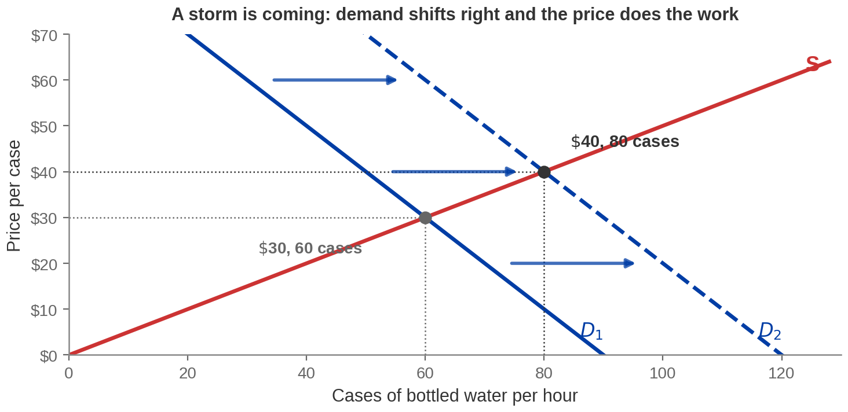
Exhibit 7.14 — A Storm Is Coming
Demand shifts right · the price rises from $30 to $40 · quantity traded rises from 60 to 80
cases
Notes:
Exhibit 7.14. Bottled water before a storm.
This is Chapter 4 machinery and it should take ninety seconds. A hurricane warning goes
out; demand for bottled water, plywood, ice and generators jumps; the demand curve shifts
right; the price rises.
What to point at, because it is the bit students skip: quantity traded ALSO rises, from 60
to 80. The higher price is not just a transfer from buyers to sellers. It is the
instruction that brings the extra 20 cases into the market — someone drove a truck through
the night because $40 made it worth doing.
Numbers, exact: supply is Qs = 2P, demand shifts from Qd = 90 − P to Qd = 120 − P.
Equilibrium moves from ($30, 60) to ($40, 80).
Hold the moral judgement for two slides. Right now this is a description, not a defence.

Slide 26
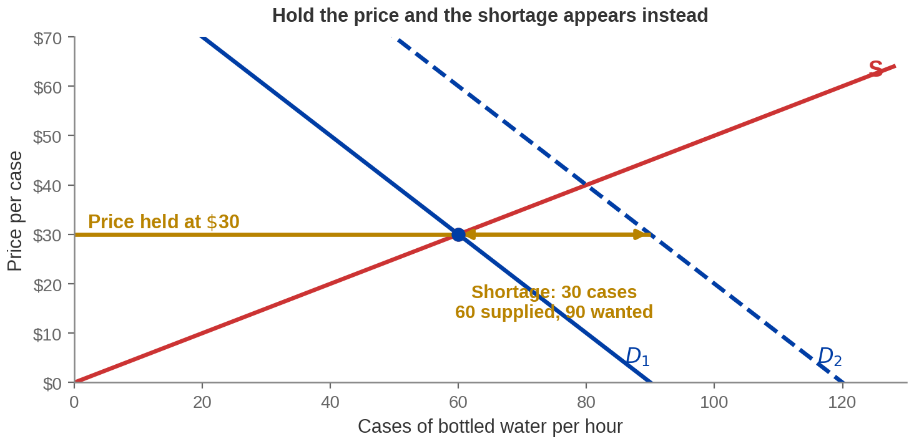
Exhibit 7.15 — Hold the Price Instead
At $30: 60 cases arrive, 90 are wanted. The 30-case gap is not filled by anything.
Notes:
Exhibit 7.15. The same storm, with the price held at $30.
Demand still shifts. Supply still slopes up. But the price is not allowed to move, so the
quantity supplied stays at 60 while quantity demanded goes to 90.
Thirty cases of shortage. And the crucial question to ask the room: who gets the 60 cases
that do exist?
Not the people who need them most — the price is no longer sorting anyone. They go to
whoever arrives first, whoever lives nearest, whoever can queue longest, whoever knows the
shop owner. Those are real allocation rules and none of them is "whoever values water
most".
Say the phrase that makes this stick: the shortage does not eliminate rationing. It
changes who does the rationing, from the price to the queue — and unlike a price, the
queue's cost is paid and received by nobody.
Do not moralise yet. The equity argument is coming in four slides and it deserves a fair
hearing.

Slide 27
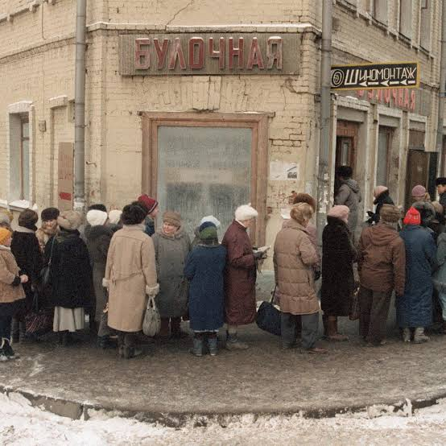
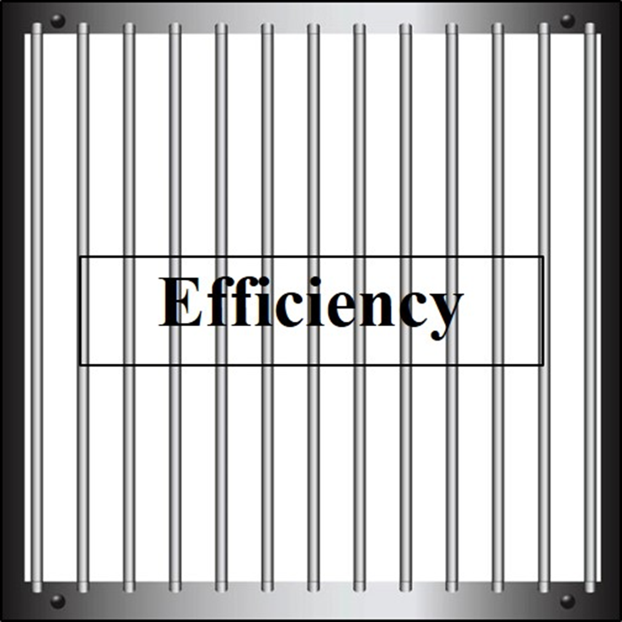
Price Controls Restrict Efficiency
If the price cannot move, it cannot carry information — and everything the invisible hand does, it does through the price.
WHAT IS BLOCKED
WHAT APPEARS
INSTEAD
Sellers do not learn that supply
is short. Buyers do not learn to
economize. Nobody outside
learns to come and help.
A shortage, a queue, and an
allocation nobody chose and
nobody can defend on efficiency
grounds.
Image: Acemoglu, Laibson & List, Microeconomics 3e
Notes:
The conceptual bridge between the shortage diagram and the deadweight-loss
measurement.
One idea: a price control does not just move money around. It disables the signalling
system. Everything in Parts 1, 2 and 3 ran through the price, so if the price is frozen,
all three mechanisms stop at once.
Worth making concrete with the three levels we have already done:
- Within the market, high-value buyers no longer outbid low-value ones.
- Within a firm, plants no longer know where to put the next unit.
- Across industries, nobody learns that this is where resources are needed.
Then set up the measurement: we have said "less efficient" three times now. On the next
two slides we put a number on it.

Slide 28

Deadweight Loss
Deadweight loss — the social surplus that a market intervention
destroys. Not transferred to anyone. Destroyed.
A TRANSFER
A DEADWEIGHT LOSS
YOU ALREADY MET
ONE
A price cap moves money from
sellers to the buyers who still
get the good. Somebody loses,
somebody gains, and the total
is unchanged.
The trades that no longer
happen at all. The buyer's gain
and the seller's gain both
vanish. Nobody picks them up.
The $20 in the capped phone
market
Ask of any policy: how much is a transfer, and how much simply disappears?
Notes:
The definition, and the distinction students most need.
Transfers and deadweight losses are completely different animals and they get conflated
constantly, including in public debate.
A transfer is a distributional question: sellers lose $X, buyers gain $X, and reasonable
people can disagree about whether that is good. Economics has no special authority there.
A deadweight loss is not a distributional question. It is value that nobody has. There is
no one to argue on its behalf because nobody received it.
Point back at the third card. They computed a deadweight loss on slide 15 without knowing
the word, which is the right order to learn it in.
Then set up the arithmetic: the next slide puts letters on the areas; the one after puts
a real statutory number on it.

Slide 29
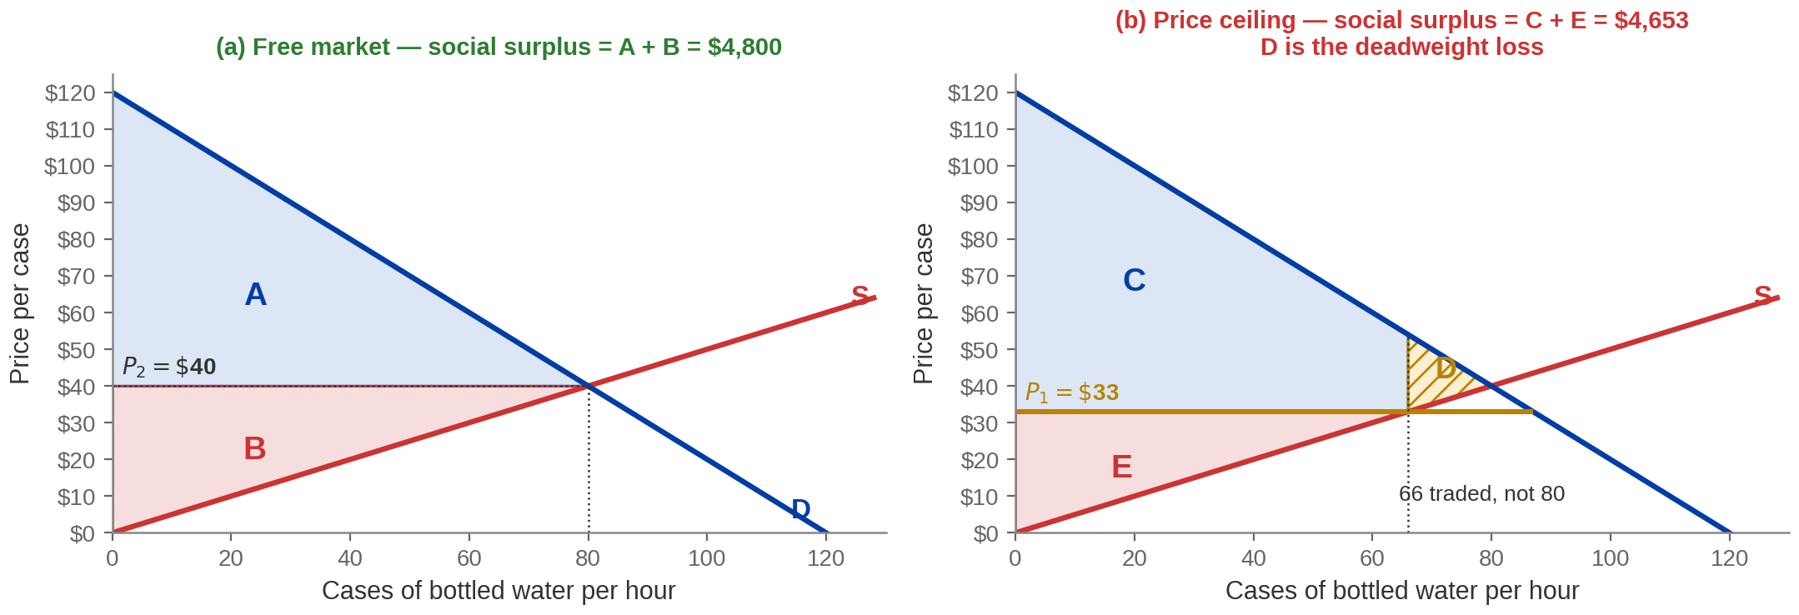
Exhibit 7.16 — Where the Surplus Goes
A + B = $4,800. C + E = $4,653. D = $147, and it belongs to nobody.
Notes:
Exhibit 7.16, redrawn with the publisher's lettering so students can match
it to the textbook.
Panel (a), free market: consumer surplus is A, producer surplus is B, and A + B is the
whole social surplus — $4,800 an hour in this market.
Panel (b), with a ceiling: consumer surplus is C, producer surplus is E. C is not simply
smaller than A — part of it is the rectangle taken from sellers and handed to the buyers
who still get water. That part is a transfer.
D is the triangle, and D is the deadweight loss: $147. It is the surplus from the 14 cases
that would have been traded and now are not. Nobody has it.
Two things students get wrong here:
Consumer surplus can RISE under a price ceiling. Buyers who still get the good pay less.
That is why price controls are popular, and it is a real gain to real people — do not
pretend otherwise.
Producer surplus falls unambiguously. Sellers lose the transfer and the lost trades.
The next slide says where the $147 and the ceiling price came from, and the answer is not
hypothetical.

Slide 30
The Case on the Other Side
THE ARGUMENT FOR THE CEILING
THE ARGUMENT AGAINST
In a disaster, willingness to pay tracks ability to pay. Letting
the price clear the market allocates water to the richest, not
the thirstiest. A queue is a worse allocator than a price in
normal times and arguably a better one here.
The high price is what brings the extra water in. Cap it and
the trucks do not come, so the shortage is deeper and lasts
longer — and the people who lose most are the ones
without the time to queue.
Notes:
Give both sides properly. Five slides in a row have now pointed one way; this
is the one that stops the sequence being a sermon, and a case that answers its strongest
objection is stronger than one that ignores it.
The equity argument is not weak and should not be presented as a naive objection. Social
surplus counts a dollar of willingness to pay identically whoever holds it, and in an
emergency that is a genuinely contestable way to count. A person who cannot afford $40
water is not revealing that they value it less.
The efficiency argument is also not weak. The supply response is the entire mechanism, and
suppressing it makes the shortage worse for everyone, including the poor.
On the study: one paper, one episode, an indirect outcome measure — contacts inferred from
phone location data rather than shortages measured directly. Cite it as evidence, not proof,
and say so. There is other work finding anti-gouging rules speed recovery in some settings;
the honest summary is that the empirical question is not settled.
Land it here: the model tells you the size of the efficiency cost. It cannot tell you whether
that cost is worth paying. That is a value judgement, and the last part of the hour is about
admitting it rather than dressing it up.

Slide 31
Two Problems Any Economy Has to Solve
THE COORDINATION PROBLEM
THE INCENTIVE PROBLEM
Getting millions of self-interested strangers to form markets
at all — to find each other, agree what to trade, and settle
on terms. Nobody has a list of who wants what.
Getting them to actually do the thing once the
market exists — to show up, produce, and not shirk,
when nobody is watching closely enough to check.
Prices solve both at once. That is why they are the answer to two questions and not just
one.
A system that solved only one of these would not work at all.
Notes:
The framing for the last stretch of Part 4.
Both problems are hard and it is worth making that felt. To coordinate an economy
centrally you would need to know every consumer's preferences, every firm's technology,
and every resource's location, and you would need it faster than any of them change. To
give incentives centrally you would need to monitor effort you cannot observe.
Prices do both simultaneously. The price tells you what to do (coordination) and paying
you the price makes you want to do it (incentive). That double duty is the thing to
underline — it is why the market answer is not simply "one of several ways to organise an
economy".
Then the honest counterweight, one sentence: markets solve these two problems well and
create others, which is what the rest of the course is about.
This slide also pays back the Adam Smith slide from the start of the hour: the butcher
does not need to be told and does not need to be supervised.

Slide 32
Two Ways to Answer Them
MARKET ECONOMY
COMMAND ECONOMY
Prices direct the flow of resources and provide the
incentives to follow them. Information stays where it
already is — with the people who have it — and nobody
needs to collect it.
A central agency directs resources and supplies
incentives. It must first gather the information that prices
would otherwise have summarized, and it must gather it
faster than it goes stale.
Notes:
The comparison.
Keep it analytical rather than ideological. The difference between the two columns is not
about motives; it is about where information sits and how much of it has to move.
The point to press is the last line of the command-economy card: a planner has to COLLECT
the information that a price would have summarised for free, and collect it faster than it
goes stale. Nobody has ever managed the second part.
Make it concrete before the kicker. Ask what a central agency would need to know to set the
price of one thing — say, copper. Every mine's cost, every user's alternative, every
substitute's price, and all of it changing daily. Then the kicker: now do that for every
product at once, where each answer depends on all the others.
Fair-minded note if a student raises it: real economies are all mixtures, and some
functions — defence, public health, basic research — are directed centrally in every
country, for reasons the next section starts to explain.

Slide 33

The Central Planner
Kmart's blue light special: a flashing light, a loudspeaker, and a discount that lasted fifteen minutes.
AS DESIGNED
AS CENTRALISED
A store manager, looking at their own overstocked shelves, decided what to
discount and when.
Head office chose the
item, the discount and the
hour — for every store in
the country at once.
Image: Acemoglu, Laibson & List, Microeconomics 3e
Notes:
The publisher's illustration of central direction, handled carefully.
The story as they tell it: the blue light special began in 1965 as a store-level tool — a
manager with too many of something switched on the light and cleared it. Later the
corporate office took the decision over, running the same promotion on the same item at the
same time nationwide, and the results were worse.
What I can source and what I cannot, and this matters. The 1965 start, the loudspeaker
announcement, the discontinuation in the early 1990s and the revivals in 2001 and 2015 are
all well documented. The claim that centralising the decision CAUSED lower profits is not
something I can find a source for. So tell it as an illustration of the mechanism, not as
evidence for it, and do not put a figure on the damage.
The mechanism is the one from the last slide, shrunk to a size students can hold: the local
manager could see which shelves were full and head office could not. Substituting a uniform
rule for local information throws away the only thing the manager had that head office
lacked.
Good question to leave hanging: what would head office have needed to know to do this
well? The answer is "everything every store manager knew", which is the coordination
problem in one sentence.

Slide 34
PART 4
Equity and Efficiency
Notes:
Section divider - Part 5, Pearson section 7.5.
Short section, and the most important twelve minutes of the hour for students who will
never take another economics course.
Everything so far has been positive economics — statements that can be checked. This
section is where we say clearly what the model does not decide, and hand that question
back.

Slide 35
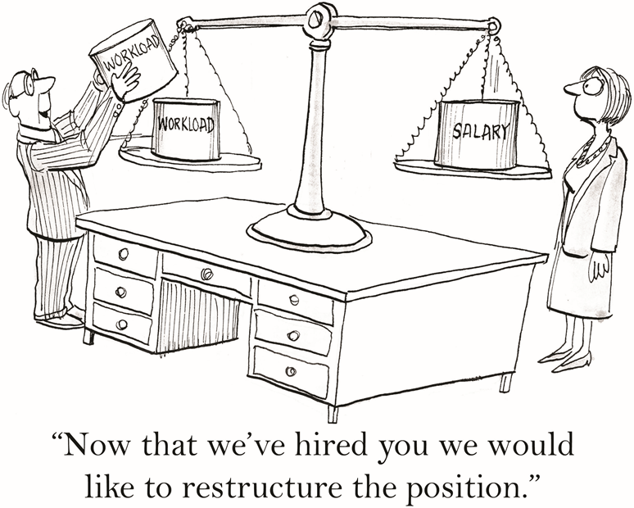
Equity
Equity asks whether the distribution of resources across a society is fair.
EFFICIENCY IS
POSITIVE
EQUITY IS
NORMATIVE
It asks what IS. Given the
curves, social surplus is
$4,800 or it is not. You can
check it.
It asks what OUGHT to be.
Nothing in the diagram
answers it, and no amount
of better data will.
Image: Acemoglu, Laibson & List, Microeconomics 3e
Notes:
Equity, and the positive/normative line.
Define equity and then be precise about what kind of question it is. This is the
distinction from Chapter 1 — positive versus normative — arriving where it finally has
teeth.
The sentence to say plainly: markets do not make judgements. A market has no opinion about
whether the person who got the water needed it. It allocates to willingness to pay, and
willingness to pay is partly a statement about preferences and partly a statement about
what is in your account.
Then the thing students most need to hear from an economist, said out loud: economics does
not have a technique for settling equity questions. It can tell you what a redistribution
costs in surplus. It cannot tell you whether to do it. Anyone who tells you the discipline
settles it is selling something.
The cartoon is the publisher's and it is a light touch after a heavy point. Use it, do not
labour it.

Slide 36

Efficient Is Not the Same as Fair
Every allocation on the frontier is efficient. The frontier does not tell you
which point on it to want.
THE TRADE-OFF IS
REAL
BUT NOT ALWAYS
WHAT ECONOMICS
CONTRIBUTES
Some inefficiencies fall hardest
on the poor, so removing them
raises both. Efficiency and
equity are not automatically
opposed.
The price of each option. It
tells you what the choice
costs. It does not tell you
which to choose.
Most ways of redistributing change
behaviour, and changed behaviour
costs surplus. Bigger pie, less equal
slices — often, not always.
One of the roles of government is to address efficient outcomes that we do not consider equitable.
Notes:
The trade-off, stated fairly in both directions.
The textbook frames this as a trade-off between making the pie as big as possible and
dividing it evenly, and that framing is standard and mostly right. But do not let the
middle card get lost, because a student who leaves thinking equity always costs efficiency
has learned something false.
Examples where both improve together, if you want one: removing a barrier to entry that
protects incumbents; funding education that credit constraints would otherwise ration by
parental wealth. Both raise total surplus AND spread it more evenly.
The third card is the professional position, and it is worth saying you hold it: an
economist's contribution to a distributional argument is the price tag, not the verdict.
Close the section by returning to the question from Part 4: the New York rule costs $147
an hour of surplus in our storm. Whether that is worth paying to keep water at $33 is not
an economics question. It is a question about what kind of society you want, and your vote
counts the same as mine.

Slide 37

Uber Surge Hour Pricing
It is raining, the game has just ended, and the app says your ride home costs $32 instead of $15.
Is that price doing something useful, or just taking advantage of you?
BOTH SIDES ARE PRICE
TAKERS
THE PRICE IS DOING A
JOB
Riders see a price and decide.
Drivers see a price and decide.
Neither can move it.
It rations the rides that
exist, and it calls more
drivers onto the road.
Image: Acemoglu, Laibson & List, Microeconomics 3e
Notes:
The carried question. Pose it, do NOT answer it.
Take a show of hands: who thinks surge pricing makes riders worse off overall? Write the
split on the board. Rooms usually run three to one against surge, and coming back to that
number at the end is the single most effective thing on this slide.
The photograph and the framing are the publisher's evidence-based-economics question for
this chapter. Do not say so on the slide.
Two things NOT to claim yet: that surge pricing is good, and that it is bad. The whole
point is that the last exhibit of the hour gives us a measurement rather than an opinion.
The $32 figure is illustrative — a plausible multiplier, not a quoted fare. Do not
attribute it to any company.

Slide 38
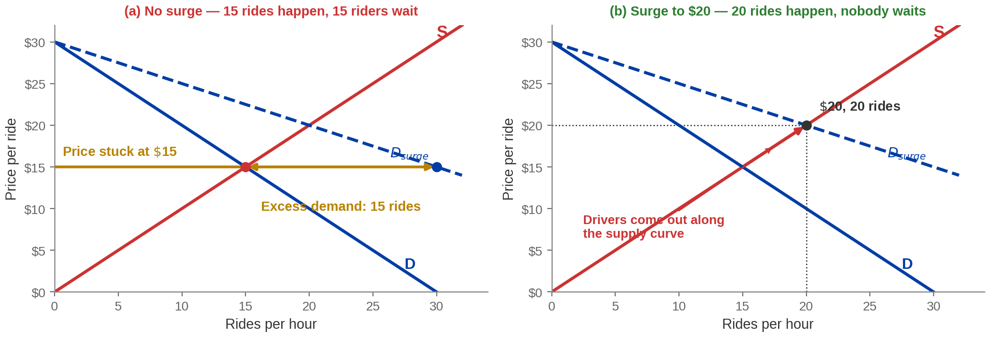
Exhibit 7.17 — Two Ways to Handle a Demand Surge
Without the surge, 15 rides happen and 15 people wait. With it, 20 rides happen and nobody does.
Notes:
Exhibit 7.17, drawn on the schedule from the end-of-chapter problem so the
picture and the arithmetic are the same market.
Panel (a): the game ends, demand shifts right, and the price is held at $15. Quantity
supplied stays at 15 rides. Quantity demanded is 30. Fifteen people are left standing in
the rain, and the app shows no cars.
Panel (b): the price is allowed to rise to $20. Drivers respond — this is a MOVEMENT along
the supply curve, not a shift, and it is worth saying that phrase because it is a
Chapter 4 distinction students still get wrong. Twenty rides happen and the market clears.
Compare the two outcomes honestly. In panel (b) the fifteen people who would have got a
ride at $15 now pay $20, and five people who would not have got one at all now do. So
there are winners and losers among riders, and the drivers gain. The total number of rides
is higher.
A note if a student compares with the textbook figure: the book draws this with $10 and
$20 and no schedule. We use $15 and $20 because those come from the schedule in the
end-of-chapter problem, so the picture and the numbers you will work in ten minutes are
the same market.

Slide 39
Chapter 7: The Full Picture
 | What it says | Key terms | Where you saw it
Efficiency | Competitive equilibrium maximises social surplus. | consumer and producer surplus, Pareto efficiency | Exhibits 7.1–7.3
Across industries | Profit attracts entry, loss forces exit; both stop at P = MC = min ATC. | free entry and exit, long-run equilibrium | Exhibits 7.9–7.12
Prices | Freeze a price and you get a shortage, a queue and a deadweight loss. | price signal, price ceiling, deadweight loss | Exhibits 7.14–7.16
Equity | Efficiency is positive, equity is normative — and the model cannot settle it. | equity, positive and normative | Section 7.5
The evidence | Kerb pricing, a real 10% price cap and surge pricing all show the mechanism. | SFpark, anti-gouging rules, surge pricing | Exhibit 7.17
Three chapters, one argument: buyers optimise, sellers optimise, and the price makes the two add up.
Notes:
Recap. Nothing new on this slide - it is the hour re-indexed so students can
find things.
Read the closing line out. It is the real close of the three-chapter arc: Chapter 5 built
demand from a buyer's problem, Chapter 6 built supply from a seller's problem, and Chapter
7 showed that putting the two together produces an outcome no one designed and no one
could improve on without hurting somebody.
If you cut material today, leave this slide up while you say what got cut and where to
read it.
Point forward: every result today depended on the conditions of perfect competition. From
here on the course removes them one at a time.

Slide 40
KEY TAKEAWAYS
Chapter 7: Perfect Competition and the Invisible Hand
Social surplus measures what a market creates. The competitive equilibrium maximises it
— restricting trade or forcing it both destroy value.
Pareto efficient is a low bar. It only means no free moves are left — one person owning
everything clears it.
Profit and loss are signals. Free entry and exit act on them until economic profit is zero and
price equals minimum average total cost.
A price is information and an incentive at once. Freeze it and you get a shortage, a queue,
and a deadweight loss nobody receives.
Efficient is not the same as fair. Economics prices the trade-off; it does not choose for you.
Notes:
Key takeaways. Five, and the first and last are the ones that matter
beyond this course.
If they remember one thing, make it the last: they now know what an economist means by
"efficient", and they know it is a narrower word than it sounds. That is worth more than
any diagram in the deck.
The second and third are the examinable core. The Pareto line is the one students most
often over-read — say the "one person owns everything" example out loud, because it is what
stops "efficient" being heard as "good".
Set up what comes next: everything today assumed many buyers, many sellers, an identical
good, free entry and good information. Chapter 8 starts taking those away, beginning with
what happens when one seller is big enough to move the price. Every result from today
weakens or reverses.
Last line to say out loud: the invisible hand is not magic and it is not a moral claim. It
is a claim about what prices do with information — and like every claim in this course, it
comes with conditions attached.

