Slide 1
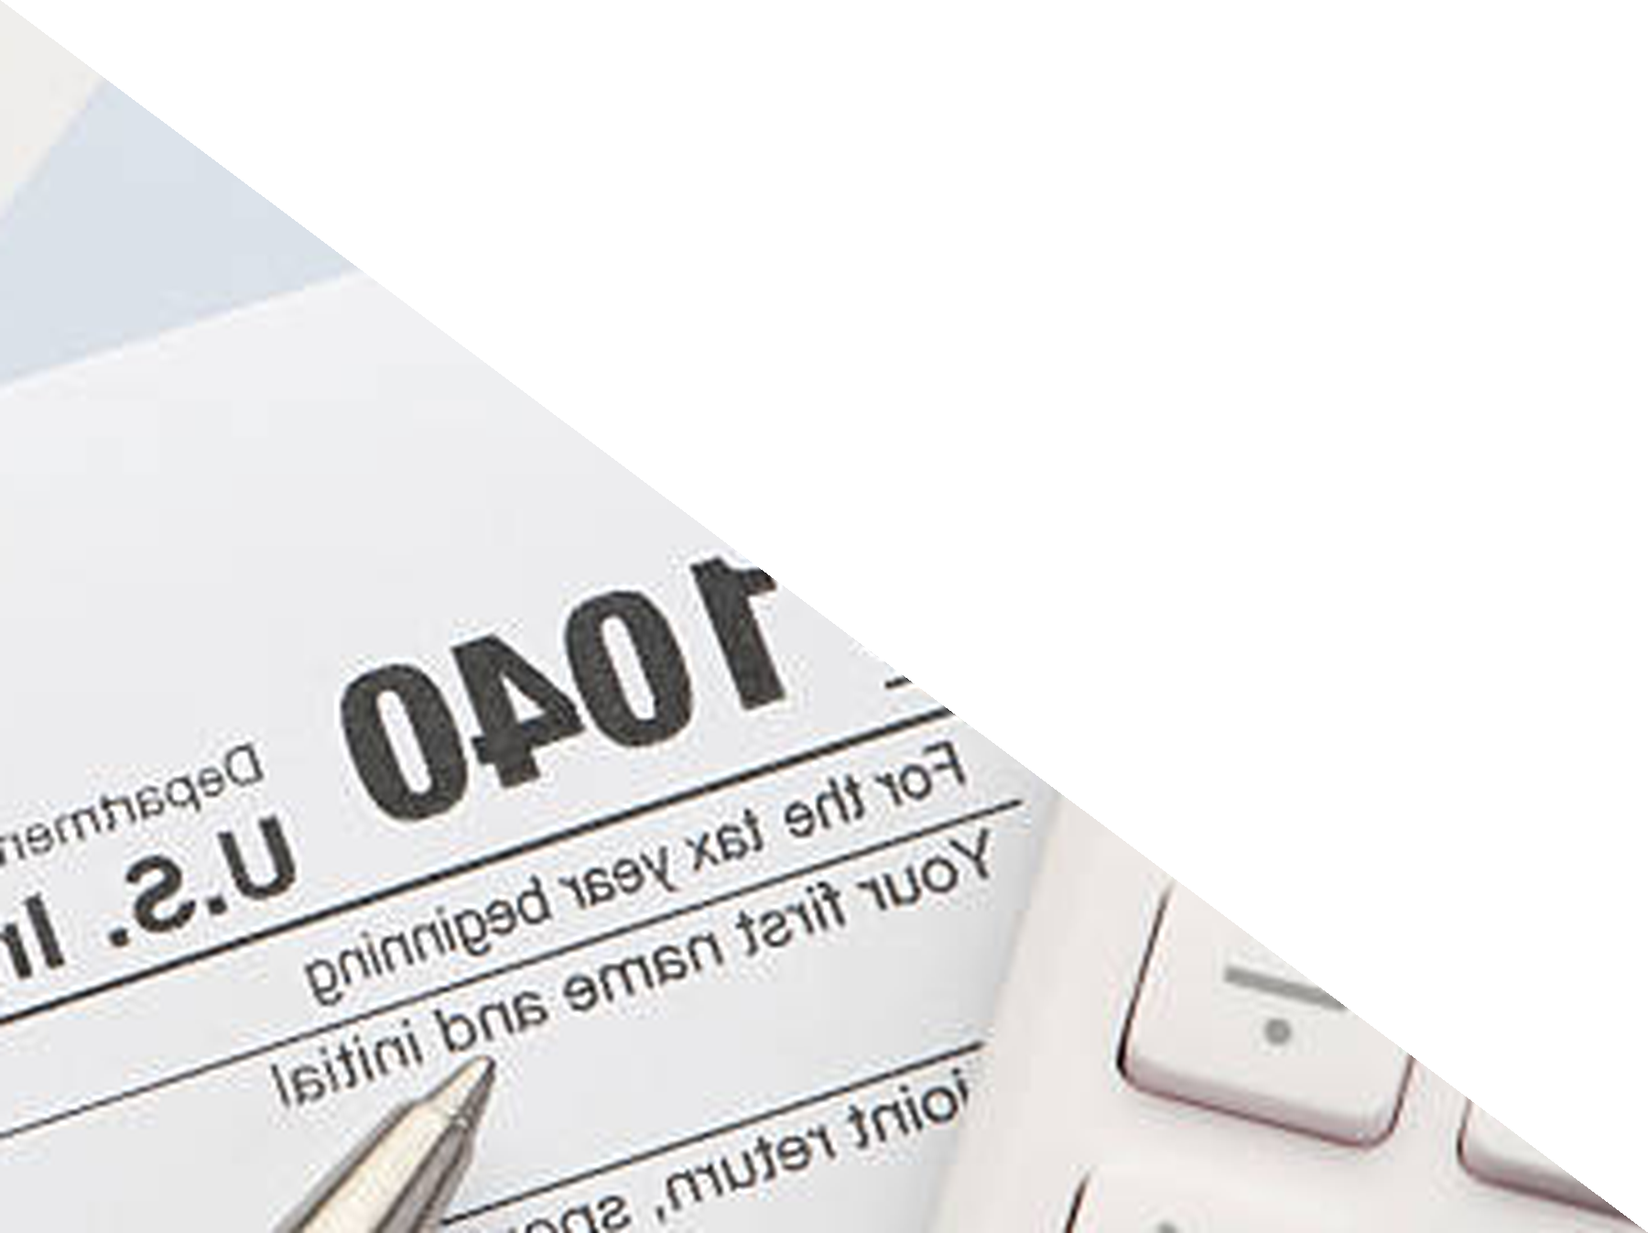
Chapter 10
Taxation and Regulation
ECON 003
UC Riverside · Summer 2026
Notes:
Title.
Chapter 10, Taxation and Regulation. Say at the top what this hour is and is not.
It is one question, asked properly for the first time in this course: WHEN THE GOVERNMENT
PUTS A TAX ON SOMETHING, WHO ACTUALLY PAYS IT? Then two shorter movements - what price
controls do, and the ways government intervention goes wrong on its own terms.
It is not the whole chapter. The book's sections on the size and structure of US
government, on progressive versus regressive tax systems, on equity versus efficiency and
on paternalism are in their reading and are not in this lecture. Tell them that once, at
the start, plainly - the recap page at the end lists them again. Students who are reading
along will notice, and it is better coming from you.
Do NOT say "you already know tax incidence from Chapter 9." They do not. Chapter 9 used a
tax as an instrument for fixing an externality and never asked who hands over the money.
Everything today is new.
No cover image on this slide, by instruction.

Slide 2



Where We Left Off
Chapter 9 used a tax as an INSTRUMENT. It never asked who hands over the money.
CHAPTER 7 GAVE US THE
TOOLS
CHAPTER 9 SET A TAX
EQUAL TO HARM
TODAY: WHO BEARS IT
TAX INCIDENCE is a different
question from the tax rate. The
law names who writes the
cheque. It does not decide who
is poorer.
CONSUMER SURPLUS,
PRODUCER SURPLUS and
DEADWEIGHT LOSS. Every
area on today's diagrams is
one of those three.
A PIGOUVIAN TAX of exactly
the MARGINAL EXTERNAL
COST moves the market to the
social optimum. That was the
tax's SIZE.
STATUTORY INCIDENCE is who the law makes liable for the tax. ECONOMIC INCIDENCE is whose income falls. They are almost never the same people.
Notes:
Opening. Two minutes, no more.
Say the debt this chapter collects. Chapter 7 built the surplus apparatus and showed what
a price control destroys. Chapter 9 reached for taxes and subsidies as if they were free
instruments - a tax of exactly the marginal external cost, and the market lands on the
optimum. Neither chapter asked the question this one is about.
BE EXPLICIT THAT INCIDENCE IS NEW. Do not say "you saw this in Chapter 9". You did not
teach it there; the word appeared on a slide about the SIZE of a Pigouvian tax, and the
students have no working picture of a tax wedge. Build it from scratch today.
The distinction on the kicker is the spine of the first half and it is worth saying twice
in different words: the law can say the SELLER remits the money, and the seller can still
end up bearing almost none of it. Whether that happens is not a legal question at all - it
is a question about elasticity, and the second half of Part 1 answers it.
Name today's scope out loud. Three sections: who pays a tax, what price controls do, and
what goes wrong when government intervenes. The rest of Chapter 10 is reading.

Slide 3



Three Questions
A TAX and a PRICE CONTROL are both WEDGES: they stop trades that both sides wanted
to make.
Who bears the
burden of a tax
Does it matter who
the law taxes?
What decides
the split
What price
controls do
Where government
itself goes wrong
Every diagram today has the same shape: a WEDGE between what buyers pay and what sellers keep,
and a quantity that falls.
Notes:
Roadmap. Read the top band aloud - it is the whole hour in one sentence.
The unifying idea is worth naming before any diagram appears, because it is what makes
the second half feel like the same lecture as the first. A per-unit tax puts a wedge
between the price a buyer pays and the price a seller receives. A price ceiling or floor
does something related: it stops the price from clearing the market, so quantity falls
and trades that both sides wanted do not happen. In both cases the quantity traded falls
below the efficient one, and the loss is a triangle.
The five markers are the beats, not five sections. The first three are all section 10.1.3
and they are where most of the hour goes.
If you are running long, the section that compresses is the last one - government failure
is three named ideas with no arithmetic. Parts 1 and 2 do not compress; the wedge diagram
has to be built slowly the first time.

Slide 4
PART 1
Who Actually Pays
a Tax
Notes:
Divider. Section 10.1.3, tax incidence.
Set the question before the diagram. A restaurant tax of two dollars a plate: the
restaurant remits it, so the restaurant pays it - true or false? Almost every student says
true, and almost every student is wrong, and the diagram is how you show it rather than
assert it.
The running example is the book's own: jambalaya, two dollars a plate. Keep it - the
numbers on every figure in this part are the book's, so a student revising from the
textbook sees the same market.

Slide 5
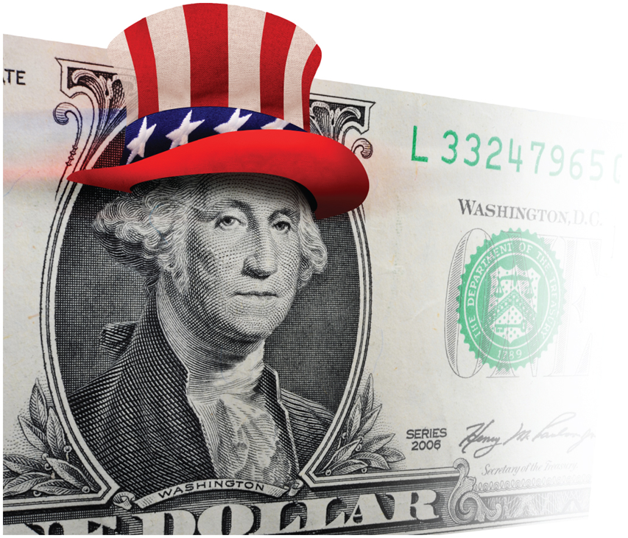
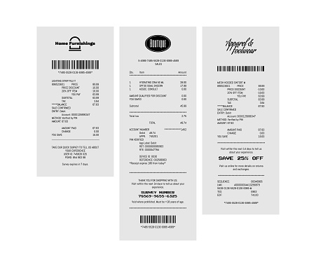
The Law Names a Payer. It Does Not Choose One.
A $2 tax on every plate of jambalaya. The
restaurant remits it. So the restaurant pays
it — yes?
TAX INCIDENCE — who actually bears the burden of a tax, measured
by whose income falls, not by whose name is on the payment.
STATUTORY INCIDENCE is a legal fact: the statute names a remitter.
ECONOMIC INCIDENCE is an economic outcome, and the market
settles it.
The restaurant will try to pass the tax on by raising the menu price.
Whether it can, and by how much, is what the next four pages work out
— and the answer turns out to have nothing to do with the wording of the
law.
The question is not WHO REMITS. The question is WHOSE PRICE CHANGES — and both prices
change.
Image: Acemoglu, Laibson & List, Microeconomics 3e
Notes:
Tax incidence, defined.
Put the two terms up and keep them up: STATUTORY INCIDENCE and ECONOMIC INCIDENCE. They
are the vocabulary for the whole part and exam questions use both.
Read the definition off the slide, then make it concrete with something outside the
textbook so they hear it twice. Payroll tax is the best one: the law splits it half and half
between employer and employee, and essentially no economist thinks the burden
splits half and half. Labour supply is famously inelastic, so workers carry most
of it - which is Part 2's rule, arriving early.
Ask the posed question and let them answer before you draw anything. Most rooms say the
restaurant pays. Some say the customer. The honest answer is BOTH, in proportions the law
has no say over, and that is a more interesting result than either guess.
The photograph is the publisher's own. The 7 pt credit line at the bottom right is the
only attribution on the page, by rule.

Slide 6
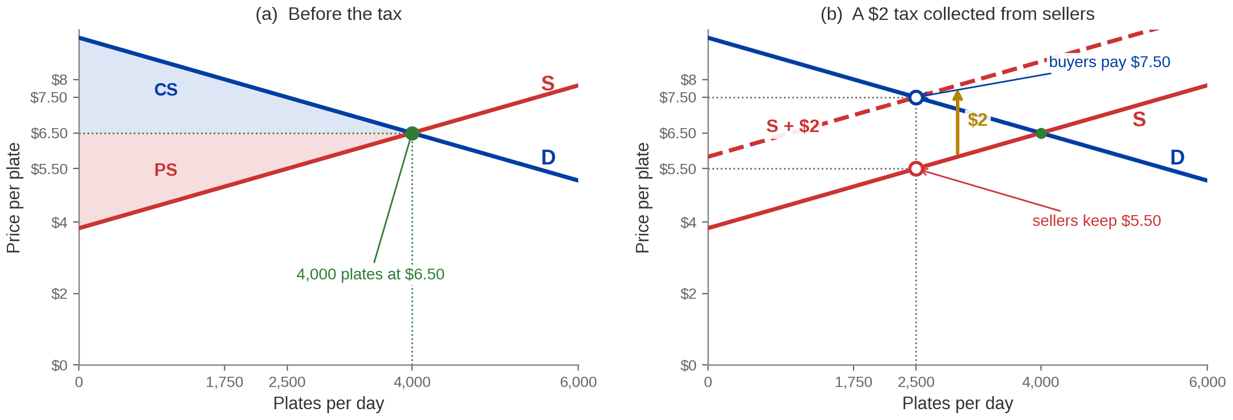
A Tax on Sellers Shifts Supply Up by Exactly the Tax
The market clears at 4,000 plates and $6.50. A $2 TAX raises every seller's required price by
$2.
Quantity falls 4,000 → 2,500. Buyers pay $7.50 and sellers keep $5.50 — the TAX WEDGE is $2 and
both prices move.
Market drawn to Acemoglu, Laibson & List, Microeconomics 3e, ch. 10
Notes:
The first tax diagram. Build it slowly - this is the page the
rest of the hour stands on.
Numbers to say exactly, and they are all the book's:
pre-tax 4,000 plates a day at $6.50
after 2,500 plates; buyers pay $7.50, sellers keep $5.50
the tax $2, and 7.50 minus 5.50 is exactly 2
WHY THE CURVE MOVES UP BY EXACTLY THE TAX. A supply curve says what price a seller needs
to be willing to supply a given quantity. If the seller must now hand $2 of that price to
the government, the price they need goes up by $2, at every quantity. So the shift is
vertical and it is the size of the tax, not more and not less. Students who have only ever
been told "taxes shift supply left" cannot tell you HOW FAR, and the how-far is the whole
calculation.
THEN THE PART THEY WILL GET WRONG. The price rose by ONE dollar, not two. Ask why out loud
before you answer it. The reason is that the higher price chokes off quantity, and at the
lower quantity sellers are willing to accept less - so they absorb the other dollar. If
the seller could pass the whole $2 on, they would have to sell to buyers who are no longer
there.
Panel (a) also re-labels consumer and producer surplus. That is a Chapter 7 callback and
it is safe to make - they built those triangles there.
Point at the two hollow markers and say what they are: buyers' price and sellers' price at
the SAME quantity. A tax makes one market have two prices. That is the wedge.

Slide 7
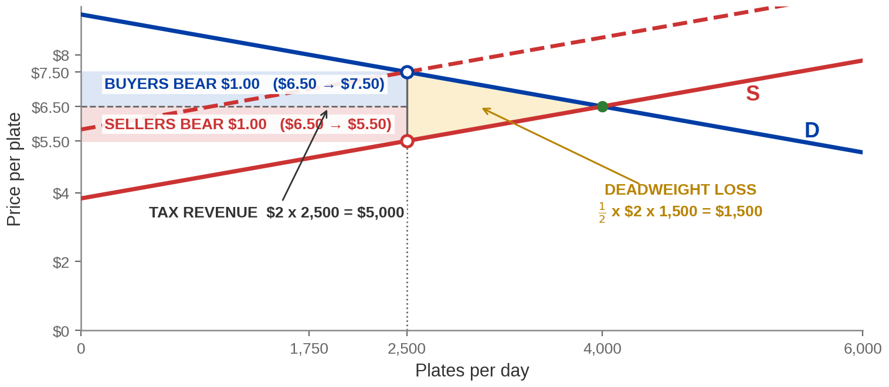
Where the $2 Goes, and the Part Nobody Gets
TAX REVENUE = tax × post-tax quantity. DEADWEIGHT LOSS = the trades the wedge
prevented.
TAX REVENUE $5,000 a day. DEADWEIGHT LOSS $1,500 a day — value destroyed, not transferred,
and nobody collects it.
Market drawn to Acemoglu, Laibson & List, Microeconomics 3e, ch. 10
Notes:
The welfare page. Three areas, and the difference between two of
them is the examinable idea.
The arithmetic, all of it worth saying aloud:
tax revenue $2 x 2,500 = $5,000 a day, split $2,500 from buyers and $2,500 from
sellers because each price moved by $1
deadweight loss one half x $2 x 1,500 = $1,500 a day
the base of that triangle is the quantity that DISAPPEARED, 4,000 minus 2,500
THE DISTINCTION TO HAMMER. Tax revenue is a TRANSFER - somebody lost it and the government
got it, and every dollar is still in the economy. Deadweight loss is DESTROYED. There are
1,500 plates a day that a buyer valued above what a seller would have accepted, and they
are simply not made. No one is holding that value. This is the same distinction Chapter 7
made about price controls, and it is worth saying that explicitly - it is one of the very
few things they can carry across from that chapter today.
The error students make here, by name: computing deadweight loss on the PRE-tax quantity,
or using the whole price change rather than the tax. The triangle's height is the tax and
its base is the CHANGE in quantity. Say the formula in the form the exam asks for: one
half times the tax times the fall in quantity.
If someone asks whether the deadweight loss means taxes are bad - the honest answer is
that it means taxes are costly, which is not the same thing, and that the chapter's own
closing question is exactly how to weigh that cost against what the revenue buys.

Slide 8
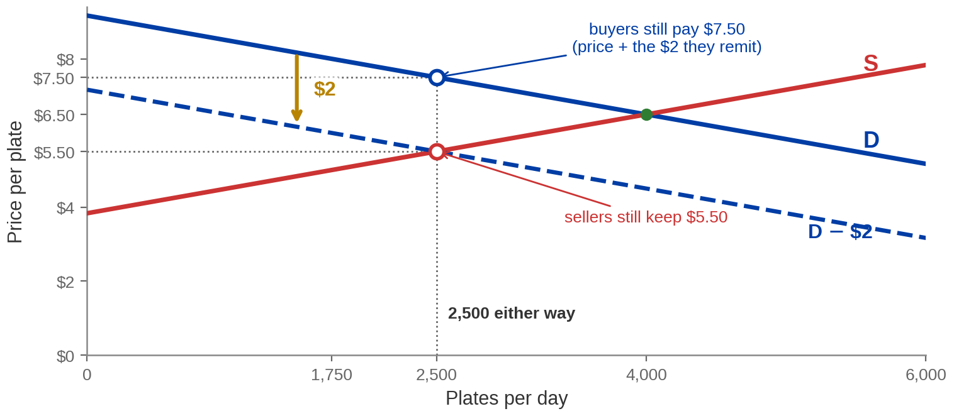
The Same $2, Collected From Buyers Instead
A tax on buyers shifts DEMAND down by the tax — what sellers may charge falls by $2 at
every quantity.
2,500 plates. Buyers pay $7.50. Sellers keep $5.50 — identical. The TAX WEDGE does not care which
side of it the law stands on.
Market drawn to Acemoglu, Laibson & List, Microeconomics 3e, ch. 10
Notes:
The equivalence, drawn.
Say what shifts and why. A demand curve says the most a buyer will pay. If the buyer must
hand $2 to the government on top of the menu price, the most they will pay the RESTAURANT
falls by $2, at every quantity. So demand shifts DOWN by exactly the tax - the mirror of
what supply did.
Then read the numbers off and let the repetition do the work:
quantity 2,500. The same.
buyers pay $5.50 to the restaurant plus $2 to the government, so $7.50. The same.
sellers keep $5.50. The same.
revenue $5,000. Deadweight loss $1,500. The same.
The line to say slowly: the market does not read the statute. It responds to the wedge,
and a $2 wedge is a $2 wedge.
A student will ask whether this means it genuinely does not matter who is taxed. In this
model, correct - it does not. In practice it can matter for collection costs, evasion and
who NOTICES the tax, and it is worth naming those as reasons outside the model rather than
pretending the model settles everything. That is a good place to stop, not a place to go
into detail.

Slide 9
Two Taxes, One Outcome
STATUTORY INCIDENCE is a legal fact. ECONOMIC INCIDENCE is a market outcome.
 | Tax collected from SELLERS | Tax collected from BUYERS
Which curve moves | Supply, UP by $2 | Demand, DOWN by $2
Quantity traded | 2,500 plates | 2,500 plates
Buyers pay | $7.50 | $7.50
Sellers keep | $5.50 | $5.50
Tax revenue | $5,000 a day | $5,000 a day
Deadweight loss | $1,500 a day | $1,500 a day
Read DOWN either column and the answer is the same. A $2 WEDGE is a $2 WEDGE, whoever the
statute names.
Notes:
The equivalence as a table, because this is the form an exam question takes.
Do not read every cell. Read the two outer columns for ONE row - buyers pay - and then say
that every remaining row is the same story.
WHY THIS TABLE EXISTS RATHER THAN A THIRD DIAGRAM. Multiple-choice items on this material
almost always give you a scenario and four candidate outcomes, and the winning strategy is
to know that the statutory side is irrelevant. A student who has this table can answer
without redrawing anything.
The one row that is NOT identical, and it is worth pre-empting because a sharp student
will raise it: the posted price differs. Under a seller-side tax the menu says $7.50 and
the customer hands over $7.50. Under a buyer-side tax the menu says $5.50 and the customer
hands over $5.50 plus $2 at the till. The economics is identical; what the customer SEES
is not. That is a real difference and it is a behavioural one, outside this model. Sales
tax in the United States works the second way, which is why the number on the shelf is
never the number you pay.
Say the kicker as the takeaway line and move on - the next part is where the split comes
from.

Slide 10
PART 2
What Decides
the Split
Notes:
Divider. The end of section 10.1.3, and the part that generalises.
Frame it as the question the last two parts left open. The law does not decide the split.
Something does. It is ELASTICITY, and the rule is one sentence long.
Warn them that the two figures coming up look almost the same and are not - one flattens
supply, the other flattens demand, and the burden moves in opposite directions.

Slide 11
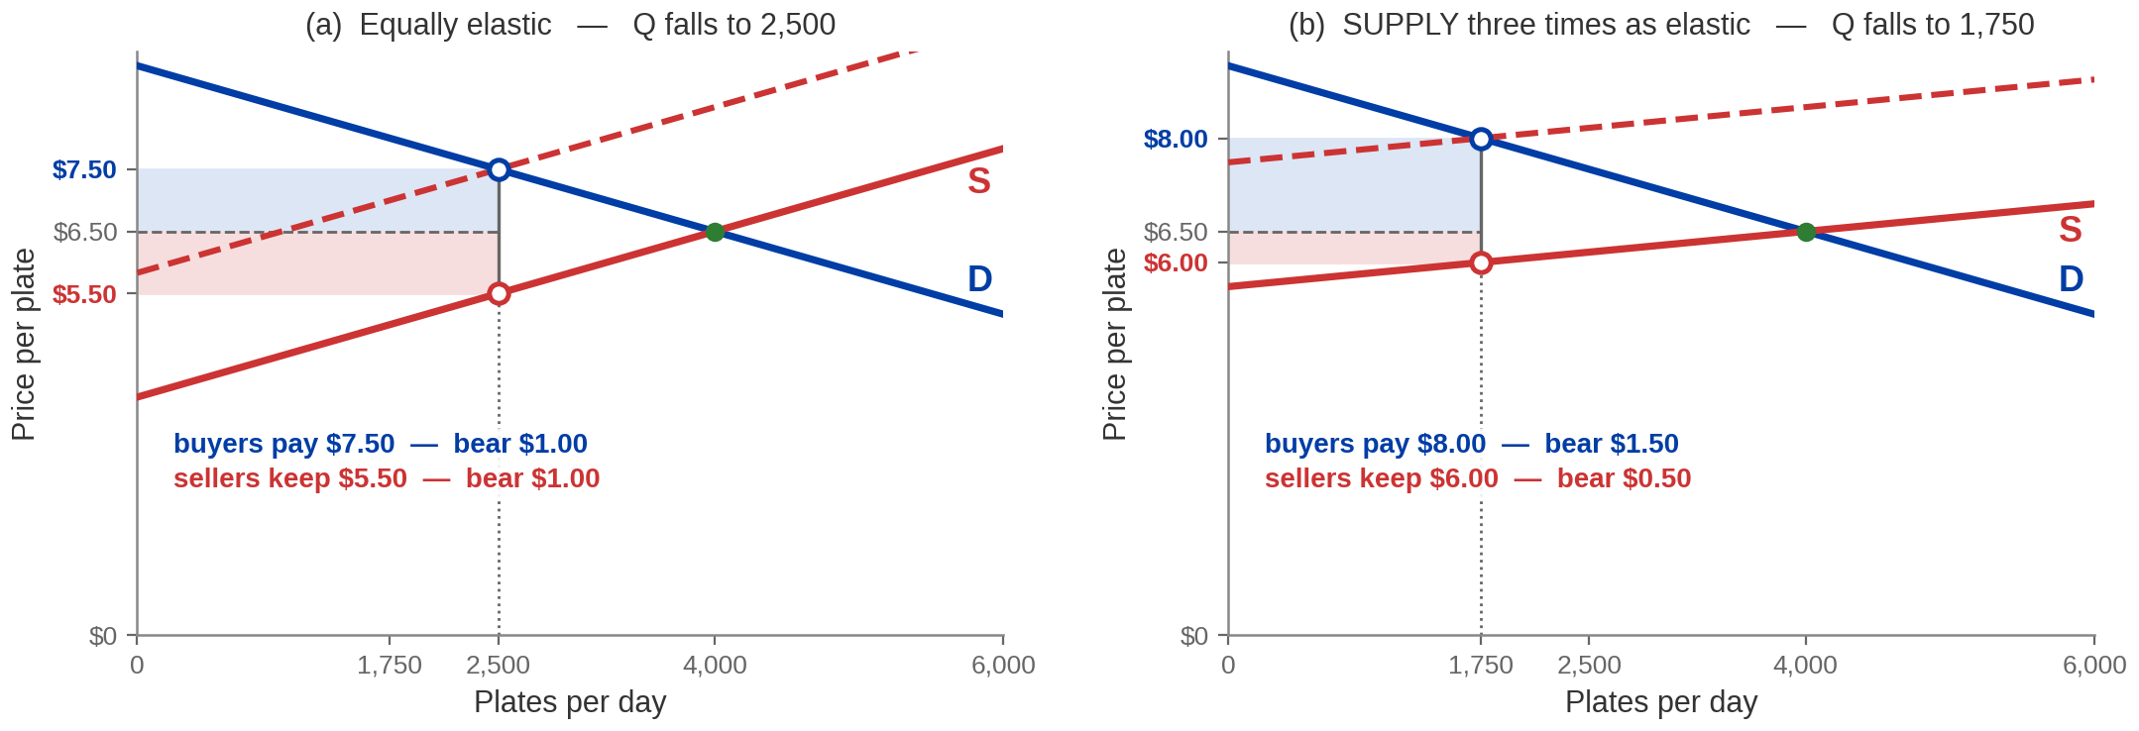
Make Supply More Elastic and Buyers Pay More
Sellers who can walk away easily do. The side that can ESCAPE the tax escapes it, and the
other side absorbs it.
ELASTIC SUPPLY → burden on BUYERS: $1.50 of the $2, against $0.50 for sellers.
Panel (b) drawn holding DEMAND genuinely constant — see speaker notes
Notes:
First elasticity figure. Say the mechanism, not just the result.
Panel (a) is the market you already know: both sides equally elastic, the tax splits
evenly at a dollar each.
Panel (b) makes SUPPLY flatter - three times as elastic. A flat supply curve means sellers
are very willing to leave this market: at a slightly lower net price, a lot of them stop
producing. So they refuse to absorb much of the tax. The quantity falls further, and
buyers end up paying $8.00 while sellers keep $6.00 - a $1.50 / $0.50 split.
THE INTUITION TO SAY IN PLAIN WORDS: elasticity is a measure of having somewhere else to
go. Whoever has somewhere else to go pays less of the tax. Whoever is stuck pays more.
That single sentence answers most exam questions on this topic.
A NUMBER THAT DIFFERS FROM THE BOOK, and say it if anyone is reading along. Their panel
(b) prints a post-tax quantity of 2,000. Their own figure quietly redraws the demand curve
about 12% steeper between the two panels, so the comparison is not holding demand
constant. Holding demand genuinely constant - which is what the exhibit is FOR - gives
1,750. Every price on our figure is theirs: $6.50, $8.00, $6.00, and the $1.50 / $0.50
split. Only the quantity moves. If a homework item uses 2,000, it is using their drawing;
the prices and the split are what matter and those agree.
Do not name the publisher out loud. "The textbook figure" is enough.

Slide 12
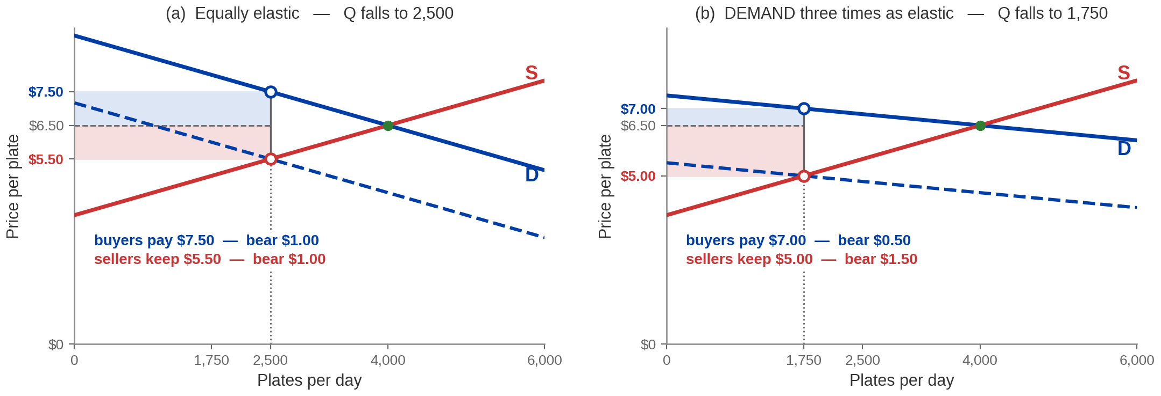
Make Demand More Elastic and Sellers Pay More
Now BUYERS are the side with somewhere else to go — and the ELASTICITY of demand
turns the burden right round.
THE RULE: the burden falls on the LESS ELASTIC side. Elastic demand → sellers bear $1.50 of the $2.
Panel (b) drawn holding SUPPLY genuinely constant — see speaker notes
Notes:
Second elasticity figure, and the general rule.
Same construction, other side. Demand is flattened threefold; buyers now abandon the
market at the smallest price rise, so sellers cannot pass the tax on. Buyers pay $7.00,
sellers keep $5.00 - the mirror image of the previous page, $0.50 / $1.50.
STATE THE RULE IN THE FORM THE EXAM USES, and it is the kicker: the tax burden falls more
heavily on the side of the market that is LESS elastic - less responsive to price. Say the
contrapositive too, because half the questions are worded that way: the burden falls LESS
heavily on the more elastic side.
Two applications that make it stick, both worth thirty seconds:
- cigarettes. Demand is highly inelastic, supply is not. Tobacco taxes are borne
overwhelmingly by smokers, which is precisely why they raise so much revenue and
reduce quantity so little.
- a tax on land. Supply is perfectly inelastic, so landowners bear all of it and the
deadweight loss is zero. That is a famous result and it is the limiting case of this
page.
Same correction as the previous figure applies here: their panel (b) redraws supply
slightly steeper, and holding it constant gives 1,750 rather than 2,000. Every price is
theirs.

Slide 13
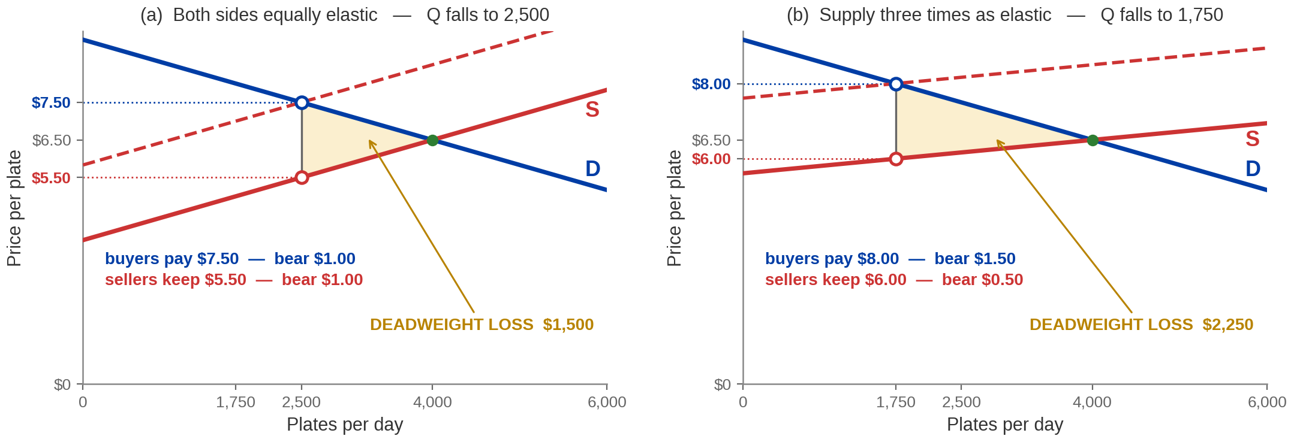
The More Elastic the Market, the More the Tax Destroys
Elasticity does two things at once: it moves the BURDEN, and it enlarges the DEADWEIGHT
LOSS.
Same $2 tax, same revenue per plate — DEADWEIGHT LOSS rises $1,500 → $2,250 because more
trades disappear.
Notes:
The page that ties incidence to efficiency. Short, and it is the
one that gets used in policy arguments.
The comparison: the same $2 tax in two markets. In the flexible market quantity falls from
4,000 to 1,750 rather than to 2,500, and the deadweight loss grows from $1,500 to $2,250 -
half again as large.
THE MECHANISM, said plainly: deadweight loss is made of trades that did not happen. The
more easily either side can walk away, the more trades the wedge prevents, and the bigger
the triangle. Elasticity IS the willingness to walk away.
THE POLICY COROLLARY, and it is the reason this matters beyond the exam: if a government
wants revenue with the least damage, it taxes inelastic things. That is a genuine
principle - the Ramsey rule, though you need not name it - and it explains why real tax
systems lean on tobacco, alcohol, fuel, and property. Then say the uncomfortable half out
loud, because a student will think it: the same logic says tax necessities rather than
luxuries, which is efficient and regressive at the same time. The book handles that
trade-off in the section on equity versus efficiency, which is in their reading. Name it
and leave it there - do not open it.
One honest caveat if it comes up: this is all partial equilibrium and it assumes the tax
is small enough that the curves are locally linear. Fine at this level; say so if asked
rather than overclaiming.

Slide 14
PART 3
Regulation, and Where
It Goes Wrong
Notes:
Divider. Sections 10.2 and 10.3 together - the shorter half of the hour.
Two moves. First, the other instrument: government can regulate the amount of an activity
directly, or control its price. Second, the honest accounting - intervention has costs of
its own that are not on any diagram.
Tell them the price-control material is a return visit. Chapter 7 built the price-ceiling
diagram in detail; today it is one page of recall plus one thing that chapter did not
show. That is deliberate and it is why this part is short.

Slide 15



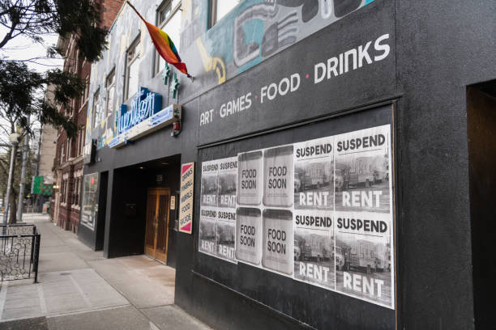
Two Ways to Intervene Without Taxing
REGULATION — government action aimed at the quantity, price, quality or safety of
what is traded.
DIRECT REGULATION
PRICE CONTROLS
Also called COMMAND-AND-CONTROL: the government sets the AMOUNT of an activity rather than its price. Emissions caps, drug approval, vehicle standards, licensing.
The government sets the PRICE instead.
A tax changes the PRICE and lets the market pick the quantity. DIRECT REGULATION picks the
quantity. A PRICE CONTROL picks the price and lets neither clear.
Notes:
The taxonomy page. Two named instruments, and one comparison worth making.
DIRECT REGULATION is genuinely new vocabulary even though they have seen an instance of
it: Chapter 9's Kansas and Oklahoma injection-volume orders were command-and-control, and
you can say so - that callback is safe, it was taught. The FDA figures are the book's own
and are fine to quote: about 9,000 employees, about $2 billion a year. The interesting
part is that the standard criticism of the FDA is that it is SLOW, and slowness is a real
economic cost that never appears on a supply-and-demand diagram. That sets up section 10.3
directly, so make the link.
PRICE CONTROLS is mostly recall. What is worth spending time on is the "which side" point
on the card, because it is where marks go: a ceiling above the market price and a floor
below it are both completely inert. Students memorise "ceilings cause shortages" and then
answer that a ceiling of $50 in a market clearing at $30 causes a shortage. It causes
nothing.
The kicker is the comparison that makes the three instruments one family, and it is worth
saying slowly. A tax moves the price and lets quantity adjust. Direct regulation fixes the
quantity. A price control fixes the price and prevents the market from clearing at all -
which is why it, uniquely, produces a shortage or a surplus rather than just a smaller
market.

Slide 16
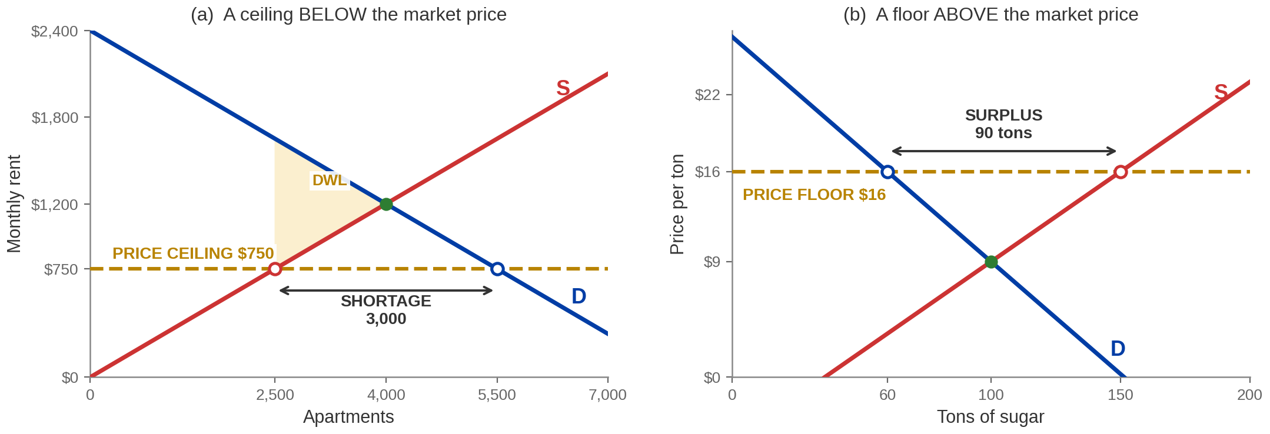
A Ceiling Makes a Shortage. A Floor Makes a Surplus.
A PRICE CEILING bites BELOW the market price; a PRICE FLOOR bites ABOVE it. Either
way the SHORT SIDE decides what trades.
Rent capped at $750: 5,500 wanted, 2,500 offered, SHORTAGE 3,000. Sugar floored at $16: 150 offered,
60 wanted, SURPLUS 90.
Markets drawn to Acemoglu, Laibson & List, Microeconomics 3e, ch. 10
Notes:
The price-control page. This is recall, so move at pace - Chapter
7 built this diagram from scratch and they have seen the deadweight-loss triangle before.
The numbers, both the book's:
apartments clears at 4,000 units and $1,200. Ceiling at $750: 2,500 supplied, 5,500
demanded, shortage 3,000.
sugar clears at 100 tons and $9. Floor at $16: 150 supplied, 60 demanded,
surplus 90 tons.
THE SHORT-SIDE RULE is the one idea to state explicitly, because it explains both panels
with one sentence: exchange is voluntary, so the quantity actually traded is the SMALLER
of what is offered and what is wanted. Under the ceiling that is supply, 2,500. Under the
floor it is demand, 60. Nobody can be forced to trade.
Two things worth saying that the diagram does not:
- Under rent control, consumer surplus can RISE. The 2,500 tenants who get an apartment
pay $750 for something they valued at up to $1,650. The people who lose are landlords
and the 3,000 households with no apartment, and the second group is invisible on the
diagram. If the tenants who keep apartments are the households the policy meant to
help, the policy can be defended - that is the book's own argument and it is a fair
one. Say it; do not sneer at rent control.
- Under a floor, somebody has to deal with the surplus. Governments typically buy it -
for foreign aid, storage, or destruction - which is a further cost on top of the
triangle.
The shading on the left panel is the deadweight loss; name it and move on, they know it.

Slide 17
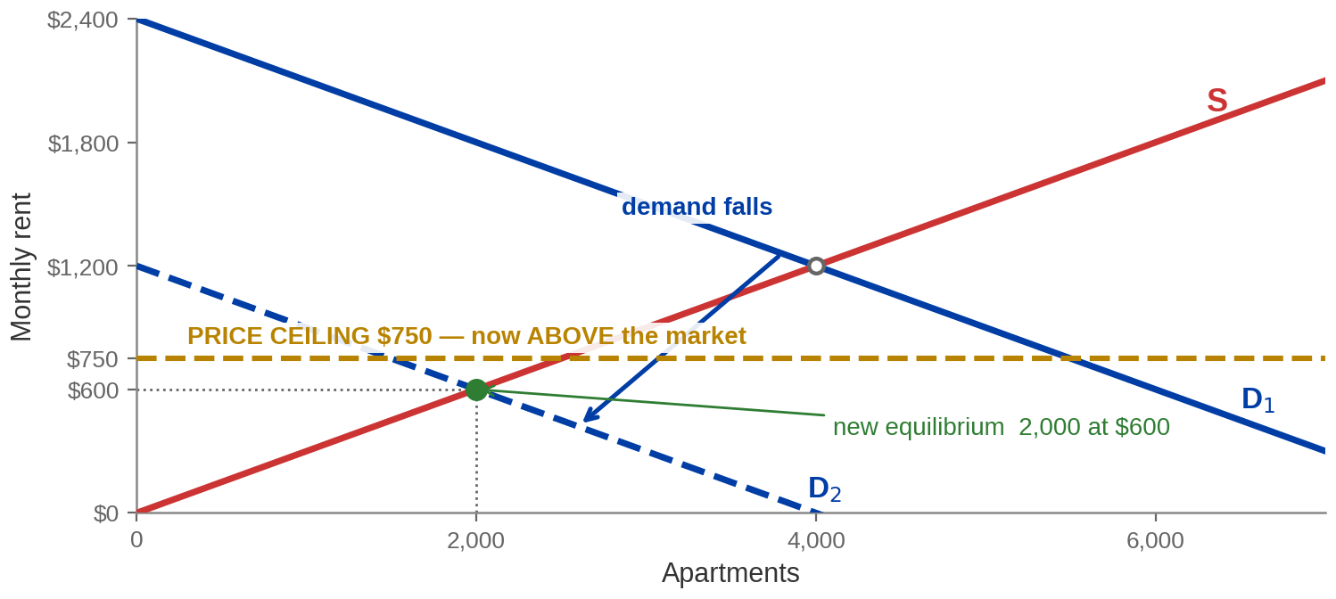
A Ceiling Only Bites If the Market Is Above It
The regulation did not change. The MARKET moved under it — and the CEILING stopped
doing anything.
Demand falls, rent would clear at $600, and a $750 ceiling is now ABOVE the market price: NO
SHORTAGE, no DEADWEIGHT LOSS, no effect at all.
Market drawn to Acemoglu, Laibson & List, Microeconomics 3e, ch. 10
Notes:
The one genuinely new thing in this section, and the reason the
section is here at all. Chapter 7 never drew this.
The story: the rent ceiling stays at $750. Demand for apartments falls - a factory closes,
the population shrinks, a university cuts enrolment. The market would now clear at 2,000
apartments and $600. The ceiling is at $750, which is ABOVE $600, so it is not binding. No
shortage. No queue. No deadweight loss. The law is still on the books and it does nothing.
TWO TERMS TO USE: a control is BINDING or NON-BINDING. Exam questions use those words and
students who have only met "ceiling causes shortage" have no way to answer them.
The general statement, which is what to leave them with: a price ceiling has an effect
only when it is set BELOW the equilibrium price, and a price floor only when it is set
ABOVE it. Whether a given control binds is not a property of the law - it is a property of
the law AND the market together, and markets move.
Worth thirty seconds of real-world context, and it is honest rather than rhetorical: this
is why price-control laws that were controversial when passed sometimes become invisible
without ever being repealed, and why a minimum wage set in nominal terms stops binding as
wages drift up around it. Same diagram, other direction.
Do not extend this into a discussion of the minimum wage's empirical literature - it is
not in the chapter and the evidence is genuinely contested.

Slide 18


Government Failures
GOVERNMENT FAILURE — inefficiency caused by the government's own intervention.
BUREAUCRATIC COST
CORRUPTION
THE UNDERGROUND
ECONOMY
More rules need more people to
enforce them, and those people
had another use. That is an
OPPORTUNITY COST, not an
accounting entry — and it is a
reason to weigh a regulation, not
a reason against having one.
Public funds diverted to private
use. Not confined to
government: rent control
produces landlords demanding
payments under the table, which
is corruption generated in the
PRIVATE sector by a public rule.
Where a control creates a shortage
or a tax makes an activity
expensive, trade moves off the
books. BLACK MARKETS grow
exactly where the wedge is biggest
— the shortage from the previous
page has to go somewhere.
DEADWEIGHT LOSS is the cost the diagram shows. GOVERNMENT FAILURE is the cost it does not —
and both belong on the same side of the ledger.
Notes:
Section 10.3, and the close of the lecture's argument. Two or three minutes.
The four costs the book lists are deadweight loss, bureaucratic cost, corruption and the
underground economy. The first one has had two figures already, so spend the time on the
other three.
BUREAUCRATIC COST. Frame it as opportunity cost, which is Chapter 1 vocabulary and worth
reaching back for: the enforcement staff could have been doing something else. Say the
balancing clause out loud - the book does, and it matters. This is not an argument that
regulations are bad. It is an argument that they are not free, and that the comparison is
cost against benefit rather than benefit alone.
CORRUPTION. The example to use is the one that ties back to the previous page: under rent
control, an apartment at $750 is worth $1,650 to somebody, and that $900 gap is an
incentive for a side payment. Note who is doing the corrupting there - private landlords,
responding to a public rule. Corruption is not a government-sector phenomenon; it is a
response to a wedge.
THE UNDERGROUND ECONOMY. Same logic once more, and this is the unifying observation of the
whole hour: WHEREVER THERE IS A WEDGE, SOMETHING GROWS IN IT. A tax makes off-the-books
trade profitable. A ceiling makes a black market profitable. The bigger the wedge, the
bigger the incentive.
If you want a closing line for the lecture, it is the kicker. Then stop - the equity
question the chapter goes on to ask is in their reading and it is not today's material.

Slide 19
Chapter 10: The Full Picture
 | What it says | Key terms | Where you saw it
Who bears a tax | The law names a remitter; the market decides who is poorer. Both prices move. | TAX INCIDENCE, STATUTORY vs ECONOMIC | §10.1.3 · the $2 jambalaya tax
It does not matter who is taxed | Tax the seller or tax the buyer: same quantity, same two prices, same revenue. | TAX WEDGE | §10.1.3 · the two-column table
What decides the split | The burden falls on the LESS elastic side — whoever cannot walk away. | ELASTICITY, INCIDENCE | §10.1.3 · the two elasticity figures
What a tax costs | Revenue is transferred; the triangle is destroyed. Both grow with elasticity. | DEADWEIGHT LOSS, TRANSFER | §10.1.3 · ½ × tax × fall in Q
Regulation | Direct limits, or price controls that bind only on one side of the market. | COMMAND-AND-CONTROL, CEILING, FLOOR, BINDING | §10.2 · rent and sugar
Government failure | Bureaucracy, corruption and black markets are costs no supply diagram shows. | GOVERNMENT FAILURE | §10.3
Not lectured, and in your reading: §10.1.1 and §10.1.2 (what government taxes and spends, progressive /
proportional / regressive, average vs marginal tax rate), §10.4 (equity vs efficiency) and §10.5 (consumer
sovereignty and paternalism).
Notes:
Recap. Read the row labels, not the cells.
SAY THE CLOSING LINE OUT LOUD AND DO NOT SKIP IT. Four parts of this chapter were not
lectured and they are in the assigned reading. Students find out either from you or from a
homework question, and the first is much better.
Point them specifically at 10.1.2 if they want something concrete to study on their own:
progressive, proportional and regressive tax systems, and the difference between an
AVERAGE and a MARGINAL tax rate worked through the federal brackets. It is the only part
of the unlectured material with arithmetic in it, and arithmetic is what gets examined.
A NOTE FOR WHOEVER PREPARES THE ASSESSMENTS, not for delivery. The MyLab assignment for
this chapter and the Chapter 10 question bank both draw on sections this lecture does not
cover, 10.1.2 above all - bracket arithmetic is a stock multiple-choice item. Either
restrict the item selection to the sections taught, or add the average-versus-marginal
slide back. That decision should be deliberate rather than discovered.
Section 10.4 is worth one sentence if anyone asks why it is missing: Chapter 7 already
made the equity-versus-efficiency argument, on the pages titled "Equity" and "Efficient Is
Not the Same as Fair".

Slide 20
KEY TAKEAWAYS
Chapter 10: Taxation and Regulation
TAX INCIDENCE — the law names who remits a tax; the market decides whose income
falls. They are rarely the same.
THE TAX WEDGE — tax the buyer or tax the seller and every number is identical: same
quantity, same two prices, same revenue.
ELASTICITY DECIDES — the burden falls on the side that cannot walk away, and the more
elastic the market the more trade the tax destroys.
DEADWEIGHT LOSS — revenue is transferred, the triangle is destroyed: ½ × tax × the
FALL in quantity.
BINDING OR NOT — a CEILING acts only below the market price and a FLOOR only
above it, and GOVERNMENT FAILURE is the cost no diagram shows.
Notes:
Key takeaways. Five lines, one per idea, each opening with its term.
Read them. Do not paraphrase - these are the retrieval keys and the exam uses these words.
If you want a single sentence to end the recording on, it is the one that unites the whole
hour: a tax and a price control are both wedges, and a wedge always does three things -
it moves quantity down, it splits the burden according to who cannot leave, and it
destroys the trades in between.
WHAT NEXT LECTURE COLLECTS. Chapter 12 removes the last assumption Chapter 7 made -
that no seller is big enough to move the price. A monopolist chooses quantity and lets
the market pick the price, and the deadweight-loss triangle comes straight back, this
time with no tax and no regulation causing it. Say that; it makes the last lecture of the
course land as the completion of an argument rather than a new topic.

