Slide 1

Chapter 13: Oligopoly
ECON 003
UC Riverside · Winter 2026

Slide 2
The Story So Far...
Weeks 1–4
Week 5
Weeks 6–10
TODAY
Professor Ye
The finale!
Thank you for rolling with the punches this quarter. Seriously.
You adapted to a new instructor mid-quarter, survived 2 midterms, and you're still here for the last chapter. That says something.
Now let's finish strong. This chapter has a game.
You'll betray your friends. It'll be fun.

Slide 3
Today's Roadmap
01
What is Oligopoly?
Few firms, big power, mutual interdependence
02
Collusion & Cartels
Why firms want to collude — and why it falls apart
03
Game Theory & Strategy
Prisoner's dilemma, Nash equilibrium, dominant strategies
04
Live Game: Betray or Cooperate?
You play. Real stakes. Poll Everywhere.

Slide 4
What Is Oligopoly?
Perfect
Competition
Monopolistic
Competition
OLIGOPOLY
Monopoly
Many sellers
Identical products
Free entry/exit
No market power
Many sellers
Differentiated
Easy entry/exit
Some power
Few large sellers
Differentiated OK
High barriers
Mutual interdependence
One seller
Unique product
Extreme barriers
Max market power
The key feature: what one firm does affects the others.

Slide 5

Measuring Market Power
CR(4) = Four-Firm Concentration Ratio
Sales of the 4 largest firms as a % of total industry sales.
Higher CR(4) → more concentrated → more market power.
Caveat: CR(4) is a rough measure. International competition also constrains domestic firms' market power.

Slide 6
Collusion & Cartels
THE DREAM
THE REALITY
Firms join together and act as a monopoly.
Collusion:
agreement on prices/quantities
Cartel: formal joint monopoly
Restrict output → raise price → share monopoly profits
Each firm thinks: "If they restrict output and prices go up... I should produce MORE!"
Someone cheats → trust breaks → cartel collapses → back to competition
Sound familiar?

Slide 7
The Cell Phone Duopoly
A tale of two carriers: Horizon vs. AT-Phone · MC = $0 · P = $180 − 0.15Q
Competitive
Monopoly / Cartel
Duopoly (Nash)
P = $0
P = $90
P = $60
Q = 1,200
Q = 600
Q = 800
P = MC = 0
Max efficiency
Max total revenue
Worst for consumers
400 each, $24K each
Between the extremes

Slide 8
Why Does the Cartel Collapse?
If both charge $90 (cartel price), each earns $27,000.
But if your rival charges $90 and you undercut to $75...
you steal all their customers and earn $52,500!
The temptation to cheat is irresistible. Both firms undercut → both lose.
This is exactly the logic of the Prisoner's Dilemma.
Competition P=$0
Duopoly Range
Monopoly P=$90

Slide 9
Real World: OPEC
23
~90%
50%+
~20%
Member Nations
World Oil Reserves
Global Production
Saudi Arabia's Share
How It Works
Why It Struggles
Output rationing: total production set, each country assigned a quota. Saudi Arabia acts as the price leader.
Members produce over quota (cheating!). Non-OPEC production rising. Shale technology disrupted their dominance.

Slide 10
More Firms = Harder to Collude
Price Effect (LOSS)
Output Effect (GAIN)
When a firm increases output, market price drops. You sell all units at a lower price. With more firms, each firm's impact on price is smaller.
By expanding output, the firm sells more units. With more firms, each cheater's extra output barely moves the price — so cheating becomes more attractive.
Bottom line: As # of firms increases → output effect dominates → more incentive to cheat → cartel collapses. Also: detecting cheaters gets harder with more members.

Slide 11
PART 2
Game Theory &
Strategic Behavior

Slide 12
Game Theory Basics
A branch of mathematics used to analyze strategic decision-making.
Players
Strategies
Payoffs
Who is making decisions?
(firms, people, countries)
What can each player do?
(price high/low, cooperate/defect)
What outcome for each
combination of choices?
Dominant Strategy: Best response no matter what the other player does.
Nash Equilibrium: Neither player wants to change, given what the other chose.

Slide 13




The Prisoner's Dilemma
The most famous game in economics.
Two suspects — “J-Rock” & Key — are caught and interrogated separately.
Each can Snitch against the other or “I ain’t sayin nothin”.
Both “Say nothin”
Both Snitch
One Snitch,
Other say nothing
1 year each
10 years each
Snitcher: 🍕
Quiet one: Life Sentence

Slide 14

GAME TIME
The Prisoner's Dilemma — Live
1. Find a partner — the person sitting next to you.
2. You have TWO choices: SNITCH or SAY NOTHING.
3. Go to Poll Everywhere and submit your choice. Do NOT show your partner.
4. We reveal results. Payoffs below.
Both Say nothing
Both Snitch
One Snitch,
Other say nothing
1 year each
10 years each
Snitcher: 🍕
Quiet one: Life Sentence

Slide 15
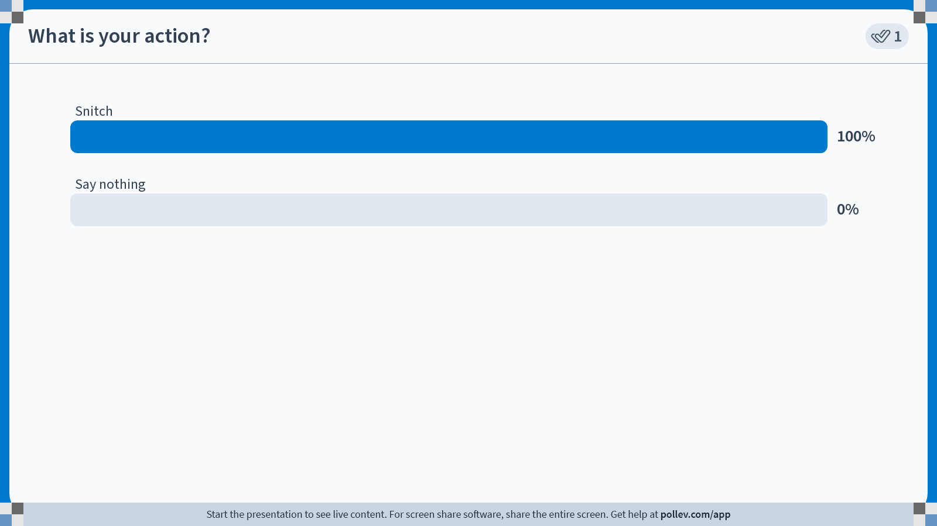
Poll Everywhere multiple choice poll activity
Activity Title: What is your action?
Slide 16
Notes:
Do not modify the notes in this section to avoid tampering with the Poll Everywhere activity.
More info at polleverywhere.com/support
What is your action?
https://www.polleverywhere.com/multiple_choice_polls/w30bByoID3nstjKMDWlTO?state=opened&flow=Default&onscreen=persist

Slide 16
RESULTS
% who COOPERATED
% who DEFECTED
[LIVE]
[LIVE]
Discussion: Did most of you cooperate or defect? Why? What would change if we played 10 rounds?

Slide 17
Solving the Prisoner's Dilemma
Key
Snitch
“I ain’t sayin nothin”
“J-Rock”
Snitch
J: 10 years
J: Pizza 🍕
K: 10 years
K: Life Sentence
“I ain’t sayin nothin”
J: Life Sentence
J: 1 year
🍕 K: Pizza
K: 1 year
Dominant Strategy: Both snitch → 10 yrs each = Nash Equilibrium
But both keeping quiet (1 yr each) = Cooperative Outcome — unstable!

Slide 18
Duopoly = Prisoner's Dilemma
Same logic, now with firms choosing output levels.
AT-Phone
Low (300)
High (400)
Horizon
Low (300)
Cartel
H: $27,000
H: $22,500
A: $27,000
A: $30,000
High (400)
H: $30,000
Nash
H: $24,000
A: $22,500
A: $24,000
Both want to collude (Low, Low) → $27K each. But High is dominant for both.
Nash: (High, High) → $24K each. They'd earn more cooperating, but can't resist cheating.

Slide 19
Escaping the Prisoner's Dilemma
The game changes when you play more than once.
One-Shot Game
Repeated Game
Defecting is always dominant.
No future consequences.
No way to punish or reward.
This is what we just played!
Cooperation can be sustained!
Compare short-run gains from cheating vs. long-run losses.
Winning strategy: Tit-for-Tat
Start cooperative. Copy opponent's last move. Forgive quickly.
Axelrod Tournament: Hundreds of strategies competed. Tit-for-Tat won — simple, forgiving, retaliatory. The nice guys finished first.

Slide 20
Price Leadership & Predatory Pricing
Price Leadership
Predatory Pricing
One dominant firm sets the price. Smaller firms match it.
Tacit collusion — not illegal.
Example: Airlines set fares on a route, others follow. No secret meetings needed.
Setting price below AVC to drive rivals out.
Areeda-Turner Rule: P < AVC is suspicious.
Courts ask: can the predator recoup losses?
Examples: Walmart and Microsoft.

Slide 21
The Full Picture: Market Structures
 | Perfect Competition | Monopolistic Competition | Oligopoly | Monopoly
# of Firms | Many | Many | Few large | One
Products | Identical | Differentiated | Identical or Differentiated | Unique
Entry/Exit | Free | Easy | High barriers | Extreme barriers
Market Power | None | Some | Significant | Maximum
Price vs MC | P = MC | P > MC | P > MC | P > MC
LR Econ. Profit | Zero | Zero | Possible | Probable
Key Feature | Price taker | Product differentiation | Mutual interdependence | Firm IS the industry

Slide 22
KEY TAKEAWAYS
Chapter 13: Oligopoly
Oligopoly = few large firms with mutual interdependence
Firms want to collude (monopoly profits) but cheating is tempting
Prisoner's dilemma explains why cartels collapse
Nash equilibrium: no one wants to change, given what others chose
Repeated games + tit-for-tat can sustain cooperation
Good luck on the final..

