Slide 1
Benchmarking

Slide 2
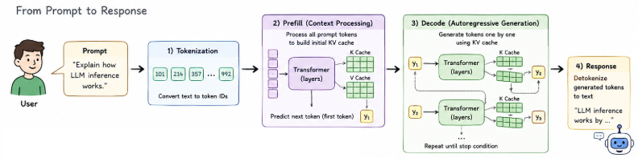
LLM Pipeline

Slide 3
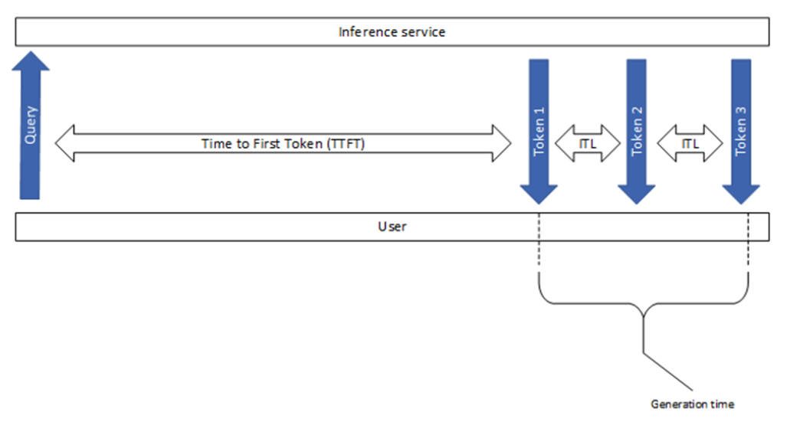
Metrics

Slide 4
Metrics -- Time to First Token (TTFT)
This metric shows how long a user needs to wait before seeing the model’s output. This is the time it takes from submitting the query to receiving the first token (if the response is not empty).
Time to first token generally includes both request queuing time, prefill time and network latency. The longer the prompt, the larger the TTFT. This is because the attention mechanism requires the whole input sequence to compute and create the so-called key-value cache (aka.KV-cache), from which point the iterative generation loop can begin. Additionally, a production application can have several requests in progress, therefore one request’s prefill phase may overlap with another request’s generation phase.
request queuing time
network overhead
tokenization time
prefill computation time
first-token sampling / selection time
scheduler overhead

Slide 5
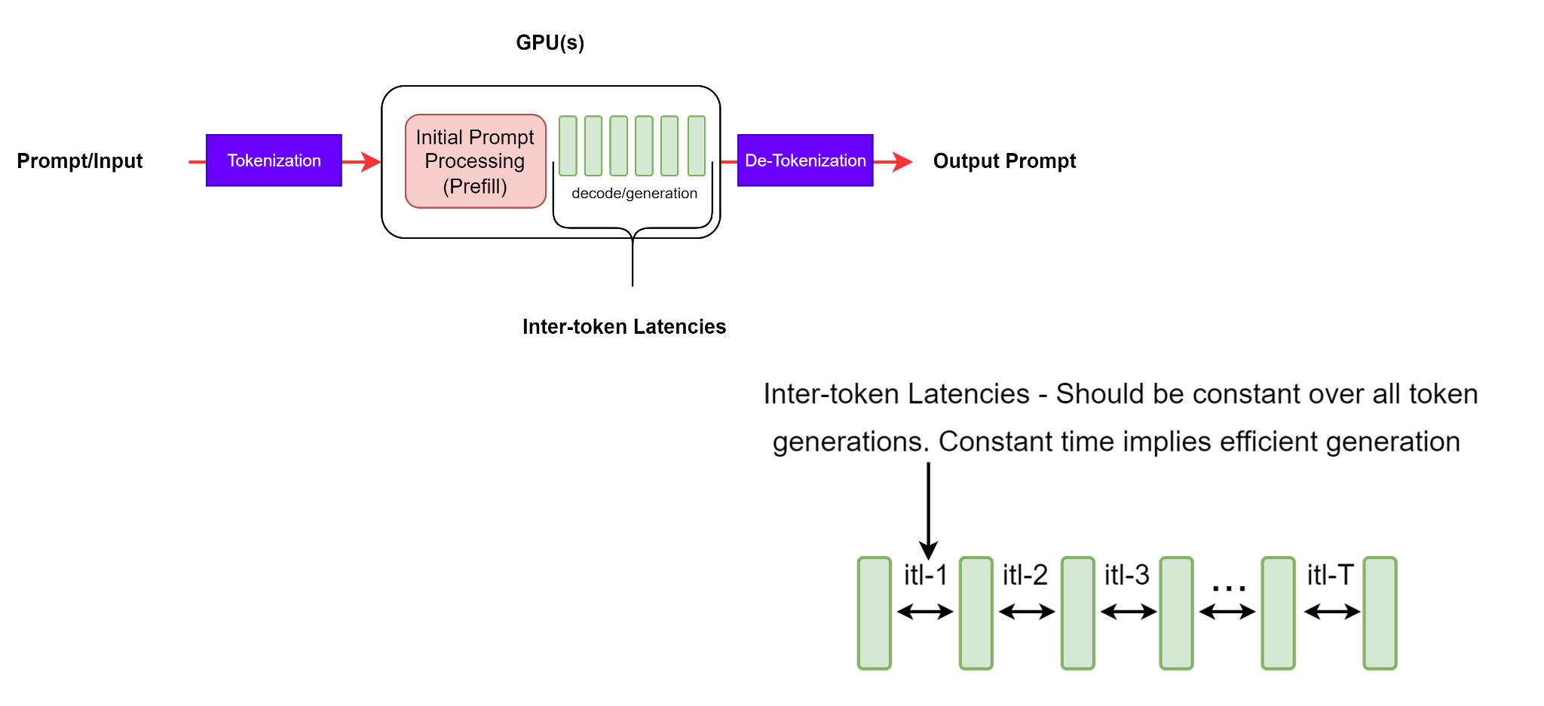
Metrics -- Time Per Output Token (TPOT)
model size
decode batch size
KV cache length
memory bandwidth
GPU utilization
sampling strategy
scheduler overhead
concurrency

Slide 6
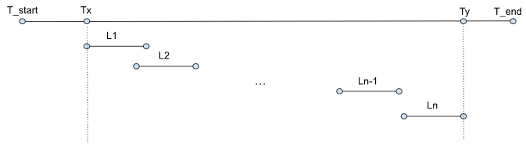
Metrics -- Tokens Per Second (TPS) and Requests/sec

Slide 7
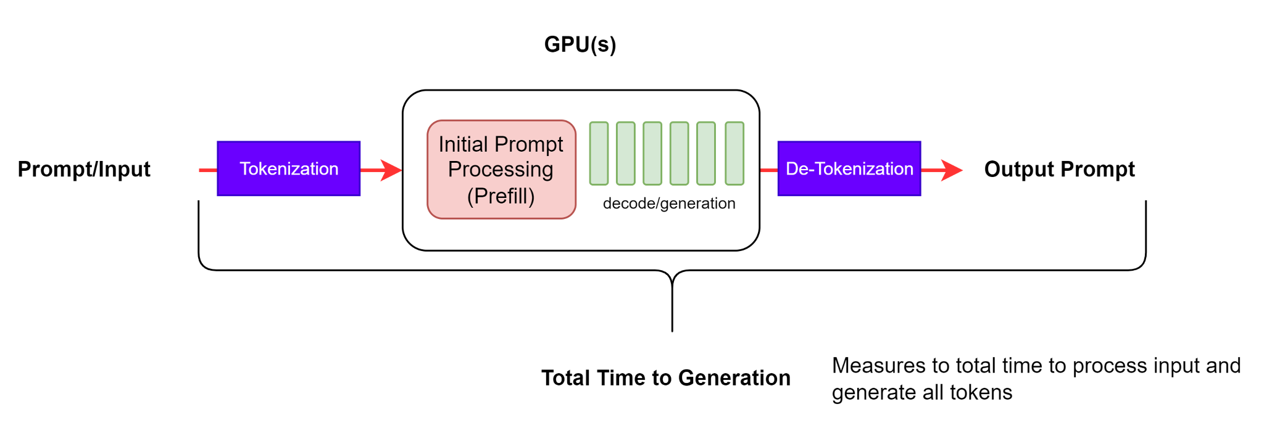
Metrics -- End-to-End Request Latency (e2e_latency)

Slide 8
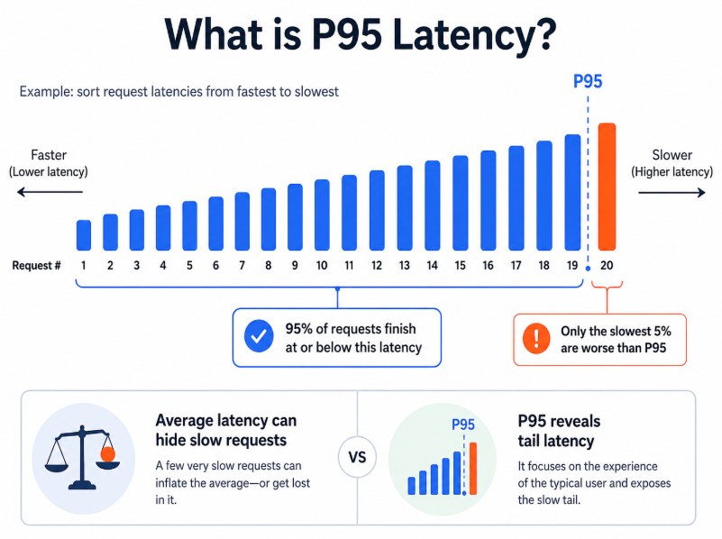
Metrics – P95

Slide 9
Metrics -- summary
Request starts
|
|<----------- TTFT ----------->|
| |
v v
Prompt received First token
|
|<-- TPOT -->|<-- TPOT -->|<-- TPOT -->|
v v v
token 2 token 3 token 4
|
v
Final response
|<-------------------- End-to-end latency -------------------->|

Slide 10
Prefill
Prefill processes the full input prompt and builds the initial KV cache before generating the first token.

Slide 11
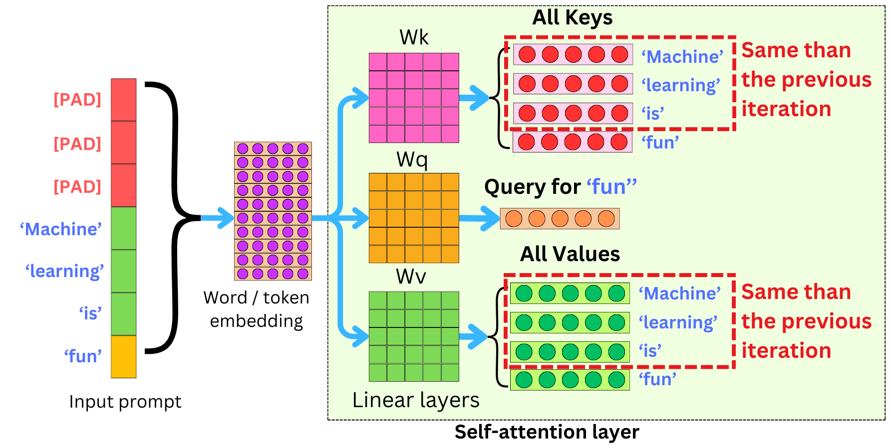
Prefill
TTFT is the time from the start of a request until the first token is generated.
It mainly reflects the cost of the prefill stage and the system’s responsiveness.
Prompt tokens: x1, x2, x3, ..., xN
|
v
┌─────────────────────────┐
│ Prefill │
│ - process full prompt │
│ - compute Q/K/V for prompt │
│ - build initial KV cache │
│ - generate first token y1 │
└─────────────────────────┘
|
v
Longer prompt -> more prefill computation (initial KV cache) -> larger attention cost -> higher TTFT
Example:
prompt 32 tokens, prefill 32 tokens
prompt 1024 tokens, prefill 1024 tokens

Slide 12
Prefill
What is the bottleneck of prefill?
compute
large attention computation
matrix multiplication
activation memory
prefill batch size
Prompt tokens: x1, x2, x3, ..., xN
|
v
┌─────────────────────────┐
│ Prefill │
│ - process full prompt │
│ - compute Q/K/V for prompt │
│ - build initial KV cache │
│ - generate first token y1 │
└─────────────────────────┘
|
v

Slide 13
Decode
TPOT is the average time required to generate each token after the first token.
It mainly reflects the sustained generation speed of the decode stage.
First token y1 + KV cache
|
v
┌──────────────────────┐
│ Decode step 1 │
│ - input y1 │
│ - read cached K/V │
│ - generate y2 │
│ - append new K/V │
└──────────────────────┘
|
v
Decode step 2 -> y3
|
v
Decode step 3 -> y4
Unlike prefill, decode is sequential across output tokens.
Decode is memory-bound: since input and output need HBM writing and read(KV cache and y_{n-1})

Slide 14
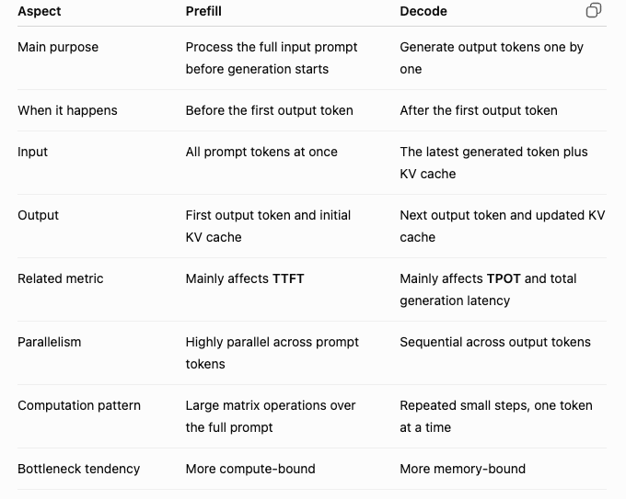
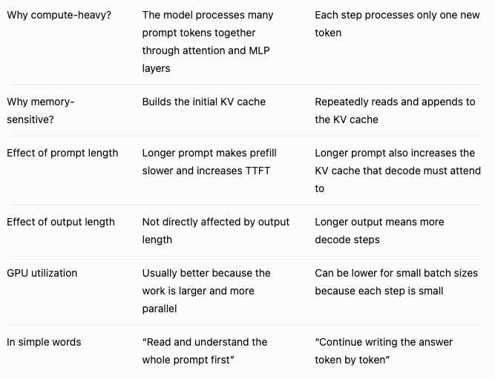
Difference between prefill and decode

Slide 15
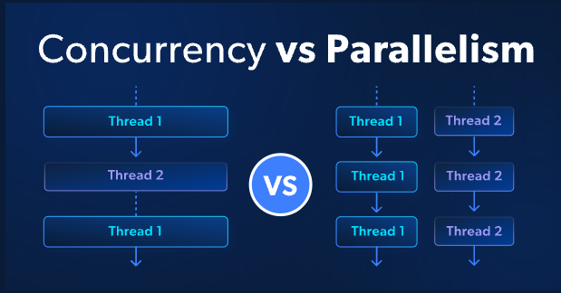
concurrency
Concurrency = Multiple tasks are in progress at the same time.
Parallelism = Multiple tasks are physically executed at the exact same time.

Slide 16
concurrency
Prefill:
1. Queueing Delay:
request arrives -> waits in queue -> prefill starts -> first token
TTFT = queueing delay + prefill time + first-token overhead
2. Prefill Contention
Multiple requests may need to run prefill at the same time.
Prefill is compute-heavy because it processes the full prompt using large matrix operations.
3. Batching Delay
Some serving systems intentionally wait for a short time to collect more requests into a batch in order to improve throughput.
Decode:
Concurrency can create batching opportunities, which improves parallelism.

Slide 17
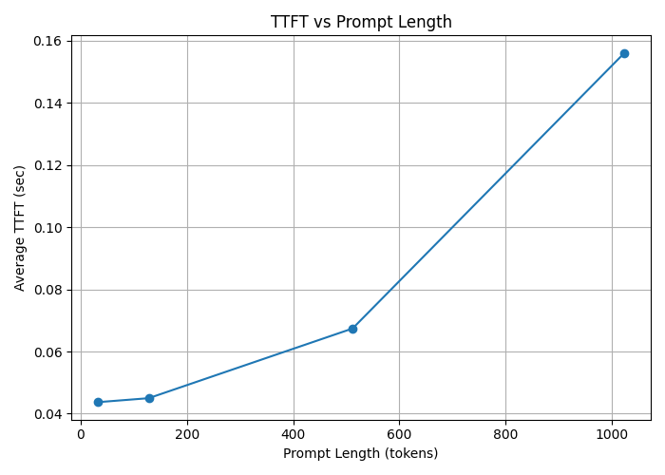
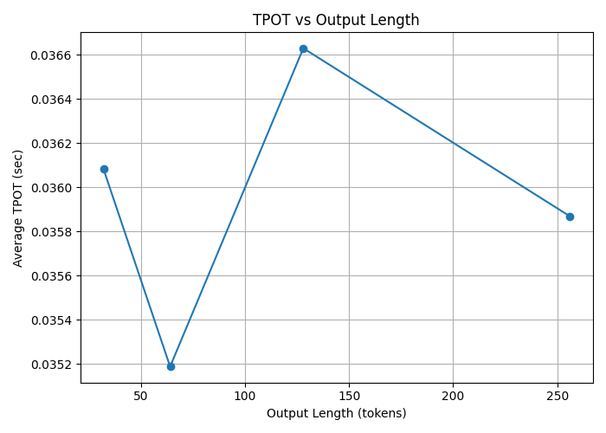
Simulation

