Slide 1
Game Players Talktive vs Skillful
A peek into bluffing and devotion of Starcraft 2 Players
Licheng Zhu
SI618 project mid-point presentation
Feb 23 2017

Slide 2
Q: forum posts vs gaming performance?
Assumptions/hypothesis:
More posts on forum = devotion to the game, which leads to better win rate?
More posts on forum = not a good player but a good bluffer?

Slide 3
Q: forum posts vs gaming performance?
Dataset1: Starcraft 2 Forum
Data collection:
Python, scraping & crawling, entire forum
Data manipulation:
Python, json, Spark
match by user id
Dataset2: Starcraft 2 Matches
Data collection:
Python, urllib.request, Blizzard API (super undocumented)
Data manipulation:
Python, json
match by user id

Slide 4
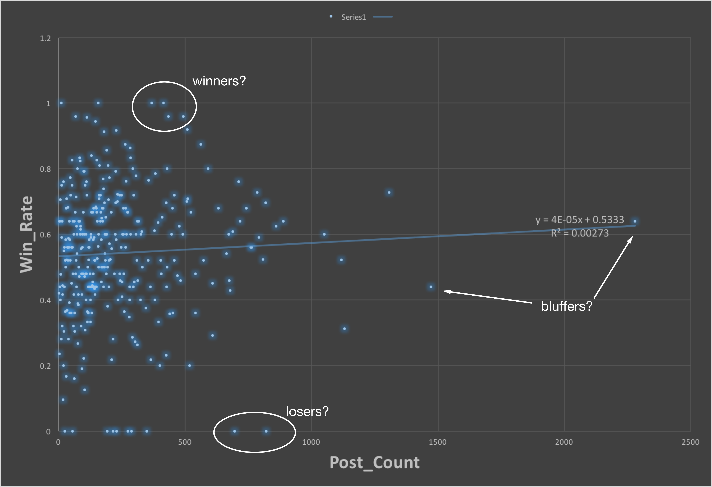
Results: Bluffing and Devotion
N:
1M+ (estimated)
20000+ (captured for now)
300+ (have records of both)
Intercept: 0.533 (not bad!)
Pathetic r2 (bad fitting)
Overall:
positive correlation
but negligible
Outliners:
Winners?
Losers?
Bluffers?

