Slide 1

Landscape Classification
Chenhao Li

Slide 2
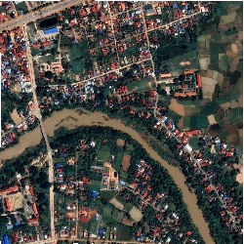
Problem
Classify land types using satellite imagery
Six land types of primary interest (water, rice field, paved road, vegetation, trees, and buildings/houses)
(UCI ML Hackathon challenge)

Slide 3
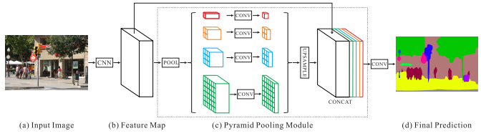
Model
Use pretrained ResNet50 with dilated convolution as encoder
PSPNet¹ as decoder, which aggregates global representation with Pyramid Pooling Module

Slide 4
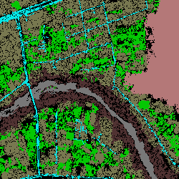
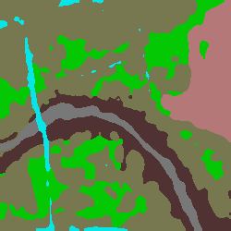

Results
Water
Rice field
Paved road
Vegetation
Trees
Buildings/Houses
True segmentation
Predict segmentation
Pixels accuracy: 0.6879
Mean IoU: 0.5675
IoU
Water: 0.7669
Rice filed: 0.8634
Paved Road: 0.2066
Vegetation: 0.5572
Trees: 0.4606
Buildings: 0.5503

Slide 5
Conclusion
Preparing data when there is few provided
Find the right scales to preparing the data, e.g. how large to crop, where to crop, need rescaling?
When predicting, it may be better to use a smaller image

