Slide 1
ECE 598HK
Computational Thinking for
Many-core Computing
Lecture 1: Introduction
© Wen-mei W. Hwu and David Kirk/NVIDIA, ECE598HK, 2010

Slide 2
Course Goals
To master commonly used algorithm techniques and computational thinking skills for many-core programming
  Especially the simple ones!
Specifically, to understand
  Many-core hardware limitations and constraints
  Desirable and undesirable computation patterns
  Practical algorithm techniques to convert undesirable computation patterns into desirable ones
© Wen-mei W. Hwu and David Kirk/NVIDIA, ECE598HK, 2010

Slide 3
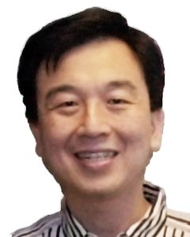

People
Professors:
  Wen-mei Hwu
  215 CSL, w-hwu@illinois.edu, 244-8270
  use ECE598HK to start your e-mail subject line
  Office hours: 3-3:50pm Tue/Thu
  David Kirk
  Fellow, NVIDIA and Professor of ECE
Teaching Assistant:
  John Stratton (stratton@illinois.edu)
  Office hours: 2-3pm Tue; 4-5pm Thu
© Wen-mei W. Hwu and David Kirk/NVIDIA, ECE598HK, 2010

Slide 4
Web Resources
Web site: http://courses.engr.illinois.edu/ece598/hk
  Handouts and lecture slides/recordings
  Textbook, documentation, software resources
  Note: While we’ll make an effort to post announcements on the web, we can’t guarantee it, and won’t make any allowances for people who miss things in class.
Web board
  Channel for electronic announcements
  Forum for Q&A - the TA and Professors read the board, and your classmates often have answers
Compass – grades, assignment submission
© Wen-mei W. Hwu and David Kirk/NVIDIA, ECE598HK, 2010

Slide 5
Grading
This is a lab oriented course!
Exam: 20%
Labs: 30%
  Demo/knowledge: 25%
  Functionality/Performance: 40%
  Report: 35%
Project: 50%
  Design Document: 25%
  Project Presentation: 25%
  Demo/Performance/Final Report: 50%
© Wen-mei W. Hwu and David Kirk/NVIDIA, ECE598HK, 2010

Slide 6
Bonus Days
Each of you get five bonus days
  A bonus day is a no-questions-asked one-day extension that can be used on most assignments
  You can use multiple bonus days on the same assignment
  Weekends/holidays don’t count for the number of days of extension (Friday-Monday is one day extension)
Intended to cover illnesses, interview visits, just needing more time, etc.
© Wen-mei W. Hwu and David Kirk/NVIDIA, ECE598HK, 2010

Slide 7
Using Bonus Days
We will automatically apply the bonus days to your late assignments.
  The most costly ones first, but you should check with the TA if you want to make sure.
Penalty for being late beyond bonus days is 10% of the possible points/day, again counting only weekdays (Spring/Fall break counts as weekdays)
Things you can’t use bonus days on:
  Final project design documents, final project presentations, final project demo, exam
© Wen-mei W. Hwu and David Kirk/NVIDIA, ECE598HK, 2010

Slide 8
Academic Honesty
You are allowed and encouraged to discuss assignments with other students in the class. Getting verbal advice/help from people outside the class is also fine.
Any copying of code is unacceptable
  Includes reading someone else’s code and then going off to write your own.
© Wen-mei W. Hwu and David Kirk/NVIDIA, ECE598HK, 2010

Slide 9
Academic Honesty (cont.)
Giving/receiving help on an exam from anyone other than the TA or Professors is unacceptable
Penalties for academic dishonesty:
  Zero on the assignment for the first occasion
  Automatic failure of the course for repeat offenses, report to University administration
© Wen-mei W. Hwu and David Kirk/NVIDIA, ECE598HK, 2010

Slide 10
Team Projects
Work can be divided up between team members in any way that works for you
However, each team member will demo the final checkpoint of each MP individually, and will get a separate demo grade
  This will include questions on the entire design
  Rationale: if you don’t know enough about the whole design to answer questions on it, you aren’t involved enough in the MP
© Wen-mei W. Hwu and David Kirk/NVIDIA, ECE598HK, 2010

Slide 11
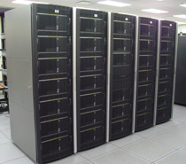
UIUC/NCSA AC Cluster
32 nodes
  4-GPU (GTX280, Tesla)
  GPUs donated by NVIDIA
  Host boxes funded by NSF
Coulomb Summation:
  1.78 TFLOPS/node
  271x speedup vs. Intel QX6700 CPU core w/ SSE
UIUC/NCSA AC Cluster
http://iacat.uiuc.edu/resources/cluster/
A partnership between NCSA and UIUC academic departments.
© Wen-mei W. Hwu and David Kirk/NVIDIA, ECE598HK, 2010

Slide 12
Text/Notes/Recordings
Lecture notes and recordings will be posted at the class web site
Recommended readings will be posted at the class web site
Draft textbook chapters by Prof. Hwu and Prof. Kirk, may becone available at the website
NVIDIA, NVidia CUDA 3.1 Programming Guide, NVidia, 2010 (reference book)
© Wen-mei W. Hwu and David Kirk/NVIDIA, ECE598HK, 2010

Slide 13
Final Project
Most important product of the semester
Could be the preliminary work on your thesis research
Could be the beginning of a library project
Should be the application of some of the techniques to a challenging problem
© Wen-mei W. Hwu and David Kirk/NVIDIA, ECE598HK, 2010

Slide 14
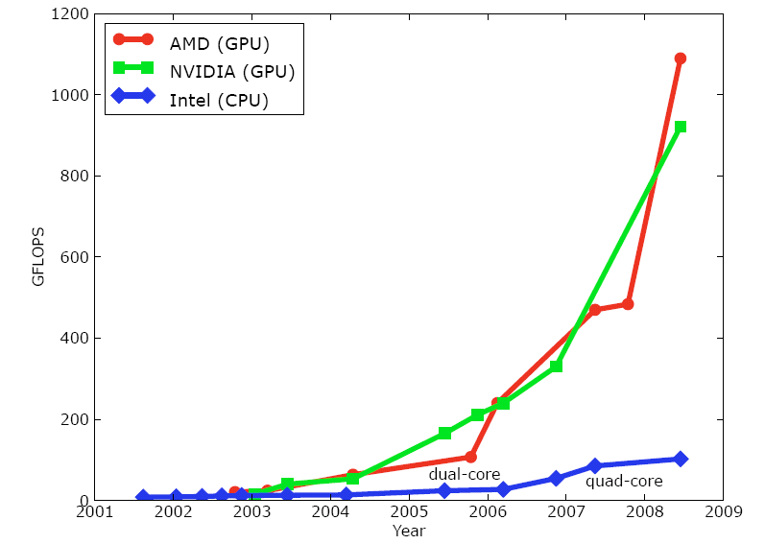
Performance Advantage of GPUs
An enlarging peak performance advantage:
  Calculation: 1 TFLOPS vs. 100 GFLOPS
  Memory Bandwidth: 100-150 GB/s vs. 32-64 GB/s
  GPU in every PC and workstation – massive volume and potential impact
Courtesy: John Owens
©Wen-mei W. Hwu and David Kirk/NVIDIA Urbana, Illinois, August 2-5, 2010

Slide 15
CPUs and GPUs have fundamentally different design philosophies.
Control
ALU
ALU
ALU
ALU
CPU
GPU
Cache
DRAM
DRAM
©Wen-mei W. Hwu and David Kirk/NVIDIA Urbana, Illinois, August 2-5, 2010

Slide 16
Harvesting Performance Benefit of Many-core GPU Requires
Massive parallelism in application algorithms
  Data parallelism
Regular computation and data accesses
  Similar work for parallel threads
Avoidance of conflicts in critical resources
  Off-chip DRAM (Global Memory) bandwidth
  Conflicting parallel updates to memory locations
©Wen-mei W. Hwu and David Kirk/NVIDIA Urbana, Illinois, August 2-5, 2010

Slide 17


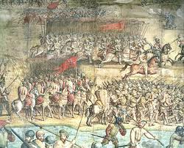
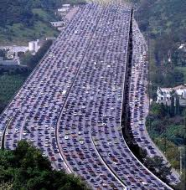
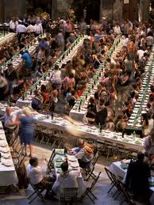

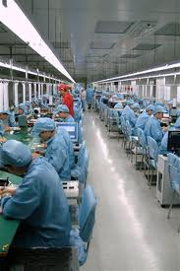
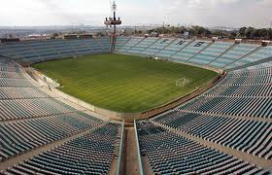
Massive Parallelism - Regularity
©Wen-mei W. Hwu and David Kirk/NVIDIA Urbana, Illinois, August 2-5, 2010

Slide 18
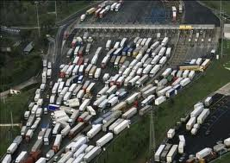
Undesirable Patterns
Serialization due to conflicting use of critical resources
Over subscription of Global Memory bandwidth
Load imbalance among parallel threads
©Wen-mei W. Hwu and David Kirk/NVIDIA Urbana, Illinois, August 2-5, 2010

Slide 19
“CUDA is an elegant solution to the problem of representing parallelism in algorithms, not all algorithms, but enough to matter.”
V. Natoli, Kudos for CUDA, HPCWire
©Wen-mei W. Hwu and David Kirk/NVIDIA Urbana, Illinois, August 2-5, 2010

Slide 20
Computational Thinking Skills
The ability to translate/formulate domain problems into computational models that can be solved efficiently by available computing resources
  Understanding the relationship between the domain problem and the computational models
  Understanding the strength and limitations of the computing devices
  Designing the model implementations to steer away from the limitations
©Wen-mei W. Hwu and David Kirk/NVIDIA Urbana, Illinois, August 2-5, 2010

Slide 21
DATA ACCESS CONFLICTS
©Wen-mei W. Hwu and David Kirk/NVIDIA Urbana, Illinois, August 2-5, 2010

Slide 22


Conflicting Data Accesses Cause Serialization and Delays
Massively parallel execution cannot afford serialization
Contentions in accessing critical data causes serialization
©Wen-mei W. Hwu and David Kirk/NVIDIA Urbana, Illinois, August 2-5, 2010

Slide 23
A Simple Example
A naïve inner product algorithm of two vectors of one million elements each
  All multiplications can be done in time unit (parallel)
  Additions to a single accumulator in one million time units (serial)
*
Time
*
+
+
+
……
+*
*
*
*
©Wen-mei W. Hwu and David Kirk/NVIDIA Urbana, Illinois, August 2-5, 2010

Slide 24
How much can conflicts hurt?
Amdahl’s Law
  If fraction X of a computation is serialized, the speedup can not be more than 1/X
In the previous example, X = 50%
  Half the calculations are serialized
  No more than 2X speedup, no matter how many computing cores are used
©Wen-mei W. Hwu and David Kirk/NVIDIA Urbana, Illinois, August 2-5, 2010

Slide 25
GLOBAL MEMORY BANDWIDTH
©Wen-mei W. Hwu and David Kirk/NVIDIA Urbana, Illinois, August 2-5, 2010

Slide 26


Global Memory Bandwidth
Ideal
Reality
©Wen-mei W. Hwu and David Kirk/NVIDIA Urbana, Illinois, August 2-5, 2010

Slide 27
Global Memory Bandwidth
Fermi
  1 TFLOPS SPFP peak throughput
  0.5 TFLOPS DPFP peak throughput
  144 GB/s peak off-chip memory access bandwidth
    36 G SPFP operands per second
    18 G DPFP operands per second
  To achieve peak throughput, a program must perform 1,000/36 = ~28 SPFP (14 DPFP) arithmetic operations for each operand value fetched from off-chip memory
©Wen-mei W. Hwu and David Kirk/NVIDIA Urbana, Illinois, August 2-5, 2010

Slide 28
A Simple CUDA Kernel for Matrix Multiplication
__global__ void MatrixMulKernel(float* Md, float* Nd, float* Pd, int Width)
{
// Calculate the row index of the Pd element and M
int Row = blockIdx.y*TILE_WIDTH + threadIdx.y;
// Calculate the column idenx of Pd and N
int Col = blockIdx.x*TILE_WIDTH + threadIdx.x;
float Pvalue = 0;
// each thread computes one element of the block sub-matrix
for (int k = 0; k < Width; ++k)
Pvalue += Md[Row][k] * Nd[k][Col];
Pd[Row][Col] = Pvalue;
}
©Wen-mei W. Hwu and David Kirk/NVIDIA Urbana, Illinois, August 2-5, 2010

Slide 29
REDUCING REDUNDANCY
©Wen-mei W. Hwu and David Kirk/NVIDIA Urbana, Illinois, August 2-5, 2010

Slide 30
Computational Efficiency
Parallel execution sometime requires doing redundant work
Total parallel execution may result in too much redundant work and longer execution
Time
4-way
parallel
Redundant
2-way
parallel
©Wen-mei W. Hwu and David Kirk/NVIDIA Urbana, Illinois, August 2-5, 2010
Unique

Slide 31
Direct Coulomb Summation (DCS) Where Redundancy Originates
At each lattice point, sum potential contributions for all atoms in the simulated structure:
  potential[j] += charge[i] / (distance to atom[i])
Distance to Atom[i]
Lattice point being evaluated
Atom[i]
© John Stratton, David Kirk/NVIDIA and Wen-mei W. Hwu PUMPS Workshop, Barcelona, España, 2010

Slide 32
DCS Initial Kernel Structure
…
float curenergy = energygrid[outaddr]; // start global mem read very early
float coorx = gridspacing * xindex;
float coory = gridspacing * yindex;
int atomid;
float energyval=0.0f;
for (atomid=0; atomid<numatoms; atomid++) {
float dx = coorx - atominfo[atomid].x;
float dy = coory - atominfo[atomid].y;
energyval += atominfo[atomid].w *
(1.0f / sqrtf(dx*dx + dy*dy + atominfo[atomid].z));
}
energygrid[outaddr] = curenergy + energyval;
© John Stratton, David Kirk/NVIDIA and Wen-mei W. Hwu PUMPS Workshop, Barcelona, España, 2010

Slide 33
Implementation Analysis
Parallelism: each potential lattice point is processed in a different thread
Redundancy: distance calculation (dx^2+dy^2+dz^2)
  In this case, one kernel processes all elements of a fixed z coordinate, a 2D “slice” of the full 3D lattice
  dz^2 is precomputed for every atom
The primary bottleneck of the first kernel is instruction issue
  Too many instructions for indexes and counting loops
  Too much redundant computation among threads in x and y
© John Stratton, David Kirk/NVIDIA and Wen-mei W. Hwu PUMPS Workshop, Barcelona, España, 2010

Slide 34
LOAD BALANCE
©Wen-mei W. Hwu and David Kirk/NVIDIA Urbana, Illinois, August 2-5, 2010

Slide 35
Load Balance
The total amount of time to complete a parallel job is limited by the thread that takes the longest to finish
good
bad
©Wen-mei W. Hwu and David Kirk/NVIDIA Urbana, Illinois, August 2-5, 2010

Slide 36
How bad can it be?
Assume that a job takes 100 units of time for one person to finish
  If we break up the job into 10 parts of 10 units each and have fo10 people to do it in parallel, we can get a 10X speedup
  If we break up the job into 50, 10, 5, 5, 5, 5, 5, 5, 5, 5 units, the same 10 people will take 50 units to finish, with 9 of them idling for most of the time. We will get no more than 2X speedup.
©Wen-mei W. Hwu and David Kirk/NVIDIA Urbana, Illinois, August 2-5, 2010

Slide 37
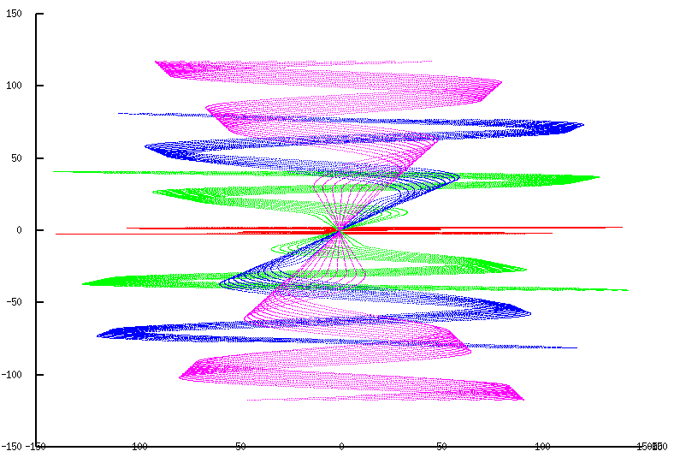
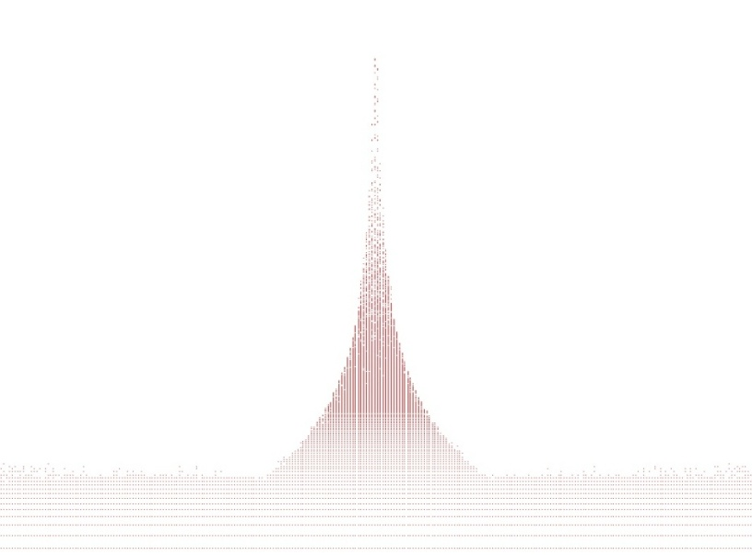
How does imbalancing come about?
Non-uniform data distributions
  Highly concentrated spatial data areas
  Astronomy, medical imaging, computer vision, rendering, …
If each thread processes the input data of a given spatial volume unit, some will do a lot more work than others
©Wen-mei W. Hwu and David Kirk/NVIDIA Urbana, Illinois, August 2-5, 2010

Slide 38
Seven Techniques in Many-core Programming
Scatter to gather transformation
Granularity coarsening and register tiling
Data access tiling
Data layout and traversal ordering
Binning and cutoff
Bin sorting and partitioning for non-uniform data
Hierarchical queues and kernels for dynamic data
ACS Annual Meeting, August 22, 2010

Slide 39
Tentative Schedule/Make-up Classes
Regular make-up classes
  TBD
Week 1:
  Tue, 8/24 : Lecture 1: Introduction
  Thu, 8/26: Lecture 2 – Review: GPU performance considerations
  Make-up class:
Week 2:
  Tue, 8/31: Lecture 3 – Parallelism Scalability Transformations
  Thu, 9/02: Lecture 4 – Thread Coarsening and Register Tiling
  Make-up class:
  MP-1: DCS – scatter vs. scatter
Week 3:
  Tue, 9/07: Lecture 5 – Memory Tiling
  Thu, 9/09: Lecture 6 – Memory Tiling
  Make-up class:
  MP-2: DCS – thread coarsening and register tiling
Week 4
  Tue, 9/14: Lecture 7 – Register Tiling (make-up class)
  Thu, 9/16: Lecture 8 – Register Tiling (make-up class)
  MP-3, 7-Point Stencil – 2D memory tiling
© Wen-mei W. Hwu and David Kirk/NVIDIA, ECE598HK, 2010

Slide 40
Tentative Schedule/Make-up Classes
Week 5:
  Tue, 9/21 : Lecture 9 - Data Layout Considerations (make-up class)
  Thu, 9/23: Lecture 10 – Input Binning
  Make-up class:
  MP-4: 7-point stencil – register tiling
Week 6:
  Tue, 9/28: Lecture 11 – Input Binning
  Thu, 9/30: Lecture 12 – Non-uniform Data (Sparse methods)
  Make-up class:
  MP-5: Matrix multiplication – register tiling
Week 7:
  Tue, 10/05: Lecture 13 – Non-Uniform Data (Sparse Methods)
  Thu, 10/07: Lecture 14 – Non-Uniform Data (Variable Binning)
  Make-up class:
  MP-6: Lattice Boltzmann Method: Data Layout
Week 8:
  Tue, 10/12: Lecture 15 – Non-Uniform Data (Variable Binning)
  Thu, 10/14: Lecture 16 – Dynamic Data
  MP-7: Cut-off CP - binning
© Wen-mei W. Hwu and David Kirk/NVIDIA, ECE598HK, 2010

Slide 41
Tentative Schedule/Make-up Classes
Week 9:
  Tue, 10/19: Lecture 17 - Dynamic Data (make-up class)
  Thu, 10/21: Lecture 18 – Mapp-Reduce
  Make-up class:
  MP-8: MRI – data sorting and partitioning
Week 10:
  Tue, 10/26: Lecture 19 – Final Project Kick-off Workshop
  Thu, 10/28: Lecture 20 – Final Project Kick-off Workshop
  Make-up class:
  MP-9: BFS – hierarchical queues and kernels
Week 11:
  Tue, 11/02: Lecture 21 – Exploratory Topics (Unstructured Mesh?)
  Thu, 10/04: Lecture 22 – Exploratory Topics (Tree-coded Data)
  Make-up class:
  Final Project Work
Week 12
  Tue, 11/09: Lecture 23 – Final Project Algorithm Presentations
  Thu, 11/11: Lecture 24 – Final Project Algorithm Presentations
  Final Project Work
© Wen-mei W. Hwu and David Kirk/NVIDIA, ECE598HK, 2010

Slide 42
Tentative Schedule/Make-up Classes
Week 13:
  Tue, 11/16: Lecture 25 - Final Project Algorithm Presentation (make-up class)
  Thu, 11/18: Lecture 26 – Final Project Algorithm Presentation
  Make-up class:
  Final Project Work
Week 14:
  Tue, 11/30: Lecture 27 – Final Project Algorithm Presentation
  Thu, 12/02: Lecture 28 – Final Project
  Make-up class:
  Final Project Work
Week 15:
  Tue, 12/07: Lecture 29 – Course Summary
  Thu, 12:09: Final Project Symposium (Date may change, 6 hours, 15 minutes per student)
© Wen-mei W. Hwu and David Kirk/NVIDIA, ECE598HK, 2010

Slide 43

You can do it.
Computational thinking is not as hard as you may think it is.
  Most techniques have been explained, if at all, at the level of computer experts.
  The purpose of the course is to make them accessible to domain scientists and engineers.
©Wen-mei W. Hwu and David Kirk/NVIDIA Urbana, Illinois, August 2-5, 2010

Slide 44
ANY MORE QUESTIONS?
©Wen-mei W. Hwu and David Kirk/NVIDIA Urbana, Illinois, August 2-5, 2010

