Slide 1
ECE 598HK
Computational Thinking for
Many-core Computing
Lecture 2: Many-core GPU Performance Considerations
© Wen-mei W. Hwu and David Kirk/NVIDIA, ECE598HK, 2010

Slide 2
Seven Techniques in Many-core Programming
Scatter to gather transformation
Granularity coarsening and register tiling
Data access tiling
Data layout and traversal ordering
Binning and cutoff
Bin sorting and partitioning for non-uniform data
Hierarchical queues and kernels for dynamic data
ACS Annual Meeting, August 22, 2010

Slide 3

You can do it.
Computational thinking is not as hard as you may think it is.
  Most techniques have been explained, if at all, at the level of computer experts.
  The purpose of the course is to make them accessible to domain scientists and engineers.
©Wen-mei W. Hwu and David Kirk/NVIDIA Urbana, Illinois, August 2-5, 2010

Slide 4
Tentative Schedule/Make-up Classes
Regular make-up classes
  TBD
Week 1:
  Tue, 8/24 : Lecture 1: Introduction
  Thu, 8/26: Lecture 2 – Review: GPU performance considerations
  Make-up class:
Week 2:
  Tue, 8/31: Lecture 3 – Parallelism Scalability Transformations
  Thu, 9/02: Lecture 4 – Thread Coarsening and Register Tiling
  Make-up class:
  MP-1: DCS – scatter vs. scatter
Week 3:
  Tue, 9/07: Lecture 5 – Memory Tiling
  Thu, 9/09: Lecture 6 – Memory Tiling
  Make-up class:
  MP-2: DCS – thread coarsening and register tiling
Week 4
  Tue, 9/14: Lecture 7 – Register Tiling (make-up class)
  Thu, 9/16: Lecture 8 – Register Tiling (make-up class)
  MP-3, 7-Point Stencil – 2D memory tiling
© Wen-mei W. Hwu and David Kirk/NVIDIA, ECE598HK, 2010

Slide 5
Tentative Schedule/Make-up Classes
Week 5:
  Tue, 9/21 : Lecture 9 - Data Layout Considerations (make-up class)
  Thu, 9/23: Lecture 10 – Input Binning
  Make-up class:
  MP-4: 7-point stencil – register tiling
Week 6:
  Tue, 9/28: Lecture 11 – Input Binning
  Thu, 9/30: Lecture 12 – Non-uniform Data (Sparse methods)
  Make-up class:
  MP-5: Matrix multiplication – register tiling
Week 7:
  Tue, 10/05: Lecture 13 – Non-Uniform Data (Sparse Methods)
  Thu, 10/07: Lecture 14 – Non-Uniform Data (Variable Binning)
  Make-up class:
  MP-6: Lattice Boltzmann Method: Data Layout
Week 8:
  Tue, 10/12: Lecture 15 – Non-Uniform Data (Variable Binning)
  Thu, 10/14: Lecture 16 – Dynamic Data
  MP-7: Cut-off CP - binning
© Wen-mei W. Hwu and David Kirk/NVIDIA, ECE598HK, 2010

Slide 6
Tentative Schedule/Make-up Classes
Week 9:
  Tue, 10/19: Lecture 17 - Dynamic Data (make-up class)
  Thu, 10/21: Lecture 18 – Mapp-Reduce
  Make-up class:
  MP-8: MRI – data sorting and partitioning
Week 10:
  Tue, 10/26: Lecture 19 – Final Project Kick-off Workshop
  Thu, 10/28: Lecture 20 – Final Project Kick-off Workshop
  Make-up class:
  MP-9: BFS – hierarchical queues and kernels
Week 11:
  Tue, 11/02: Lecture 21 – Exploratory Topics (Unstructured Mesh?)
  Thu, 10/04: Lecture 22 – Exploratory Topics (Tree-coded Data)
  Make-up class:
  Final Project Work
Week 12
  Tue, 11/09: Lecture 23 – Final Project Algorithm Presentations
  Thu, 11/11: Lecture 24 – Final Project Algorithm Presentations
  Final Project Work
© Wen-mei W. Hwu and David Kirk/NVIDIA, ECE598HK, 2010

Slide 7
Tentative Schedule/Make-up Classes
Week 13:
  Tue, 11/16: Lecture 25 - Final Project Algorithm Presentation (make-up class)
  Thu, 11/18: Lecture 26 – Final Project Algorithm Presentation
  Make-up class:
  Final Project Work
Week 14:
  Tue, 11/30: Lecture 27 – Final Project Algorithm Presentation
  Thu, 12/02: Lecture 28 – Final Project
  Make-up class:
  Final Project Work
Week 15:
  Tue, 12/07: Lecture 29 – Course Summary
  Thu, 12:09: Final Project Symposium (Date may change, 6 hours, 15 minutes per student)
© Wen-mei W. Hwu and David Kirk/NVIDIA, ECE598HK, 2010

Slide 8
Global Memory Bandwidth
Many-core processors have limited off-chip memory access bandwidth compared to peak compute throughput
Fermi
  1.5 TFLOPS SPFP peak throughput
  0.75 TFLOPS DPFP peak throughput
  144 GB/s peak off-chip memory access bandwidth
    36 G SPFP operands per second
    18 G DPFP operands per second
  To achieve peak throughput, a program must perform 1,500/36 = ~42 SPFP (21 DPFP) arithmetic operations for each operand value fetched from off-chip memory
©Wen-mei W. Hwu and David Kirk/NVIDIA Urbana, Illinois, August 2-5, 2010

Slide 9
A Simple CUDA Kernel for Matrix Multiplication
__global__ void MatrixMulKernel(float* Md, float* Nd, float* Pd, int Width)
{
// Calculate the row index of the Pd element and M
int Row = blockIdx.y*TILE_WIDTH + threadIdx.y;
// Calculate the column idenx of Pd and N
int Col = blockIdx.x*TILE_WIDTH + threadIdx.x;
float Pvalue = 0;
// each thread computes one element of the block sub-matrix
for (int k = 0; k < Width; ++k)
Pvalue += Md[Row][k] * Nd[k][Col];
Pd[Row][Col] = Pvalue;
}
©Wen-mei W. Hwu and David Kirk/NVIDIA Urbana, Illinois, August 2-5, 2010

Slide 10
Performance Implication on Fermi
Two Global (DRAM) accesses (8 bytes) per floating point multiply-add
  4B/s of memory bandwidth/FLOPS
4*1,500GFLOPS = 6,000 GB/s needed to achieve peak SP FLOP rating
8*750GFLOPS = 6,000 GB/s needed to achieve peak DP FLOP rating
144 GB/s limits the code at 36 SP / 18 DP GFLOPS
Grid
Block (0, 0)
Block (1, 0)
Shared Memory
Shared Memory
Registers
Registers
Registers
Registers
Thread (0, 0)
Thread (1, 0)
Thread (0, 0)
Thread (1, 0)
Host
Global Memory
Constant Memory
©Wen-mei W. Hwu and David Kirk/NVIDIA Urbana, Illinois, August 2-5, 2010

Slide 11
However
The calculation is over simplified
It assumes that peak memory bandwidth is achieved through the execution
We need to first understand the memory architecture…
© Wen-mei W. Hwu and David Kirk/NVIDIA, ECE598HK, 2010

Slide 12
GPU Memory Architecture, SImplified
Host
Input Assembler
Thread Execution Manager
Parallel Data
Cache
Parallel Data
Cache
Parallel Data
Cache
Parallel Data
Cache
Parallel Data
Cache
Parallel Data
Cache
Parallel Data
Cache
Parallel Data
Cache
Texture
Texture
Texture
Texture
Texture
Texture
Texture
Texture
Texture
Load/store
Load/store
Load/store
Load/store
Load/store
Load/store
Global Memory
© David Kirk/NVIDIA and Wen-mei W. Hwu Barcelonal, Spain, July 5-9, 2010

Slide 13
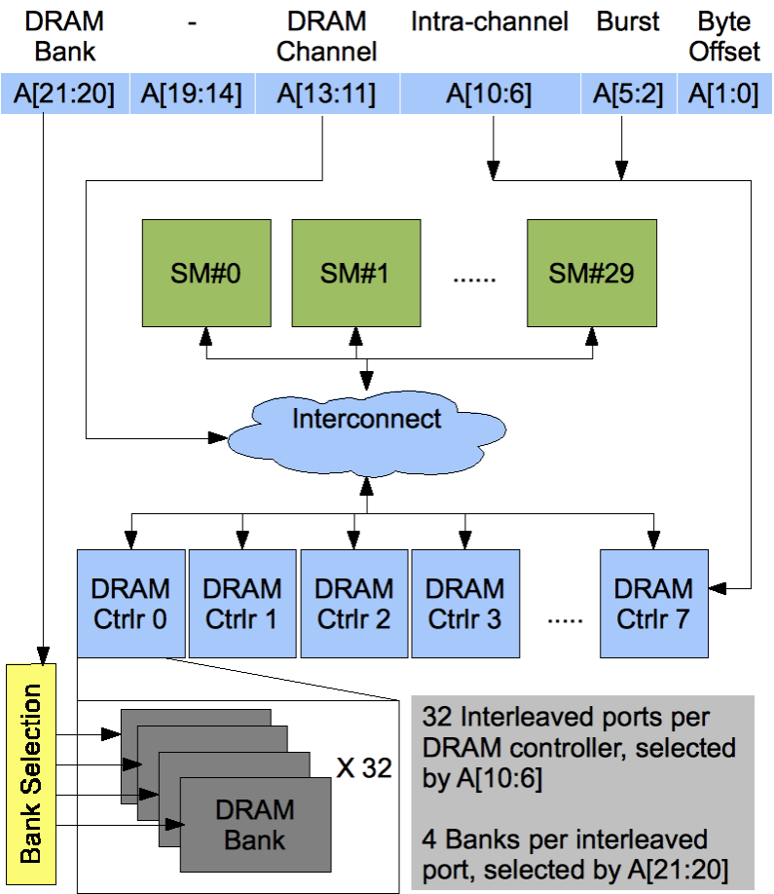
GPU Memory Architecture – Less Simplified
Channels
  Main form of access parallelism
  8 in Fermi
Ports
  Second-level (pipelined) access parallelism
  32 / channel in Fermi
Bursts
  Bandwidth efficiency
  128B/ burst in Fermi
© Wen-mei W. Hwu and David Kirk/NVIDIA, ECE598HK, 2010

Slide 14
Achieving Peak Bandwidth
All words of the a burst need to be used
  Every word transferred corresponds to one of the program accesses
All channels are actively used
  Each channel connects to a set of pins
Many ports in each channel are activated
  Enough active burst requests to fully utilize the pin bandwidth
© Wen-mei W. Hwu and David Kirk/NVIDIA, ECE598HK, 2010

Slide 15
Example: Vector Addition Kernel
Device Code
// Compute vector sum C = A+B
// Each thread performs one pair-wise addition
__global__
void vecAdd(float* A, float* B, float* C, int n)
{
int i = threadIdx.x + blockDim.x * blockIdx.x;
if(i<n) C[i] = A[i] + B[i];
}
int main()
{
// Run ceil(N/256) blocks of 256 threads each
vecAdd<<<ceil(N/256), 256>>>(d_A, d_B, d_C, n);
}
© David Kirk/NVIDIA and Wen-mei W. Hwu Barcelonal, Spain, July 5-9, 2010

Slide 16
A Good Memory Access Pattern
Adjacent threads access adjacent locations
  Adjacent warps activate different ports
  Adjacent thread blocks activate different ports/channels
in
Thread Block 1
Thread Block N - 1
0
1
2
3
4
5
6
7
0
1
2
3
4
5
6
7
0
1
2
3
4
5
6
7
Thread Block 0
© Wen-mei W. Hwu and David Kirk/NVIDIA, ECE598HK, 2010

Slide 17
GPU Memory Architecture – Less Simplified
Channels
  Main form of access parallelism
  8 in Fermi
Ports
  Second-level (pipelined) access parallelism
  32 / channel in Fermi
Bursts
  Bandwidth efficiency
  128B/ burst in Fermi
© Wen-mei W. Hwu and David Kirk/NVIDIA, ECE598HK, 2010

Slide 18
Memory Layout of a Matrix in C
Access direction in Kernel code
M_{0,0}
M_{1,0}
M_{2,0}
M_{3,0}
M_{0,1}
M_{1,1}
M_{2,1}
M_{3,1}
M_{0,2}
M_{1,2}
M_{2,2}
M_{3,2}
M_{0,3}
M_{1,3}
M_{2,3}
M_{3,3}
Time Period 1
Time Period 2
…
T₁
T₂
T₃
T₄
T₁
T₂
T₃
T₄
M
M_{0,0}
M_{1,0}
M_{2,0}
M_{3,0}
M_{0,1}
M_{1,1}
M_{2,1}
M_{3,1}
M_{0,2}
M_{1,2}
M_{2,2}
M_{3,2}
M_{0,3}
M_{1,3}
M_{2,3}
M_{3,3}
© David Kirk/NVIDIA and Wen-mei W. Hwu Barcelona, Spain, July 5-9, 2010

Slide 19
Memory Layout of a Matrix in C
Access direction in Kernel code
M_{0,0}
M_{1,0}
M_{2,0}
M_{3,0}
M_{0,1}
M_{1,1}
M_{2,1}
M_{3,1}
M_{0,2}
M_{1,2}
M_{2,2}
M_{3,2}
M_{0,3}
M_{1,3}
M_{2,3}
M_{3,3}
…
Time Period 2
T₁
T₂
T₃
T₄
Time Period 1
T₁
T₂
T₃
T₄
M
M_{0,0}
M_{1,0}
M_{2,0}
M_{3,0}
M_{0,1}
M_{1,1}
M_{2,1}
M_{3,1}
M_{0,2}
M_{1,2}
M_{2,2}
M_{3,2}
M_{0,3}
M_{1,3}
M_{2,3}
M_{3,3}
© David Kirk/NVIDIA and Wen-mei W. Hwu Barcelona, Spain, July 5-9, 2010

Slide 20
Memory Access Pattern
(Corner Turning)
Md
Nd
Original
H
Access
T
D
I
Pattern
W
WIDTH
Copy into
scratchpad
memory
Md
Nd
Tiled
Access
Pattern
Perform
multiplication
with scratchpad
values
© David Kirk/NVIDIA and Wen-mei W. Hwu Barcelona, Spain, July 5-9, 2010

Slide 21
Data Layout Transformation
Transpose a 2D matrix layout can convert a non-coalesced access pattern into a coalesced pattern
Md
Nd
T
© Wen-mei W. Hwu and David Kirk/NVIDIA, ECE598HK, 2010

Slide 22
DATA ACCESS CONFLICTS
©Wen-mei W. Hwu and David Kirk/NVIDIA Urbana, Illinois, August 2-5, 2010

Slide 23
Atomic Operations on DRAM
Each Load-Modify-Store has two full memory access delays
  All atomic operations on the same variable (RAM location) are serialized
time
internal routing
internal routing
DRAM delay
DRAM delay
DRAM delay
..
transfer delay
transfer delay
atomic operation N
atomic operation N+1
© Wen-mei W. Hwu and David Kirk/NVIDIA, ECE598HK, 2010

Slide 24
Hardware Improvements
Atomic operations on Shared Memory
  Very short latency, but still serialized
  Private to each thread block
  Algorithm work for programmers (more later)
time
internal routing
..
data transfer
atomic operation N
atomic operation N+1
© Wen-mei W. Hwu and David Kirk/NVIDIA, ECE598HK, 2010

Slide 25
Hardware Improvements (cont.)
Atomic operations on Fermi L2 cache
  medium latency, but still serialized
  Global to all blocks
  “Free improvement” on Global Memory atomics
time
internal routing
..
data transfer
data transfer
atomic operation N
atomic operation N+1
© Wen-mei W. Hwu and David Kirk/NVIDIA, ECE598HK, 2010

Slide 26
ANY MORE QUESTIONS?
©Wen-mei W. Hwu and David Kirk/NVIDIA Urbana, Illinois, August 2-5, 2010

