Slide 1
ECE598HK
Computational Thinking for
Many-core Computing
Lecture 3: Parallelism Scalability Transformations
©Wen-mei W. Hwu and David Kirk/NVIDIA Urbana, Illinois, August 2-5, 2010

Slide 2
A Common Sequential Computation Pattern
in
Double Nested Loop
iterate over out
iterate over in
out
©Wen-mei W. Hwu and David Kirk/NVIDIA Urbana, Illinois, August 2-5, 2010

Slide 3
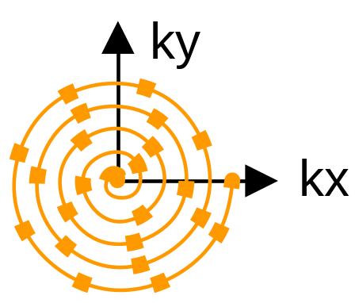
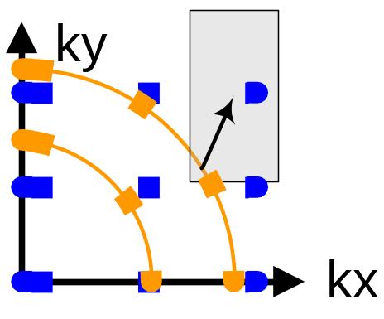
A Simple Code Example
for (m = 0; m < M; m++) {
for (n = 0; n < N; n++) {
out[n] += f(in[m], m, n);
}
}
Gridding¹
Input data in
  M = # scan points
Output data out
  N = # regularized scan points
Complexity is O(MN)
Output tends to be more regular than input
©Wen-mei W. Hwu and David Kirk/NVIDIA Urbana, Illinois, August 2-5, 2010
Notes:
The algorithms for Q and FHd are nearly identical, so in the interest of time we’ll examine only Q.
There are M scan points, with the 3D scan data represented by kx, ky, kz, and phi.
There are N pixels, with the 3D pixel data represented by x, y, and z (inputs) and Q (output).
As you can see, the algorithm is embarrassingly data-parallel.
Each iteration of the outer loop corresponds to a single point of scan data. For that single point of scan data, we first compute the magnitude-squared of phi. Then, the inner loop iterates over all the pixels, because the current scan data point contributes to the value of Q at every pixel. In other words, the value of Q at each pixel depends on every scan point. Clearly, the algorithm is O(MN).
Examining the inner loop more closely, we see that there are 10 floating-point arithmetic operations, 2 floating-point trig operations, and 10 loads. This instruction mix hints at the bottlenecks we face as we map this algorithm to the G80.

Slide 4
Scatter Parallelization
in
Thread 1
Thread 2
…
out
©Wen-mei W. Hwu and David Kirk/NVIDIA Urbana, Illinois, August 2-5, 2010

Slide 5
Scatter can be very slow.
All threads have conflicting updates to the same out elements
  Serialized with atomic operations
  Very costly (slow) for large number of threads
Time
+
+
+
……
+*
+
+
+
……
+*
All threads update out[0]
All threads update out[1]
©Wen-mei W. Hwu and David Kirk/NVIDIA Urbana, Illinois, August 2-5, 2010

Slide 6
Gather Parallelization
in
Thread 1
Thread 2
…
out
©Wen-mei W. Hwu and David Kirk/NVIDIA Urbana, Illinois, August 2-5, 2010

Slide 7
Gather can be very fast.
All threads can read the same in elements
  No serialization
  Can even be efficiently consolidated through caches or local memories
Time
+
+
+
+
+
+
…
+
+
+
All threads update their own out elements
+*
+*
+*
©Wen-mei W. Hwu and David Kirk/NVIDIA Urbana, Illinois, August 2-5, 2010

Slide 8
Why is scatter parallelization often used rather than gather?
In practice, each in element does not affect all out elements
Output tends to be much more regular than input
©Wen-mei W. Hwu and David Kirk/NVIDIA Urbana, Illinois, August 2-5, 2010

Slide 9
Why is scatter parallelization often used rather than gather?
It is easy to calculate all out elements affected by an in element
  Harder to calculate all in elements to affect an out
  Easy thread kernel code if written in scatter
©Wen-mei W. Hwu and David Kirk/NVIDIA Urbana, Illinois, August 2-5, 2010

Slide 10
Challenges in Gather Parallelization
Regularize input elements so that it is easier to find all in elements that affects an out element
  Cut-off Binning Lecture
Can be even more challenging if data is highly non-uniform
  Cut-off Binning for Non-Uniform Data Lecture
For this lecture, we assume that all in elements affect all out elements
©Wen-mei W. Hwu and David Kirk/NVIDIA Urbana, Illinois, August 2-5, 2010

Slide 11
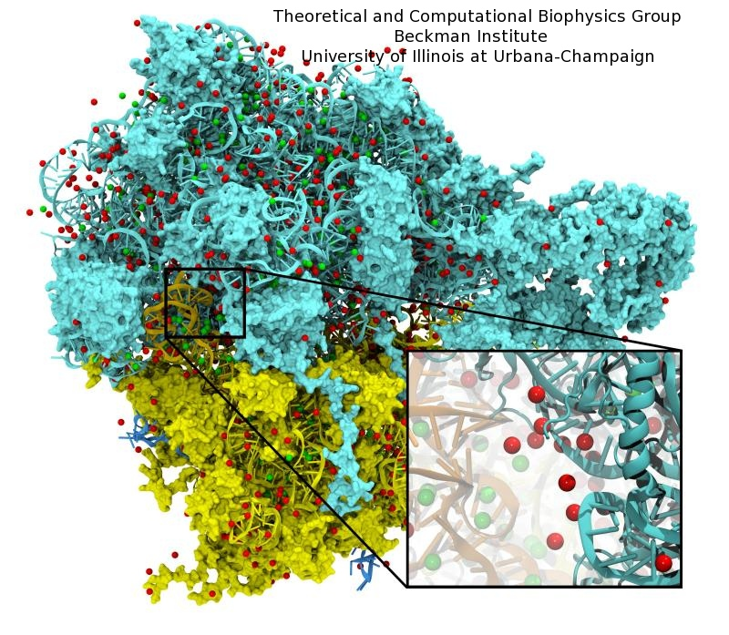
Molecular Modeling: Ion Placement
Biomolecular simulations attempt to replicate in vivo conditions in silico
Model structures are initially constructed in vacuum
Solvent (water) and ions are added as necessary to reproduce the required biological conditions
©Wen-mei W. Hwu and David Kirk/NVIDIA Urbana, Illinois, August 2-5, 2010

Slide 12
Ion Placement Process (Step 1)
Calculate initial electrostatic potential map around the simulated structure considering the contributions of all atoms
  Most time consuming, focus of our example.
Lattice point being evaluated
©Wen-mei W. Hwu and David Kirk/NVIDIA Urbana, Illinois, August 2-5, 2010

Slide 13
Ion Placement Process (Step 2)
Ions are then placed one at a time:
  Find the voxel containing the minimum potential value
  Add a new ion atom at location of minimum potential
  Add the potential contribution of the newly placed ion to the entire map
  Repeat until the required number of ions have been added
©Wen-mei W. Hwu and David Kirk/NVIDIA Urbana, Illinois, August 2-5, 2010

Slide 14
Overview of Direct Coulomb Summation (DCS) Algorithm
One way to compute the electrostatic potentials on a grid, ideally suited for the GPU
  All atoms affect all map lattice points, most accurate
For each lattice point, sum potential contributions for all atoms in the simulated structure:
  potential += charge[i] / (distance to atom[i])
Approximation-based methods such as cut-off summation can achieve much higher performance at the cost of some numerical accuracy and flexibility
  Will cover these later
©Wen-mei W. Hwu and David Kirk/NVIDIA Urbana, Illinois, August 2-5, 2010

Slide 15
Direct Coulomb Summation (DCS) Algorithm Detail
At each lattice point, sum potential contributions for all atoms in the simulated structure:
  potential += charge[i] / (distance to atom[i])
Distance to Atom[i]
Lattice point being evaluated
Atom[i]
©Wen-mei W. Hwu and David Kirk/NVIDIA Urbana, Illinois, August 2-5, 2010

Slide 16
Electrostatic Potential Map Calculation Function Overview
Each call calculates an x-y slice of the energy map
  energygrid – pointer to the entire potential map
  grid – the x, y, z dimensions of the potential map
  gridspacing – modeled physical dist between grid points
  atoms – array of x, y, z coordinates and charge of atoms
  numatoms – number of atoms in atoms array
void cenergy(float *energygrid, dim3 grid, float gridspacing, float z, const float *atoms, int numatoms) {}
©Wen-mei W. Hwu and David Kirk/NVIDIA Urbana, Illinois, August 2-5, 2010

Slide 17
An Intuitive Sequential C Version
void cenergy(float *energygrid, dim3 grid, float gridspacing, float z, const float *atoms, int numatoms) {
int atomarrdim = numatoms * 4; //x,y,z, and charge info for each atom
for (int n=0; n<atomarrdim; n+=4) { // calculate potential contribution of each atom
float dz = z - atoms[n+2]; // all grid points in a slice have the same z value
float dz2 = dz*dz;
int grid_slice_offset = (grid.x*grid.y*z) / gridspacing;
float charge = atoms[n+3];
for (int j=0; j<grid.y; j++) {
float y = gridspacing * (float) j;
float dy = y - atoms[n+1]; // all grid points in a row have the same y value
float dy2 = dy*dy;
int grid_row_offset = grid_slice_offset+ grid.x*j;
for (int i=0; i<grid.x; i++) {
float x = gridspacing * (float) i;
float dx = x - atoms[n ];
energygrid[grid_row_offset + i] += charge / sqrtf(dx*dx + dy2+ dz2);
}
}
} }
Input oriented
©Wen-mei W. Hwu and David Kirk/NVIDIA Urbana, Illinois, August 2-5, 2010

Slide 18
An Intuitive Sequential C Version
void cenergy(float *energygrid, dim3 grid, float gridspacing, float z, const float *atoms, int numatoms) {
int atomarrdim = numatoms * 4; //x,y,z, and charge info for each atom
for (int n=0; n<atomarrdim; n+=4) { // calculate potential contribution of each atom
float dz = z - atoms[n+2]; // all grid points in a slice have the same z value
float dz2 = dz*dz;
int grid_slice_offset = (grid.x*grid.y*z) / gridspacing;
float charge = atoms[n+3];
for (int j=0; j<grid.y; j++) {
float y = gridspacing * (float) j;
float dy = y - atoms[n+1]; // all grid points in a row have the same y value
float dy2 = dy*dy;
int grid_row_offset = grid_slice_offset+ grid.x*j;
for (int i=0; i<grid.x; i++) {
float x = gridspacing * (float) i;
float dx = x - atoms[n ];
energygrid[grid_row_offset + i] += charge / sqrtf(dx*dx + dy2+ dz2);
}
}
} }
©Wen-mei W. Hwu and David Kirk/NVIDIA Urbana, Illinois, August 2-5, 2010

Slide 19
An Intuitive Sequential C Version
void cenergy(float *energygrid, dim3 grid, float gridspacing, float z, const float *atoms, int numatoms) {
int atomarrdim = numatoms * 4; //x,y,z, and charge info for each atom
for (int n=0; n<atomarrdim; n+=4) { // calculate potential contribution of each atom
float dz = z - atoms[n+2]; // all grid points in a slice have the same z value
float dz2 = dz*dz;
int grid_slice_offset = (grid.x*grid.y*z) / gridspacing;
float charge = atoms[n+3];
for (int j=0; j<grid.y; j++) {
float y = gridspacing * (float) j;
float dy = y - atoms[n+1]; // all grid points in a row have the same y value
float dy2 = dy*dy;
int grid_row_offset = grid_slice_offset+ grid.x*j;
for (int i=0; i<grid.x; i++) {
float x = gridspacing * (float) i;
float dx = x - atoms[n ];
energygrid[grid_row_offset + i] += charge / sqrtf(dx*dx + dy2+ dz2);
}
}
} }
©Wen-mei W. Hwu and David Kirk/NVIDIA Urbana, Illinois, August 2-5, 2010

Slide 20
An Intuitive Sequential C Version
void cenergy(float *energygrid, dim3 grid, float gridspacing, float z, const float *atoms, int numatoms) {
int atomarrdim = numatoms * 4; //x,y,z, and charge info for each atom
for (int n=0; n<atomarrdim; n+=4) { // calculate potential contribution of each atom
float dz = z - atoms[n+2]; // all grid points in a slice have the same z value
float dz2 = dz*dz;
int grid_slice_offset = (grid.x*grid.y*z) / gridspacing;
float charge = atoms[n+3];
for (int j=0; j<grid.y; j++) {
float y = gridspacing * (float) j;
float dy = y - atoms[n+1]; // all grid points in a row have the same y value
float dy2 = dy*dy;
int grid_row_offset = grid_slice_offset+ grid.x*j;
for (int i=0; i<grid.x; i++) {
float x = gridspacing * (float) i;
float dx = x - atoms[n ];
energygrid[grid_row_offset + i] += charge / sqrtf(dx*dx + dy2+ dz2);
}
}
} }
©Wen-mei W. Hwu and David Kirk/NVIDIA Urbana, Illinois, August 2-5, 2010

Slide 21
Summary of Sequential C Version
Algorithm is input oriented
  For each input atom, calculate its contribution to all grid points in an x-y slice
Output (energygrid) is very regular
  Simple linear mapping between grid point indices and modeled physical coordinates
Input (atom) is irregular
  Modeled x,y,z coordinate of each atom needs to be stored in the atom array
The algorithm is efficient in performing minimal calculations on distances, coordinates, etc.
©Wen-mei W. Hwu and David Kirk/NVIDIA Urbana, Illinois, August 2-5, 2010

Slide 22
Irregular Input vs. Regular Output
Atoms come from modeled molecular structures, solvent (water) and ions
  Irregular by necessity
Energy grid models the electrostatic potential value at regularly spaced points
  Regular by design
©Wen-mei W. Hwu and David Kirk/NVIDIA Urbana, Illinois, August 2-5, 2010

Slide 23
CUDA DCS Implementation Overview
Allocate and initialize potential map memory on host CPU
Allocate potential map slice buffer on GPU
Preprocess atom coordinates and charges
Loop over potential map slices:
  Copy potential map slice from host to GPU
  Loop over groups of atoms:
    Copy atom data to GPU
    Run CUDA Kernel on atoms and potential map slice on GPU
  Copy potential map slice from GPU to host
Free resources
©Wen-mei W. Hwu and David Kirk/NVIDIA Urbana, Illinois, August 2-5, 2010

Slide 24
Straightforward CUDA Parallelization
Use each thread to compute the contribution of an atom to all grid points in the current slice
  Scatter parallelization
Kernel code largely correspond to CPU version with outer loop stripped
  Each thread corresponds to an outer loop iteration of CPU version
  numatoms used in kernel launch configuration host code
©Wen-mei W. Hwu and David Kirk/NVIDIA Urbana, Illinois, August 2-5, 2010

Slide 25
A Very Slow DCS Scatter Kernel!
void __global__ cenergy(float *energygrid, float *atoms, dim3 grid, float gridspacing, float z) {
int n = (blockIdx.x * blockDim .x + threadIdx.x) * 4;
float dz = z - atoms[n+2]; // all grid points in a slice have the same z value
float dz2 = dz*dz;
int grid_slice_offset = (grid.x*grid.y*z) / gridspacing;
float charge = atoms[n+3];
for (int j=0; j<grid.y; j++) {
float y = gridspacing * (float) j;
float dy = y - atoms[n+1]; // all grid points in a row have the same y value
float dy2 = dy*dy;
int grid_row_offset = grid_slice_offset+ grid.x*j;
for (int i=0; i<grid.x; i++) {
float x = gridspacing * (float) i;
float dx = x - atoms[n ];
energygrid[grid_row_offset + i] += charge / sqrtf(dx*dx + dy2+ dz2));
}
}
}
}
©Wen-mei W. Hwu and David Kirk/NVIDIA Urbana, Illinois, August 2-5, 2010

Slide 26
A Very Slow DCS Scatter Kernel!
void __global__ cenergy(float *energygrid, float *atoms, dim3 grid, float gridspacing, float z) {
int n = (blockIdx.x * blockDim .x + threadIdx.x) *4;
float dz = z - atoms[n+2]; // all grid points in a slice have the same z value
float dz2 = dz*dz;
int grid_slice_offset = (grid.x*grid.y*z) / gridspacing;
float charge = atoms[n+3];
for (int j=0; j<grid.y; j++) {
float y = gridspacing * (float) j;
float dy = y - atoms[n+1]; // all grid points in a row have the same y value
float dy2 = dy*dy;
int grid_row_offset = grid_slice_offset+ grid.x*j;
for (int i=0; i<grid.x; i++) {
float x = gridspacing * (float) i;
float dx = x - atoms[n ];
energygrid[grid_row_offset + i] += charge / sqrtf(dx*dx + dy2+ dz2));
}
}
}
}
Needs to be done as an atomic operation
©Wen-mei W. Hwu and David Kirk/NVIDIA Urbana, Illinois, August 2-5, 2010

Slide 27
Pros and Cons of the Scatter Kernel
Pros
  Follows closely the simple CPU version
  Good for software engineering and code maintenance
  Preserves computation efficiency (coordinates, distances, offsets) of sequential code
Cons
  The atomic add serializes the execution, very slow!
  Not even worth trying this yourself.
©Wen-mei W. Hwu and David Kirk/NVIDIA Urbana, Illinois, August 2-5, 2010

Slide 28
A Slower Sequential C Version
void cenergy(float *energygrid, dim3 grid, float gridspacing, float z, const float *atoms, int numatoms) {
int atomarrdim = numatoms * 4;
int k = z / gridspacing;
for (int j=0; j<grid.y; j++) {
float y = gridspacing * (float) j;
for (int i=0; i<grid.x; i++) {
float x = gridspacing * (float) i;
float energy = 0.0f;
for (int n=0; n<atomarrdim; n+=4) { // calculate potential contribution of each atom
float dx = x - atoms[n ];
float dy = y - atoms[n+1];
float dz = z - atoms[n+2];
energy += atoms[n+3] / sqrtf(dx*dx + dy*dy + dz*dz);
}
energygrid[grid.x*grid.y*k + grid.x*j + i] += energy;
}
}
}
Output oriented.
©Wen-mei W. Hwu and David Kirk/NVIDIA Urbana, Illinois, August 2-5, 2010

Slide 29
A Slower Sequential C Version
void cenergy(float *energygrid, dim3 grid, float gridspacing, float z, const float *atoms, int numatoms) {
int atomarrdim = numatoms * 4;
int k = z / gridspacing;
for (int j=0; j<grid.y; j++) {
float y = gridspacing * (float) j;
for (int i=0; i<grid.x; i++) {
float x = gridspacing * (float) i;
float energy = 0.0f
for (int n=0; n<atomarrdim; n+=4) { // calculate potential contribution of each atom
float dx = x - atoms[n ];
float dy = y - atoms[n+1];
float dz = z - atoms[n+2];
energy += atoms[n+3] / sqrtf(dx*dx + dy*dy + dz*dz);
}
energygrid[grid.x*grid.y*k + grid.x*j + i] += energy;
}
}
}
More redundant work.
©Wen-mei W. Hwu and David Kirk/NVIDIA Urbana, Illinois, August 2-5, 2010

Slide 30
Pros and Cons of the Slower Sequential Code
Pros
  Fewer access to the energygrid array
  Simpler code structure
Cons
  Many more calculations on the coordinates
  More access to the atom array
  Overall, much slower sequential execution due to the sheer number of calculations performed
©Wen-mei W. Hwu and David Kirk/NVIDIA Urbana, Illinois, August 2-5, 2010

Slide 31
DCS CUDA Block/Grid Decomposition
(no register tiling)
Grid of thread blocks:
Thread blocks:
64-256 threads
0,0
0,1
…
1,0
1,1
…
Threads compute
1 potential each
…
…
…
Padding waste
©Wen-mei W. Hwu and David Kirk/NVIDIA Urbana, Illinois, August 2-5, 2010

Slide 32
A Fast DCS CUDA Gather Kernel
void __global__ cenergy(float *energygrid, dim3 grid, float gridspacing, float z, float *atoms, int numatoms) {
int i = blockIdx.x * blockDim.x + threadIdx.x;
int j = blockIdx.y * blockDim.y + threadIdx.y;
int atomarrdim = numatoms * 4;
int k = z / gridspacing;
float y = gridspacing * (float) j;
float x = gridspacing * (float) i;
float energy = 0.0f;
for (int n=0; n<atomarrdim; n+=4) { // calculate potential contribution of each atom
float dx = x - atoms[n ];
float dy = y - atoms[n+1];
float dz = z - atoms[n+2];
energy += atoms[n+3] / sqrtf(dx*dx + dy*dy + dz*dz);
}
energygrid[grid.x*grid.y*k + grid.x*j + i] += energy;
}
One thread per grid point
©Wen-mei W. Hwu and David Kirk/NVIDIA Urbana, Illinois, August 2-5, 2010

Slide 33
A Fast DCS CUDA Gather Kernel
void __global__ cenergy(float *energygrid, dim3 grid, float gridspacing, float z, float *atoms, int numatoms) {
int i = blockIdx.x * blockDim.x + threadIdx.x;
int j = blockIdx.y * blockDim.y + threadIdx.y;
int atomarrdim = numatoms * 4;
int k = z / gridspacing;
float y = gridspacing * (float) j;
float x = gridspacing * (float) i;
float energy = 0.0f;
for (int n=0; n<atomarrdim; n+=4) { // calculate potential contribution of each atom
float dx = x - atoms[n ];
float dy = y - atoms[n+1];
float dz = z - atoms[n+2];
energy += atoms[n+3] / sqrtf(dx*dx + dy*dy + dz*dz);
}
energygrid[grid.x*grid.y*k + grid.x*j + i] += energy;
}
All threads access all atoms.
Consolidated writes to grid points
©Wen-mei W. Hwu and David Kirk/NVIDIA Urbana, Illinois, August 2-5, 2010

Slide 34
Additional Comments
Further optimizations
  dz*dz can be pre-calculated and sent in place of z
Gather kernel is much faster than a scatter kernel
  No serialization due to atomic operations
Compute efficient sequential algorithm does not translate into the fast parallel algorithm
  Gather vs. scatter is a big factor
  But we will come back to this point later!
©Wen-mei W. Hwu and David Kirk/NVIDIA Urbana, Illinois, August 2-5, 2010

Slide 35
Even More Comments
In modern CPUs, cache effectiveness is often more important than compute efficiency
The input oriented (scatter) sequential code actually has very bad cache performance
  energygrid[] is a very large array, typically 20X or more larger than atom[]
  The input oriented sequential code sweeps through the large data structure for each atom, trashing cache.
The fastest sequential code is actually an optimized output oriented code
©Wen-mei W. Hwu and David Kirk/NVIDIA Urbana, Illinois, August 2-5, 2010

Slide 36
Outline of A Fast Sequential Code
for all z {
for all atoms {precompute dz² }
for all y {
for all atoms {precompute dy² (+ dz²) }
for all x {
for all atoms {
compute contribution to current x,y,z point
using precomputed dy² and dz²
}
} } }
©Wen-mei W. Hwu and David Kirk/NVIDIA Urbana, Illinois, August 2-5, 2010

Slide 37
More Thoughts on Fast Sequential Code
Need temporary arrays for pre-calculated dz² and dy² + dz² values
So, why does this code has better cache behaior on CPUs?
©Wen-mei W. Hwu and David Kirk/NVIDIA Urbana, Illinois, August 2-5, 2010

Slide 38

Reduction – a Degenerate Case
©Wen-mei W. Hwu and David Kirk/NVIDIA Urbana, Illinois, August 2-5, 2010

Slide 39
A Sequential Reduction Pattern
in
Double Nested Loop
iterate over in
out
©Wen-mei W. Hwu and David Kirk/NVIDIA Urbana, Illinois, August 2-5, 2010

Slide 40
There is no output parallelism!
There is only one output
But scatter style code is not acceptable
  Each threads reads one input and accumulate into one reduction variable with atomic operation
  All input threads write to ONE output location
Tree reduction makes more sense
©Wen-mei W. Hwu and David Kirk/NVIDIA Urbana, Illinois, August 2-5, 2010

Slide 41
Solution – Create Multiple Outputs
Thread 0
Thread 2
Thread 4
Thread 6
Thread 8
Thread 10
0
1
2
3
4
5
6
7
8
9
10
11
1
0+1
2+3
4+5
6+7
8+9
10+11
2
0...3
4..7
8..11
3
0..7
8..15
iterations
Array elements
© David Kirk/NVIDIA and Wen-mei W. Hwu Barcelona, Spain, July 5-9, 2010

Slide 42
ANY MORE QUESTIONS?
©Wen-mei W. Hwu and David Kirk/NVIDIA Urbana, Illinois, August 2-5, 2010

