Slide 1
ECE598HK
Computational Thinking for Many-core Computing
Lecture 6: Advanced Blocking/Tiling
©Wen-mei W. Hwu and David Kirk/NVIDIA, 2010

Slide 2
1D Thread Coarsening for Tiling
bx
0
1
2
tx
Each block computes multiple square sub-matrix Pd_{sub} of size TILE_WIDTH
  Each thread computes elements of multiple tiles of Pd_{sub}
  Good for coalescing
Further reduced loads from global memory (Md) to shared memory
Reduced instruction overhead
  More work done in each iteration
0
TILE_WIDTH-1
1
2
Nd
TILE_WIDTH
WIDTH
TILE_WIDTH
Md
Pd
0
0
Pd_{sub}
Pd_{sub}
by
ty
1
1
2
WIDTH
TILE_WIDTHE
TILE_WIDTH-1
2
TILE_WIDTH
TILE_WIDTH
TILE_WIDTH
©Wen-mei W. Hwu and David Kirk/NVIDIA, 2010
WIDTH
WIDTH

Slide 3
1D Thread Coarsening
Assume merging N threads into 1
  Each thread loads 2+(N-1) = N+1 (1 Md and N Nd) elements into shared memory
  In each inner loop iteration, load an Md element into a register.
  Use the register for all multiplications with the current Nd elements
Increase the use of shared memory (N+1) tiles as opposed 2 tiles
Cut down global memory bandwidth to (N+1)/2N
  For N=4, reduction to 5/8
  Also reduce the loads from shared memory
©Wen-mei W. Hwu and David Kirk/NVIDIA, 2010

Slide 4
More Difficult Blocking/Tiling Cases
Some applications do not access input data in a uniform way
  Convolution
  PDE solvers
©Wen-mei W. Hwu and David Kirk/NVIDIA, 2010

Slide 5
STENCIL CODE EXAMPLE
©Wen-mei W. Hwu and David Kirk/NVIDIA, 2010

Slide 6
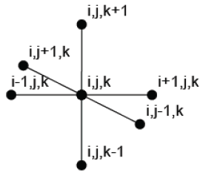
Stencil Computation
Describes the class of nearest neighbour computations on structured grids.
Each point in the grid is a weighted linear combination of a subset of neighbouring values.
©Wen-mei W. Hwu and David Kirk/NVIDIA, 2010

Slide 7
Overview
Application: 7-pt Stencil Computation/ Stencil Probe.
Optimizations and concepts covered : Improving locality and Data Reuse
  2D Tiling in Shared Memory
  Register Tiling
©Wen-mei W. Hwu and David Kirk/NVIDIA, 2010

Slide 8
Stencil Computation
High parallelism: Conceptually, all points in the grid can be updated in parallel.
Each computation performs a global sweep through the data structure.
Low computational intensity: High memory traffic for very few computations.
Challenge: Exploit parallelism without overusing memory bandwidth
©Wen-mei W. Hwu and David Kirk/NVIDIA, 2010

Slide 9

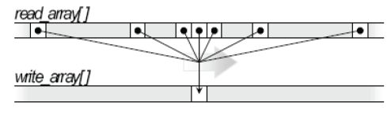
Implementation Details
General Equation:
Separate read and write arrays.
Mapping of arrays from 3D space to linear array space.
©Wen-mei W. Hwu and David Kirk/NVIDIA, 2010

Slide 10
Naïve implementation
Each thread calculates a one-element thin column along the z-dimension
  Each block computes a rectangular column along the z-dimension
Each thread loads its input elements from global memory, independently of other threads
  High read redundancy, heavy global memory traffic
Optimization – each thread can reuse data along the z-dimension
  The current center input becomes the bottom input
  The current top input becomes the center input
©Wen-mei W. Hwu and David Kirk/NVIDIA, 2010

Slide 11
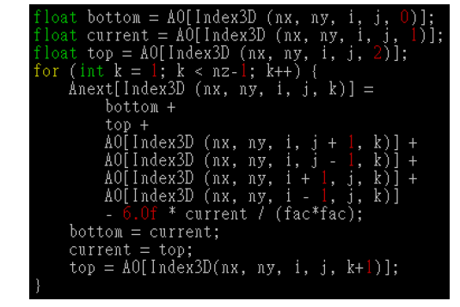
Sample Naïve Kernel Code
©Wen-mei W. Hwu and David Kirk/NVIDIA, 2010

Slide 12
Memory Loads in the Naïve Kernel
Assume no data reuse along the z-direction within each thread,
  A thread loads 7 input elements for each output element.
With data reuse within each thread,
  A thread loads 5 input elements for each output
©Wen-mei W. Hwu and David Kirk/NVIDIA, 2010

Slide 13
Data Reuse
Each internal point is used to calculate seven output values
  self, 4 planar neighbors, top and bottom neighbors
Surface, edge, and corner points are used for fewer output values
©Wen-mei W. Hwu and David Kirk/NVIDIA, 2010

Slide 14
Improving Locality: 2D Tiling
Assume that all threads of a block march up the z-direction in synchronized phases
In each phase, all threads calculate a 2-D slide of the rectangular output column
For each phase, maintain three slices of relevant input data in the on-chip memories
  One top and one bottom element in each thread’s private registers
  All current elements also in shared memory
©Wen-mei W. Hwu and David Kirk/NVIDIA, 2010

Slide 15
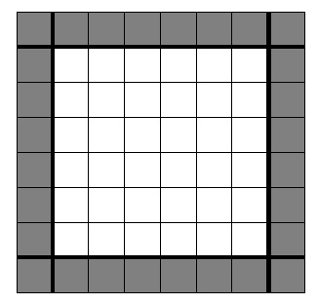
Improving Locality: 2D Tiling (cont.)
From one phase to next, the kernel code
  Moves current element to register for lower element
  Moves top element from top register to current register and shared memory
  Load new top element from Global Memory to register
Need to load halo data as well
  Needed to calculate edge elements
  of the column
  For each 3D nxmxp output block to
  be computed, we need to load
  (n+2)x(m+2)x(p+2) inputs..
©Wen-mei W. Hwu and David Kirk/NVIDIA, 2010

Slide 16
Halo overhead can hurt.
For small n and m, the halo overhead can be very significant
  If n=16 and m = 8, each slice calculates 16*8=128 output elements in each slice and needs to load 18*10=180 input elements
  In optimized naive code, each output element needs 5 loads from global memory, a total of 5*128=640 loads
  The total ratio of improvement is 640/180 = 3.5, rather than 5 times
  The value of n and m are limited by the amount of registers and shared memory in each SM
©Wen-mei W. Hwu and David Kirk/NVIDIA, 2010

Slide 17
CONVOLUTION EXAMPLE
©Wen-mei W. Hwu and David Kirk/NVIDIA, 2010

Slide 18
Convolution
A convolution kernel is used to change an input element to the weighed linear combination of its neighbors.
in
Thread 1
Thread 2
…
out
©Wen-mei W. Hwu and David Kirk/NVIDIA, 2010

Slide 19
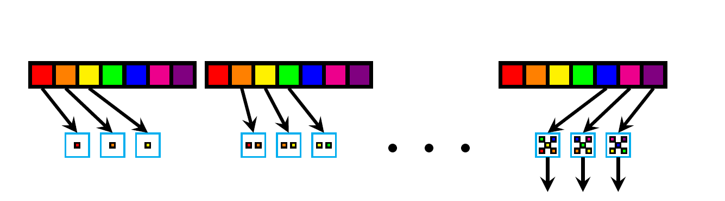
Example: Convolution – Base Code
Each parallel task calculates an output element
Figure shows
  1D convolution with K=5 kernel
  Calculation of 3 output elements
Highly parallel but memory bandwidth inefficient
  Each input element loaded up to K times
Input elements in main memory
©Wen-mei W. Hwu and David Kirk/NVIDIA, 2010

Slide 20
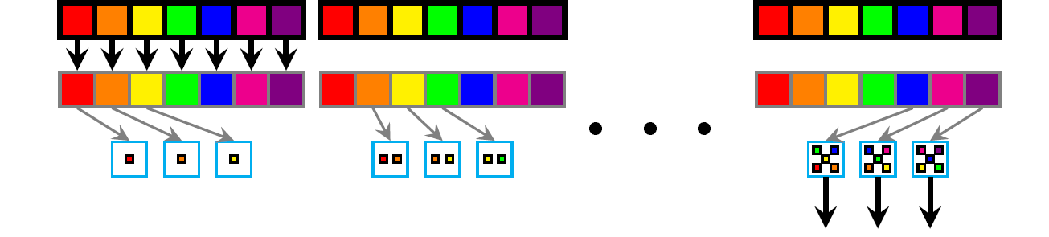
Example: convolution using shared memory
Output elements calculated from shared memory contents
  Each input element loaded only once
  Shared memory pressure – (K-1+N) input elements needed for N output elements
    7/3 = 2.3, 7²/3² = 5.4, 7³ / 3³ = 12
    For small shared memory, the benefit can be significantly reduced due to the high-ratio of additional elements loaded.
Input elements first loaded into cache
©Wen-mei W. Hwu and David Kirk/NVIDIA, 2010

Slide 21
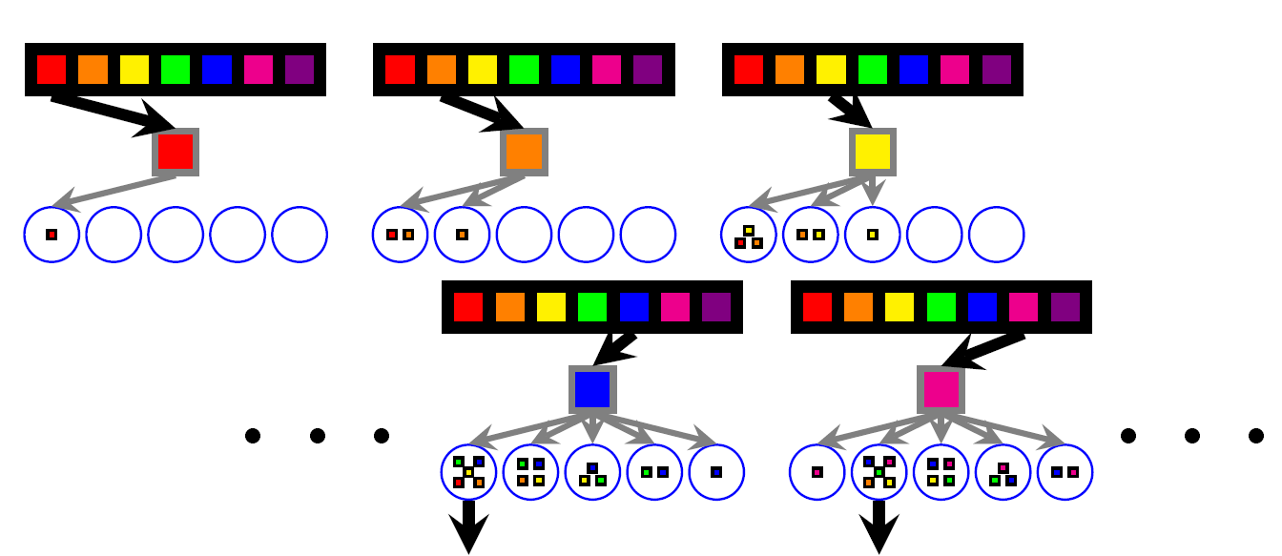
Example: Streaming for Reduced Shared Memory Pressure
1D: Each input element is loaded into shared memory in turn
  Or a (n-1)D slice in nD convolution
All threads consume that input element
  “loop skewing” needed to align the consumption of input elements
  This stretches the effective size of the on-chip cache

Slide 22
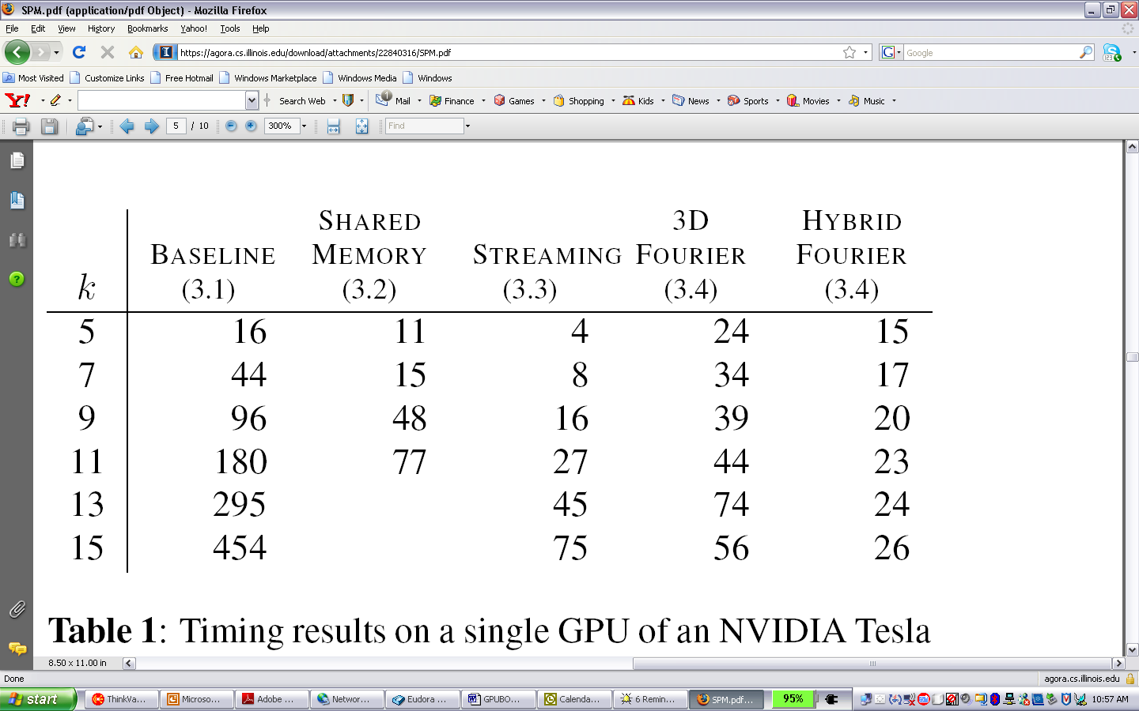
Many-core GPU Timing Results
Time to compute a 3D k³-kernel convolution on 4 frames of a 720X560 video sequence
  All times are in milliseconds
  Timed on a Tesla S1070 using one G280 GPU

Slide 23
Tiling for convolution is both easy and hard
Convolution is conceptually easy to block
  All threads that calculate a tile of output can share a tile of input
High-performance tiling can be hard to achieve
  Larger convolution kernels increase data sharing but also increase halo overhead
  Many 3D convolution kernels cannot be done by traversing along the z-dimension sequentially
  Higher-dimension convolution quickly run out of on-chip memory space
©Wen-mei W. Hwu and David Kirk/NVIDIA, 2010

Slide 24
ANY MORE QUESTIONS?
©Wen-mei W. Hwu and David Kirk/NVIDIA, 2010

