Slide 1
A Framework for Detection of Anomalous and Suspicious Behavior from Agent’s Spatio-Temporal Traces
Boštjan Kaluža Depratment of Intelligent Systems, Jožef Stefan Institute December 12, 2012, Ljubljana, Slovenia

Slide 2

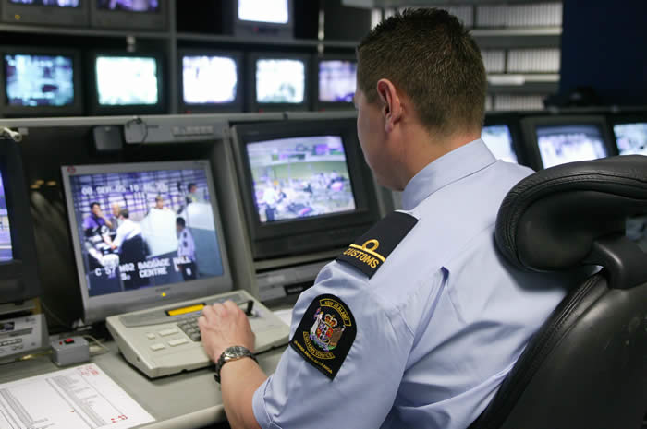

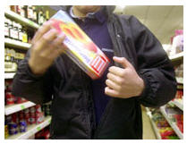

Suspicious and Anomalous Behavior
-
Suspicious behavior detection
Fits negative behavior pattern
Anomalous behavior detection
Does not fit positive behavior pattern
Example domains
Passengers at the airport
Reckless drivers
Misuse of server access
Shoplifting
Pirate vessels
An elderly person at home
-
-
-
-
-
o
-
-
+
+
+
+
+
o
+
+
+

Slide 3
Problem Statement
Goal: Detect suspicious and anomalous behavior from agent’s spatio-temporal traces in environment
Main challenges
Noisy sensors, noisy traces
Behavior consist of actions and activities
Behavior reflects on different time scales and modalities
Non-linear accumulation of suspicion over time
Environment
Agent

Slide 4
Outline
Framework
Overview
Components
Example domains
Security domain
Ambient-assisted living domain
Surveillance domain
Conclusion

Slide 5
General Framework Overview
LEARNING
DETECTION
Agent’s Traces in the Environment
New Trace
Preprocessing
Action Trace
Behavioral Pattern Discovery
Behavioral Pattern Matching
Domain Knowledge
Discovered Patterns
Behavior Evaluation

Slide 6
Environment
Agent’s traces in the environment
Environment
Agent
Activity recognition pipeline
Agent
Activity trace
Behavior signatures
Behavior trace
Time scale 1
Time scale n
Modality
1
Modality m
…
…
Deviant behavior detection
Deviant behavior detection
Deviant behavior detection
Deviant behavior detection
…
…
Combining time scales and modalities
Accumulating deviant behavior over time
Degree of deviation

Slide 7
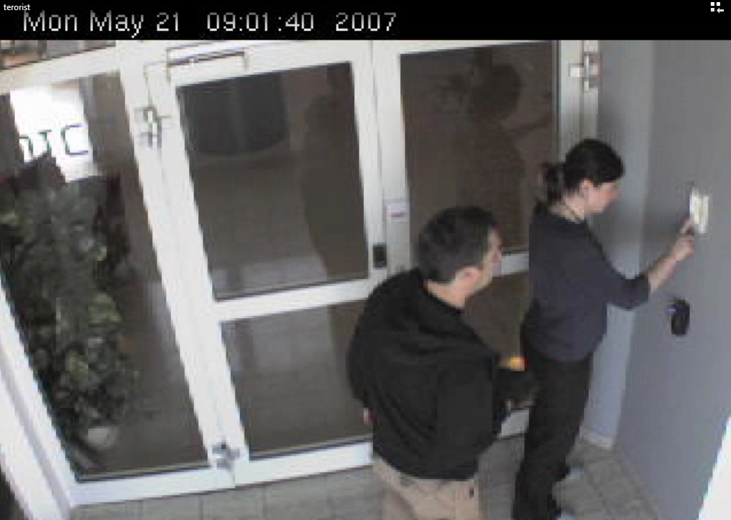
Security Domain (CIVaBiS)
Biometrically secured access point
Fingerprint reader
Wireless ID card
Electronic lock
We observe
Timings registered at various HW
Task: Decide whether identity of entering person matches introduced identity
video
B. Kaluža, E. Dovgan, T. Tušar, M. Tambe, M. Gams. A Probabilistic Risk Analysis for Multimodal Entry Control. Expert Systems with Applications, 2011.

Slide 8
Environment
Agent’s traces in the environment
High-security access point
Agent
Discrete actions
Person
Activity trace
Behavior signatures:
Sensor data + context
Behavior trace
Micro scale
Mezo scale
Macro scale
Visual modality
Expert knowledge
LOF
Decision trees
Decision trees
Optical flows
Expert rules
Combining time scales and modalities
Bayesian network
None accumulation over time
Degree of deviation

Slide 9
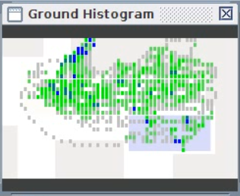
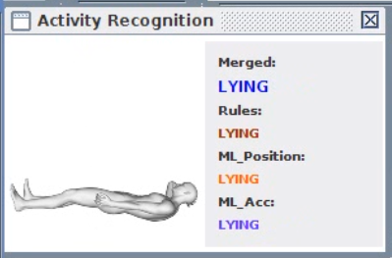
Ambient Assisted Living (Confidence)
User lives at home alone
We observe
3D coordinates
Posture
Location
Task: detect anomalous changes in behavior that indicate health problem
video
B. Kaluža and M. Gams. Analysis of Daily-Living Dynamics. Journal of Ambient Intelligence and Smart Environments, 2012. M. Luštrek and B. Kaluža. Fall Detection and Activity Recognition with Machine Learning. Informatica, 2009.

Slide 10
Environment
Agent’s traces in the environment
Home
Agent
Activity recognition pipeline
Noise filtering
Attribute computation
Random forest model
HMM smoothing
Elderly
Activity trace
Behavior signatures:
Spatial-activity matrix
Behavior trace
Half Day
Full day
Week
Month
PCA
LOF
PCA
LOF
PCA
LOF
PCA
LOF
Combining time scales and modalities:
Expert rules
None accumulation over time
Degree of deviation

Slide 11
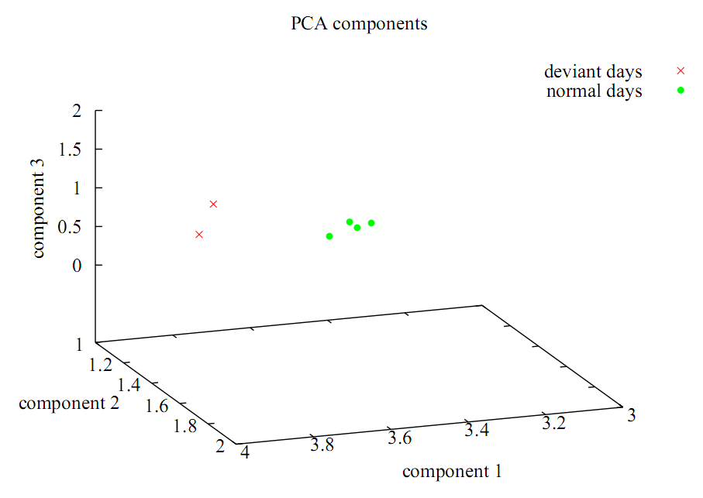
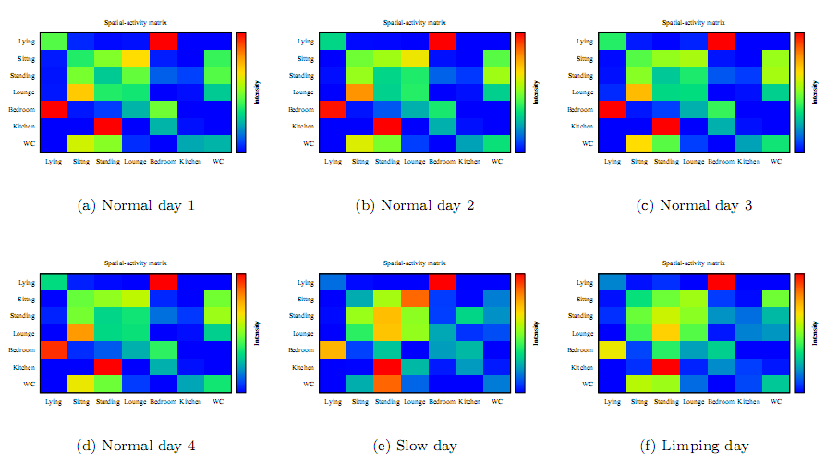
Ambient Assisted Living (Confidence)

Slide 12
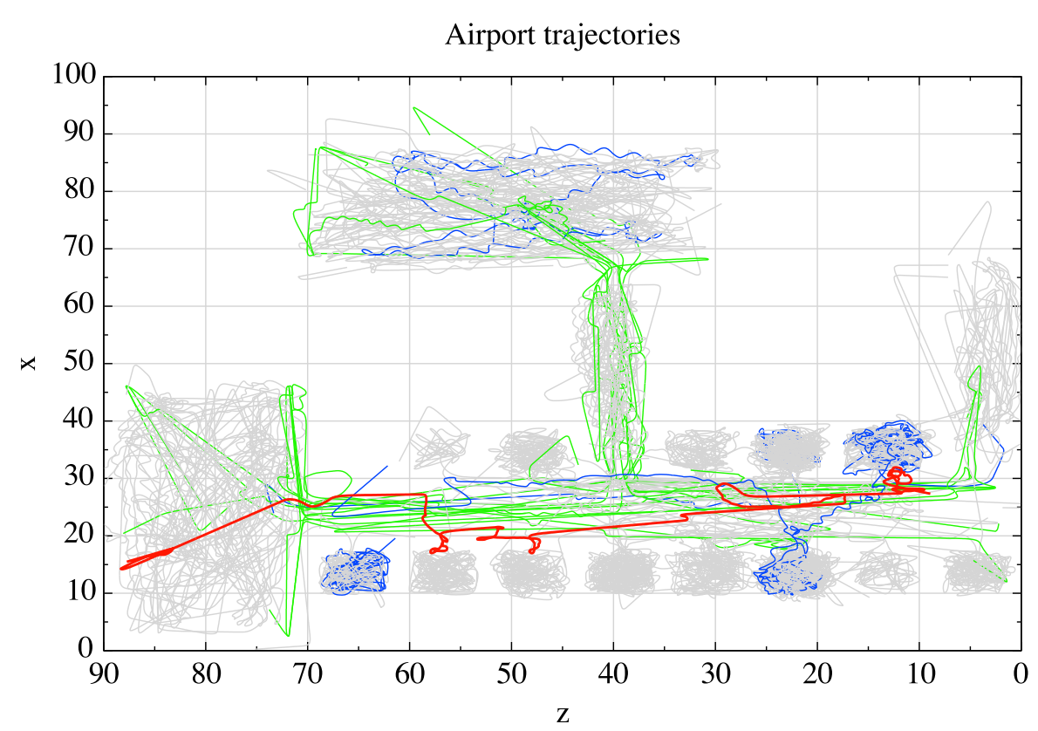
Surveillance (LAX)
video
Observe passengers at the airport
Extract
2D traces of movement
Trigger events
Task: detect and evaluate trigger events that help to identify individuals that indicate high level of stress, fear or deception
B. Kaluža, G. Kaminka, M. Tambe. Detection of Suspicious Behavior from a Sparse Set of Multiagent Interactions. AAMAS 2012, Valencia, Spain, June 2012.

Slide 13
Environment
Agent’s traces in the environment
Airport
Agent
Action discretization
Passenger
Activity trace
Behavior signatures:
Trigger events, expert rules
Behavior trace
Interactions with authorities
Turning maneuvers
Coupled HMM
Naive Bayes
Combining time scales and modalities:
Expert rules
Accumulating deviant behavior over time
Naive Bayes
HMM
UPR
F-UPR
Degree of deviation

Slide 14
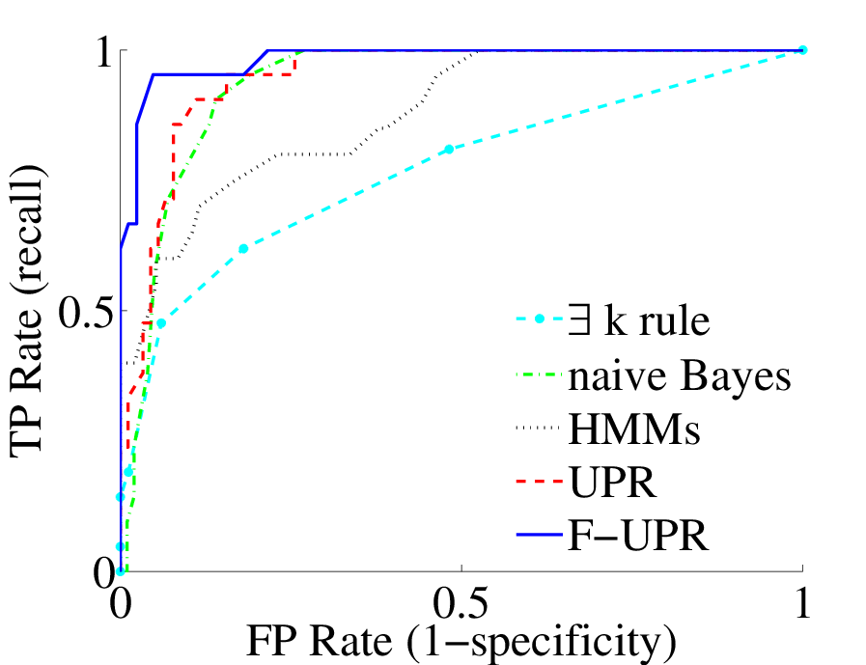
Surveillance (LAX): Results

Slide 15
Summary
Framework for deviant behavior detection
Activity recognition
Behavior signatures
Multiple time spans and modalities
Accumulation over time
Applied on three domains
High-security access point
Ambient assisted living
Airport surveillance

