Slide 1
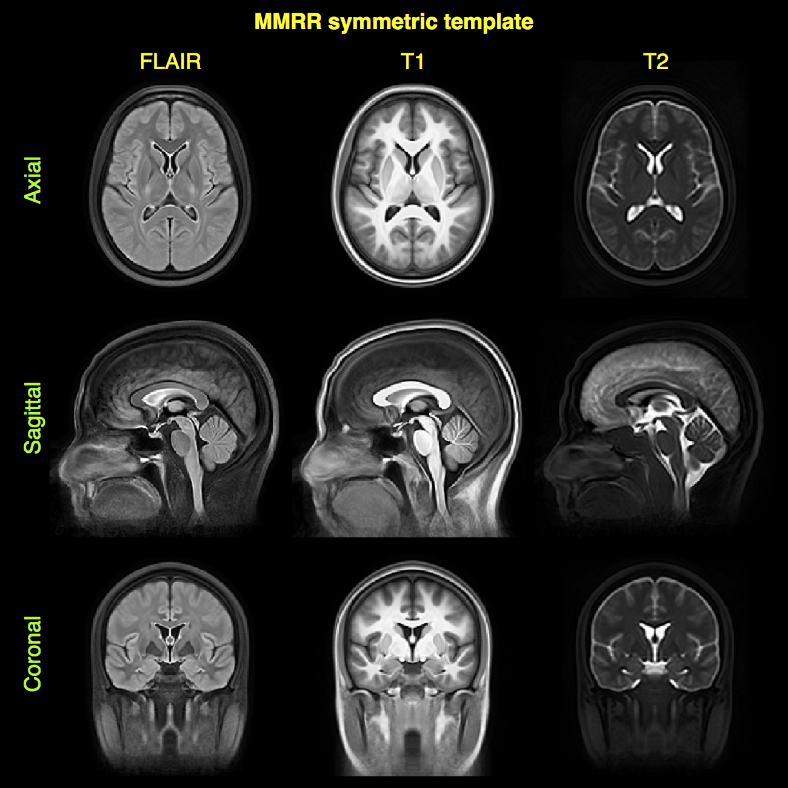
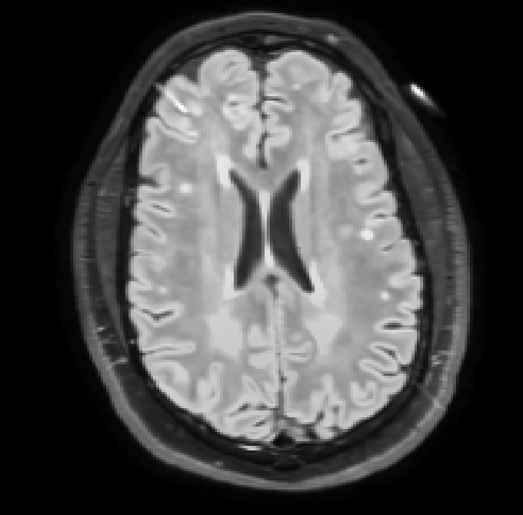
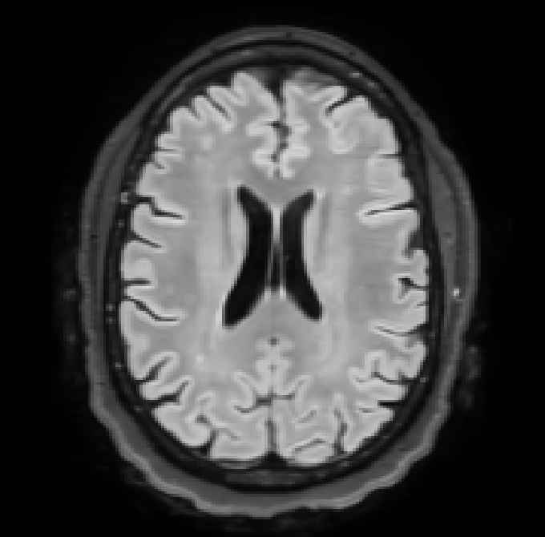
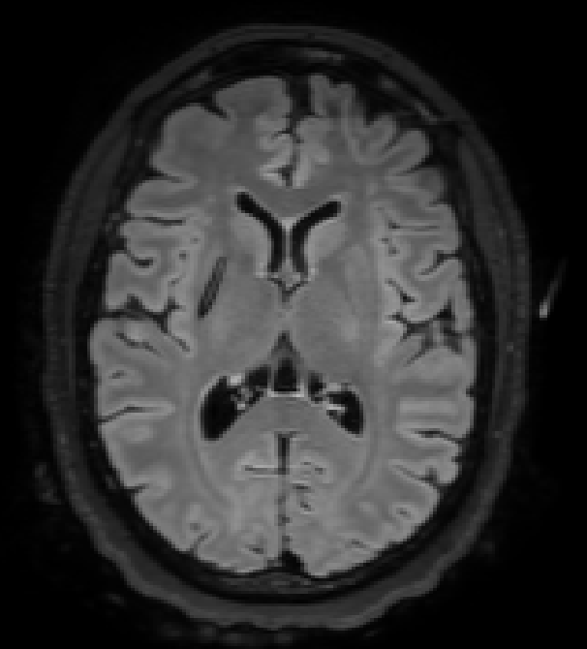
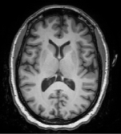

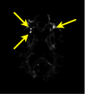
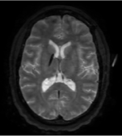
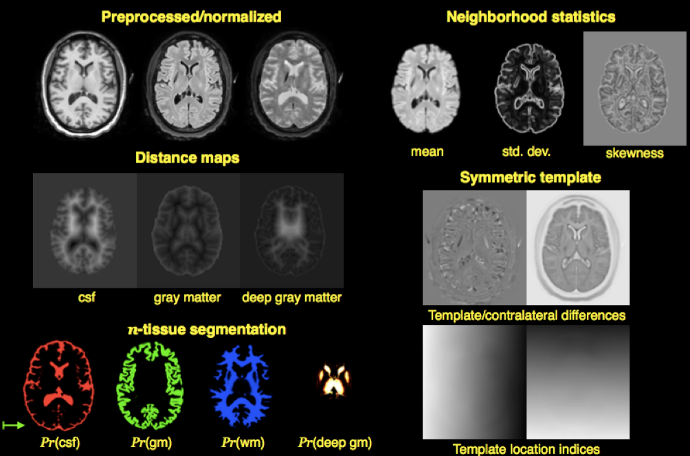
Symmetric
multimodal template
Random forest model construction
(offline)
Training data (original + feature images)
Multi-modal input
(single subject)
Output
Subject 1
Subject 2
Subject N
T1
FLAIR
Calculate feature images
RF stage 1 model
RF stage 2 model
WMH prob. map
T2

