Slide 1
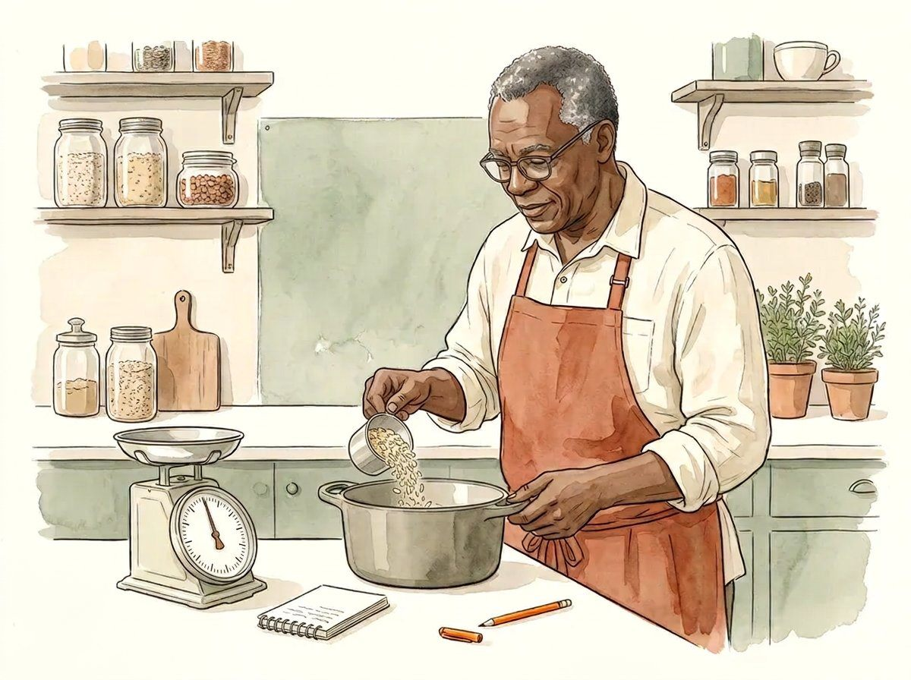
PANTRY NOTES / THE MEASUREMENT NOTEBOOK
01
01 / Start with a question
THE OBSERVATION
Notice before you measure.
This field journal explores quantities, units and written observations through a familiar kitchen setting. Its numbers are invented learning examples, not readings from the pictured instruments. Start by saying what you want to describe.
MODEL / METHOD NOTE
Observation → quantity → unit → method.
Watercolour study 1 / illustration, not measurement evidence
TRY / REFLECT
Name one quantity you could describe without claiming a recipe or safety outcome.
COMPLETE / 32 PAGES / 16 INDEPENDENT MAIN ILLUSTRATIONS / MODEL NUMBERS, NOT REAL READINGS

Slide 2
PANTRY NOTES / THE MEASUREMENT NOTEBOOK
02
01 / Start with a question
THE OBSERVATION
Make the question small.
“How much is in this bowl?” is ambiguous. It might ask for mass, volume, price or a portion count. A useful measurement question names one quantity, the object and the intended comparison.
MODEL / METHOD NOTE
Example question: What is the mass of these dry oats, excluding the bowl?
Watercolour study 1 / illustration, not measurement evidence
TRY / REFLECT
Rewrite a broad kitchen question so a second reader knows what would be measured.
COMPLETE / 32 PAGES / 16 INDEPENDENT MAIN ILLUSTRATIONS / MODEL NUMBERS, NOT REAL READINGS

Slide 3
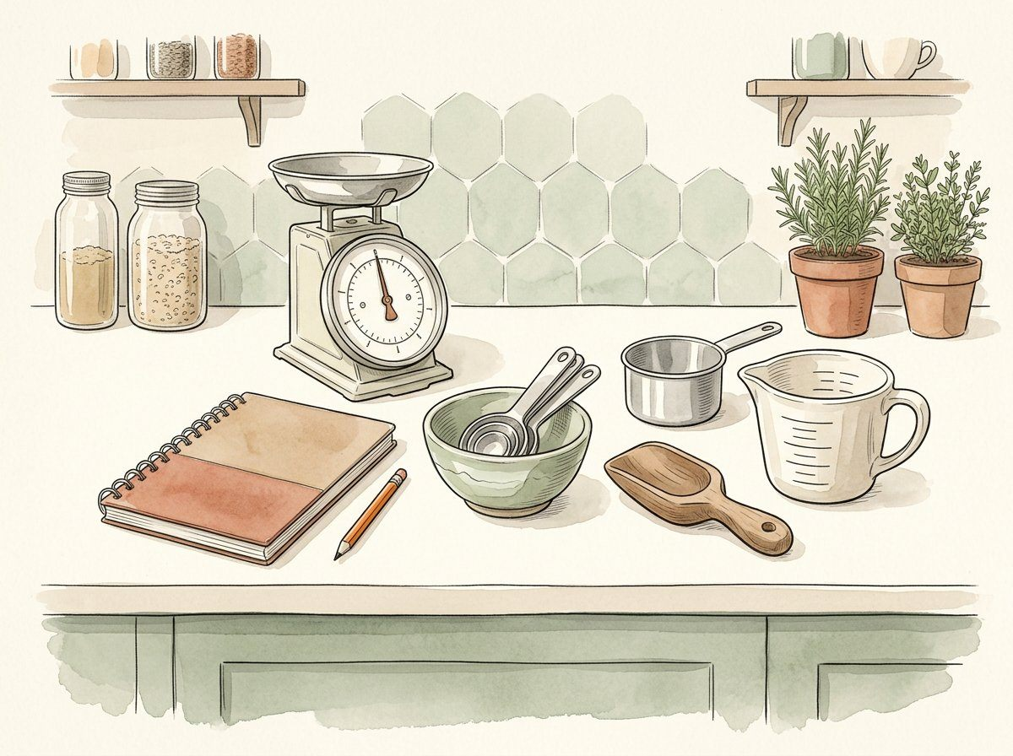
PANTRY NOTES / THE MEASUREMENT NOTEBOOK
03
01 / Start with a question
THE OBSERVATION
A tool does not define the claim.
A scale and a jug answer different questions. The illustration is contextual, not a calibrated instrument. Select a method appropriate to the quantity and describe the method rather than inferring accuracy from an attractive picture.
MODEL / METHOD NOTE
Mass and volume are different quantities.
Watercolour study 2 / illustration, not measurement evidence
TRY / REFLECT
Which question calls for a mass reading, and which calls for a volume reading?
COMPLETE / 32 PAGES / 16 INDEPENDENT MAIN ILLUSTRATIONS / MODEL NUMBERS, NOT REAL READINGS

Slide 4
PANTRY NOTES / THE MEASUREMENT NOTEBOOK
04
01 / Start with a question
THE OBSERVATION
Attach the unit immediately.
A bare number is not enough. “200” might mean grams, millilitres or a count. Keep the quantity and unit together in notes and handoffs so someone else does not have to reconstruct the meaning.
MODEL / METHOD NOTE
200 g is a mass expression; 200 mL is a volume expression.
Watercolour study 2 / illustration, not measurement evidence
TRY / REFLECT
Write two complete observations using different quantity-unit pairs.
COMPLETE / 32 PAGES / 16 INDEPENDENT MAIN ILLUSTRATIONS / MODEL NUMBERS, NOT REAL READINGS

Slide 5
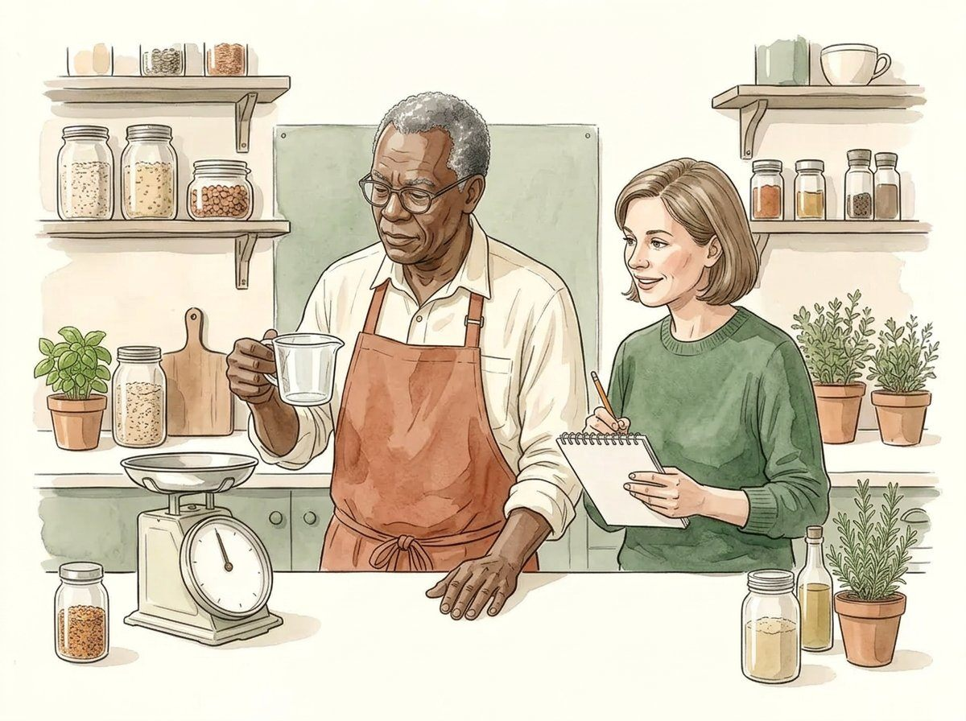
PANTRY NOTES / THE MEASUREMENT NOTEBOOK
05
02 / Read the units
THE OBSERVATION
One thousand grams.
For this unit relationship, one kilogram equals one thousand grams. Converting the written unit does not change the physical quantity, improve the instrument or make an observation more accurate.
MODEL / METHOD NOTE
1 kg = 1,000 g; 0.25 kg = 250 g.
Watercolour study 3 / illustration, not measurement evidence
TRY / REFLECT
Express 0.6 kg in grams without changing the quantity described.
COMPLETE / 32 PAGES / 16 INDEPENDENT MAIN ILLUSTRATIONS / MODEL NUMBERS, NOT REAL READINGS

Slide 6
PANTRY NOTES / THE MEASUREMENT NOTEBOOK
06
02 / Read the units
THE OBSERVATION
One thousand millilitres.
One litre equals one thousand millilitres. Keep this volume conversion separate from mass. A conversion between litres and grams needs additional material information and cannot be inferred from the unit names alone.
MODEL / METHOD NOTE
1 L = 1,000 mL; 0.4 L = 400 mL.
Watercolour study 3 / illustration, not measurement evidence
TRY / REFLECT
Explain why 400 mL cannot automatically be renamed 400 g for every material.
COMPLETE / 32 PAGES / 16 INDEPENDENT MAIN ILLUSTRATIONS / MODEL NUMBERS, NOT REAL READINGS

Slide 7
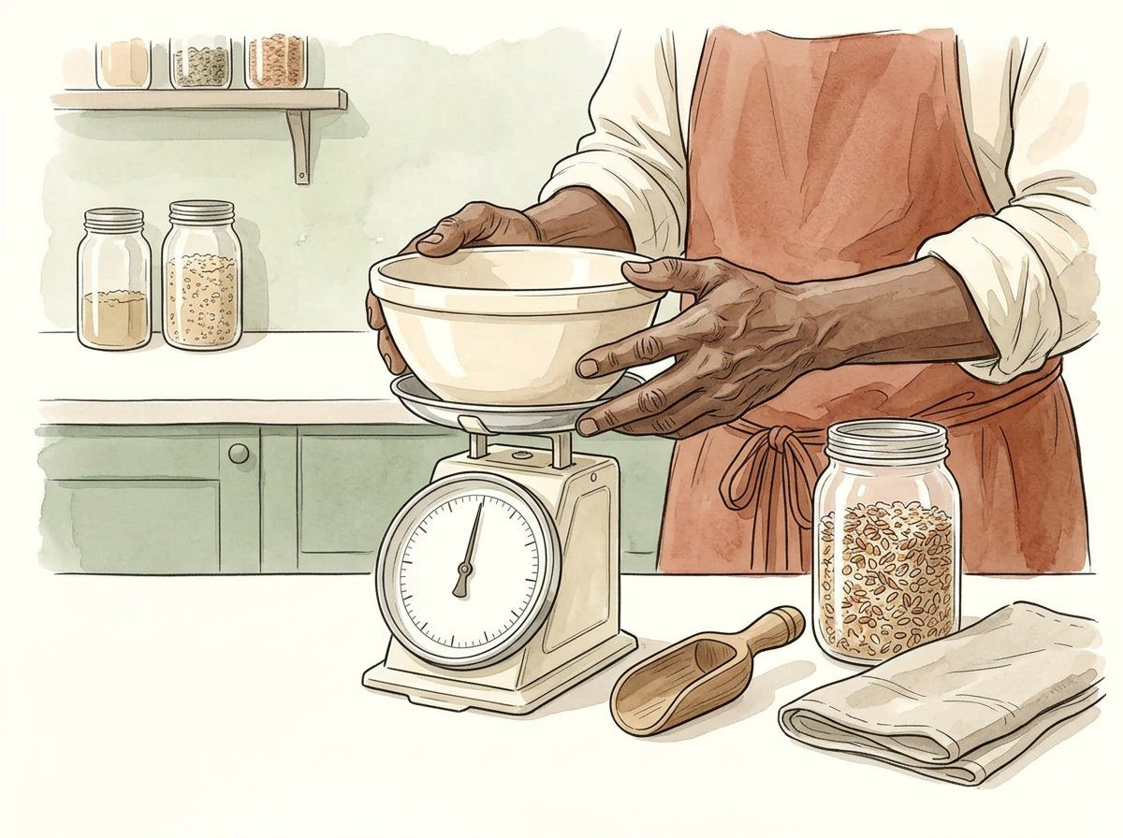
PANTRY NOTES / THE MEASUREMENT NOTEBOOK
07
02 / Read the units
THE OBSERVATION
The container belongs in the method.
If a reading includes a bowl, that reading describes bowl plus contents. Record whether the container was excluded by the method or subtracted later. Do not silently compare a combined reading with a contents-only reading.
MODEL / METHOD NOTE
Name the empty-container step before recording a contents-only result.
Watercolour study 4 / illustration, not measurement evidence
TRY / REFLECT
What would be missing from a note that says only “the bowl reads 320 g”?
COMPLETE / 32 PAGES / 16 INDEPENDENT MAIN ILLUSTRATIONS / MODEL NUMBERS, NOT REAL READINGS

Slide 8
PANTRY NOTES / THE MEASUREMENT NOTEBOOK
08
02 / Read the units
THE OBSERVATION
Subtract like quantities.
In this invented arithmetic example, bowl plus contents is 320 g and the empty bowl is 120 g. Subtracting the container gives 200 g for the contents within the example. This is not evidence of scale accuracy.
MODEL / METHOD NOTE
320 g − 120 g = 200 g.
Watercolour study 4 / illustration, not measurement evidence
TRY / REFLECT
If the combined example is 410 g and the bowl is 160 g, what mass remains?
COMPLETE / 32 PAGES / 16 INDEPENDENT MAIN ILLUSTRATIONS / MODEL NUMBERS, NOT REAL READINGS

Slide 9
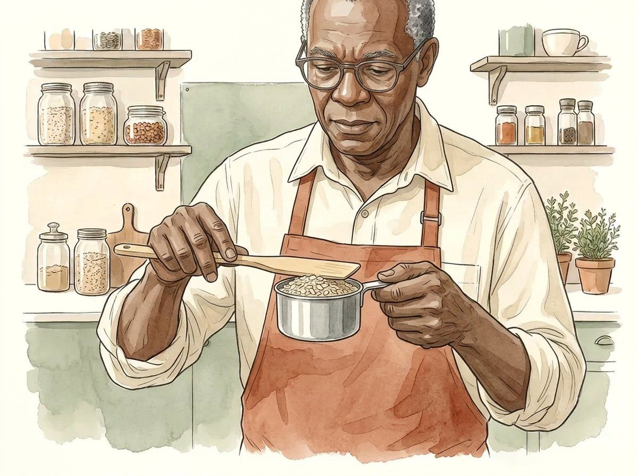
PANTRY NOTES / THE MEASUREMENT NOTEBOOK
09
03 / Keep a method
THE OBSERVATION
Describe the fill.
A cup of dry material may be loosely filled, compressed or heaped. Those are different preparation methods. Name the chosen method before comparing results; the drawing is an illustration, not a universally specified kitchen standard.
MODEL / METHOD NOTE
Record: material / container / fill method / unit.
Watercolour study 5 / illustration, not measurement evidence
TRY / REFLECT
Which part of a fill method would you need to repeat for a fair comparison?
COMPLETE / 32 PAGES / 16 INDEPENDENT MAIN ILLUSTRATIONS / MODEL NUMBERS, NOT REAL READINGS

Slide 10
PANTRY NOTES / THE MEASUREMENT NOTEBOOK
10
03 / Keep a method
THE OBSERVATION
Volume is not a material shortcut.
Equal volumes of different materials need not have equal mass. A cup of oats and a cup of another material cannot be exchanged by mass without a justified relationship. This journal supplies no density table or recipe conversion.
MODEL / METHOD NOTE
Same stated volume does not guarantee the same mass.
Watercolour study 5 / illustration, not measurement evidence
TRY / REFLECT
Identify the unsupported assumption in “every full cup weighs the same”.
COMPLETE / 32 PAGES / 16 INDEPENDENT MAIN ILLUSTRATIONS / MODEL NUMBERS, NOT REAL READINGS

Slide 11
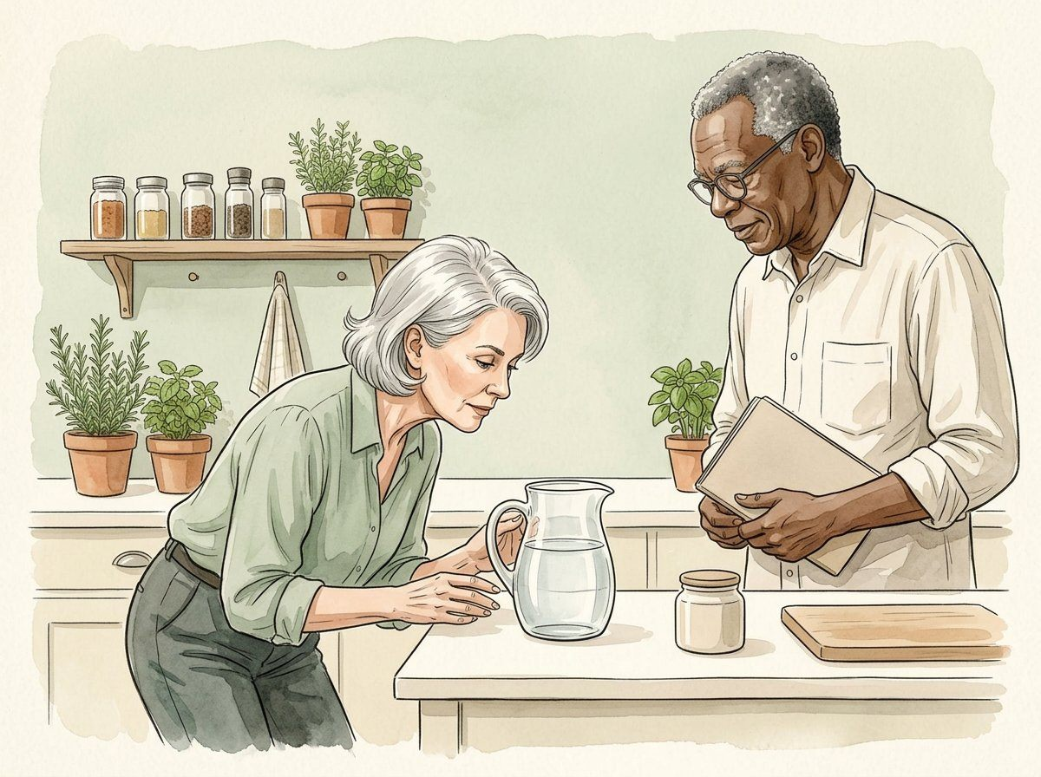
PANTRY NOTES / THE MEASUREMENT NOTEBOOK
11
03 / Keep a method
THE OBSERVATION
Name how you read a level.
A liquid-level observation depends on the vessel and reading method. Describe the position and tool used, and follow the actual tool instructions. The pictured jug has no calibrated markings and should not be used to estimate a numeric reading.
MODEL / METHOD NOTE
Contextual illustration only; no numeric reading can be taken from the art.
Watercolour study 6 / illustration, not measurement evidence
TRY / REFLECT
What method details should accompany a real liquid-volume observation?
COMPLETE / 32 PAGES / 16 INDEPENDENT MAIN ILLUSTRATIONS / MODEL NUMBERS, NOT REAL READINGS

Slide 12
PANTRY NOTES / THE MEASUREMENT NOTEBOOK
12
03 / Keep a method
THE OBSERVATION
Hold the comparison conditions.
When comparing two observations, keep the named method and object consistent where the question requires it. If the material, container or preparation changes, record that change rather than presenting the values as directly interchangeable.
MODEL / METHOD NOTE
A changed method belongs beside the changed value.
Watercolour study 6 / illustration, not measurement evidence
TRY / REFLECT
Name one change that would prevent a simple like-for-like comparison.
COMPLETE / 32 PAGES / 16 INDEPENDENT MAIN ILLUSTRATIONS / MODEL NUMBERS, NOT REAL READINGS

Slide 13
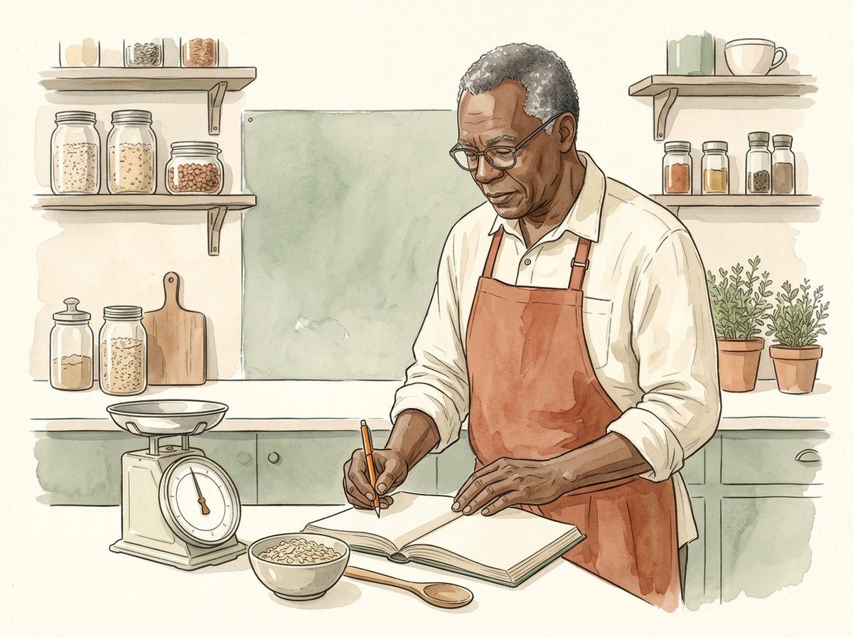
PANTRY NOTES / THE MEASUREMENT NOTEBOOK
13
04 / Keep a record
THE OBSERVATION
Write while the meaning is clear.
A compact note can preserve the quantity, unit, object, method and source. You do not need personal details to describe a kitchen arithmetic example. Write enough for another reader to understand what the value means.
MODEL / METHOD NOTE
Record template: object / quantity / unit / method / context.
Watercolour study 7 / illustration, not measurement evidence
TRY / REFLECT
Draft a short observation note without including anyone’s personal information.
COMPLETE / 32 PAGES / 16 INDEPENDENT MAIN ILLUSTRATIONS / MODEL NUMBERS, NOT REAL READINGS

Slide 14
PANTRY NOTES / THE MEASUREMENT NOTEBOOK
14
04 / Keep a record
THE OBSERVATION
Digits are not a quality certificate.
A longer number may appear precise, but its appearance does not prove accuracy. Avoid adding unsupported decimal places to a result or suggesting that a finely drawn scale is a calibration record.
MODEL / METHOD NOTE
More displayed digits do not by themselves establish accuracy.
Watercolour study 7 / illustration, not measurement evidence
TRY / REFLECT
Why is writing 200.000 g not an automatic improvement over 200 g?
COMPLETE / 32 PAGES / 16 INDEPENDENT MAIN ILLUSTRATIONS / MODEL NUMBERS, NOT REAL READINGS

Slide 15
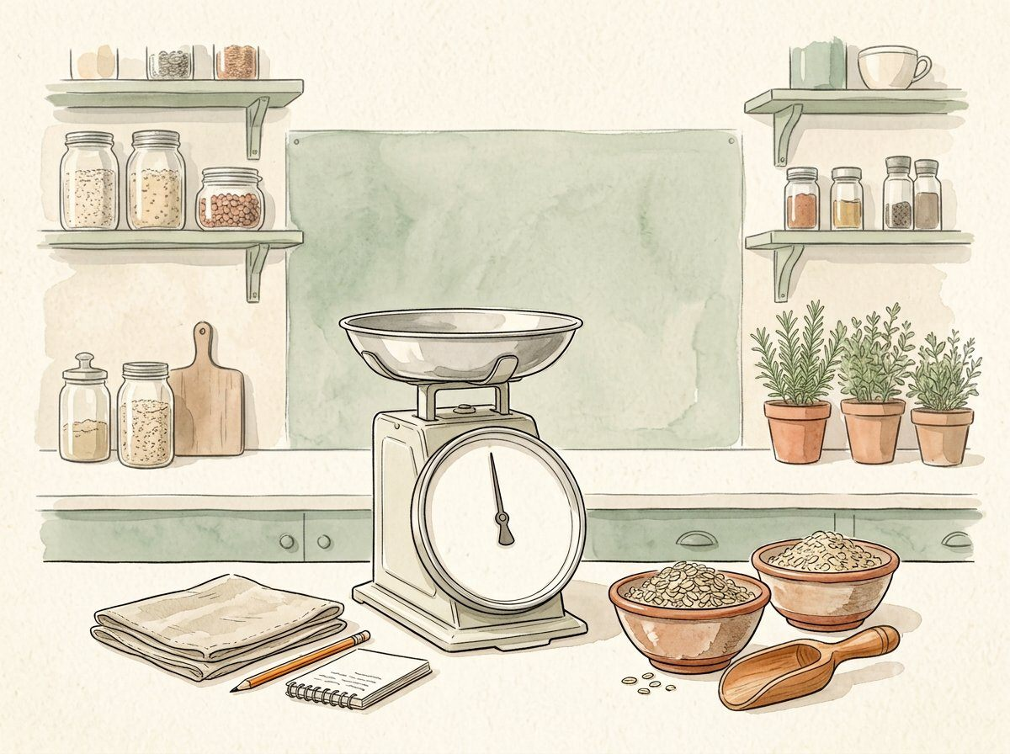
PANTRY NOTES / THE MEASUREMENT NOTEBOOK
15
04 / Keep a record
THE OBSERVATION
Repeat the stated question.
Repeated observations are useful only when their context is recorded. State whether the same material and method were used. Three values are not enough to certify an instrument or establish a general performance claim.
MODEL / METHOD NOTE
Repeated examples should keep labels and method notes attached.
Watercolour study 8 / illustration, not measurement evidence
TRY / REFLECT
What context would you preserve beside three repeated readings?
COMPLETE / 32 PAGES / 16 INDEPENDENT MAIN ILLUSTRATIONS / MODEL NUMBERS, NOT REAL READINGS

Slide 16
PANTRY NOTES / THE MEASUREMENT NOTEBOOK
16
04 / Keep a record
THE OBSERVATION
An average describes this set.
For the invented values 100 g, 102 g and 101 g, the arithmetic mean is 101 g. That summary describes these three numbers only. It does not establish the true mass or justify a claim about instrument accuracy.
MODEL / METHOD NOTE
(100 + 102 + 101) g ÷ 3 = 101 g.
Watercolour study 8 / illustration, not measurement evidence
TRY / REFLECT
Name one question the mean does not answer.
COMPLETE / 32 PAGES / 16 INDEPENDENT MAIN ILLUSTRATIONS / MODEL NUMBERS, NOT REAL READINGS

Slide 17
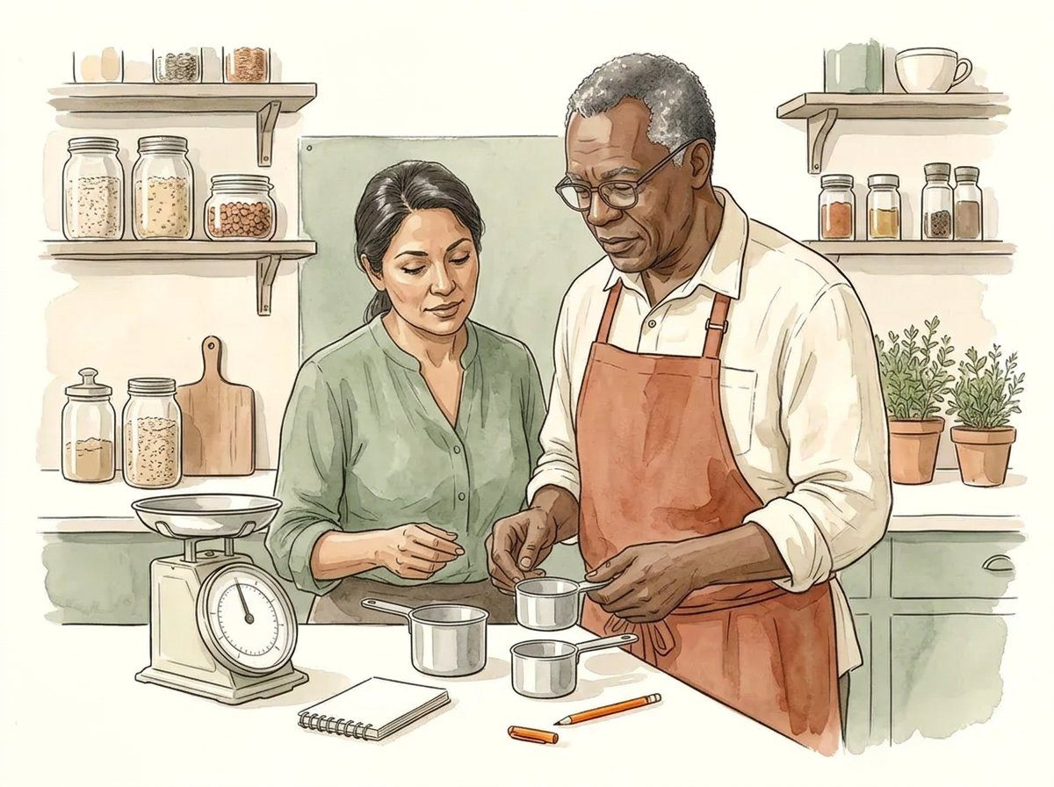
PANTRY NOTES / THE MEASUREMENT NOTEBOOK
17
05 / Compare with care
THE OBSERVATION
A cup needs a definition.
The word cup can refer to different conventions or household vessels. In this model only, cup A is defined as 240 mL and cup B as 250 mL. These definitions explain the arithmetic; they are not a universal rule for every cup.
MODEL / METHOD NOTE
Model definitions: A = 240 mL; B = 250 mL; difference = 10 mL.
Watercolour study 9 / illustration, not measurement evidence
TRY / REFLECT
Why must the chosen cup definition stay in a shared note?
COMPLETE / 32 PAGES / 16 INDEPENDENT MAIN ILLUSTRATIONS / MODEL NUMBERS, NOT REAL READINGS

Slide 18
PANTRY NOTES / THE MEASUREMENT NOTEBOOK
18
05 / Compare with care
THE OBSERVATION
Convert only a stated relationship.
A written conversion needs a known relationship between units of the same quantity, or additional justified information for unlike quantities. Do not fill a gap with a guess just to produce a clean-looking answer.
MODEL / METHOD NOTE
Known: 1 L = 1,000 mL. Not supplied: material density.
Watercolour study 9 / illustration, not measurement evidence
TRY / REFLECT
Which conversion can you complete from this page, and which must remain unresolved?
COMPLETE / 32 PAGES / 16 INDEPENDENT MAIN ILLUSTRATIONS / MODEL NUMBERS, NOT REAL READINGS

Slide 19
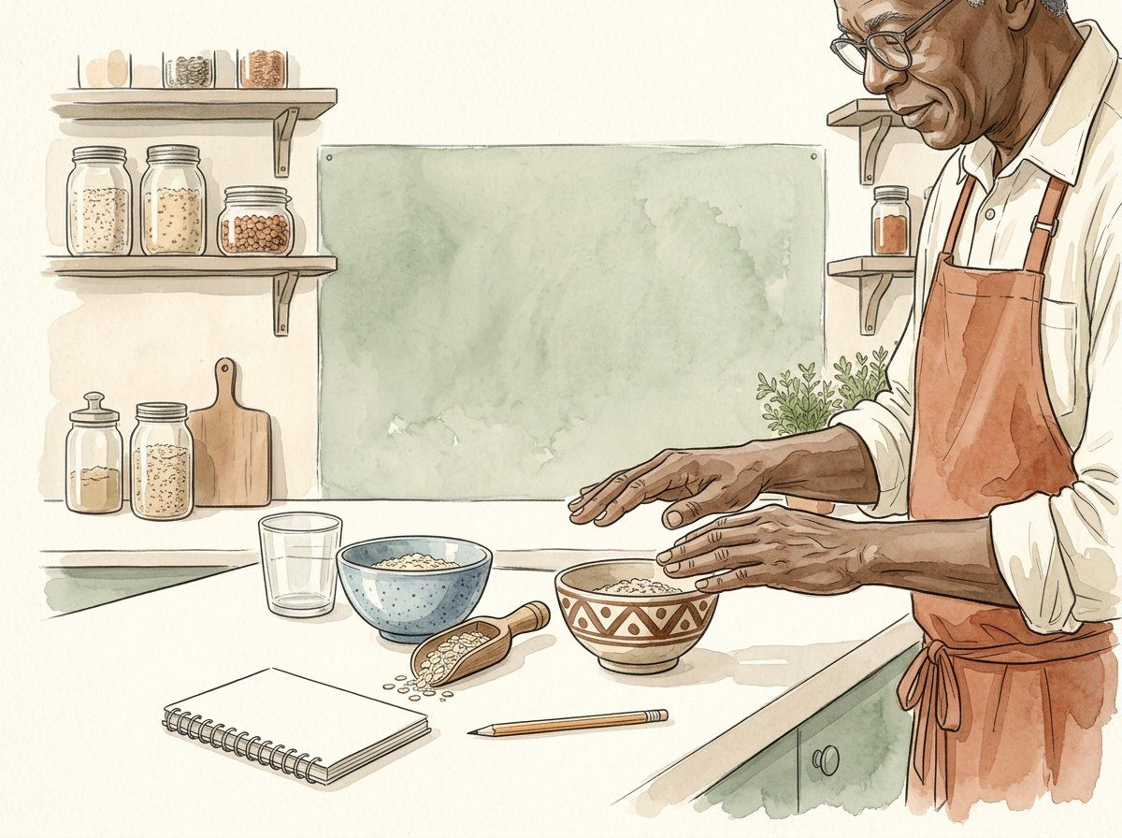
PANTRY NOTES / THE MEASUREMENT NOTEBOOK
19
05 / Compare with care
THE OBSERVATION
Double the named amount.
In this arithmetic model, doubling a specified 125 g amount gives 250 g. The operation describes a quantity relationship, not a recommendation to scale a recipe, equipment setting or process time.
MODEL / METHOD NOTE
2 × 125 g = 250 g.
Watercolour study 10 / illustration, not measurement evidence
TRY / REFLECT
Double 175 g and retain the unit in the answer.
COMPLETE / 32 PAGES / 16 INDEPENDENT MAIN ILLUSTRATIONS / MODEL NUMBERS, NOT REAL READINGS

Slide 20
PANTRY NOTES / THE MEASUREMENT NOTEBOOK
20
05 / Compare with care
THE OBSERVATION
Halve without losing the unit.
Half of the model amount 180 g is 90 g. Keeping the unit makes the result readable outside this page. A numerical scaling example does not imply that every real cooking process can be scaled in the same way.
MODEL / METHOD NOTE
180 g ÷ 2 = 90 g.
Watercolour study 10 / illustration, not measurement evidence
TRY / REFLECT
Explain what this arithmetic does—and does not—say about a real recipe.
COMPLETE / 32 PAGES / 16 INDEPENDENT MAIN ILLUSTRATIONS / MODEL NUMBERS, NOT REAL READINGS

Slide 21
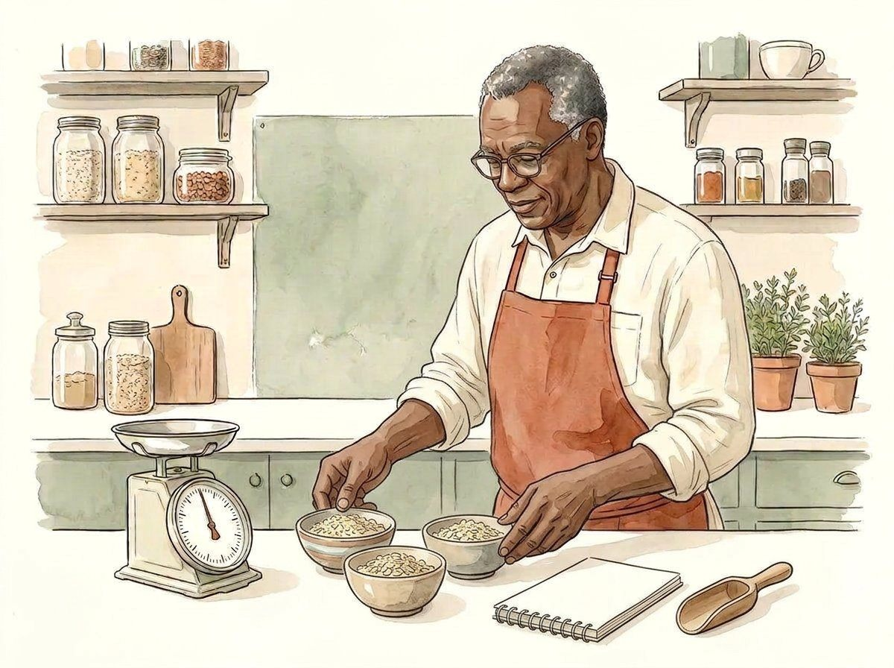
PANTRY NOTES / THE MEASUREMENT NOTEBOOK
21
06 / Describe the model
THE OBSERVATION
Equal groups are an assumption.
If a model explicitly gives three equal groups of 200 g, their combined mass is 600 g. Equal grouping is a stated assumption here, not a conclusion drawn from an illustration of several bowls.
MODEL / METHOD NOTE
3 × 200 g = 600 g, assuming three equal model groups.
Watercolour study 11 / illustration, not measurement evidence
TRY / REFLECT
What would change if the groups were not equal?
COMPLETE / 32 PAGES / 16 INDEPENDENT MAIN ILLUSTRATIONS / MODEL NUMBERS, NOT REAL READINGS

Slide 22
PANTRY NOTES / THE MEASUREMENT NOTEBOOK
22
06 / Describe the model
THE OBSERVATION
Separate fixed and variable parts.
A container contribution and a contents contribution play different roles in a combined reading. If contents change while the same container is retained, record which part was held fixed. Do not compare totals without this context.
MODEL / METHOD NOTE
Combined model = container contribution + contents contribution.
Watercolour study 11 / illustration, not measurement evidence
TRY / REFLECT
Which part would stay fixed if only the contents changed?
COMPLETE / 32 PAGES / 16 INDEPENDENT MAIN ILLUSTRATIONS / MODEL NUMBERS, NOT REAL READINGS

Slide 23
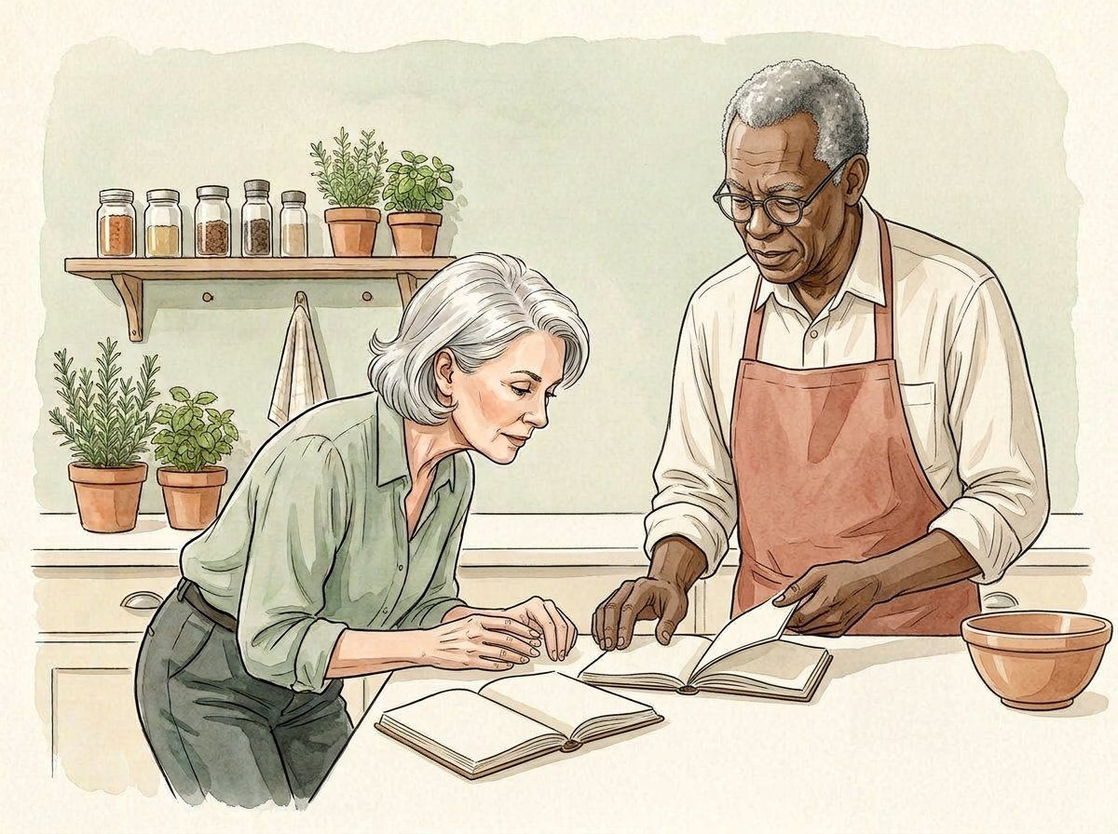
PANTRY NOTES / THE MEASUREMENT NOTEBOOK
23
06 / Describe the model
THE OBSERVATION
A discrepancy is a question.
Different numbers can arise from different objects, methods, notation or instruments. A discrepancy alone does not prove which explanation is correct. Keep the original records and list a checkable question before assigning a cause.
MODEL / METHOD NOTE
Difference observed; cause not established.
Watercolour study 12 / illustration, not measurement evidence
TRY / REFLECT
Write a question that would help distinguish a notation change from an object change.
COMPLETE / 32 PAGES / 16 INDEPENDENT MAIN ILLUSTRATIONS / MODEL NUMBERS, NOT REAL READINGS

Slide 24
PANTRY NOTES / THE MEASUREMENT NOTEBOOK
24
06 / Describe the model
THE OBSERVATION
A range is a description.
For the invented readings 98 g, 100 g and 102 g, the range is 4 g. This is the difference between largest and smallest in this set, not an uncertainty guarantee or a limit on future readings.
MODEL / METHOD NOTE
102 g − 98 g = 4 g.
Watercolour study 12 / illustration, not measurement evidence
TRY / REFLECT
Why could a later observation lie outside this three-value range?
COMPLETE / 32 PAGES / 16 INDEPENDENT MAIN ILLUSTRATIONS / MODEL NUMBERS, NOT REAL READINGS

Slide 25
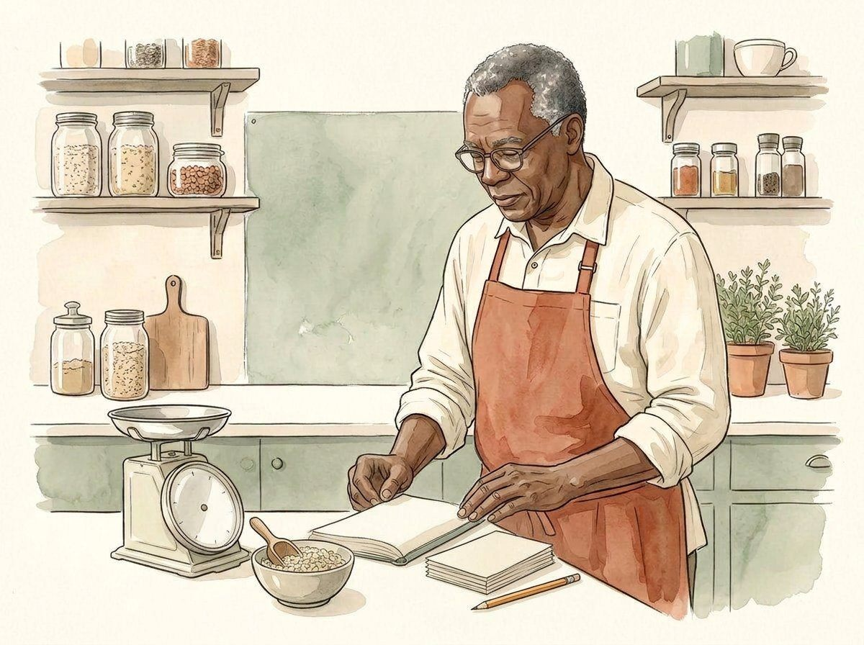
PANTRY NOTES / THE MEASUREMENT NOTEBOOK
25
07 / Share the context
THE OBSERVATION
Keep the origin attached.
When sharing an example, state whether the values were invented, observed or copied from a named source. All numbers in this journal are learning models. The illustrations do not document an actual measurement session.
MODEL / METHOD NOTE
Source label: fictional arithmetic for measurement literacy.
Watercolour study 13 / illustration, not measurement evidence
TRY / REFLECT
How would you stop someone mistaking this page for real measurement evidence?
COMPLETE / 32 PAGES / 16 INDEPENDENT MAIN ILLUSTRATIONS / MODEL NUMBERS, NOT REAL READINGS

Slide 26
PANTRY NOTES / THE MEASUREMENT NOTEBOOK
26
07 / Share the context
THE OBSERVATION
Missing is not zero.
An unrecorded value means the record does not supply a value. Replacing it with zero introduces information that was never observed. Keep a missing state explicit until there is an appropriate source or method to resolve it.
MODEL / METHOD NOTE
Not recorded ≠ observed zero.
Watercolour study 13 / illustration, not measurement evidence
TRY / REFLECT
Describe a missing reading without inventing a replacement number.
COMPLETE / 32 PAGES / 16 INDEPENDENT MAIN ILLUSTRATIONS / MODEL NUMBERS, NOT REAL READINGS

Slide 27
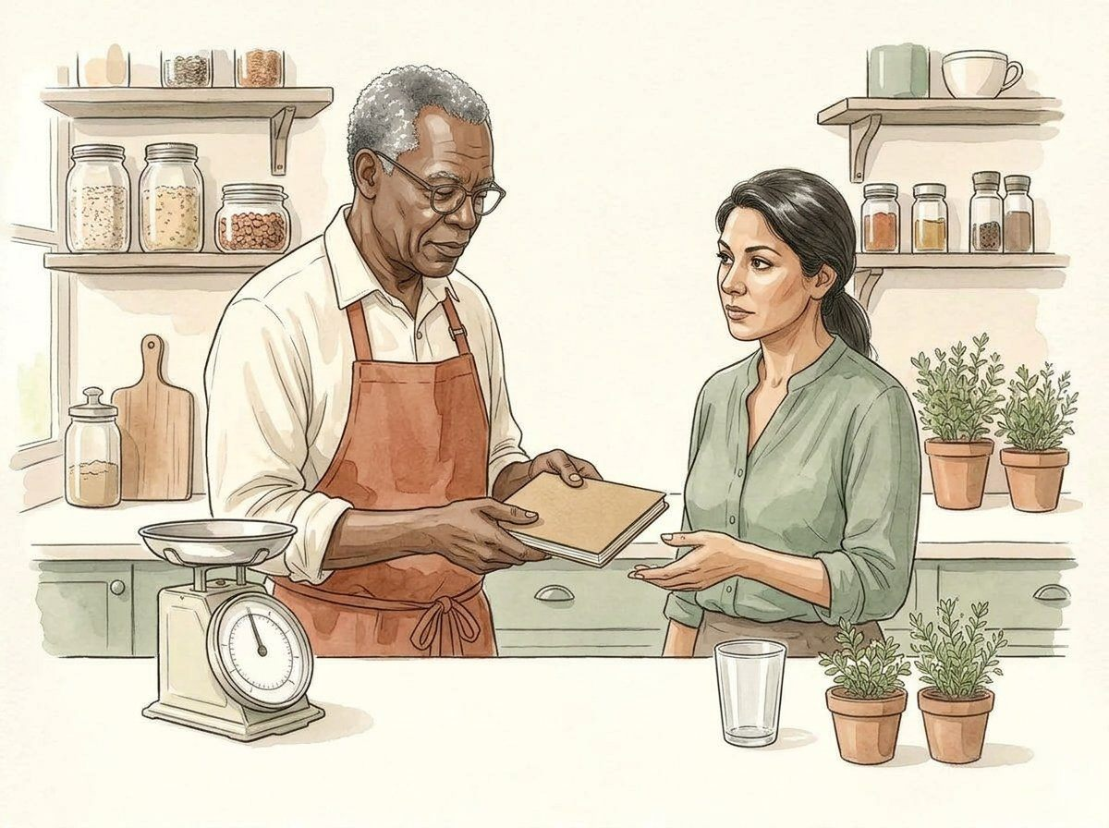
PANTRY NOTES / THE MEASUREMENT NOTEBOOK
27
07 / Share the context
THE OBSERVATION
Leave unsupported certainty out.
These examples do not quantify instrument uncertainty or certify a measurement process. If a real decision requires such information, seek an appropriate documented method and qualified support instead of inferring it from these pages.
MODEL / METHOD NOTE
No calibration, uncertainty bound or safety-critical suitability is claimed.
Watercolour study 14 / illustration, not measurement evidence
TRY / REFLECT
Which claim would exceed the evidence supplied by this notebook?
COMPLETE / 32 PAGES / 16 INDEPENDENT MAIN ILLUSTRATIONS / MODEL NUMBERS, NOT REAL READINGS

Slide 28
PANTRY NOTES / THE MEASUREMENT NOTEBOOK
28
07 / Share the context
THE OBSERVATION
Hand over a method, not a guess.
A useful handoff gives the question, the named quantity and unit, the method and known limitations. Ask the next reader to explain the note back in their own words so unclear terms can be corrected.
MODEL / METHOD NOTE
Question → quantity/unit → method → limitations → next reader.
Watercolour study 14 / illustration, not measurement evidence
TRY / REFLECT
Which term would you clarify before a second person repeats the example?
COMPLETE / 32 PAGES / 16 INDEPENDENT MAIN ILLUSTRATIONS / MODEL NUMBERS, NOT REAL READINGS

Slide 29
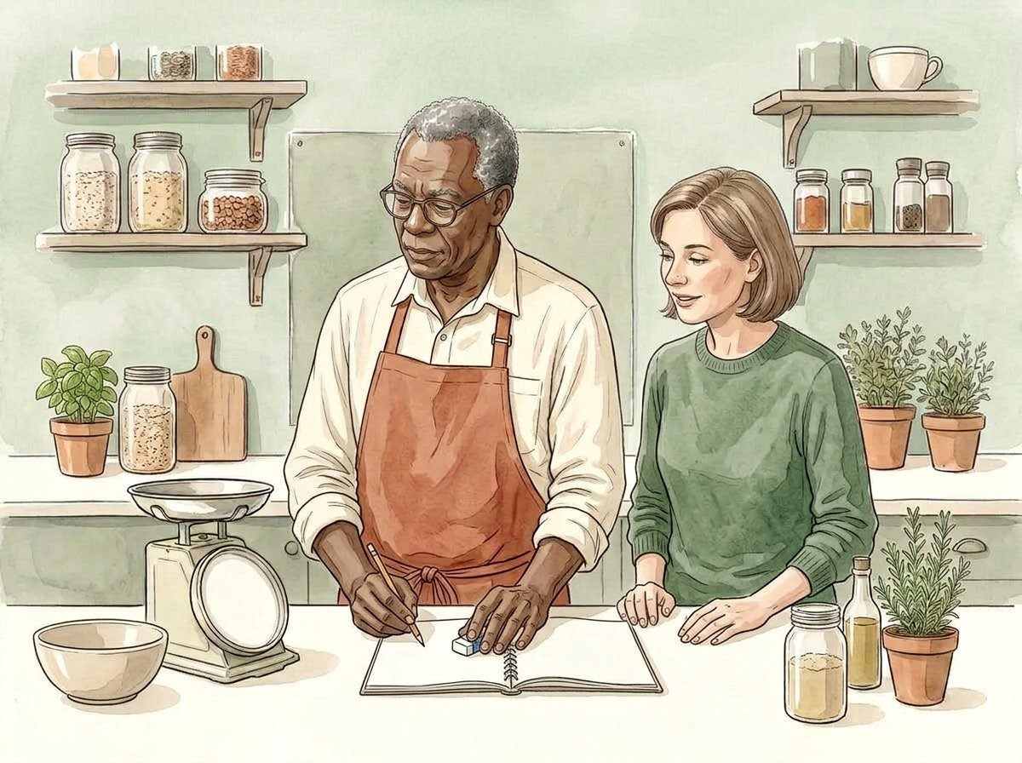
PANTRY NOTES / THE MEASUREMENT NOTEBOOK
29
08 / Close the notebook
THE OBSERVATION
Revise without erasing the trail.
If a notation error is found, preserve the distinction between the original note and the corrected version. A correction should explain what changed; it is not a reason to invent a missing observation or conceal a method difference.
MODEL / METHOD NOTE
Correction example: unit label clarified; original observation not re-created.
Watercolour study 15 / illustration, not measurement evidence
TRY / REFLECT
How would you label a correction without pretending to have remeasured the object?
COMPLETE / 32 PAGES / 16 INDEPENDENT MAIN ILLUSTRATIONS / MODEL NUMBERS, NOT REAL READINGS

Slide 30
PANTRY NOTES / THE MEASUREMENT NOTEBOOK
30
08 / Close the notebook
THE OBSERVATION
Check the unit in the answer.
Review arithmetic and units together. Adding 100 g to 50 g gives 150 g within the model. Adding a mass to an unrelated volume is not justified just because both values are numbers.
MODEL / METHOD NOTE
100 g + 50 g = 150 g; grams + millilitres needs a different explanation.
Watercolour study 15 / illustration, not measurement evidence
TRY / REFLECT
Find one valid calculation and one unsupported combination in your own draft notes.
COMPLETE / 32 PAGES / 16 INDEPENDENT MAIN ILLUSTRATIONS / MODEL NUMBERS, NOT REAL READINGS

Slide 31
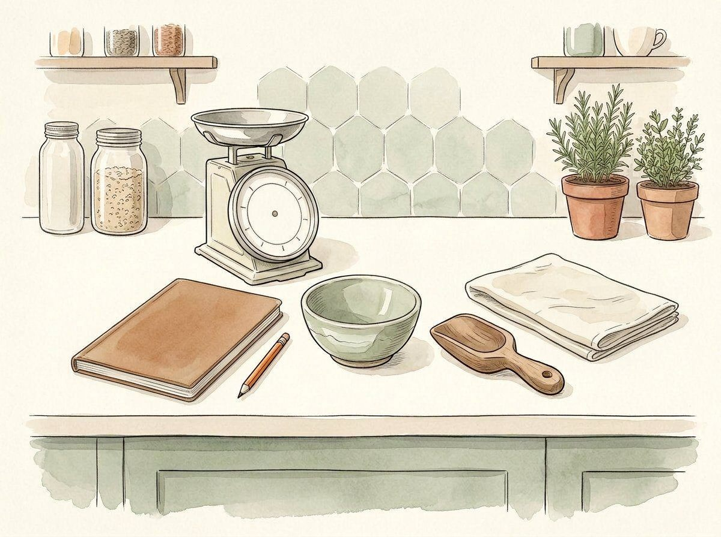
PANTRY NOTES / THE MEASUREMENT NOTEBOOK
31
08 / Close the notebook
THE OBSERVATION
Review the claim before sharing.
Before exporting a note, ask whether a reader can distinguish model arithmetic from real evidence. Review units, assumptions and limitations. A local review mark is a personal reminder, not formal approval or certification.
MODEL / METHOD NOTE
Review checklist: question / unit / method / source / limitation.
Watercolour study 16 / illustration, not measurement evidence
TRY / REFLECT
Which limitation must remain visible when this notebook is shared?
COMPLETE / 32 PAGES / 16 INDEPENDENT MAIN ILLUSTRATIONS / MODEL NUMBERS, NOT REAL READINGS

Slide 32
PANTRY NOTES / THE MEASUREMENT NOTEBOOK
32
08 / Close the notebook
THE OBSERVATION
Leave a clearer next question.
A useful notebook ends with a question that can be understood and examined, not a claim that every uncertainty has disappeared. Keep the object, quantity, unit and method in view as you plan the next observation.
MODEL / METHOD NOTE
Notice carefully. Name the quantity. Keep the context.
Watercolour study 16 / illustration, not measurement evidence
TRY / REFLECT
Write the next small question you would want a reader to understand.
COMPLETE / 32 PAGES / 16 INDEPENDENT MAIN ILLUSTRATIONS / MODEL NUMBERS, NOT REAL READINGS

