Slide 1
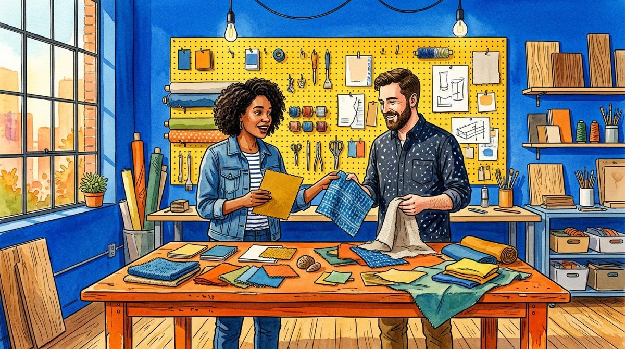
SWATCH
SW-001 / NOTICE / UNTESTED INSPIRATION
VISUAL MATERIAL QUESTION INDEX
Start with a visual question.
Fictional watercolour / not a tested specimen or supplier record
READ THE BOUNDARY
This index organises imagined material conversations. The illustrated workshop is a setting, not a laboratory. Begin with something the picture invites you to notice, without turning it into a measured material property.
01 / LOOK
02 / DO NOT ASSUME
Describe one visible colour or arrangement.
A convincing illustration is not a tested sample.
03 / ASK NEXT
04 / KEEP ATTACHED
What would you want to inspect in a real specimen?
Retain the distinction between inspiration and evidence.
DRAFT / 9 OF 15 MAIN ARTWORKS / NO VERIFIED MATERIAL PROPERTIES
SW-001 / 1 OF 30

Slide 2
SWATCH
SW-002 / NOTICE / UNTESTED INSPIRATION
VISUAL MATERIAL QUESTION INDEX
Name the source before the sample.
Fictional watercolour / not a tested specimen or supplier record
READ THE BOUNDARY
Every scene is a fictional watercolour. Its paper, cloth and coloured sheets have no verified composition, dimensions or supplier. A source note travels with every useful creative question.
01 / LOOK
02 / DO NOT ASSUME
Notice which objects appear together.
An illustrated texture does not identify composition.
03 / ASK NEXT
04 / KEEP ATTACHED
Which source would a real material claim require?
Label this page as visual inspiration.
DRAFT / 9 OF 15 MAIN ARTWORKS / NO VERIFIED MATERIAL PROPERTIES
SW-002 / 2 OF 30

Slide 3
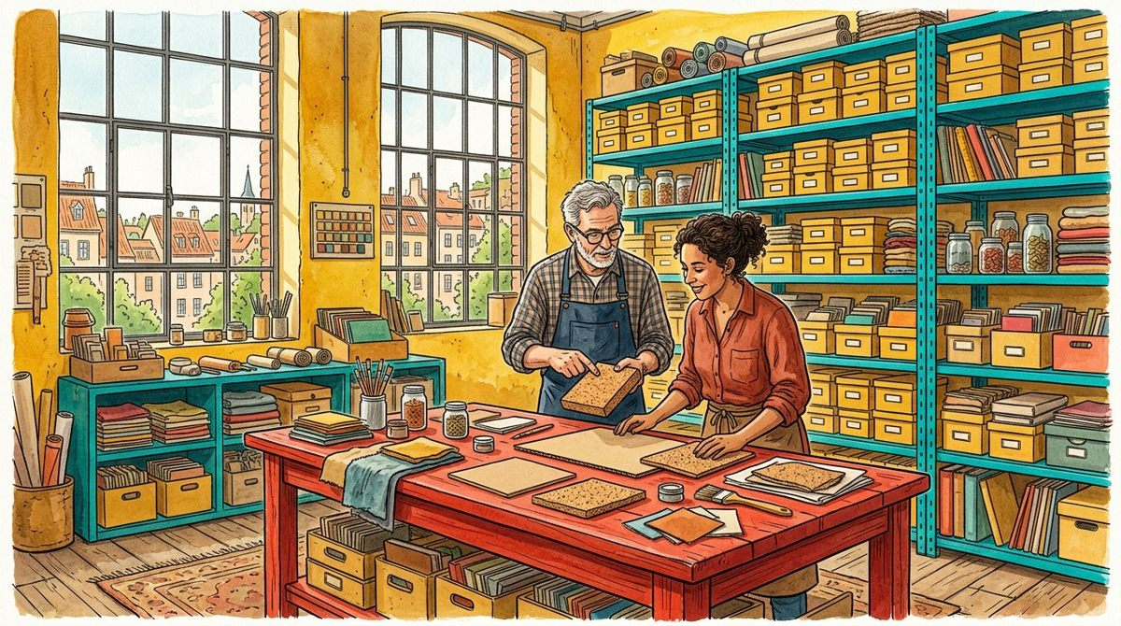
SWATCH
SW-003 / NOTICE / UNTESTED INSPIRATION
VISUAL MATERIAL QUESTION INDEX
Look without naming performance.
Fictional watercolour / not a tested specimen or supplier record
READ THE BOUNDARY
A surface can look rough, smooth, soft or glossy in a picture. Those visual impressions do not measure friction, flexibility, durability or any other physical property.
01 / LOOK
02 / DO NOT ASSUME
Use appears rather than is when describing a texture.
Visual appearance cannot establish tactile behaviour.
03 / ASK NEXT
04 / KEEP ATTACHED
What is visible, and what would require separate evidence?
Keep the original observation separate from interpretation.
DRAFT / 9 OF 15 MAIN ARTWORKS / NO VERIFIED MATERIAL PROPERTIES
SW-003 / 3 OF 30

Slide 4
SWATCH
SW-004 / NOTICE / UNTESTED INSPIRATION
VISUAL MATERIAL QUESTION INDEX
Give colour its context.
Fictional watercolour / not a tested specimen or supplier record
READ THE BOUNDARY
A coloured card changes its apparent relationship to neighbouring colours and imagined light. The picture supplies no calibrated colour measurement or production colour standard.
01 / LOOK
02 / DO NOT ASSUME
Compare a card with its illustrated surroundings.
The display and illustration are not calibrated references.
03 / ASK NEXT
04 / KEEP ATTACHED
What context is missing from a precise colour claim?
Avoid assigning a production colour code.
DRAFT / 9 OF 15 MAIN ARTWORKS / NO VERIFIED MATERIAL PROPERTIES
SW-004 / 4 OF 30

Slide 5
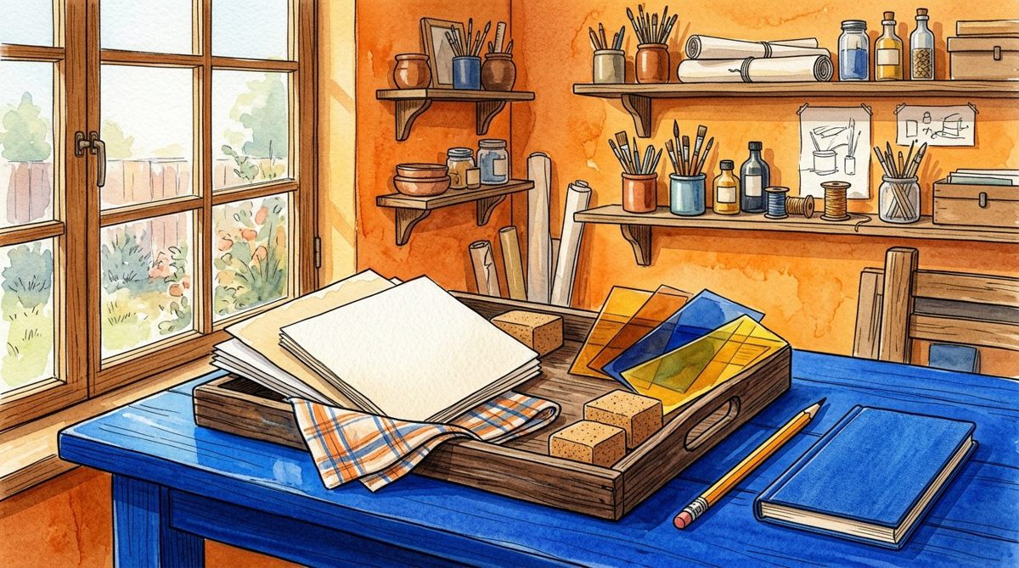
SWATCH
SW-005 / NOTICE / UNTESTED INSPIRATION
VISUAL MATERIAL QUESTION INDEX
Let a tray organise attention.
Fictional watercolour / not a tested specimen or supplier record
READ THE BOUNDARY
The specimen tray is an imagined arrangement of objects, not an inventory of real stock. Use grouping to generate questions rather than infer availability, price or suitability.
01 / LOOK
02 / DO NOT ASSUME
Notice a grouping that makes comparison easier.
An object in a picture is not an available product.
03 / ASK NEXT
04 / KEEP ATTACHED
Which grouping would clarify your next creative question?
Do not invent a supplier or stock count.
DRAFT / 9 OF 15 MAIN ARTWORKS / NO VERIFIED MATERIAL PROPERTIES
SW-005 / 5 OF 30

Slide 6
SWATCH
SW-006 / NOTICE / UNTESTED INSPIRATION
VISUAL MATERIAL QUESTION INDEX
Write a bounded observation.
Fictional watercolour / not a tested specimen or supplier record
READ THE BOUNDARY
Choose one detail and write a short sentence about what the image shows. Follow it with something the image cannot tell you. The two sentences should do different jobs.
01 / LOOK
02 / DO NOT ASSUME
Record one visual detail.
The missing information is not automatically negative.
03 / ASK NEXT
04 / KEEP ATTACHED
What limitation belongs next to this observation?
Keep both observation and limitation visible.
DRAFT / 9 OF 15 MAIN ARTWORKS / NO VERIFIED MATERIAL PROPERTIES
SW-006 / 6 OF 30

Slide 7

SWATCH
SW-007 / SEPARATE / UNTESTED INSPIRATION
VISUAL MATERIAL QUESTION INDEX
Separate appearance from identity.
Fictional watercolour / not a tested specimen or supplier record
READ THE BOUNDARY
A cork-coloured block may suggest a material family, but the illustration cannot identify it. Use the resemblance as a prompt, not as a composition statement.
01 / LOOK
02 / DO NOT ASSUME
Describe the colour and shape without naming a material.
Resemblance does not establish identity.
03 / ASK NEXT
04 / KEEP ATTACHED
Which document could establish an actual specimen’s identity?
Use fictional visual sample in a shared note.
DRAFT / 9 OF 15 MAIN ARTWORKS / NO VERIFIED MATERIAL PROPERTIES
SW-007 / 7 OF 30

Slide 8
SWATCH
SW-008 / SEPARATE / UNTESTED INSPIRATION
VISUAL MATERIAL QUESTION INDEX
Separate preference from suitability.
Fictional watercolour / not a tested specimen or supplier record
READ THE BOUNDARY
A designer may enjoy a colour combination without knowing whether a material suits an application. This exercise supplies no product requirements, test method or use conditions.
01 / LOOK
02 / DO NOT ASSUME
Name a personal visual preference.
Preference is not evidence of fitness for use.
03 / ASK NEXT
04 / KEEP ATTACHED
What requirements would a real selection need?
Keep the application question open.
DRAFT / 9 OF 15 MAIN ARTWORKS / NO VERIFIED MATERIAL PROPERTIES
SW-008 / 8 OF 30

Slide 9
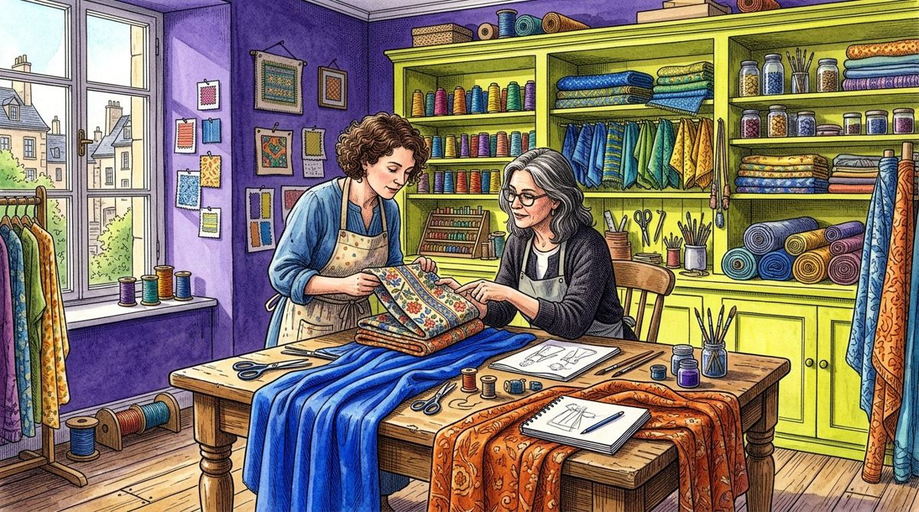
SWATCH
SW-009 / SEPARATE / UNTESTED INSPIRATION
VISUAL MATERIAL QUESTION INDEX
Separate a label from a fact.
Fictional watercolour / not a tested specimen or supplier record
READ THE BOUNDARY
A short catalogue label can make a page easy to find, but it does not prove a physical characteristic. Our SW identifiers label pages, not real specimens or batches.
01 / LOOK
02 / DO NOT ASSUME
Read the page ID as a filing aid.
A page identifier is not traceability evidence.
03 / ASK NEXT
04 / KEEP ATTACHED
What would real traceability need beyond a label?
Do not present SW IDs as supplier lot numbers.
DRAFT / 9 OF 15 MAIN ARTWORKS / NO VERIFIED MATERIAL PROPERTIES
SW-009 / 9 OF 30

Slide 10
SWATCH
SW-010 / SEPARATE / UNTESTED INSPIRATION
VISUAL MATERIAL QUESTION INDEX
Separate missing from measured.
Fictional watercolour / not a tested specimen or supplier record
READ THE BOUNDARY
No thickness, mass, strength, cost or environmental result is supplied. Missing values are not zero values. Do not fill an attractive comparison table with invented measurements.
01 / LOOK
02 / DO NOT ASSUME
Name a variable that is not supplied.
Not measured is different from measured zero.
03 / ASK NEXT
04 / KEEP ATTACHED
How can a question stay useful without a made-up number?
Leave the missing value explicitly unknown.
DRAFT / 9 OF 15 MAIN ARTWORKS / NO VERIFIED MATERIAL PROPERTIES
SW-010 / 10 OF 30

Slide 11

SWATCH
SW-011 / SEPARATE / UNTESTED INSPIRATION
VISUAL MATERIAL QUESTION INDEX
Separate mood from outcome.
Fictional watercolour / not a tested specimen or supplier record
READ THE BOUNDARY
The sunny studio may make an arrangement feel optimistic. That mood does not establish that a real product is useful, accessible, sustainable or welcomed by its users.
01 / LOOK
02 / DO NOT ASSUME
Describe the mood as a visual reading.
Mood is not a user-study result.
03 / ASK NEXT
04 / KEEP ATTACHED
What separate evidence would an outcome claim require?
Do not invent participant feedback.
DRAFT / 9 OF 15 MAIN ARTWORKS / NO VERIFIED MATERIAL PROPERTIES
SW-011 / 11 OF 30

Slide 12
SWATCH
SW-012 / SEPARATE / UNTESTED INSPIRATION
VISUAL MATERIAL QUESTION INDEX
Keep two kinds of note.
Fictional watercolour / not a tested specimen or supplier record
READ THE BOUNDARY
An observation describes the picture; an assumption proposes something beyond it. Write them in different slips so the next reader can see the boundary.
01 / LOOK
02 / DO NOT ASSUME
Keep the visual description specific.
A proposed explanation remains an assumption.
03 / ASK NEXT
04 / KEEP ATTACHED
Which part of your note reaches beyond the image?
Use the four slips to separate the jobs.
DRAFT / 9 OF 15 MAIN ARTWORKS / NO VERIFIED MATERIAL PROPERTIES
SW-012 / 12 OF 30

Slide 13
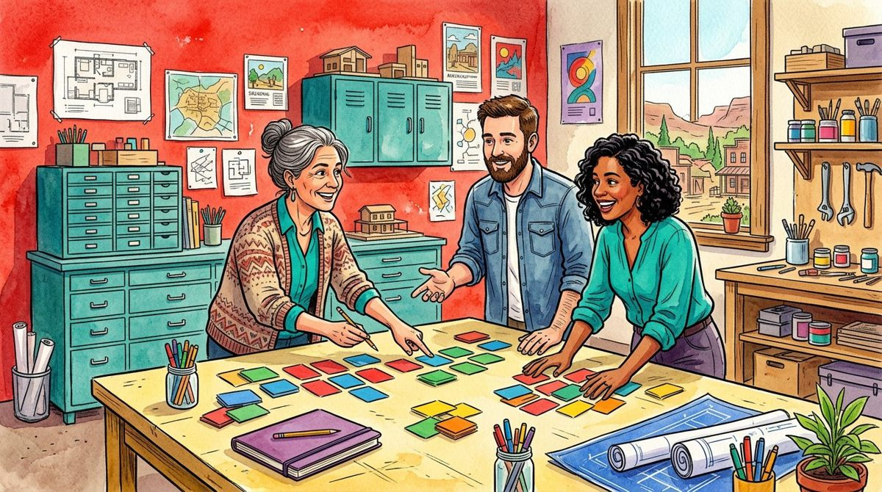
SWATCH
SW-013 / COMPARE / UNTESTED INSPIRATION
VISUAL MATERIAL QUESTION INDEX
Compare questions, not properties.
Fictional watercolour / not a tested specimen or supplier record
READ THE BOUNDARY
Pin up to three pages to the comparison tray. It places their current questions and assumptions side by side. It does not rank physical materials or calculate a performance score.
01 / LOOK
02 / DO NOT ASSUME
Choose pages with useful contrasting questions.
Pinned cards are creative references, not benchmarks.
03 / ASK NEXT
04 / KEEP ATTACHED
What does this comparison help you ask?
No winner or material recommendation is implied.
DRAFT / 9 OF 15 MAIN ARTWORKS / NO VERIFIED MATERIAL PROPERTIES
SW-013 / 13 OF 30

Slide 14
SWATCH
SW-014 / COMPARE / UNTESTED INSPIRATION
VISUAL MATERIAL QUESTION INDEX
Keep the comparison scope small.
Fictional watercolour / not a tested specimen or supplier record
READ THE BOUNDARY
A few carefully labelled references can be clearer than a wall of unrelated inspiration. The tray accepts at most three pages, making the chosen scope visible.
01 / LOOK
02 / DO NOT ASSUME
Notice why each card belongs in the set.
A small reference set is not a representative sample.
03 / ASK NEXT
04 / KEEP ATTACHED
Which page would you remove to clarify the question?
Unpin a card rather than silently expanding the scope.
DRAFT / 9 OF 15 MAIN ARTWORKS / NO VERIFIED MATERIAL PROPERTIES
SW-014 / 14 OF 30

Slide 15

SWATCH
SW-015 / COMPARE / UNTESTED INSPIRATION
VISUAL MATERIAL QUESTION INDEX
Compare the words you used.
Fictional watercolour / not a tested specimen or supplier record
READ THE BOUNDARY
Read two observations for differences in wording. One may describe a visible arrangement while the other implies an untested property. Revise the wording rather than pretend the missing evidence exists.
01 / LOOK
02 / DO NOT ASSUME
Underline a word that implies physical performance.
A confident adjective can hide an unsupported claim.
03 / ASK NEXT
04 / KEEP ATTACHED
How could you make the sentence more precise?
Retain the earlier question if it remains useful.
DRAFT / 9 OF 15 MAIN ARTWORKS / NO VERIFIED MATERIAL PROPERTIES
SW-015 / 15 OF 30

Slide 16
SWATCH
SW-016 / COMPARE / UNTESTED INSPIRATION
VISUAL MATERIAL QUESTION INDEX
Give alternatives equal room.
Fictional watercolour / not a tested specimen or supplier record
READ THE BOUNDARY
Two visual directions can remain plausible at once. The index does not require a final selection. Keep alternatives labelled without declaring an engineering or procurement decision.
01 / LOOK
02 / DO NOT ASSUME
Describe what interests you in each direction.
A creative shortlist is not an approved specification.
03 / ASK NEXT
04 / KEEP ATTACHED
What would need to happen before an actual selection?
Leave unresolved alternatives visible.
DRAFT / 9 OF 15 MAIN ARTWORKS / NO VERIFIED MATERIAL PROPERTIES
SW-016 / 16 OF 30

Slide 17
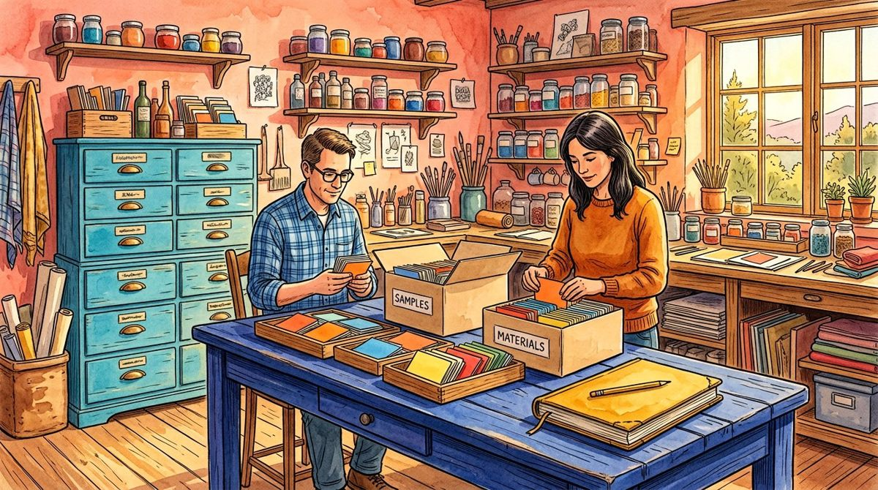
SWATCH
SW-017 / COMPARE / UNTESTED INSPIRATION
VISUAL MATERIAL QUESTION INDEX
Notice what the image omits.
Fictional watercolour / not a tested specimen or supplier record
READ THE BOUNDARY
The illustrated drawers may be full of appealing samples, but no maintenance, sourcing, end-of-life or real user context is provided. Absence from the picture is not evidence that these questions are unimportant.
01 / LOOK
02 / DO NOT ASSUME
List one important topic outside the frame.
A scene cannot stand in for a product lifecycle study.
03 / ASK NEXT
04 / KEEP ATTACHED
Who would need to investigate the omitted topic?
Keep the boundary beside the visual reference.
DRAFT / 9 OF 15 MAIN ARTWORKS / NO VERIFIED MATERIAL PROPERTIES
SW-017 / 17 OF 30

Slide 18
SWATCH
SW-018 / COMPARE / UNTESTED INSPIRATION
VISUAL MATERIAL QUESTION INDEX
Write the comparison question.
Fictional watercolour / not a tested specimen or supplier record
READ THE BOUNDARY
A useful comparison ends with a better question, not a fabricated verdict. State which missing source would help distinguish the alternatives in a real project.
01 / LOOK
02 / DO NOT ASSUME
Summarise the reason for comparing these cards.
The tray supplies no test results.
03 / ASK NEXT
04 / KEEP ATTACHED
Which source would change your understanding?
Preserve the selected page IDs in your export.
DRAFT / 9 OF 15 MAIN ARTWORKS / NO VERIFIED MATERIAL PROPERTIES
SW-018 / 18 OF 30

Slide 19
SWATCH
SW-019 / QUESTION / UNTESTED INSPIRATION
VISUAL MATERIAL QUESTION INDEX
Ask about composition separately.
MAIN ART 10 PENDING
Filing frame only, not a primary illustration. 9 of 15 independent artworks are present.
Fictional watercolour / not a tested specimen or supplier record
READ THE BOUNDARY
If a real project needs composition information, that requires an appropriate source for the actual specimen. This template supplies neither a supplier declaration nor a verified material identity.
01 / LOOK
02 / DO NOT ASSUME
Treat the illustrated object as unidentified.
A visual resemblance is not a composition record.
03 / ASK NEXT
04 / KEEP ATTACHED
What reliable source would identify the real specimen?
Do not infer chemistry from the artwork.
DRAFT / 9 OF 15 MAIN ARTWORKS / NO VERIFIED MATERIAL PROPERTIES
SW-019 / 19 OF 30

Slide 20
SWATCH
SW-020 / QUESTION / UNTESTED INSPIRATION
VISUAL MATERIAL QUESTION INDEX
Ask about conditions separately.
MAIN ART 10 PENDING
Filing frame only, not a primary illustration. 9 of 15 independent artworks are present.
Fictional watercolour / not a tested specimen or supplier record
READ THE BOUNDARY
Real material behaviour depends on context and appropriate evaluation. This folio gives no test setup, operating instruction or permission to use tools or equipment.
01 / LOOK
02 / DO NOT ASSUME
Name an application condition that is absent.
The workshop scene is not a technical procedure.
03 / ASK NEXT
04 / KEEP ATTACHED
Who is responsible for a suitable real evaluation?
Refer operational questions outside this template.
DRAFT / 9 OF 15 MAIN ARTWORKS / NO VERIFIED MATERIAL PROPERTIES
SW-020 / 20 OF 30

Slide 21
SWATCH
SW-021 / QUESTION / UNTESTED INSPIRATION
VISUAL MATERIAL QUESTION INDEX
Ask about claims separately.
MAIN ART 11 PENDING
Filing frame only, not a primary illustration. 9 of 15 independent artworks are present.
Fictional watercolour / not a tested specimen or supplier record
READ THE BOUNDARY
Words such as durable, safe or sustainable require relevant evidence and scope. None is established by a bright studio picture or a local note in this index.
01 / LOOK
02 / DO NOT ASSUME
Spot a claim that would need support.
A reassuring label is not certification.
03 / ASK NEXT
04 / KEEP ATTACHED
What evidence and scope would make the claim meaningful?
Do not add unsupported certification language.
DRAFT / 9 OF 15 MAIN ARTWORKS / NO VERIFIED MATERIAL PROPERTIES
SW-021 / 21 OF 30

Slide 22
SWATCH
SW-022 / QUESTION / UNTESTED INSPIRATION
VISUAL MATERIAL QUESTION INDEX
Ask about people responsibly.
MAIN ART 11 PENDING
Filing frame only, not a primary illustration. 9 of 15 independent artworks are present.
Fictional watercolour / not a tested specimen or supplier record
READ THE BOUNDARY
A real product inquiry may involve people and appropriate review. This fictional index needs no participant names, identifiers or personal information in its browser notes.
01 / LOOK
02 / DO NOT ASSUME
Keep the creative question impersonal.
Local storage is not a secure participant system.
03 / ASK NEXT
04 / KEEP ATTACHED
Can the question be written without personal details?
Do not enter sensitive participant information.
DRAFT / 9 OF 15 MAIN ARTWORKS / NO VERIFIED MATERIAL PROPERTIES
SW-022 / 22 OF 30

Slide 23
SWATCH
SW-023 / QUESTION / UNTESTED INSPIRATION
VISUAL MATERIAL QUESTION INDEX
Keep an unanswered question useful.
MAIN ART 12 PENDING
Filing frame only, not a primary illustration. 9 of 15 independent artworks are present.
Fictional watercolour / not a tested specimen or supplier record
READ THE BOUNDARY
A question can be specific even when no result is available. State what is unknown and why the answer would matter, without inventing an outcome to make the page look complete.
01 / LOOK
02 / DO NOT ASSUME
Write the unknown in ordinary language.
An open question is not a failed measurement.
03 / ASK NEXT
04 / KEEP ATTACHED
What would an answer help someone decide?
Keep the missing evidence visible.
DRAFT / 9 OF 15 MAIN ARTWORKS / NO VERIFIED MATERIAL PROPERTIES
SW-023 / 23 OF 30

Slide 24
SWATCH
SW-024 / QUESTION / UNTESTED INSPIRATION
VISUAL MATERIAL QUESTION INDEX
Choose the next source to seek.
MAIN ART 12 PENDING
Filing frame only, not a primary illustration. 9 of 15 independent artworks are present.
Fictional watercolour / not a tested specimen or supplier record
READ THE BOUNDARY
Identify a category of source that could help a real project, such as a relevant specification or responsible specialist. This page does not supply that source or assert its contents.
01 / LOOK
02 / DO NOT ASSUME
Name the type of missing source.
A planned source is not evidence already obtained.
03 / ASK NEXT
04 / KEEP ATTACHED
Who could verify that the source fits the actual context?
Label the action as a question, not completed research.
DRAFT / 9 OF 15 MAIN ARTWORKS / NO VERIFIED MATERIAL PROPERTIES
SW-024 / 24 OF 30

Slide 25
SWATCH
SW-025 / FILE / UNTESTED INSPIRATION
VISUAL MATERIAL QUESTION INDEX
File the question with its boundary.
MAIN ART 13 PENDING
Filing frame only, not a primary illustration. 9 of 15 independent artworks are present.
Fictional watercolour / not a tested specimen or supplier record
READ THE BOUNDARY
A useful card keeps the inspiration, assumption and missing source together. Filing is an organisational step, not approval of a material, design or product.
01 / LOOK
02 / DO NOT ASSUME
Read all four slips before sharing.
A neat archive does not verify its contents.
03 / ASK NEXT
04 / KEEP ATTACHED
What context would be lost if only the picture travelled?
Retain the fictional-source label.
DRAFT / 9 OF 15 MAIN ARTWORKS / NO VERIFIED MATERIAL PROPERTIES
SW-025 / 25 OF 30

Slide 26
SWATCH
SW-026 / FILE / UNTESTED INSPIRATION
VISUAL MATERIAL QUESTION INDEX
Keep the selected set visible.
MAIN ART 13 PENDING
Filing frame only, not a primary illustration. 9 of 15 independent artworks are present.
Fictional watercolour / not a tested specimen or supplier record
READ THE BOUNDARY
The pinned comparison tray records up to three page IDs. These are references to this folio, not specimen identifiers. Current exports preserve the chosen set with your edits.
01 / LOOK
02 / DO NOT ASSUME
Check which pages are currently pinned.
A saved selection is not a material recommendation.
03 / ASK NEXT
04 / KEEP ATTACHED
Does the selected set match your current question?
Unpin references you no longer intend to include.
DRAFT / 9 OF 15 MAIN ARTWORKS / NO VERIFIED MATERIAL PROPERTIES
SW-026 / 26 OF 30

Slide 27
SWATCH
SW-027 / FILE / UNTESTED INSPIRATION
VISUAL MATERIAL QUESTION INDEX
Choose the right copy to share.
MAIN ART 14 PENDING
Filing frame only, not a primary illustration. 9 of 15 independent artworks are present.
Fictional watercolour / not a tested specimen or supplier record
READ THE BOUNDARY
Current HTML embeds the artwork, your text and private note. JSON records edits and pinned IDs. Original PDF/PPTX are fixed builds and do not automatically change when you edit the browser copy.
01 / LOOK
02 / DO NOT ASSUME
Check the version and private note before exporting.
Current and original exports are different copies.
03 / ASK NEXT
04 / KEEP ATTACHED
Which version contains the question you intend to share?
Do not share a private note unintentionally.
DRAFT / 9 OF 15 MAIN ARTWORKS / NO VERIFIED MATERIAL PROPERTIES
SW-027 / 27 OF 30

Slide 28
SWATCH
SW-028 / FILE / UNTESTED INSPIRATION
VISUAL MATERIAL QUESTION INDEX
Correct the note, not the source.
MAIN ART 14 PENDING
Filing frame only, not a primary illustration. 9 of 15 independent artworks are present.
Fictional watercolour / not a tested specimen or supplier record
READ THE BOUNDARY
A text edit changes your explanation, not the underlying fictional illustration or a real test record. State the reason for an explanatory correction without implying new evidence.
01 / LOOK
02 / DO NOT ASSUME
Identify the sentence you changed.
A revised assumption is not a new result.
03 / ASK NEXT
04 / KEEP ATTACHED
What misunderstanding does the correction address?
Preserve the fictional and untested status.
DRAFT / 9 OF 15 MAIN ARTWORKS / NO VERIFIED MATERIAL PROPERTIES
SW-028 / 28 OF 30

Slide 29
SWATCH
SW-029 / FILE / UNTESTED INSPIRATION
VISUAL MATERIAL QUESTION INDEX
Leave a responsible handoff.
MAIN ART 15 PENDING
Filing frame only, not a primary illustration. 9 of 15 independent artworks are present.
Fictional watercolour / not a tested specimen or supplier record
READ THE BOUNDARY
A handoff should explain the visual source, intended question and unresolved evidence. It should not imply that a supplier, specialist or user has approved a selection.
01 / LOOK
02 / DO NOT ASSUME
Name one creative intention and one limitation.
A shared folio is not external approval.
03 / ASK NEXT
04 / KEEP ATTACHED
What separate responsible work remains?
Keep the next question bounded.
DRAFT / 9 OF 15 MAIN ARTWORKS / NO VERIFIED MATERIAL PROPERTIES
SW-029 / 29 OF 30

Slide 30
SWATCH
SW-030 / FILE / UNTESTED INSPIRATION
VISUAL MATERIAL QUESTION INDEX
A drawer can stay open.
MAIN ART 15 PENDING
Filing frame only, not a primary illustration. 9 of 15 independent artworks are present.
Fictional watercolour / not a tested specimen or supplier record
READ THE BOUNDARY
This draft contains nine of fifteen independent illustrations. The final six are explicitly pending. A useful closing card leaves a clear question rather than pretending the visual archive or real-world research is complete.
01 / LOOK
02 / DO NOT ASSUME
Review the current artwork count honestly.
Pending frames are not extra primary illustrations.
03 / ASK NEXT
04 / KEEP ATTACHED
Which source would help the next reader most?
Keep inspiration separate from evidence.
DRAFT / 9 OF 15 MAIN ARTWORKS / NO VERIFIED MATERIAL PROPERTIES
SW-030 / 30 OF 30

