Slide 1
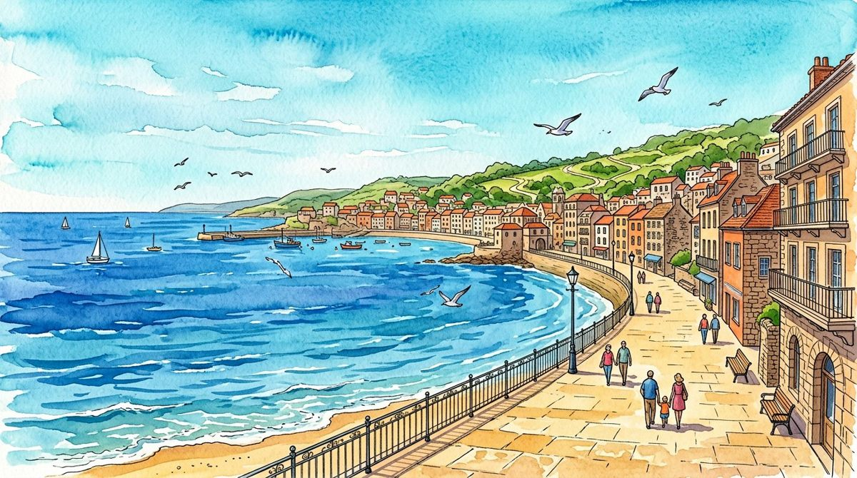
TIDELINE
COASTAL MODEL ATLAS / SYNTHETIC EVENTS ONLY
01
01 / Read the atlas
A coast is a setting, not evidence.
MODEL EVENTS IN SCOPE
FICTIONAL SEGMENTS
MODEL DAY LABELS
240
3
5
Illustrated scene 1 / fictional setting, not field or weather evidence
TIDELINE is an illustrated atlas for reading a small synthetic event model. The coastal scenes supply visual context only. No observer visited this fictional setting, and no count was inferred from people drawn in a picture.
Chart scope: full model / 240 events. Prose remains full-model teaching context.
FICTIONAL SEGMENT INDEX
COUNTS BY MODEL DAY
Quay
50
46
58
42
44
Garden Bend
Overlook
Not a navigational map.
Mon
Tue
Wed
Thu
Fri
Source: synthetic teaching model / unit: entry event
240 invented entry events / five model day labels / three fictional segments.
Which claim would exceed the evidence if these pictures were called field photographs?
COMPLETE ATLAS / 32 PAGES / 16 OF 16 MAIN ILLUSTRATIONS / NO REAL ROUTE OR PEOPLE DATA / 1 OF 32

Slide 2
TIDELINE
COASTAL MODEL ATLAS / SYNTHETIC EVENTS ONLY
02
01 / Read the atlas
Count events. Do not rename them people.
MODEL EVENTS IN SCOPE
FICTIONAL SEGMENTS
MODEL DAY LABELS
240
3
5
Illustrated scene 1 / fictional setting, not field or weather evidence
An entry event is one record in this teaching model. The source has no person identifier or exit record. It cannot establish unique visitors, occupancy, dwell time or whether anyone benefited from a public space.
Chart scope: full model / 240 events. Prose remains full-model teaching context.
FICTIONAL SEGMENT INDEX
COUNTS BY MODEL DAY
Quay
50
46
58
42
44
Garden Bend
Overlook
Not a navigational map.
Mon
Tue
Wed
Thu
Fri
Source: synthetic teaching model / unit: entry event
Entry events ≠ unique people ≠ live occupancy.
Why could the same person contribute more than one event in a real entry-count study?
COMPLETE ATLAS / 32 PAGES / 16 OF 16 MAIN ILLUSTRATIONS / NO REAL ROUTE OR PEOPLE DATA / 2 OF 32

Slide 3

TIDELINE
COASTAL MODEL ATLAS / SYNTHETIC EVENTS ONLY
03
01 / Read the atlas
Three labels are not a real route.
MODEL EVENTS IN SCOPE
FICTIONAL SEGMENTS
MODEL DAY LABELS
240
3
5
Illustrated scene 2 / fictional setting, not field or weather evidence
Quay, Garden Bend and Overlook are fictional segment labels. The spine diagram has no coordinates, scale, distances or verified connections. It is an index for the model, not a map to follow outdoors.
Chart scope: full model / 240 events. Prose remains full-model teaching context.
FICTIONAL SEGMENT INDEX
COUNTS BY FICTIONAL SEGMENT
Quay
70
80
90
Garden Bend
Overlook
Not a navigational map.
Quay
Garden Bend
Overlook
Source: synthetic teaching model / unit: entry event
Abstract segment index / not navigational or safety information.
What information is absent from an illustrated segment spine?
COMPLETE ATLAS / 32 PAGES / 16 OF 16 MAIN ILLUSTRATIONS / NO REAL ROUTE OR PEOPLE DATA / 3 OF 32

Slide 4
TIDELINE
COASTAL MODEL ATLAS / SYNTHETIC EVENTS ONLY
04
01 / Read the atlas
The weather belongs to the illustration.
MODEL EVENTS IN SCOPE
FICTIONAL SEGMENTS
MODEL DAY LABELS
240
3
5
Illustrated scene 2 / fictional setting, not field or weather evidence
Blue water, rain, sunset and night scenes demonstrate varied visual backgrounds. They do not record the model’s weather, time of day or environmental conditions. Those variables are not present in the source rows.
Chart scope: full model / 240 events. Prose remains full-model teaching context.
FICTIONAL SEGMENT INDEX
COUNTS BY FICTIONAL SEGMENT
Quay
70
80
90
Garden Bend
Overlook
Not a navigational map.
Quay
Garden Bend
Overlook
Source: synthetic teaching model / unit: entry event
Image mood is not a measured explanatory variable.
Why should a sunset illustration not be used to explain a model count?
COMPLETE ATLAS / 32 PAGES / 16 OF 16 MAIN ILLUSTRATIONS / NO REAL ROUTE OR PEOPLE DATA / 4 OF 32

Slide 5

TIDELINE
COASTAL MODEL ATLAS / SYNTHETIC EVENTS ONLY
05
02 / Open the source
One row has a small definition.
MODEL EVENTS IN SCOPE
FICTIONAL SEGMENTS
MODEL DAY LABELS
240
3
5
Illustrated scene 3 / fictional setting, not field or weather evidence
Each synthetic row contains an event ID, model day, fictional segment, unit and source label. The unique event ID distinguishes records, not people. The source is intentionally limited so the interpretation must stay limited too.
Chart scope: full model / 240 events. Prose remains full-model teaching context.
FICTIONAL SEGMENT INDEX
COUNTS BY MODEL DAY
Quay
50
46
58
42
44
Garden Bend
Overlook
Not a navigational map.
Mon
Tue
Wed
Thu
Fri
Source: synthetic teaching model / unit: entry event
Source fields: event_id / day / segment / unit / source.
Which question could not be answered from these five fields?
COMPLETE ATLAS / 32 PAGES / 16 OF 16 MAIN ILLUSTRATIONS / NO REAL ROUTE OR PEOPLE DATA / 5 OF 32

Slide 6
TIDELINE
COASTAL MODEL ATLAS / SYNTHETIC EVENTS ONLY
06
02 / Open the source
A source label travels with the number.
MODEL EVENTS IN SCOPE
FICTIONAL SEGMENTS
MODEL DAY LABELS
240
3
5
Illustrated scene 3 / fictional setting, not field or weather evidence
All 240 rows are deterministically constructed teaching records. They are not observations, estimates of a real town or data obtained from a sensor. Keep that source label visible in charts, tables and exports.
Chart scope: full model / 240 events. Prose remains full-model teaching context.
FICTIONAL SEGMENT INDEX
COUNTS BY MODEL DAY
Quay
50
46
58
42
44
Garden Bend
Overlook
Not a navigational map.
Mon
Tue
Wed
Thu
Fri
Source: synthetic teaching model / unit: entry event
Source: synthetic-teaching-model.
What would be misleading about sharing only the chart and removing its source note?
COMPLETE ATLAS / 32 PAGES / 16 OF 16 MAIN ILLUSTRATIONS / NO REAL ROUTE OR PEOPLE DATA / 6 OF 32

Slide 7

TIDELINE
COASTAL MODEL ATLAS / SYNTHETIC EVENTS ONLY
07
02 / Open the source
A day label is not a full time window.
MODEL EVENTS IN SCOPE
FICTIONAL SEGMENTS
MODEL DAY LABELS
240
3
5
Illustrated scene 4 / fictional setting, not field or weather evidence
The model supplies Monday through Friday labels but no real dates, opening hours or observation duration. Equal coverage and hourly rates cannot be verified from these rows. The day totals are invented examples, not a season or forecast.
Chart scope: full model / 240 events. Prose remains full-model teaching context.
FICTIONAL SEGMENT INDEX
COUNTS BY FICTIONAL SEGMENT
Quay
70
80
90
Garden Bend
Overlook
Not a navigational map.
Quay
Garden Bend
Overlook
Source: synthetic teaching model / unit: entry event
No real date range or observation-hours denominator is supplied.
Why can this source not support a reliable events-per-hour comparison?
COMPLETE ATLAS / 32 PAGES / 16 OF 16 MAIN ILLUSTRATIONS / NO REAL ROUTE OR PEOPLE DATA / 7 OF 32

Slide 8
TIDELINE
COASTAL MODEL ATLAS / SYNTHETIC EVENTS ONLY
08
02 / Open the source
Two margins, one set of records.
MODEL EVENTS IN SCOPE
FICTIONAL SEGMENTS
MODEL DAY LABELS
240
3
5
Illustrated scene 4 / fictional setting, not field or weather evidence
Daily totals and segment totals both describe the same 240 model events. They are two summaries of one constructed joint allocation, not independent observation campaigns or evidence that day and location are empirically independent.
Chart scope: full model / 240 events. Prose remains full-model teaching context.
FICTIONAL SEGMENT INDEX
COUNTS BY FICTIONAL SEGMENT
Quay
70
80
90
Garden Bend
Overlook
Not a navigational map.
Quay
Garden Bend
Overlook
Source: synthetic teaching model / unit: entry event
42+50+46+58+44 = 70+80+90 = 240.
What mistake would be made by adding the two grand totals together?
COMPLETE ATLAS / 32 PAGES / 16 OF 16 MAIN ILLUSTRATIONS / NO REAL ROUTE OR PEOPLE DATA / 8 OF 32

Slide 9
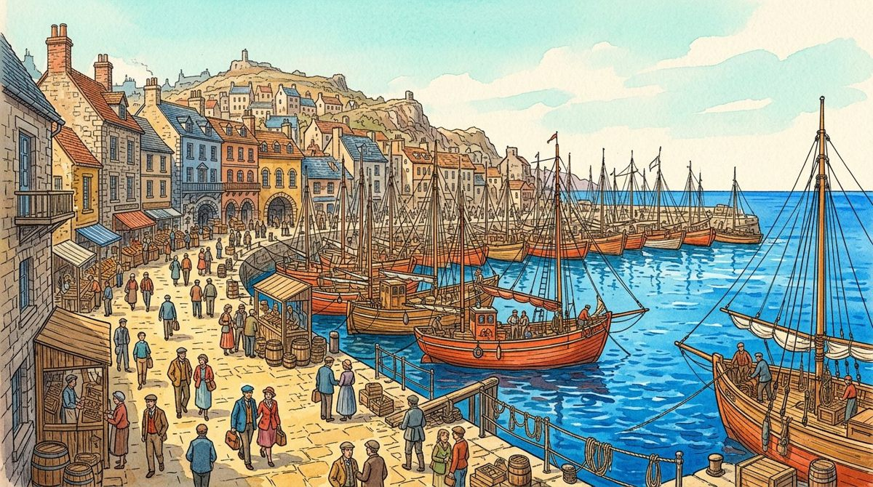
TIDELINE
COASTAL MODEL ATLAS / SYNTHETIC EVENTS ONLY
09
03 / Compare model days
Monday starts at 42.
MODEL EVENTS IN SCOPE
FICTIONAL SEGMENTS
MODEL DAY LABELS
240
3
5
Illustrated scene 5 / fictional setting, not field or weather evidence
Monday contributes 42 events in the full teaching model. Tuesday contributes 50, a difference of eight events. The source contains no programme, weather or closure variables that explain this invented difference.
Chart scope: full model / 240 events. Prose remains full-model teaching context.
FICTIONAL SEGMENT INDEX
COUNTS BY MODEL DAY
Quay
50
46
58
42
44
Garden Bend
Overlook
Not a navigational map.
Mon
Tue
Wed
Thu
Fri
Source: synthetic teaching model / unit: entry event
50 − 42 = 8 model events; cause not supplied.
What context would a real comparison need before offering an explanation?
COMPLETE ATLAS / 32 PAGES / 16 OF 16 MAIN ILLUSTRATIONS / NO REAL ROUTE OR PEOPLE DATA / 9 OF 32

Slide 10
TIDELINE
COASTAL MODEL ATLAS / SYNTHETIC EVENTS ONLY
10
03 / Compare model days
Wednesday is 46, not automatically typical.
MODEL EVENTS IN SCOPE
FICTIONAL SEGMENTS
MODEL DAY LABELS
240
3
5
Illustrated scene 5 / fictional setting, not field or weather evidence
A middle-of-week label does not make a day representative. Wednesday contributes 46 invented events. The model does not contain repeated weeks, seasonal variation or a sampling design from which typical demand could be established.
Chart scope: full model / 240 events. Prose remains full-model teaching context.
FICTIONAL SEGMENT INDEX
COUNTS BY MODEL DAY
Quay
50
46
58
42
44
Garden Bend
Overlook
Not a navigational map.
Mon
Tue
Wed
Thu
Fri
Source: synthetic teaching model / unit: entry event
Wednesday / 46 of 240 model events.
What evidence would be needed before calling a real day typical?
COMPLETE ATLAS / 32 PAGES / 16 OF 16 MAIN ILLUSTRATIONS / NO REAL ROUTE OR PEOPLE DATA / 10 OF 32

Slide 11

TIDELINE
COASTAL MODEL ATLAS / SYNTHETIC EVENTS ONLY
11
03 / Compare model days
Thursday is largest in this set.
MODEL EVENTS IN SCOPE
FICTIONAL SEGMENTS
MODEL DAY LABELS
240
3
5
Illustrated scene 6 / fictional setting, not field or weather evidence
Thursday contributes 58 events, the largest of these five model totals. That bounded description does not predict the next Thursday or establish how a venue should staff a real coastal route.
Chart scope: full model / 240 events. Prose remains full-model teaching context.
FICTIONAL SEGMENT INDEX
COUNTS BY FICTIONAL SEGMENT
Quay
70
80
90
Garden Bend
Overlook
Not a navigational map.
Quay
Garden Bend
Overlook
Source: synthetic teaching model / unit: entry event
58 ÷ 240 ≈ 24.17% of the full model.
Why is largest in this set not the same as highest expected future demand?
COMPLETE ATLAS / 32 PAGES / 16 OF 16 MAIN ILLUSTRATIONS / NO REAL ROUTE OR PEOPLE DATA / 11 OF 32

Slide 12
TIDELINE
COASTAL MODEL ATLAS / SYNTHETIC EVENTS ONLY
12
03 / Compare model days
A mean describes the model.
MODEL EVENTS IN SCOPE
FICTIONAL SEGMENTS
MODEL DAY LABELS
240
3
5
Illustrated scene 6 / fictional setting, not field or weather evidence
The five full-model totals sum to 240. Dividing by five gives a mean of 48 events per model day label. This arithmetic is not a forecast, a capacity target or a count of distinct people.
Chart scope: full model / 240 events. Prose remains full-model teaching context.
FICTIONAL SEGMENT INDEX
COUNTS BY FICTIONAL SEGMENT
Quay
70
80
90
Garden Bend
Overlook
Not a navigational map.
Quay
Garden Bend
Overlook
Source: synthetic teaching model / unit: entry event
240 ÷ 5 = 48 model events per day label.
Which extra assumptions would be hidden by treating 48 as a real operating target?
COMPLETE ATLAS / 32 PAGES / 16 OF 16 MAIN ILLUSTRATIONS / NO REAL ROUTE OR PEOPLE DATA / 12 OF 32

Slide 13

TIDELINE
COASTAL MODEL ATLAS / SYNTHETIC EVENTS ONLY
13
04 / Compare segments
Quay has 70 model events.
MODEL EVENTS IN SCOPE
FICTIONAL SEGMENTS
MODEL DAY LABELS
240
3
5
Illustrated scene 7 / fictional setting, not field or weather evidence
The fictional Quay label contributes 70 events across the five model days. A segment total is a count for this synthetic source, not footfall density, an area-normalised measure or a description of a real path.
Chart scope: full model / 240 events. Prose remains full-model teaching context.
FICTIONAL SEGMENT INDEX
COUNTS BY MODEL DAY
Quay
50
46
58
42
44
Garden Bend
Overlook
Not a navigational map.
Mon
Tue
Wed
Thu
Fri
Source: synthetic teaching model / unit: entry event
70 ÷ 240 ≈ 29.17% of the full model.
Which denominator would be missing from an events-per-area claim?
COMPLETE ATLAS / 32 PAGES / 16 OF 16 MAIN ILLUSTRATIONS / NO REAL ROUTE OR PEOPLE DATA / 13 OF 32

Slide 14
TIDELINE
COASTAL MODEL ATLAS / SYNTHETIC EVENTS ONLY
14
04 / Compare segments
Garden Bend has one third.
MODEL EVENTS IN SCOPE
FICTIONAL SEGMENTS
MODEL DAY LABELS
240
3
5
Illustrated scene 7 / fictional setting, not field or weather evidence
Garden Bend contributes 80 of 240 model events, exactly one third. Selecting this segment changes the plotted subset and the detail rows. The explanatory examples below the chart remain explicitly full-model teaching notes.
Chart scope: full model / 240 events. Prose remains full-model teaching context.
FICTIONAL SEGMENT INDEX
COUNTS BY MODEL DAY
Quay
50
46
58
42
44
Garden Bend
Overlook
Not a navigational map.
Mon
Tue
Wed
Thu
Fri
Source: synthetic teaching model / unit: entry event
80 ÷ 240 = 1/3 ≈ 33.33%.
Select Garden Bend and check that the subset total is 80, not 240.
COMPLETE ATLAS / 32 PAGES / 16 OF 16 MAIN ILLUSTRATIONS / NO REAL ROUTE OR PEOPLE DATA / 14 OF 32

Slide 15

TIDELINE
COASTAL MODEL ATLAS / SYNTHETIC EVENTS ONLY
15
04 / Compare segments
Overlook is 90, not a recommendation.
MODEL EVENTS IN SCOPE
FICTIONAL SEGMENTS
MODEL DAY LABELS
240
3
5
Illustrated scene 8 / fictional setting, not field or weather evidence
Overlook contributes 90 model events. This is the largest of three invented segment totals. It does not establish popularity, accessibility, environmental suitability or a reason to redirect real people to an actual location.
Chart scope: full model / 240 events. Prose remains full-model teaching context.
FICTIONAL SEGMENT INDEX
COUNTS BY FICTIONAL SEGMENT
Quay
70
80
90
Garden Bend
Overlook
Not a navigational map.
Quay
Garden Bend
Overlook
Source: synthetic teaching model / unit: entry event
90 ÷ 240 = 37.5% of the full model.
Which claim about a real public space would this total not justify?
COMPLETE ATLAS / 32 PAGES / 16 OF 16 MAIN ILLUSTRATIONS / NO REAL ROUTE OR PEOPLE DATA / 15 OF 32

Slide 16
TIDELINE
COASTAL MODEL ATLAS / SYNTHETIC EVENTS ONLY
16
04 / Compare segments
Shares need a visible denominator.
MODEL EVENTS IN SCOPE
FICTIONAL SEGMENTS
MODEL DAY LABELS
240
3
5
Illustrated scene 8 / fictional setting, not field or weather evidence
The full-model segment shares sum to 100% because the three labels partition the same 240 rows. A selected segment has a different scope. Do not silently use a full-model denominator to describe a subset distribution.
Chart scope: full model / 240 events. Prose remains full-model teaching context.
FICTIONAL SEGMENT INDEX
COUNTS BY FICTIONAL SEGMENT
Quay
70
80
90
Garden Bend
Overlook
Not a navigational map.
Quay
Garden Bend
Overlook
Source: synthetic teaching model / unit: entry event
70 + 80 + 90 = 240; full-model shares sum to 100%.
What would you write beside a percentage to make its denominator clear?
COMPLETE ATLAS / 32 PAGES / 16 OF 16 MAIN ILLUSTRATIONS / NO REAL ROUTE OR PEOPLE DATA / 16 OF 32

Slide 17

TIDELINE
COASTAL MODEL ATLAS / SYNTHETIC EVENTS ONLY
17
05 / Describe variation
Order values before naming the middle.
MODEL EVENTS IN SCOPE
FICTIONAL SEGMENTS
MODEL DAY LABELS
240
3
5
Illustrated scene 9 / fictional setting, not field or weather evidence
Sorting the five day totals gives 42, 44, 46, 50 and 58. The median is 46. Sorting reveals rank but removes calendar order, so keep labels available rather than pretending the ordered sequence is a time trend.
Chart scope: full model / 240 events. Prose remains full-model teaching context.
FICTIONAL SEGMENT INDEX
COUNTS BY MODEL DAY
Quay
50
46
58
42
44
Garden Bend
Overlook
Not a navigational map.
Mon
Tue
Wed
Thu
Fri
Source: synthetic teaching model / unit: entry event
Sorted day totals: 42 / 44 / 46 / 50 / 58.
Why should a sorted sequence not be drawn as a Monday-to-Friday trend?
COMPLETE ATLAS / 32 PAGES / 16 OF 16 MAIN ILLUSTRATIONS / NO REAL ROUTE OR PEOPLE DATA / 17 OF 32

Slide 18
TIDELINE
COASTAL MODEL ATLAS / SYNTHETIC EVENTS ONLY
18
05 / Describe variation
The range is 16 events.
MODEL EVENTS IN SCOPE
FICTIONAL SEGMENTS
MODEL DAY LABELS
240
3
5
Illustrated scene 9 / fictional setting, not field or weather evidence
The largest full-model day is 58 and the smallest is 42. Their difference is 16. This five-value range is not a confidence interval, measurement uncertainty or a guaranteed bound on a later real observation.
Chart scope: full model / 240 events. Prose remains full-model teaching context.
FICTIONAL SEGMENT INDEX
COUNTS BY MODEL DAY
Quay
50
46
58
42
44
Garden Bend
Overlook
Not a navigational map.
Mon
Tue
Wed
Thu
Fri
Source: synthetic teaching model / unit: entry event
58 − 42 = 16 model events.
Why might a future real count fall outside this example’s range?
COMPLETE ATLAS / 32 PAGES / 16 OF 16 MAIN ILLUSTRATIONS / NO REAL ROUTE OR PEOPLE DATA / 18 OF 32

Slide 19

TIDELINE
COASTAL MODEL ATLAS / SYNTHETIC EVENTS ONLY
19
05 / Describe variation
Mean and median answer different summaries.
MODEL EVENTS IN SCOPE
FICTIONAL SEGMENTS
MODEL DAY LABELS
240
3
5
Illustrated scene 10 / fictional setting, not field or weather evidence
The full-model mean is 48 and the median is 46. Their difference is a property of these invented values, not evidence that one statistic is universally better or that the source represents a real population.
Chart scope: full model / 240 events. Prose remains full-model teaching context.
FICTIONAL SEGMENT INDEX
COUNTS BY FICTIONAL SEGMENT
Quay
70
80
90
Garden Bend
Overlook
Not a navigational map.
Quay
Garden Bend
Overlook
Source: synthetic teaching model / unit: entry event
Mean 48 / median 46 / range 16.
Which parts of the original five values disappear in each summary?
COMPLETE ATLAS / 32 PAGES / 16 OF 16 MAIN ILLUSTRATIONS / NO REAL ROUTE OR PEOPLE DATA / 19 OF 32

Slide 20
TIDELINE
COASTAL MODEL ATLAS / SYNTHETIC EVENTS ONLY
20
05 / Describe variation
A filter is a scope change.
MODEL EVENTS IN SCOPE
FICTIONAL SEGMENTS
MODEL DAY LABELS
240
3
5
Illustrated scene 10 / fictional setting, not field or weather evidence
The segment selector recalculates the actual plotted counts, KPI total and source rows. It does not collect new evidence or change the underlying source. Read the chart scope label before comparing a subset with the full model.
Chart scope: full model / 240 events. Prose remains full-model teaching context.
FICTIONAL SEGMENT INDEX
COUNTS BY FICTIONAL SEGMENT
Quay
70
80
90
Garden Bend
Overlook
Not a navigational map.
Quay
Garden Bend
Overlook
Source: synthetic teaching model / unit: entry event
Chart and table follow the selector; prose remains full-model teaching context.
Select Overlook and verify that its 90 rows reconcile with the chart.
COMPLETE ATLAS / 32 PAGES / 16 OF 16 MAIN ILLUSTRATIONS / NO REAL ROUTE OR PEOPLE DATA / 20 OF 32

Slide 21

TIDELINE
COASTAL MODEL ATLAS / SYNTHETIC EVENTS ONLY
21
06 / Inspect the ledger
The table is the chart’s source.
MODEL EVENTS IN SCOPE
FICTIONAL SEGMENTS
MODEL DAY LABELS
240
3
5
Illustrated scene 11 / fictional setting, not field or weather evidence
The source dialog displays the selected synthetic rows in pages of 25. Pagination is a viewing aid, not a different dataset. For Overlook, four pages contain 25, 25, 25 and 15 rows.
Chart scope: full model / 240 events. Prose remains full-model teaching context.
FICTIONAL SEGMENT INDEX
COUNTS BY MODEL DAY
Quay
50
46
58
42
44
Garden Bend
Overlook
Not a navigational map.
Mon
Tue
Wed
Thu
Fri
Source: synthetic teaching model / unit: entry event
Overlook subset: 90 rows / four pages at 25 rows per page.
Why does the final short table page not indicate missing events?
COMPLETE ATLAS / 32 PAGES / 16 OF 16 MAIN ILLUSTRATIONS / NO REAL ROUTE OR PEOPLE DATA / 21 OF 32

Slide 22
TIDELINE
COASTAL MODEL ATLAS / SYNTHETIC EVENTS ONLY
22
06 / Inspect the ledger
Export the selected rows honestly.
MODEL EVENTS IN SCOPE
FICTIONAL SEGMENTS
MODEL DAY LABELS
240
3
5
Illustrated scene 11 / fictional setting, not field or weather evidence
Filtered CSV includes exactly the selected segment’s rows and the same source/unit fields as the full model. It is a portable teaching dataset, not a download of real visitor records or confidential participant data.
Chart scope: full model / 240 events. Prose remains full-model teaching context.
FICTIONAL SEGMENT INDEX
COUNTS BY MODEL DAY
Quay
50
46
58
42
44
Garden Bend
Overlook
Not a navigational map.
Mon
Tue
Wed
Thu
Fri
Source: synthetic teaching model / unit: entry event
CSV scope matches the visible segment selector.
Which label should stay attached when this CSV is shared separately?
COMPLETE ATLAS / 32 PAGES / 16 OF 16 MAIN ILLUSTRATIONS / NO REAL ROUTE OR PEOPLE DATA / 22 OF 32

Slide 23
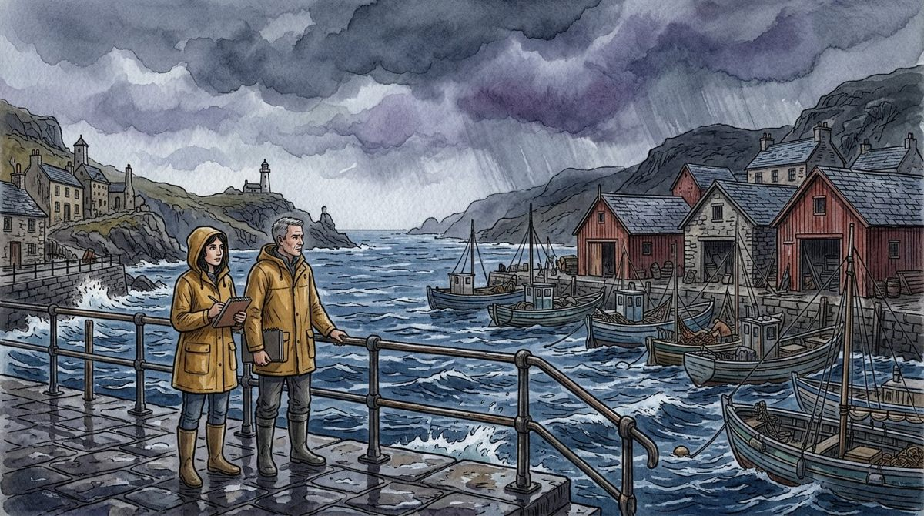
TIDELINE
COASTAL MODEL ATLAS / SYNTHETIC EVENTS ONLY
23
06 / Inspect the ledger
Missing is not observed zero.
MODEL EVENTS IN SCOPE
FICTIONAL SEGMENTS
MODEL DAY LABELS
240
3
5
Illustrated scene 12 / fictional setting, not field or weather evidence
The source supplies no weekend, hours, exits or identity fields. An absent variable or period is not an observed zero. Keep the boundary explicit instead of filling a table with invented certainty.
Chart scope: full model / 240 events. Prose remains full-model teaching context.
FICTIONAL SEGMENT INDEX
COUNTS BY FICTIONAL SEGMENT
Quay
70
80
90
Garden Bend
Overlook
Not a navigational map.
Quay
Garden Bend
Overlook
Source: synthetic teaching model / unit: entry event
Not supplied ≠ observed zero.
How would you describe a weekend for which no records are provided?
COMPLETE ATLAS / 32 PAGES / 16 OF 16 MAIN ILLUSTRATIONS / NO REAL ROUTE OR PEOPLE DATA / 23 OF 32

Slide 24
TIDELINE
COASTAL MODEL ATLAS / SYNTHETIC EVENTS ONLY
24
06 / Inspect the ledger
Keep the constructed joint allocation visible.
MODEL EVENTS IN SCOPE
FICTIONAL SEGMENTS
MODEL DAY LABELS
240
3
5
Illustrated scene 12 / fictional setting, not field or weather evidence
The rows use a deterministic allocation to reconcile the stated day and segment margins. This is a teaching construction. It does not demonstrate how real locations and days relate or validate a sampling method.
Chart scope: full model / 240 events. Prose remains full-model teaching context.
FICTIONAL SEGMENT INDEX
COUNTS BY FICTIONAL SEGMENT
Quay
70
80
90
Garden Bend
Overlook
Not a navigational map.
Quay
Garden Bend
Overlook
Source: synthetic teaching model / unit: entry event
Constructed margins / no empirical relationship claim.
Why can the apparent day-by-segment pattern not be used as field evidence?
COMPLETE ATLAS / 32 PAGES / 16 OF 16 MAIN ILLUSTRATIONS / NO REAL ROUTE OR PEOPLE DATA / 24 OF 32

Slide 25

TIDELINE
COASTAL MODEL ATLAS / SYNTHETIC EVENTS ONLY
25
07 / Guard the claim
A beautiful scene cannot repair missing data.
MODEL EVENTS IN SCOPE
FICTIONAL SEGMENTS
MODEL DAY LABELS
240
3
5
Illustrated scene 13 / fictional setting, not field or weather evidence
The illustrations change weather, setting and colour palette, but none adds a measured field to the dataset. A vivid harbor image cannot supply missing duration, routes, accessibility information or a real source study.
Chart scope: full model / 240 events. Prose remains full-model teaching context.
FICTIONAL SEGMENT INDEX
COUNTS BY MODEL DAY
Quay
50
46
58
42
44
Garden Bend
Overlook
Not a navigational map.
Mon
Tue
Wed
Thu
Fri
Source: synthetic teaching model / unit: entry event
Illustration and evidence serve different purposes.
Which tempting story would rely on information supplied only by the artwork?
COMPLETE ATLAS / 32 PAGES / 16 OF 16 MAIN ILLUSTRATIONS / NO REAL ROUTE OR PEOPLE DATA / 25 OF 32

Slide 26
TIDELINE
COASTAL MODEL ATLAS / SYNTHETIC EVENTS ONLY
26
07 / Guard the claim
A difference is not a cause.
MODEL EVENTS IN SCOPE
FICTIONAL SEGMENTS
MODEL DAY LABELS
240
3
5
Illustrated scene 13 / fictional setting, not field or weather evidence
The source contains no intervention, control, randomisation or real contextual observation. Differences between days or segments therefore cannot establish the effect of a design change, programme or environmental condition.
Chart scope: full model / 240 events. Prose remains full-model teaching context.
FICTIONAL SEGMENT INDEX
COUNTS BY MODEL DAY
Quay
50
46
58
42
44
Garden Bend
Overlook
Not a navigational map.
Mon
Tue
Wed
Thu
Fri
Source: synthetic teaching model / unit: entry event
No causal study or intervention data.
What makes a causal explanation stronger than a difference in counts?
COMPLETE ATLAS / 32 PAGES / 16 OF 16 MAIN ILLUSTRATIONS / NO REAL ROUTE OR PEOPLE DATA / 26 OF 32

Slide 27

TIDELINE
COASTAL MODEL ATLAS / SYNTHETIC EVENTS ONLY
27
07 / Guard the claim
Record IDs are not person IDs.
MODEL EVENTS IN SCOPE
FICTIONAL SEGMENTS
MODEL DAY LABELS
240
3
5
Illustrated scene 14 / fictional setting, not field or weather evidence
MODEL identifiers label synthetic events only. The atlas provides no personal information and requires none in the private note. Browser-local storage is not a secure participant-management system or a compliance guarantee.
Chart scope: full model / 240 events. Prose remains full-model teaching context.
FICTIONAL SEGMENT INDEX
COUNTS BY FICTIONAL SEGMENT
Quay
70
80
90
Garden Bend
Overlook
Not a navigational map.
Quay
Garden Bend
Overlook
Source: synthetic teaching model / unit: entry event
No person identifiers or real participant records.
How could you write an analytic question without collecting personal details?
COMPLETE ATLAS / 32 PAGES / 16 OF 16 MAIN ILLUSTRATIONS / NO REAL ROUTE OR PEOPLE DATA / 27 OF 32

Slide 28
TIDELINE
COASTAL MODEL ATLAS / SYNTHETIC EVENTS ONLY
28
07 / Guard the claim
Real studies need a separate method.
MODEL EVENTS IN SCOPE
FICTIONAL SEGMENTS
MODEL DAY LABELS
240
3
5
Illustrated scene 14 / fictional setting, not field or weather evidence
A real observation project would require appropriate local review, definitions and responsible people. This template supplies no fieldwork protocol, route instructions, weather advice or permission to collect information about real users.
Chart scope: full model / 240 events. Prose remains full-model teaching context.
FICTIONAL SEGMENT INDEX
COUNTS BY FICTIONAL SEGMENT
Quay
70
80
90
Garden Bend
Overlook
Not a navigational map.
Quay
Garden Bend
Overlook
Source: synthetic teaching model / unit: entry event
Teaching atlas, not an approved collection or outdoor-use plan.
Which question should be referred to an appropriate real-world reviewer?
COMPLETE ATLAS / 32 PAGES / 16 OF 16 MAIN ILLUSTRATIONS / NO REAL ROUTE OR PEOPLE DATA / 28 OF 32

Slide 29

TIDELINE
COASTAL MODEL ATLAS / SYNTHETIC EVENTS ONLY
29
08 / Hand over the atlas
Give the next reader the source.
MODEL EVENTS IN SCOPE
FICTIONAL SEGMENTS
MODEL DAY LABELS
240
3
5
Illustrated scene 15 / fictional setting, not field or weather evidence
A useful handoff states that the source is synthetic, identifies the selected scope and retains the unit. It separates what the rows show from the stories a reader might imagine from the coastal illustrations.
Chart scope: full model / 240 events. Prose remains full-model teaching context.
FICTIONAL SEGMENT INDEX
COUNTS BY MODEL DAY
Quay
50
46
58
42
44
Garden Bend
Overlook
Not a navigational map.
Mon
Tue
Wed
Thu
Fri
Source: synthetic teaching model / unit: entry event
Source / scope / unit / limitation / next question.
Which three labels would prevent the most common misreading of this report?
COMPLETE ATLAS / 32 PAGES / 16 OF 16 MAIN ILLUSTRATIONS / NO REAL ROUTE OR PEOPLE DATA / 29 OF 32

Slide 30
TIDELINE
COASTAL MODEL ATLAS / SYNTHETIC EVENTS ONLY
30
08 / Hand over the atlas
Correct the note, not the evidence history.
MODEL EVENTS IN SCOPE
FICTIONAL SEGMENTS
MODEL DAY LABELS
240
3
5
Illustrated scene 15 / fictional setting, not field or weather evidence
Browser text edits change your copy of the explanation. They do not turn invented rows into observations or rewrite the original source CSV. Keep a correction’s purpose visible when sharing an edited HTML or JSON record.
Chart scope: full model / 240 events. Prose remains full-model teaching context.
FICTIONAL SEGMENT INDEX
COUNTS BY MODEL DAY
Quay
50
46
58
42
44
Garden Bend
Overlook
Not a navigational map.
Mon
Tue
Wed
Thu
Fri
Source: synthetic teaching model / unit: entry event
Edited prose is not a new data-collection result.
How would you label an explanatory correction without implying new evidence?
COMPLETE ATLAS / 32 PAGES / 16 OF 16 MAIN ILLUSTRATIONS / NO REAL ROUTE OR PEOPLE DATA / 30 OF 32

Slide 31

TIDELINE
COASTAL MODEL ATLAS / SYNTHETIC EVENTS ONLY
31
08 / Hand over the atlas
Choose the right export.
MODEL EVENTS IN SCOPE
FICTIONAL SEGMENTS
MODEL DAY LABELS
240
3
5
Illustrated scene 16 / fictional setting, not field or weather evidence
Current HTML preserves the selected chart scope and text edits; JSON preserves the edit record and scope. Original PDF/PPTX are unchanged full-model exports. Full source CSV/JSON remain the 240-row synthetic model.
Chart scope: full model / 240 events. Prose remains full-model teaching context.
FICTIONAL SEGMENT INDEX
COUNTS BY FICTIONAL SEGMENT
Quay
70
80
90
Garden Bend
Overlook
Not a navigational map.
Quay
Garden Bend
Overlook
Source: synthetic teaching model / unit: entry event
Current exports ≠ original full-model exports.
What could confuse someone receiving an edited subset report and an original PDF?
COMPLETE ATLAS / 32 PAGES / 16 OF 16 MAIN ILLUSTRATIONS / NO REAL ROUTE OR PEOPLE DATA / 31 OF 32

Slide 32
TIDELINE
COASTAL MODEL ATLAS / SYNTHETIC EVENTS ONLY
32
08 / Hand over the atlas
Leave a clearer coastal question.
MODEL EVENTS IN SCOPE
FICTIONAL SEGMENTS
MODEL DAY LABELS
240
3
5
Illustrated scene 16 / fictional setting, not field or weather evidence
A useful atlas closes with a bounded question, not a promise that a real route has been evaluated. All 16 independent primary illustrations are present. Their changing backgrounds remain visual context, not additional source data.
Chart scope: full model / 240 events. Prose remains full-model teaching context.
FICTIONAL SEGMENT INDEX
COUNTS BY FICTIONAL SEGMENT
Quay
70
80
90
Garden Bend
Overlook
Not a navigational map.
Quay
Garden Bend
Overlook
Source: synthetic teaching model / unit: entry event
Keep the source small, explicit and honestly labelled.
What is the next question that this model can—and cannot—help you practise?
COMPLETE ATLAS / 32 PAGES / 16 OF 16 MAIN ILLUSTRATIONS / NO REAL ROUTE OR PEOPLE DATA / 32 OF 32

