Slide 1
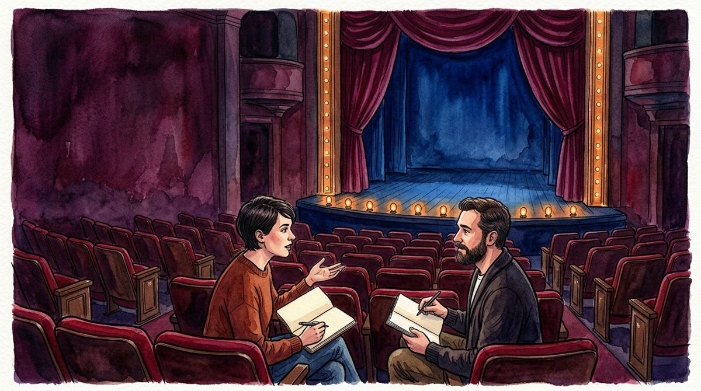
DESIGN BUDDY
CREATIVE EXERCISE
ACT 1 / ARRIVAL
LOCAL / UNMARKED
Begin before the curtain.
1
Begin before the curtain.
2
Give the room a point of view.
3
Let an object ask a question.
4
Start with an incomplete want.
5
Make an entrance meaningful.
6
Choose an opening question.
A
F
T
E
R
G
L
O
W
STORY INTENTION
Imagine a small theatre with no announced production. Two collaborators arrive with different memories of the same room. Let the first exchange reveal a question rather than announce a finished programme.
LEAVE A QUESTION
What does one character notice that the other overlooks?
Beat order is not timing, a technical call or a show schedule.
Watercolour 1 / invented setting and adults / not production evidence
01 / NOTICE
02 / TRY IN WORDS
03 / KEEP VISIBLE
01
A room can establish mood without establishing a plot.
Write two opening lines with different priorities.
Keep both versions; do not vote for a winner yet.
ACT 1 / 5
BEAT 1 / 6
FICTIONAL WRITING WORKSHOP / NOT A STAGING OR APPROVAL PLAN
DRAFT / 14 OF 15 ARTWORKS / 1 OF 30

Slide 2
DESIGN BUDDY
CREATIVE EXERCISE
ACT 1 / ARRIVAL
LOCAL / UNMARKED
Give the room a point of view.
1
Begin before the curtain.
2
Give the room a point of view.
3
Let an object ask a question.
4
Start with an incomplete want.
5
Make an entrance meaningful.
6
Choose an opening question.
A
F
T
E
R
G
L
O
W
STORY INTENTION
Describe the auditorium through one imagined character’s attention. A worn seat might suggest familiarity to one person and neglect to another. These are narrative choices, not findings about a real venue.
LEAVE A QUESTION
Which detail changes meaning when the observer changes?
Beat order is not timing, a technical call or a show schedule.
Watercolour 1 / invented setting and adults / not production evidence
01 / NOTICE
02 / TRY IN WORDS
03 / KEEP VISIBLE
02
The same visible detail can carry two interpretations.
Rewrite a room description from the second character’s view.
Separate description from a character’s assumption.
ACT 1 / 5
BEAT 2 / 6
FICTIONAL WRITING WORKSHOP / NOT A STAGING OR APPROVAL PLAN
DRAFT / 14 OF 15 ARTWORKS / 2 OF 30

Slide 3
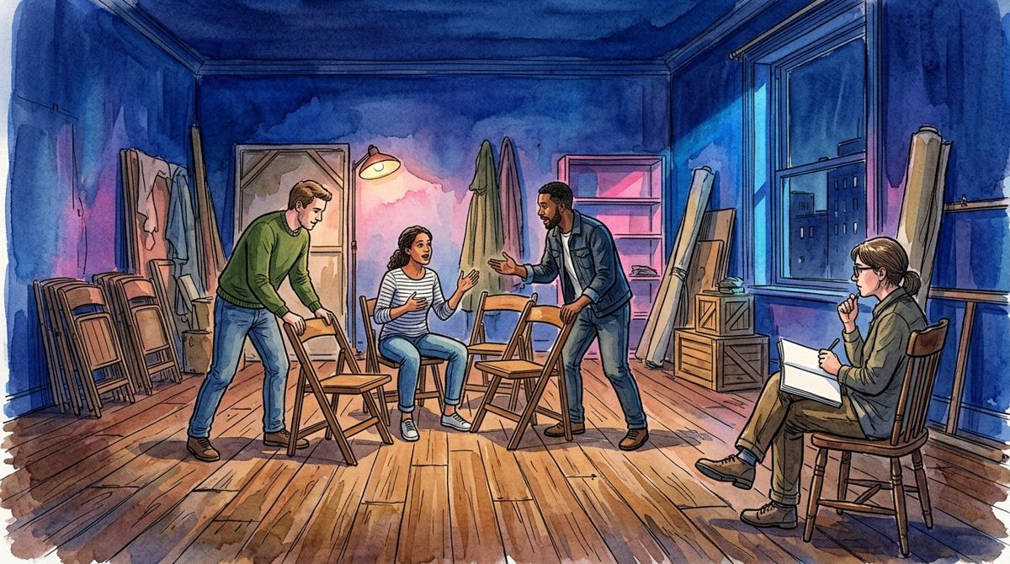
DESIGN BUDDY
CREATIVE EXERCISE
ACT 1 / ARRIVAL
LOCAL / UNMARKED
Let an object ask a question.
1
Begin before the curtain.
2
Give the room a point of view.
3
Let an object ask a question.
4
Start with an incomplete want.
5
Make an entrance meaningful.
6
Choose an opening question.
A
F
T
E
R
G
L
O
W
STORY INTENTION
Choose a blank notebook, an empty chair or a folded coat. Give it a personal meaning within the invented story. Do not present the illustrated object as a historical artefact or an actual production prop.
LEAVE A QUESTION
What question could a closed notebook leave unanswered?
Beat order is not timing, a technical call or a show schedule.
Watercolour 2 / invented setting and adults / not production evidence
01 / NOTICE
02 / TRY IN WORDS
03 / KEEP VISIBLE
03
An ordinary object can hold a story’s uncertainty.
Invent two incompatible explanations for the object.
Leave one explanation unresolved for a later page.
ACT 1 / 5
BEAT 3 / 6
FICTIONAL WRITING WORKSHOP / NOT A STAGING OR APPROVAL PLAN
DRAFT / 14 OF 15 ARTWORKS / 3 OF 30

Slide 4
DESIGN BUDDY
CREATIVE EXERCISE
ACT 1 / ARRIVAL
LOCAL / UNMARKED
Start with an incomplete want.
1
Begin before the curtain.
2
Give the room a point of view.
3
Let an object ask a question.
4
Start with an incomplete want.
5
Make an entrance meaningful.
6
Choose an opening question.
A
F
T
E
R
G
L
O
W
STORY INTENTION
A character can want to be heard without knowing what to say. Write a modest desire that could change through conversation. Avoid turning a creative exercise into a diagnosis of a real participant.
LEAVE A QUESTION
What would count as a small change for this invented character?
Beat order is not timing, a technical call or a show schedule.
Watercolour 2 / invented setting and adults / not production evidence
01 / NOTICE
02 / TRY IN WORDS
03 / KEEP VISIBLE
04
A desire is not the same as a complete plan.
Describe the want in one sentence without naming a trait.
Keep the character fictional and the stakes bounded.
ACT 1 / 5
BEAT 4 / 6
FICTIONAL WRITING WORKSHOP / NOT A STAGING OR APPROVAL PLAN
DRAFT / 14 OF 15 ARTWORKS / 4 OF 30

Slide 5
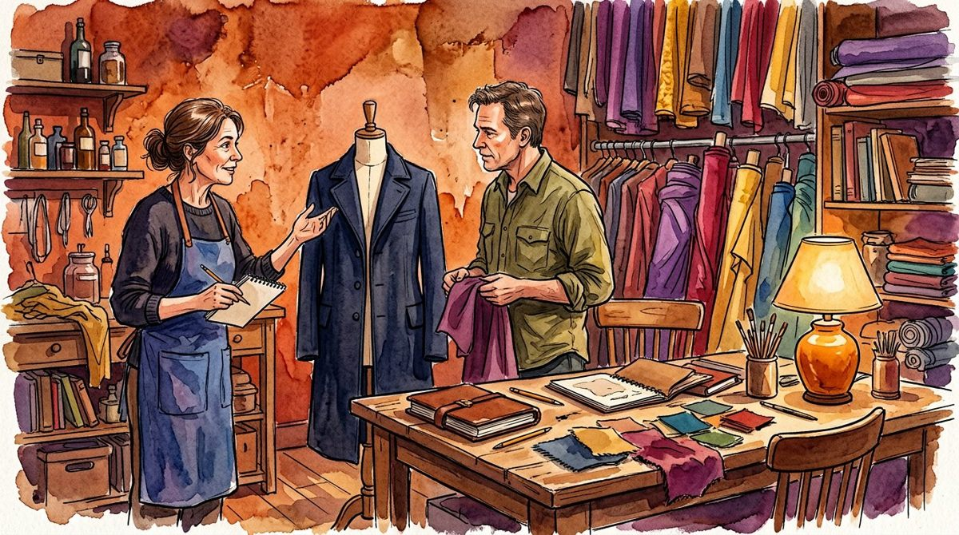
DESIGN BUDDY
CREATIVE EXERCISE
ACT 1 / ARRIVAL
LOCAL / UNMARKED
Make an entrance meaningful.
1
Begin before the curtain.
2
Give the room a point of view.
3
Let an object ask a question.
4
Start with an incomplete want.
5
Make an entrance meaningful.
6
Choose an opening question.
A
F
T
E
R
G
L
O
W
STORY INTENTION
An arrival can change what people expect from a room. Imagine a late collaborator entering an otherwise quiet conversation. Explore attention and hesitation in prose, not directions for moving real performers.
LEAVE A QUESTION
What expectation shifts when the third voice arrives?
Beat order is not timing, a technical call or a show schedule.
Watercolour 3 / invented setting and adults / not production evidence
01 / NOTICE
02 / TRY IN WORDS
03 / KEEP VISIBLE
05
A new voice can alter an exchange without raising its volume.
Write the same entrance as welcome and as interruption.
Compare meanings, not physical rehearsal instructions.
ACT 1 / 5
BEAT 5 / 6
FICTIONAL WRITING WORKSHOP / NOT A STAGING OR APPROVAL PLAN
DRAFT / 14 OF 15 ARTWORKS / 5 OF 30

Slide 6
DESIGN BUDDY
CREATIVE EXERCISE
ACT 1 / ARRIVAL
LOCAL / UNMARKED
Choose an opening question.
1
Begin before the curtain.
2
Give the room a point of view.
3
Let an object ask a question.
4
Start with an incomplete want.
5
Make an entrance meaningful.
6
Choose an opening question.
A
F
T
E
R
G
L
O
W
STORY INTENTION
Look back at the five opening exercises. Select a question that leaves more than one plausible response. This local choice is a creative note, not a confirmed programme, booking or audience commitment.
LEAVE A QUESTION
Which question invites the clearest next scene?
Beat order is not timing, a technical call or a show schedule.
Watercolour 3 / invented setting and adults / not production evidence
01 / NOTICE
02 / TRY IN WORDS
03 / KEEP VISIBLE
06
An opening can promise exploration rather than an answer.
Write a one-sentence invitation to the fictional story.
Name the uncertainty you intentionally keep.
ACT 1 / 5
BEAT 6 / 6
FICTIONAL WRITING WORKSHOP / NOT A STAGING OR APPROVAL PLAN
DRAFT / 14 OF 15 ARTWORKS / 6 OF 30

Slide 7

DESIGN BUDDY
CREATIVE EXERCISE
ACT 2 / CONTRAST
LOCAL / UNMARKED
Set two versions side by side.
1
Set two versions side by side.
2
Change the light in the sentence.
3
Let silence have alternatives.
4
Offer a generous disagreement.
5
Test a reversal of expectation.
6
Name what contrast reveals.
A
F
T
E
R
G
L
O
W
STORY INTENTION
One character remembers a generous room; another remembers a room that never listened. Give each a specific fictional detail. Contrast becomes richer when neither voice is reduced to a slogan.
LEAVE A QUESTION
How can both versions feel internally plausible?
Beat order is not timing, a technical call or a show schedule.
Watercolour 4 / invented setting and adults / not production evidence
01 / NOTICE
02 / TRY IN WORDS
03 / KEEP VISIBLE
07
Contrasting memories need not be ranked as measured facts.
Write one short memory for each imagined speaker.
Keep the source of each claim inside the story.
ACT 2 / 5
BEAT 1 / 6
FICTIONAL WRITING WORKSHOP / NOT A STAGING OR APPROVAL PLAN
DRAFT / 14 OF 15 ARTWORKS / 7 OF 30

Slide 8
DESIGN BUDDY
CREATIVE EXERCISE
ACT 2 / CONTRAST
LOCAL / UNMARKED
Change the light in the sentence.
1
Set two versions side by side.
2
Change the light in the sentence.
3
Let silence have alternatives.
4
Offer a generous disagreement.
5
Test a reversal of expectation.
6
Name what contrast reveals.
A
F
T
E
R
G
L
O
W
STORY INTENTION
Describe the same lobby first with distant violet evening, then with warm amber lamps. Use language to explore mood. The pictures are visual prompts, not a lighting specification or electrical plan.
LEAVE A QUESTION
What emotional reading changes while the facts stay the same?
Beat order is not timing, a technical call or a show schedule.
Watercolour 4 / invented setting and adults / not production evidence
01 / NOTICE
02 / TRY IN WORDS
03 / KEEP VISIBLE
08
Colour can suggest a mood without proving an emotion.
Replace three descriptive words, leaving the action unchanged.
Do not turn a colour association into a universal rule.
ACT 2 / 5
BEAT 2 / 6
FICTIONAL WRITING WORKSHOP / NOT A STAGING OR APPROVAL PLAN
DRAFT / 14 OF 15 ARTWORKS / 8 OF 30

Slide 9

DESIGN BUDDY
CREATIVE EXERCISE
ACT 2 / CONTRAST
LOCAL / UNMARKED
Let silence have alternatives.
1
Set two versions side by side.
2
Change the light in the sentence.
3
Let silence have alternatives.
4
Offer a generous disagreement.
5
Test a reversal of expectation.
6
Name what contrast reveals.
A
F
T
E
R
G
L
O
W
STORY INTENTION
A pause may suggest care, doubt, distraction or refusal within fiction. Write more than one reading before choosing one. No pause in this exercise measures an actual person’s intention.
LEAVE A QUESTION
What else could this fictional silence mean?
Beat order is not timing, a technical call or a show schedule.
Watercolour 5 / invented setting and adults / not production evidence
01 / NOTICE
02 / TRY IN WORDS
03 / KEEP VISIBLE
09
Silence does not have one dependable interpretation.
Draft three different thoughts beneath the same unsaid line.
Keep at least two interpretations available.
ACT 2 / 5
BEAT 3 / 6
FICTIONAL WRITING WORKSHOP / NOT A STAGING OR APPROVAL PLAN
DRAFT / 14 OF 15 ARTWORKS / 9 OF 30

Slide 10
DESIGN BUDDY
CREATIVE EXERCISE
ACT 2 / CONTRAST
LOCAL / UNMARKED
Offer a generous disagreement.
1
Set two versions side by side.
2
Change the light in the sentence.
3
Let silence have alternatives.
4
Offer a generous disagreement.
5
Test a reversal of expectation.
6
Name what contrast reveals.
A
F
T
E
R
G
L
O
W
STORY INTENTION
Give two invented collaborators different priorities for a story ending. Let each acknowledge a useful part of the other’s idea. This explores dialogue rather than a procedure for resolving real workplace disputes.
LEAVE A QUESTION
Which acknowledgement makes the disagreement more interesting?
Beat order is not timing, a technical call or a show schedule.
Watercolour 5 / invented setting and adults / not production evidence
01 / NOTICE
02 / TRY IN WORDS
03 / KEEP VISIBLE
10
A response can recognise value without agreeing.
Write a disagreement without using always or never.
Keep the disagreement about the imagined story.
ACT 2 / 5
BEAT 4 / 6
FICTIONAL WRITING WORKSHOP / NOT A STAGING OR APPROVAL PLAN
DRAFT / 14 OF 15 ARTWORKS / 10 OF 30

Slide 11

DESIGN BUDDY
CREATIVE EXERCISE
ACT 2 / CONTRAST
LOCAL / UNMARKED
Test a reversal of expectation.
1
Set two versions side by side.
2
Change the light in the sentence.
3
Let silence have alternatives.
4
Offer a generous disagreement.
5
Test a reversal of expectation.
6
Name what contrast reveals.
A
F
T
E
R
G
L
O
W
STORY INTENTION
A character who expected to speak finds a reason to listen. Describe a small fictional event that changes the expectation. Avoid treating surprise as a requirement for every narrative.
LEAVE A QUESTION
What new detail makes the change understandable?
Beat order is not timing, a technical call or a show schedule.
Watercolour 6 / invented setting and adults / not production evidence
01 / NOTICE
02 / TRY IN WORDS
03 / KEEP VISIBLE
11
A reversal needs context to feel earned.
Write the expected response and one plausible alternative.
Retain the detail connecting both versions.
ACT 2 / 5
BEAT 5 / 6
FICTIONAL WRITING WORKSHOP / NOT A STAGING OR APPROVAL PLAN
DRAFT / 14 OF 15 ARTWORKS / 11 OF 30

Slide 12
DESIGN BUDDY
CREATIVE EXERCISE
ACT 2 / CONTRAST
LOCAL / UNMARKED
Name what contrast reveals.
1
Set two versions side by side.
2
Change the light in the sentence.
3
Let silence have alternatives.
4
Offer a generous disagreement.
5
Test a reversal of expectation.
6
Name what contrast reveals.
A
F
T
E
R
G
L
O
W
STORY INTENTION
Review this act’s paired descriptions, memories and responses. Name a tension in ordinary language. A useful creative tension opens possibilities; it does not establish a psychological fact about the people using this template.
LEAVE A QUESTION
What tension could sustain another conversation?
Beat order is not timing, a technical call or a show schedule.
Watercolour 6 / invented setting and adults / not production evidence
01 / NOTICE
02 / TRY IN WORDS
03 / KEEP VISIBLE
12
A theme can emerge from specific choices.
Write a provisional theme beginning with Perhaps.
Label it provisional, not the project’s approved message.
ACT 2 / 5
BEAT 6 / 6
FICTIONAL WRITING WORKSHOP / NOT A STAGING OR APPROVAL PLAN
DRAFT / 14 OF 15 ARTWORKS / 12 OF 30

Slide 13
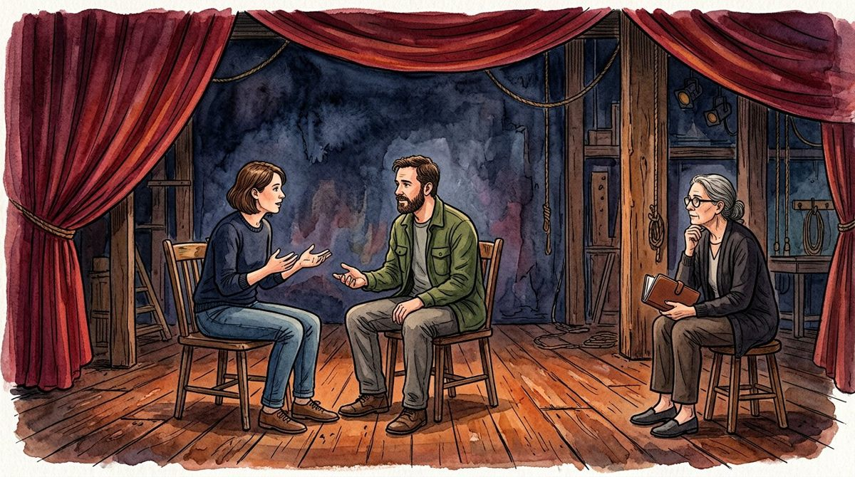
DESIGN BUDDY
CREATIVE EXERCISE
ACT 3 / MOVEMENT
LOCAL / UNMARKED
Move an idea, not a person.
1
Move an idea, not a person.
2
Use a repeated phrase carefully.
3
Make room for another voice.
4
Let an object return changed.
5
Keep a transition readable.
6
Find the turn without a verdict.
A
F
T
E
R
G
L
O
W
STORY INTENTION
Trace how a thought changes between two lines of dialogue. The movement here is narrative: from certainty to curiosity, or from haste to attention. The folio does not supply physical blocking or accessibility instructions.
LEAVE A QUESTION
Which word marks the shift in the imagined exchange?
Beat order is not timing, a technical call or a show schedule.
Watercolour 7 / invented setting and adults / not production evidence
01 / NOTICE
02 / TRY IN WORDS
03 / KEEP VISIBLE
13
Narrative movement is a change of understanding.
Write two lines in which a confident claim becomes a question.
Keep the change visible in the language.
ACT 3 / 5
BEAT 1 / 6
FICTIONAL WRITING WORKSHOP / NOT A STAGING OR APPROVAL PLAN
DRAFT / 14 OF 15 ARTWORKS / 13 OF 30

Slide 14
DESIGN BUDDY
CREATIVE EXERCISE
ACT 3 / MOVEMENT
LOCAL / UNMARKED
Use a repeated phrase carefully.
1
Move an idea, not a person.
2
Use a repeated phrase carefully.
3
Make room for another voice.
4
Let an object return changed.
5
Keep a transition readable.
6
Find the turn without a verdict.
A
F
T
E
R
G
L
O
W
STORY INTENTION
Give a short phrase a different meaning when it returns. A line such as We can wait may first sound reluctant and later generous. Repetition is an optional writing device, not a guaranteed emotional effect.
LEAVE A QUESTION
What changed around the repeated words?
Beat order is not timing, a technical call or a show schedule.
Watercolour 7 / invented setting and adults / not production evidence
01 / NOTICE
02 / TRY IN WORDS
03 / KEEP VISIBLE
14
Context can transform a familiar phrase.
Place the same line in two different fictional exchanges.
Keep both surrounding contexts available.
ACT 3 / 5
BEAT 2 / 6
FICTIONAL WRITING WORKSHOP / NOT A STAGING OR APPROVAL PLAN
DRAFT / 14 OF 15 ARTWORKS / 14 OF 30

Slide 15
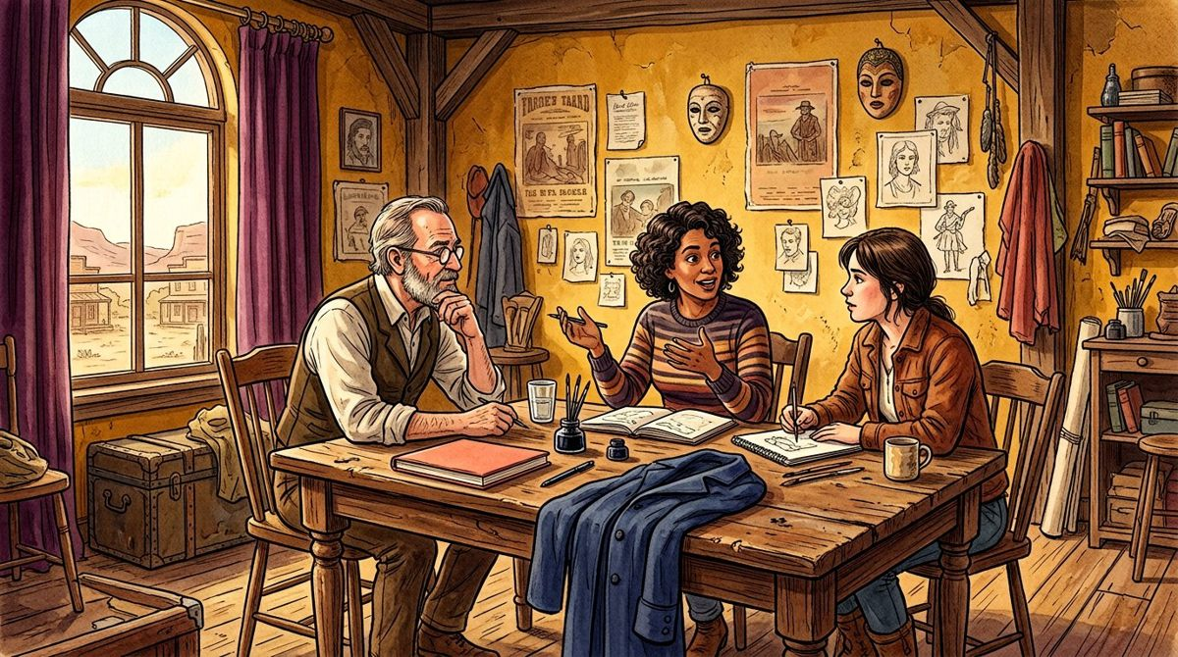
DESIGN BUDDY
CREATIVE EXERCISE
ACT 3 / MOVEMENT
LOCAL / UNMARKED
Make room for another voice.
1
Move an idea, not a person.
2
Use a repeated phrase carefully.
3
Make room for another voice.
4
Let an object return changed.
5
Keep a transition readable.
6
Find the turn without a verdict.
A
F
T
E
R
G
L
O
W
STORY INTENTION
Introduce a third imagined perspective without asking it to represent a whole community. Give this character a specific concern and a limited view. A fictional voice is not evidence of real audience needs.
LEAVE A QUESTION
What can this new speaker know, and what can they not know?
Beat order is not timing, a technical call or a show schedule.
Watercolour 8 / invented setting and adults / not production evidence
01 / NOTICE
02 / TRY IN WORDS
03 / KEEP VISIBLE
15
No single fictional speaker represents everyone.
Write a concern that belongs to this particular character.
Avoid borrowing real participant details.
ACT 3 / 5
BEAT 3 / 6
FICTIONAL WRITING WORKSHOP / NOT A STAGING OR APPROVAL PLAN
DRAFT / 14 OF 15 ARTWORKS / 15 OF 30

Slide 16
DESIGN BUDDY
CREATIVE EXERCISE
ACT 3 / MOVEMENT
LOCAL / UNMARKED
Let an object return changed.
1
Move an idea, not a person.
2
Use a repeated phrase carefully.
3
Make room for another voice.
4
Let an object return changed.
5
Keep a transition readable.
6
Find the turn without a verdict.
A
F
T
E
R
G
L
O
W
STORY INTENTION
Bring back the ordinary object from the opening act. Its physical description can remain the same while a character’s understanding changes. Explore that difference in a short paragraph.
LEAVE A QUESTION
What does the character now understand differently?
Beat order is not timing, a technical call or a show schedule.
Watercolour 8 / invented setting and adults / not production evidence
01 / NOTICE
02 / TRY IN WORDS
03 / KEEP VISIBLE
16
A returning object can connect separate moments.
Write before and after descriptions of the same notebook.
Preserve the detail that lets readers recognise it.
ACT 3 / 5
BEAT 4 / 6
FICTIONAL WRITING WORKSHOP / NOT A STAGING OR APPROVAL PLAN
DRAFT / 14 OF 15 ARTWORKS / 16 OF 30

Slide 17
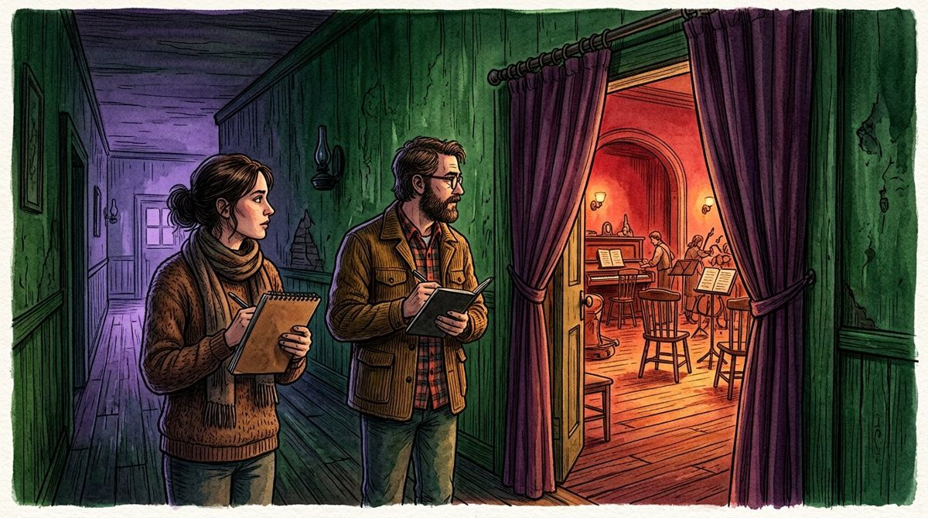
DESIGN BUDDY
CREATIVE EXERCISE
ACT 3 / MOVEMENT
LOCAL / UNMARKED
Keep a transition readable.
1
Move an idea, not a person.
2
Use a repeated phrase carefully.
3
Make room for another voice.
4
Let an object return changed.
5
Keep a transition readable.
6
Find the turn without a verdict.
A
F
T
E
R
G
L
O
W
STORY INTENTION
Describe what carries the reader from one imagined exchange to the next: a question, a remembered phrase or an unresolved choice. These are reading connections, not a timed running order for a real show.
LEAVE A QUESTION
Why would a reader want to follow this next exchange?
Beat order is not timing, a technical call or a show schedule.
Watercolour 9 / invented setting and adults / not production evidence
01 / NOTICE
02 / TRY IN WORDS
03 / KEEP VISIBLE
17
A transition can connect questions rather than locations.
Finish one scene with a question the next scene complicates.
Do not assign invented minutes or technical calls.
ACT 3 / 5
BEAT 5 / 6
FICTIONAL WRITING WORKSHOP / NOT A STAGING OR APPROVAL PLAN
DRAFT / 14 OF 15 ARTWORKS / 17 OF 30

Slide 18
DESIGN BUDDY
CREATIVE EXERCISE
ACT 3 / MOVEMENT
LOCAL / UNMARKED
Find the turn without a verdict.
1
Move an idea, not a person.
2
Use a repeated phrase carefully.
3
Make room for another voice.
4
Let an object return changed.
5
Keep a transition readable.
6
Find the turn without a verdict.
A
F
T
E
R
G
L
O
W
STORY INTENTION
Review the changes of understanding in this act. Identify a small turning point, while leaving later consequences open. A turn can be useful without declaring that a character or community has been fixed.
LEAVE A QUESTION
Which choice opens the richest set of consequences?
Beat order is not timing, a technical call or a show schedule.
Watercolour 9 / invented setting and adults / not production evidence
01 / NOTICE
02 / TRY IN WORDS
03 / KEEP VISIBLE
18
A turn changes possibilities, not necessarily outcomes.
Describe the turn in one sentence and two possible responses.
Keep the alternatives separate from the chosen draft.
ACT 3 / 5
BEAT 6 / 6
FICTIONAL WRITING WORKSHOP / NOT A STAGING OR APPROVAL PLAN
DRAFT / 14 OF 15 ARTWORKS / 18 OF 30

Slide 19

DESIGN BUDDY
CREATIVE EXERCISE
ACT 4 / REVISION
LOCAL / UNMARKED
Read a draft as a draft.
1
Read a draft as a draft.
2
Revise one thing at a time.
3
Distinguish taste from intention.
4
Keep the unused possibility.
5
Return to the story’s boundary.
6
Choose a revision question.
A
F
T
E
R
G
L
O
W
STORY INTENTION
Return to one earlier passage and mark what is clear, ambiguous or missing. These are local creative observations. They are not an official review, performer assessment or permission to produce a show.
LEAVE A QUESTION
Which ambiguity is intentional, and which is accidental?
Beat order is not timing, a technical call or a show schedule.
Watercolour 10 / invented setting and adults / not production evidence
01 / NOTICE
02 / TRY IN WORDS
03 / KEEP VISIBLE
19
A local mark records a question, not approval.
Use try, revise or park to record your own next step.
Keep the reason for a mark in the private note.
ACT 4 / 5
BEAT 1 / 6
FICTIONAL WRITING WORKSHOP / NOT A STAGING OR APPROVAL PLAN
DRAFT / 14 OF 15 ARTWORKS / 19 OF 30

Slide 20
DESIGN BUDDY
CREATIVE EXERCISE
ACT 4 / REVISION
LOCAL / UNMARKED
Revise one thing at a time.
1
Read a draft as a draft.
2
Revise one thing at a time.
3
Distinguish taste from intention.
4
Keep the unused possibility.
5
Return to the story’s boundary.
6
Choose a revision question.
A
F
T
E
R
G
L
O
W
STORY INTENTION
Choose a single sentence, object detail or reply to change. Compare the before and after versions against a stated creative intention. This is a writing comparison, not a claim that a real audience has responded better.
LEAVE A QUESTION
What change are you actually testing in this draft?
Beat order is not timing, a technical call or a show schedule.
Watercolour 10 / invented setting and adults / not production evidence
01 / NOTICE
02 / TRY IN WORDS
03 / KEEP VISIBLE
20
A narrow revision makes comparison easier to explain.
Write the intention before changing the sentence.
Retain the earlier version outside this local page if needed.
ACT 4 / 5
BEAT 2 / 6
FICTIONAL WRITING WORKSHOP / NOT A STAGING OR APPROVAL PLAN
DRAFT / 14 OF 15 ARTWORKS / 20 OF 30

Slide 21

DESIGN BUDDY
CREATIVE EXERCISE
ACT 4 / REVISION
LOCAL / UNMARKED
Distinguish taste from intention.
1
Read a draft as a draft.
2
Revise one thing at a time.
3
Distinguish taste from intention.
4
Keep the unused possibility.
5
Return to the story’s boundary.
6
Choose a revision question.
A
F
T
E
R
G
L
O
W
STORY INTENTION
A reader can dislike a choice that still serves the intended story, or enjoy a choice that distracts from it. Note the difference without pretending taste is a measured audience verdict.
LEAVE A QUESTION
Does this note describe preference, clarity or the stated aim?
Beat order is not timing, a technical call or a show schedule.
Watercolour 11 / invented setting and adults / not production evidence
01 / NOTICE
02 / TRY IN WORDS
03 / KEEP VISIBLE
21
Different kinds of feedback call for different questions.
Rewrite one vague judgement as a specific creative question.
Do not invent audience survey results.
ACT 4 / 5
BEAT 3 / 6
FICTIONAL WRITING WORKSHOP / NOT A STAGING OR APPROVAL PLAN
DRAFT / 14 OF 15 ARTWORKS / 21 OF 30

Slide 22
DESIGN BUDDY
CREATIVE EXERCISE
ACT 4 / REVISION
LOCAL / UNMARKED
Keep the unused possibility.
1
Read a draft as a draft.
2
Revise one thing at a time.
3
Distinguish taste from intention.
4
Keep the unused possibility.
5
Return to the story’s boundary.
6
Choose a revision question.
A
F
T
E
R
G
L
O
W
STORY INTENTION
A discarded line can remain useful as an alternative. Park it rather than rewriting the project’s history as though only one version existed. Browser-local marks are a convenience, not a version-control system.
LEAVE A QUESTION
What future question might make this version useful again?
Beat order is not timing, a technical call or a show schedule.
Watercolour 11 / invented setting and adults / not production evidence
01 / NOTICE
02 / TRY IN WORDS
03 / KEEP VISIBLE
22
An unused draft is not necessarily a failed draft.
Write a brief label explaining why you parked an idea.
Export your record before clearing local storage.
ACT 4 / 5
BEAT 4 / 6
FICTIONAL WRITING WORKSHOP / NOT A STAGING OR APPROVAL PLAN
DRAFT / 14 OF 15 ARTWORKS / 22 OF 30

Slide 23
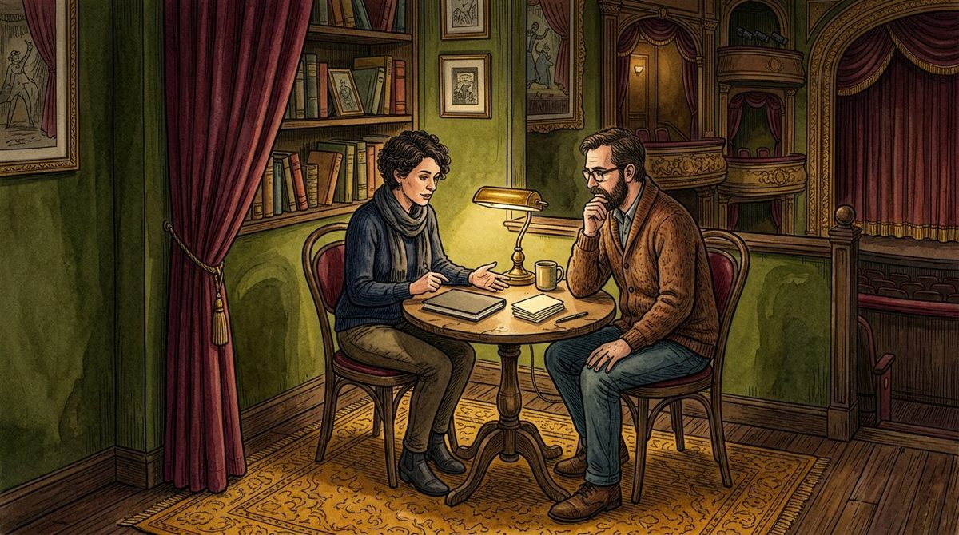
DESIGN BUDDY
CREATIVE EXERCISE
ACT 4 / REVISION
LOCAL / UNMARKED
Return to the story’s boundary.
1
Read a draft as a draft.
2
Revise one thing at a time.
3
Distinguish taste from intention.
4
Keep the unused possibility.
5
Return to the story’s boundary.
6
Choose a revision question.
A
F
T
E
R
G
L
O
W
STORY INTENTION
Check that the imagined exercise still fits its original scope. The folio supplies no venue permissions, participant consent process, technical staging plan or production budget. Those would require separate responsible work.
LEAVE A QUESTION
Which question belongs outside this creative folio?
Beat order is not timing, a technical call or a show schedule.
Watercolour 12 / invented setting and adults / not production evidence
01 / NOTICE
02 / TRY IN WORDS
03 / KEEP VISIBLE
23
An evocative illustration is not an operational plan.
Name one creative choice and one separate production question.
Do not record sensitive personal information here.
ACT 4 / 5
BEAT 5 / 6
FICTIONAL WRITING WORKSHOP / NOT A STAGING OR APPROVAL PLAN
DRAFT / 14 OF 15 ARTWORKS / 23 OF 30

Slide 24
DESIGN BUDDY
CREATIVE EXERCISE
ACT 4 / REVISION
LOCAL / UNMARKED
Choose a revision question.
1
Read a draft as a draft.
2
Revise one thing at a time.
3
Distinguish taste from intention.
4
Keep the unused possibility.
5
Return to the story’s boundary.
6
Choose a revision question.
A
F
T
E
R
G
L
O
W
STORY INTENTION
Gather the open creative notes without turning them into a promise that the story is ready for a real stage. Choose one question to carry into the handoff act. Keep unresolved alternatives visible.
LEAVE A QUESTION
Which question would help another writer respond usefully?
Beat order is not timing, a technical call or a show schedule.
Watercolour 12 / invented setting and adults / not production evidence
01 / NOTICE
02 / TRY IN WORDS
03 / KEEP VISIBLE
24
A handoff can be ready for discussion, not for production.
Write a question that another reader can answer from the draft.
Name what the reader would need that is not supplied.
ACT 4 / 5
BEAT 6 / 6
FICTIONAL WRITING WORKSHOP / NOT A STAGING OR APPROVAL PLAN
DRAFT / 14 OF 15 ARTWORKS / 24 OF 30

Slide 25

DESIGN BUDDY
CREATIVE EXERCISE
ACT 5 / HANDOFF
LOCAL / UNMARKED
Introduce the draft honestly.
1
Introduce the draft honestly.
2
Separate a choice from a promise.
3
Send the version you mean.
4
Leave a useful open question.
5
Keep the workshop fictional.
6
Close with another possibility.
A
F
T
E
R
G
L
O
W
STORY INTENTION
Tell the next reader what this fictional exercise explores and what remains undecided. State that the pictures are illustrations and the beat order is a reading sequence. No actual event or production is announced.
LEAVE A QUESTION
What should the reader know before opening the folio?
Beat order is not timing, a technical call or a show schedule.
Watercolour 13 / invented setting and adults / not production evidence
01 / NOTICE
02 / TRY IN WORDS
03 / KEEP VISIBLE
25
Context belongs with the draft, not only in a conversation.
Write a two-sentence introduction including one limitation.
Keep fictional status visible in shared exports.
ACT 5 / 5
BEAT 1 / 6
FICTIONAL WRITING WORKSHOP / NOT A STAGING OR APPROVAL PLAN
DRAFT / 14 OF 15 ARTWORKS / 25 OF 30

Slide 26
DESIGN BUDDY
CREATIVE EXERCISE
ACT 5 / HANDOFF
LOCAL / UNMARKED
Separate a choice from a promise.
1
Introduce the draft honestly.
2
Separate a choice from a promise.
3
Send the version you mean.
4
Leave a useful open question.
5
Keep the workshop fictional.
6
Close with another possibility.
A
F
T
E
R
G
L
O
W
STORY INTENTION
A provisional creative choice is not a booking, contract, funding commitment or accessibility approval. Describe a preferred story direction without implying that real arrangements have been made.
LEAVE A QUESTION
Which word could accidentally imply an external commitment?
Beat order is not timing, a technical call or a show schedule.
Watercolour 13 / invented setting and adults / not production evidence
01 / NOTICE
02 / TRY IN WORDS
03 / KEEP VISIBLE
26
Creative intention and external permission are different.
Replace a promise with a bounded provisional statement.
Leave operational decisions to a separate real process.
ACT 5 / 5
BEAT 2 / 6
FICTIONAL WRITING WORKSHOP / NOT A STAGING OR APPROVAL PLAN
DRAFT / 14 OF 15 ARTWORKS / 26 OF 30

Slide 27

DESIGN BUDDY
CREATIVE EXERCISE
ACT 5 / HANDOFF
LOCAL / UNMARKED
Send the version you mean.
1
Introduce the draft honestly.
2
Separate a choice from a promise.
3
Send the version you mean.
4
Leave a useful open question.
5
Keep the workshop fictional.
6
Close with another possibility.
A
F
T
E
R
G
L
O
W
STORY INTENTION
Current HTML includes your edited text, local marks and private note. JSON records the editable state. Original PDF/PPTX are fixed exports, not automatically revised by this browser.
LEAVE A QUESTION
Which export matches the state you intend to share?
Beat order is not timing, a technical call or a show schedule.
Watercolour 14 / invented setting and adults / not production evidence
01 / NOTICE
02 / TRY IN WORDS
03 / KEEP VISIBLE
27
Current exports and original downloads are different versions.
Check the title and local mark before exporting.
Do not include private notes you do not intend to share.
ACT 5 / 5
BEAT 3 / 6
FICTIONAL WRITING WORKSHOP / NOT A STAGING OR APPROVAL PLAN
DRAFT / 14 OF 15 ARTWORKS / 27 OF 30

Slide 28
DESIGN BUDDY
CREATIVE EXERCISE
ACT 5 / HANDOFF
LOCAL / UNMARKED
Leave a useful open question.
1
Introduce the draft honestly.
2
Separate a choice from a promise.
3
Send the version you mean.
4
Leave a useful open question.
5
Keep the workshop fictional.
6
Close with another possibility.
A
F
T
E
R
G
L
O
W
STORY INTENTION
A good handoff invites a response without asking the next reader to guess the intention. Connect a specific passage to a specific question, and explain what kind of creative response would help.
LEAVE A QUESTION
What response would help you write the next version?
Beat order is not timing, a technical call or a show schedule.
Watercolour 14 / invented setting and adults / not production evidence
01 / NOTICE
02 / TRY IN WORDS
03 / KEEP VISIBLE
28
A bounded question is easier to answer than Is it good?
Ask about one moment of clarity or one plausible alternative.
Keep the request about the draft, not the reader’s identity.
ACT 5 / 5
BEAT 4 / 6
FICTIONAL WRITING WORKSHOP / NOT A STAGING OR APPROVAL PLAN
DRAFT / 14 OF 15 ARTWORKS / 28 OF 30

Slide 29
DESIGN BUDDY
CREATIVE EXERCISE
ACT 5 / HANDOFF
LOCAL / UNMARKED
Keep the workshop fictional.
1
Introduce the draft honestly.
2
Separate a choice from a promise.
3
Send the version you mean.
4
Leave a useful open question.
5
Keep the workshop fictional.
6
Close with another possibility.
A
F
T
E
R
G
L
O
W
STORY INTENTION
The folio can organise a personal writing exercise, but it does not verify consent, permissions, funding, access or a venue’s readiness. No real participant data is needed in its browser-local notes.
MAIN ART 15 PENDING
A frame for a future illustration.
This typographic placeholder is not a primary artwork. 14 of 15 independent illustrations are present.
LEAVE A QUESTION
What separate responsible work would a real event require?
Beat order is not timing, a technical call or a show schedule.
Missing main illustration / not counted as completed art
01 / NOTICE
02 / TRY IN WORDS
03 / KEEP VISIBLE
29
Creative structure is not a real-world approval system.
State the difference between this exercise and an actual event.
Use no personal identifiers in the exported note.
ACT 5 / 5
BEAT 5 / 6
FICTIONAL WRITING WORKSHOP / NOT A STAGING OR APPROVAL PLAN
DRAFT / 14 OF 15 ARTWORKS / 29 OF 30

Slide 30
DESIGN BUDDY
CREATIVE EXERCISE
ACT 5 / HANDOFF
LOCAL / UNMARKED
Close with another possibility.
1
Introduce the draft honestly.
2
Separate a choice from a promise.
3
Send the version you mean.
4
Leave a useful open question.
5
Keep the workshop fictional.
6
Close with another possibility.
A
F
T
E
R
G
L
O
W
STORY INTENTION
A story can close while leaving room for another reading. Keep the question that still interests you. This preview contains fourteen of fifteen independent artworks; the final closing illustration remains explicitly pending, not counted as a completed illustration.
MAIN ART 15 PENDING
A frame for a future illustration.
This typographic placeholder is not a primary artwork. 14 of 15 independent illustrations are present.
LEAVE A QUESTION
Which possibility deserves the next draft?
Beat order is not timing, a technical call or a show schedule.
Missing main illustration / not counted as completed art
01 / NOTICE
02 / TRY IN WORDS
03 / KEEP VISIBLE
30
The reading order ends; the creative enquiry can continue.
Write one closing line and a different line you might try later.
Preserve the scope, source and current draft status.
ACT 5 / 5
BEAT 6 / 6
FICTIONAL WRITING WORKSHOP / NOT A STAGING OR APPROVAL PLAN
DRAFT / 14 OF 15 ARTWORKS / 30 OF 30

