Slide 1
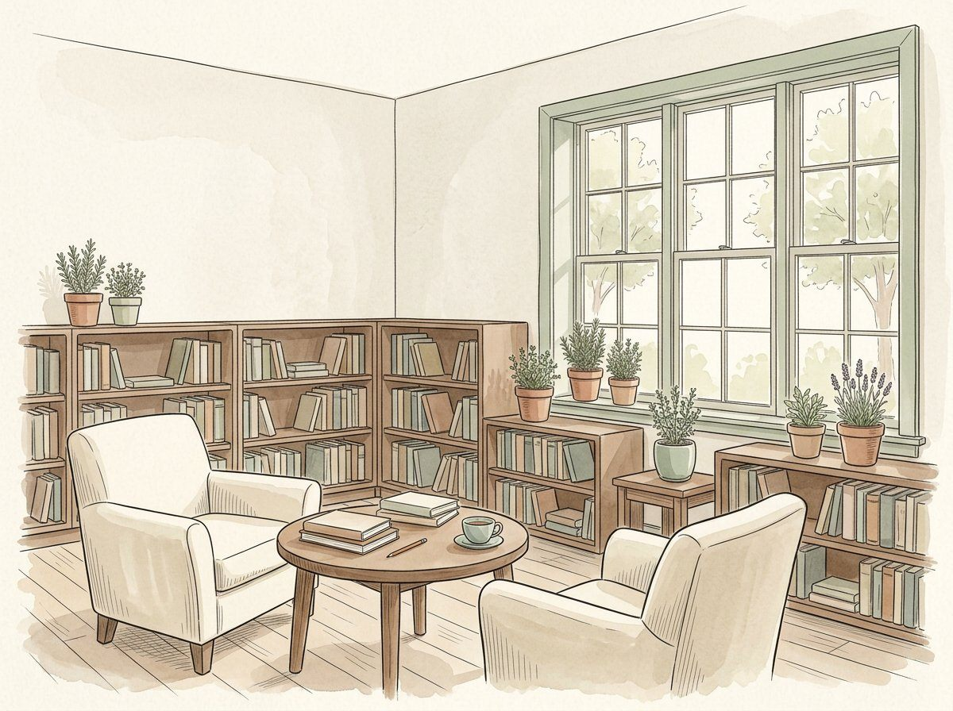
OPEN SHELF / SPATIAL CONCEPT SERIES
01
A small place to read together.
CHAPTER
PROPOSED REVIEW ROLE
PRIVATE DRAFT MARK
01 / Establish the purpose
Project convenor
LOCAL REVIEW / OPEN
ZONING STUDY / DISCUSSION ONLY
QUIET READING
WELCOME
SHARED TABLE
Not to scale. No real dimensions, capacity or approved route.
Watercolour 1 / fictional scene, not site evidence
PROPOSAL / BOUNDARY
NEXT ACTION / REVIEW QUESTION
OPEN SHELF is a fictional concept for an adult community reading corner. It connects a spatial idea to responsibilities and unanswered questions. The illustrations and sketches are discussion aids, not an approved building or service plan.
Name the question this proposal should answer.
What is the smallest useful purpose for this corner?
Concept only / no real site or participant study.
PREVIEW / 32 BOARDS / 10 OF 16 MAIN ILLUSTRATIONS / NOT APPROVED / 1 OF 32

Slide 2
OPEN SHELF / SPATIAL CONCEPT SERIES
02
Define the promise before the furniture.
CHAPTER
PROPOSED REVIEW ROLE
PRIVATE DRAFT MARK
01 / Establish the purpose
Project convenor
LOCAL REVIEW / OPEN
ZONING STUDY / DISCUSSION ONLY
QUIET READING
WELCOME
SHARED TABLE
Not to scale. No real dimensions, capacity or approved route.
Watercolour 1 / fictional scene, not site evidence
PROPOSAL / BOUNDARY
NEXT ACTION / REVIEW QUESTION
The concept offers a place for adult reading and modest conversation. It does not promise staffing, borrowing services, accessible provision, equipment or opening hours that a real operator has not reviewed and agreed.
List what is and is not proposed.
Which expectation would need a separate operational decision?
Proposed purpose ≠ committed service.
PREVIEW / 32 BOARDS / 10 OF 16 MAIN ILLUSTRATIONS / NOT APPROVED / 2 OF 32

Slide 3
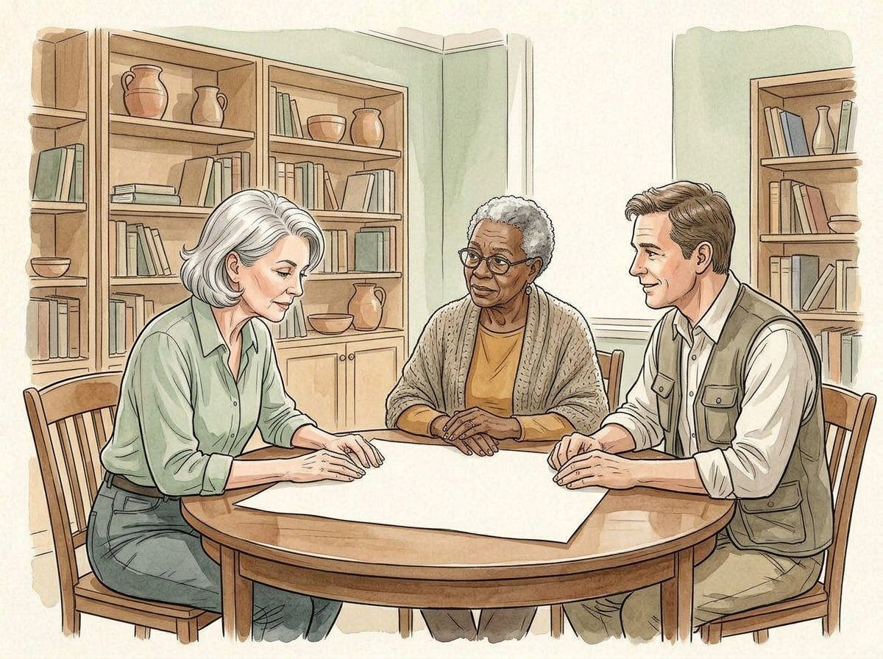
OPEN SHELF / SPATIAL CONCEPT SERIES
03
Invite voices without inventing demand.
CHAPTER
PROPOSED REVIEW ROLE
PRIVATE DRAFT MARK
01 / Establish the purpose
Engagement lead
LOCAL REVIEW / OPEN
ZONING STUDY / DISCUSSION ONLY
QUIET READING
WELCOME
SHARED TABLE
Not to scale. No real dimensions, capacity or approved route.
Watercolour 2 / fictional scene, not site evidence
PROPOSAL / BOUNDARY
NEXT ACTION / REVIEW QUESTION
The pictured neighbors are illustrative. No consultation has actually been conducted. A real project would need an appropriate process for asking questions, hearing disagreement and deciding what information may be recorded.
Draft a bounded consultation question.
Whose perspective is missing from the concept discussion?
No attendance, demand or consent evidence is supplied.
PREVIEW / 32 BOARDS / 10 OF 16 MAIN ILLUSTRATIONS / NOT APPROVED / 3 OF 32

Slide 4
OPEN SHELF / SPATIAL CONCEPT SERIES
04
Keep a decision separate from a discussion.
CHAPTER
PROPOSED REVIEW ROLE
PRIVATE DRAFT MARK
01 / Establish the purpose
Project convenor
LOCAL REVIEW / OPEN
ZONING STUDY / DISCUSSION ONLY
QUIET READING
WELCOME
SHARED TABLE
Not to scale. No real dimensions, capacity or approved route.
Watercolour 2 / fictional scene, not site evidence
PROPOSAL / BOUNDARY
NEXT ACTION / REVIEW QUESTION
An idea raised around a table is not an agreement to fund, build or operate it. Record the topic, responsible reviewer and next step without treating informal enthusiasm as authorisation.
Keep a list of unresolved decisions.
What would be needed before calling an idea an agreed commitment?
Discussion → review question → responsible reviewer.
PREVIEW / 32 BOARDS / 10 OF 16 MAIN ILLUSTRATIONS / NOT APPROVED / 4 OF 32

Slide 5
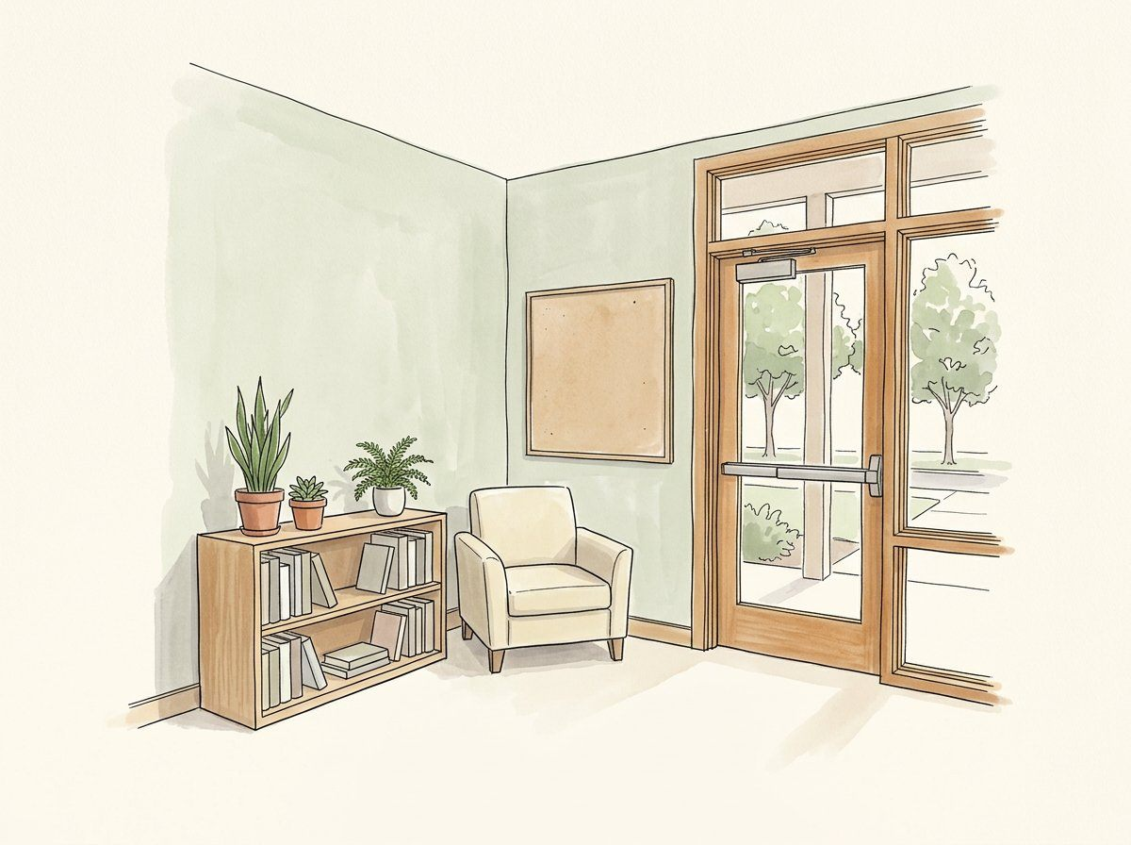
OPEN SHELF / SPATIAL CONCEPT SERIES
05
A threshold is an information moment.
CHAPTER
PROPOSED REVIEW ROLE
PRIVATE DRAFT MARK
02 / Explore the space
Venue liaison
LOCAL REVIEW / OPEN
ZONING STUDY / DISCUSSION ONLY
QUIET READING
WELCOME
SHARED TABLE
Not to scale. No real dimensions, capacity or approved route.
Watercolour 3 / fictional scene, not site evidence
PROPOSAL / BOUNDARY
NEXT ACTION / REVIEW QUESTION
The welcome zone is an abstract location for programme information. The sketch has no dimensions, capacity, real entrance geometry or approved circulation route. It cannot establish that a real site is suitable.
Request the appropriate site information.
What must a venue reviewer know before considering this idea?
Concept diagram / not to scale / no real address.
PREVIEW / 32 BOARDS / 10 OF 16 MAIN ILLUSTRATIONS / NOT APPROVED / 5 OF 32

Slide 6
OPEN SHELF / SPATIAL CONCEPT SERIES
06
Three zones, not a technical drawing.
CHAPTER
PROPOSED REVIEW ROLE
PRIVATE DRAFT MARK
02 / Explore the space
Space reviewer
LOCAL REVIEW / OPEN
ZONING STUDY / DISCUSSION ONLY
QUIET READING
WELCOME
SHARED TABLE
Not to scale. No real dimensions, capacity or approved route.
Watercolour 3 / fictional scene, not site evidence
PROPOSAL / BOUNDARY
NEXT ACTION / REVIEW QUESTION
Welcome, quiet reading and shared conversation are labels for discussion. They are not partitions, measured areas or a claim that these activities can coexist in any room. Actual space constraints remain unknown.
Discuss relationships between proposed uses.
Which pair of uses could conflict in a real room?
Three conceptual uses; no verified floor area.
PREVIEW / 32 BOARDS / 10 OF 16 MAIN ILLUSTRATIONS / NOT APPROVED / 6 OF 32

Slide 7
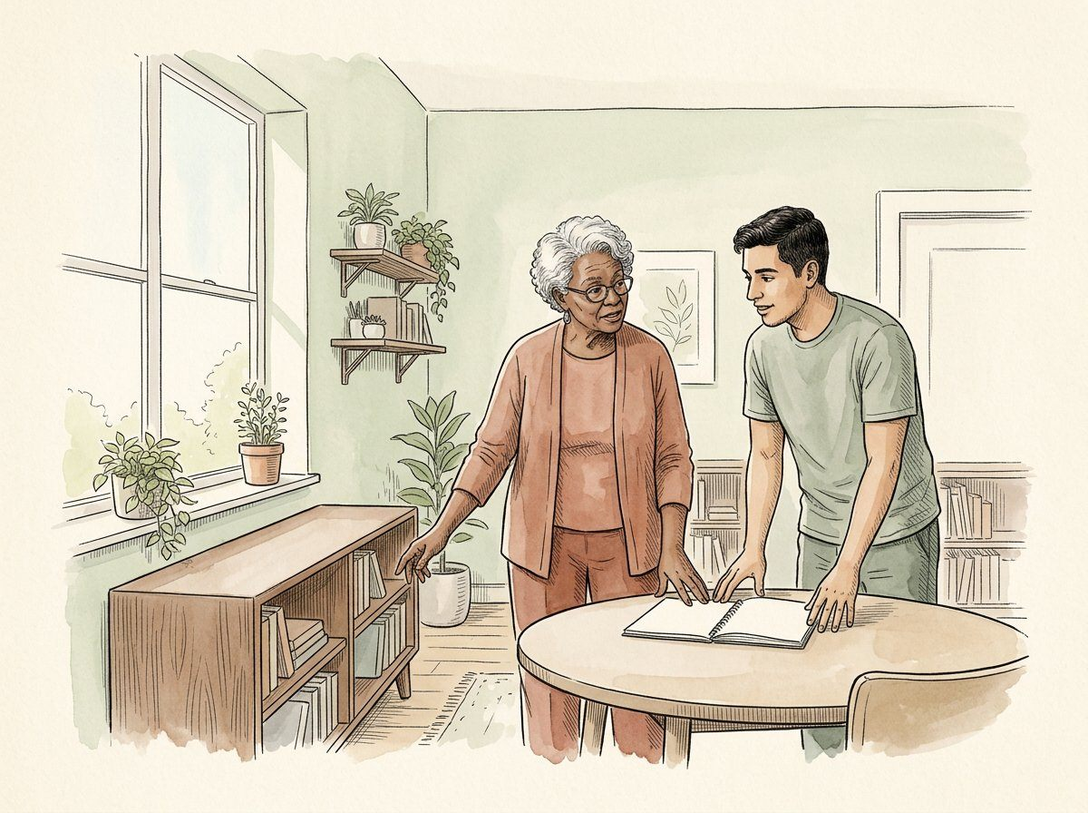
OPEN SHELF / SPATIAL CONCEPT SERIES
07
Review the arrangement with the right people.
CHAPTER
PROPOSED REVIEW ROLE
PRIVATE DRAFT MARK
02 / Explore the space
Venue liaison
LOCAL REVIEW / OPEN
ZONING STUDY / DISCUSSION ONLY
QUIET READING
WELCOME
SHARED TABLE
Not to scale. No real dimensions, capacity or approved route.
Watercolour 4 / fictional scene, not site evidence
PROPOSAL / BOUNDARY
NEXT ACTION / REVIEW QUESTION
An illustrated arrangement does not authorise moving furniture or changing routes. Local venue professionals and relevant reviewers must evaluate any real proposal through their own approved processes.
Refer arrangement questions to venue reviewers.
Which question should not be answered by a decorative sketch?
No construction, egress or access sign-off.
PREVIEW / 32 BOARDS / 10 OF 16 MAIN ILLUSTRATIONS / NOT APPROVED / 7 OF 32

Slide 8
OPEN SHELF / SPATIAL CONCEPT SERIES
08
Keep options reversible on paper.
CHAPTER
PROPOSED REVIEW ROLE
PRIVATE DRAFT MARK
02 / Explore the space
Space reviewer
LOCAL REVIEW / OPEN
ZONING STUDY / DISCUSSION ONLY
QUIET READING
WELCOME
SHARED TABLE
Not to scale. No real dimensions, capacity or approved route.
Watercolour 4 / fictional scene, not site evidence
PROPOSAL / BOUNDARY
NEXT ACTION / REVIEW QUESTION
Compare ideas as concepts before making a real commitment. A drawn alternative can help discuss trade-offs, but it does not prove that furniture can be moved, that an area is available or that changes are permitted.
Record the reason for preferring an option.
What information could change the preferred arrangement?
Paper alternatives are not physical permissions.
PREVIEW / 32 BOARDS / 10 OF 16 MAIN ILLUSTRATIONS / NOT APPROVED / 8 OF 32

Slide 9
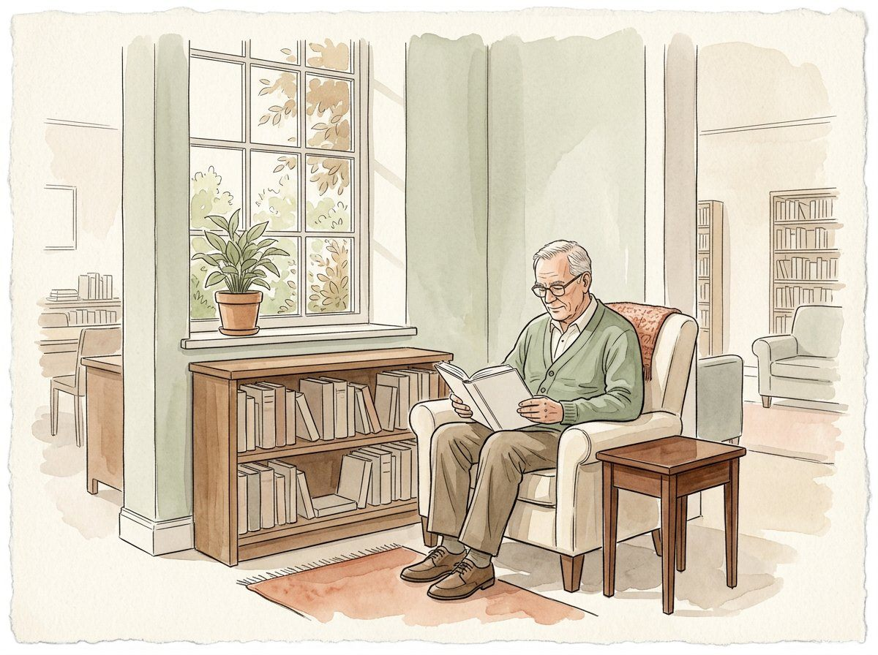
OPEN SHELF / SPATIAL CONCEPT SERIES
09
Quiet reading is a proposed experience.
CHAPTER
PROPOSED REVIEW ROLE
PRIVATE DRAFT MARK
03 / Consider shared use
Use reviewer
LOCAL REVIEW / OPEN
ZONING STUDY / DISCUSSION ONLY
QUIET READING
WELCOME
SHARED TABLE
Not to scale. No real dimensions, capacity or approved route.
Watercolour 5 / fictional scene, not site evidence
PROPOSAL / BOUNDARY
NEXT ACTION / REVIEW QUESTION
A reading alcove suggests concentration, but a picture cannot establish acoustic performance, comfort or suitability for every person. Treat those qualities as questions requiring appropriate review, not demonstrated outcomes.
Ask which environmental questions need review.
What would you need to understand about a real quiet-reading setting?
Illustration ≠ acoustic or comfort evidence.
PREVIEW / 32 BOARDS / 10 OF 16 MAIN ILLUSTRATIONS / NOT APPROVED / 9 OF 32

Slide 10
OPEN SHELF / SPATIAL CONCEPT SERIES
10
Conversation needs a bounded purpose.
CHAPTER
PROPOSED REVIEW ROLE
PRIVATE DRAFT MARK
03 / Consider shared use
Programme reviewer
LOCAL REVIEW / OPEN
ZONING STUDY / DISCUSSION ONLY
QUIET READING
WELCOME
SHARED TABLE
Not to scale. No real dimensions, capacity or approved route.
Watercolour 5 / fictional scene, not site evidence
PROPOSAL / BOUNDARY
NEXT ACTION / REVIEW QUESTION
A shared table could support adult discussion if the responsible operator agrees. The concept does not define session capacity, supervision, booking, conduct rules or a service schedule. These remain separate operational matters.
Name one proposed discussion use.
Which responsibilities would that use introduce?
A table is not an operating model.
PREVIEW / 32 BOARDS / 10 OF 16 MAIN ILLUSTRATIONS / NOT APPROVED / 10 OF 32

Slide 11
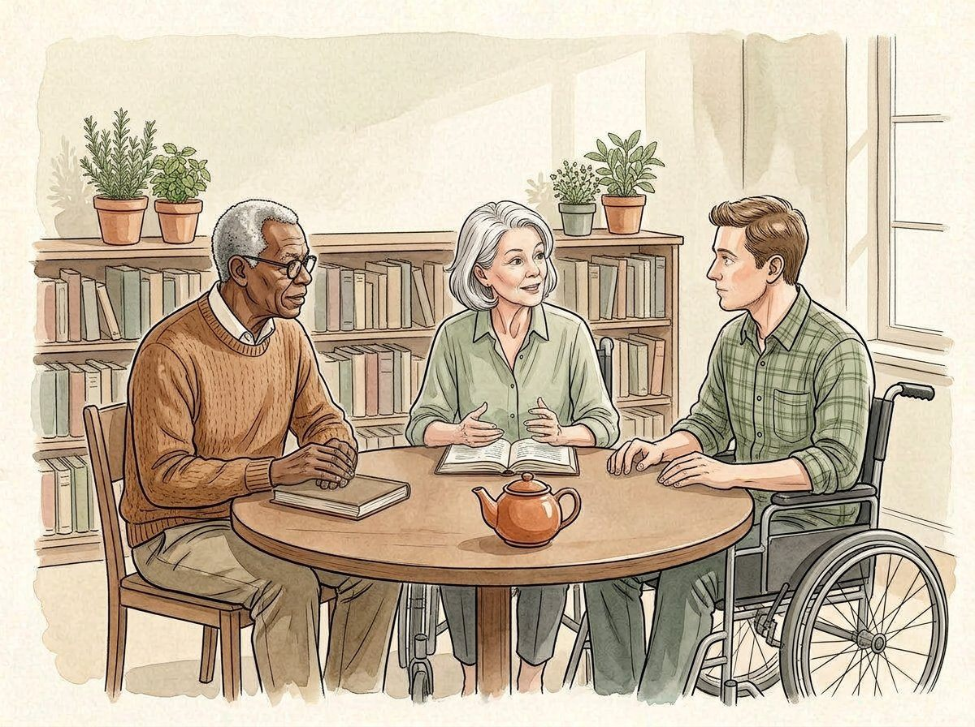
OPEN SHELF / SPATIAL CONCEPT SERIES
11
Do not infer inclusion from an image.
CHAPTER
PROPOSED REVIEW ROLE
PRIVATE DRAFT MARK
03 / Consider shared use
Engagement lead
LOCAL REVIEW / OPEN
ZONING STUDY / DISCUSSION ONLY
QUIET READING
WELCOME
SHARED TABLE
Not to scale. No real dimensions, capacity or approved route.
Watercolour 6 / fictional scene, not site evidence
PROPOSAL / BOUNDARY
NEXT ACTION / REVIEW QUESTION
The scene illustrates adults participating together. It does not verify access, equality of experience or compliance at an actual venue. Relevant people should be involved in reviewing real needs through appropriate local processes.
List inclusion questions without collecting sensitive details.
What would be inappropriate to claim from this illustration alone?
Illustrative participation; no access certification.
PREVIEW / 32 BOARDS / 10 OF 16 MAIN ILLUSTRATIONS / NOT APPROVED / 11 OF 32

Slide 12
OPEN SHELF / SPATIAL CONCEPT SERIES
12
Make room for different preferences.
CHAPTER
PROPOSED REVIEW ROLE
PRIVATE DRAFT MARK
03 / Consider shared use
Programme reviewer
LOCAL REVIEW / OPEN
ZONING STUDY / DISCUSSION ONLY
QUIET READING
WELCOME
SHARED TABLE
Not to scale. No real dimensions, capacity or approved route.
Watercolour 6 / fictional scene, not site evidence
PROPOSAL / BOUNDARY
NEXT ACTION / REVIEW QUESTION
Some adults may prefer quiet reading, others conversation, and others may not wish to participate. Avoid describing one preferred activity as a universal community need without an actual evidence base.
Keep alternative preferences visible.
Which assumption about participation should remain open?
Preferences are not yet studied.
PREVIEW / 32 BOARDS / 10 OF 16 MAIN ILLUSTRATIONS / NOT APPROVED / 12 OF 32

Slide 13
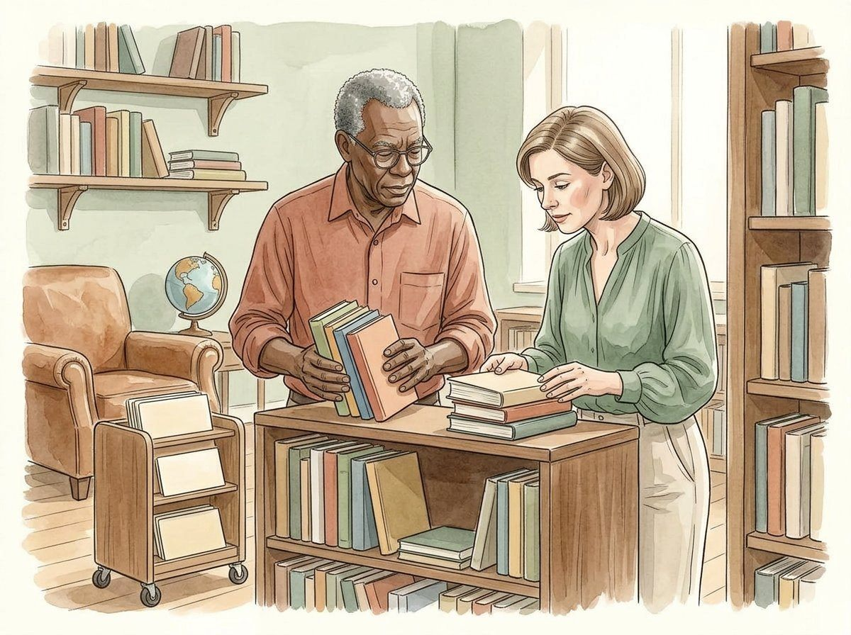
OPEN SHELF / SPATIAL CONCEPT SERIES
13
Books imply a stewardship question.
CHAPTER
PROPOSED REVIEW ROLE
PRIVATE DRAFT MARK
04 / Name stewardship
Collection reviewer
LOCAL REVIEW / OPEN
ZONING STUDY / DISCUSSION ONLY
QUIET READING
WELCOME
SHARED TABLE
Not to scale. No real dimensions, capacity or approved route.
Watercolour 7 / fictional scene, not site evidence
PROPOSAL / BOUNDARY
NEXT ACTION / REVIEW QUESTION
Placing books on a shelf raises questions about ownership, selection, condition and responsibility. This concept does not supply a lending policy, catalog, real inventory or permission to use anyone’s materials.
Identify who would review stewardship.
Who would need to agree before materials were offered?
No real collection or lending service is provided.
PREVIEW / 32 BOARDS / 10 OF 16 MAIN ILLUSTRATIONS / NOT APPROVED / 13 OF 32

Slide 14
OPEN SHELF / SPATIAL CONCEPT SERIES
14
Separate a role from a named commitment.
CHAPTER
PROPOSED REVIEW ROLE
PRIVATE DRAFT MARK
04 / Name stewardship
Project convenor
LOCAL REVIEW / OPEN
ZONING STUDY / DISCUSSION ONLY
QUIET READING
WELCOME
SHARED TABLE
Not to scale. No real dimensions, capacity or approved route.
Watercolour 7 / fictional scene, not site evidence
PROPOSAL / BOUNDARY
NEXT ACTION / REVIEW QUESTION
A role label helps organise a proposal but does not mean a person has accepted it. Keep proposed responsibilities distinct from actual assignments and let real participants review the scope before agreeing.
Mark each responsibility as proposed.
How would you record an unaccepted responsibility honestly?
Proposed role ≠ accepted appointment.
PREVIEW / 32 BOARDS / 10 OF 16 MAIN ILLUSTRATIONS / NOT APPROVED / 14 OF 32

Slide 15

OPEN SHELF / SPATIAL CONCEPT SERIES
15
Care belongs in the operational discussion.
CHAPTER
PROPOSED REVIEW ROLE
PRIVATE DRAFT MARK
04 / Name stewardship
Operations reviewer
LOCAL REVIEW / OPEN
ZONING STUDY / DISCUSSION ONLY
QUIET READING
WELCOME
SHARED TABLE
Not to scale. No real dimensions, capacity or approved route.
Watercolour 8 / fictional scene, not site evidence
PROPOSAL / BOUNDARY
NEXT ACTION / REVIEW QUESTION
A tidy still life is not evidence that a room can be maintained at no cost. Actual upkeep, staffing and equipment arrangements need an operator and local review; this proposal gives no cleaning or maintenance instructions.
Ask who would review ongoing resource needs.
Which ongoing question is easily hidden by an attractive room image?
Ongoing care is not costed or approved.
PREVIEW / 32 BOARDS / 10 OF 16 MAIN ILLUSTRATIONS / NOT APPROVED / 15 OF 32

Slide 16
OPEN SHELF / SPATIAL CONCEPT SERIES
16
Define the handoff before claiming readiness.
CHAPTER
PROPOSED REVIEW ROLE
PRIVATE DRAFT MARK
04 / Name stewardship
Project convenor
LOCAL REVIEW / OPEN
ZONING STUDY / DISCUSSION ONLY
QUIET READING
WELCOME
SHARED TABLE
Not to scale. No real dimensions, capacity or approved route.
Watercolour 8 / fictional scene, not site evidence
PROPOSAL / BOUNDARY
NEXT ACTION / REVIEW QUESTION
A handoff needs an issue, current status and responsible next reviewer. Do not mark a dependency resolved merely because a concept board has been completed or a local review menu has been changed.
Write one explicit handoff dependency.
What acknowledgement would the next reviewer need to provide?
Local review marks are private drafting notes.
PREVIEW / 32 BOARDS / 10 OF 16 MAIN ILLUSTRATIONS / NOT APPROVED / 16 OF 32

Slide 17

OPEN SHELF / SPATIAL CONCEPT SERIES
17
A resource model is not a quote.
CHAPTER
PROPOSED REVIEW ROLE
PRIVATE DRAFT MARK
05 / Bound the resources
Resource reviewer
LOCAL REVIEW / OPEN
ZONING STUDY / DISCUSSION ONLY
QUIET READING
WELCOME
SHARED TABLE
Not to scale. No real dimensions, capacity or approved route.
Watercolour 9 / fictional scene, not site evidence
PROPOSAL / BOUNDARY
NEXT ACTION / REVIEW QUESTION
The fictional planning allowances are shelving 1,800 units, seating 1,400, paper materials 600 and a provisional reserve 400. These invented values support arithmetic discussion, not procurement or a funded budget.
Label every number as a planning assumption.
Which description would falsely turn this model into a real quotation?
1,800 + 1,400 + 600 + 400 = 4,200 model units.
PREVIEW / 32 BOARDS / 10 OF 16 MAIN ILLUSTRATIONS / NOT APPROVED / 17 OF 32

Slide 18
OPEN SHELF / SPATIAL CONCEPT SERIES
18
A subtotal can omit major costs.
CHAPTER
PROPOSED REVIEW ROLE
PRIVATE DRAFT MARK
05 / Bound the resources
Resource reviewer
LOCAL REVIEW / OPEN
ZONING STUDY / DISCUSSION ONLY
QUIET READING
WELCOME
SHARED TABLE
Not to scale. No real dimensions, capacity or approved route.
Watercolour 9 / fictional scene, not site evidence
PROPOSAL / BOUNDARY
NEXT ACTION / REVIEW QUESTION
The model excludes staffing, insurance, venue use, specialist review and other unknown costs. A tidy subtotal does not make a complete cost plan. Keep omissions visible beside the arithmetic.
Record major unpriced categories.
Why should an omitted cost not automatically become zero?
4,200 units is an illustrative subtotal only.
PREVIEW / 32 BOARDS / 10 OF 16 MAIN ILLUSTRATIONS / NOT APPROVED / 18 OF 32

Slide 19
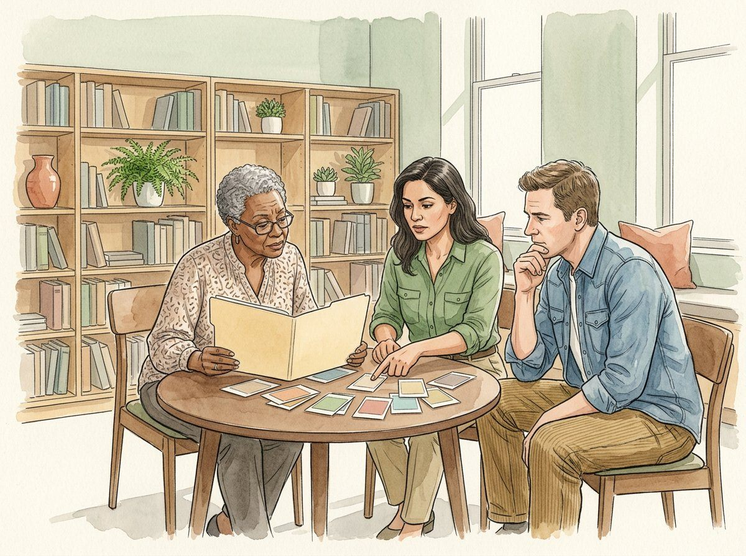
OPEN SHELF / SPATIAL CONCEPT SERIES
19
A change has an explicit effect.
CHAPTER
PROPOSED REVIEW ROLE
PRIVATE DRAFT MARK
05 / Bound the resources
Resource reviewer
LOCAL REVIEW / OPEN
ZONING STUDY / DISCUSSION ONLY
QUIET READING
WELCOME
SHARED TABLE
Not to scale. No real dimensions, capacity or approved route.
Watercolour 10 / fictional scene, not site evidence
PROPOSAL / BOUNDARY
NEXT ACTION / REVIEW QUESTION
If an illustrative additional allowance is 800 units, the model subtotal becomes 5,000. This arithmetic does not authorise a purchase, establish affordability or indicate that money is available.
Record the assumption behind an addition.
What real decision is not answered by the new subtotal?
4,200 + 800 = 5,000 fictional units.
PREVIEW / 32 BOARDS / 10 OF 16 MAIN ILLUSTRATIONS / NOT APPROVED / 19 OF 32

Slide 20
OPEN SHELF / SPATIAL CONCEPT SERIES
20
Keep procurement outside the illustration.
CHAPTER
PROPOSED REVIEW ROLE
PRIVATE DRAFT MARK
05 / Bound the resources
Procurement reviewer
LOCAL REVIEW / OPEN
ZONING STUDY / DISCUSSION ONLY
QUIET READING
WELCOME
SHARED TABLE
Not to scale. No real dimensions, capacity or approved route.
Watercolour 10 / fictional scene, not site evidence
PROPOSAL / BOUNDARY
NEXT ACTION / REVIEW QUESTION
The furniture images are generic concepts, not product specifications or supplier endorsements. A real purchase would require its own appropriate review, authority and process. No transaction occurs in this template.
Identify the responsible procurement process.
Which promise would exceed this concept’s scope?
No supplier, order, funding or contract is provided.
PREVIEW / 32 BOARDS / 10 OF 16 MAIN ILLUSTRATIONS / NOT APPROVED / 20 OF 32

Slide 21

OPEN SHELF / SPATIAL CONCEPT SERIES
21
A risk question is not a safety instruction.
CHAPTER
PROPOSED REVIEW ROLE
PRIVATE DRAFT MARK
06 / Surface the boundaries
Venue liaison
LOCAL REVIEW / OPEN
ZONING STUDY / DISCUSSION ONLY
QUIET READING
WELCOME
SHARED TABLE
Not to scale. No real dimensions, capacity or approved route.
MAIN ART 11 PENDING / SUPPORTING RESPONSIBILITY MAP ONLY
PROPOSAL / BOUNDARY
NEXT ACTION / REVIEW QUESTION
This proposal can name uncertainties and the relevant reviewer. It cannot diagnose a venue, provide an emergency plan or certify a safe arrangement. Real safety questions belong to the responsible qualified people and local procedures.
Route specialist questions to the appropriate reviewer.
Which question needs expertise outside this proposal?
No safety or technical assessment is supplied.
PREVIEW / 32 BOARDS / 10 OF 16 MAIN ILLUSTRATIONS / NOT APPROVED / 21 OF 32

Slide 22
OPEN SHELF / SPATIAL CONCEPT SERIES
22
Keep an unresolved dependency unresolved.
CHAPTER
PROPOSED REVIEW ROLE
PRIVATE DRAFT MARK
06 / Surface the boundaries
Project convenor
LOCAL REVIEW / OPEN
ZONING STUDY / DISCUSSION ONLY
QUIET READING
WELCOME
SHARED TABLE
Not to scale. No real dimensions, capacity or approved route.
MAIN ART 11 PENDING / SUPPORTING RESPONSIBILITY MAP ONLY
PROPOSAL / BOUNDARY
NEXT ACTION / REVIEW QUESTION
Missing information is not approval and a blank field is not evidence that there is no issue. State what is unknown, who should review it and what kind of response would allow the next discussion.
Make one missing dependency explicit.
What would be lost by replacing unknown with ready?
Unknown ≠ approved ≠ not applicable.
PREVIEW / 32 BOARDS / 10 OF 16 MAIN ILLUSTRATIONS / NOT APPROVED / 22 OF 32

Slide 23
OPEN SHELF / SPATIAL CONCEPT SERIES
23
Name the origin of each claim.
CHAPTER
PROPOSED REVIEW ROLE
PRIVATE DRAFT MARK
06 / Surface the boundaries
Evidence reviewer
LOCAL REVIEW / OPEN
ZONING STUDY / DISCUSSION ONLY
QUIET READING
WELCOME
SHARED TABLE
Not to scale. No real dimensions, capacity or approved route.
MAIN ART 12 PENDING / SUPPORTING RESPONSIBILITY MAP ONLY
PROPOSAL / BOUNDARY
NEXT ACTION / REVIEW QUESTION
All scenes and resource figures here are fictional. A future real proposal should distinguish observed facts, attributed sources, assumptions and open questions rather than combining them into a single confident narrative.
Label evidence and assumptions separately.
Which sentence would need an actual source before real-world use?
Sources: concept art and invented teaching numbers.
PREVIEW / 32 BOARDS / 10 OF 16 MAIN ILLUSTRATIONS / NOT APPROVED / 23 OF 32

Slide 24
OPEN SHELF / SPATIAL CONCEPT SERIES
24
Avoid unnecessary personal records.
CHAPTER
PROPOSED REVIEW ROLE
PRIVATE DRAFT MARK
06 / Surface the boundaries
Record reviewer
LOCAL REVIEW / OPEN
ZONING STUDY / DISCUSSION ONLY
QUIET READING
WELCOME
SHARED TABLE
Not to scale. No real dimensions, capacity or approved route.
MAIN ART 12 PENDING / SUPPORTING RESPONSIBILITY MAP ONLY
PROPOSAL / BOUNDARY
NEXT ACTION / REVIEW QUESTION
These boards need no participant names, contact details or sensitive stories to illustrate a concept. The private browser note is not a secure data store or a shared case-management record. Use appropriate real processes for any personal information.
Keep the draft note non-sensitive.
How could you describe an issue without recording a personal story?
No personal-data collection is required here.
PREVIEW / 32 BOARDS / 10 OF 16 MAIN ILLUSTRATIONS / NOT APPROVED / 24 OF 32

Slide 25
OPEN SHELF / SPATIAL CONCEPT SERIES
25
Open means a question remains.
CHAPTER
PROPOSED REVIEW ROLE
PRIVATE DRAFT MARK
07 / Review the proposal
Draft reviewer
LOCAL REVIEW / OPEN
ZONING STUDY / DISCUSSION ONLY
QUIET READING
WELCOME
SHARED TABLE
Not to scale. No real dimensions, capacity or approved route.
MAIN ART 13 PENDING / SUPPORTING RESPONSIBILITY MAP ONLY
PROPOSAL / BOUNDARY
NEXT ACTION / REVIEW QUESTION
The local menu offers open, revise, discuss and defer. Those values help you annotate a draft in your browser. They do not send anything to a team, record official approval or change real venue permissions.
Choose a local review mark for this board.
What must remain clear when a locally marked board is exported?
Browser-local drafting status only.
PREVIEW / 32 BOARDS / 10 OF 16 MAIN ILLUSTRATIONS / NOT APPROVED / 25 OF 32

Slide 26
OPEN SHELF / SPATIAL CONCEPT SERIES
26
Revise the assumption, not the history.
CHAPTER
PROPOSED REVIEW ROLE
PRIVATE DRAFT MARK
07 / Review the proposal
Draft reviewer
LOCAL REVIEW / OPEN
ZONING STUDY / DISCUSSION ONLY
QUIET READING
WELCOME
SHARED TABLE
Not to scale. No real dimensions, capacity or approved route.
MAIN ART 13 PENDING / SUPPORTING RESPONSIBILITY MAP ONLY
PROPOSAL / BOUNDARY
NEXT ACTION / REVIEW QUESTION
If an assumption changes, state what was changed and why. Do not rewrite a fictional consultation as if it had actually happened or present a proposed resource as already committed.
Write a bounded reason for revision.
Which earlier distinction should survive a revised proposal?
Revision is not retrospective evidence.
PREVIEW / 32 BOARDS / 10 OF 16 MAIN ILLUSTRATIONS / NOT APPROVED / 26 OF 32

Slide 27
OPEN SHELF / SPATIAL CONCEPT SERIES
27
Discuss a specific question.
CHAPTER
PROPOSED REVIEW ROLE
PRIVATE DRAFT MARK
07 / Review the proposal
Project convenor
LOCAL REVIEW / OPEN
ZONING STUDY / DISCUSSION ONLY
QUIET READING
WELCOME
SHARED TABLE
Not to scale. No real dimensions, capacity or approved route.
MAIN ART 14 PENDING / SUPPORTING RESPONSIBILITY MAP ONLY
PROPOSAL / BOUNDARY
NEXT ACTION / REVIEW QUESTION
A useful review request names one issue, the information needed and the relevant role. “Please approve everything” hides dependencies and can imply authority that this template does not provide.
Frame one concrete review request.
What information would make the next conversation more useful?
Issue → needed information → reviewer → next discussion.
PREVIEW / 32 BOARDS / 10 OF 16 MAIN ILLUSTRATIONS / NOT APPROVED / 27 OF 32

Slide 28
OPEN SHELF / SPATIAL CONCEPT SERIES
28
Deferral can be an honest outcome.
CHAPTER
PROPOSED REVIEW ROLE
PRIVATE DRAFT MARK
07 / Review the proposal
Project convenor
LOCAL REVIEW / OPEN
ZONING STUDY / DISCUSSION ONLY
QUIET READING
WELCOME
SHARED TABLE
Not to scale. No real dimensions, capacity or approved route.
MAIN ART 14 PENDING / SUPPORTING RESPONSIBILITY MAP ONLY
PROPOSAL / BOUNDARY
NEXT ACTION / REVIEW QUESTION
A concept can remain on hold when information, responsibility or permission is missing. Deferral is not a failure to produce a pretty board; it preserves the boundary between a design idea and a real-world commitment.
Name the reason for a proposed deferral.
Which unanswered question would justify waiting?
A complete concept may still be unsuitable for implementation.
PREVIEW / 32 BOARDS / 10 OF 16 MAIN ILLUSTRATIONS / NOT APPROVED / 28 OF 32

Slide 29
OPEN SHELF / SPATIAL CONCEPT SERIES
29
Make a bounded next step.
CHAPTER
PROPOSED REVIEW ROLE
PRIVATE DRAFT MARK
08 / Hand over clearly
Project convenor
LOCAL REVIEW / OPEN
ZONING STUDY / DISCUSSION ONLY
QUIET READING
WELCOME
SHARED TABLE
Not to scale. No real dimensions, capacity or approved route.
MAIN ART 15 PENDING / SUPPORTING RESPONSIBILITY MAP ONLY
PROPOSAL / BOUNDARY
NEXT ACTION / REVIEW QUESTION
A next step might be to draft a question for a venue reviewer. It should name a proposed owner and review point without implying that the person has accepted the task or that the project is funded.
Write one limited proposed action.
How would you distinguish a suggestion from an assigned task?
Proposed next step, subject to acceptance.
PREVIEW / 32 BOARDS / 10 OF 16 MAIN ILLUSTRATIONS / NOT APPROVED / 29 OF 32

Slide 30
OPEN SHELF / SPATIAL CONCEPT SERIES
30
Explain the version being shared.
CHAPTER
PROPOSED REVIEW ROLE
PRIVATE DRAFT MARK
08 / Hand over clearly
Record reviewer
LOCAL REVIEW / OPEN
ZONING STUDY / DISCUSSION ONLY
QUIET READING
WELCOME
SHARED TABLE
Not to scale. No real dimensions, capacity or approved route.
MAIN ART 15 PENDING / SUPPORTING RESPONSIBILITY MAP ONLY
PROPOSAL / BOUNDARY
NEXT ACTION / REVIEW QUESTION
When sharing a draft, identify which local text and review marks it contains. Current HTML and JSON exports preserve browser edits; the original PDF/PPTX remain unchanged source exports.
Choose the intended export and state its scope.
What could confuse a reviewer receiving two different versions?
Editable draft exports are separate from original downloads.
PREVIEW / 32 BOARDS / 10 OF 16 MAIN ILLUSTRATIONS / NOT APPROVED / 30 OF 32

Slide 31
OPEN SHELF / SPATIAL CONCEPT SERIES
31
Check the claim, not just the appearance.
CHAPTER
PROPOSED REVIEW ROLE
PRIVATE DRAFT MARK
08 / Hand over clearly
Draft reviewer
LOCAL REVIEW / OPEN
ZONING STUDY / DISCUSSION ONLY
QUIET READING
WELCOME
SHARED TABLE
Not to scale. No real dimensions, capacity or approved route.
MAIN ART 16 PENDING / SUPPORTING RESPONSIBILITY MAP ONLY
PROPOSAL / BOUNDARY
NEXT ACTION / REVIEW QUESTION
Before sharing, verify that the proposal still distinguishes concept from permission, model from quote and local note from approval. An illustration does not close a missing evidence or responsibility gap.
Inspect one unsupported-sounding sentence.
Which limitation must stay visible outside this browser?
Review: purpose / source / owner / limit / next question.
PREVIEW / 32 BOARDS / 10 OF 16 MAIN ILLUSTRATIONS / NOT APPROVED / 31 OF 32

Slide 32
OPEN SHELF / SPATIAL CONCEPT SERIES
32
Leave a clear question on the table.
CHAPTER
PROPOSED REVIEW ROLE
PRIVATE DRAFT MARK
08 / Hand over clearly
Project convenor
LOCAL REVIEW / OPEN
ZONING STUDY / DISCUSSION ONLY
QUIET READING
WELCOME
SHARED TABLE
Not to scale. No real dimensions, capacity or approved route.
MAIN ART 16 PENDING / SUPPORTING RESPONSIBILITY MAP ONLY
PROPOSAL / BOUNDARY
NEXT ACTION / REVIEW QUESTION
A useful spatial concept ends with a transparent next discussion, not a claim that the room is ready to operate. This preview still lacks six primary illustrations; supporting maps are not counted as main art.
Hand over the current question and its boundaries.
What should the next reader understand before proposing a real decision?
A concept is a starting point, not implementation authority.
PREVIEW / 32 BOARDS / 10 OF 16 MAIN ILLUSTRATIONS / NOT APPROVED / 32 OF 32

