Slide 1

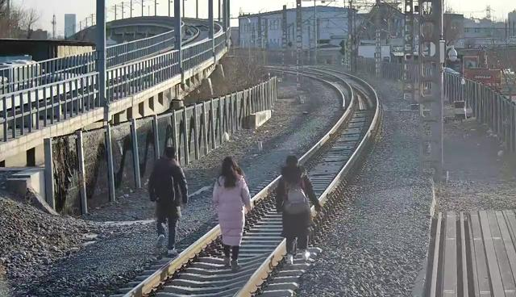
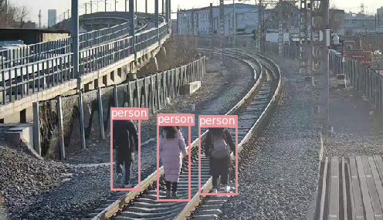
My Laboratory and Research
Laboratory : rail transit safety
Research
  railway perimeter security
  computer vision
Method
traditional algorithms based statistics
convolutional neural network(CNN)
Significance
improve the intelligence and efficiency
reduce the cost
Input
Output

