Slide 1
Hydrological Modeling with HydroLearn
水文模型教学库
An Educational Repository for Rainfall-Runoff Modeling
降雨径流模型教学库

Slide 2
Learning Objectives / 学习目标
• Understand the fundamental concepts of hydrological modeling
理解水文模拟的基本概念
• Learn different runoff generation mechanisms
学习不同的产流机制
• Master parameter calibration and validation techniques
掌握参数率定和验证技术
• Compare performance of different hydrological models
比较不同水文模型的性能
• Apply models to real-world problems
将模型应用于实际问题

Slide 3
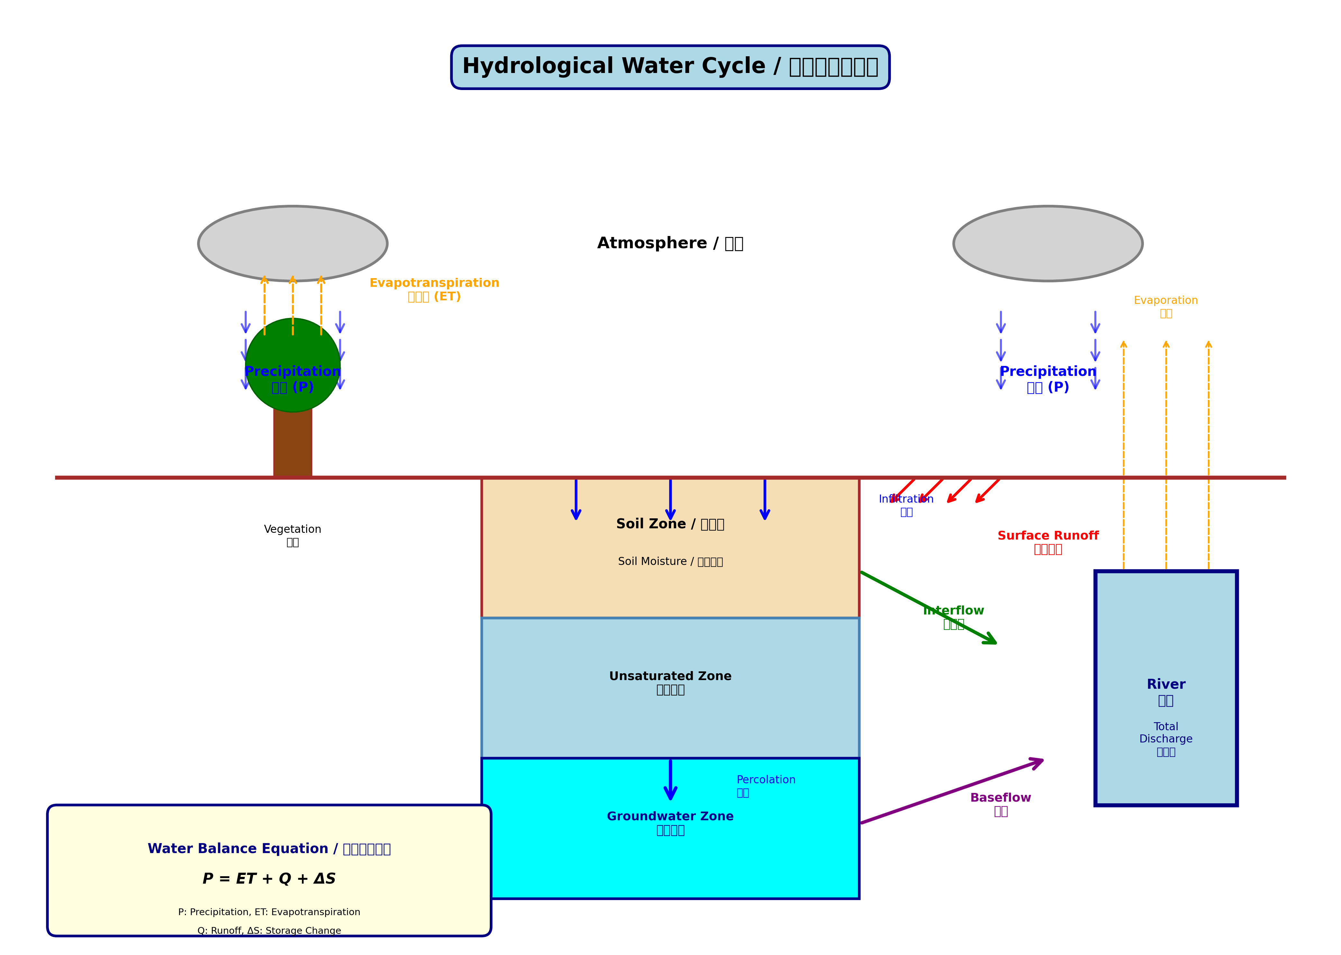
The Hydrological Water Cycle / 水文循环
Water Balance: P = ET + Q + ΔS

Slide 4
What is a Hydrological Model? / 什么是水文模型?
• Mathematical representation of the hydrological cycle
水文循环的数学表示
• Transforms inputs (P, T, PET) into outputs (Q)
将输入(降水、温度、蒸散发)转换为输出(径流)
• Three main types:
- Physical-based (physically-based processes)
- Conceptual (simplified representations)
- Data-driven (statistical/machine learning)
• We focus on conceptual models in this course
本课程重点关注概念性模型

Slide 5
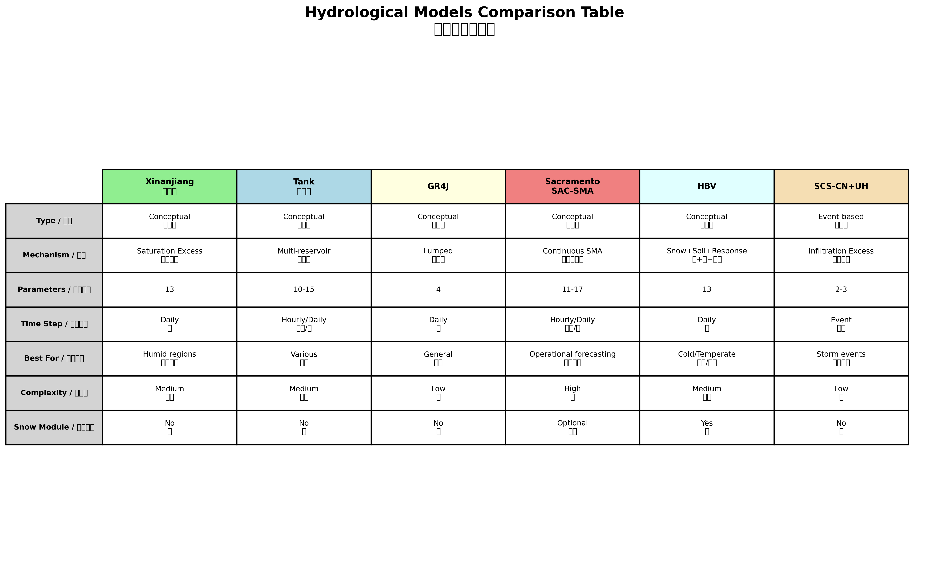
HydroLearn Model Portfolio / 模型组合
Six different hydrological models for various applications / 六种不同的水文模型

Slide 6
Xinanjiang Model (新安江模型)
📍 Origin:
• Developed by Zhao Ren-jun (1973)
• Hohai University, China
🎯 Key Features:
• Saturation excess mechanism
• Three-layer evapotranspiration
• Parabolic distribution curves
• Best for humid regions
📊 Parameters: 13
• Evaporation: K, C
• Soil: WM, WUM, WLM, B
• Runoff: SM, EX, IMP
• Routing: KI, KG, CI, CG
🔧 Main Components:
1. Three-Layer ET Module
• Upper layer (WUM)
• Lower layer (WLM)
• Deep layer (WDM)
2. Runoff Generation
• Saturation excess
• Parabolic curve
3. Runoff Separation
• Surface runoff
• Interflow
• Groundwater
4. Flow Routing
• Linear reservoirs

Slide 7
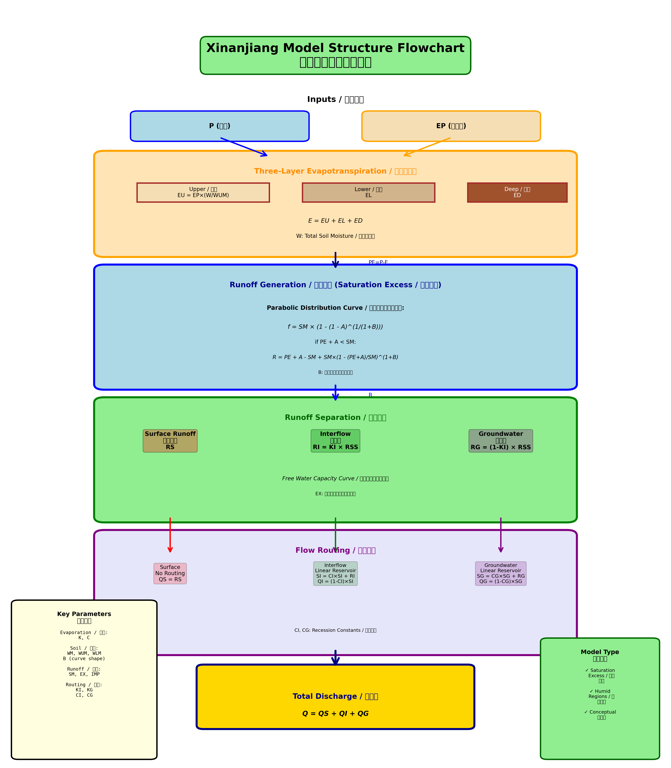
Xinanjiang Model Structure / 新安江模型结构
Complete model flowchart showing all components / 完整模型流程图

Slide 8
HBV Model
📍 Origin:
• Swedish Meteorological and
Hydrological Institute (1970s)
• Widely used worldwide
🎯 Key Features:
• Temperature-driven processes
• Snow accumulation and melt
• Soil moisture accounting
• Three-component runoff
• Best for cold/temperate regions
📊 Parameters: 13
• Snow: TT, CFMAX, CWH, CFR
• Soil: FC, LP, BETA
• Response: PERC, UZL, K0, K1, K2
• Routing: MAXBAS
🔧 Main Modules:
1. Snow Routine
• Degree-day method
• Snow accumulation
• Snowmelt calculation
2. Soil Moisture Routine
• Actual ET calculation
• Recharge to response zone
3. Response Routine
• Upper zone (SUZ)
• Lower zone (SLZ)
• Q0 (quick runoff)
• Q1 (interflow)
• Q2 (baseflow)
4. Routing
• Triangular weighting

Slide 9
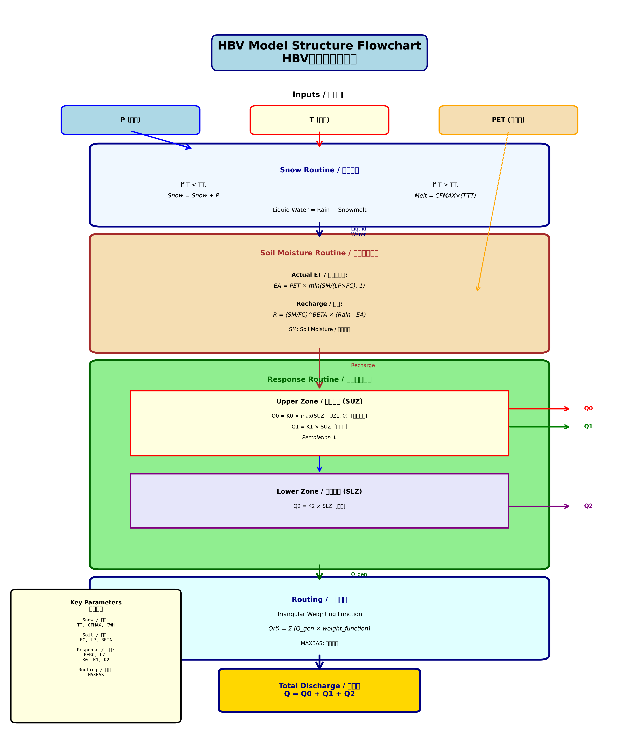
HBV Model Structure / HBV模型结构
Complete model flowchart with snow, soil, and response routines / 完整流程图

Slide 10
Other Models in HydroLearn / 其他模型
🔹 Tank Model (タンクモデル)
• Multi-reservoir conceptual model from Japan
• Flexible structure for various catchments
🔹 GR4J Model
• Only 4 parameters - very parsimonious!
• Excellent for daily streamflow simulation
🔹 Sacramento Model (SAC-SMA)
• Continuous soil moisture accounting
• Used in operational flood forecasting
🔹 SCS-CN + Unit Hydrograph
• Event-based model for storm analysis
• Design flood estimation

Slide 11
Model Calibration & Validation / 参数率定与验证
📌 What is Calibration?
• Finding optimal parameter values
• Maximizing model performance metrics
• Using historical observed data
📌 Common Performance Metrics:
• Nash-Sutcliffe Efficiency (NSE): -∞ to 1 (1 = perfect)
• Root Mean Square Error (RMSE): lower is better
• Coefficient of Determination (R²)
📌 Best Practices:
• Split data: Calibration (60-70%) + Validation (30-40%)
• Use independent validation period
• Check parameter physical meaning

Slide 12
Getting Started with HydroLearn / 开始使用
📥 Step 1: Installation
git clone https://github.com/licm13/HydroLearn.git
pip install -r requirements.txt
🔬 Step 2: Run Examples
python examples.py # Compare all models
python hbv_model.py # Run HBV model
python xinanjiang_model.py # Run Xinanjiang
📊 Step 3: Explore Visualizations
Check the figures/ directory for plots
🎓 Step 4: Try Calibration
python calibration_example.py # Parameter optimization

Slide 13
Repository Structure / 项目结构
📁 HydroLearn/
├── 📄 README.md # Documentation
├── 📄 requirements.txt # Dependencies
├── 📂 data/ # Sample datasets
├── 📂 figures/ # Output visualizations
├── 📂 docs/ # Teaching materials
├── 📜 xinanjiang_model.py # Xinanjiang implementation
├── 📜 hbv_model.py # HBV implementation
├── 📜 tank_model.py # Tank model
├── 📜 gr4j_model.py # GR4J model
├── 📜 sacramento_model.py # Sacramento model
├── 📜 event_model_scs_uh.py # SCS-CN + UH
├── 📜 examples.py # Model comparison
└── 📜 calibration_example.py # Calibration demo

Slide 14
Key Concepts / 关键概念
💧 Water Balance: P = ET + Q + ΔS
• Input = Output + Storage Change
🌊 Runoff Generation Mechanisms:
• Saturation Excess (Xinanjiang): Runoff when soil is saturated
• Infiltration Excess (SCS-CN): Runoff when rainfall > infiltration
📈 Model Complexity Trade-off:
• More parameters ≠ Better performance
• Balance between complexity and data availability
🎯 Model Selection:
• Choose based on region, data, and purpose
• No single 'best' model for all situations

Slide 15
Practice Assignments / 练习作业
📝 Assignment 1: Model Exploration
• Run all models with default parameters
• Compare outputs and water balance
• Analyze strengths and weaknesses
📝 Assignment 2: Parameter Sensitivity
• Vary key parameters (±20%)
• Observe impact on simulated discharge
• Identify most sensitive parameters
📝 Assignment 3: Model Calibration
• Calibrate Xinanjiang or HBV model
• Validate on independent period
• Compare NSE, RMSE, and visual fit
📝 Assignment 4: Report and Presentation
• Write technical report on findings
• Present model comparison results

Slide 16
Additional Resources / 额外资源
📚 Documentation:
• README.md - Complete usage guide
• Model docstrings - Detailed parameter descriptions
• Jupyter notebooks - Interactive tutorials
🔗 References:
• Zhao (1992) - Xinanjiang model original paper
• Bergström (1992) - HBV model documentation
• Perrin et al. (2003) - GR4J model
💻 GitHub Repository:
• https://github.com/licm13/HydroLearn
• Issues and discussions welcome
📧 Contact:
• Questions? Open an issue on GitHub

Slide 17
Summary / 总结
✅ We covered:
• Fundamentals of hydrological modeling
• Six different rainfall-runoff models
• Model structures and components
• Calibration and validation techniques
• Practical implementation with Python
🎯 Key Takeaways:
• Models are tools - understand their assumptions
• Calibration requires both data and physical insight
• Validation is essential for credible results
• Different models for different purposes
🚀 Next Steps:
• Practice with the repository
• Complete assignments
• Apply to your own catchment data

Slide 18
Thank You! / 谢谢!
Questions and Discussions Welcome
欢迎提问和讨论
HydroLearn Teaching Team

