Slide 1
Sea Ice Imagery Classification with Machine Learning and High-Performance Computing
Alek Petty – NASA Goddard, Univ. Maryland
Xin Miao – Missouri State University
Vivek Balasubramanian – Rutgers University
Phil McDowell – Stoneybrook University
Andy Barrett – National Snow and Ice Data Center

Slide 2
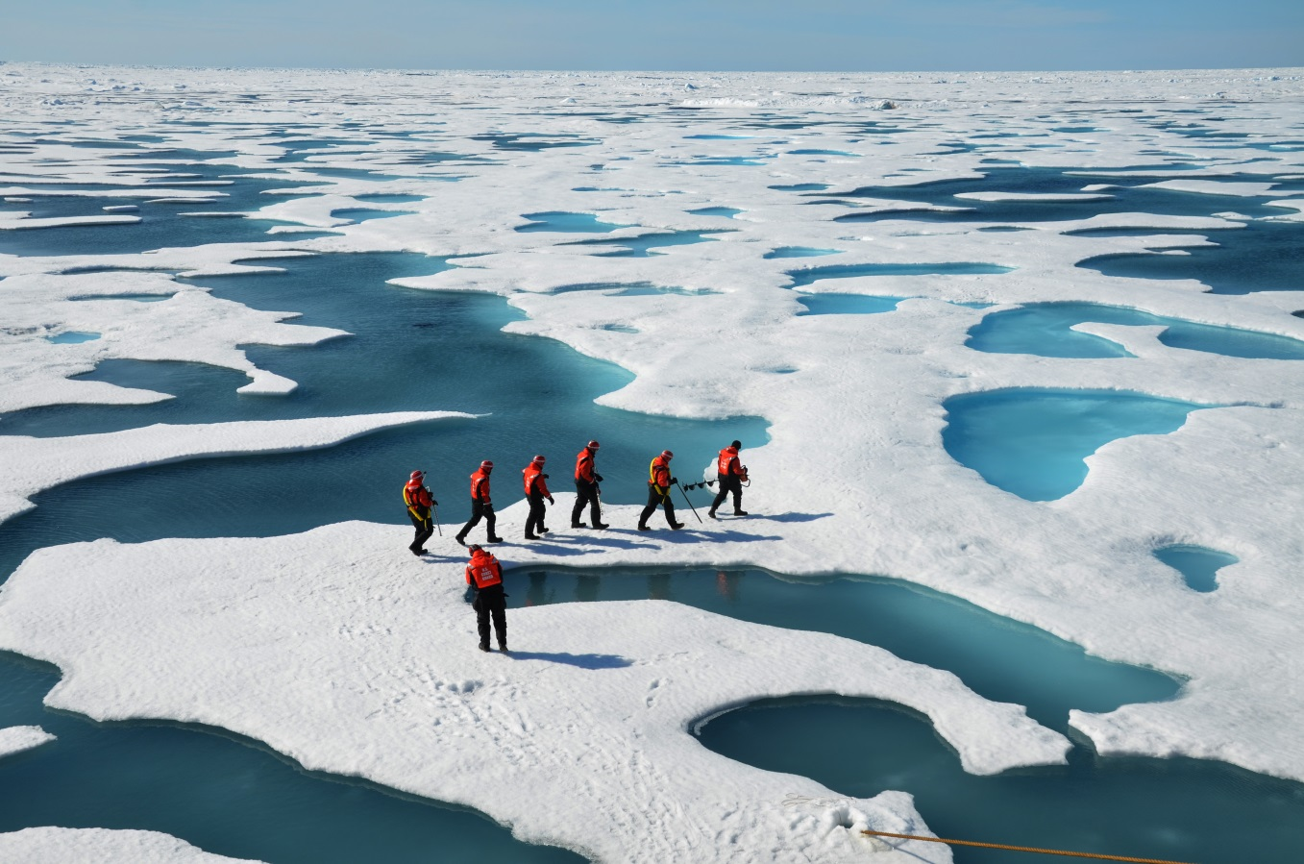
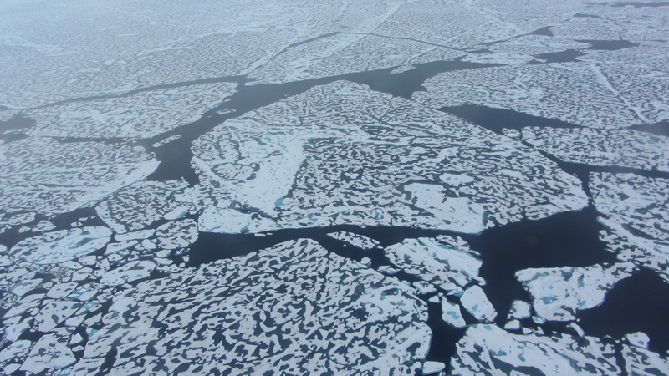
Ice and snow at the poles are critical components of the climate system .
Extent of ice and snow determines how much solar radiation is reflected back to space.
Size and number distribution of melt ponds is needed for models

Slide 3

Hackathon Goals
Develop an open-source toolkit for classification of sea ice images
Support HPC resources through XSEDE
Support data from multiple sensor platforms (Aerial photography, Quickbird, etc)
Support multiple segmentation and classification methods
Community effort
Extensibility

Slide 4
Raw sea ice images
Supervised classification
Image-segmentation (Quick-shift)
Unsupervised classification
Pixel-based images
Pixel-based feature extraction
Object-based feature extraction
Sample selection
(2 approaches)
iterative GMM
GMM
Random Forest
GMM
Random Forest
Preliminary accuracy assessment
Accuracy assessment & comparison

Slide 5
jupyter notebooks describing methods

Slide 6
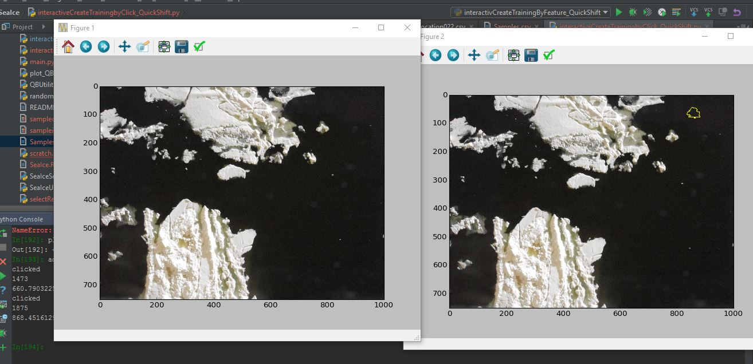
Interactive Object Selection Tool (or a more acronym-friendly name)

Slide 7
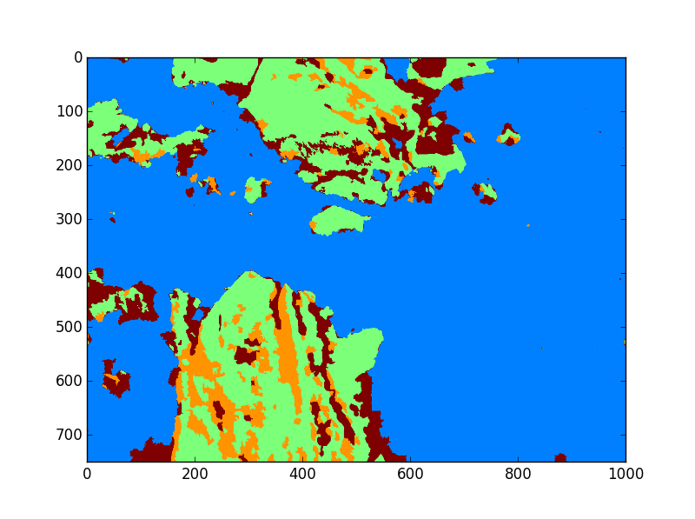
Random Forest Classification

Slide 8
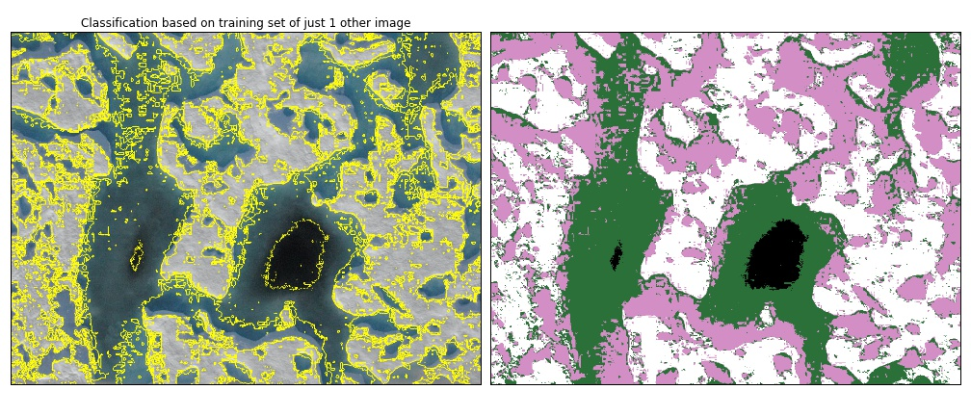
Gaussian Mixture Model classification of Aerial Photography

Slide 9
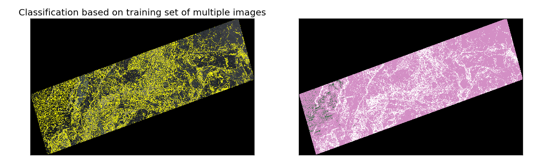
Gaussian Mixture Model classification of Quickbird GeoTiff on Comet
Size of classified image: 67 MB
Number of training images: 3
Size of training images: 8 MB, 32 MB, 64 MB
Runtime: 32 minutes
Number of cores: 1

Slide 10
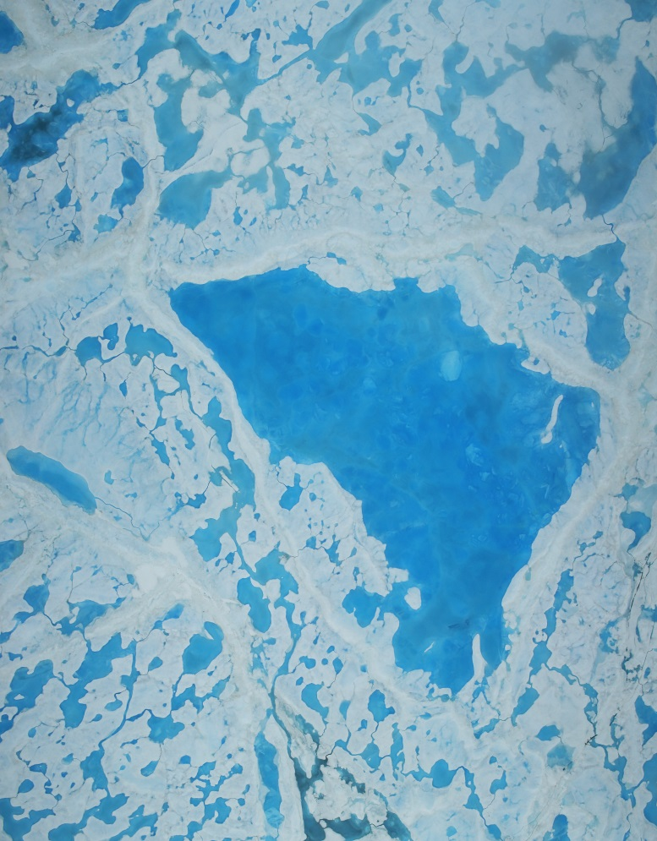
Outlook and Future Work
Plan to use toolkit on Comet to classify more images, for example DMS imagery from Operation Icebridge
Continue to develop toolkit
Implement GMM and Quickshift in CUDA to use GPU
Distinguish melt ponds from submerged ice
Submit abstract for poster at fall meeting of American Geophysical Union, San Francisco, December 2016.
Paper?
Just in! DMS from Operation Icebridge collected 14 July 2016.

Slide 11
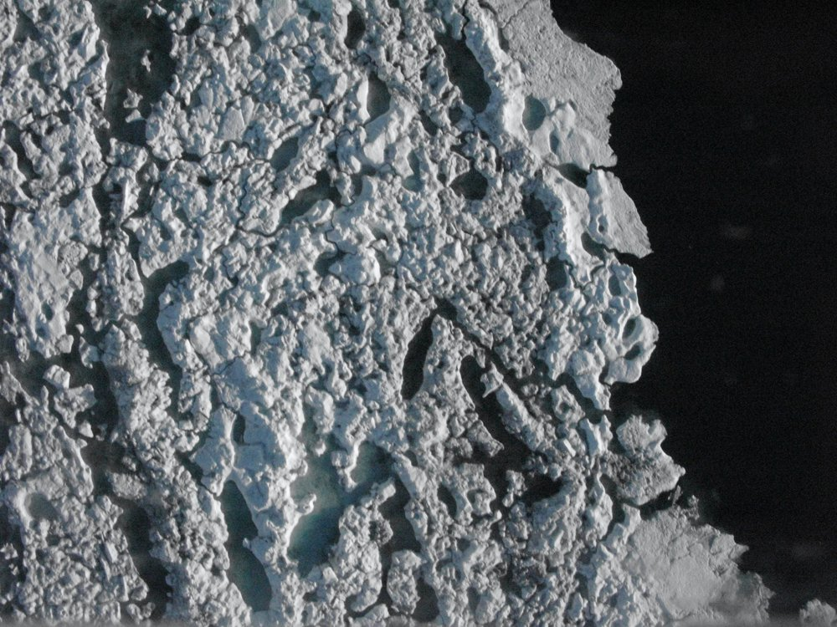
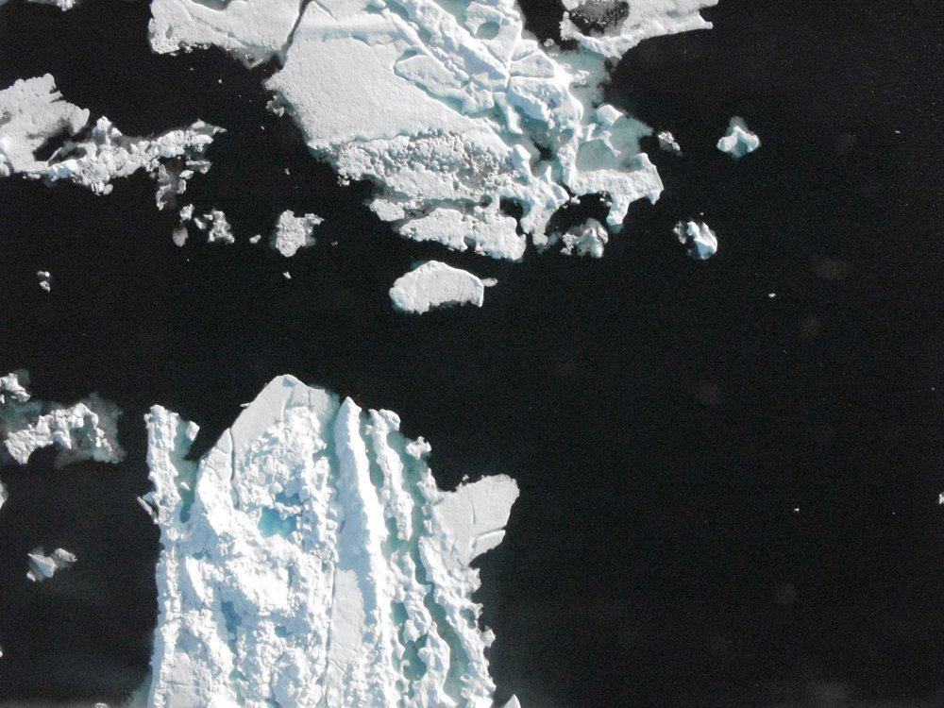
Surface types and reflectivity (Albedo) can be estimated from remotely sensed imagery
Bare Ice
Snow
Melt ponds
Leads
Open water

Slide 12
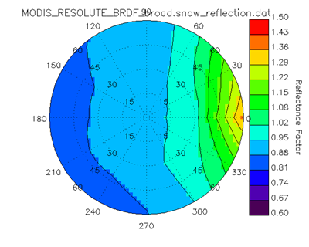
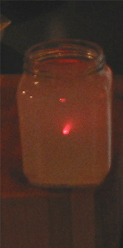
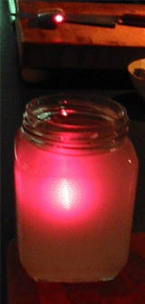
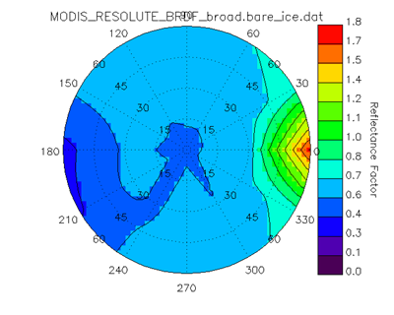
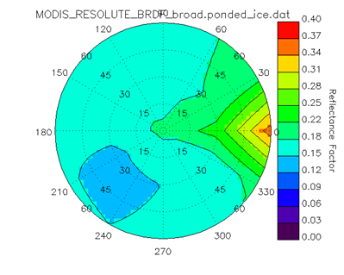
Why is surface type important?
Back Scatter
Forward Scatter
Snow
Ice
Pond

