Slide 1
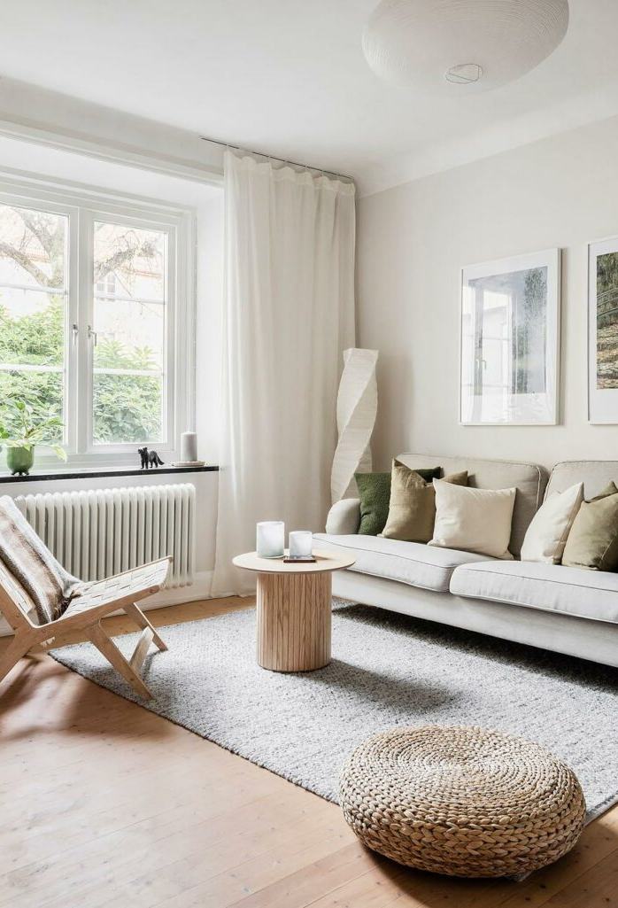
Your rental, watched while you're away
Sensors + AI agents that protect Airbnb hosts from smoking, noise and unbooked guests
Notes:
Interior photograph: Alvhem, Waernsgatan 4B. https://www.alvhem.com/objekt/waernsgatan-4b-bagaregarden-5/
https://www.alvhem.com/app/uploads/MED359751976C504784AA01A2BFA5DCCFAE-1536x1025.jpg

Slide 2
Guests don't treat it like their home
Smoking
Noise
Extra guests
Steam
Smell, fines and lost bookings
Parties and neighbour complaints
More people than booked
Showers run for humidity, mould risk
The host is not there to see it. Today they find out from reviews or neighbours.
Notes:
Icons: Lucide, ISC license. https://lucide.dev https://github.com/lucide-icons/lucide

Slide 3
One small device in kitchen and living room
CO₂
Humidity
Temperature
Noise level
Occupancy trend vs. guests booked
Steam and ventilation
Heating, open windows
Decibels only, no audio recorded
Living room and kitchen only. Never bedrooms or bathrooms. Disclosed in the listing as per Airbnb policy.
Notes:
Icons: Lucide, ISC license. https://lucide.dev https://github.com/lucide-icons/lucide

Slide 4
The agent lives inside Airbnb and decides what matters
1. Sense
2. Message
3. Report
Live readings, compared with the booking
Polite note to the guest, alert to the host, only when needed
Summary and dashboard after checkout
A cooking spike is not a nachpiel. A threshold alone cannot tell the difference.
Notes:
Icons: Lucide, ISC license. https://lucide.dev https://github.com/lucide-icons/lucide

Slide 5


