Slide 1
ShotSki Mahi组装
产品放在指定位置
mahi扫码( 欧姆龙 Fins Tcp)
产品放入压合机(欧姆龙 Fins Tcp)
PLC1 192.168.251.1
PLC2 192.168.125.11
不可组装
允许组装
不可组装
D3000=1
开始压合
完成压合
D3003=1
允许组装
D3010=1
D3010=2
开始扫码
D3007=1
压合时间：
D3105=20
压合温度：
D3107=80
complete
D3000=2
D3005=1
pass
fail
fail
start
GetSfcKey
校验小件码是否唯一
pass
TestDataCollect2MainChild
addsfckey
PC
TCP扫码枪1(常触发)
TCP扫码枪2(命令触发)
Notes:
1、TCP1扫码枪1扫入产品码SFC➔2、调用start接口根据返回结果PASS(PLC1寄存器地址D3010写入值1)/FAIL(D3010=2 业务流程终止 表示不可组装)➔3、监控PLC1D3003=1 TCP2发送命令T 给TCP扫码枪2表示开始扫码➔4、调用GetSfcKey
校验小件码是否唯一 返回结果FAIL(D3000写1)或PASS(D3000写2不可组装流程终止)➔5、实时监控寄存器D3005=1开始压合读取后重置D3005=0。➔6、监控D3007=1表示完成压合，使用后重置值为0。➔7、读取D3105值、D3107值作为 TestDataCollect2MainChild 参数值。➔8、调用addsfckey➔TestDataCollect2MainChild➔complete流程结束(闭环)。

Slide 2
业务流程解读： 1、TCP1扫码枪1扫入产品码SFC➔2、调用start接口根据返回结果PASS(欧姆龙PLC1寄存器地址D3010写入值1)/FAIL(D3010=2 业务流程终止 表示不可组装)、网络异常等➔3、监控欧姆龙PLC1 D3003=1 TCP2发送命令T 给TCP扫码枪2表示开始扫码➔4、调用GetSfcKey
校验小件码是否唯一 返回结果FAIL(D3000写1)或PASS(D3000写2不可组装流程终止)➔5、(欧姆龙PLC2)实时监控寄存器D3005=1开始压合读取后重置D3005=0。➔6、(PLC2)监控D3007=1表示完成压合，使用后重置值为0。➔7、(欧姆龙PLC2)读取D3105值、D3107值作为 TestDataCollect2MainChild 参数值。➔8、调用addsfckey➔TestDataCollect2MainChild➔complete流程结束(闭环)。

Slide 3
产品扫码
PASS
小件扫码
日志界面

Slide 4
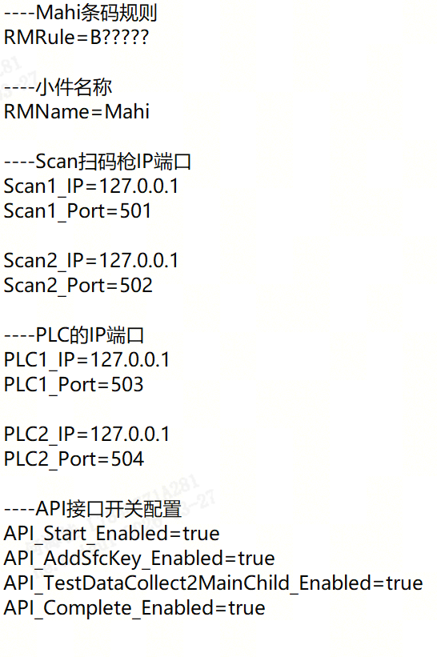
1、首次打开软件显示扫码枪1和扫码枪2和PLC1、PLC2的连接情况，超时20s未连接后自动重新连接

Slide 5
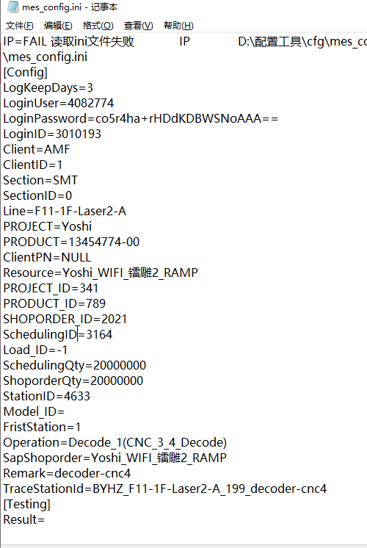
Start接口(get)
http://10.6.78.14/Service.action?method=Start&param={
"LOGIN_ID":"815048",
"SFC":"BHY0000006083613",
"STATION_ID":"5921",
"LINE":"F3-3F-Assy-C1",
"SHOPORDER":"Peach_CELL_包装_星尘粉_P2",
"SCHEDULING_ID":"4385",
"CLIENT_ID":"1"
}
1、LOGIN_ID对应mes_config里面的LoginID
3、STATION_NAME对应mes_config里面的Operation
4、LINE对应mes_config里面的Line
5、SHOPORDER对应mes_config里面Resource
6、SCHEDULING_ID对应mes_config里面SchedulingID
7、CLIENT_ID对应mes_config里面ClientID
PASS返回:
{"RESULT":"PASS","MESSAGE":"PASS","SERVICE_RUNTIME":10,"IP_ADDRESS":"10.76.78.174","TIME":"2023-10-25 14:39:26.646","SERVER_IP":"10.6.79.214"}
FAIL返回:
{"RESULT":"FAIL","MESSAGE":"登录超时,请重新登录! 10.6.79.38:80","CODE":1,"SERVICE_RUNTIME":1,"IP_ADDRESS":"10.76.78.174","TIME":"2023-10-25 15:33:42.657","SERVER_IP":"10.6.79.38"}
FAIL返回要把"MESSAGE"内容显示到软件界面

Slide 6
GetSfcKey接口(get)
http://10.6.78.14/Service.action?method=GetSfcKey&param= {"LOGIN_ID": "5110728", "SFC": "HG0012", "CLIENT_ID": "1", "STATION": "Mahi组装", "SHOPORDER": "PHA25034_包装_0001JT4_P1"}
1、LOGIN_ID对应mes_config里面的LoginID
2、STATION_NAME对应mes_config里面的Operation
3、SHOPORDER对应mes_config里面Resource
4、CLIENT_ID对应mes_config里面ClientID
5、SFC对应小件码
PASS返回:
{"RESULT":"PASS","MESSAGE":"PASS","SERVICE_RUNTIME":10,"IP_ADDRESS":"10.76.78.174","TIME":"2023-10-25 14:39:26.646","SERVER_IP":"10.6.79.214"}
FAIL返回:
{"RESULT":"FAIL","MESSAGE":"登录超时,请重新登录! 10.6.79.38:80","CODE":1,"SERVICE_RUNTIME":1,"IP_ADDRESS":"10.76.78.174","TIME":"2023-10-25 15:33:42.657","SERVER_IP":"10.6.79.38"}
FAIL返回要把"MESSAGE"内容显示到软件界面

Slide 7
AddSfcKey接口(get)
http://10.6.78.14/Service.action?method=AddSfcKey&param={"LOGIN_ID":"5555914","CLIENT_ID":"1","SFC":"HGVHRG000010001JT4","STATION_ID":"13547","STATION_NAME":"磁铁组装","SHOPORDER":"PHA25034_包装_0001JT4_P1","DATA_NAME":"Mahi","DATA_VALUE":"HG0012","PROJECT_ID":"1541","PRODUCT_ID":"3897"}
1、LOGIN_ID对应mes_config里面的LoginID
2、STATION_ID对应mes_config里面的StationID
3、STATION_NAME对应mes_config里面的Operation
4、SHOPORDER对应mes_config里面的Resource
5、DATA_NAME对应setting配置文件里面的RMName
6、DATA_VALUE对应输入的值
7、PROJECT_ID对应mes_config里面的PROJECT_ID
8、PRODUCT_ID对应mes_config里面的PRODUCT_ID
PASS返回:
{"RESULT":"PASS","MESSAGE":"PASS","SERVICE_RUNTIME":10,"IP_ADDRESS":"10.76.78.174","TIME":"2023-10-25 14:39:26.646","SERVER_IP":"10.6.79.214"}
FAIL返回:
{"RESULT":"FAIL","MESSAGE":"登录超时,请重新登录! 10.6.79.38:80","CODE":1,"SERVICE_RUNTIME":1,"IP_ADDRESS":"10.76.78.174","TIME":"2023-10-25 15:33:42.657","SERVER_IP":"10.6.79.38"}
FAIL返回要把"MESSAGE"内容显示到软件界面

Slide 8
TestDataCollect2MainChild接口(get)
http://10.6.78.14/Service.action?method=TestDataCollect2MainChild&param={LOGIN_ID:5550466,CLIENT_ID:1,SN:HGVHRG000000001JT4,PRODUCT_NAME:A613-40153,SHOPORDER_NO:PHA25034_包装_0001JT4_P1,PROJECT_NAME:PHA25034,TDS_NAME:LOKI,STARTIME:'2026-03-08 10:21:36',STATION_ID:13547,LINE_NO:F2-1F-Assy-A1,TEST_STATION:磁铁组装,FIXTURE_NO:BYHZ_F5-1F-Assy-B_03_spring-finger-assy,TEST_RESULT:PASS,TEST_DATA_LIST:[{NAME:压合时间,VALUE:"20"},{NAME:压合温度,VALUE:"80"}]}
1、LOGIN_ID对应mes_config里面的LoginID
2、PRODUCT_NAME对应mes_config里面的PRODUCT
3、SHOPORDER_NO对应mes_config里面的Resource
4、PROJECT_NAME对应mes_config里面的PROJECT
5、TDS_NAME固定传LOKI
6、STATION_ID对应mes_config里面的StationID
7、LINE_NO对应mes_config里面的Line
8、TEST_STATION对应mes_config里面的Operation
9、FIXTURE_NO对应mes_config里面的traceStationId
压合时间、压合温度不是固定值，分别为D3105和D3107的值
PASS返回:
{"RESULT":"PASS","MESSAGE":"PASS","SERVICE_RUNTIME":10,"IP_ADDRESS":"10.76.78.174","TIME":"2023-10-25 14:39:26.646","SERVER_IP":"10.6.79.214"}
FAIL返回:
{"RESULT":"FAIL","MESSAGE":"登录超时,请重新登录! 10.6.79.38:80","CODE":1,"SERVICE_RUNTIME":1,"IP_ADDRESS":"10.76.78.174","TIME":"2023-10-25 15:33:42.657","SERVER_IP":"10.6.79.38"}
FAIL返回要把"MESSAGE"内容显示到软件界面

Slide 9
Complete接口(get)
http://10.6.78.14/Service.action?method=Complete&param={
"LOGIN_ID":"2827304",
"CLIENT_ID":"1",
"SFC":"BHY0000006083613",
"SCHEDULING_ID":"4385",
"STATION_ID":"5921",
}
1、LOGIN_ID对应mes_config里面的LoginID
2、CLIENT_ID对应mes_config里面ClientID
3、SFC对应“产品码”
4、SCHEDULING_ID对应mes_config里面SchedulingID
5、STATION_ID对应mes_config里面的StationID
PASS返回:
{"RESULT":"PASS","MESSAGE":"PASS","SERVICE_RUNTIME":10,"IP_ADDRESS":"10.76.78.174","TIME":"2023-10-25 14:39:26.646","SERVER_IP":"10.6.79.214"}
FAIL返回:
{"RESULT":"FAIL","MESSAGE":"登录超时,请重新登录! 10.6.79.38:80","CODE":1,"SERVICE_RUNTIME":1,"IP_ADDRESS":"10.76.78.174","TIME":"2023-10-25 15:33:42.657","SERVER_IP":"10.6.79.38"}
FAIL返回要把"MESSAGE"内容显示到软件界面

