Slide 1
Linked Data in Linguistics, March 7 – 9, 2012, Frankfurt/Main, Germany
Creating Linked Data for the Interdisciplinary International Collaborative study of Language Acquisition and Use
Achievements and Challenges of a new Virtual Linguistics Lab
María Blume¹, Suzanne Flynn², and Barbara Lust³
University of Texas at El Paso¹, Massachusetts Institute of Technology², and Cornell University³

Slide 2
Organization of this talk
Purpose and goals.
Cybertool: The Data Transcription and Analysis Tool.
Necessity of a cybertool for data documentation, management, and analysis.
Design and architecture.
Examples of data and data-linking capabilities.
Discussion.
Dissemination, accessibility, licensing related issues.

Slide 3
Purpose and goals

Slide 4
Purpose and goals
Purpose
Goal
To create a culture of national and international collaboration among researchers and their labs.
to create shared principles and methods of data documentation, management and collaboration
to enable the practice of these principles and methods through the use of cybertools.
To provide a new generation of researchers and students, including those with diverse disciplinary, geographical and cultural backgrounds, with a solid foundation in these principles and methods through the use of these new cybertools.

Slide 5
Purpose and goals
Purpose
Goal
To create a tool for collaboration that can allow for the management, documentation and analysis of crosslinguistic language data.
To provide a resource that allows users to manage data across datasets and projects, including the ability to reuse previously collected data.

Slide 6
The Virtual Center for Language Acquisition Research
A community of researchers that are linked in their assumption that the most fundamental questions of language acquisition require interdisciplinary collaboration, both theoretical and empirical methods, and a cross-linguistic approach.
Eight founding member institutions.
One international collaborator in Peru.

Slide 7
The Virtual Linguistics Lab
The VLL portal provides structured access to the components of a virtual linguistic lab:
Materials for the scientific and collaborative study of language acquisition.
web-based courses, integrating synchronous and asynchronous forms of interactive information distribution.

Slide 8
The Data Transcription and Analysis (DTA) Tool

Slide 9
Data quality: the opportunities
Technology can enable:
Precision and completeness in data-capture procedures
Capacity for many levels of structural description and analysis
Capacity to link points of data along multiple dimensions

Slide 10
Why do we need the DTA tool in the study of language acquisition and use?
Multiple languages
Multiple formats
Multiple methods of data collection
observational vs. experimental,
cross-sectional or longitudinal.
Multiple aspects of metadata
age and/or developmental/cognitive stage of speaker.
social and pragmatic context
culture.

Slide 11
Data management and use
Different labs practice distinct forms of data management.
The scientific use of any single record requires access to many levels of data, ranging from raw (establishing provenance) to structured and analyzed data (establishing intellectual worth).

Slide 12
The DTA Tool
It provides the user with a structured annotation scheme for the representation of layers of metadata related to language data (i.e., the actual utterances) as well as for representation of transcriptions and analyses of the utterances themselves.
It can handle either naturalistic or experimental language data which can be accessed, connected and queried in linked fashion.
Data entry through this tool automatically feeds a structured, calibrated, and infinitely expandable cross-linguistic relational database and an experiment bank.
The DTA tool conforms with USA government requirements that funded projects have a data management plan.

Slide 13
Design and architecture
Notes:
This slide is just a title slide for the section

Slide 14
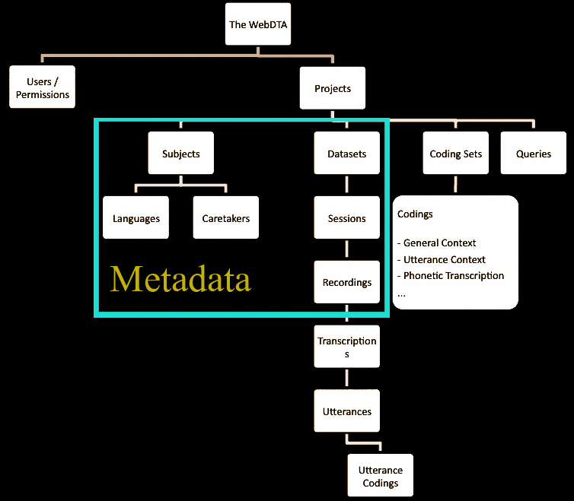
WebDTA tool basic structure.

Slide 15
Structure
The current version of the WebDTA tool is built on Yii, a PHP web development framework that uses the "Model-View-Controller" pattern to structure the application and the "Active Record" pattern to manage records from the database.
MySQL is used for the database platform.
All are open source technologies.

Slide 16
Summary
DTA tool is a primary research tool, guiding the researcher and/or student in data collection and management. Users complete a series of tables through a graphical user interface whose screens facilitate and structure data and metadata entry.
It provides a rich, continually growing archive allowing present and future collaboration on shared data, potentially long distance and interdisciplinary.
Its usability extends from specific research projects to use in educational domains.

Slide 17
Summary
The DTA tool’s database can be linked to a wide intellectual knowledge base, e.g., linking published forms of research to the actual data and data methods used to create the results reported.
It is designed to maximize the possibility for linked data by integrating with field standards.
UTF-8 encoding to store text, which can represent any language.
ISO 639-3 standard language codes, which lists over 7000 languages, developed by Ethnologue/SIL
(http://www.ethnologue.com/codes/default.asp)
It links to GeoNames.org in geographic reference.

Slide 18
External links
We are collaborating with Cornell University’s Albert Mann Library in their current pilot program, DataStaR (Data Staging Repository) intended to help researchers create high quality metadata in the formats required by external repositories…”(Steinhart 2010: 1) (Funded by the National Science Foundation (Grant No. 111-0712989)
The program adopts a semantic web approach to metadata.
At present, one VCLA dataset (Sinhala language) from more than 400 children studied in Sri Lanka has been entered in DataStaR, linking the VCLA database to the Library staging repository, and is available for collaborative use through this repository.
DataStaR uses RDF (Resource Description Framework (RDF)) statements and OWL (Web Ontology Language) classes in order to integrate different metadata frameworks across disciplines.
http://datastar.mannlib.cornell.edu/display/n6291 and http://www.news.cornell.edu/stories/Oct11/SinhalaTools.html

Slide 19
Challenges
Notes:
Change this title to Challenges

Slide 20
Challenges
Technical

Slide 21
Technical challenges
We are currently working with Cornell Information Technologies to pursue the possibility for alternative video and audio streaming.
A version of the tool allowing asynchronous uploading of data to facilitate work in field situations, e.g., cross-linguistic work without Internet access.
We need an export function to other software such as SPSS, and Excel.

Slide 22
Challenges
Technical
Dissemination/Accessibility

Slide 23
Dissemination/ accessibility
To widely extend the DTA tool to new users, we must establish a set of principles for “use” viz., agreements involving the shared use of materials and data.
We must also establish PI rights with respect to their data and users’ responsibilities when sharing or using these data.
We must establish a “leveled” set of permissions, e.g., read only, write and read, etc.
We must preserve the anonymity of the subjects’ identities while maintaining selective access to this information.

Slide 24
Challenges
Technical
Dissemination/Accessibility
Sustainability/Licensing

Slide 25
Sustainability/licensing
In order disseminate, we must build a sustainability model.
This model must include:
Provisions for long-term storage of the database.
An infrastructure for long-term management of the tool and the data-base.
One potential source of sustainability would be to create a licensing model.
Notes:
-On this slide, Dissemination is now the second challenge after the technical problems.
-One way you can list these challenges is to simply list them as Technical, Dissemination/Accessibility, Sustainability/lLicensing and allow a click on them.. Make these hotspots that can be opened up as you pass over them.
-Edit the above and open as the last hot spot. It should now pull together some of #50 and #52. Change what %0 says in order to disseminate we must build a sustainabiltiy model. Then add stuff from 52: The sustainabillity model must include; the long-term storage and an infrastructure for long term management.

Slide 26
Discussion and suggestions
How should this licensing work?
What principles for data and tool sharing should be put into place?
How can we build a federated infrastructure rather than one that relies on one institution alone?

Slide 27
Acknowledgments
María Blume and Barbara Lust. 2008. Transforming the Primary Research Process Through Cybertool Dissemination: An Implementation of a Virtual Center for the Study of Language Acquisition. NSF OCI-0753415
Lust, Barbara. 2003. Planning Grant: A Virtual Center for Child Language Acquisition Research. National Science Foundation. NSF BCS-0126546
VCLA founding members:
Cornell: Marianella Casasola, Claire Cardie, James Gair, and Qi Wang.
NeuroFocus: Elise Temple
Boston College: Claire Foley
Rutgers University at New Brusnwick: Liliana Sánchez.
Rutgers University at Newark: Jennifer Austin
California State University at San Bernardino: YuChin Chien.
Southern Illinois University at Carbondale: Usha Lakshmanan.

Slide 28
Acknowledgments
VCLA affiliates:
City University of New Yors: Gita Martohardjono, Valerie Shafer, and Isabelle Barrière .
Newcastle University: Cristina Dye.
Ben Gurion University at the Negev: Yarden Kedar
Tyndale University College and Seminary: Sujin Yang.
Columbia University: Joy Hirsch.
University of Texas at El Paso: Ellen Courtney and Alfredo Urzúa.
University of California at San Diego: Sarah Callahan.
Pontificia Universidad Católica Del Perú: Jorge Iván Pérez Silva
Kyungsung University: Kwee Ock Lee
Central Institute of English and Foreign Languages: R. Amritavalli
Osmania University: A. Usha Rani.

Slide 29
Acknowledgments
New York State Hatch grant.
Our application developers Ted Caldwell and Greg Kops (GORGES).
Our consultants Cliff Crawford and Tommy Cusick;
Our student RAs: Darlin Alberto, Gabriel Clandorf, Natalia Buitrago, Poornima Guna, Jennie Lin, and Jordan Whitlock formerly at Cornell now MIT, and Marina Kalashnikova. Martha Rayas Tanaka, Lizzeth Pattison, María Jiménez, and Mónica Martínez at UTEP.
The students at all the participating institutions that helped us with comments and suggestions.
Janet McCue and Barbara Lust 2004-2006. National Science Foundation Award: Planning Information Infrastructure Through a New Library-Research Partnership. (SGER=Small Grant for Exploratory Research)
American Institute for Sri Lankan Studies, Cornell University Einaudi Center.
Cornell University Faculty Innovation in Teaching Awards, Cornell Institute for Social and Economic Research (CISER).

Slide 30
References
Berners-Lee, Tim. .3/2009. Ted Lecture. Tim Berners-Lee on the next Web. http://en.wikipedia.org/wiki/Linked_data.
Bickel, Balthasar, Bernard Comrie, and Martin Haspelmath. 2008. Leipzig Glossing Rules: Conventions for Interlinear Morpheme-by-Morpheme Glosses. Available online at http://www.eva.mpg.de/lingua/resources/glossing-rules.php.
Blume, María and Barbara Lust, 2011a and in prep. Data Transcription and Analysis Tool User’s Manual. (with the collaboration of Shamitha Somashekar, and Tina Ogden).
Blume, María and Barbara Lust. 2011b. Presentation to the National Science Foundation. CI Team Principal Investigator’s Meeting. University of Illinois at Urbana Champaign, Ill. May 24-26. Transforming the Primary Research Process Through Cybertool Dissemination: An Implementation of a Virtual Center for the Study of Language Acquisition. NSF OCI-0753415.
Farrar, S.O. and Langendoen, D.T. 2003 A linguistic ontology for the semantic web. GLOT International, 7(3) 97-100.
Khan, Huda, Brian Caruso, Brian Lowe, Jon Corson-Rikert, Diane Dietrich and Gail Steinhart. 2011. DataStaR: Using the Semantic Web approach for Data Curation. International Journal of Digital Curation 2(6): 209-221.
Lowe, Brian. 2009. DataStaR: Bridging XML and OWL in Science Metadata Management. Metadata and Semantics Research 46: 141-150. http://www.springerlink.com/content/q0825vj78ul38712/

Slide 31
References
Lust, Barbara, Suzanne Flynn, María Blume, Elaine Westbrooks, and Theresa Tobin. (2010). Constructing Adequate Documentation for Multi-faceted Cross Linguistic Language Data: A Case Study from a Virtual Center for Study of Language Acquisition. In Grenoble, Lenore and Louanna Furbee, (eds.), Language Documentation: Theory, Practice and Values. pp. 127-152. Amsterdam/Philadelphia: John Benjamins.
Open Archives Initiative (OAI), http://www.openarchives.org/ (15 Mar. 2005).
Open Language Archives Community (OLAC), http://www.language-archives.org/ (24 Feb. 2011).
Simons, G. Farrar, JS., Fitzsimons, B., Lewis, W., Langendoen, D.T. and Gonzalez, H. 2004a. The semantics of markup: Mapping legacy markup schemas to a common semantics.
Simons, G., Fitzsimons, B., Langendoen, D.T., Lewis, Wm., Farrar, S., Lanham, A., Basham, R. and Gonzalez H. 2004b. http://emeld.org/workshop/2004/langendoen-paper.html
Steinhart, Gail. 2010. DataStaR: A Data Staging Repository to Support the Sharing and Publication of Research Data. 31st Annual IATUL Conference - The Evolving World of e-Science: Impact and Implications for Science and Technology Libraries. June 20-24, 2010. West Lafayette, IN. http://docs.lib.purdue.edu/iatul2010/conf/day2/8/.

Slide 32
APPENDIX: DTA SCREENS

Slide 33
Entering MetaData in the DTA Tool http://webdta.clal.cornell.edu

Slide 34
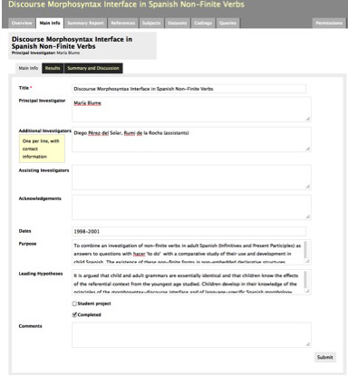
Project level metadata
Notes:
The tool first leads the user to enter detailed project-level information and metadata. The DTA’s Experiment Bank component collects all information related to a study (experimental or observational) in the same location.

Slide 35
Dataset metadata
Notes:
A project can include one or more datasets.
The user enters information on the datasets and on its sessions.

Slide 36
Participant metadata
Notes:
The subjects in a project can be used in one or more of the datasets and are linked to the dataset through their session information.

Slide 37
Session metadata
This screen provides info for every time a subject was recorded for a given dataset.
Notes:
Each session has associated:
recordings screen
transcription screen
coding screen.

Slide 38
Link recordings
Notes:
The recordings screen houses information on all available primary data for a given session:
audio or video files or previous transcripts in a number of formats
an inventory of the location of such files, and their backups.
Files supported by the JW Player, QuickTime player, PDF, HTML, and image files, and, with additional software, other file formats such as Microsoft Office files.

Slide 39
How to enter, analyze, and query data

Slide 40
Data transcription
Notes:
This screen allows one to transcribe, switch between recordings, and time-align recordings and transcripts.

Slide 41
Coding Natural Speech data
Notes:
Basic coding of an utterance of natural speech data of a Peruvian monolingual Spanish-speaking child from the “Spanish Natural Speech-Blume” corpus. Such codings render the data ready for further analyses in connection with specific research questions.
Non-project-specific linguistic coding sets
an utterance level coding set (including a literal gloss and a general gloss as well as pragmatic context specification)
a speech act coding set (including speech act and speech mode)
basic linguistic coding set (including sentence codings and syllable, morpheme and word counts).
Users working on natural speech data are expected to use these basic codings, so that the data are calibrated across projects. A researcher working on an experimental project may select if s/he wants to use all, none or some of the established codings. Regardless of the project type, researchers can create new project-specific coding sets or global coding sets.

Slide 42
Coding experimental data
Notes:
An example of a project-specific coding created for an experimental task.

Slide 43
How does one query linked data?

Slide 44
Example of a query on Natural Speech data: MLUs by 2-year-olds speakers of Spanish and English
Notes:
When a research project is completed, results, and conclusions can be linked. Queries search properties of the data such as:
MLU (Mean Length of Utterance) in words, syllables, and morphemes
coded information on all subjects across projects who
speak a particular language or have a certain age
utterances that are sentences
utterances that are NPs
sentences with overt verbs
simple vs. complex sentences
specific speech acts or speech modes. \
Queries can be run on all sessions that have been coded for the relevant features in all projects in the DTA tool, thus linking across sessions and subjects.

Slide 45
Wh-question emergence in 2-year-olds speakers of Spanish and English
Example of a query on Natural Speech data:
Notes:
Data from the English Natural Speech Corpus-Lust and the Spanish Natural Speech Corpus-Blume.

Slide 46
Relative clauses in French and English
Incorrect Imitation of lexically-headed relative clauses in English
Example of a query on experimental Elicited Imitation data
Notes:
Data from “Acquisition of relative clauses: Developmental changes in their heads-Flynn and Lust” and” First language acquisition of relative clauses in French-Foley” projects.

Slide 47
Relative clauses in French and English
Incorrect Imitation of lexically-headed relative clauses in French
Example of a query on experimental Elicited Imitation data:
Notes:
Data from “Acquisition of relative clauses: Developmental changes in their heads-Flynn and Lust” and” First language acquisition of relative clauses in French-Foley” projects.

