Slide 1




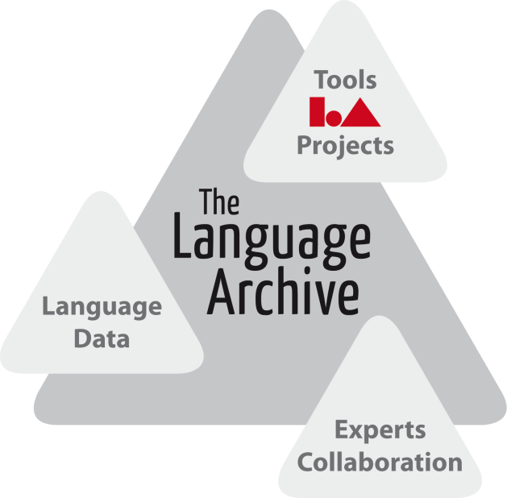
Linking to Linguistic Data Categories in ISOcat
Menzo Windhouwerª, Sue Ellen Wright^{b}
ªThe Language Archive - MPI for Psycholinguistics, ^{b}Kent State University
menzo.windhouwer@mpi.nl, sellenwright@gmail.com

Slide 2
Outline
A short introduction to data categories
the ISOcat registry
How to refer to ISOcat data categories
using PIDs
from XML and RDF resources
Fine-tuning (personal) relationships between data categories
the RELcat registry
Status

Slide 3
ISOcat: a Data Category Registry
An implementation of ISO 12620:2009
Terminology and other content and language resources — Specification of data categories and management of a Data Category Registry for language resources
Successor to ISO 12620:1999 which contained a hardcoded list of Data Categories
A data category
is the result of the specification of a given data field
an elementary descriptor in a linguistic structure or an annotation scheme

Slide 4
Data Category example
Data category: /Grammatical gender/
Administrative part:
Identifier: grammaticalGender
PID: http://www.isocat.org/datcat/DC-1297
Descriptive part:
English definition: Category based on (depending on languages) the natural distinction between sex and formal criteria.
French definition: Catégorie fondée (selon la langue) sur la distinction naturelle entre les sexes ou d'autres critères formels.
Conceptual domain:
Morposyntax conceptual domain: /masculine/, /feminine/, /neuter/, /common/
Linguistic part:
French conceptual domain: /masculine/, /feminine/

Slide 5
Data Category types
complex:
open
closed
constrained
writtenForm
grammaticalGender
email
string
string
string
Constraint: .+@.+
neuter
feminine
masculine
simple:

Slide 6
Data Category types
container:
lexicon
language
alphabet
entry
japanese
ipa
lemma
writtenForm

Slide 7
Data Category relationships
Value domain membership
Subsumption relationships between simple data categories (legacy)
Relationships between complex/container data categories are not stored in the DCR
partOfSpeech
string
pronoun
personal
pronoun

Slide 8
ISOcat: a Data Category Registry
You can:
Find Data Categories relevant for your resources and embed references to them so the semantics of (parts of) your resources are made explicit
This can be supported by tools you use, e.g., ELAN, LEXUS and the CMDI Component Editor directly interact with ISOcat
Interact with Data Category owners to improve (the coverage of) their Data Categories
Create (together with others) new Data Categories and/or selections needed for your resources and share those
Submit (your) Data Categories for standardization
ISOcat is the DCR for ISO TC 37
Free of charge
Grass roots approach
www.isocat.org

Slide 9
The usage of data categories?
wordOrder
grammaticalGender
Language | BWO | genders
Lexicon
1..*
A (schema for a) typological database
Lexical Entry
Shared semantics!
partOfSpeech
Lemma
writtenForm
1..*
0..*
Form
Sense
writtenForm
Word Form
grammaticalGender
0..*
lexicalType
A (schema for a) lexicon

Slide 10
Referencing Data Categories
Each Data Category should be uniquely identifiable
Ambiguity: different domains use the same term but mean different ‘things’
Semantic rot: even in the same domain the meaning of a term changes over time
Persistence: for archived resources Data Category references should still be resolvable and point to the specification as it was at/close to time of creation
Persistent IDentifiers
ISO 24619:2011 Language resource management - Persistent identification and sustainable access (PISA)
ISOcat uses ‘cool URIs’:
http://www.isocat.org/datcat/DC-1297 (/grammaticalGender/)

Slide 11
XML – DC Reference vocabulary
ISO 12620:2009 is rather XML oriented
why not RDF?
history
terminology management is a separate tradition from Semantic Web/Linked Data
DCIF -> GMT (TMF) -> own XML vocabulary based on UML data model
but there is an RDF representation
needs to cover more of the data model
Annex A provides the DC reference vocabulary
dcr:datcat to link to any DC
dcr:valueDatcat to link to a simple DC
www.isocat.org/12620/
Preferably annotate a schema, e.g., a Relax NG or W3C XML Schema documents
XML vocabularies might also provide their own means to link to a data category
TBX XCS, TEI ODD, CMDI, ..., TEI (?)
(Semantics by reference)

Slide 12
LMF Example
<LexicalResource xmlns:dcr="http://www.isocat.org/ns/dcr"> <GlobalInformation> <feat att="languageCoding" dcr:datcat=".../DC-2008" val="ISO 639-3"/> </GlobalInformation> <Lexicon> <feat att="language" dcr:datcat=".../DC-1969" val="eng"/> <LexicalEntry> <feat att="partOfSpeech" dcr:datcat=".../DC-1345" val="commonNoun" dcr:valueDatcat=".../DC-1256"/> <Lemma> <feat att="writtenForm" dcr:datcat=".../DC-1836" val="clergyman"/> </Lemma> ... <WordForm> <feat att="writtenForm" dcr:datcat=".../DC-1836“ val="clergymen"/> <feat att="grammaticalNumber" dcr:datcat=".../DC-1298" val="plural" dcr:valueDatcat=".../DC-1354"/> </WordForm></LexicalEntry></Lexicon></LexicalResource>

Slide 13
RDF – DC annotation property
The dcr:datcat RDF annotation property mimics the DC Reference vocabulary
minimizes impact, i.e., allows the data model to use its own terminology
can be tuned using OWL (2) equivalentClass, equivalentPropery or sameAs
problem: annotating literals with simple Data Categories (names can be ambiguous)
@prefix dcr: <http://www.isocat.org/ns/dcr.rdf#> .
:headword dcr:datcat <http://www.isocat.org/datcat/DC-258> ;
rdfs:label "head word"@en ;
rdfs:comment "A lemma heading a dictionary entry."@en .
:partOfSpeech dcr:datcat <http://www.isocat.org/datcat/DC-396> ;
rdfs:label "part of speech"@en ;
rdfs:comment "A category assigned to a word based on its
grammatical and semantic properties."@en .

Slide 14
RDF – directly use Data Category PIDs
Container Data Categories as RDF classes
Complex Data Categories as RDF properties
Simple Data Categories
as RDF literals
problem: names can be ambiguous
as RDF classes
(GrAF example <f name=“” val=“.../DC-3581”/> vs <f name=“” val=“plural noun” dcr:datcat=“.../DC-3581”/>)
@prefix cat: <http://www.isocat.org/datcat/> .
cat:DC-258 rdfs:label "head word"@en ;
rdfs:comment "A lemma heading a dictionary entry."@en .
cat:DC-396 rdfs:label "part of speech"@en ;
rdfs:comment "A category assigned to a word based on its
grammatical and semantic properties."@en .

Slide 15
Data Category Relations
In the linked data world its natural to have, next to structural, ontological relationships
RDFS, OWL (2), SKOS, ...
But other resource/schema formats lack these features
Relationships between Data Categories (also across vocabularies) are important for federated search, i.e., to find semantically related resources in another archive

Slide 16
RELcat a Relation Registry
Stores relationships among Data Categories and also with ‘other’ concept registries
Dublin Core, OLAC, GOLD
(OLiA, OntoLingAnnot)
relationships can be the individual view of a (group of) linguist(s)
RELcat is a quad store (graph, subject, predicate, object)
Based on a ‘private’ relation type taxonomy so existing relationships specified in other vocabularies can easily be loaded
OWL (2), SKOS
normalized RELcat queries
The aim is to support various levels of traversing the semantic network, not formal reasoning
conflicting (theoretical) views
(parameters of variation)
but within known combination of sets reasoning may well be possible
also targets semantic search outside of the RDF domain

Slide 17
Relation type taxonomy
related
same as (a symmetric and transitive relationship)
almost same as (a symmetric relationship)
broader than (a transitive relationship and the inverse of the ’narrower than’ relationship)
superclass of (a transitive relationship and the inverse of the ’subclass of’ relationship)
has part (a transitive relationship and the inverse of the ’part of’ relationship)
has direct part (the inverse of the ’direct part of’ relationship)
narrower than (a transitive relationship and the inverse of the ’broader than’ relationship)
sub class of (a transitive relationship and the inverse of the ’super class of’ relationship)
part of (a transitive relationship and the inverse of the ’has part’ relationship)
direct part of (the inverse of the ’has direct part’ relationship)

Slide 18
Relation set
@prefix relcat : <http://www.isocat.org/relcat/set/> .
@prefix rel : <http://www.isocat.org/relcat/relations#> .
@prefix dc : <http://purl.org/dc/elements/1.1/> .
@prefix cat : <http://www.isocat.org/datcat/> .
relcat:cmdi {
cat:DC-2573 rel:sameAs dc:identifier .
cat:DC-2482 rel:sameAs dc:language .
...
cat:DC-2556 rel:subClassOf dc:contributor .
cat:DC-2502 rel:subClassOf dc:coverage .
}

Slide 19
Extension
related
same as (a symmetric and transitive relationship)
owl:equivalentClass
owl:equivalentProperty
owl:sameAs
skos:exactMatch
almost same as (a symmetric relationship)
skos:closeMatch

Slide 20
Normalized query
PREFIX rel:<http://www.isocat.org/relcat/relations#>
PREFIX cat:<http://www.isocat.org/datcat/>
SELECT ?c WHERE { cat:DC-2482 rel:sameAs ?c . }
Finds the same-as clique for /languageID/ (DC-2482) specified in any vocabulary, e.g., RELcat (CMDI) for Dublin Core and annotated OWL for GOLD

Slide 21
Semantic network
Linguistic resource (schema)
Linguistic knowledge base
Data categories
Containers
Concepts
Relation
Schema Registry - SCHEMAcat
Data Category Registry - ISOcat
Concept Registry
Relation Registry - RELcat

Slide 22
Status
ISOcat: in production, mainly lacking in standardization
http://www.isocat.org/
RELcat: alpha version gives read only access to some relation sets, lacking some reasoning and UI
http://lux13.mpi.nl/isocat/relcat/
SCHEMAcat: design phase

Slide 23
Thank you for your attention!
Visit
www.isocat.org
Questions?
www.isocat.org/forum/
isocat@mpi.nl

