Slide 1
Term bank of copyright-related concepts
JURIX 2015, the 28th International Conference on Legal Knowledge and Information System
Víctor RODRIGUEZ-DONCEL, Cristiana SANTOS, Pompeu CASANOVAS,
Asunción GÓMEZ-PÉREZ, Jorge GRACIA
December 2015

Slide 2
Preliminary concepts
Term base = terminology = term bank
database consisting of concept-oriented terminological entries (or ‘concepts’) and related information, usually in multilingual format
Format of terminologies
Term Base eXchange (TBX) is an open standard the for interchange of terminological data. It is the standard ISO 30042
Notable terminologies
Inter-Active Terminology for Europe (IATE) is the inter-institutional terminology database of the European Union
Notes:
IATE project was launched in 1999 with the objective of providing a web-based infrastructure for all EU terminology resources, enhancing the availability and standardisation of the information.
IATE incorporates all of the existing terminology databases of the EU’s translation services into a single new, highly interactive and accessible interinstitutional database. The following legacy databases have been imported into IATE, which now contains approximately 1.4 million multilingual entries:
Eurodicautom (Commission),
TIS (Council),
Euterpe (EP),
Euroterms (Translation Centre),
CDCTERM (Court of Auditors),

Slide 3
General idea behind termbanks
Clear separation between abstract concepts and terms
Notes:
ISO 25964 "Thesauri and interoperability with other vocabularies"

Slide 4
Term banks as Linked Data
A novel approach (2015)
Academic publication: Linked Terminology: Applying Linked Data Principles to Terminological Resources, JP. Cimiano, J. McCrae, V. Rodriguez-Doncel, T. Gornostay, A. Gomez-Perez and B. Simoneit in Proc. of the 4th Biennial Conference on Electronic Lexicography (ELEX 2015)
Guidelines: Best W3C Practices for Multilingual Linked Open Data Community Group, September 2015. http://www.w3.org/2015/09/bpmlod-reports/multilingual-terminologies/
Advantages
The RDF version of a termbase is more suitable to be linked to other terminologies.
Clear separation and identification of concepts and terms, as data fits a formalized model and every resource is identifiable in a permanent manner.
Easy browsing from a term in one language to an equivalent term in another language, although this makes only full sense when a preferred term is specified .
Easy browsing among general terms and the jurisdiction-specific terms, as concepts can be hierarchically organized. This clarity helps towards the harmonization of copyright terms in the EU, an explicit goal in the EU copyright roadmap .
Easy comparative analysis, as multiple sources are provided.
Improved discovery and unequivocal identification of concepts and corresponding terms at both European and national levels.
Better organization of conceptual domain knowledge and its availability of interrelated data sets on the Web in standard formats.

Slide 5
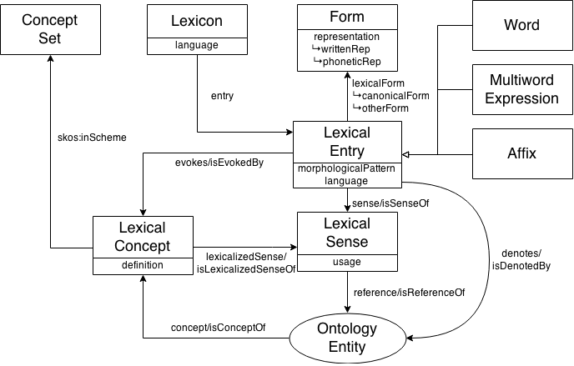
The ontolex-lemon model
There is a complete and rich model (OWL) supporting the expression of concepts, terms, definitions, lexical forms, etc.

Slide 6
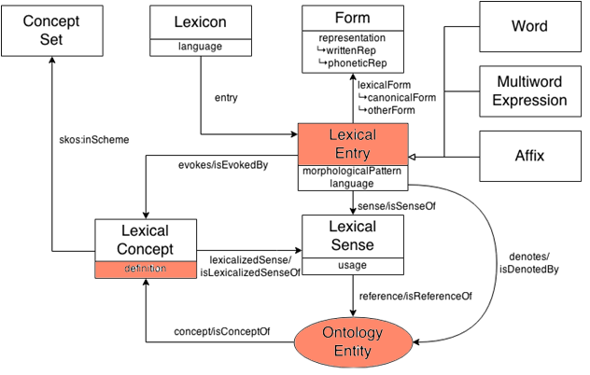
Key elements
Concepts
Multilingual lexicalizations
Definitions

Slide 7
purpose / experimentation
Purpose. Publish a term-bank for one specific domain (copyright) as linked data
The work is timely, as the publication of terminologies as linked data is a new advance postulated only in 2015. Some research problems are still open (how to make automatic matching, how to qualify relations, etc.)
Experiment. Populate the term bank with data semi-automatically extracted from disparate, highly heterogenous sources
In principle, a dubious effort (disparate
By describing the provenance and adding only minimal semantics, a potentially interesting result
Notes:
New knowledge is constructed on the basis of what is already understood and believed.

Slide 8
Scope
Scope is limited enough as to be supervised
Copyright glossaries define some dozens of definitions
Treaties and laws on copyright are manageable, comprising also some dozens of printed pages
→ They can be supervised by a human with assumable effort
Scope is limited to a few jurisdictions / laws
Useful for having covered territories with high activity wrt copyright (US, Australia, etc.)
Enough as to test the validity of the effort
Special attention deserved to jurisdictions with several co-official languages (Canada, Belgium, Switzerland, Spain)

Slide 9
Sources
Sources for general concepts
WIPO (World Intellectual Property Organization). UN agency maintaining treaties almost-universally agreed. Official treaties and other publications (glossaries)
Some national laws
UK, US and Canadian Copyright Acts have been considered
Spanish LPI has been considered
IATE term bank
The Inter-Active Terminology for Europe
Some Creative Common licenses
Relevant because they have been ported to the different jurisdictions by qualified translators (localization has been made)

Slide 10
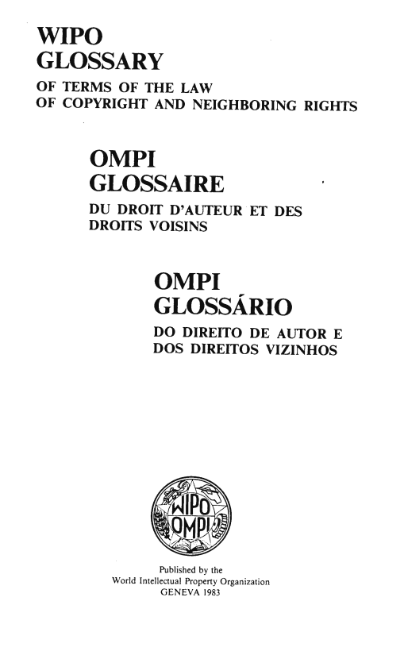
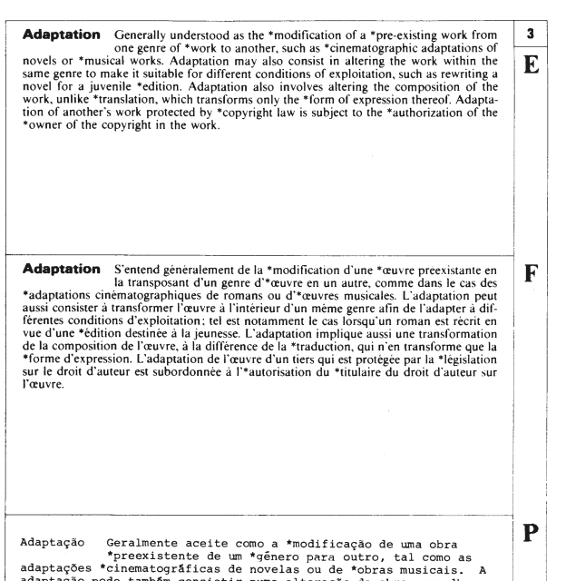

Some disparate sources
265 legal terms
Cross references
Multilingual
Source of:
Concepts
Lexicalizations
Definitions
Other specific references. Detailed sources
Systematic document structure:
Easy to be automatically parsed by computers (in this case withOCR errors)
Republication is granted

Slide 11
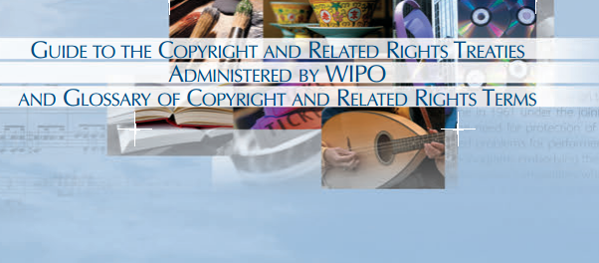
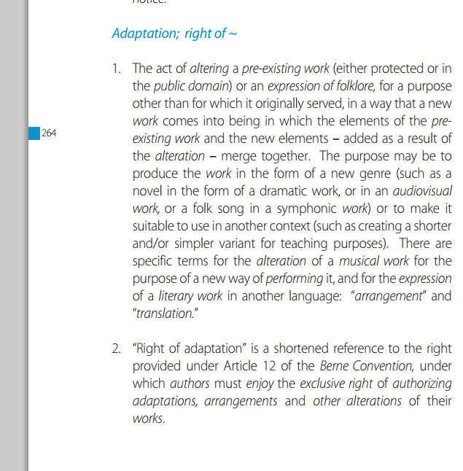

Some disparate sources (II)

Slide 12
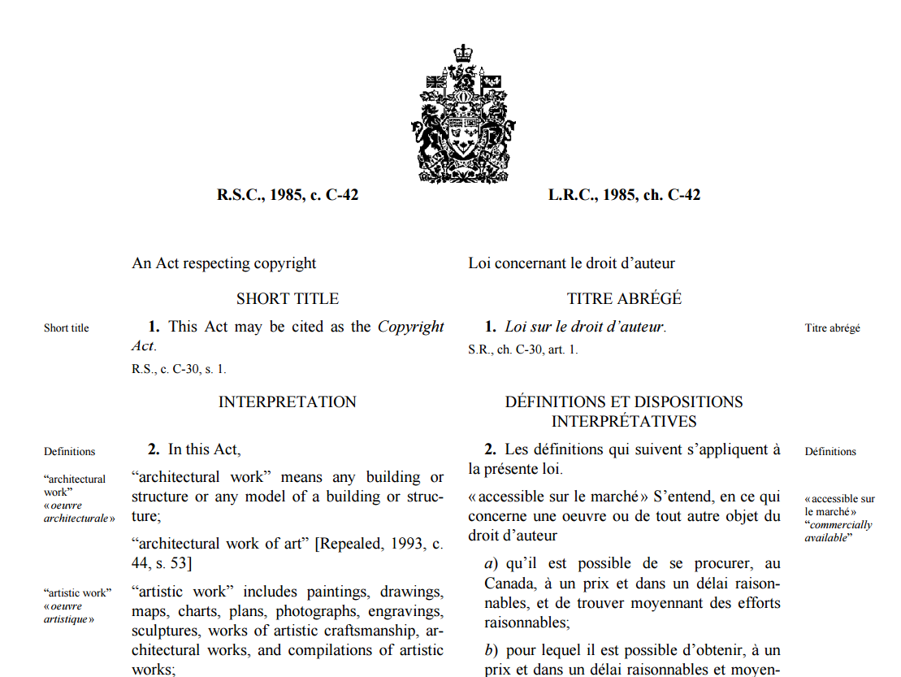
Defined terms in national jurisdictions
Some laws include some definitions within the scope of the legal document
Also
multilingual

Slide 13
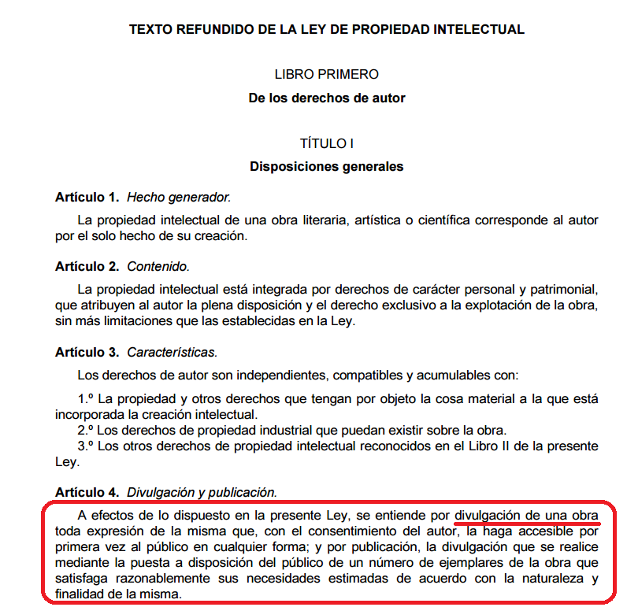
Defined terms in national laws
Not always in a separated, distinct section
Not automatically parseable
Definitions not systematically present
Cross references make the extraction of definitions sometimes difficult/impossible
Difficult to identify the defined term
Still of the highest interest.

Slide 14
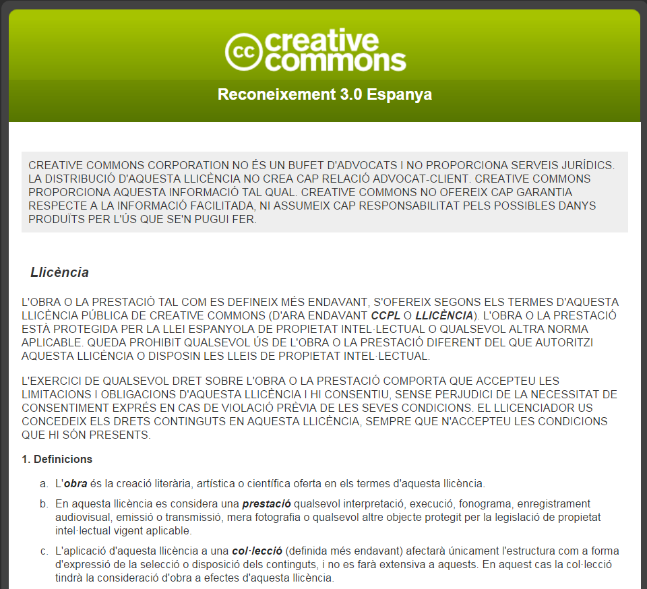
Definitions specific to CC licenses
With little value but high relevance for its wide adoption
Text is localized for the different jurisdictions
Within one jurisdiction, several lexicalizations are given.
Ex:(obra, (es) lan (eu), obra (ca), òbra (oci)…)
Definitions are given only for the regards of that specific document

Slide 15
Never forgetting where semantics come from
Definitions
Common
understanding
Meaning
Every use and relation to other concepts
Case Law
…

Slide 16
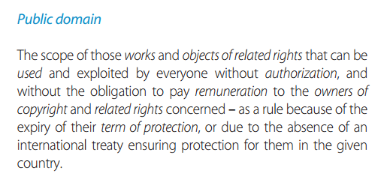
Relations between concepts
Minimal hierarchical relationship between evident concepts.
Public domain
General concept.
WIPO definition
Public domain (PT)
Specialized concept
Only for the jurisdiction of PT
For example, the specificity of the ’70 years’
Notes:
We take a minimal-risk approach. We do not interpret the contents (but really minimally)

Slide 17
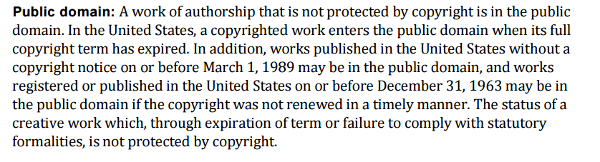
Relations between concepts (II)
Minimal hierarchical relationship between evident concepts.
Public domain
General concept.
WIPO definition
Public domain (US)
Specialized concept
Only for the jurisdiction of US
US Copyright Office definition
Notes:
We take a minimal-risk approach. We do not interpret the contents (but really minimally)

Slide 18
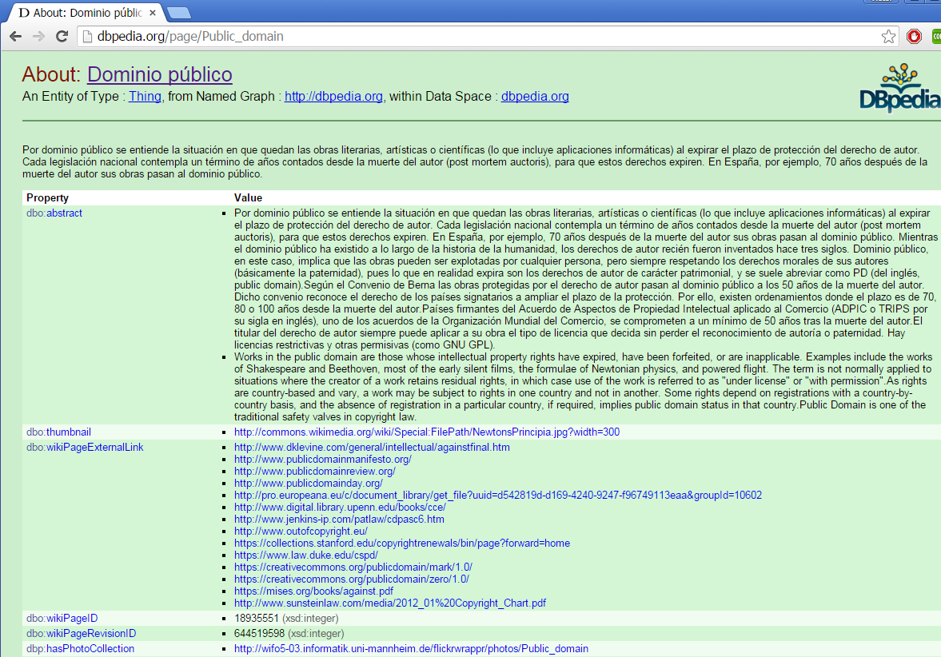
General concepts
General concepts can be related to other generally accepted conceptualizations
Public domain
General concept.
WIPO definition
See also
Linked data

Slide 19
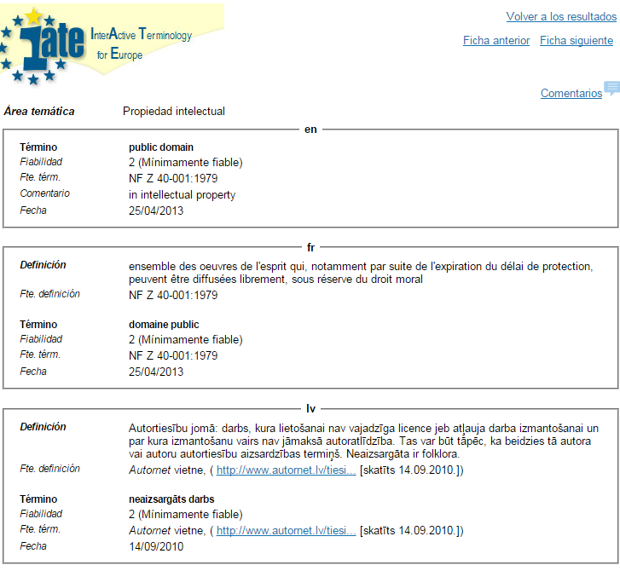
IATE- European terminology
Public domain
General concept.
WIPO definition
See also

Slide 20
Results
http://copyrighttermbank.linkeddata.es
Notes:
Five hundred copyright-related concepts

Slide 21
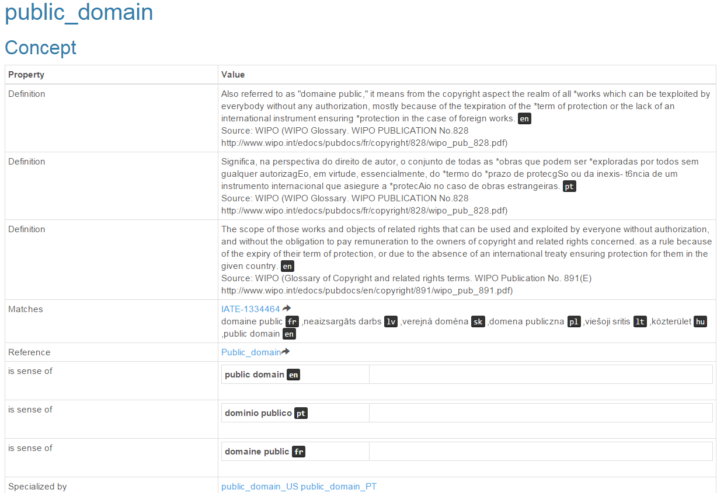
http://copyrighttermbank.linkeddata.es

Slide 22
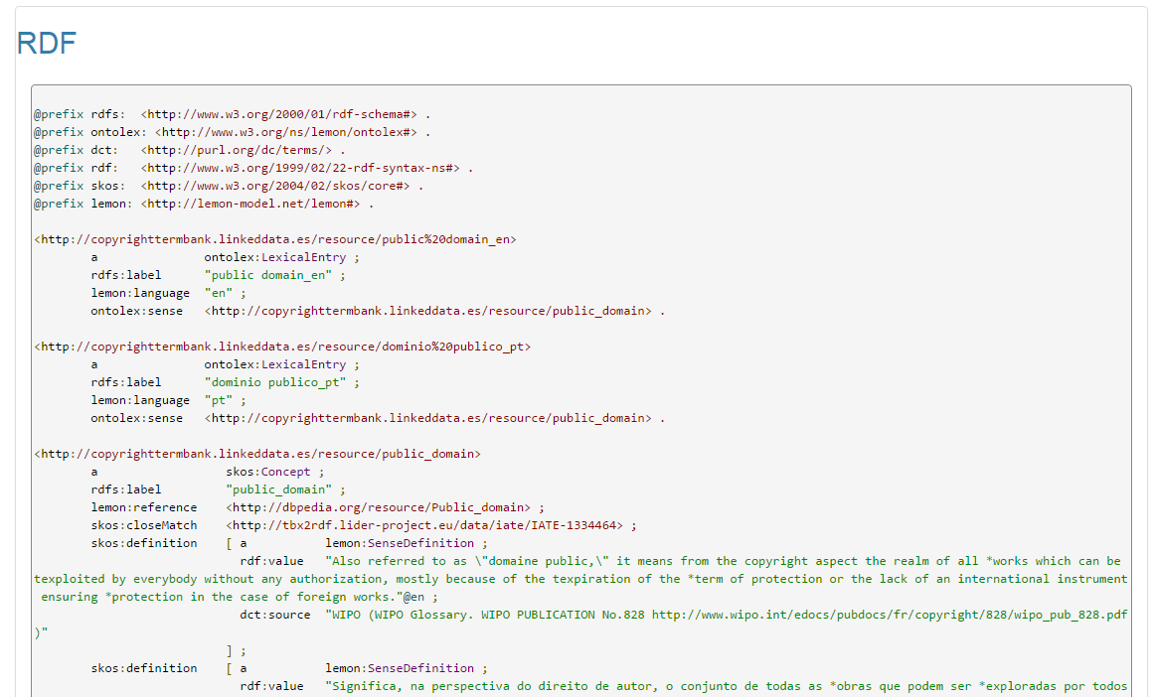
http://copyrighttermbank.linkeddata.es

Slide 23
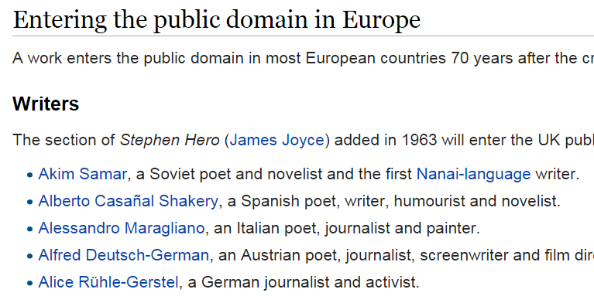
Linked Data Graph
http://copyrighttermbank.linkeddata.es/resource/public_domain
http://tbx2rdf.lider-project.eu/data/iate/IATE-1334464
http://dbpedia.org/resource/Public_domain
Linked to other terminologies
Many links to other RDF info.
Example: list of authors entering the public domain in Europe

Slide 24
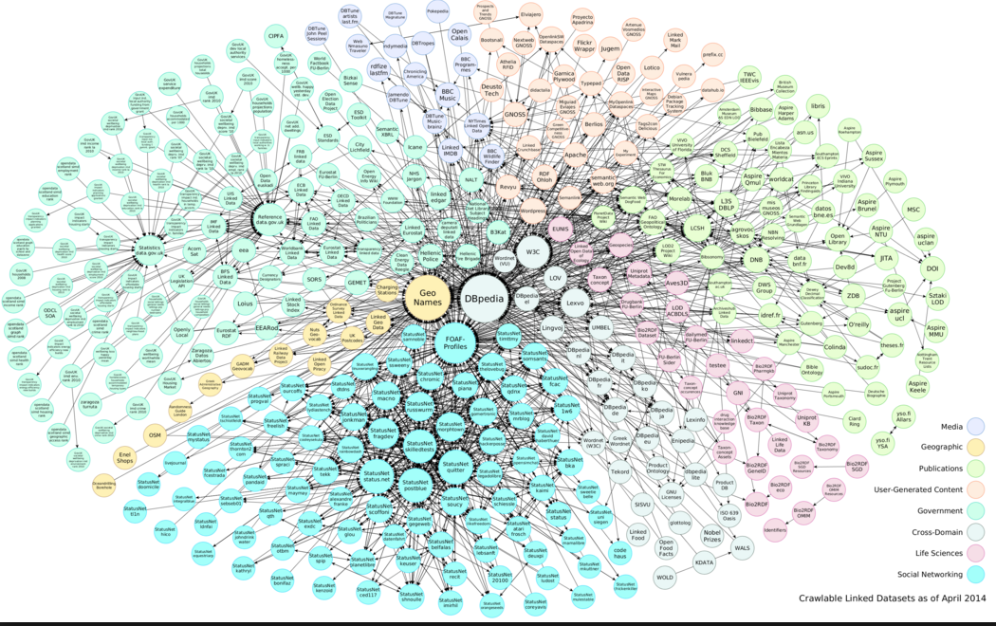
Linked Data Cloud
Individual entitites conform a graph (previous slide)
Global resources conform another graph (where this terminology is only one bubble)

Slide 25
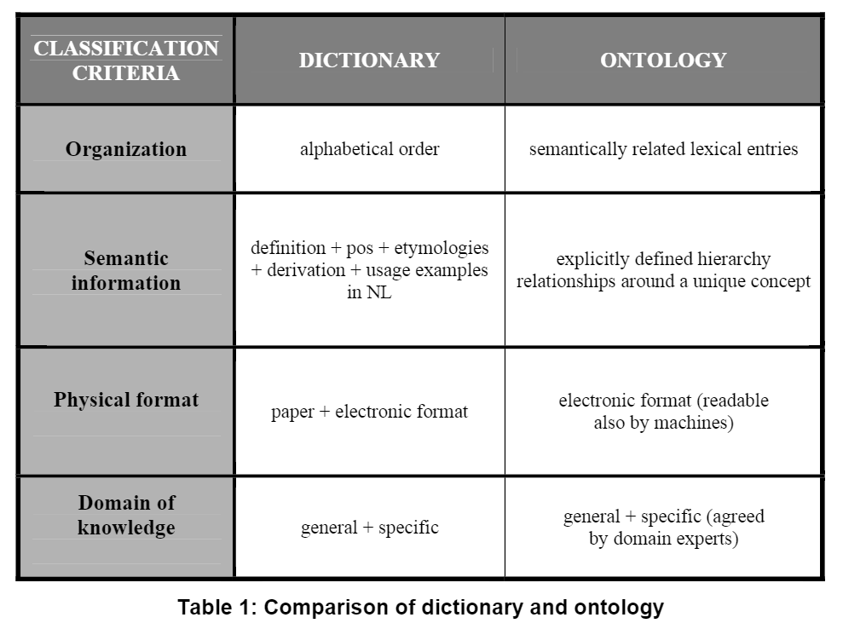
Previous work
Previous work in our group
Benefits of Ontologies to Multilingual Needs. Guadalupe Aguado, Elena Montiel, 6th International AELFE Conference Editors: Maria Kuteeva, Helder Fanha Martins. September 13th-15th, 2007. Lisbon, Portugal. ISBN: 978-972-98646-1-2. Pages: 519-531 Benefits of Ontologies to Multilingual Needs. Available from: https://www.researchgate.net/publication/47900998_Benefits_of_Ontologies_to_Multilingual_Needs [accessed Nov 30, 2015].

Slide 26
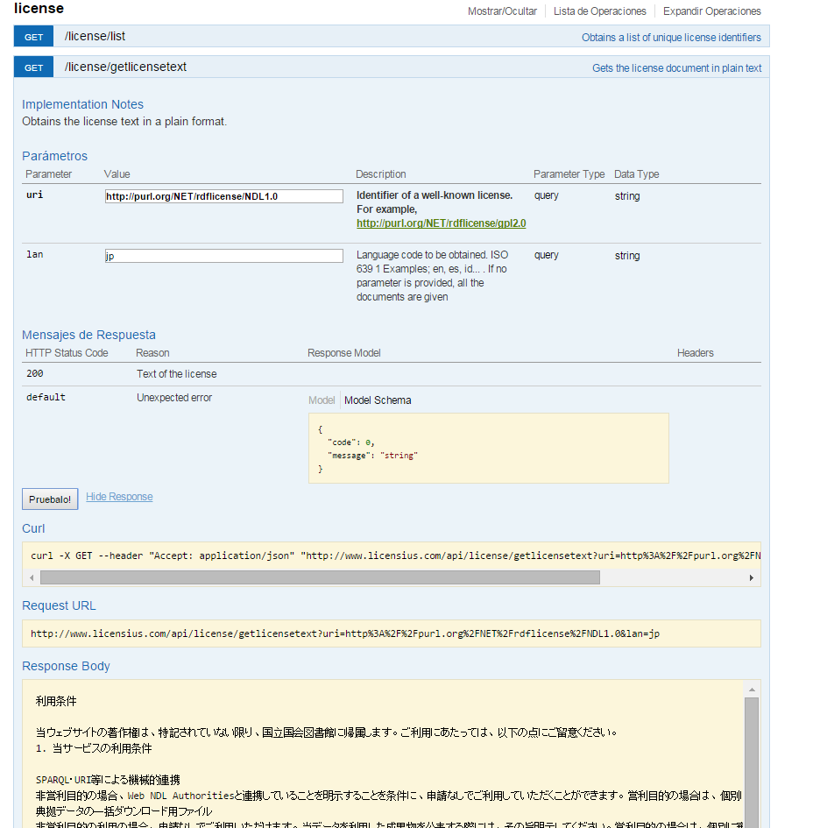
Previous work II
Licensius
Service (API for programmers)
to get the license text of over one hundred of licenses

Slide 27
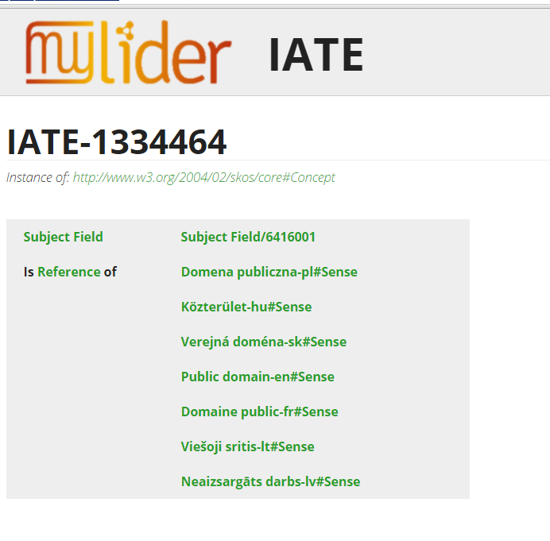
Previous work III
LIDER project
Guidelines to convert TBX terminologies into RDF
Conversion of the IATE term bank to RDF

Slide 28
Authorisation to publish the sources
WIPO
Content offered by WIPO as long as we mention their name
“Salvo indicación en contrario en condiciones específicas de utilización, en particular en lo que atañe a las bases de datos de la OMPI, cualquier persona puede reproducir, distribuir, adaptar, traducir e interpretar en público el contenido de este sitio web sin necesidad de autorización expresa, siempre y cuando el contenido esté acompañado por la mención de la OMPI como fuente y, en su caso, se indique claramente que se ha modificado el contenido original.”
Creative Commons
Content in the Creative Commons site is offered as CC-BY
“Except where otherwise noted, content on this site is licensed under a Creative Commons Attribution 4.0 International license.”
dbpedia
Content extracted from dbpedia is CC-BY-SA
“This content was extracted from Wikipedia and is licensed under the Creative Commons Attribution-ShareAlike 3.0 Unported License”
Etc…
Similar conditions for the other sources….

Slide 29
Conclusions
A pioneer effort
A terminological resource has been launched as Linked Data
For the first time, strongly linked to other disparate resources
Minimal, cautious relationship. Provenance systematically given.
Model of conversion of TBX to RDF
To be learnt which is the most relevant use
Applications to enhance translation
Comparative law study
Enrichment of licenses with links to specific definitions
Error spotting
etc.

Slide 30
Term bank of copyright-related concepts
Thanks, obrigado
JURIX 2015, the 28th International Conference on Legal Knowledge and Information System
Víctor RODRIGUEZ-DONCEL, Cristiana SANTOS, Pompeu CASANOVAS,
Asunción GÓMEZ-PÉREZ, Jorge GRACIA
December 2015

