Slide 1
Term bank of copyright-related concepts
JURIX 2015, the 28th International Conference on Legal Knowledge and Information System
Víctor RODRIGUEZ-DONCEL, Cristiana SANTOS, Pompeu CASANOVAS,
Asunción GÓMEZ-PÉREZ, Jorge GRACIA
December 2015

Slide 2
Preliminary concepts
Term base = terminology = term bank
database consisting of concept-oriented terminological entries (or ‘concepts’) and related information, usually in multilingual format
Format of terminologies
Term Base eXchange (TBX) is an open standard the for interchange of terminological data. It has been published by the Localization Industry Standards Association (LISA) and it is ISO standard 30042
Notable terminologies
Inter-Active Terminology for Europe (IATE) is the inter-institutional terminology database of the European Union
Notes:
IATE project was launched in 1999 with the objective of providing a web-based infrastructure for all EU terminology resources, enhancing the availability and standardisation of the information.
IATE incorporates all of the existing terminology databases of the EU’s translation services into a single new, highly interactive and accessible interinstitutional database. The following legacy databases have been imported into IATE, which now contains approximately 1.4 million multilingual entries:
Eurodicautom (Commission),
TIS (Council),
Euterpe (EP),
Euroterms (Translation Centre),
CDCTERM (Court of Auditors),

Slide 3
General idea behind termbanks
Clear separation between abstract concepts and terms

Slide 4
Term banks as Linked Data
A novel approach (2015)
Academic publication: Linked Terminology: Applying Linked Data Principles to Terminological Resources, JP. Cimiano, J. McCrae, V. Rodriguez-Doncel, T. Gornostay, A. Gomez-Perez and B. Simoneit in Proc. of the 4th Biennial Conference on Electronic Lexicography (ELEX 2015)
Guidelines: Best W3C Practices for Multilingual Linked Open Data Community Group, September 2015. http://www.w3.org/2015/09/bpmlod-reports/multilingual-terminologies/
Advantages
The RDF version of a termbase is more suitable to be linked to other terminologies.
Clear separation and identification of concepts and terms, as data fits a formalized model and every resource is identifiable in a permanent manner.
Easy browsing from a term in one language to an equivalent term in another language, although this makes only full sense when a preferred term is specified .
Easy browsing among general terms and the jurisdiction-specific terms, as concepts can be hierarchically organized. This clarity helps towards the harmonization of copyright terms in the EU, an explicit goal in the EU copyright roadmap .
Easy comparative analysis, as multiple sources are provided.
Improved discovery and unequivocal identification of concepts and corresponding terms at both European and national levels.
Better organization of conceptual domain knowledge and its availability of interrelated data sets on the Web in standard formats.

Slide 5
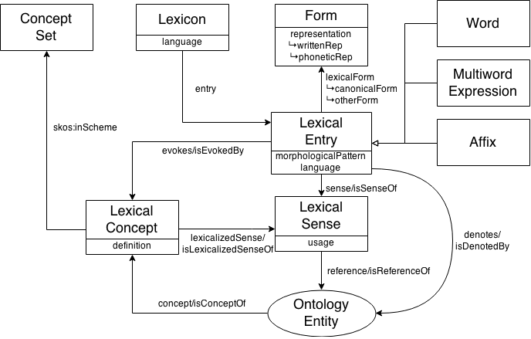
The ontolex-lemon model
There is a complete and rich model (OWL) supporting the expression of concepts, terms, definitions, lexical forms, etc.

Slide 7
Authorisation to publish the sources
WIPO
Content offered by WIPO as long as we mention their name
“Salvo indicación en contrario en condiciones específicas de utilización, en particular en lo que atañe a las bases de datos de la OMPI, cualquier persona puede reproducir, distribuir, adaptar, traducir e interpretar en público el contenido de este sitio web sin necesidad de autorización expresa, siempre y cuando el contenido esté acompañado por la mención de la OMPI como fuente y, en su caso, se indique claramente que se ha modificado el contenido original.”
Creative Commons
Content in the Creative Commons site is offered as CC-BY
“Except where otherwise noted, content on this site is licensed under a Creative Commons Attribution 4.0 International license.”
dbpedia
Content extracted from dbpedia is CC-BY-SA
“This content was extracted from Wikipedia and is licensed under the Creative Commons Attribution-ShareAlike 3.0 Unported License”
Etc…
Similar conditions for the other sources….

Slide 8
ISO 25964 "Thesauri and interoperability with other vocabularies"

