Slide 1



WishfulBazaar
SALES PERFORMANCE ANALYSIS
by Lidia Puspa Ningtyas
Sales Performance Dashboard

Slide 2



WishfulBazaar
Business
Background
You are a data analyst at one of the most reputable e-commerce companies WishfulBazaar, we want to utilize more data insight to support company growth. You will analyze all information in this company using the given data.
Mr. Ronaldinho (CEO), requested Mr. Neymar (head of data) to create a company-wide dashboard.
Mr. Neymar trusts you to create the dashboard about sales performances & getting to know our customers.
Mr. CEO requested some chart for analysis of company-wide to understand our business performance better. The bigger picture is he need your help to capture and understand more metrics and make the data more comprehensive and insightful.
Sales Performance Dashboard

Slide 3



WishfulBazaar
Key Responsibilities of the Dashboard
Decider
Mr. Ronaldinho (CEO)
Accountable
Mr. Neymar (Head of Data)
Responsible
Data Analyst
Consulted
Sales & Marketing team
Informed
All team
Sales Performance Dashboard

Slide 4



WishfulBazaar
Objectives
Problem Statement
How to create dashboard about sales performances & getting to know our customers within 3 months?
Objectives
Gain insights into overall business performance
Understand sales trends and customer behavior
Support data-driven strategic decisions and optimize marketing efforts.
Sales Performance Dashboard

Slide 5

WishfulBazaar
Sales Metrics
Metrics
Definition
Sales Success
sum sales with Order Confirmation="TRUE" and OrderReturn="FALSE" and sales from
Price*Quantity
Abandoned Sales
sum sales with OrderConfirmation="FALSE" and sales from Price*Quantity
Return Sales
sum sales with OrderReturn="TRUE" and sales from Price*Quantity
Purchase Order per Month
sum success sales and divide Counts the number of unique months in your data based on the Session Start dates (using COUNTD & DATETRUNC).
Session Duration per Customer
Find time difference, measured in hours or minutes between session end and session start (by hour/minutes), and summarized it make it average by customer using LOD
Company Profit
PROFIT = SALES - COST
(from succes sales only)
Sales Performance Dashboard

Slide 6

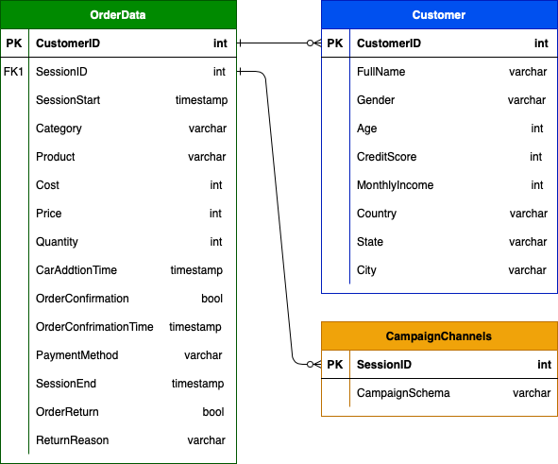

WishfulBazaar
ERD WishfulBazaar Dataset
Why Joining the Datasets is Necessary?
To analyze sales performance based on customer demographics such as country and age, which requires customer location from the Customer table and sales data from the OrderData table using the CustomerID as primary key.
Sales Performance Dashboard

Slide 7
WishfulBazaar
Font & Color
Font: Tableau Light
#3779e3
#e99842
Sales Performance Dashboard

Slide 8
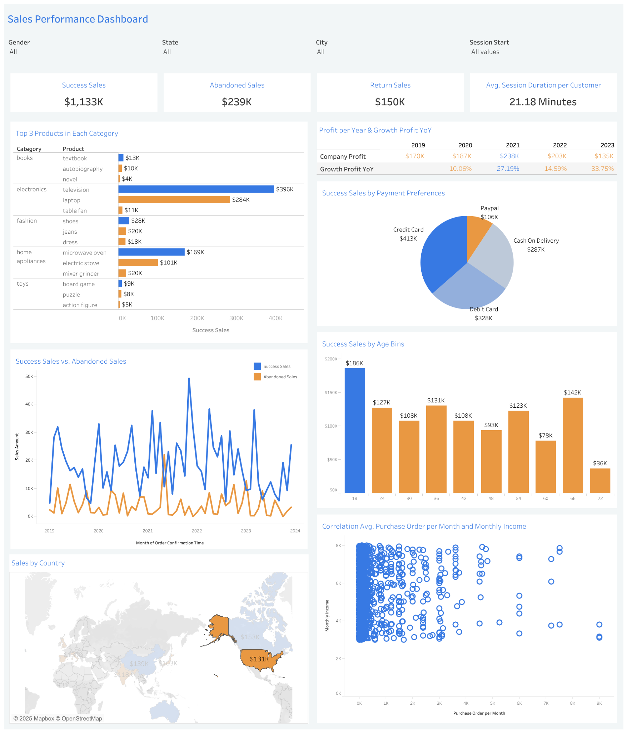
WishfulBazaar
Dashboard Interface
Sales Performance Dashboard

Slide 9
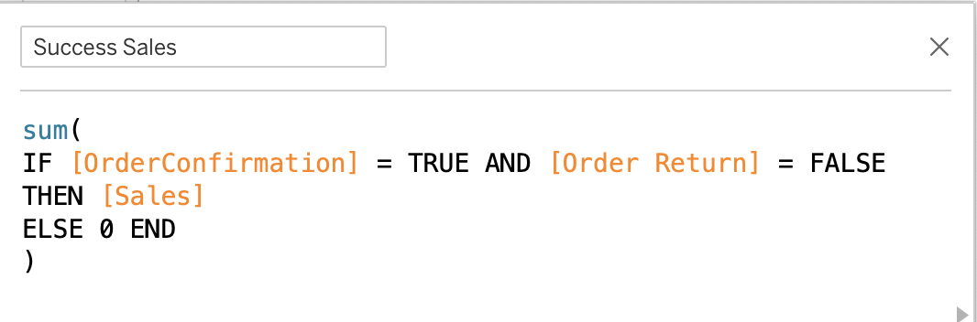

WishfulBazaar
Success Sales
Calculation
Visualization
Total Success Sales from 2019–2023 amounted to $1,133K, representing the gross sales value (confirmed orders with no returns) before deducting costs.
It reflects the gross revenue generated from product sales based on confirmed order status without any returns.
Sales Performance Dashboard

Slide 10
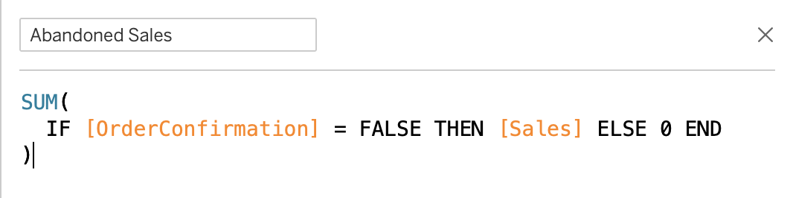

WishfulBazaar
Abandoned Sales
Calculation
Visualization
Total Abandoned Sales from 2019–2023 amounted to $239K, representing the potential sales value from orders that were not confirmed.
It reflects the gross revenue lost due to uncompleted transactions where customers initiated but did not finalize their purchases.
Sales Performance Dashboard

Slide 11
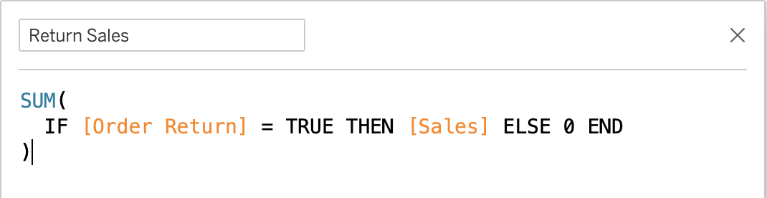

WishfulBazaar
Return Sales
Calculation
Visualization
Total Return Sales from 2019–2023 amounted to $150K, representing the gross value of confirmed transactions that were eventually returned by customers.
It reflects the revenue lost after the sale was completed, indicating potential issues in product satisfaction, delivery, or post-purchase experience.
Sales Performance Dashboard

Slide 12
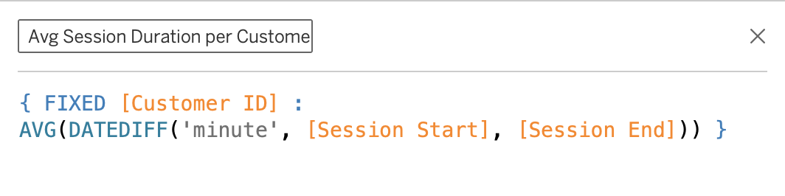
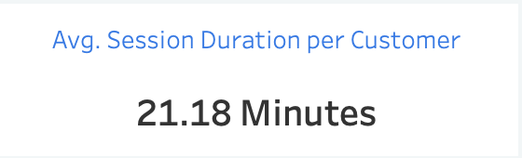
WishfulBazaar
Average Session Duration per Customer
Calculation
Visualization
The average session duration per customer from 2019–2023 is 21.18 minutes, calculated based on the time difference between session start and end, averaged at the individual customer level.
This metric reflects the typical time customers spend per session, which may indicate user engagement or ease of navigation across the platform.
Sales Performance Dashboard

Slide 13
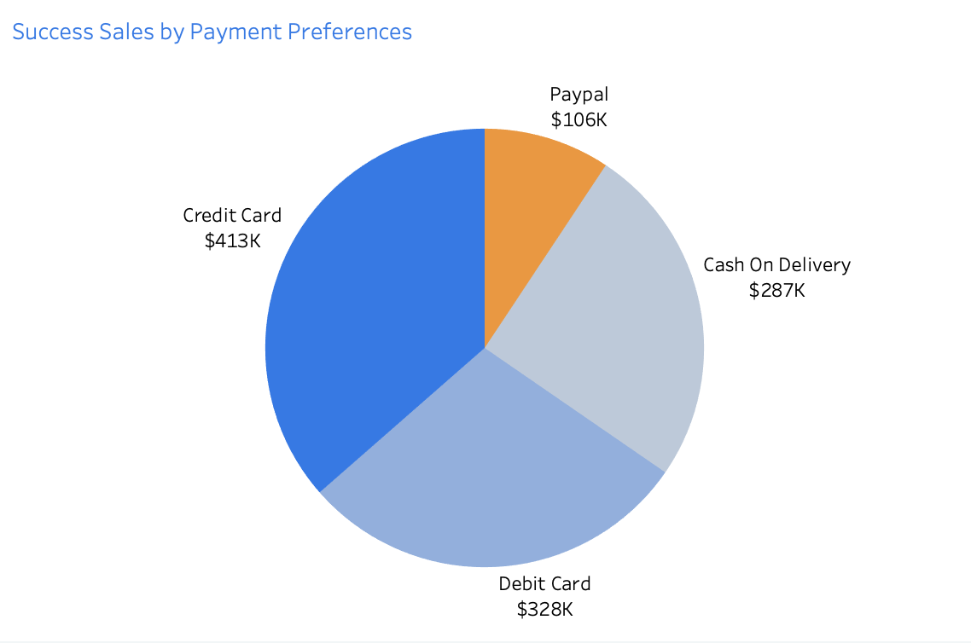
WishfulBazaar
Credit Card Leads as Top Payment Method
Success Sales by Payment Preferences from 2019–2023 show that Credit Card led with $413K, followed by Debit Card ($328K), Cash on Delivery ($287K), and PayPal with the lowest at $106K.
The dominant role of Credit Cards, likely due to ease of use, trust, and promotional offers. Debit Cards also performed strongly, reflecting wide accessibility and customer familiarity. Meanwhile, PayPal contributed the least, which may be attributed to limited user adoption, less visibility during checkout, or a more complex payment flow.
Sales Performance Dashboard

Slide 14
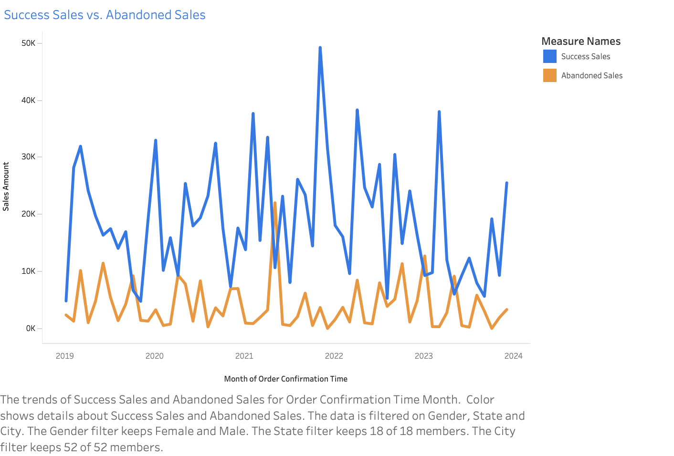
WishfulBazaar
Monthly Trend of Success Sales and Abandoned Sales
While Success Sales generally remain higher than Abandoned Sales, there is a visible inverse relationship, during months when Success Sales significantly drop, Abandoned Sales tend to increase.
This pattern indicates that a lower success sales is often associated with a rise in abandoned transactions, possibly due to checkout issues, payment failures, or external disruptions affecting purchase completion.
Sales Performance Dashboard

Slide 15
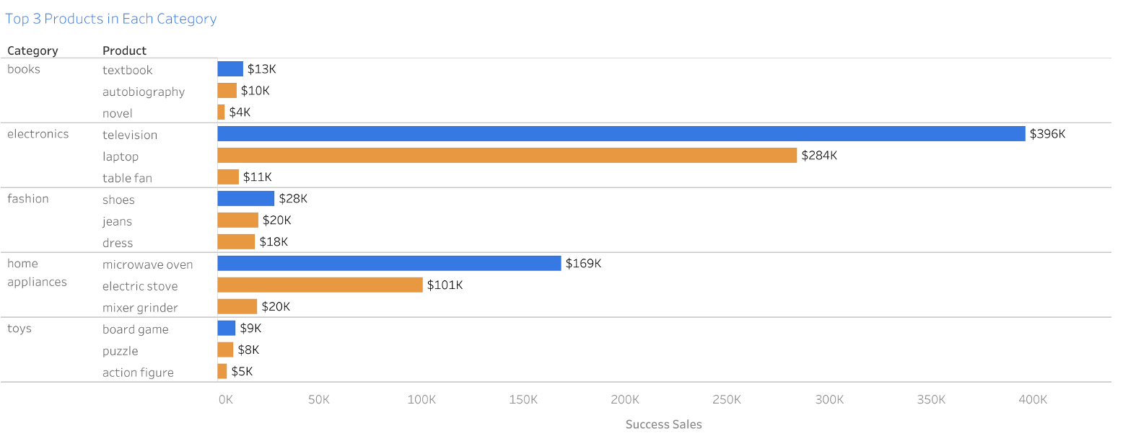
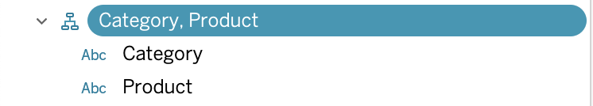
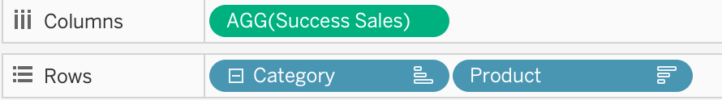
WishfulBazaar
Top 3 Products using Hierarchy
Top 3 Products in Each Category from 2019–2023 were identified using hierarchical grouping by category and product, based on success sales values.
The television in the electronics category led all products with $396K, followed by laptop ($284K) and microwave oven ($169K) in home appliances. This metric helps highlight which specific products are the key revenue drivers in their respective categories and can guide marketing focus, inventory planning, or promotion strategies.
Sales Performance Dashboard

Slide 16
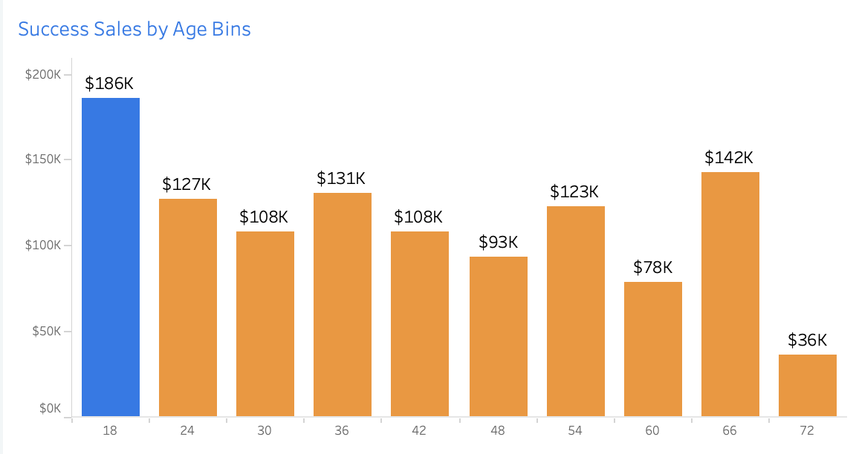
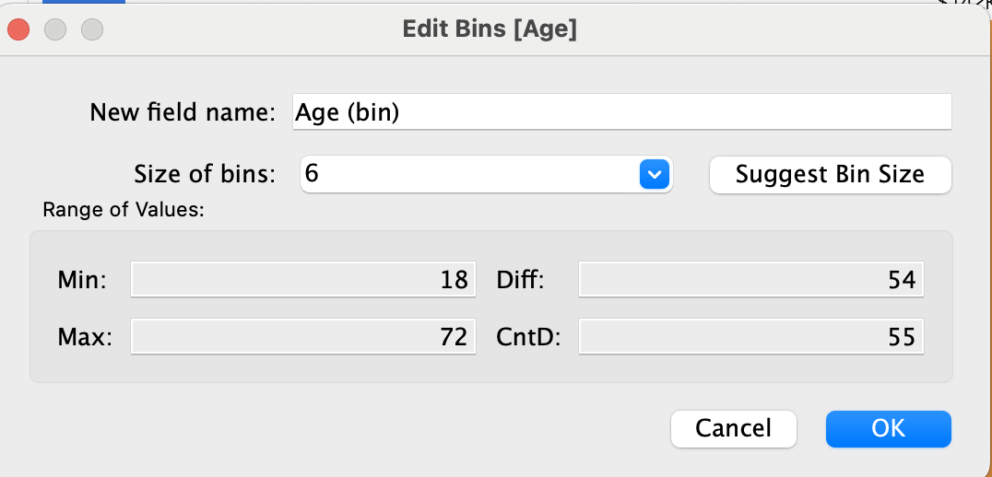
WishfulBazaar
Ages 18–24 as the Top Sales Contributor
Success Sales by Age Bins from 2019–2023 show that the 18–24 age group contributed the highest sales at $186K, followed by age groups 66 ($142K) and 36 ($131K). The age bins are segmented in intervals of 6 years.
This metric reflects that younger consumers (ages 18–24) are the most active buyers, likely due to higher digital engagement and comfort with online transactions. Meanwhile, the age group 66 also shows strong performance, which could be linked to higher purchasing power or increased online adoption among older users. This insight can help guide age-targeted marketing strategies, product positioning, and user experience optimization
Sales Performance Dashboard

Slide 17
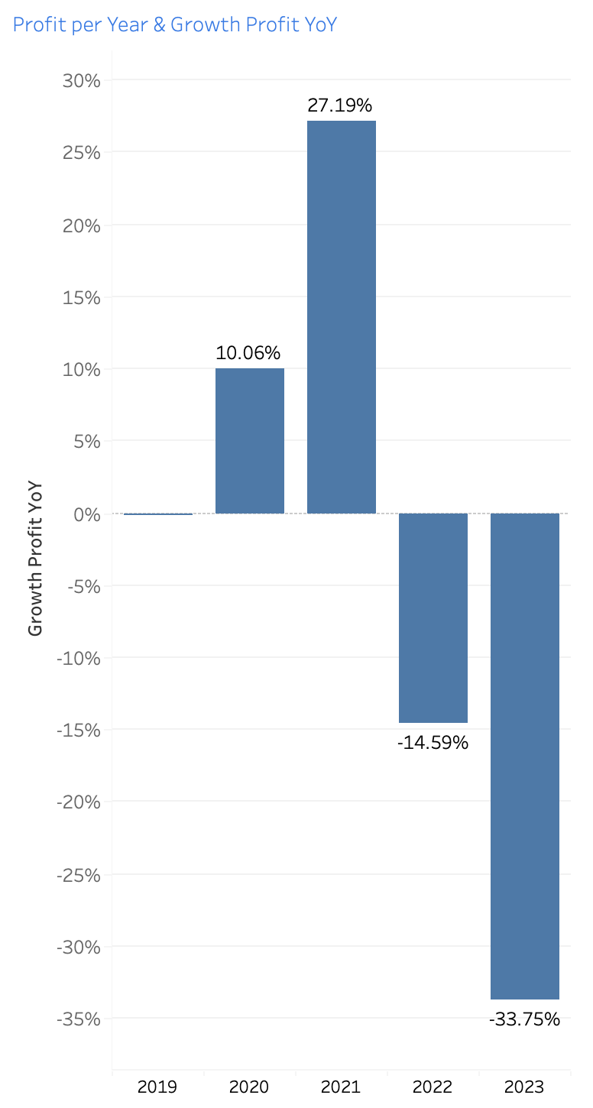
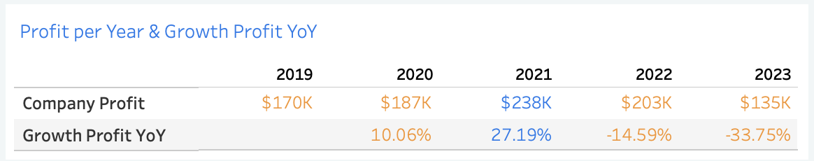
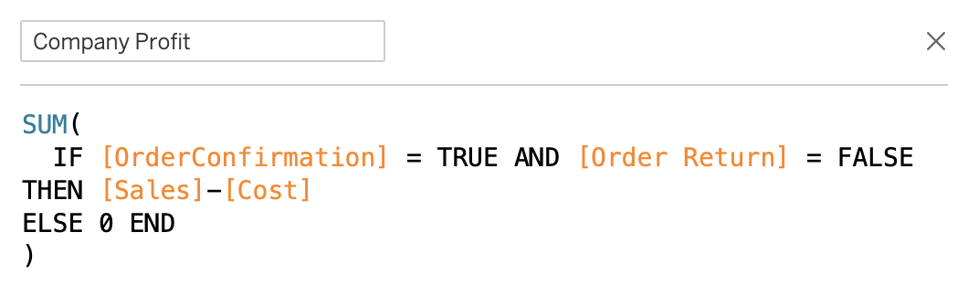
WishfulBazaar
2021 Achieved the Highest Profit Growth
Profit per Year and Year-over-Year (YoY) Growth from 2019–2023 shows that 2021 achieved the highest profit growth at +27.19%, reaching $238K in profit.
This metric is calculated by subtracting cost from confirmed, non-returned sales, and highlights 2021 as the peak year in company profitability. The strong growth in 2021 may reflect optimized operations, higher sales volume, or improved cost efficiency. However, this trend declined in subsequent years, with negative growth in 2022 (–14.59%) and 2023 (–33.75%), signaling a need to reassess pricing, cost structure, or customer retention strategies.
Sales Performance Dashboard

Slide 18
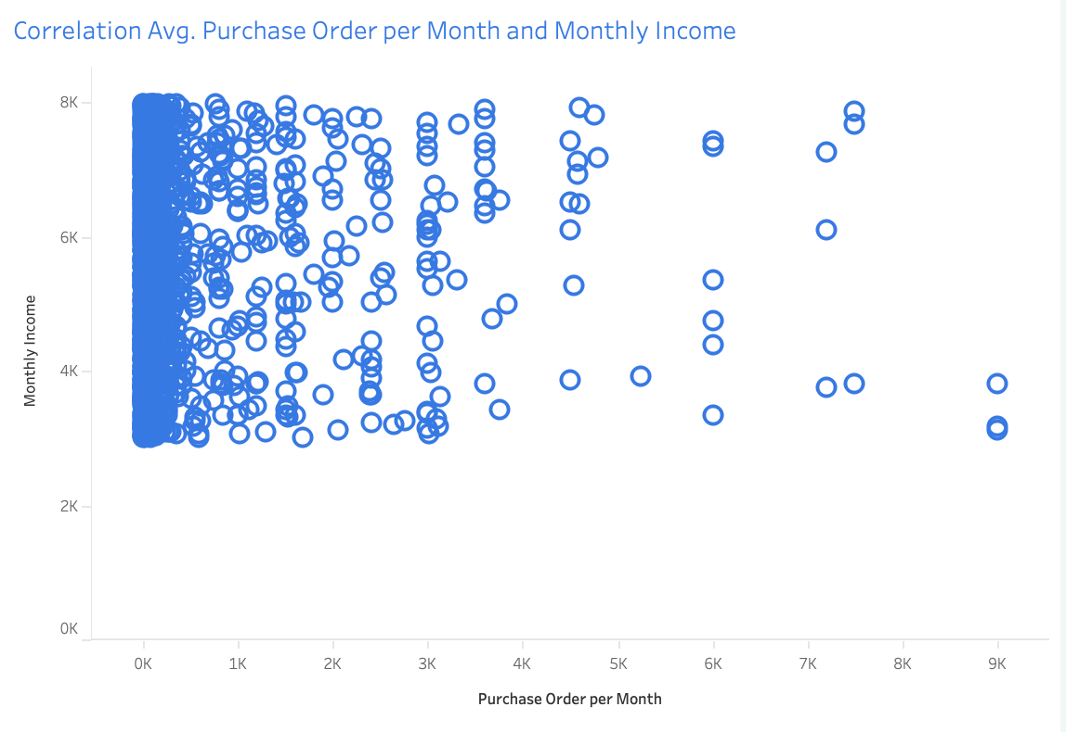
WishfulBazaar
Correlation Avg Purchase Order per Month vs. Monthly Income
The scatter plot shows widely spread with no clear linear pattern, indicating a weak or no strong correlation between how much a customer earns monthly and how many purchase orders they place per month.
This suggests that income alone may not be a strong predictor of purchasing frequency, and other factors—such as user behavior, promotions, or product type—might have a more significant influence.
Sales Performance Dashboard

Slide 19
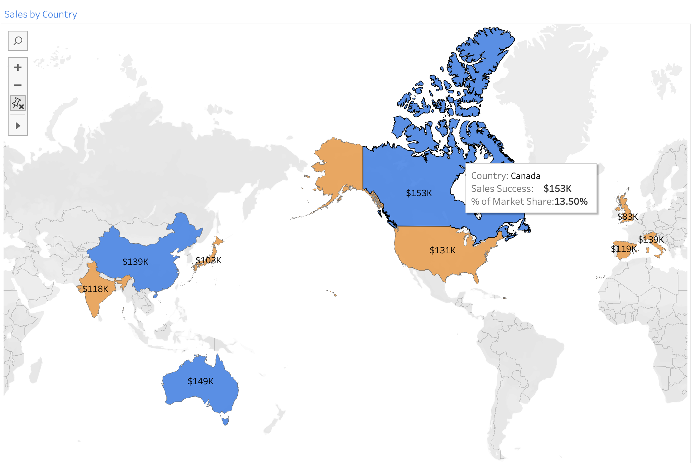
WishfulBazaar
Canada Generated the Highest Revenue
Sales by Country from 2019–2023 show that Canada generated the highest revenue with $153K in success sales and held the top market share at 13.50%.
Australia ($149K) and China ($139K) follow as the next highest contributors. These three countries are highlighted in blue, indicating the top 3 performing markets in terms of confirmed and non-returned sales.
This metric highlights where the business is strongest geographically, and can inform decisions related to market expansion, targeted campaigns, and regional investments.
Sales Performance Dashboard

Slide 20

WishfulBazaar
Insights & Recommendations
Topic | Insights | Recommendations
Success Sales | Total Success Sales reached $1,133K, representing gross revenue from confirmed non-returned orders. | Use as a baseline to measure sales performance and funnel effectiveness.
Abandoned Sales | Abandoned Sales totaled $239K, indicating lost potential revenue from unconfirmed transactions. | Improve checkout flow and apply retargeting strategies to recover abandoned sales.
Return Sales | Return Sales hit $150K, reflecting confirmed orders that were later returned. | Review return policy and improve product/service quality to reduce return rates.
Session Duration | Average session duration per customer is 21.18 minutes, suggesting strong user engagement. | Enhance product recommendations and interactive elements during sessions to boost conversion.
Payment Preferences | Credit Card ($413K) dominates payment methods, PayPal ($106K) is the least used. | Prioritize credit/debit optimization and review PayPal UX or visibility.
Top Products | Top-selling products include Television ($396K) and Laptop ($284K) under Electronics. | Focus marketing and stock strategies on top-performing products.
Success vs Abandoned Trend | A visible inverse relationship: when Success Sales drop, Abandoned Sales tend to rise. | Analyze periods with success dips and abandoned spikes, stabilize checkout process and monitor closely during peak seasons.
Customer Age | Age group 18–24 is the highest contributor to sales ($186K) in 6-year bins. | Target this segment with youth-centric digital campaigns and platforms.
Profit Growth | 2021 recorded the highest profit ($238K) and YoY growth (+27.19%) before declining in 2022–2023. | Reapply successful 2021 strategies and investigate 2022–2023 decline for corrective action.
Income vs Purchase | No strong correlation between monthly income and purchase frequency. | Segment customers based on behavior rather than just income levels.
Country Performance | Canada ($153K) leads in revenue and market share (13.5%), followed by Australia and China. | Strengthen efforts in top markets; evaluate strategy in underperforming regions like the UK/Japan.
Sales Performance Dashboard

Slide 21

WishfulBazaar
Thank You
Sales Performance Dashboard

