Slide 1
Peer-graded Assignment: Capstone Project - Car accident severity
Ildiko Balazs-Papp

Slide 2
Table of contents
Introduction
Methodology
Data analysis and preparation
Data visualization
Building a classification model
Model evaluation
Results

Slide 3
Data types in DataFrame
Column name | Data type
SEVERITYCODE | int64
X | float64
Y | float64
OBJECTID | int64
INCKEY | int64
COLDETKEY | int64
REPORTNO | object
STATUS | object
ADDRTYPE | object
INTKEY | float64
LOCATION | object
EXCEPTRSNCODE | object
EXCEPTRSNDESC | object
SEVERITYCODE.1 | int64
SEVERITYDESC | object
COLLISIONTYPE | object
PERSONCOUNT | int64
PEDCOUNT | int64
PEDCYLCOUNT | int64
VEHCOUNT | int64
Column name | Data type
INCDATE | object
INCDTTM | object
JUNCTIONTYPE | object
SDOT_COLCODE | int64
SDOT_COLDESC | object
INATTENTIONIND | object
UNDERINFL | object
WEATHER | object
ROADCOND | object
LIGHTCOND | object
PEDROWNOTGRNT | object
SDOTCOLNUM | float64
SPEEDING | object
ST_COLCODE | object
ST_COLDESC | object
SEGLANEKEY | int64
CROSSWALKKEY | int64
HITPARKEDCAR | object

Slide 4
Preparation steps
Determining the correlation between columns
Dropping unnecessary/redundant columns
Determining columns with missing values and dealing with them (Missing data in categorical columns (ADDRTYPE, COLLISIONTYPE, JUNCTIONTYPE, WEATHER,UNDERINFL, ROADCOND, LIGHTCOND, ST_COLCODE ) will be filled with the most frequent data in the given column.)
Correcting data format

Slide 5
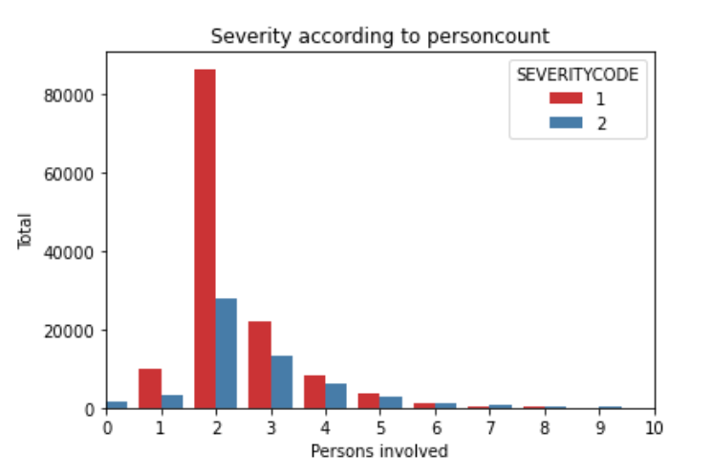
Severity according to persons involved

Slide 6
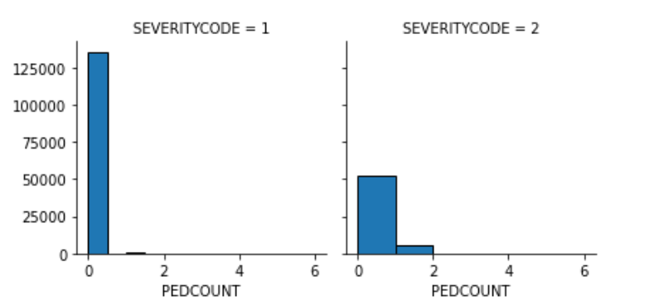
Severity according to pedestrians involved

Slide 7
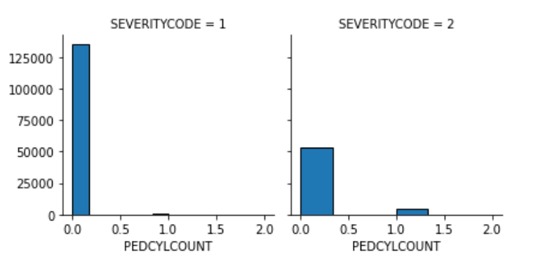
Severity according to cyclists involved

Slide 8
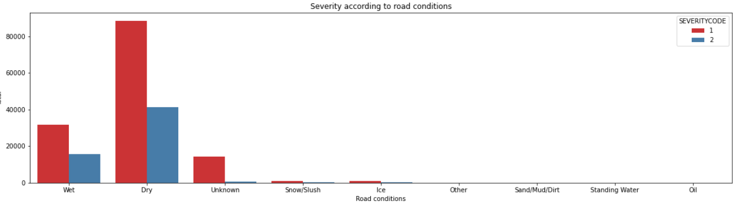
Severity according to road conditions

Slide 9
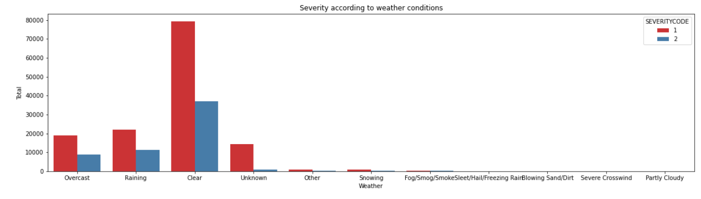
Severity according to weather conditions

Slide 10
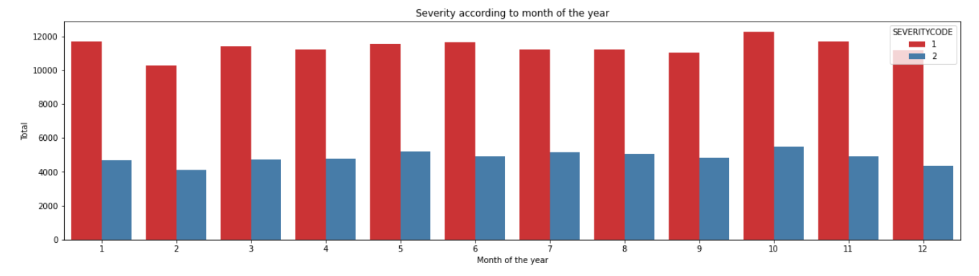
Severity according to month of the year

Slide 11
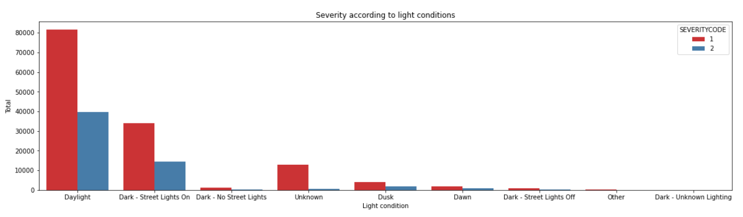
Severity according to light conditions

Slide 12
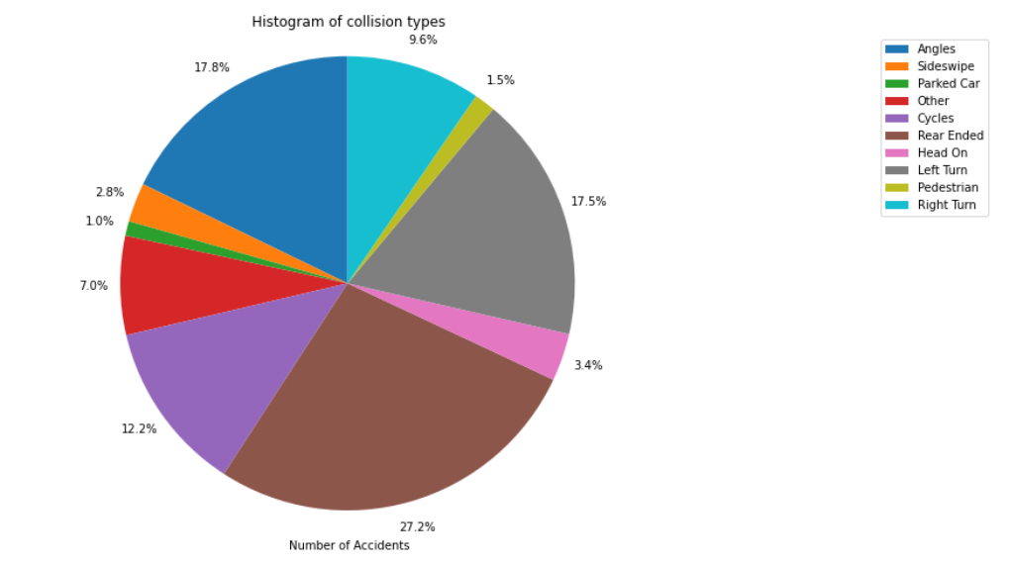
Distribution of collision types

Slide 13
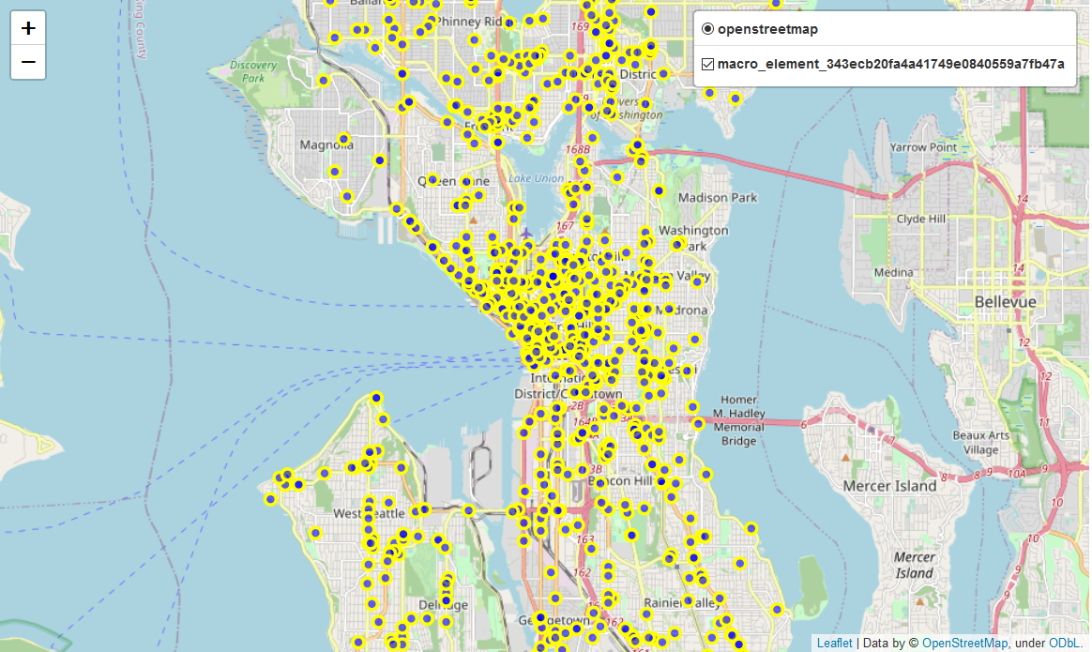
Distribution of accidents across Seattle

Slide 14
Accuracy of the build KNN model
KNN model accuracy for test set: 0.989
KNN model f1 score for test set: 0.989
KNN model Jaccard score for test set: 0.984

Slide 15
Results
The majority (70 %) of the accidents fell into the category represented by severity code 1, which is property damage.
More than 99.8 % of the accidents involved less then or equal to 10 people.
In the 96 % of the accidents no pedestrians were involved in the accident.
In the 97 % of the accidents no cyclists were involved in the accident.
The majority of both severity 1 and 2 accidents happened in clear weather conditions with dry roads in daylight.
The distribution of accidents is approximately constant in in regards with the month of the year.
* These findings not necessarily mirror reality as here eg. the majority of the accidents happened in clear weather conditions with dry roads in daylight. Besides that no fatal accidents were recorded in the data set. This is probably due to previous manipulation of the dataset which I am not aware of.

Slide 16
Conclusions
As stated above the reality of the original data set is questionable therefore the model trained on it could be unrealistic. That is why I think that going forward a collection of more real-life data could be advisable, so the model could be further developed and specified.

