Slide 1
Linked Justifications

Slide 2
Directed Hypergraph Representation
English Interpretation
A,B,C,D,E are statements.
s1 ~s6 are steps in justification j1
A was derived by s1 from B,C,D
B was derived by s2 from E
B was alternatively derived by s3 from C,D
E,C,D were directly derived by s4,s5,s6 respectively
s4~s6 are terminal
Hyper-graph syntax
Directed Hypergraph
j1
vertex
A
Hyperarc
s1
AND
B
OR
s2
s3
E
C
D
s4
s5
s6
Notes:
Syntax: (id, head-list, tail-list, weight, source-list)
CSV syntax
"s1","A","B,C,D","0","j1"
"s2","B","E,C","0","j1"
"s3","B","C,D","0","j1"
"s4","E","","1","j1"
"s5","C","","1","j1"
"s6","D","","1","j1"

Slide 3
General Problem Context
Justifications (or proofs) generated by different reasoners may derive semantically equivalent intermediate/final conclusions; therefore,
We can combine existing justifications into an AND-OR graph (encoded as a hypergraph)
We can search the AND-OR graph for a “better” solution graph which is a combination of justification fragments
j1
j2
j3
j4
j5
A
B
B
A
A
s1
s2
s3
s1
s1
B
B
B
C
D
E
C
D
+ + = =>
s3
s4
s2
s3
s4
s5
s6
s7
s8
s9
combine
Search
C
D
B is derived from E
E is asserted
E
C
D
A is derived from B, C, D
B,C,D are asserted
B is derived from C,D
C,D are asserted
s7
s5
s8
s6
s9
s5
s6
legend
Linked justifications rooted at A
P4 is created by linking p1,p2 and p3
A is derived from B,C,D
C,D are asserted
B
vertex hyperarc is conclusion of has antecedent
s3

Slide 4
Directed HyperGraph Formalism
A justification is encoded by an annotated directed hypergraph H(V, A, C):
V={v1,v2…vn}, set of vertex – a vertex denotes a unique formula
A={a1,a2,…am}, set of hyperarc – a hyperarc denotes a step in justification
C: context data
Source – a hyperarc may come from multiple sources
Weight – each hyperarc has a weight for optimization purpose
Notations
Hyperarc ai ∈ A(H)
output(ai) ⊆ V(H), formula derived as conclusions, OR?
input(ai) ⊆ V(H), formula used as antecedents, AND
Vertex vi ∈ V(H)
Inlink(vi) ⊆ A(H), hyperarcs having vi as tail
Outlink(vi) ⊆ A(H) , hyperarcs having vi as head
Hyergraph -H
A(H) = ∪ ai where ai ∈ H
V(H) = ∪ vi where vi ∈ H
Output(H)= ∪ output(ai) where ai ∈ A(H)
Input(H) = ∪ Input(ai) where ai ∈ A(H)
Roots(H) = Output(H) – Input(H)
Hyperpath – p={v1,a1,v2,a2,..vn} , a path in hypergraph
Vi ∈ input(ai)
Vi+1 ∈ output(ai)
Notes:
EQ: V X V, tracks asserted equivalent semantics on V
S, semantic annotation functions
m_source: A X V->P(URI), tracks provenance of hyperarc
m_condition: A -> {sufficient, necessary}
SA is a collection of semantic annotation functions

Slide 5
More Definitions
A hyperpath p is cyclic iff. p ends at its starting vertex, i.e. p = {V1, …Vn, An, V1}
A hypergraph H(X,A,C) is
concise iff. No two steps derives the same statement i.e. output(ai) ∩ output(aj) = ∅ ∀ai,aj ∈A, i ≠j
complete iff. Every statement has justification i.e. Input(H) ⊆Output(H)
acyclic iff. H has no cyclic hyperpath.
A solution graph Hs(X’,A’,C’) for v of a hypergraph H w.r.t. vertex v is
A subgraph of H i.e. A’⊆ A
Rooted at vertex v i.e. Roots(Hs)={v}
Concise
Complete
Acyclic
Weighted directed hypergraph
Each hyperedge has a numeric weight, weight(ai)
The weight of a directed hypergraph weight(H) = ∑ weight (ai) ai ∈A

Slide 6
The “Search” Problem
Given a weighted directed hypergraph H(X,A,C) and a starting vertex v, find the optimal solution graph H’(X’,A’,C’) rooted at v.
Optimal – minimal weight
Discussion
Search space is huge, could be exponential
Similar to AO* search, which assumes Tree instead of DAG

Slide 7
Example1: AO* Search does not work Find minimal (weight) solution graph
j0 is the input
j1 is AO* Search result
j2 is the optimal result
j0
j1
j2
A
A
A
s1
s1
s1
B
B
B
s2
s3
s2
s3
s2
s3
E
C
D
E
C
D
E
C
D
s4
s5
s6
s4
s5
s6
s4
s5
s6
Assign each hyperarc weight 1
AO* does not consider shared hyperarc
j0
j1
j2
A
A
5
A
4
1
s1
s1
5
s1
4
B
2
?
B
B
1
s2
1
s3
s2
2
s3
3
s2
2
s3
3
E
C
D
E
C
D
E
C
D
1
s4
1
s5
1
s6
s4
s5
s6
s4
s5
s6

Slide 8
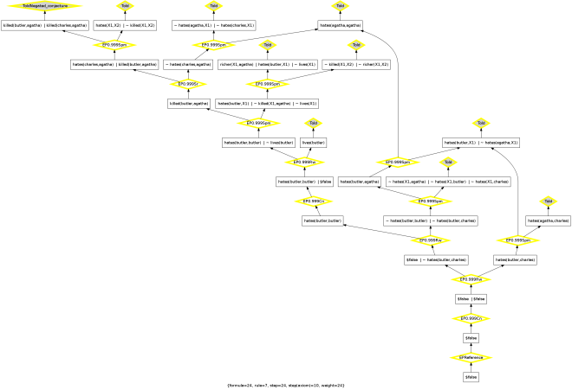
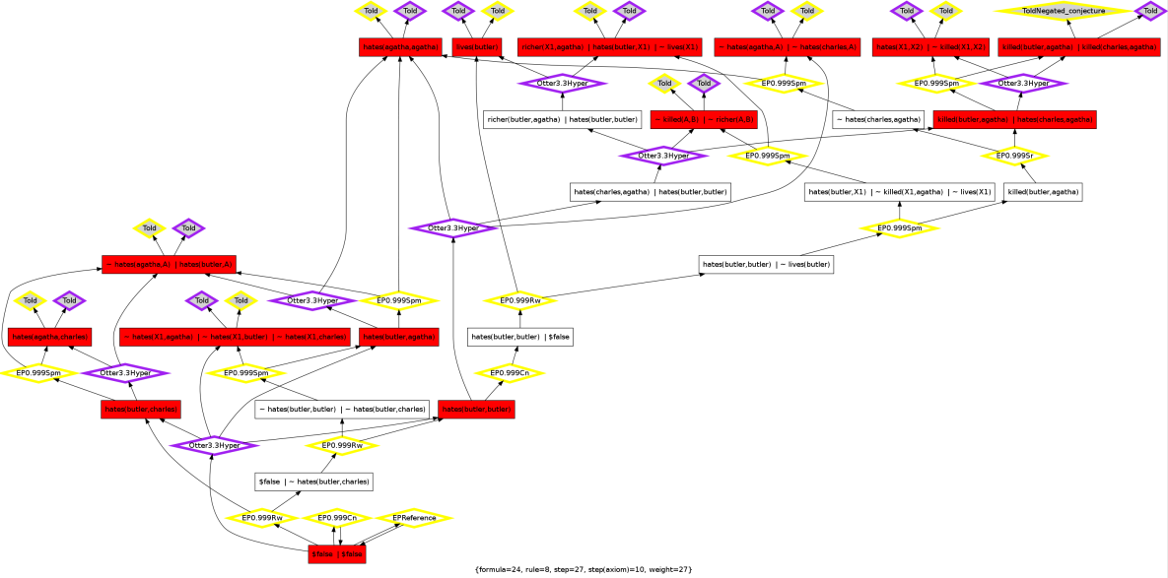
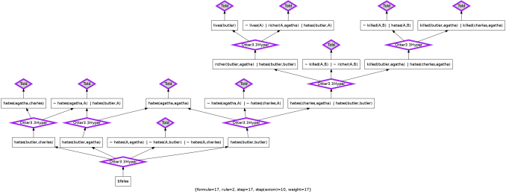
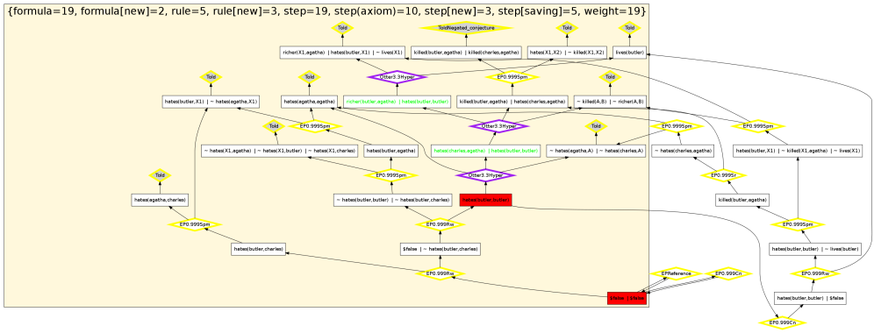
Example2: Combine & Improve Proof

Slide 9
Architecture
Proofs
(tptp)
visualize
statistics
diff
translate
map
J1
(pml2)
J2
(pml2)
J_ALL
(pml2)
J_OPT
(pml2)
Mappings
(owl)
hg2pml
combine
H(A,X,C)
(Graph)
H_OPT(A,X,C)
(Graph)
search

Slide 10
Backup

Slide 11
RDF graph syntax
A
output
s1
weight
partOf
0
input
0
B
s3
0
s2
0
j1
C
s4
1
D
s5
1
E
s6
1

