Slide 1


Linked Justifications: Provenance Aware Data Integration on Linked Data
Li Ding
Tetherless World Constellation Rensselaer Polytechnic Institute
Nov 2, 2009

Slide 2

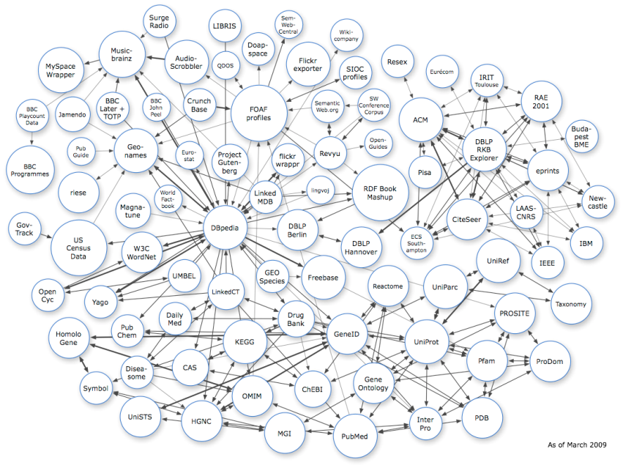



Linked Data
Data on the Web
Use RDF
Use dereferenceable HTTP URI
Linked by typed links
rdfs:seeAlso
owl:sameAs
...
Many datasets

Slide 3
A Simple Linked Data Example
RPI
Troy, NY
Li Ding
Ying Ding
Katy Bӧrner

Slide 4
Motivation
Justification shows why someone properly holds a belief
Justifications are important
Daily life, e.g. government budget, résumé
Intelligent systems, e.g. GPS rounting
It would be nice to reuse justifications
Chained justifications: organic eggs
Alternative justifications: creation of human

Slide 5
Challenges and Solutions
Challenges: reuse distributed, isolate and heterogeneous Justifications
Solutions
Make it linked data
Use general purposed simple structure
Support extensible semantic annotation
Use RDF with dereferencable URI
Make it linked
Support interesting computations

Slide 6
Puzzle “who killed Aunt Agatha?”
(1) Someone who lives in Dreadsbury Mansion killed Aunt Agatha.
(2) Agatha, the butler, and Charles live in Dreadsbury Mansion, and are the only people who live therein.
(3) A killer always hates his victim, and is never richer than his victim.
(4) Charles hates no one that Aunt Agatha hates.
(5) Agatha hates everyone except the butler.
(6) The butler hates everyone not richer than Aunt Agatha.
(7) The butler hates everyone Agatha hates.
(8) No one hates everyone.
(9) Agatha is not the butler.

Slide 7
Linked Justifications

Slide 8
Intuition 1+1 ≠2
B2
B1
A
A

Slide 9
Roadmap for Linked Justification
Put linked justifications on the Web
Choose TPTP dataset
Model Justification (TPTP proofs) using Hypergraph
Publish justifications in PML
Link justifications using owl:sameAs
Consume linked justifications
Visualize
Validation
Improve

Slide 10
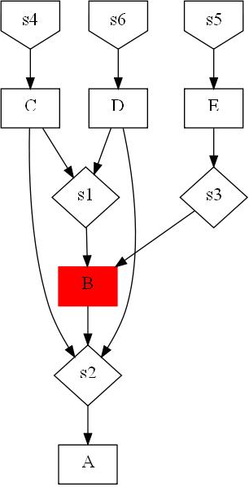
Encoding Linked Justification
English interpretation
A,B,C,D,E are statements.
s1 ~s6 are steps in justification j1
A was derived by s1 from B,C,D
B was derived by s2 from E
B was also derived by s3 from C,D
D,C,E were derived from s4, s5, s6 respectively
D
s4
A
s1
A
s1
B
s3
s3
C
s5
s2
B
C
s4
legend
s2
E
B
vertex
hyperarc
output
input
s6
D
s5
s3
E
s6
(a) directed hypergraph
(b) directed bipartite graph

Slide 11
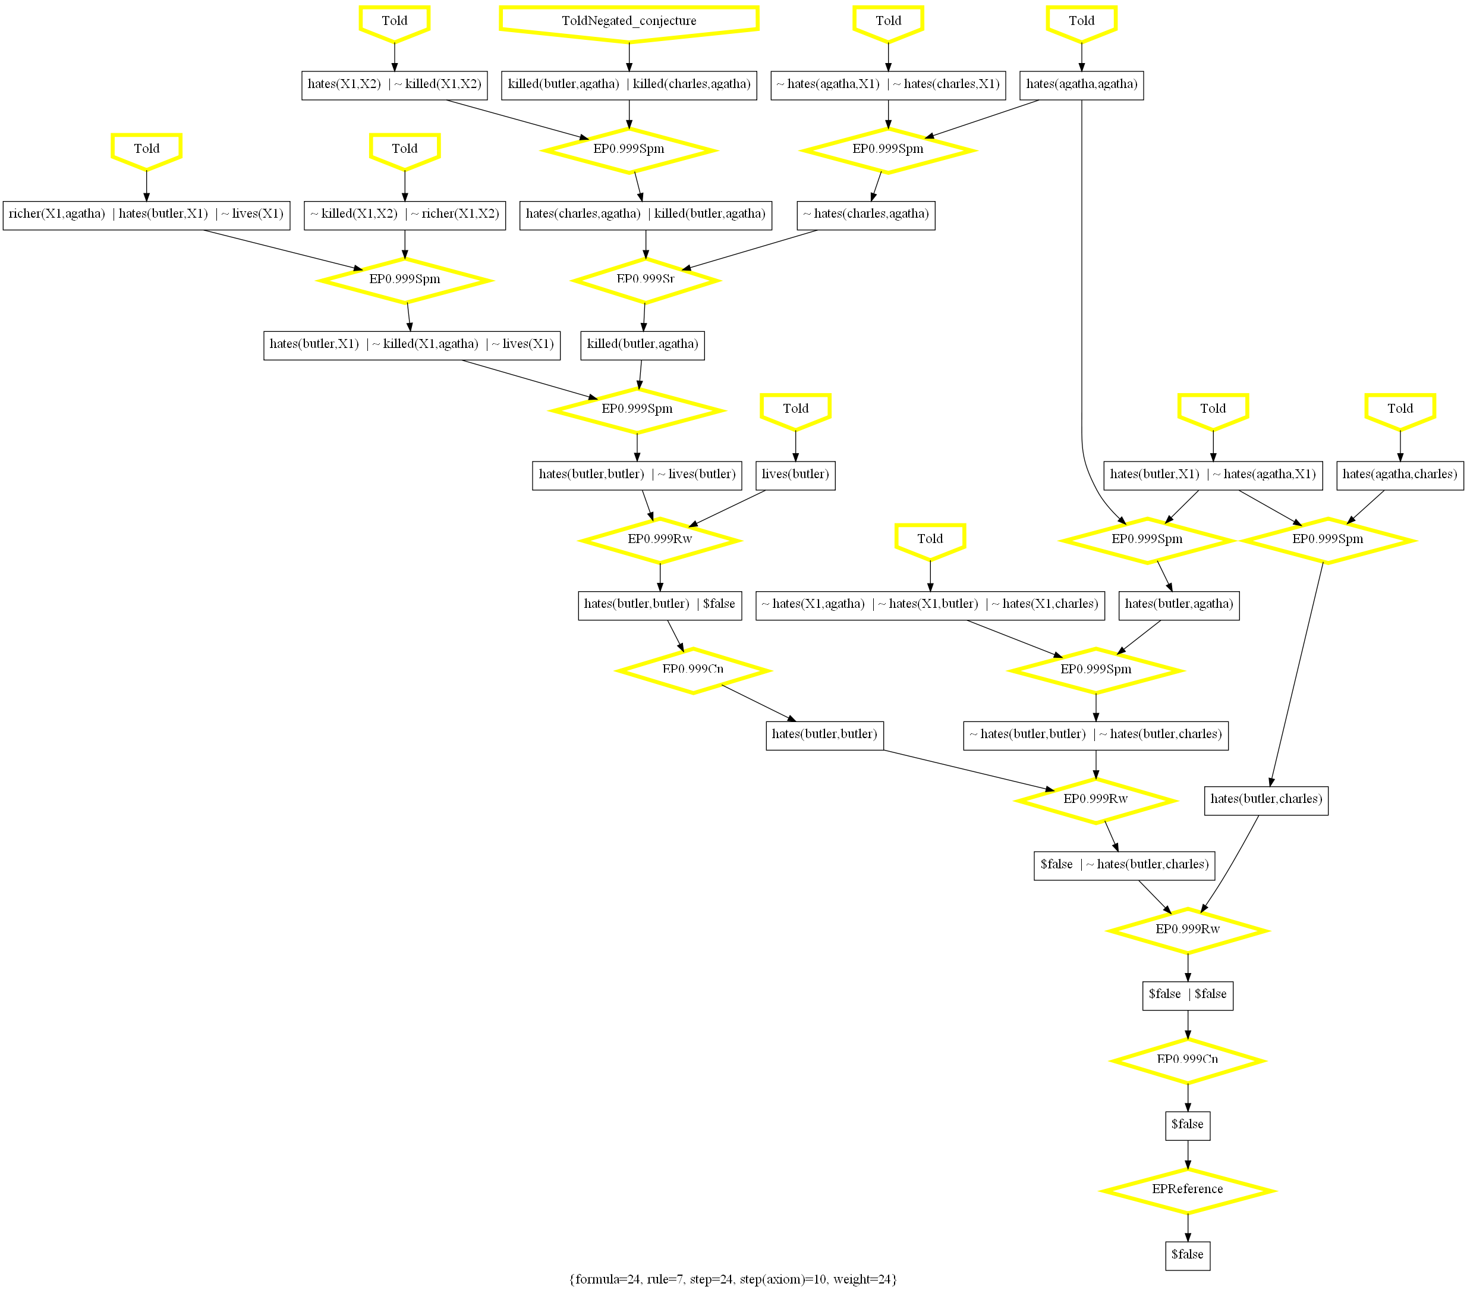
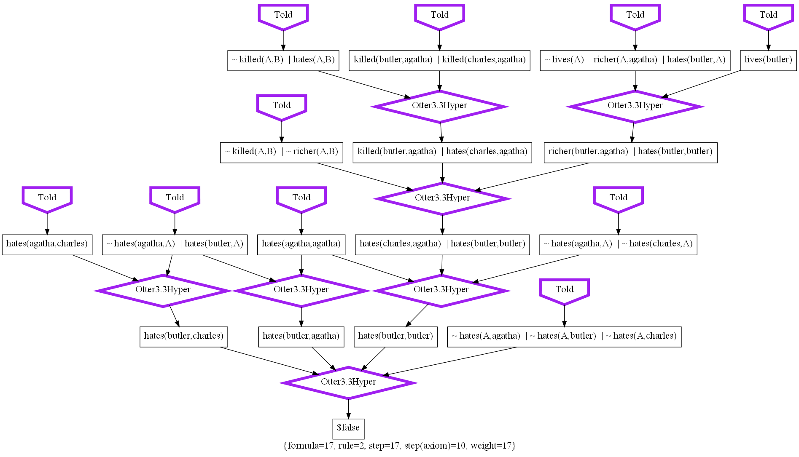

Slide 12
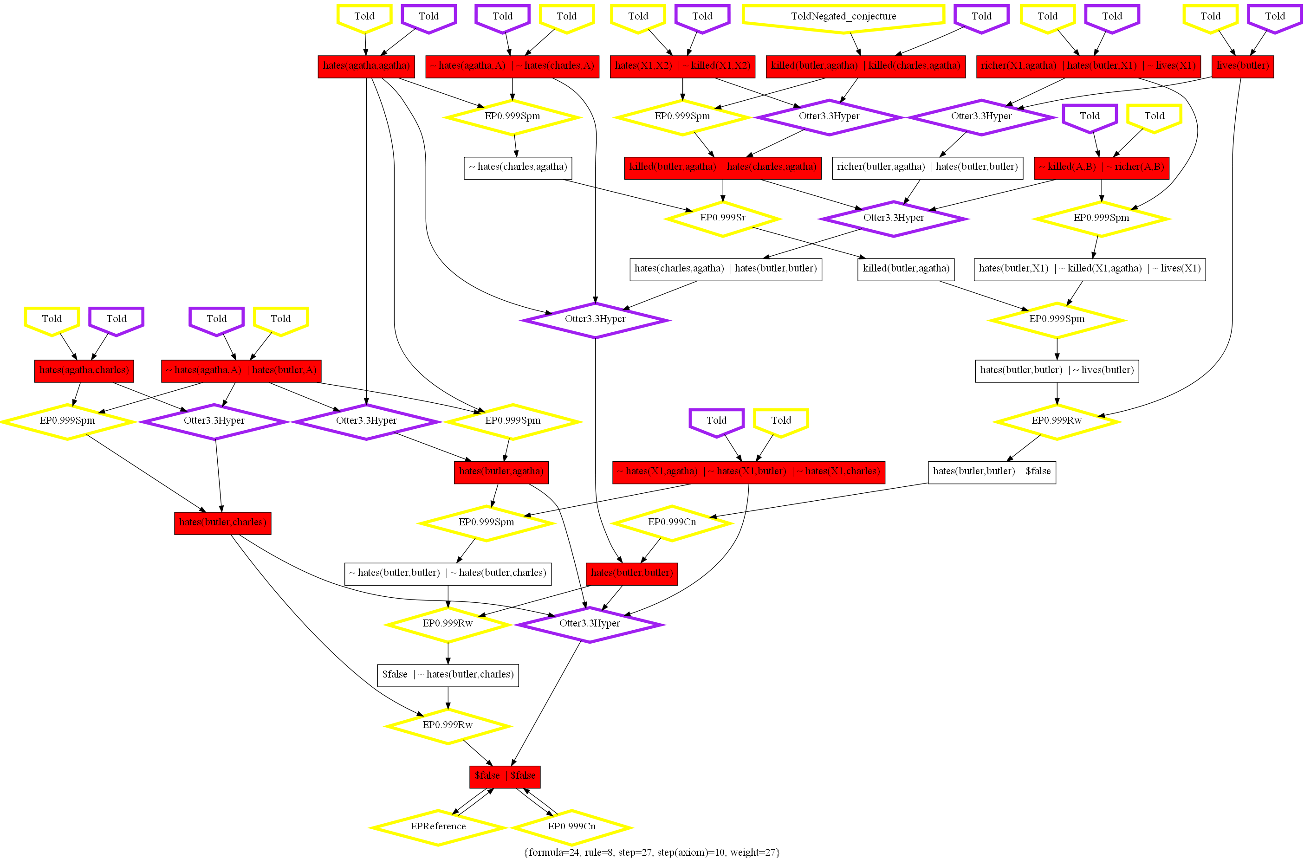
Example Linked justification

Slide 13
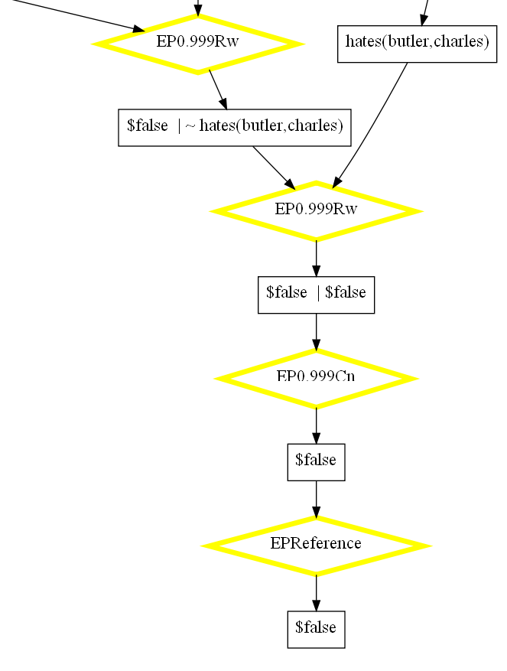
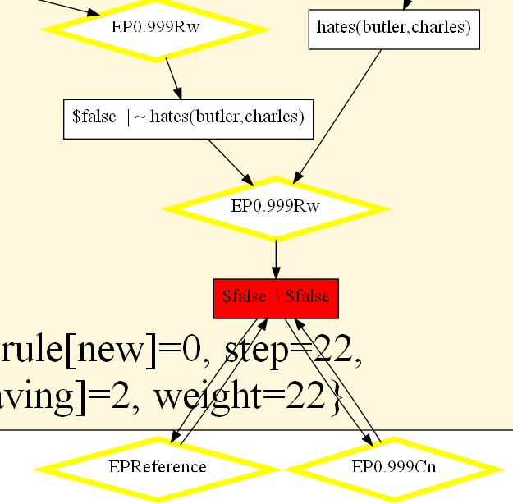
Self-Improve

Slide 15
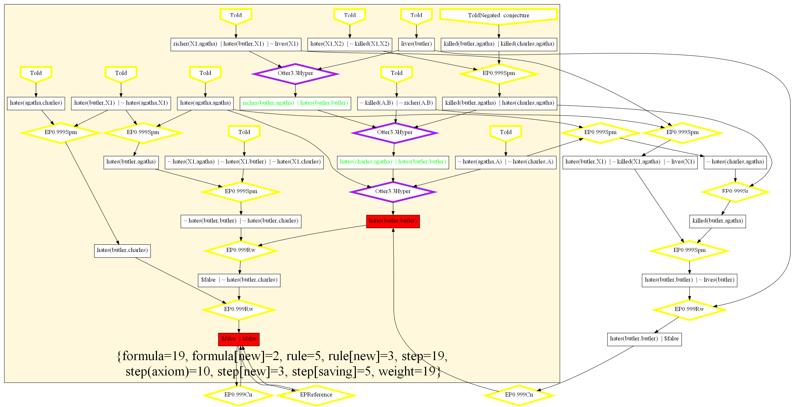
Improve
Less steps
New formula
hybird

Slide 16
Some statistics

Slide 18
G(dbpedia:Virginia)
G(Freebase:Virginia)
address
address
#George Mason
#Virginia1
#Virginia2
reference
reference
G(dbpedia:Fairfax_County_
Board_of_Supervisors)
G(dbpedia:Fairfax_County
%2C_Virginia)
G(Freebase:fairfax_county)
address
address
address
#Fairfax_County3
#Fairfax_County1
#Fairfax_County2

Slide 19
G(dbpedia:Virginia)
G(Freebase:Virginia)
address
address
#George Mason
#Virginia1
reference
reference
G(dbpedia:Fairfax_County_
Board_of_Supervisors)
G(dbpedia:Fairfax_County
%2C_Virginia)
G(Freebase:fairfax_county)
address
address
address
#Fairfax_County1

Slide 20
s4
E
C
D
s3
s2
B
s1
A
s5
s6

Slide 21
Directed Hypergraph Representation
English Interpretation
A,B,C,D,E are statements.
s1 ~s6 are steps in justification j1
A was derived by s1 from B,C,D
B was derived by s2 from E
B was alternatively derived by s3 from C,D
E,C,D were directly derived by s4,s5,s6 respectively
s4~s6 are terminal
Hyper-graph syntax
Directed Hypergraph
j1
vertex
A
Hyperarc
s1
AND
B
OR
s2
s3
E
C
D
s4
s5
s6
Notes:
Syntax: (id, head-list, tail-list, weight, source-list)
CSV syntax
"s1","A","B,C,D","0","j1"
"s2","B","E,C","0","j1"
"s3","B","C,D","0","j1"
"s4","E","","1","j1"
"s5","C","","1","j1"
"s6","D","","1","j1"

Slide 22
General Problem Context
Justifications (or proofs) generated by different reasoners may derive semantically equivalent intermediate/final conclusions; therefore,
We can combine existing justifications into an AND-OR graph (encoded as a hypergraph)
We can search the AND-OR graph for a “better” solution graph which is a combination of justification fragments
j1
j2
j3
j4
j5
A
B
B
A
A
s1
s2
s3
s1
s1
B
B
B
C
D
E
C
D
+ + = =>
s3
s4
s2
s3
s4
s5
s6
s7
s8
s9
combine
Search
C
D
B is derived from E
E is asserted
E
C
D
A is derived from B, C, D
B,C,D are asserted
B is derived from C,D
C,D are asserted
s7
s5
s8
s6
s9
s5
s6
legend
Linked justifications rooted at A
P4 is created by linking p1,p2 and p3
A is derived from B,C,D
C,D are asserted
B
vertex hyperarc is conclusion of has antecedent
s3

Slide 23
General Problem Context
j1
j2
j3
j4
j5
A
B
B
A
A
s1
s2
s3
s1
s1
B
B
B
C
D
E
C
D
+ + = =>
s3
s4
s2
s3
s4
s5
s6
s7
s8
s9
combine
Search
C
D
B is derived from E
E is asserted
E
C
D
A is derived from B, C, D
B,C,D are asserted
B is derived from C,D
C,D are asserted
s7
s5
s8
s6
s9
s5
s6
legend
Linked justifications rooted at A
P4 is created by linking p1,p2 and p3
A is derived from B,C,D
C,D are asserted
B
vertex hyperarc is conclusion of has antecedent
s3

Slide 24
Directed HyperGraph Formalism
A justification is encoded by an annotated directed hypergraph H(V, A, C):
V={v1,v2…vn}, set of vertex – a vertex denotes a unique formula
A={a1,a2,…am}, set of hyperarc – a hyperarc denotes a step in justification
C: context data
Source – a hyperarc may come from multiple sources
Weight – each hyperarc has a weight for optimization purpose
Notations
Hyperarc ai ∈ A(H)
output(ai) ⊆ V(H), formula derived as conclusions, OR?
input(ai) ⊆ V(H), formula used as antecedents, AND
Vertex vi ∈ V(H)
Inlink(vi) ⊆ A(H), hyperarcs having vi as tail
Outlink(vi) ⊆ A(H) , hyperarcs having vi as head
Hyergraph -H
A(H) = ∪ ai where ai ∈ H
V(H) = ∪ vi where vi ∈ H
Output(H)= ∪ output(ai) where ai ∈ A(H)
Input(H) = ∪ Input(ai) where ai ∈ A(H)
Roots(H) = Output(H) – Input(H)
Hyperpath – p={v1,a1,v2,a2,..vn} , a path in hypergraph
Vi ∈ input(ai)
Vi+1 ∈ output(ai)
Notes:
EQ: V X V, tracks asserted equivalent semantics on V
S, semantic annotation functions
m_source: A X V->P(URI), tracks provenance of hyperarc
m_condition: A -> {sufficient, necessary}
SA is a collection of semantic annotation functions

Slide 25
More Definitions
A hyperpath p is cyclic iff. p ends at its starting vertex, i.e. p = {V1, …Vn, An, V1}
A hypergraph H(X,A,C) is
concise iff. No two steps derives the same statement i.e. output(ai) ∩ output(aj) = ∅ ∀ai,aj ∈A, i ≠j
complete iff. Every statement has justification i.e. Input(H) ⊆Output(H)
acyclic iff. H has no cyclic hyperpath.
A solution graph Hs(X’,A’,C’) for v of a hypergraph H w.r.t. vertex v is
A subgraph of H i.e. A’⊆ A
Rooted at vertex v i.e. Roots(Hs)={v}
Concise
Complete
Acyclic
Weighted directed hypergraph
Each hyperedge has a numeric weight, weight(ai)
The weight of a directed hypergraph weight(H) = ∑ weight (ai) ai ∈A

Slide 26
The “Search” Problem
Given a weighted directed hypergraph H(X,A,C) and a starting vertex v, find the optimal solution graph H’(X’,A’,C’) rooted at v.
Optimal – minimal weight
Discussion
Search space is huge, could be exponential
Similar to AO* search, which assumes Tree instead of DAG

Slide 27
Example1: AO* Search does not work Find minimal (weight) solution graph
j0 is the input
j1 is AO* Search result
j2 is the optimal result
j0
j1
j2
A
A
A
s1
s1
s1
B
B
B
s2
s3
s2
s3
s2
s3
E
C
D
E
C
D
E
C
D
s4
s5
s6
s4
s5
s6
s4
s5
s6
Assign each hyperarc weight 1
AO* does not consider shared hyperarc
j0
j1
j2
A
A
5
A
4
1
s1
s1
5
s1
4
B
2
?
B
B
1
s2
1
s3
s2
2
s3
3
s2
2
s3
3
E
C
D
E
C
D
E
C
D
1
s4
1
s5
1
s6
s4
s5
s6
s4
s5
s6

Slide 28
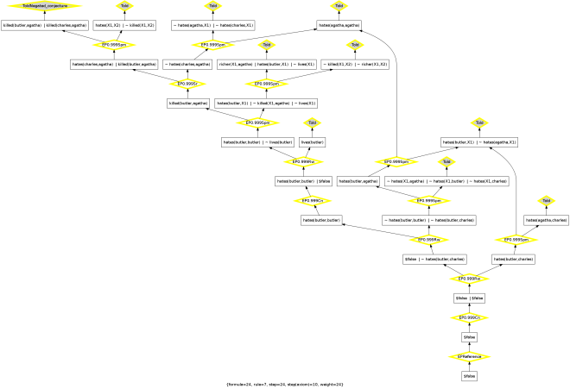
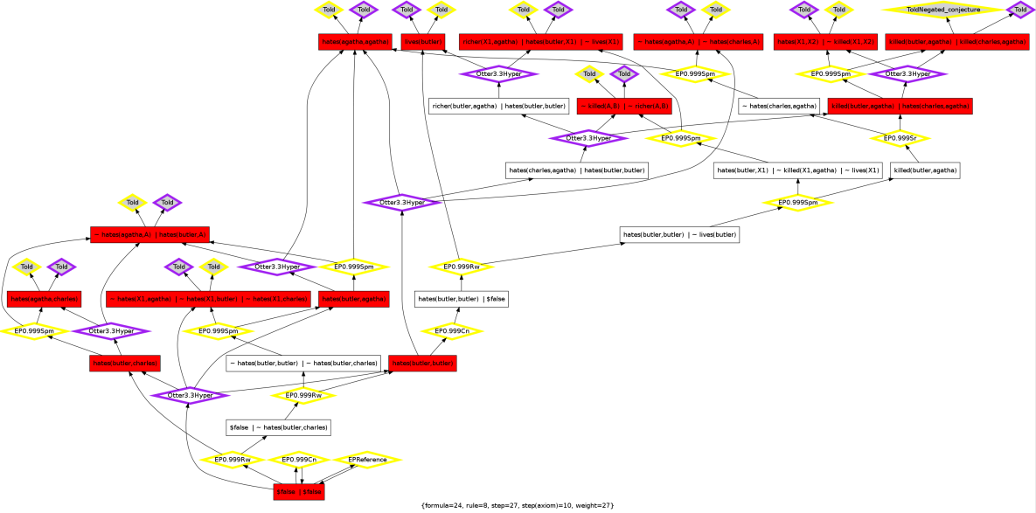
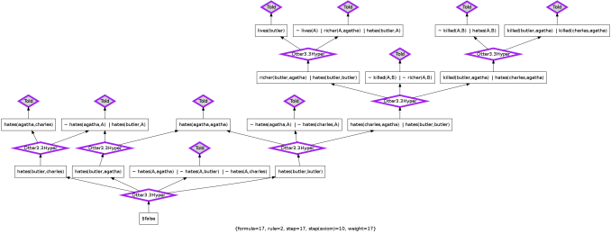
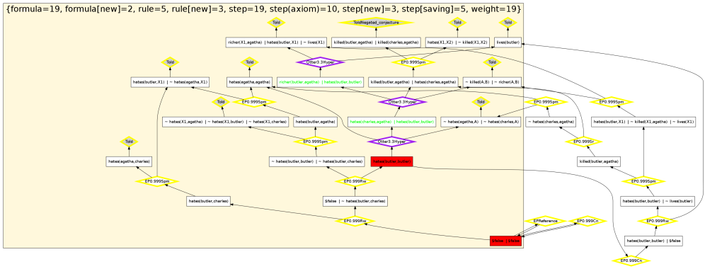
Example2: Combine & Improve Proof

Slide 29
Architecture
Proofs
(tptp)
visualize
statistics
diff
translate
map
J1
(pml2)
J2
(pml2)
J_ALL
(pml2)
J_OPT
(pml2)
Mappings
(owl)
hg2pml
combine
H(A,X,C)
(Graph)
H_OPT(A,X,C)
(Graph)
search

Slide 30
Backup

Slide 31
RDF graph syntax
A
output
s1
weight
partOf
0
input
0
B
s3
0
s2
0
j1
C
s4
1
D
s5
1
E
s6
1

Slide 33
A
A → B
A
A → C
Modus Ponens
Modus Ponens
B
B → C
C
Modus Ponens
C

Slide 34
address
Freebase:fairfax_county
same
Freebase:Virginia
dbpedia:Fairfax_County_Board_of_Supervisors
dbpedia:Fairfax_County%2C_Virginia
address
same
dbpedia:Virginia
address
geonames:4758041
rdfabout:fairfax_county
address
geonames:6254928

Slide 35
Freebase:fairfax_county
address
G(Freebase:fairfax_county)
reference
Freebase:Virginia
address
G(Freebase:Virginia)
dbpedia:Fairfax_County%2C_Virginia
address
G(dbpedia:Fairfax_County%2C_Virginia)
reference
dbpedia:Virginia
address
G(dbpedia:Virginia)
dbpedia:Fairfax_County_Board_of_Supervisors
address
G(dbpedia:Fairfax_County_Board_of_Supervisors)

Slide 36
G(dbpedia:Virginia)
G(Freebase:Virginia)
address
address
#George Mason
#Virginia
reference
reference
G(dbpedia:Fairfax_County_
Board_of_Supervisors)
G(dbpedia:Fairfax_County
%2C_Virginia)
G(Freebase:fairfax_county)
address
address
address
#Fairfax_County

Slide 38
http://www.rdfabout.com/rdf/usgov/geo/us/va/counties/fairfax_county
population818584
http://dbpedia.org/resource/Fairfax_County%2C_Virginia
dbpedia-owl:populationTotal 1077000
http://sws.geonames.org/4758041/about.rdf
Population818584
http://sws.geonames.org/6254928/about.rdf
Population7642884
parent FeatureVirginia

Slide 39
g2
g3
address
address
uri2
same
uri3
parse
g1

Slide 40
g2
g3
address
address
g1

Slide 41
Hypergraph Notation
A
output
s1
D
input
A
s1
B
s3
s2
C
s2
B
s3
C
legend
E
B
vertex
hyperarc
output
input
D
s3
E
(a) directed hypergraph
(b) directed bipartite graph

Slide 42
Hypergraph Notation
A
output
s1
D
input
A
s1
B
s3
s2
C
s2
B
C
s4
s3
E
D
s5
E
s6
legend
B
vertex hyperarc output input
s3
(a) directed hypergraph
(b) directed bipartite graph
legend
B
vertex
hyperarc
output
input
s3

