Slide 1
R – a brief introduction
Gilberto Câmara

Slide 2
Original material
Johannes Freudenberg
  Cincinnati Children’s Hospital Medical Center
Marcel Baumgartner
  Nestec S.A.
Jaeyong Lee
  Penn State University
Jennifer Urbano Blackford, Ph.D
  Department of Psychiatry, Kennedy Center
Wolfgang Huber

Slide 3
History of R
Statistical programming language S developed at Bell Labs since 1976 (at the same time as UNIX)
Intended to interactively support research and data analysis projects
Exclusively licensed to Insightful (“S-Plus”)
R: Open source platform similar to S developed by R. Gentleman and R. Ihaka (U of Auckland, NZ) during the 1990s
Since 1997: international “R-core” developing team
Updated versions available every couple months

Slide 4
What R is and what it is not
R is
  a programming language
  a statistical package
  an interpreter
  Open Source
R is not
  a database
  a collection of “black boxes”
  a spreadsheet software package
  commercially supported

Slide 5
What R is
data handling and storage: numeric, textual
matrix algebra
hash tables and regular expressions
high-level data analytic and statistical functions
classes (“OO”)
graphics
programming language: loops, branching, subroutines

Slide 6
What R is not
is not a database, but connects to DBMSs
has no click-point user interfaces, but connects to Java, TclTk
language interpreter can be very slow, but allows to call own C/C++ code
no spreadsheet view of data, but connects to Excel/MsOffice
no professional /commercial support

Slide 7
R and statistics
Packaging: a crucial infrastructure to efficiently produce, load and keep consistent software libraries from (many) different sources / authors
Statistics: most packages deal with statistics and data analysis
State of the art: many statistical researchers provide their methods as R packages

Slide 8
Getting started
To obtain and install R on your computer
  Go to http://cran.r-project.org/mirrors.html to choose a mirror near you
  Click on your favorite operating system (Linux, Mac, or Windows)
  Download and install the “base”
To install additional packages
  Start R on your computer
  Choose the appropriate item from the “Packages” menu

Slide 9
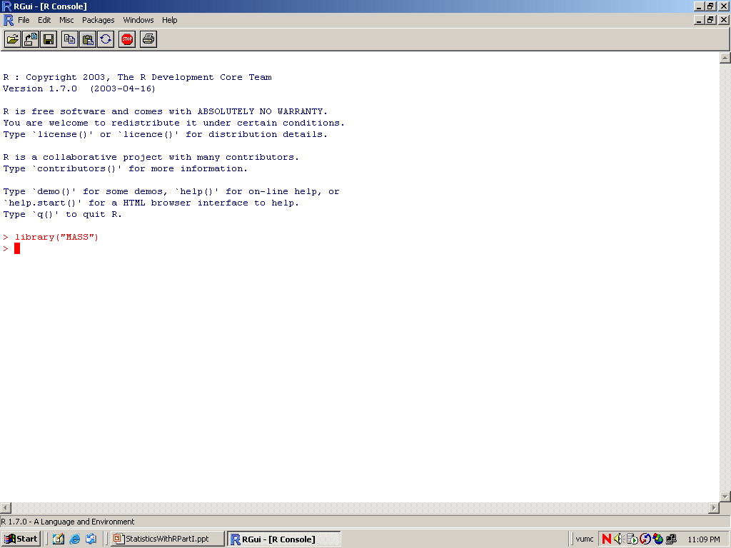

Slide 10
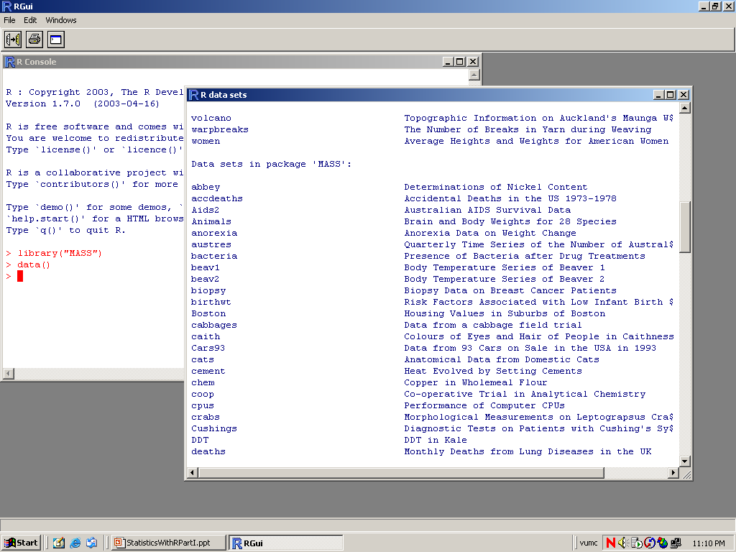

Slide 11
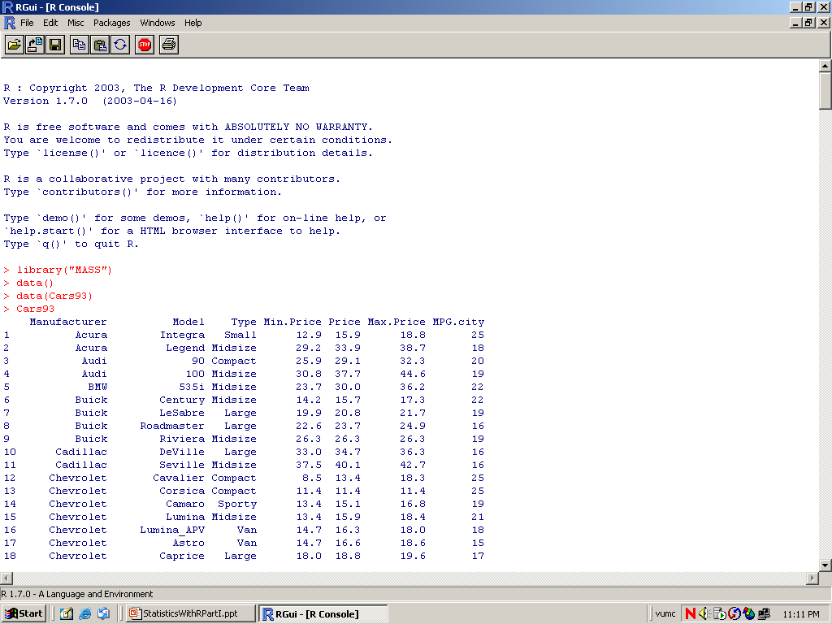

Slide 12
R: session management
Your R objects are stored in a workspace
To list the objects in your workspace: > ls()
To remove objects you no longer need:
> rm(weight, height, bmi)
To remove ALL objects in your workspace:
> rm(list=ls()) or use Remove all objects in the Misc menu
To save your workspace to a file, you may type
> save.image() or use Save Workspace… in the File menu
The default workspace file is called .RData

Slide 13
Basic data types

Slide 14
Objects
names
types of objects: vector, factor, array, matrix, data.frame, ts, list
attributes
  mode: numeric, character, complex, logical
  length: number of elements in object
creation
  assign a value
  create a blank object

Slide 15
Naming Convention
must start with a letter (A-Z or a-z)
can contain letters, digits (0-9), and/or periods “.”
case-sensitive
  mydata different from MyData
do not use use underscore “_”

Slide 16
Assignment
“<-” used to indicate assignment
x<-c(1,2,3,4,5,6,7)
x<-c(1:7)
x<-1:4
note: as of version 1.4 “=“ is also a valid assignment operator

Slide 17
R as a calculator
> 5 + (6 + 7) * pi^2
[1] 133.3049
> log(exp(1))
[1] 1
> log(1000, 10)
[1] 3
> sin(pi/3)^2 + cos(pi/3)^2
[1] 1
> Sin(pi/3)^2 + cos(pi/3)^2
Error: couldn't find function "Sin"

Slide 18
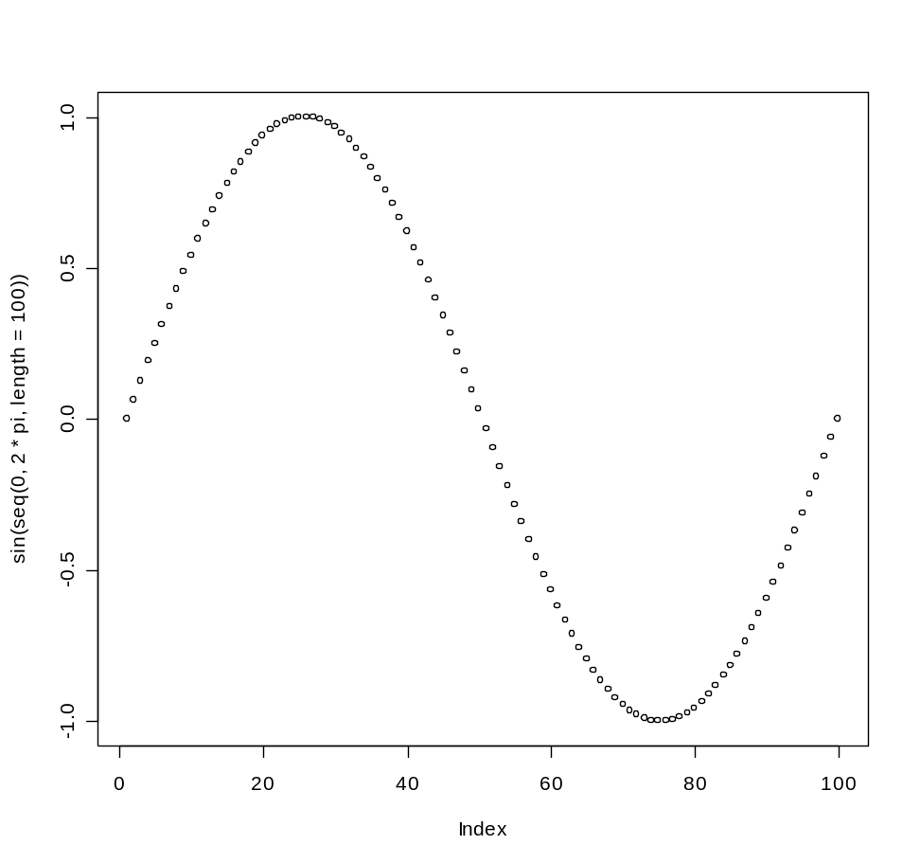
R as a calculator
> log2(32)
[1] 5
> sqrt(2)
[1] 1.414214
> seq(0, 5, length=6)
[1] 0 1 2 3 4 5
> plot(sin(seq(0, 2*pi, length=100)))

Slide 19
Basic (atomic) data types
Logical
> x <- T; y <- F
> x; y
[1] TRUE
[1] FALSE
Numerical
> a <- 5; b <- sqrt(2)
> a; b
[1] 5
[1] 1.414214
Character
> a <- "1"; b <- 1
> a; b
[1] "1"
[1] 1
> a <- "character"
> b <- "a"; c <- a
> a; b; c
[1] "character"
[1] "a"
[1] "character"

Slide 20
Vectors, Matrices, Arrays
Vector
  Ordered collection of data of the same data type
  Example:
    last names of all students in this class
    Mean intensities of all genes on an oligonucleotide microarray
  In R, single number is a vector of length 1
Matrix
  Rectangular table of data of the same type
  Example
    Mean intensities of all genes measured during a microarray experiment
Array
  Higher dimensional matrix

Slide 21
Vectors
Vector: Ordered collection of data of the same data type
> x <- c(5.2, 1.7, 6.3)
> log(x)
[1] 1.6486586 0.5306283 1.8405496
> y <- 1:5
> z <- seq(1, 1.4, by = 0.1)
> y + z
[1] 2.0 3.1 4.2 5.3 6.4
> length(y)
[1] 5
> mean(y + z)
[1] 4.2

Slide 22
Vecteurs
> Mydata <- c(2,3.5,-0.2) Vector (c=“concatenate”)
> Colors <-
c("Red","Green","Red") Character vector
> x1 <- 25:30
> x1
[1] 25 26 27 28 29 30 Number sequences
> Colors[2]
[1] "Green" One element
> x1[3:5]
[1] 27 28 29 Various elements

Slide 23
Operation on vector elements
> Mydata
[1] 2 3.5 -0.2
> Mydata > 0
[1] TRUE TRUE FALSE
> Mydata[Mydata>0]
[1] 2 3.5
> Mydata[-c(1,3)]
[1] 3.5
Test on the elements
Extract the positive elements
Remove elements

Slide 24
Vector operations
> x <- c(5,-2,3,-7)
> y <- c(1,2,3,4)*10 Operation on all the elements
> y
[1] 10 20 30 40
> sort(x) Sorting a vector
[1] -7 -2 3 5
> order(x)
[1] 4 2 3 1 Element order for sorting
> y[order(x)]
[1] 40 20 30 10 Operation on all the components
> rev(x) Reverse a vector
[1] -7 3 -2 5

Slide 25
Matrices
Matrix: Rectangular table of data of the same type
> m <- matrix(1:12, 4, byrow = T); m
[,1] [,2] [,3]
[1,] 1 2 3
[2,] 4 5 6
[3,] 7 8 9
[4,] 10 11 12
> y <- -1:2
> m.new <- m + y
> t(m.new)
[,1] [,2] [,3] [,4]
[1,] 0 4 8 12
[2,] 1 5 9 13
[3,] 2 6 10 14
> dim(m)
[1] 4 3
> dim(t(m.new))
[1] 3 4

Slide 26
Matrices
Matrix: Rectangular table of data of the same type
> x <- c(3,-1,2,0,-3,6)
> x.mat <- matrix(x,ncol=2) Matrix with 2 cols
> x.mat
[,1] [,2]
[1,] 3 0
[2,] -1 -3
[3,] 2 6
> x.mat <- matrix(x,ncol=2,
byrow=T) By row creation
> x.mat
[,1] [,2]
[1,] 3 -1
[2,] 2 0
[3,] -3 6

Slide 27
Dealing with matrices
> x.mat[,2] 2nd col
[1] -1 0 6
> x.mat[c(1,3),] 1st and 3rd lines
[,1] [,2]
[1,] 3 -1
[2,] -3 6
> x.mat[-2,] No 2nd line
[,1] [,2]
[1,] 3 -1
[2,] -3 6

Slide 28
Dealing with matrices
> dim(x.mat) Dimension
[1] 3 2
> t(x.mat) Transpose
[,1] [,2] [,3]
[1,] 3 2 -3
[2,] -1 0 6
> x.mat %*% t(x.mat) Multiplication
[,1] [,2] [,3]
[1,] 10 6 -15
[2,] 6 4 -6
[3,] -15 -6 45
> solve() Inverse of a square matrix
> eigen() Eigenvectors and eigenvalues

Slide 29
Missing values
R is designed to handle statistical data and therefore predestined to deal with missing values
Numbers that are “not available”
> x <- c(1, 2, 3, NA)
> x + 3
[1] 4 5 6 NA
“Not a number”
> log(c(0, 1, 2))
[1] -Inf 0.0000000 0.6931472
> 0/0
[1] NaN

Slide 30
Subsetting
It is often necessary to extract a subset of a vector or matrix
R offers a couple of neat ways to do that
> x <- c("a", "b", "c", "d", "e", "f", "g", "h")
> x[1]
> x[3:5]
> x[-(3:5)]
> x[c(T, F, T, F, T, F, T, F)]
> x[x <= "d"]
> m[,2]
> m[3,]

Slide 31
Lists, data frames, and factors

Slide 32
Lists
vector: an ordered collection of data of the same type.
> a = c(7,5,1)
> a[2]
[1] 5
list: an ordered collection of data of arbitrary types.
> doe = list(name="john",age=28,married=F)
> doe$name
[1] "john“
> doe$age
[1] 28
Typically, vector elements are accessed by their index (an integer), list elements by their name (a character string). But both types support both access methods.

Slide 33
Lists 1
A list is an object consisting of objects called components.
The components of a list don’t need to be of the same mode or type and they can be a numeric vector, a logical value and a function and so on.
A component of a list can be referred as aa[[I]] or aa$times, where aa is the name of the list and times is a name of a component of aa.

Slide 34
Lists 2
The names of components may be abbreviated down to the minimum number of letters needed to identify them uniquely.
aa[[1]] is the first component of aa, while aa[1] is the sublist consisting of the first component of aa only.
There are functions whose return value is a List. We have seen some of them, eigen, svd, …

Slide 35
Lists are very flexible
> my.list <- list(c(5,4,-1),c("X1","X2","X3"))
> my.list
[[1]]:
[1] 5 4 -1
[[2]]:
[1] "X1" "X2" "X3"
> my.list[[1]]
[1] 5 4 -1
> my.list <- list(c1=c(5,4,-1),c2=c("X1","X2","X3"))
> my.list$c2[2:3]
[1] "X2" "X3"

Slide 36
Lists: Session
Empl <- list(employee=“Anna”, spouse=“Fred”, children=3, child.ages=c(4,7,9))
Empl[[4]]
Empl$child.a
Empl[4] # a sublist consisting of the 4th component of Empl
names(Empl) <- letters[1:4]
Empl <- c(Empl, service=8)
unlist(Empl) # converts it to a vector. Mixed types will be converted to character, giving a character vector.

Slide 37
More lists
> x.mat
[,1] [,2]
[1,] 3 -1
[2,] 2 0
[3,] -3 6
> dimnames(x.mat) <- list(c("L1","L2","L3"),
c("R1","R2"))
> x.mat
R1 R2
L1 3 -1
L2 2 0
L3 -3 6

Slide 38
Data frames
data frame: represents a spreadsheet.
Rectangular table with rows and columns; data within each column has the same type (e.g. number, text, logical), but different columns may have different types.
Example:
> cw = chickwts
> cw
weight feed
1 179 horsebean
11 309 linseed
23 243 soybean
37 423 sunflower
...

Slide 39
Data Frames 1
A data frame is a list with class “data.frame”. There are restrictions on lists that may be made into data frames.
a. The components must be vectors (numeric, character, or logical), factors, numeric matrices, lists, or other data frames.
b. Matrices, lists, and data frames provide as many variables to the new data frame as they have columns, elements, or variables, respectively.
c. Numeric vectors and factors are included as is, and non-numeric vectors are coerced to be factors, whose levels are the unique values appearing in the vector.
d. Vector structures appearing as variables of the data frame must all have the same length, and matrix structures must all have the same row size.

Slide 40
Subsetting
Individual elements of a vector, matrix, array or data frame are accessed with “[ ]” by specifying their index, or their name
> cw = chickwts
> cw
weight feed
1 179 horsebean
11 309 linseed
23 243 soybean
37 423 sunflower
...
> cw [3,2]
[1] horsebean
6 Levels: casein horsebean linseed ... sunflower
> cw [3,]
weight feed
3 136 horsebean

Slide 41
Subsetting in data frames
an = Animals
an
body brain
Mountain beaver 1.350 8.1
Cow 465.000 423.0
Grey wolf 36.330 119.5
> an [3,]
body brain
Grey wolf 36.33 119.5

Slide 42
Labels in data frames
> labels (an)
[[1]]
[1] "Mountain beaver" "Cow"
[3] "Grey wolf" "Goat"
[5] "Guinea pig" "Dipliodocus"
[7] "Asian elephant" "Donkey"
[9] "Horse" "Potar monkey"
[11] "Cat" "Giraffe"
[13] "Gorilla" "Human"
[15] "African elephant" "Triceratops"
[17] "Rhesus monkey" "Kangaroo"
[19] "Golden hamster" "Mouse"
[21] "Rabbit" "Sheep"
[23] "Jaguar" "Chimpanzee"
[25] "Rat" "Brachiosaurus"
[27] "Mole" "Pig"
[[2]]
[1] "body" "brain"

Slide 43
Control structures and functions

Slide 44
Grouped expressions in R
x = 1:9
if (length(x) <= 10)
{
x <- c(x,10:20);
print(x)
}
else
{
print(x[1])
}

Slide 45
Loops in R
>for(i in 1:10) {
x[i] <- rnorm(1)
}
j = 1
while( j < 10) {
print(j)
j <- j + 2
}

Slide 46
Functions
Functions do things with data
  “Input”: function arguments (0,1,2,…)
  “Output”: function result (exactly one)
Example:
add = function(a,b)
{ result = a+b
return(result) }
Operators:
Short-cut writing for frequently used functions of one or two arguments.
Examples: + - * / ! & | %%

Slide 47
General Form of Functions
function(arguments) {
expression
}
larger <- function(x,y) {
if(any(x < 0)) return(NA)
y.is.bigger <- y > x
x[y.is.bigger] <- y[y.is.bigger]
x
}

Slide 48
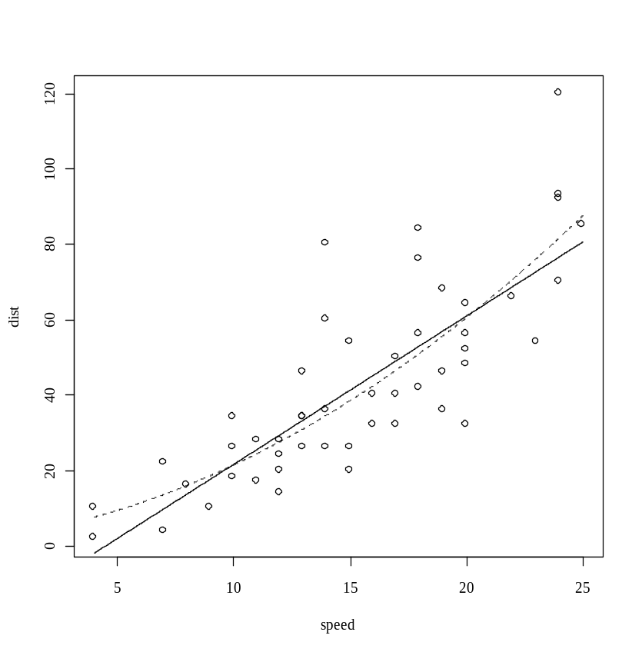
Functions inside functions
> attach(cars)
> plot(speed,dist)
> x <- seq(min(speed),max(speed),length=1000)
> newdata=data.frame(speed=x)))
> lines(x,predict(lm(dist~speed),newdata))
> rm(x) ; detach()

Slide 49
If you are in doubt...
> help (predict)
'predict' is a generic function for predictions from the results
of various model fitting functions.
> help (predict.lm)
'predict.lm' produces predicted values, obtained by evaluating the
regression function in the frame 'newdata'
> predict(lm(dist~speed),newdata)

Slide 50
Calling Conventions for Functions
Arguments may be specified in the same order in which they occur in function definition, in which case the values are supplied in order.
Arguments may be specified as name=value, when the order in which the arguments appear is irrelevant.
Above two rules can be mixed.
> t.test(x1, y1, var.equal=F, conf.level=.99)
> t.test(var.equal=F, conf.level=.99, x1, y1)

Slide 51
Missing Arguments
R function can handle missing arguments two ways:
either by providing a default expression in the argument list of definition, or
by testing explicitly for missing arguments.

Slide 52
Missing Arguments in Functions
> add <- function(x,y=0){x + y}
> add(4)
> add <- function(x,y){
if(missing(y)) x
else x+y
}
> add(4)

Slide 53
Variable Number of Arguments
The special argument name “…” in the function definition will match any number of arguments in the call.
nargs() returns the number of arguments in the current call.

Slide 54
Variable Number of Arguments
> mean.of.all <- function(…) mean(c(…))
> mean.of.all(1:10,20:100,12:14)
> mean.of.means <- function(…)
{
means <- numeric()
for(x in list(…)) means <- c(means,mean(x))
mean(means)
}

Slide 55
Variable Number of Arguments
mean.of.means <- function(…)
{
n <- nargs()
means <- numeric(n)
all.x <- list(…)
for(j in 1:n) means[j] <- mean(all.x[[j]])
mean(means)
}
mean.of.means(1:10,10:100)

Slide 56
Useful functions
> seq(2,12,by=2)
[1] 2 4 6 8 10 12
> seq(4,5,length=5)
[1] 4.00 4.25 4.50 4.75 5.00
> rep(4,10)
[1] 4 4 4 4 4 4 4 4 4 4
> paste("V",1:5,sep="")
[1] "V1" "V2" "V3" "V4" "V5"
> LETTERS[1:7]
[1] "A" "B" "C" "D" "E" "F" "G"

Slide 57
Mathematical operation
Opérations usuelles : + - * /
Puissances: 2^5 ou bien 2**5
Divisions entières: %/%
Modulus: %% (7%%5 gives 2)
Fonctions standards: abs(), sign(), log(), log10(), sqrt(),
exp(), sin(), cos(), tan()
gamma(), lgamma(), choose()
Pour arrondir: round(x,3) arrondi à 3 chiffres après la virgule
Et aussi: floor(2.5) donne 2, ceiling(2.5) donne 3

Slide 58
Vector functions
> vec <- c(5,4,6,11,14,19)
> sum(vec)
[1] 59
> prod(vec)
[1] 351120
> mean(vec)
[1] 9.833333
> median(vec)
[1] 8.5
> var(vec)
[1] 34.96667
> sd(vec)
[1] 5.913262
> summary(vec)
Min. 1st Qu. Median Mean 3rd Qu. Max.
4.000 5.250 8.500 9.833 13.250 19.000
And also: min() max()
cummin() cummax()
range()

Slide 59
Des fonctions logiques
R contient deux valeurs logiques: TRUE (ou T) et FALSE (ou F).
Exemple:
> 3 == 4
[1] FALSE
> 4 > 3
[1] TRUE
> x <- -4:3
> x > 1
[1] FALSE FALSE FALSE FALSE FALSE FALSE TRUE TRUE
> sum(x[x>1])
[1] 5
> sum(x>1)
[1] 2
== exactement égal
< plus petit
> plus grand
<= plus petit ou égal
>= plus grand ou égal
!= différent
& “et” (“and”)
| “ou” (“or”)
Notez la différence !

Slide 60
Graphics in R

Slide 61
Plot()
If x and y are vectors, plot(x,y) produces a scatterplot of x against y.
plot(x) produces a time series plot if x is a numeric vector or time series object.
plot(df), plot(~ expr), plot(y ~ expr), where df is a data frame, y is any object, expr is a list of object names separated by `+' (e.g. a + b + c).
The first two forms produce distributional plots of the variables in a data frame (first form) or of a number of named objects (second form). The third form plots y against every object named in expr.

Slide 62
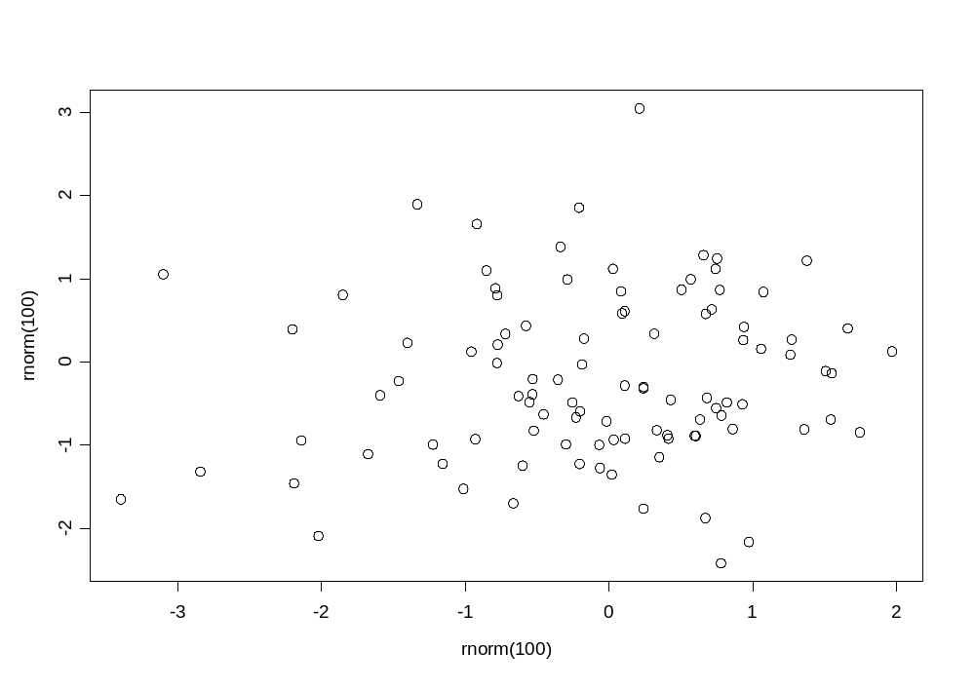
Graphics with plot()
> plot(rnorm(100),rnorm(100))
The function rnorm()
Simulates a random normal distribution .
Help ?rnorm,
and ?runif,
?rexp,
?binom, ...

Slide 63
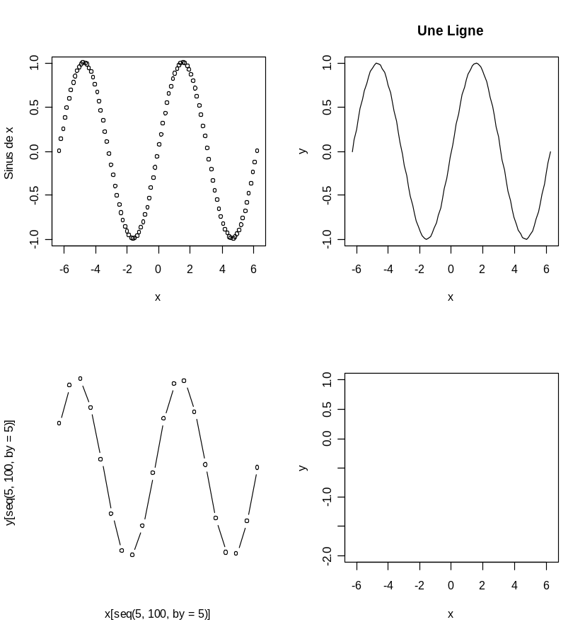
Graphics with plot()
> x <- seq(-2*pi,2*pi,length=100)
> y <- sin(x)
> par(mfrow=c(2,2))
> plot(x,y,xlab="x”,
ylab="Sin x")
> plot(x,y,type= "l",
main=“A Line")
> plot(x[seq(5,100,by=5)],
y[seq(5,100,by=5)],
type= "b",axes=F)
> plot(x,y,type="n",
ylim=c(-2,1)
> par(mfrow=c(1,1))

Slide 64
Graphical Parameters of plot()
type = “c”: c =p (default), l, b,s,o,h,n.
pch=“+” : character or numbers 1 – 18
lty=1 : numbers
lwd=2 : numbers
axes = “L”: L= F, T
xlab =“string”, ylab=“string”
sub = “string”, main =“string”
xlim = c(lo,hi), ylim= c(lo,hi)
And some more.

Slide 65
Graphical Parameters of plot()
x <- 1:10
y <- 2*x + rnorm(10,0,1)
plot(x,y,type=“p”) #Try l,b,s,o,h,n
# axes=T, F
# xlab=“age”, ylab=“weight”
# sub=“sub title”, main=“main title”
# xlim=c(0,12), ylim=c(-1,12)

Slide 66
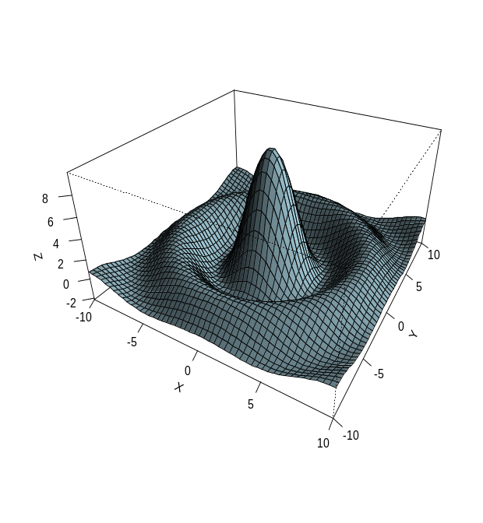
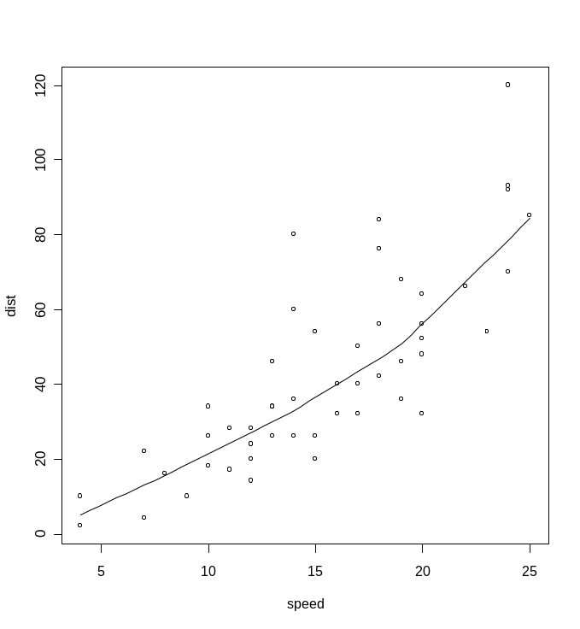
Other graphical functions
See also:
barplot()
image()
hist()
pairs()
persp()
piechart()
polygon()
library(modreg)
scatter.smooth()

Slide 67
Interactive Graphics Functions
locator(n,type=“p”) :Waits for the user to select locations on the current plot using the left mouse button. This continues until n (default 500) points have been selected.
identify(x, y, labels) : Allow the user to highlight any of the points defined by x and y.
text(x,y,”Hey”): Write text at coordinate x,y.

Slide 68
Plots for Multivariate Data
pairs(stack.x)
x <- 1:20/20
y <- 1:20/20
z <- outer(x,y,function(a,b){cos(10*a*b)/(1+a*b^2)})
contour(x,y,z)
persp(x,y,z)
image(x,y,z)

Slide 69
Other graphical functions
> axis(1,at=c(2,4,5), Axis details (“ticks”, légende, …)
legend("A","B","C")) Use xaxt="n" ou yaxt="n" inside plot()
> lines(x,y,…) Line plots
> abline(lsfit(x,y)) Add an adjustment
> abline(0,1) add a line of slope 1 and intercept 0
> legend(locator(1),…) Legends: very flexible

Slide 70
Histogram
A histogram is a special kind of bar plot
It allows you to visualize the distribution of values for a numerical variable
When drawn with a density scale:
  the AREA (NOT height) of each bar is the proportion of observations in the interval
  the TOTAL AREA is 100% (or 1)

Slide 71
R: making a histogram
Type ?hist to view the help file
  Note some important arguments, esp breaks
Simulate some data, make histograms varying the number of bars (also called ‘bins’ or ‘cells’), e.g.
  > par(mfrow=c(2,2)) # set up multiple plots
  > simdata <-rchisq(100,8)
  > hist(simdata) # default number of bins
  > hist(simdata,breaks=2) # etc,4,20

Slide 72
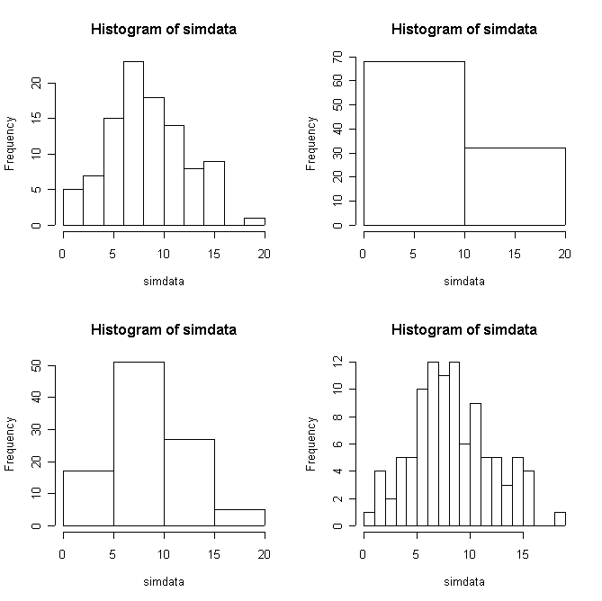

Slide 73
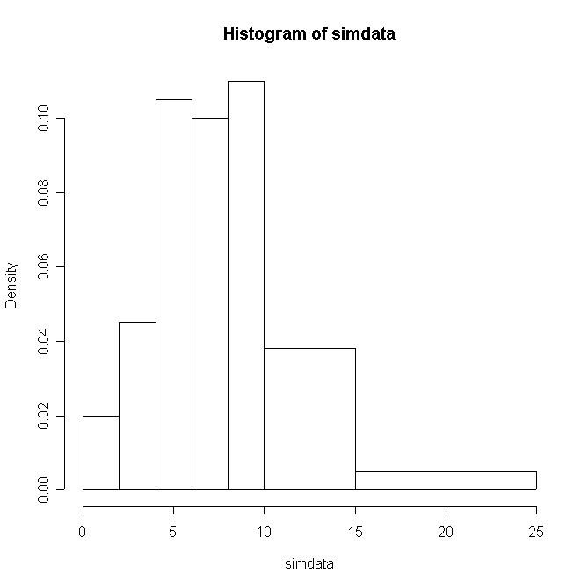
R: setting your own breakpoints
  > bps <- c(0,2,4,6,8,10,15,25)
  > hist(simdata,breaks=bps)

Slide 74
Scatterplot
A scatterplot is a standard two-dimensional (X,Y) plot
Used to examine the relationship between two (continuous) variables
It is often useful to plot values for a single variable against the order or time the values were obtained

Slide 75
R: making a scatterplot
Type ?plot to view the help file
  For now we will focus on simple plots, but R allows extensive user control for highly customized plots
Simulate a bivariate data set:
  > z1 <- rnorm(50)
  > z2 <- rnorm(50)
  > rho <- .75 # (or any number between –1 and 1)
  > x2<- rho*z1+sqrt(1-rho^2)*z2
  > plot(z1,x2)

Slide 76
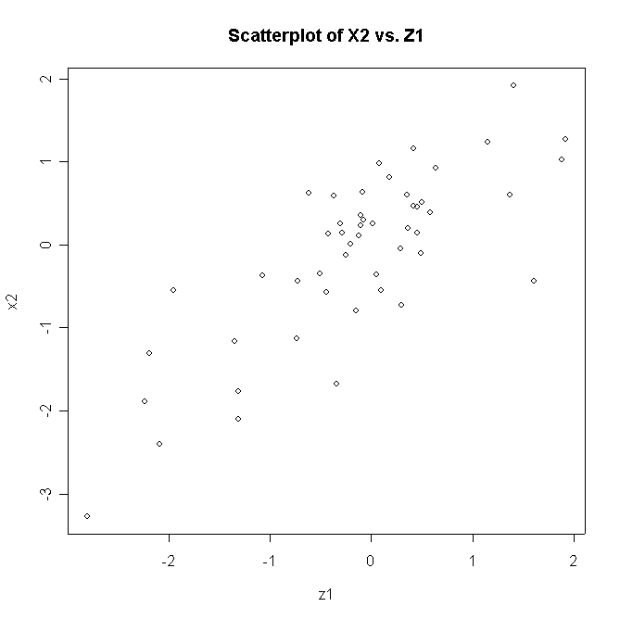

Slide 77
Statistical functions

Slide 78
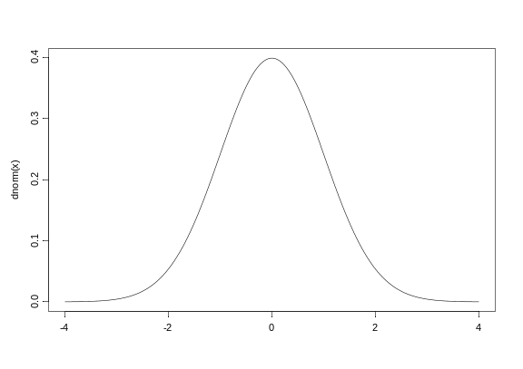
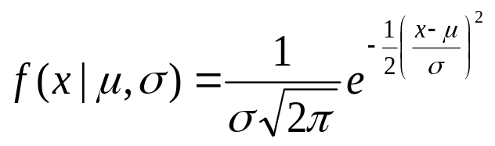
Lots of statistical functions
Normal distr
> dnorm(2,mean=1,sd=2) PDF in point 2
[1] 0.1760327 for X ~ N(1,4)
> qnorm(0.975) Quantile for
[1] 1.959964 the 0.975 for N~ (0,1)
> pnorm(c(2,3),mean=2) = P(X<2) and P(X<3), where X ~ N(2,1)
[1] 0.5000000 0.8413447
> norm.alea <- rnorm(1000) Pseudo-random normally distributed numbers
> summary(norm.alea)
Min. 1st Qu. Median Mean 3rd Qu. Max.
-3.418 -0.6625 -0.0429 -0.01797 0.6377 3.153
> sd(norm.alea)
[1] 0.9881418

Slide 79
How to remember functions
For a normal distribution, the root is norm. Then add the letters
d density ( dnorm() )
p probability( pnorm() )
q quantiles ( qnorm() )
r pseudo-random ( rnorm() )
Distribution Root Argument
normal norm mean, sd, log
t (Student) t df, log
uniform unif min, max, log
F (Fisher) f df1, df2
^{χ2} chisq df, ncp, log
Binomial binom size, prob, log
exponential exp rate, log
Poisson pois lambda, log
...

Slide 80
Hypotheses tests
t.test()
  Student (test t), determines if the averages of two populations are statistically different.
prop.test()
hypothesis tests with proportions
Non-parametrical tests
kruskal.test() Kruskal-Wallis test (variance analysis)
chisq.test() χ² test for convergence
ks.test() Kolmogorov-Smirnov test
...

Slide 81
Statistical models

Slide 82
Linear regression: lsfit() et lm()
lsfit() adjusment of regression models
Example – inclination of the Pisa tower
> year <- 75:87
> inclin <- c(642,644,656,667,673,688,
696,698,713,717,725,742,757)
> plot(year,inclin)
> pisa.lsfit <- lsfit(year,inclin)
> ls.print(pise.lsfit)
Residual Standard Error=4.181
R-Square=0.988
F-statistic (df=1, 11)=904.1198
p-value=0
Estimate Std.Err t-value Pr(>|t|)
Intercept -61.1209 25.1298 -2.4322 0.0333
X 9.3187 0.3099 30.0686 0.0000
> abline(pisa.lsfit)
642 corresponds to
2.9642m, the distance of a point from its current position
and a vertical tower

Slide 83
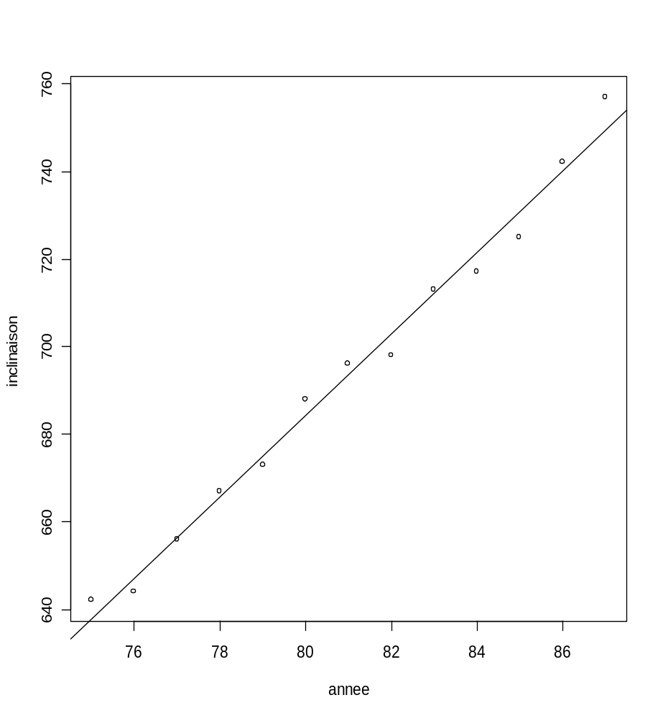
Data and models for Pisa tower

Slide 84
Using lm() instead of lsfit()
> pisa.lm <- lm(inclin ~ year)
> pisa.lm
> summary(pisa.lm)
Call:
lm(formula = inclin ~ year)
Residuals:
Min 1Q Median 3Q Max
-5.9670 -3.0989 0.6703 2.3077 7.3956
Coefficients:
Estimate Std. Error t value Pr(>|t|)
(Intercept) -61.1209 25.1298 -2.432 0.0333 *
year 9.3187 0.3099 30.069 6.5e-12 ***
---
Signif. codes: 0 `***' 0.001 `**' 0.01 `*' 0.05 `.' 0.1 ` ' 1
Residual standard error: 4.181 on 11 degrees of freedom
Multiple R-Squared: 0.988, Adjusted R-squared: 0.9869
F-statistic: 904.1 on 1 and 11 DF, p-value: 6.503e-012

Slide 85
Generic functions ...
> residuals(pisa.lm)
1 2 3 4 ...
4.21978 -3.098901 -0.4175824 1.263736 ...
> fitted(pise.lm)
1 2 3 4 ...
637.7802 647.0989 656.4176 665.7363 ...
> coef(pise.lm)
(Intercept) annee
-61.12088 9.318681
> par(mfrow=c(2,3))
> plot(pise.lm) #cf. prochaine page

Slide 86
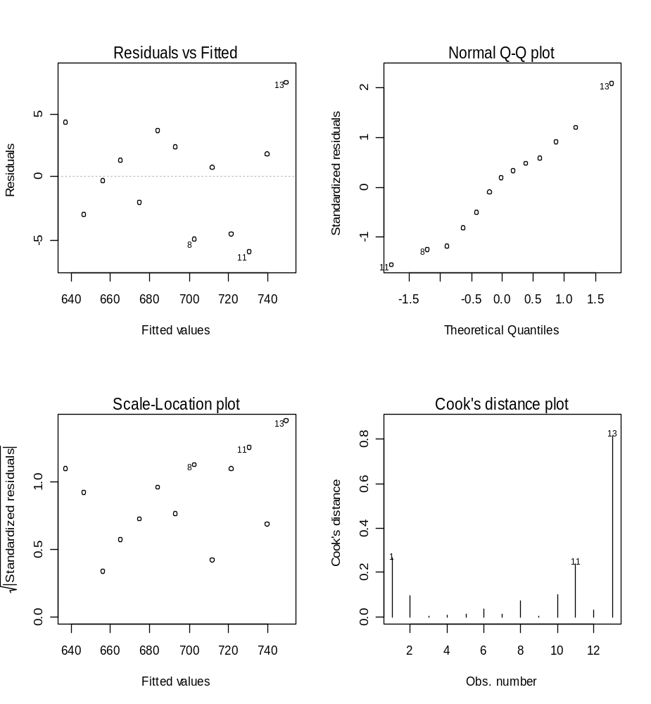
Diagnostics

Slide 87
Multiple regression
> wheat <- data.frame(yield=c(210,110,103,103,1,76,73,70,68,53,45,31),
temp=c(16.7,17.4,18.4,16.8,18.9,17.1,17.3,
18.2,21.3,21.2,20.7,18.5),
sunexp=c(30,42,47,47,43,41,48,44,43,50,56,60))
> wheat.lm <- lm(yield~temp+sunexp,
data=wheat)
> summary(wheat.lm,cor=F)
Residuals:
Min 1Q Median 3Q Max
-85.733 -11.117 6.411 16.476 53.375
Coefficients:
Estimate Std. Error t value Pr(>|t|)
(Intercept) 420.660 131.292 3.204 0.0108 *
temperature -8.840 7.731 -1.143 0.2824
ensoleillement -3.880 1.704 -2.277 0.0488 *
---
Signif. codes: 0 `***' 0.001 `**' 0.01 `*' 0.05 `.' 0.1 ` ' 1
...

Slide 88
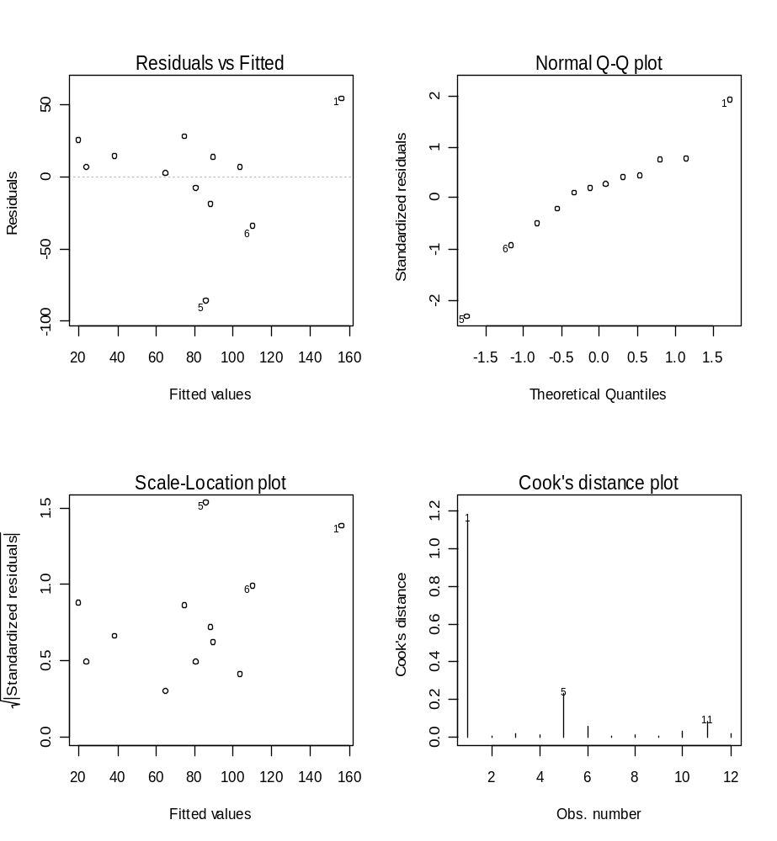
Multiple regression diagnostics
> par(mfrow=c(2,2))
> plot(ble.lm)

Slide 89
Hash tables

Slide 90
hash tables
In vectors, lists, dataframes, arrays, elements are stored one after another, and are accessed in that order by their offset (or: index), which is an integer number.
Sometimes, consecutive integer numbers are not the “natural” way to access: e.g., gene names, oligo sequences
E.g., if we want to look for a particular gene name in a long list or data frame with tens of thousands of genes, the linear search may be very slow.
Solution: instead of list, use a hash table. It sorts, stores and accesses its elements in a way similar to a telephone book.

Slide 91
hash tables
In R, a hash table is the same as a workspace for variables, which is the same as an environment.
> tab = new.env(hash=T)
> assign("btk", list(cloneid=682638,
fullname="Bruton agammaglobulinemia tyrosine kinase"), env=tab)
> ls(env=tab)
[1] "btk"
> get("btk", env=tab)
$cloneid
[1] 682638
$fullname
[1] "Bruton agammaglobulinemia tyrosine kinase"

Slide 92
Object orientation

Slide 93
Object orientation
.
primitive (or: atomic) data types in R are:
numeric (integer, double, complex)
character
logical
function
out of these, vectors, arrays, lists can be built

Slide 94
Object orientation
Object: a collection of atomic variables and/or other objects that belong together
Example: a microarray experiment
  probe intensities
  patient data (tissue location, diagnosis, follow-up)
  gene data (sequence, IDs, annotation)
Parlance:
  class: the “abstract” definition of it
  object: a concrete instance
  method: other word for ‘function’
  slot: a component of an object

Slide 95
Object orientation advantages
Encapsulation (can use the objects and methods someone else has written without having to care about the internals)
Generic functions (e.g. plot, print)
Inheritance (hierarchical organization of complexity)

Slide 96
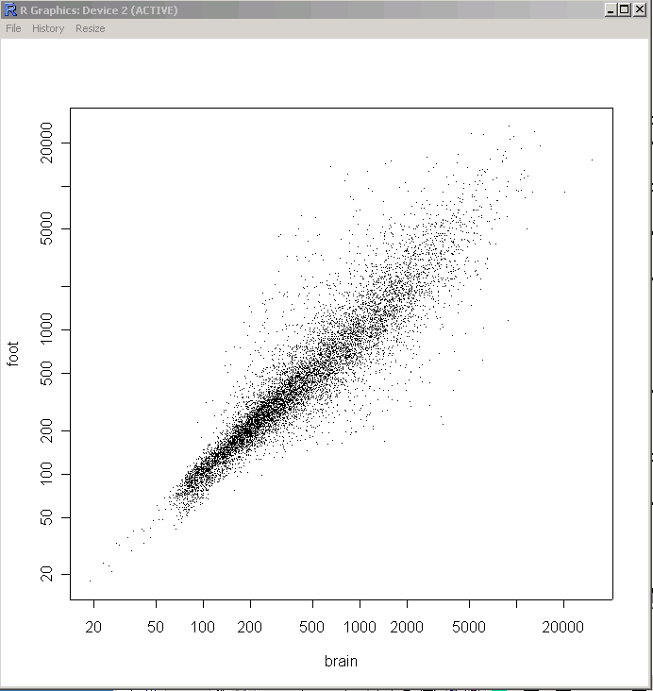
Object orientation
library('methods')
setClass('microarray', ## the class definition
representation( ## its slots
qua = 'matrix',
samples = 'character',
probes = 'vector'),
prototype = list( ## and default values
qua = matrix(nrow=0, ncol=0),
samples = character(0),
probes = character(0)))
dat = read.delim('../data/alizadeh/lc7b017rex.DAT')
z = cbind(dat$CH1I, dat$CH2I)
setMethod('plot', ## overload generic function ‘plot’
signature(x='microarray'), ## for this new class
function(x, ...)
plot(x@qua, xlab=x@samples[1], ylab=x@samples[2], pch='.', log='xy'))
ma = new('microarray', ## instantiate (construct)
qua = z,
samples = c('brain','foot'))
plot(ma)

Slide 97
Object orientation in R
The plot(pisa.lm) command is different from
plot(year,inclin) .
plot(pise.lm)
R recognizes that pisa.lm is a “lm” object.
Uses plot.lm() .
Most R functions are object-oriented.
For more details see ?methods and ?class

Slide 98
Importing/Exporting Data
Importing data
  R can import data from other applications
  Packages are available to import microarray data, Excel spreadsheets etc.
  The easiest way is to import tab delimited files
  > my.data<-read.table("file",sep=",") *⁾
  > SimpleData <- read.table(file = "http://eh3.uc.edu/SimpleData.txt", header = TRUE, quote = "", sep = "\t", comment.char="")
Exporting data
  R can also export data in various formats
  Tab delimited is the most common
  > write.table(x, "filename") *⁾
*⁾ make sure to include the path or
to first change the working directory

Slide 99
Getting help… and quitting
Getting information about a specific command
> help(rnorm)
> ?rnorm
Finding functions related to a key word
> help.search("boxplot")
Starting the R installation help pages
> help.start()
Quitting R
> q()

Slide 100
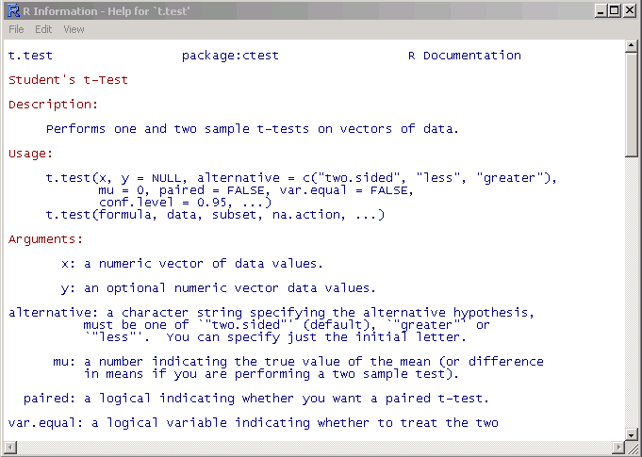
Getting help
Details about a specific command whose name you know (input arguments, options, algorithm, results):
>? t.test
or
>help(t.test)

Slide 101
Resources
Books
  Assigned text book
  For an extended list visit http://www.r-project.org/doc/bib/R-publications.html
Mailing lists
  R-help
  (http://www.r-project.org/mail.html)
  Bioconductor (http://www.bioconductor.org/mailList.html)
  However, first
    read the posting guide/ general instructions and
    search archives
Online documentation
  R Project documentation (http://www.r-project.org/)
    Manuals
    FAQs
    …
  Bioconductor documentation (http://www.bioconductor.org/)
    Vignettes
    Short Courses
    …
  Google

