Slide 1

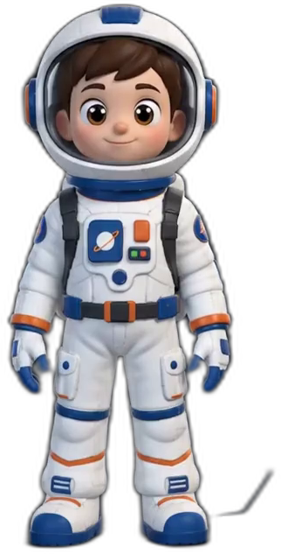

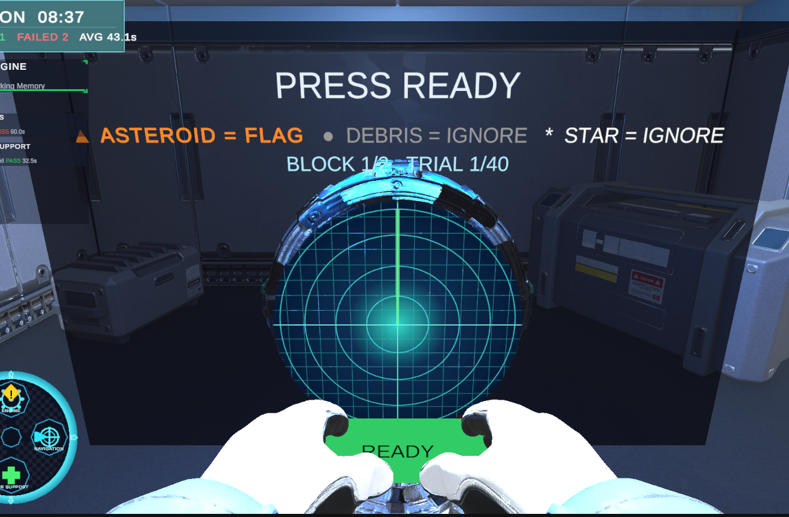
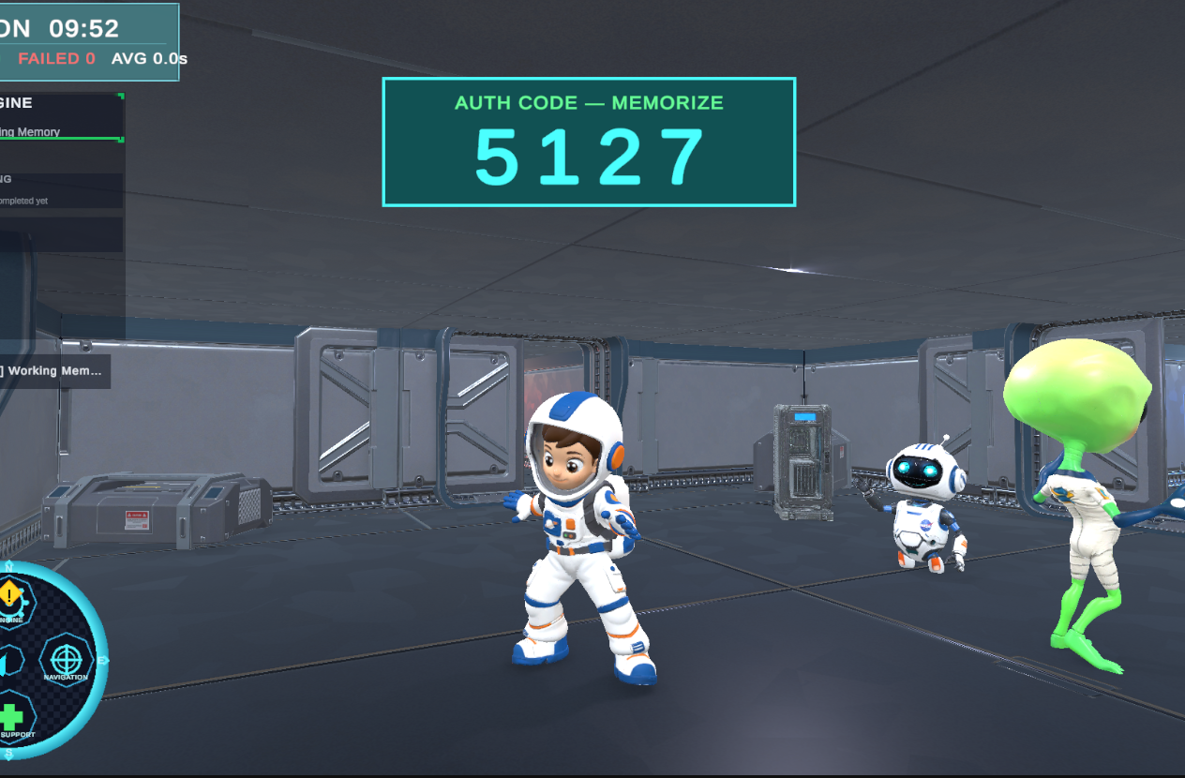
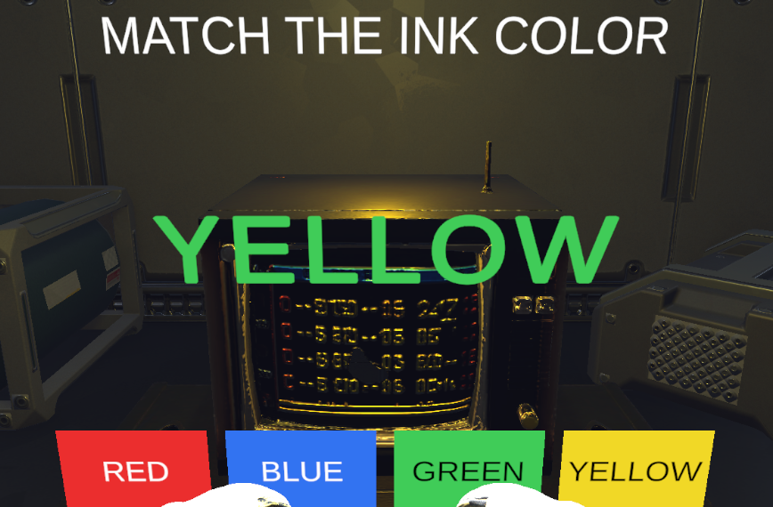
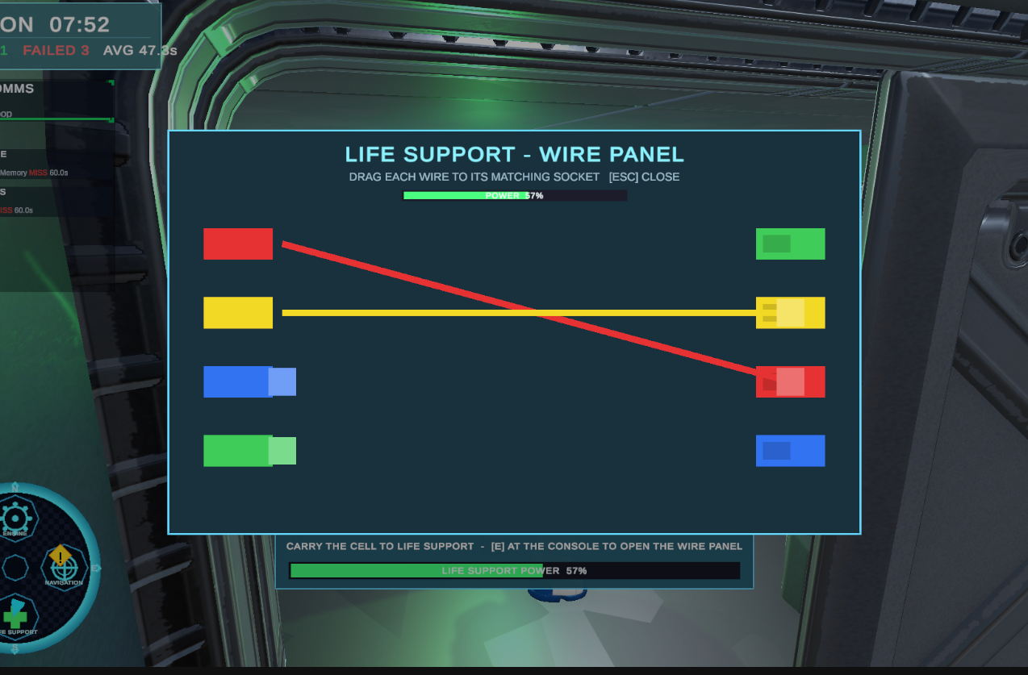

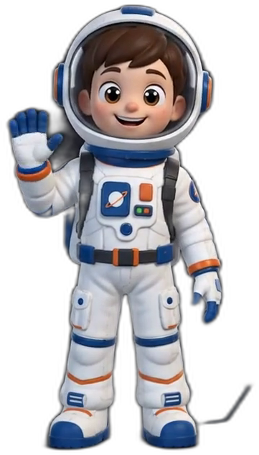
CAPSTONE PROJECT — PHASE B
TEAM 26-1-D-17
MISSION FOCUS
A SPACE-STATION COGNITIVE ASSESSMENT GAME FOR ADHD
Lidor Ben Hamo & Yahli Rapaport
Advisor: Dr. Moshe Sulamy · Department of Software Engineering & Information Systems
01 BACKGROUND & NEED
05 PLAYABLE COGNITIVE TASKS
06 TECH STACK
Executive-function assessment still relies on questionnaires (BRIEF-A) and traditional lab-style tests:
Unity 6 + URP — 3D spaceship mission
◆ Stressful & repetitive — scores may reflect motivation, not true ability
◆ Low engagement, especially for young users
◆ Subjective ratings — no objective behavioral data
C# — gameplay, tasks & data logging
HTML + CSV — assessor report outputs
The need: measurement that is objective, repeatable — and actually fun to take.
GitHub — version control & collaboration
02 THE SOLUTION
RADAR SCAN SUSTAINED ATTENTION · INHIBITION
AI Tools — voice-over and 3D asset support
Mission Focus turns assessment into a 10-minute spaceship mission.
Measures: Hits · False alarms · d′ sensitivity
Instead of asking the participant to describe behavior after the fact, the game observes behavior while it happens.
07 DESIGN CHALLENGES
◆ More engaging — the player completes a mission, not a dry test
◆ Objective measurement — reactions, errors, choices and timing are logged automatically
◆ More realistic behavior — the player handles tasks, distractions and priorities inside one dynamic environment
◆ Assessor-ready output — the session becomes an executive-function profile + CSV
01 Fun vs. valid data — the mission feels playful, while console tasks stay precisely timed
02 Invisible measurement — the player focuses on the game while behavior is logged silently
03 Modular task design — new cognitive tasks can be added without rebuilding the system
04 3D asset integration — AI-generated props needed Unity cleanup and adaptation
CODE RECALL WORKING MEMORY
Why it works: the player feels inside a mission, while the system quietly turns behavior into measurable data.
Measures: Recall accuracy · Typos · Timeout
03 CORE CAPABILITIES
08 THE ASSESSOR REPORT
✓ Playable 10-minute mission — game-based, not a quiz
✓ Measures key executive functions — attention, memory, inhibition & planning
✓ Logs behavior automatically — reactions, errors, choices and timing
✓ Generates assessor outputs — HTML report + CSV
✓ Keeps data local — privacy by design
Every mission ends with a clear, auto-generated profile — pass/fail per cognitive domain, plus a CSV with ~26 raw metrics for research.
EXECUTIVE FUNCTION REPORT
AUTO-GENERATED
6
5
83%
TASKS
PASSED
ACCURACY
INHIBIT
PASS
STROOP CONSOLE INHIBITION
Stroop console · 100% accuracy · RT 1563 ms
WORKING MEMORY
PASS
Measures: RT mean/SD · Commissions · Post-error slowing
Code recall · 0 wrong keys
04 HOW IT WORKS
TASK MONITOR
PASS
1
Participant Onboarding
Radar scan · d′ 3.17 · 0 false alarms
Basic details are entered before the mission
PLAN / ORGANIZE
PASS
2
Interactive Tutorial
Power cell run · delivered on time
The player learns movement and station controls
Sample from a real session — the full HTML report opens in any browser.
3
10-Minute Mission
Tasks appear across 4 stations while the player chooses priorities
FULL CODE & DOCS
4
Background Logging
github.com/ lidorbenhamo26/ Final-Project
Reactions, errors, choices and timing are recorded silently
5
Assessor Report
POWER CELL RUN PLANNING · ORGANIZATION
Executive-function profile + CSV, generated instantly
Measures: Pickup latency · Wiring errors · Completion time
Unity project · project book · demo video
Not a test — a mission that measures.
Ready for launch!
A 10-minute space mission produces an executive-function profile while keeping the player engaged.
Braude College of Engineering, Karmiel ◆ Department of Software Engineering & Information Systems ◆ Capstone Project 61999 — Phase B ◆ 2026

