Slide 1
Inferential Statistics and Probability a Holistic Approach
Chapter 4
Probability
This Course Material by Maurice Geraghty is licensed under a Creative Commons Attribution-ShareAlike 4.0 International License. Conditions for use are shown here: https://creativecommons.org/licenses/by-sa/4.0/

Slide 2
Probability
Classical probability
Based on mathematical formulas
Empirical probability
Based on the relative frequencies of historical data.
Subjective probability
“one-shot” educated guess.

Slide 3
Examples of Probability
What is the probability of rolling a four on a 6-sided die?
What percentage of HAMK students live in Hämeenlinna?
What is the chance that your favorite team will win the championship?

Slide 4
Classical Probability
Outcome
A single result of the experiment in question
Event
A set of outcomes
Can be empty, have one outcome, or several outcomes
Sample Space
The set of all possible outcomes
Probability Event A Occurs - written as P(A)
Number of Outcomes in Event A / Number of Outcomes in Sample Space
Example – flip two coins, find the probability of exactly 1 head.
Sample Space = {HH, HT, TH, TT} A= {HT, TH}
P(A) = 2/4 = 0.50

Slide 5
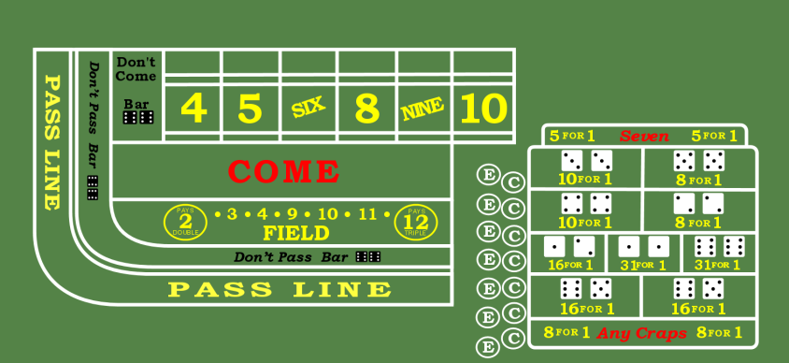
Example – Field Bet in Craps
Field Bet
2 dice are rolled and totaled
Player wins even money on 3, 4, 9, 10, 11,
Player wins double on 2
Player wins triple on 12
Player loses bet on 5, 6, 7, 8
Who has the advantage in this game?

Slide 6
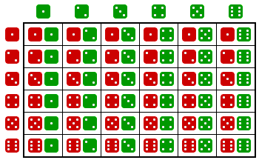
Sample Space 36 possible pairs of rolls

Slide 7
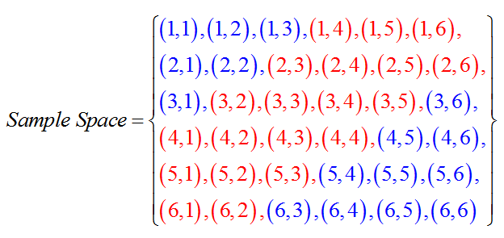
More ways to make 5, 6, 7, 8
P(Win) = 16/36 = 0.444
P(Lose) = 20/36 = 0.556

Slide 8
Empirical Probability
Historical Data
Relative Frequencies
Example: What is the chance someone rates their community as good or better?
0.51 + 0.32 = 0.83

Slide 9
Rule of Complement
Complement of an event A is A’
if A occurs then A’ does not occur (and vice versa)
Then P(A) + P(A’) =1
or also P(A) = 1 – P(A’)
In some cases A is very hard to calculate, but A’ is not
A
A’

Slide 10
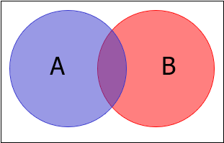
Joint Probability
The UNION of two events A and B is that either A or B occur (or both). (All colored parts)
The INTERSECTION of two events A and B is that both A and B will occur. (Purple Part only)
Additive Rule: P(A or B) = P(A) + P(B) – P(A and B)

Slide 11
Example
In a group of students, 40% are taking Math, 20% are taking History.
10% of students are taking both Math and History.
Find the Probability of a Student taking either Math or History or both.
P(M or H) = 40% + 20% - 10% = 50%

Slide 12
Mutually Exclusive
Mutually Exclusive
Both cannot occur
If A and B are mutually exclusive, then
P(A or B) = P(A) + P(B)
Example roll a die
A: Roll 2 or less B: Roll 5 or more
P(A)=2/6 P(B)=2/6
P(A or B) = P(A) + P(B) = 4/6

Slide 13
Conditional Probability
The probability of an event occuring GIVEN another event has already occurred.
P(A|B) = P(A and B) / P(B)
Example: Of all smart phone users in the US, 21% have an Apple iPhone and AT&T. 35% of all smart phone users have AT&T. Given a selected smart phone user has AT&T, find the probability the user also has an Apple iPhone.
A=AT&T subscriber B=Apple iPhone
P(A and B) = 0.21 P(A)=0.35
P(B|A) = 0.21/0.35 = 0.60

Slide 14
Marginal, Joint and Conditional Probability
Marginal Probability means the probability of a single event occurring.
Joint Probability means the probability of the union or intersection of multiple events occurring (and/or statements).
Conditional Probability means the probability of an event occurring given that another event has already occurred.

Slide 15
Contingency Tables
Two data items can be displayed in a contingency table.
Example: auto accident during year and DUI of driver.
 | Accident | No Accident | Total
DUI | 70 | 130 | 200
Non- DUI | 30 | 770 | 800
Total | 100 | 900 | 1000

Slide 16
Marginal Probability
 | Accident | No Accident | Total
DUI | 70 | 130 | 200
Non- DUI | 30 | 770 | 800
Total | 100 | 900 | 1000
A = Accident
D = DUI
Find the Probability a Driver had an Accident
P(A) = 100/1000 = 0.10
Find the Probability was not DUI
P(D’) = 1 – 200/1000 = 0.80

Slide 17
Joint Probability
 | Accident | No Accident | Total
DUI | 70 | 130 | 200
Non- DUI | 30 | 770 | 800
Total | 100 | 900 | 1000
A = Accident
D = DUI
Find the Probability a Driver had an Accident and was DUI
P(A and D) = 70/1000 = 0.07
Find the Probability a Driver had an Accident or was DUI
P(A or D) = P(A) + P(D) – P(A and D) = (100+200-70)/1000 = 0.23

Slide 18
Conditional Probability
 | Accident | No Accident | Total
DUI | 70 | 130 | 200
Non- DUI | 30 | 770 | 800
Total | 100 | 900 | 1000
A = Accident
D = DUI
Find the Probability a DUI Driver had an Accident
P(A|D) = 70/200 = 0.35
Find the Probability a Driver who had an Accident is also DUI
P(D|A) = 70/100 = 0.70

Slide 19
Creating Contingency Tables
You can create a hypothetical contingency table from reported cross tabulated data.
First choose a convenient sample size (called a radix) like 10000.
Then apply the reported marginal probabilities to the radix of one of the variables.
Then apply the reported conditional probabilities to the total values of one of the other variable.
Complete the table with arithmetic.

Slide 20
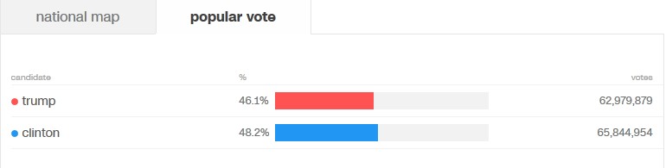
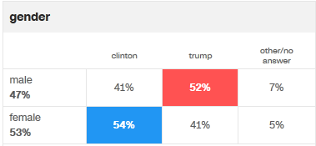
Example
Create a two-way table from the cross tabulation of gender from the 2016 election results (from CNN)

Slide 21
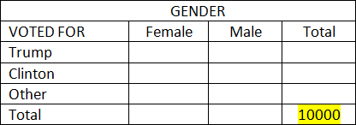
Example
First select a radix (sample size) of 10000

Slide 22
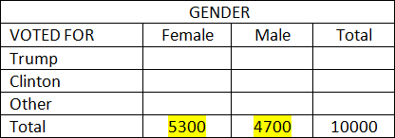
Example
Then apply the marginal probabilities to the radix (53% female, 47% male)

Slide 23
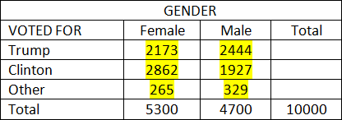
Example
Then apply the cross tabulated percentages for each gender. Make sure the numbers add up.

Slide 24
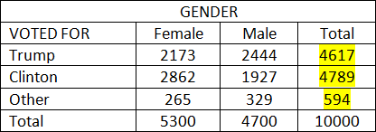
Example
Finally, complete the table using arithmetic.

Slide 25
Multiplicative Rule
P(A and B) = P(A)P(B|A) or also
P(A and B) = P(B)P(A|B)
Example: A box contains 4 green balls and 3 red balls. Two balls are drawn without replacement. Find the probability of choosing two red balls.
A=Red Ball on 1st draw B=Red Ball on 2nd Draw
P(A)=3/7 P(B|A)=2/6
P(A and B) = (3/7)(2/6) = 1/7

Slide 26
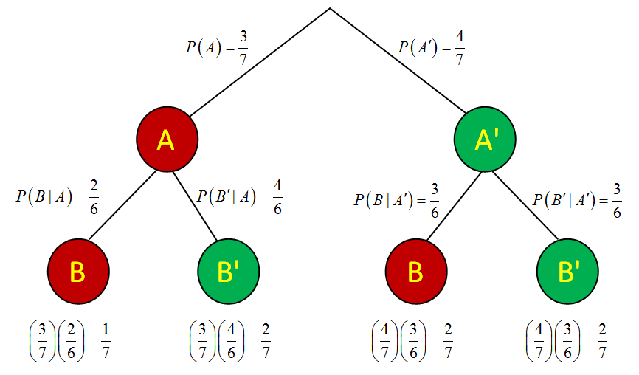
Multiplicative Rule – Tree Diagram

Slide 27
Multiplicative Rule – Tree Diagram

Slide 28
Multiplicative Rule – Tree Diagram

Slide 29
Multiplicative Rule – Tree Diagram

Slide 30
Independence
If A is not dependent on B, then they are INDEPENDENT events, and the following statements are true:
P(A|B)=P(A)
P(B|A)=P(B)
P(A and B) = P(A) x P(B)
Example: Throw a dice and toss a coin: A = {6}, B={“Tail”}. A and B are clearly independent.

Slide 31
Example
 | Accident | No Accident | Total
DUI | 70 | 130 | 200
Non- DUI | 30 | 770 | 800
Total | 100 | 900 | 1000
A: Accident D:DUI Driver
P(A) = .10 P(A|D) = .35 (70/200)
Therefore A and D are DEPENDENT events as P(A) < P(A|D)

Slide 32
Example
 | Accident | No Accident | Total
Domestic Car | 60 | 540 | 600
Import Car | 40 | 360 | 400
Total | 100 | 900 | 1000
A: Accident D:Domestic Car
P(A) = .10 P(A|D) = .10 (60/600)
Therefore A and D are INDEPENDENT events as P(A) = P(A|D)
Also P(A and D) = P(A)xP(D) = (.1)(.6) = .06

Slide 33
Random Sample
A random sample is where each member of the population has an equally likely chance of being chosen, and each member of the sample is INDEPENDENT of all other sampled data.

Slide 34
Tree Diagram method
Alternative Method of showing probability
Example: Flip Three Coins
Example: A Circuit has three switches. If at least two of the switches function, the Circuit will succeed. Each switch has a 10% failure rate if all are operating, and a 20% failure rate if one switch has already failed. Find the probability the circuit will succeed.

Slide 35
Circuit Problem
Pr(Good)=
.81+.072+.064=.946
.9
.1
A
A’
.9
.1
.8
.2
B’
B
B’
B
.8
.8
.2
.2
.02
.81
C
C’
C’
C
.072
.016
.018
.064

Slide 36
Switching the Conditionality
Often there are questions where you desire to change the conditionality from one variable to the other variable
First construct a tree diagram.
Second, create a Contingency Table using a convenient radix (sample size)
From the Contingency table it is easy to calculate all conditional probabilities.

Slide 37
Example
10% of prisoners in a Canadian prison are HIV positive.
A test will correctly detect HIV 95% of the time, but will incorrectly “detect” HIV in non-infected prisoners 15% of the time (false positive).
If a randomly selected prisoner tests positive, find the probability the prisoner is HIV+

Slide 38
Example
.1
.9
A
A’
.95
.05
.15
.85
B’
B
B’
B
.095
.005
.135
.765
A=Prisoner is HIV+
B=Test is Positive for HIV

Slide 39
Example
 | HIV+ A | HIV- A’ | Total
Test+ B | 950 | 1350 | 2300
Test- B’ | 50 | 7650 | 7700
Total | 1000 | 9000 | 10000

