Slide 1

An analysis of software applications in financial institutions
By Dumitrescu Cristian Mihail

Slide 2
Motivation

Slide 3
Literature review

Slide 4
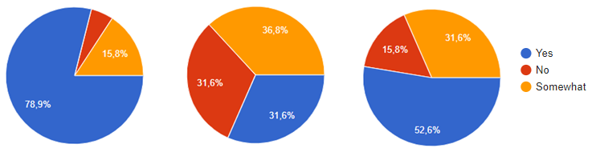
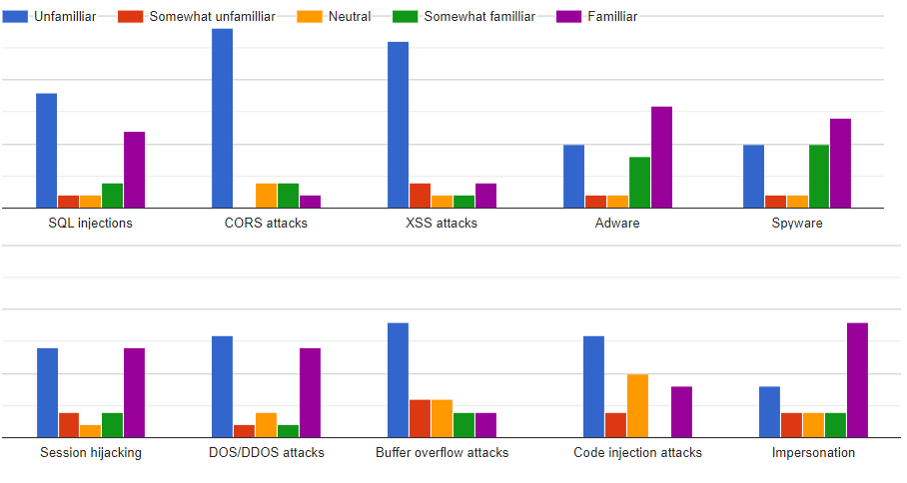
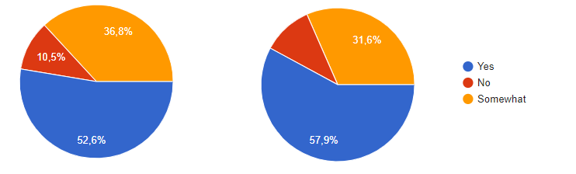
Questionnaire and its results
Q1: Have you ever considered data protection in your life?
Q2: Do you feel like you are a person prone to having your personal data stolen?
Q3: Have you taken any steps to protect your data?
Q4: Do you feel like the bank you use is protecting your data properly?
Q5: Do you feel like your bank has a good interest in protecting your data?

Slide 5
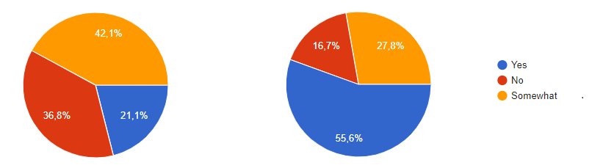
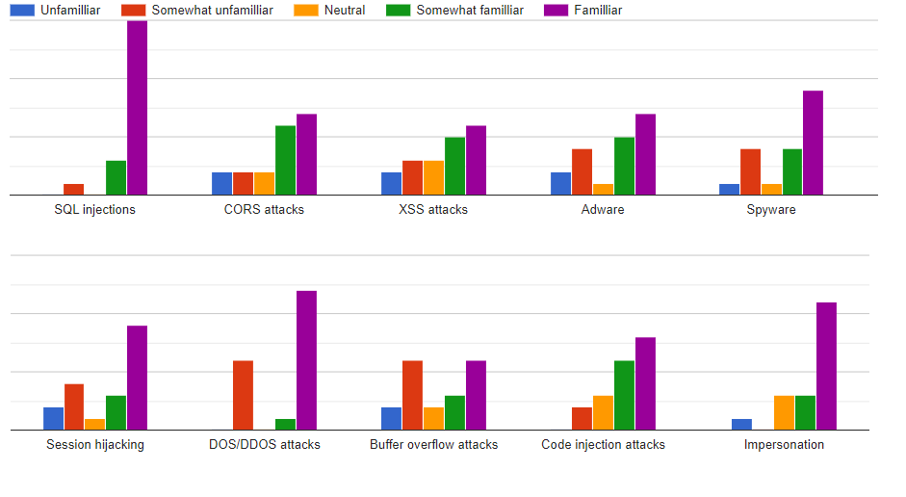
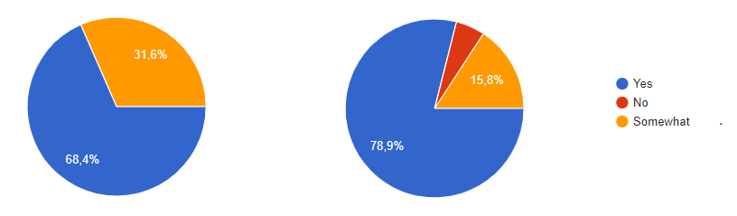
Questionnaire and its results
Q1: Do you research security issues for the languages and apps you currently use?
Q2: Are you involved in discussions about the level of security of the apps you develop?
Q3: Are you interested in the security of the applications you create?
Q4: Are you interested in the security of data for the applications you develop?

Slide 6
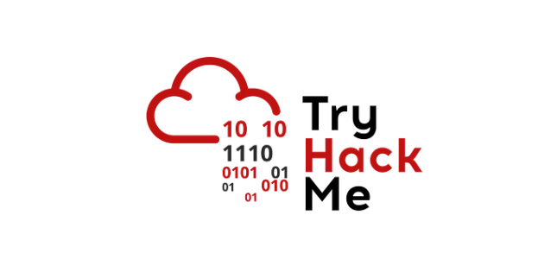

Application Idea

Slide 7



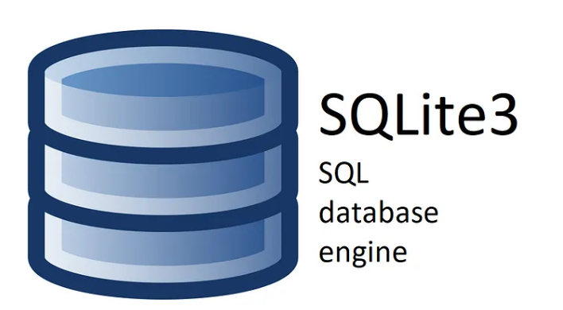
Technologies used

Slide 8
Application implementation and improvements

Slide 9
Thank You!

