Slide 1

An analysis of software applications in financial institutions
By Dumitrescu Cristian-Mihail

Slide 2
Contents
Literature review of papers that tackle the subject. Not only general papers but also more specific and technical ones.
Study with questionnaire that reveals that although everyday people trust financial institutions, the developers that can work within their sphere of influence may put them at risk.
An application that can be used as an internal training method to avoid problems caused by security negletfull developers.

Slide 3
Literature review
In the literature review, there have been works that prove that:
Physical security
Network security
Client application security
are no taken lightly when it comes to financial institutions.

Slide 4
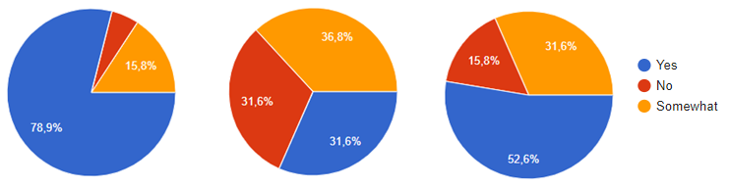
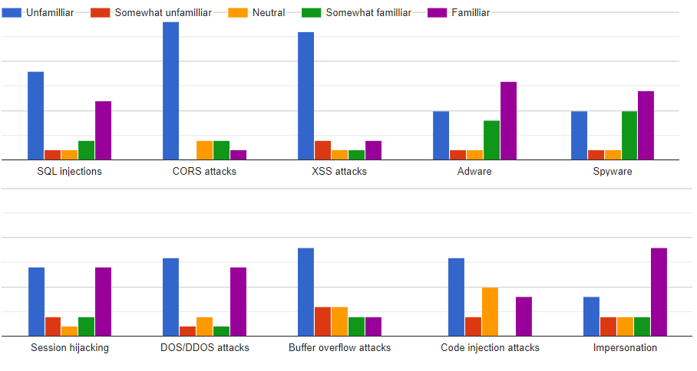
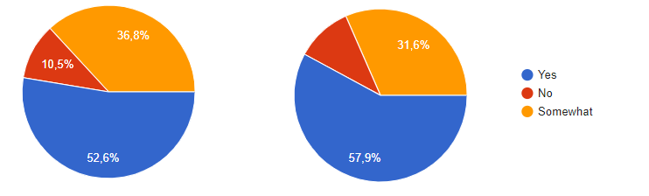
Questionnaire and its results
Q1: Have you ever considered data protection in your life?
Q2: Do you feel like you are a person prone to having your personal data stolen?
Q3: Have you taken any steps to protect your data?
Q4: Do you feel like the bank you use is protecting your data properly?
Q5: Do you feel like your bank has a good interest in protecting your data?

Slide 5
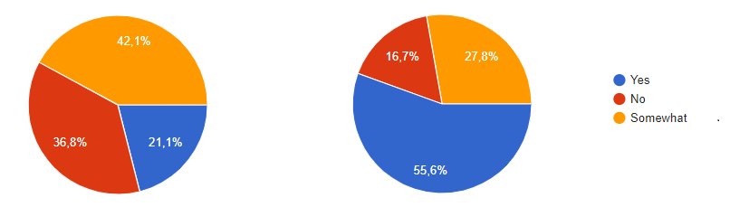
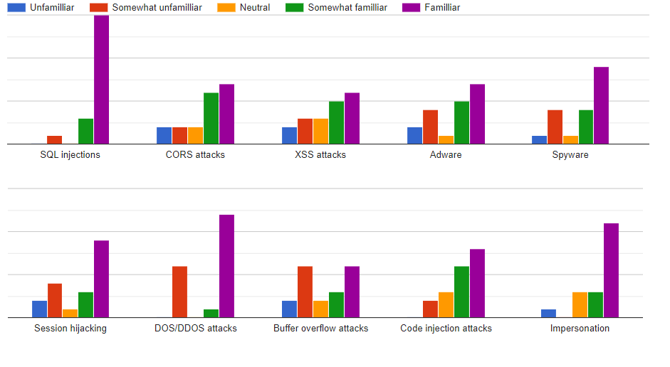
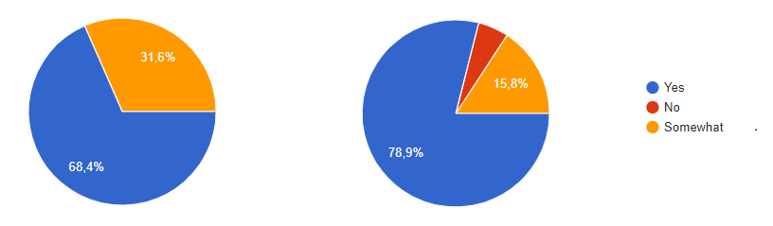
Questionnaire and its results
Q1: Do you research security issues for the languages and apps you currently use?
Q2: Are you involved in discussions about the level of security of the apps you develop?
Q3: Are you interested in the security of the applications you create?
Q4: Are you interested in the security of data for the applications you develop?

Slide 6
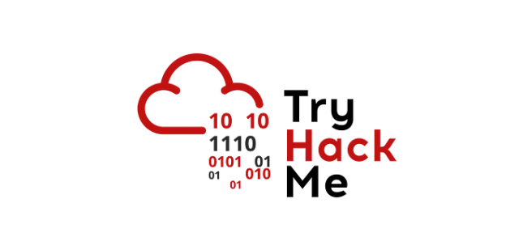

Application Idea

Slide 7

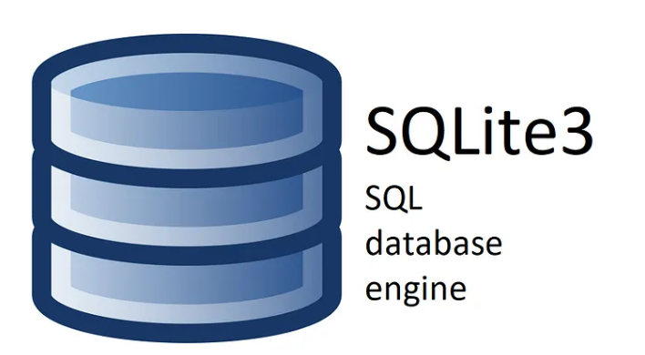


Technologies used

Slide 8
Application implementation and improvements
WHAT IT DELIVERS
POSSIBLE IMPROVEMENTS
Administration page
-for writing more security articles
-for managing tags of articles and languages
Secure endpoints:
-for commercial use
-requires writing code example for each issue that are safe to run
Programming languages linked to possible security issues by tags
Live examples of insecure vs secure code
Good practices to keep the application secure

Slide 9
Thank You for your attention!

