Slide 1



m3: Accurate Flow-Level Performance Estimation using Machine Learning
Chenning Li*, Arash Nasr-Esfahany*, Kevin Zhao, Kimia Noorbakhsh
Prateesh Goyal, Mohammad Alizadeh, and Thomas Anderson
*Equal Contribution
Notes:
[Click]

Slide 2


Lead Authors (not here due to visa issues)
Chenning Li
Arash Nasr-Esfahany

Slide 3
Predicting datacenter network performance
Network topology/configs
Workload
Notes:
Datacenter network operators often need to predict how network performance would be affected by various changes, for example, a new workload, a change in topology, or network configuration.
[Click]

Slide 4


Existing tools for network perf. prediction
Network topology/configs
packet loss ratio
buffer occupancies for specific flows at specific times
flow jitter
But ns-3 is very slow…
Workload
~6,000 hosts
~ 10 millions of flows
~10 hours for 5s simulated time!
Notes:
A common way to predict network performance is to use packet-level simulators such as using ns-3.
[Click] ns-3 takes as input the network topology, configurations and the workload, and can simulate detailed packet-level information, such as the packet loss ratio, flow jitter, and even specific buffer occupancies.
[Click] However, as anyone who has run such simulations knows, ns-3 is very slow. In our experiments, simulating a modest 6,000-host topology took 10 hours to simulate for just 5 seconds of simulated time.
[Click]

Slide 5

Prior work on faster simulation
Exact parallel simulation
ns-3
OMNET++
DONS, SIGCOMM’23
Unison, EuroSys’24
Approximate simulation
Parsimon, NSDI’23
DeepQueueNet, SIGCOMM’22
MimicNet, SIGCOMM’21
All are packet-level simulators slow for large-scale networks, especially as the network becomes faster
Notes:
[Click] In response, recent work has proposed a variety of techniques to accelerate simulation. These include parallel simulation techniques and various approximation and machine learning methods.
[Click] However, they are still packet-level simulators. And any packet-level model has inherent scalability limitations in high-speed, large-scale networks. This is a problem that will only get worse over time as networks become larger and faster.
[Click]

Slide 6

Do we always need packet-level simulation?
Many questions are about aggregate performance statistics
Tail latency
Throughput
Loss rates
Short & long flow completion time
How would workload/design changes impact these statistics?
Can we raise the level of abstraction for answering such questions without compromising fidelity?

Slide 7


Abstract the network simulator as a function
Network topology/config
FCT Slowdown
FCT slowdown: The ratio of the flow completion time (FCT) to the ideal completion time for a flow in an unloaded network
Workload:
A sequence of flows
Use supervised learning to learn the end-to-end function?
Notes:
At a high level, we can abstract the network simulator as a function. This function takes the network topology, configuration, and workload as inputs, and outputs aggregate network statistics.
[Click] As a concrete example, we focus on flow completion time slowdown as an important performance statistic. FCT slowdown is the ratio of …
[Click] Can we use supervised learning to learn this end-to-end function? By avoiding the modeling of packet-level events, this supervised ML model should run significantly faster.
[Click]

Slide 8
The simulator is a complex function
~6,000 hosts
FCT Slowdown
~ 10 millions of flows
Hard to represent the function in a compact way
Slow to generate the training dataset for the ML model
Notes:
Unfortunately, using machine learning to model this simulator is challenging due to its complexity.
[Click] There are two main challenges:
It is hard to represent this complex function in a compact way.
Generating the training dataset for the ML model is slow. [Click]

Slide 9
m3: Accurate flow-level performance estimation using machine learning
m3
Topology
Workload
Config parameters
FCT Slowdown
m3: ~1200X speedup with only ~10% estimation error in a 384-rack, 6144-host topology (vs. ns-3)
From ~10 hours (ns-3) to less than 1 min (m3)
Notes:
We introduce m3 for faster network simulation at scale.
m3 takes as input the network topology, configurations, and workloads, and outputs network tail latency quickly.
[Click] While m3 uses machine learning, it is designed to require only simple training examples. Thanks to its two key ideas´, the trained ML models generalize to unseen workloads, topologies, and network configurations.
[Click] In our experiments, compared to ns-3, the packet-level simulator used as the ground truth, m3 achieves a 1200X speedup with only 10% estimation error in a ~6000-host topology. It reduces the simulation running time from around 10 hours to less than 1 minute.
[Click]

Slide 10
Building block: A path simulation
Flows along this path
A path
Notes:
Let me start with m3’s first idea, the path decomposition. Given a large-scale network simulation,
[Click] m3’s first step is to decompose the network-wide simulation into independent path-level simulations. For each path-level simulation, we can focus on flows traversing that specific path and estimate their performance in parallel.
To start, we can prune the network topology at first.
[Click]

Slide 11
Assumption:
Flows that do not intersect a path have only second-order effects on that path
(and thus can be ignored)
Flows along this path
A path
Notes:
m3 has its assumption to further prune the flows for this path-level simulation.
That is, flows that do not intersect this path have the second-order effect on the behavior of flows entirely along this path.
Based on this assumption, m3 prunes flows that do not intersect the target path.
[Click]

Slide 12
Assumption:
Flows that do not intersect a path have only second-order effects on that path
(and thus can be ignored)
Flows along this path
A path
Notes:
As a result
[Click]

Slide 13
Path-level simulation
Select one path and prune flows that do not intersect it
Foreground flows follow the entire path
Background flows intersect only certain links along this path, not all of them
Goal: estimate the FCT slowdown distribution of the foreground flows
Notes:
m3's path-level simulation includes only flows that directly intersect the target path.
[Click] m3 further categorizes these flows into two groups: foreground flows that follow the entire path and background flows that intersect only certain links along the path.
[Click] The goal of m3’s path-level simulation is to estimate the FCT distribution of the foreground flows along this path.
[Click]

Slide 14
Path decomposition & aggregation
Notes:
[Click]

Slide 15
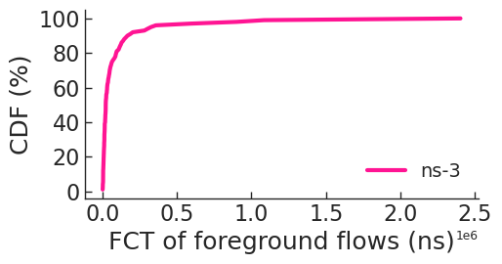

Path decomposition & aggregation
Flow Completion Time (FCT)
Benefits:
Path-level sims are easier to learn
Massive parallelism
Notes:
Using path-level simulations as building blocks,
[Click] m3 decomposes the full network simulation into independent path-level simulations and then aggregates their performance to estimate the network-wide FCT distribution.
[Click]

Slide 16
Is path decomposition accurate?
Experiment
Three scenarios on a 32-rack 256-host topology with different workloads
Randomly select 500 paths for each scenario
Compare the tail latency (P99 FCT slowdown) of foreground flows for each path
[ns-3]
[ns-3-path]
Notes:
The path decomposition helps m3 speed up network simulation, but what about its fidelity? To verify this, we conducted experiments with three scenarios on a 256-host topology, using ns-3 as the ground truth.
[Click] For each scenario, we randomly selected 500 paths.
[Click] For each path, we ran the ns-3-path simulation, where we pruned flows that do not intersect that path.
[Click] Finally, we compared the tail latency between ns-3 and ns-3-path.
[Click]

Slide 17
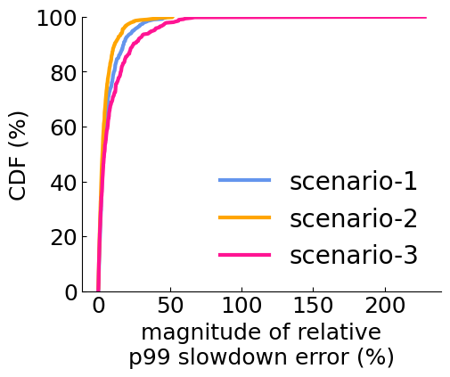
Path-level sim is accurate but still slow
[ns-3]
[ns-3-path]
Scenario | Median relative estimation error | Overall speedup
1 | -0.83% | 3.6X
2 | -2.13% | 5.4X
3 | -5.91% | 14.2X
Magnitude of relative estimation error (%)
Notes:
We show the CDF of the magnitude of relative estimation error for tail latency across 500 paths for each scenario. 80% of the paths have an estimation error of less than 10%. There are many unique paths for each scenario. Simulating just 500 paths and aggregating their results is sufficient to provide a good estimate of the network-wide tail latency, with an error up to 6%.
[Click] While the path-level simulation is quite accurate, it remains slow, with an overall speedup ranging from 3 to 14 times.
[Click]

Slide 18
Estimate path-level perf. with ML
~ 10 K foreground flows
~ 1 million background flows
m3 uses a flow-level simulator to extract compact features for its ML model
Notes:
m3’s second idea is to estimate path-level performance with ML to make it faster.
[Click] This is non-trivial, as even a path-level simulation may have 10,000 foreground flows and 1 million background flows as its workload.
[Click] Instead of feeding these complex path-level workload directly to the ML model, m3 first uses a flow-level simulator to extract compact features for its ML models.
[Click]

Slide 19

Flow-level simulator (flowSim)
Max-min flow-level simulation
No packets – A “fluid” flow i sending at time-varying rates r_{i} (t)
Flows transmit at the max-min fair rates ^{[1]} (approximates congestion control)
Events: flow arrivals and departures
No queues!
Fast: <1 sec for a path-level sim with 1 million flows
Notes:
So, what is this flow-level simulator? We call it flowSim.
First, it's a max-min flow-level simulation. This means it operates without packets, and each flow sends at its max-min fair rate.
Second, the simulator handles flow arrivals and departures as events.
Third, because flowSim operates on flows and not packets, it cannot tell you anything about the queue length at each switch.
[Click] By ignoring those packet-level details, it's incredibly fast. It can complete a path-level simulation with 1 million flows in less than 1 second.
[Click]

Slide 20
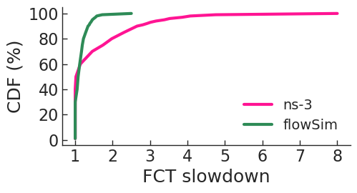
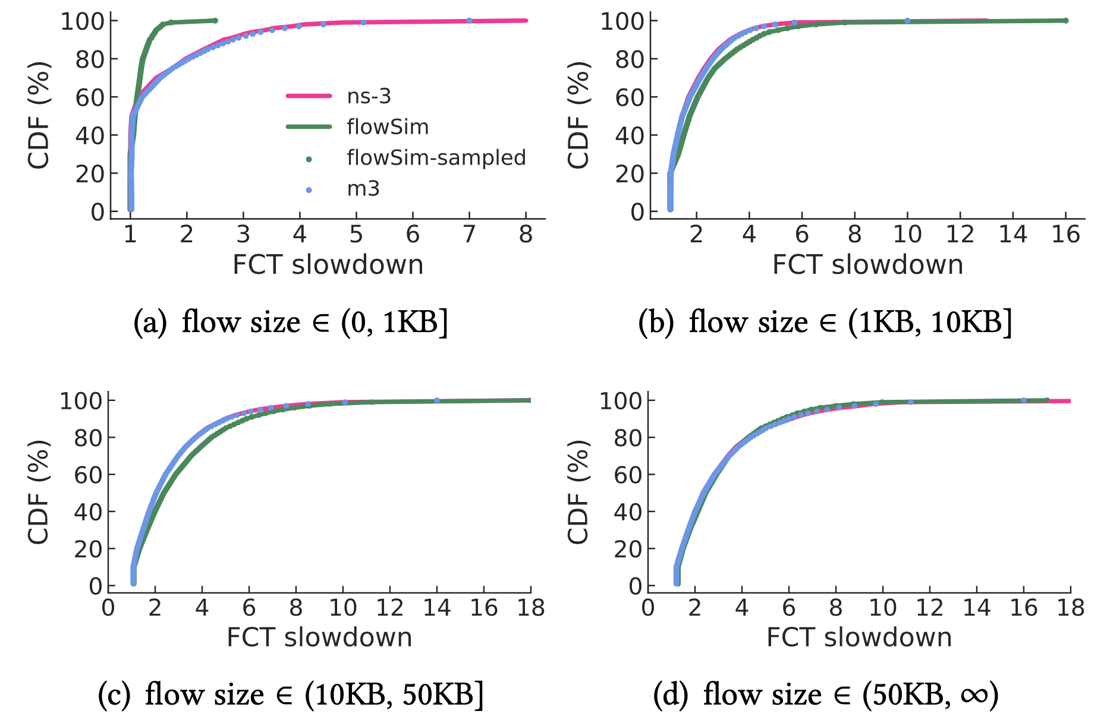
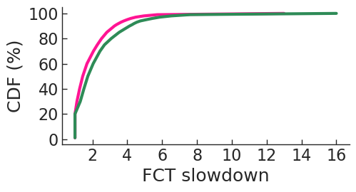
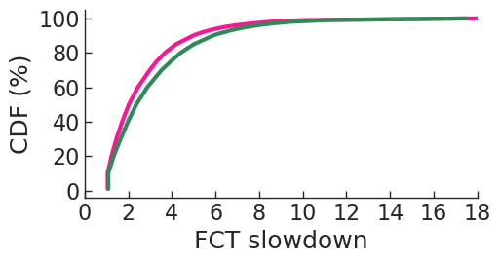
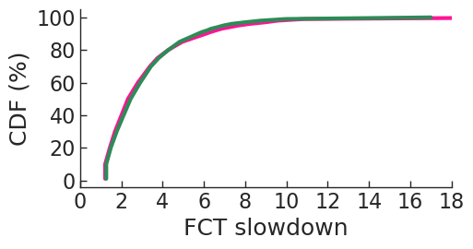
flowSim is fast but inaccurate
Not accurate, esp. for short flows
Notes:
flowSim is fast but not accurate.
Given a path-level simulation, we compare the FCT slowdown estimated by ns-3 and flowSim across four flow size buckets.
[Click] flowSim tends to underestimate the flow completion time slowdown for small flows.
Because the FCT slowdown of small flows is significantly impacted by queuing delay
[Click]

Slide 21
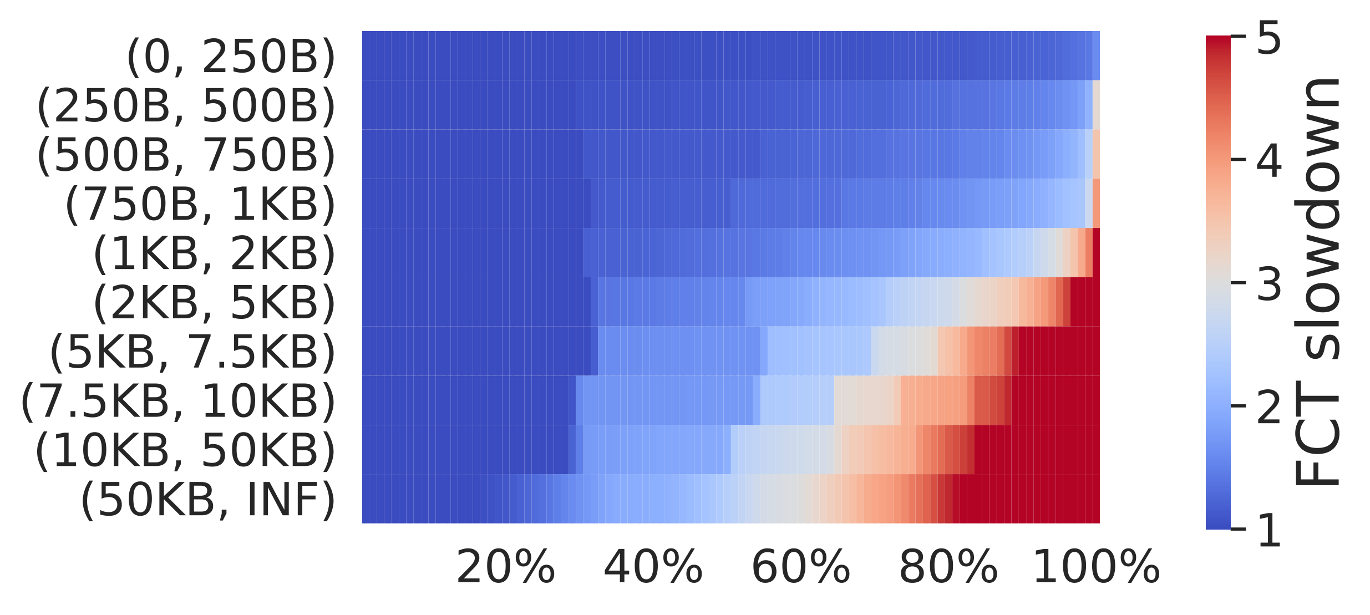
Use flowSim to extract a feature map
Run path-level simulation on flowSim
Summarize per-flow FCT slowdown into a feature map
Flow size buckets
Percentiles
Notes:
Although flowSim is not entirely accurate, it is efficient to extract compact features from workloads.
To use flowSim, m3 first runs flowSim and then summarizes the per-flow FCT slowdown estimated by flowSim into a compact feature map.
[Click] In the y-axis of this figure, we first group flows into different size buckets.
In the x axis, we sample the FCT slowdown at specific percentiles and observe the discrete distribution of slowdowns for flows within each size bucket.
[Click]

Slide 22
m3’s feature map captures workload characteristics
Example: Different levels of load for the simulated network
Load = 20%
Load = 50%
Load = 80%
Notes:
These compact features from flowSim provide a concise summary of the workload and can distinguish between different workloads in a logical way.
[Click] For example, when increasing the network load from 20% to 80%, we observe that the FCT slowdown increases gradually, especially for large flows
[Click]

Slide 23
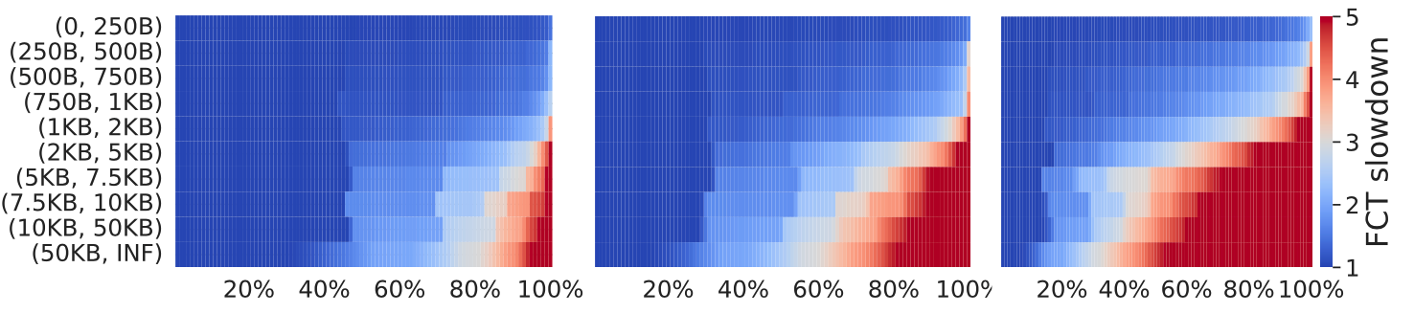
m3’s feature map captures workload characteristics
Example: Different levels of burstiness of the workload
𝜎 = 1.0
𝜎 = 1.5
𝜎 = 2.0
(higher 𝜎 → more bursty)
Notes:
When the workload is more bursty, the FCT slowdown also gradually increases, particularly for large flows.
These results demonstrate that flowSim can quickly summarize workloads into compact features, and these features effectively distinguish between different workloads in a logical way.
[Click]

Slide 24
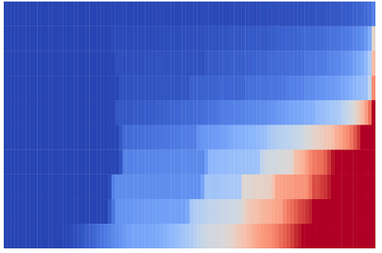
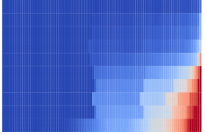
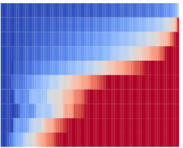
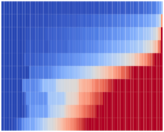
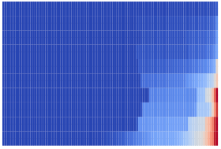

m3 uses ML to correct flowSim
flowSim
ML Model
ns-3’s
FCT slowdown distribution
Buffer size, initial window size, different CCAs as a one-hot vector, and CCA parameters
Notes:
For a given path-level simulation,
[Click] m3 inputs several feature maps extracted from flowSim for the foreground and background flows, along with other network specifications such as buffer size, different CCAs, and their parameters, into its ML models.
[Click] Using ns-3’s FCT slowdown distribution as the ground truth, m3 corrects flowSim and finally generates its own estimates for this path-level simulation.
[Click]

Slide 25
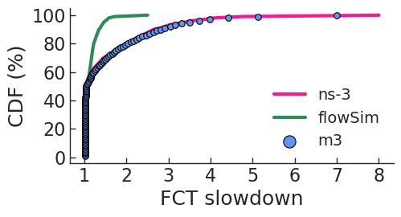
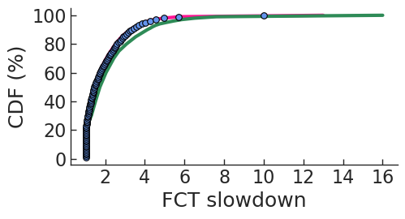
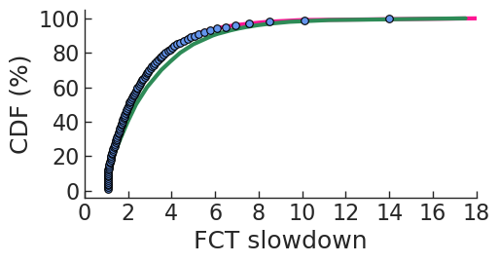
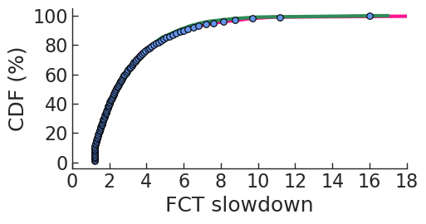
Example
Notes:
For a path-level simulation scenario, m3 effectively corrects the FCT slowdown distribution by flowSim, making its estimates very close to those of ns-3 for all four size buckets.
[Click]

Slide 26
Training
Train on diverse synthetic scenarios
Path topology: 2-hop, 4-hop, 6-hop parking-lot topology
Flow size distribution: Pareto, Lognormal, Exponential, Gaussian
Flow inter-arrival time distribution: burstiness from low (𝜎 = 1.0) to high (𝜎 = 2.0)
Randomly chosen network config: Buffer size, initial window size, CC from DCTCP, TIMELY, DCQCN, HPCC, etc.
We train the model once and use it directly for inference
m3 generalizes to unseen workloads & topologies
Notes:
How do we train m3?
Based on m3’s path decomposition, we only need to train it using 2-hop, 4-hop, and 6-hop parking-lot topologies.
Due to its flowSim featurization, we only need to train m3 on synthetic workloads, such as the synthetic flow size distributions and different workload burstiness. For each scenario, we randomly choose network configurations, such as buffer size, initial window size, and different CC protocols.
[Click] We train the model once and use it directly for different scenarios with production workloads and topologies. m3 generalizes to unseen workloads, topologies, and network configurations.
[Click]

Slide 27


Accuracy evaluation
Various production workloads based on Meta’s data center network
Notes:
Given around 200 scenarios with different workloads and topologies, we use ns-3 to provide the ground truth for network tail latency. We use Parsimon as the baseline, a fast packet-level simulator for estimating network tail latency. Parsimon decomposes the full network simulation into independent link-level simulations and aggregates their results.
[Click] In terms of prediction accuracy, m3 reduces Parsimon’s mean error from 18.3% to 9.9%.
[Click] Besides, m3 is faster, achieving a 5.7 times speedup over Parsimon and being 3 orders of magnitude faster than ns-3.
[Click]

Slide 28
Accuracy evaluation
Various production workloads based on Meta’s data center network
Baseline: Parsimon [NSDI’23]
m3 reduces Parsimon’s mean error from 18.3% to 9.9%
Notes:
Given around 200 scenarios with different workloads and topologies, we use ns-3 to provide the ground truth for network tail latency. We use Parsimon as the baseline, a fast packet-level simulator for estimating network tail latency. Parsimon decomposes the full network simulation into independent link-level simulations and aggregates their results.
[Click] In terms of prediction accuracy, m3 reduces Parsimon’s mean error from 18.3% to 9.9%.
[Click] Besides, m3 is faster, achieving a 5.7 times speedup over Parsimon and being 3 orders of magnitude faster than ns-3.
[Click]

Slide 29
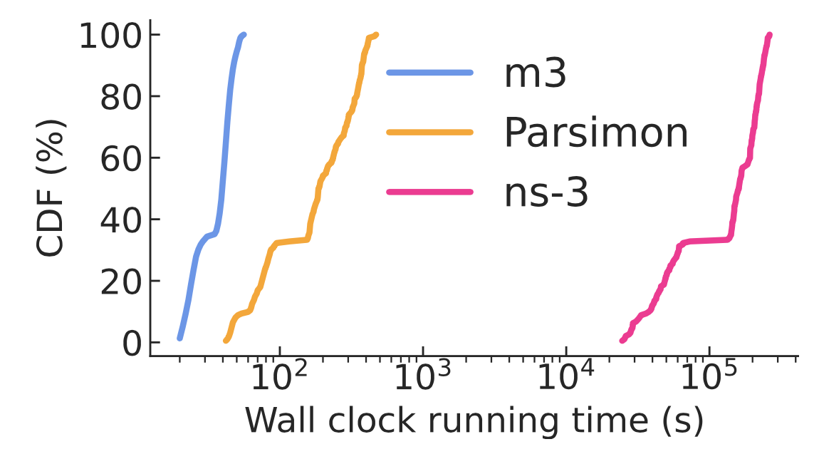
Runtime evaluation
Various production workloads based on Meta’s data center network
Baseline: Parsimon [NSDI’23]
m3 is 5.7X faster than Parsimon and ~1000X faster than ns-3
Notes:
Given around 200 scenarios with different workloads and topologies, we use ns-3 to provide the ground truth for network tail latency. We use Parsimon as the baseline, a fast packet-level simulator for estimating network tail latency. Parsimon decomposes the full network simulation into independent link-level simulations and aggregates their results.
[Click] In terms of prediction accuracy, m3 reduces Parsimon’s mean error from 18.3% to 9.9%.
[Click] Besides, m3 is faster, achieving a 5.7 times speedup over Parsimon and being 3 orders of magnitude faster than ns-3.
[Click]

Slide 30
What m3 does not do
m3 assumes static flow routes known in advance
Cannot model dynamic routing strategies like packet-spraying or flowlets
m3 predicts the distribution of FCT slowdown, not per-flow or per-packet performance
m3 learns the impact of network parameters from training examples, so it cannot predict unseen protocols
Notes:
Here we show what m3 does and does not do.
First, m3 assumes static routes known in advance. It does not handle dynamic routing strategies.
Second, m3 predicts the distribution of FCT slowdown, it does not predict per-flow or per-packet performance.
Lastly, m3 learns the impact of network parameters from training examples, it cannot predict the performance of unseen protocols.
[Click]

Slide 31
Summary
m3 is fast and accurate for estimating flow-level performance
Two key ideas:
Path decomposition
Workload featurization via flow-level simulation
General principle: Learn to map from simple reference system to real system
https://github.com/netiken/m3

Slide 33
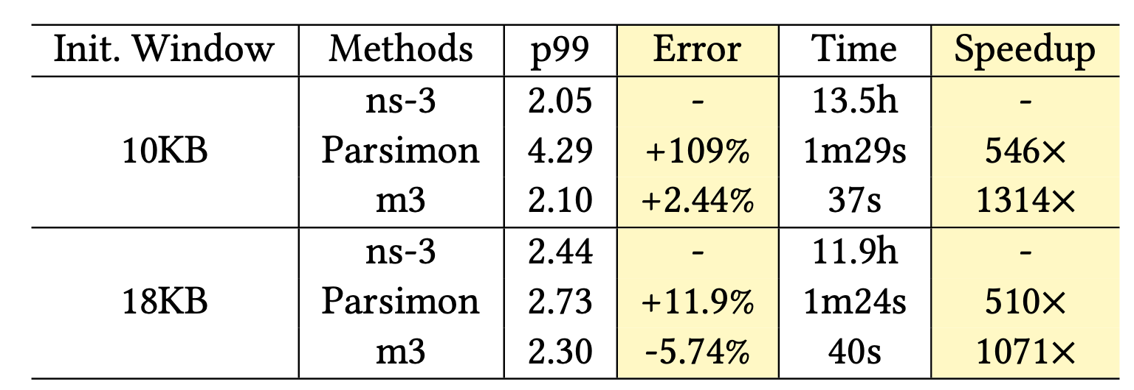
Large-scale simulation
Meta Production Workload
A 384-racks, 6,144-host Meta’s data center fabric
Baseline: Parsimon
m3 is faster, more accurate, and robust
Notes:
We also compare m3, Parsimon and ns-3 on the 6000-host Meta’s data center fabric.
[Click] m3 is faster, more accurate, and robust, especially for different initial congestion control windows.
[Click]
the initial window size becomes a bottleneck for flows larger than 10KB in each link-level simulation. Parsimon adds the slowdowns incurred in the link-level simulations, and thus it over-counts the effect of the window size on the delay.

Slide 34
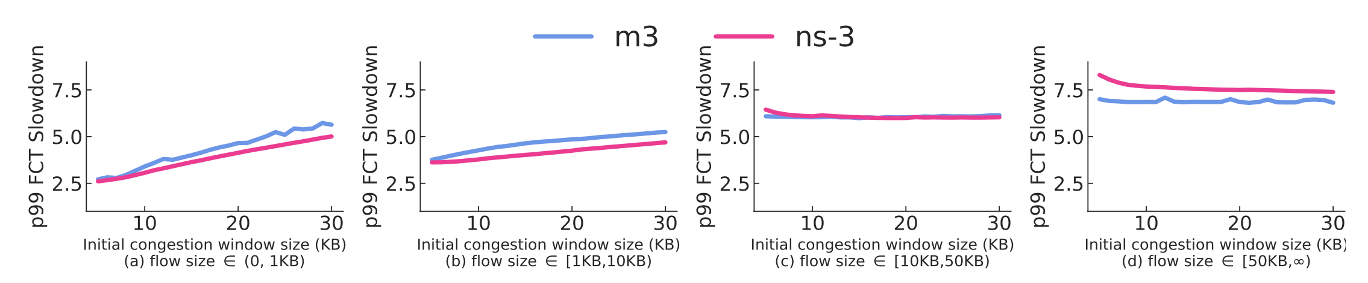
m3 enables rapid design-space exploration
Example: Effect of initial window size on p99 FCT slowdown for different classes of flows
The mean runtimes of each configuration in the plot
m3: 25.2 seconds
Ns-3: 8 hours
Notes:
m3 enables rapid design-space exploration. We show an example of using m3 to explore the effect of initial window size on p99 FCT slowdown.
Given a list of initial congestion window sizes, m3 provides accurate predictions that are close to those of ns-3.
[Click] Additionally, m3 runs much faster than ns-3, reducing the mean runtime of each configuration from 8 hours to 25 seconds.
[Click]

