Slide 1

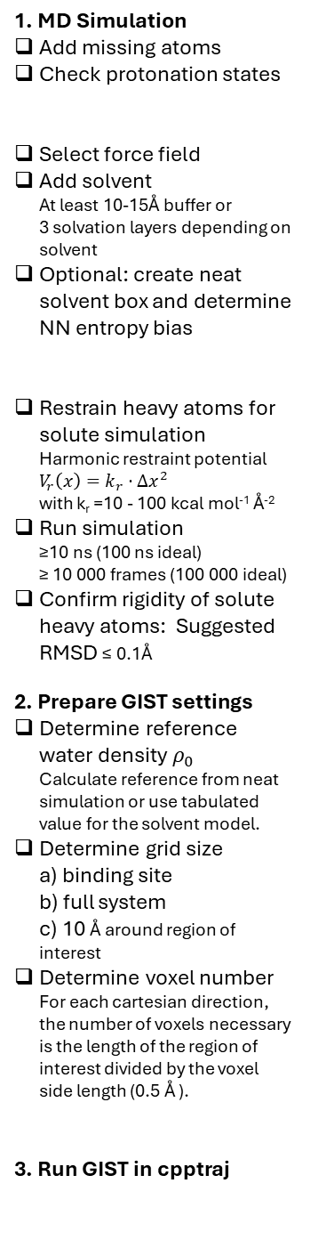



1. MD Simulation
Add missing atoms
Check protonation states
Select force field
Add solvent At least 10-15Å buffer or 3 solvation layers depending on solvent
Optional: create neat solvent box and determine NN entropy bias
Restrain heavy atoms for solute simulation Harmonic restraint potential $V_{r}\left(x\right)=k_{r}⋅Δx^{2}$ with k_{r} =10 - 100 kcal mol⁻¹ Å⁻²
Run simulation ≥10 ns (100 ns ideal) ≥ 10 000 frames (100 000 ideal)
Confirm rigidity of solute heavy atoms: Suggested RMSD ≤ 0.1Å
2. Prepare GIST settings
Determine reference water density $ρ_{0}$ Calculate reference from neat simulation or use tabulated value for the solvent model.
Determine grid size a) binding site b) full system c) 10 Å around region of interest
Determine voxel number For each cartesian direction, the number of voxels necessary is the length of the region of interest divided by the voxel side length (0.5 Å ).
3. Run GIST in cpptraj
Prepare solute structure
Solute structure
Prepare solvated solute box
Optional
Neat solvent box for accurate referencing
Minimization & Equilibration
Run restrained MD simulation
Run unrestrained MD simulation
Solute Trajectory
Neat Solvent Trajectory
Reimage and center MD trajectory
Calculate reference density $ρ_{0}$ of neat solvent
Save solute coordinates of first frame
Calculate reference water-water energy $E_{ww}$
gist.pdb
$$ρ_{0}$$
$$E_{ww, ref}$$
Define region of interest
Calculate number of voxels necessary
Define grid center if solute/region is not centered on origin
Set voxel number per axis
Run GIST
gist.dat

Slide 2

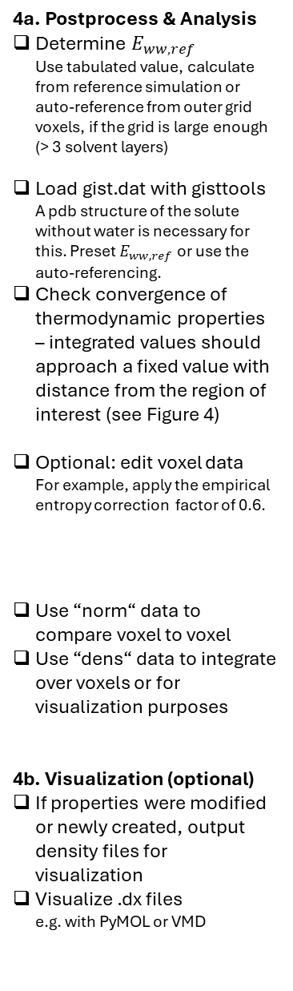
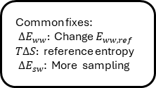

gist.pdb
gist.dat
$$E_{ww, ref}$$
4a. Postprocess & Analysis
Determine $E_{ww, ref}$ Use tabulated value, calculate from reference simulation or auto-reference from outer grid voxels, if the grid is large enough (> 3 solvent layers)
Load gist.dat with gisttools A pdb structure of the solute without water is necessary for this. Preset $E_{ww, ref}$or use the auto-referencing.
Check convergence of thermodynamic properties – integrated values should approach a fixed value with distance from the region of interest (see Figure 4)
Optional: edit voxel data For example, apply the empirical entropy correction factor of 0.6.
Use “norm“ data to compare voxel to voxel
Use “dens“ data to integrate over voxels or for visualization purposes
4b. Visualization (optional)
If properties were modified or newly created, output density files for visualization
Visualize .dx files e.g. with PyMOL or VMD
Load with gisttools in python
Check convergence of ${ΔE}_{ww}, { ΔE}_{sw}, TΔS, ΔA_{solv}$
Common fixes: ${ ΔE}_{ww}:$ Change $E_{ww, ref}$
$TΔS:$ reference entropy
${ ΔE}_{sw}$: More sampling
Converged?
no
yes
Edit voxel data
optional
"norm" data
"dens" data
Compare voxels on a per-solvent basis
Integrate over grid volumes to calculate thermodynamic data
Output .dx files
Load .dx files into visualization software
Visualize thermodynamic densities
Volumes
Isosurfaces
Mesh grids
Isodots

