Slide 1

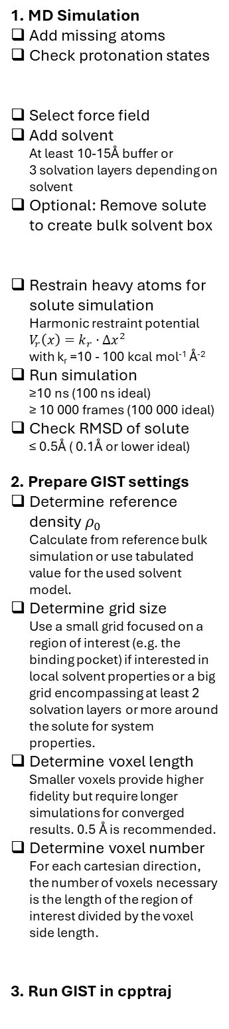



1. MD Simulation
Add missing atoms
Check protonation states
Select force field
Add solvent At least 10-15Å buffer or 3 solvation layers depending on solvent
Optional: Remove solute to create bulk solvent box
Restrain heavy atoms for solute simulation Harmonic restraint potential $V_{r}\left(x\right)=k_{r}⋅Δx^{2}$ with k_{r} =10 - 100 kcal mol⁻¹ Å⁻²
Run simulation ≥10 ns (100 ns ideal) ≥ 10 000 frames (100 000 ideal)
Check RMSD of solute ≤ 0.5Å ( 0.1Å or lower ideal)
2. Prepare GIST settings
Determine reference density $ρ_{0}$ Calculate from reference bulk simulation or use tabulated value for the used solvent model.
Determine grid size Use a small grid focused on a region of interest (e.g. the binding pocket) if interested in local solvent properties or a big grid encompassing at least 2 solvation layers or more around the solute for system properties.
Determine voxel length Smaller voxels provide higher fidelity but require longer simulations for converged results. 0.5 Å is recommended.
Determine voxel number For each cartesian direction, the number of voxels necessary is the length of the region of interest divided by the voxel side length.
3. Run GIST in cpptraj
Prepare solute structure
Solute structure
Prepare solvated solute box
Optional
Pure solvent box for accurate referencing
Minimization
Equilibration
Run restrained MD simulation
Run unrestrained MD simulation
Solute Trajectory
Bulk Solvent Trajectory
Reimage and center MD trajectory
Calculate reference density $ρ_{0}$ of bulk solvent
Save solute coordinates of first frame
Calculate reference water-water enthalpy $E_{ww}$
gist.pdb
$$ρ_{0}$$
$$E_{ww, ref}$$
Define region of interest
Calculate number of voxels necessary
Define grid center if solute/region is not centered on origin
Set voxel number per axis
Run GIST
gist.dat

Slide 2

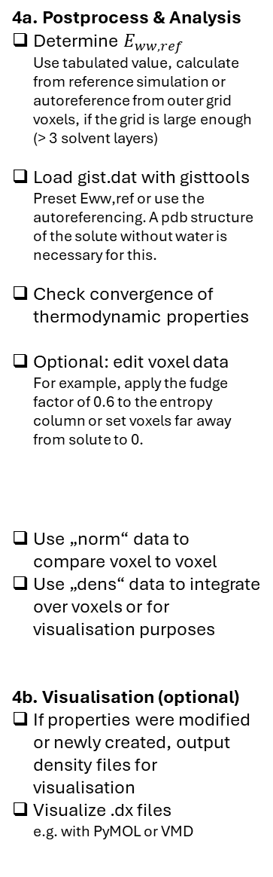
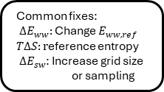

gist.pdb
gist.dat
$$E_{ww, ref}$$
4a. Postprocess & Analysis
Determine $E_{ww, ref}$ Use tabulated value, calculate from reference simulation or autoreference from outer grid voxels, if the grid is large enough (> 3 solvent layers)
Load gist.dat with gisttools Preset Eww,ref or use the autoreferencing. A pdb structure of the solute without water is necessary for this.
Check convergence of thermodynamic properties
Optional: edit voxel data For example, apply the fudge factor of 0.6 to the entropy column or set voxels far away from solute to 0.
Use „norm“ data to compare voxel to voxel
Use „dens“ data to integrate over voxels or for visualisation purposes
4b. Visualisation (optional)
If properties were modified or newly created, output density files for visualisation
Visualize .dx files e.g. with PyMOL or VMD
Load with gisttools in python
Check convergence of ${ΔE}_{ww}, { ΔE}_{sw}, TΔS, ΔA_{solv}$
Common fixes: ${ ΔE}_{ww}:$Change $E_{ww, ref}$
$TΔS:r$eference entropy
${ ΔE}_{sw}$: Increase grid size or sampling
Converged?
no
yes
Edit voxel data
optional
„norm“ data
„dens“ data
Compare voxels on a per-solvent basis
Integrate over grid volumes to calculate thermodynamic data
Output .dx files
Load .dx files into visualisation software
Visualize thermodynamic densities
Volumes
Isosurfaces
Mesh grids
Isodots

