Slide 1
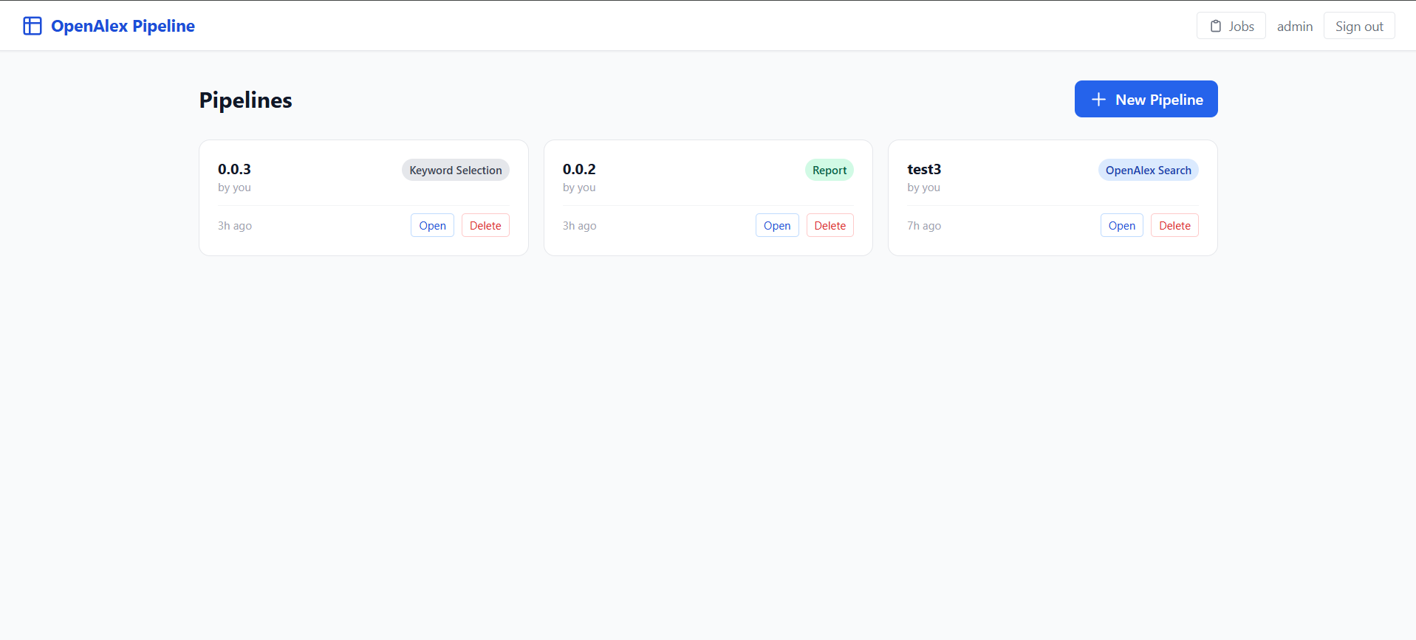
MACHINE LEARNING AND ARTIFICIAL INTELLIGENCE IN SUSTAINABLE FUELS

