Slide 1
Classes, Objects
and Constructors

Slide 2
What is Object
is a basic unit of Object-Oriented Programming;
represents real life entities (creature, person, body, thing, being, etc)

Slide 3
Object consists of:
State (it is represented by the attributes of an Object, also reflects properties of an Object);
Behavior (it is represented by methods of an Object, also reflects the response of an Object with other Objects);
Identity (it gives unique name to an Object and enables one Object to interact with other Objects)

Slide 4
Example of an Object:
Identity: name of a dog
State/Attributes: breed, age, color
Behaviors: bark, sleep, eat

Slide 5
What is a Class
is a user defined blueprint or prototype from which Objects are created;
it represents the set of properties or methods that are common to all Objects of one type.

Slide 6
Components of Class declaration:
Modifiers - public or default access
Class name - starts with initial (capitalized) letter
Body - class body surrounded by braces {}

Slide 7




Class Dog
Object1
Object2
Object3

Slide 8
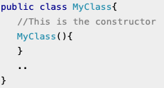
What is Constructor
a block of code that initializes the newly created Object.
ALWAYS has the same name as Class name

Slide 9
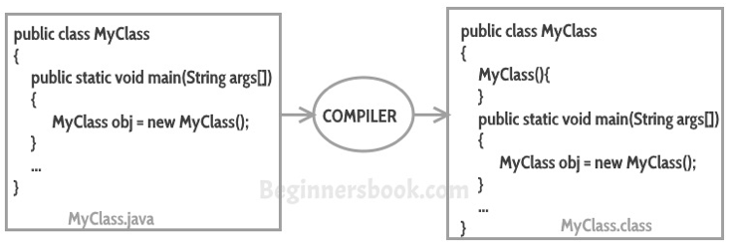
Types of Constructors
Default
if no constructor was implemented, Java compiler will insert a default constructor on your behalf.

Slide 10
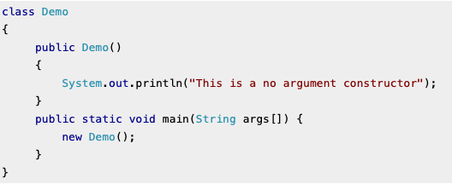
Types of Constructors
No-arg
constructor without arguments. Looks like a default one (doesn’t take any parameters), but body can contain any code, when default’s is always empty

Slide 11
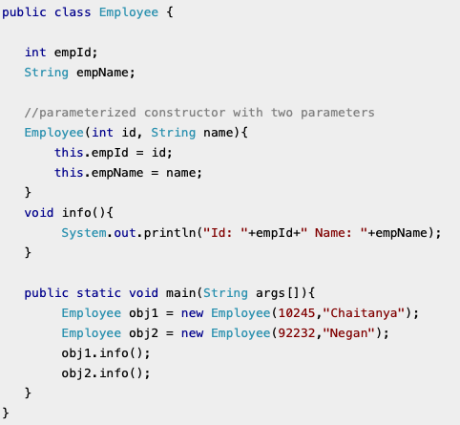
Types of Constructors
Parameterized
is a Constructor with arguments/parameters

Slide 12
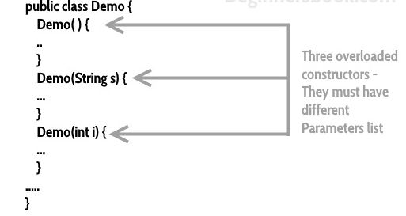
Constructor overloading
Constructor overloading is a concept of having more than one constructor with different parameters list, in such way so that each constructor performs different task

Slide 13
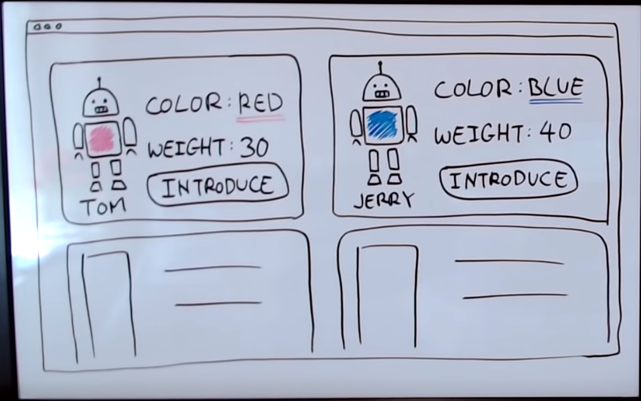
Robots example

Slide 14

instance vars /
attributes
Object
Object
-name: “Tom”
-color: “red”
-weight: 30
-name: “Jerry”
-color: “blue”
-weight: 40
properties
properties
r1 =
r2 =
+introduceSelf()
function
+introduceSelf()
function
method
method
Robot
class
name:
color:
weight:
- same set of properties,
values aren’t defined
+introduceSelf()
- class doesn’t refer to
any particular Object
System.out.println(“My name is “ + name);

Slide 15

name/reference
no instance vars set yet
instance vars to define class
data type
keyword
class
class Robot {
Robot r1 = new Robot();
r1.name = “Tom”;
String name;
String color;
int weight;
r1.color = “red”;
r1.weight = 30;
constructor
when custom constructor is created
Robot r2 = new Robot();
Robot(String n, String c, int w) {
this.name = n;
this.color = c;
this.weight = w;
}
r2.name = “Jerry”;
default constructor no longer works
r2.color = “blue”;
r2.weight = 40;
Robot r1 = new Robot(“Tom”, “red”, 30)
void introduceSelf() {
System.out.println
(“My name is ” + this.name)
}
Robot r2 = new Robot(“Jerry”, “blue”, 40)
r1.introduceSelf();
“My name is Tom”
}
r2.introduceSelf();
“My name is Jerry”
defining a function
this —> refers to r1 or r2

Slide 16
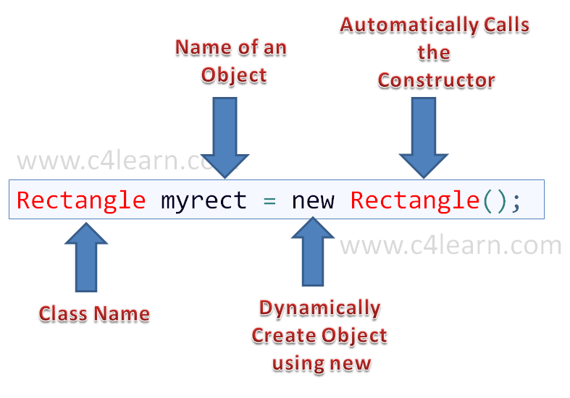

Slide 17
