Slide 1
Arrays
Notes:
HAVING PRESENTATION FOR CLASSES
ABOUT RECAP CLASSES

Slide 2
Topics to cover
What is array?
Declaring array variables
Creating arrays
How to access and use arrays
Advantages of using arrays
Arrays class methods
Multi-dimensional arrays
Create several void methods that accepts multi-dimensional arrays
How to answer related questions in interview

Slide 3
What is Array?
Array is a data structure provided by Java (and many other languages)
Array stores collection of elements of the same type.
Instead of declaring individual variables, such as number0, number1, number3, … you declare one array variable such as numbers and use numbers[0], numbers[1], …, numbers[99] to represent individual variables.
Notes:
hitting keywords in the interview

Slide 4
Array is useful when you want to have a bunch of related information
It can only store values of the same data type.
So if you want to store a String and an int into same array, you cannot do it!

Slide 5
Declaring Array Variables
To use an array in a program, you must declare a variable to reference the array, and you must specify the type of array the variable can reference.
Ex1: int [] numbers; ← Preferred way
int numbers []; ←Works but not preferred way
Ex2: String [] cars; ← Preferred way
String cars []; ←Works but not preferred way

Slide 6
Creating Arrays
If you do not provide with an initialization list, the “new” keyword must be used to create the array.
dataType[] nameOfArray= new dataType[arraySize];
Ex: String [] names = new String [4];
What is initialization list?
String [] names = {“john”, “james”, “jennifer”, “ken”, “apple”};
int[] numbers = {4,1,5,6,7,8}
double [] myList = {1.5, 1.2, 5.2, 3.2};

Slide 7
So, to create an array you either have to use the “new” keyword
Ex: int [] nums = new int [5];
Ex: String [] techBrands = new String [4];
OR, we have to provide with an initialization list
Ex: int [] nums = {1,2,3,4,5};
Ex: String [] techBrands = {“Apple”, “Samsung”, “LG”, “HP”};

Slide 8
How to access and use arrays?
Indexes are assigned to each element of your array.
int [] numbers = { 5, 3, 2, 4, 5,7 ,4 ,3 ,2 ,1};
System.out.print(numbers [1]); → 5?

Slide 9
int [] numbers = { 5, 3, 2, 4, 5,7 ,4 ,3 ,2 ,1};
System.out.print(numbers [0]); → 5
System.out.print(numbers [1]); → 3
The array elements are accessed through the index.
INDEX starts from 0. Not 1.

Slide 10
Graphical Representation
0 | 1 | 2 | 3 | 4 | 5 | 6 | 7 | 8 | 9
5 | 3 | 2 | 4 | 5 | 7 | 4 | 3 | 2 | 1
←Index
numbers[10]
←Elements
0 | 1 | 2 | 3 | 4
john | james | jennifer | ken | apple
←Index
names[5]
←Elements

Slide 11
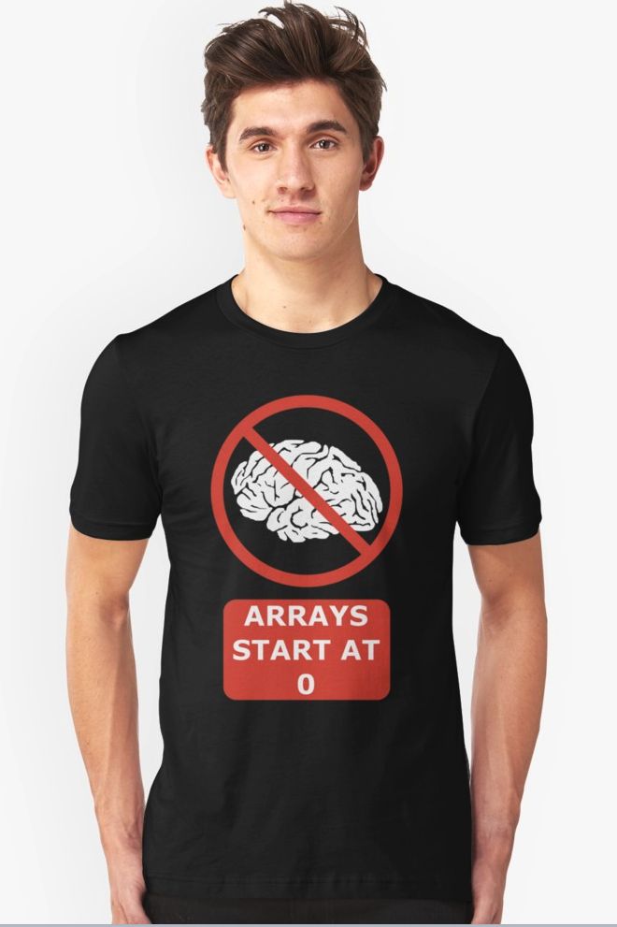
Remember!

Slide 12
Assigning values to declared arrays;
EX: int[] myList = new int[6]; ← Creating the array myList
myList[0] = 85;
myList[1]= 367;
myList [0] | 85
myList [1] | 367
myList [2] | 52
myList [3] | 85
myList [4] | 345
myList [5] | 15

Slide 13
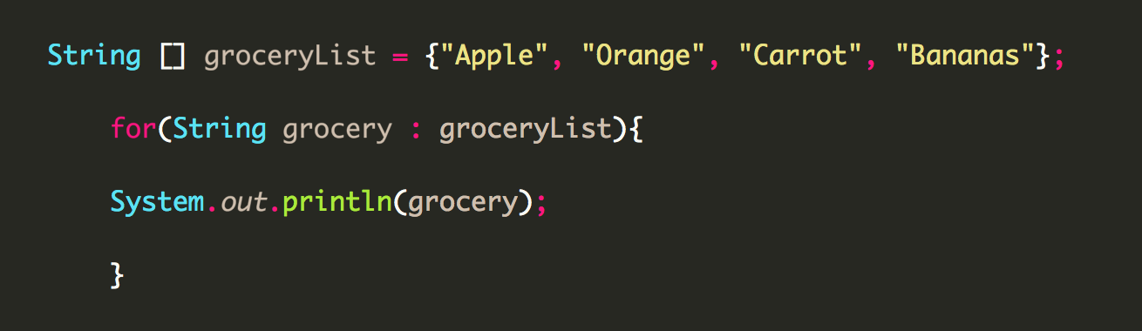
Looping an array
Looping an array using a forEach loop;

Slide 14
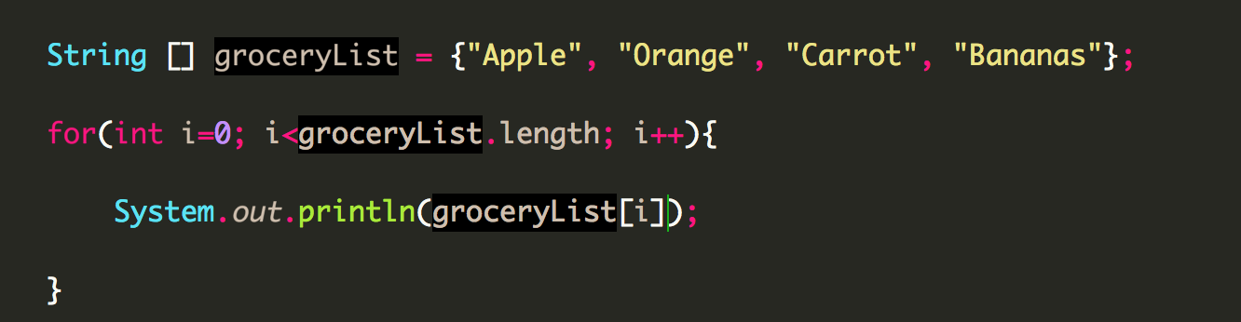
using THE FOR LOOP
Looping an array using for loop

Slide 15
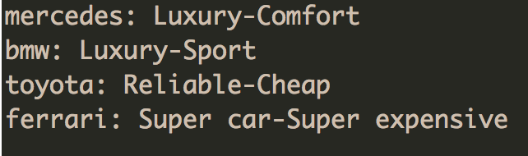
Example#1
Create a java program that has an array of String called carBrands.
mercedes, bmw, toyota, ferrari
Loop through this array.
Then provides information about that brand
Output should be as below;

Slide 16
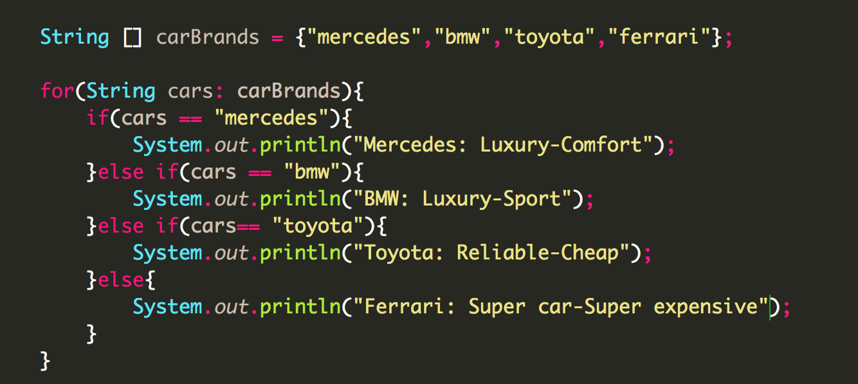
Solution with forEach loop

Slide 17
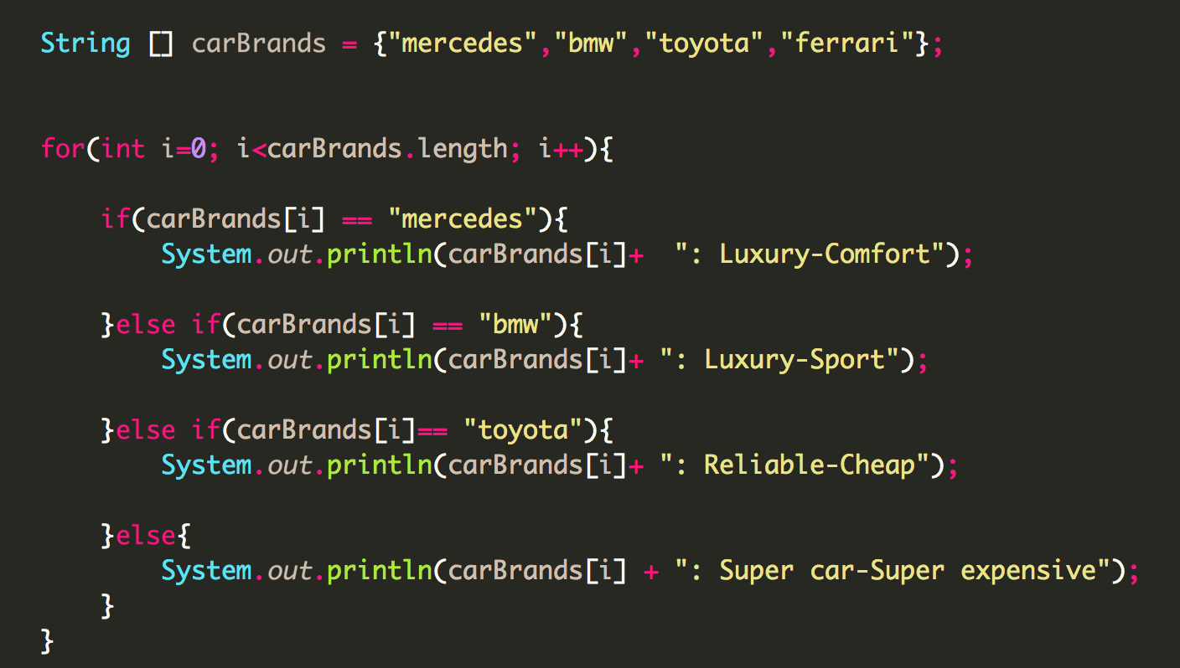
Solution with for loop

Slide 18
Advantage of using Array
Arrays are used to represent multiple data items of same type by using only single name.
It can be used to implement other data structures like linked lists, stacks, queues, trees, graphs etc.
2D arrays are used to represent matrices.

Slide 19
Like a variable, it can refer to different values at different points in the program
String carBrand1=“toyota”;
String carBrand2=“subaru”;
String carBrand3=“bmw”;
Example:
String [] carBrands = {“subaru”, “toyota”, “mercedes”, “bmw”};
carBrands[1] → toyota
carBrands[0] → subaru
carBrands[3] → bmw

Slide 20
Arrays class
This class is used to help us manipulate arrays.
Some ready methods are:
Sorting
Searching
Copying
Comparing
Formatting the data

Slide 21
Arrays.sort(array);
Sort method accepts any type of array and sorts it in ascending order.
If value is String, sorts from A-Z
If value is int, double etc, sorts from smaller to bigger number

Slide 22
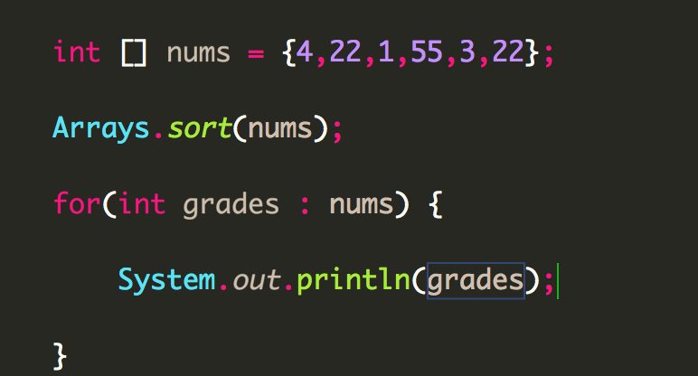

Arrays.sort(array);
Input
Output

Slide 23
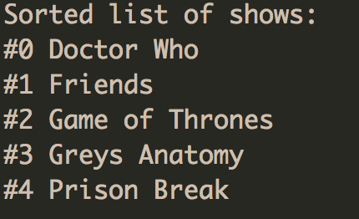
Sort- example #2
Write a java program that has the following array of String called “shows”
Game of Thrones, Friends, Prison Break, Doctor Who, Greys Anatomy
Sort it, and print them in the following format.
Output should be:

Slide 24
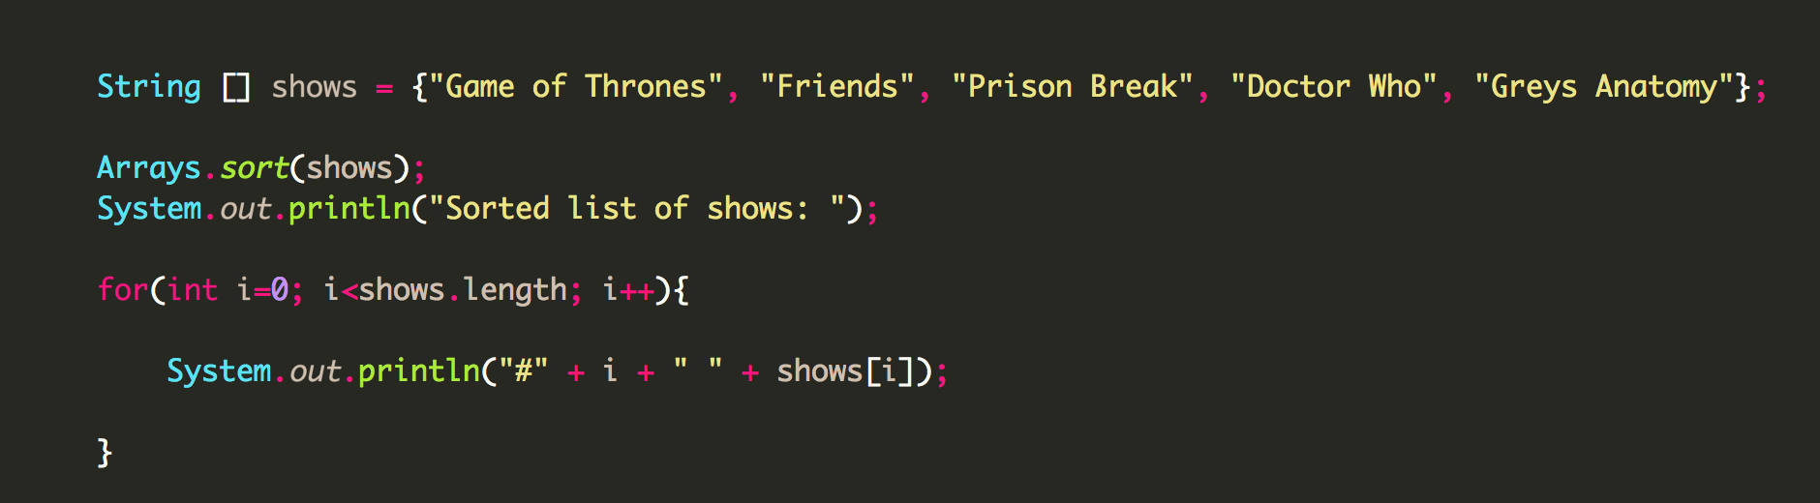
Answer

Slide 25
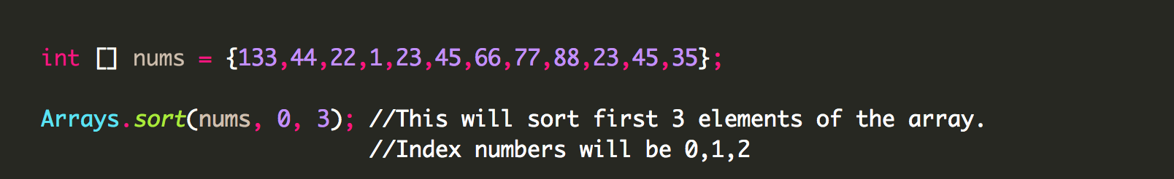
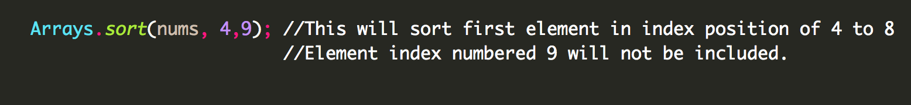
Partial sort
Partial sort syntax:
Ex;

Slide 26
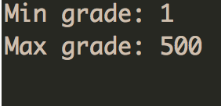
Example #3: Find max value, min value
Create an array of numbers called grades.
Elements of the array should be as followed.
15, 25, 33, 35, 66, 44, 78, 95, 98, 1, 500
Create a logic that prints out the max and min of grades.
The output should be:

Slide 27
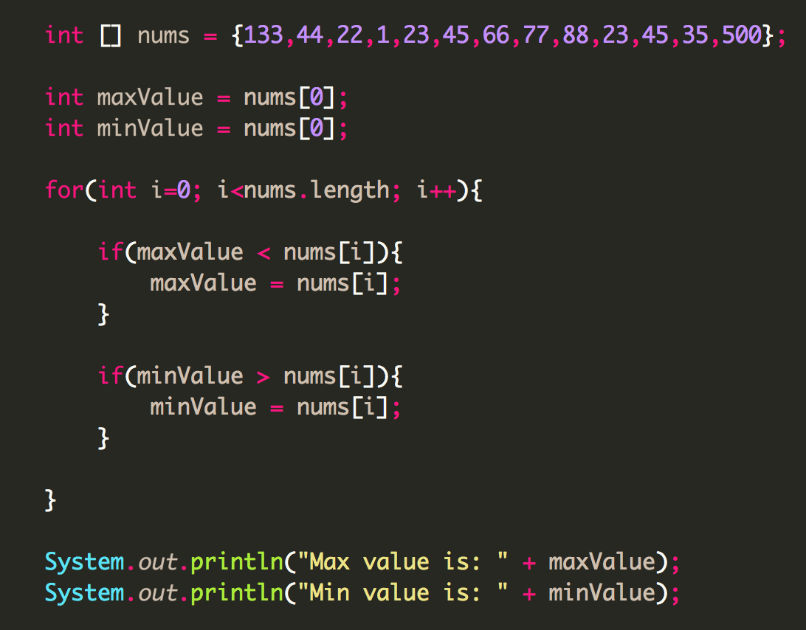
First way

Slide 28
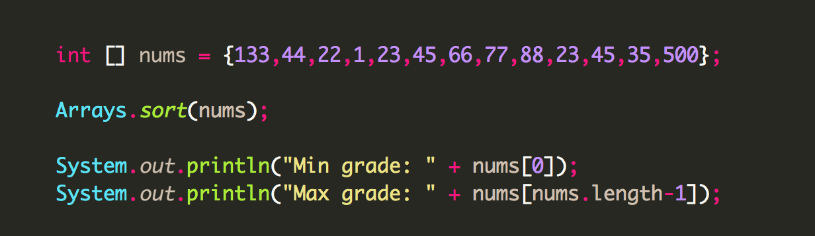
Second way

Slide 29
Searching within an array
Arrays.binarySearch method makes it easy to search for a specific element
Condition: Array has to be sorted
Returns: index number of the matching result
Arrays.binarySearch(nameOfArray, “element”); → will return the index num

Slide 30
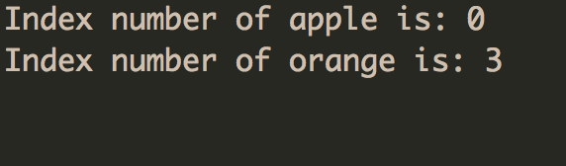
Example #4:
Create an array of String named groceryList
Grocery list should be : apple, carrot, orange, cherry, strawberry
Sort it and print out the index numbers of apple and orange.
Output:
Arrays.binarySearch(nameOfArray, “element”); → will return the index num

Slide 31
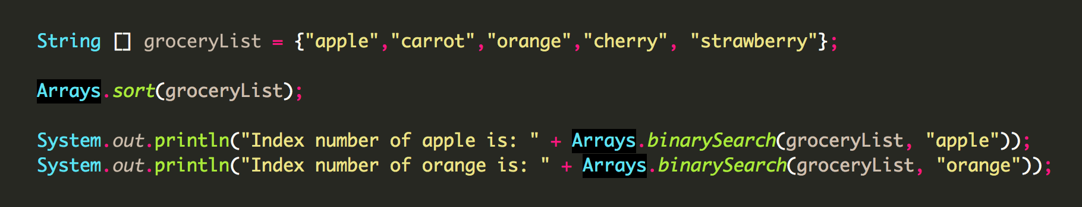
Answer

Slide 32
Arrays.copyOfRange
Copies the specified range of the specified array into a new array
Arrays.copyOfRange(originalArray, from, to);
The number that is entered to “from” cannot be bigger than “to”

Slide 33
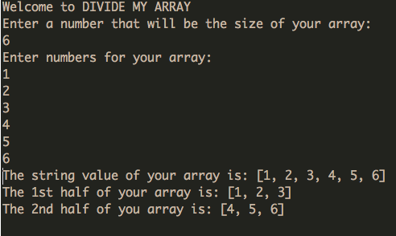
Example #5: DivideMyArray app
Create a java program:
Acceptance Criteria:
User should be able to enter the size of the array.
User should be able to enter the elements of array.
Program output should be:
Arrays.copyOfRange(originalArray, from, to);

Slide 34
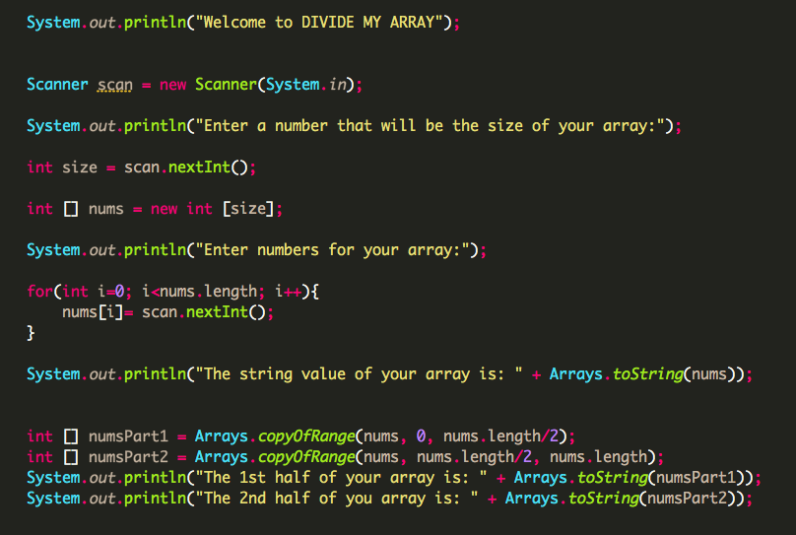
Answer

Slide 35
EXAMPLE:
Create a program that reverses a given String
Reverse the whole string AS IS.
Example: Input = “We went to picnic today”
Output= “yadot cincip ot tnew eW ”

Slide 37
EXAMPLE:
Create a program that reverses the words in a String while keeping the positions.
So you will not be reversing the whole string
You will be reversing the words in the sentence
Example: Input = “We went to picnic today”
Output= “eW tnew ot cincip yadot”

Slide 38
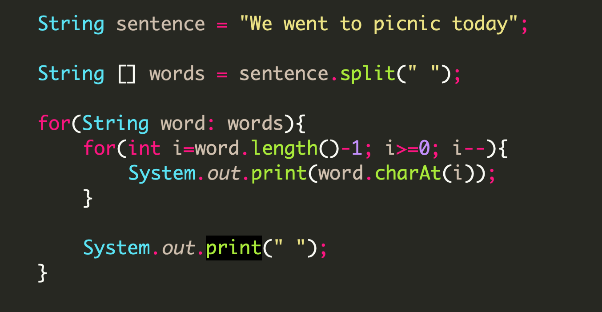
Answer

Slide 39

Multi-Dimensional Arrays

Slide 40
Multi-Dimensional Arrays
Means an array holding other arrays within itself.
Useful for creating tables with java
Useful for creating coordinates with java

Slide 41
Right index determines columns
[0][0] | [0][1] | [0][2] | [0][3] | [0][4]
[1][0] | [1][1] | [1][2] | [1][3] | [1][4]
[2][0] | [2][1] | [2][2] | [2][3] | [2][4]
Left index
determines
row

Slide 42
Example:
int a, b ,c ,d;
int a=1, b=2, c=3, d=4;
int[] nums1 = {1, 2, 3, 4};
int[] nums2 = {5, 6, 7, 8};
int[][] numsTable = { {1,2,3,4} , {5,6,7,8} };
Let’s move to IntelliJ for a more clear example!

Slide 43
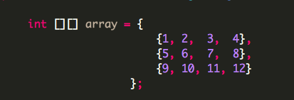
If it helps you visualize better :
This
Equal to this:

Slide 44
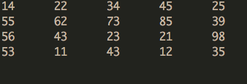
Example #6:
Create a multi dimensional array that has 4 rows, and 5 columns
Give random numbers manually
Print it out as a table
Output should be something like →

Slide 45
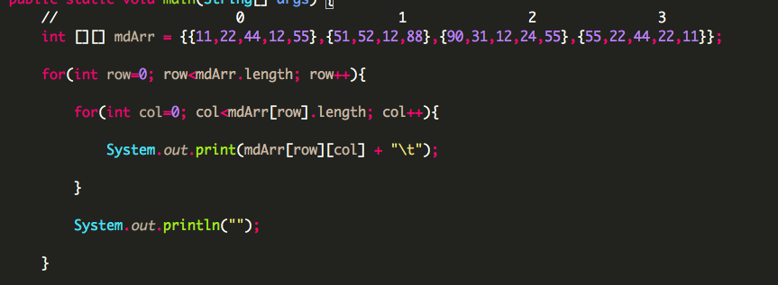
ANSWER

Slide 46

Example #7:
Create a void method that accepts a multi-dimensional array
Accepts 2 integers that will be assigned as row, and column of the array
Print out those values
Output should be like this:
Have a small commented section in your method about what your method is doing.

Slide 47
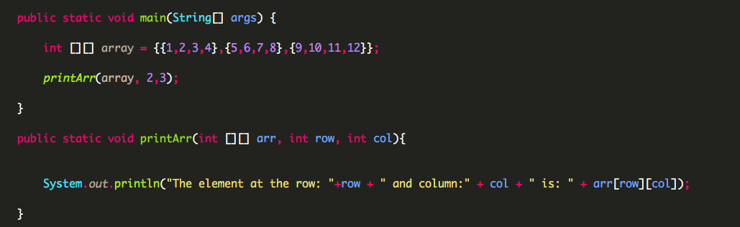
Answer

Slide 48
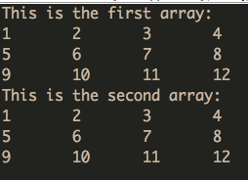
Example #8:
Create a method that accepts a multi-dimensional array
And prints out the values of that array in a table format
Pass two multi-dimensional array in.
Output should be like this:

Slide 49
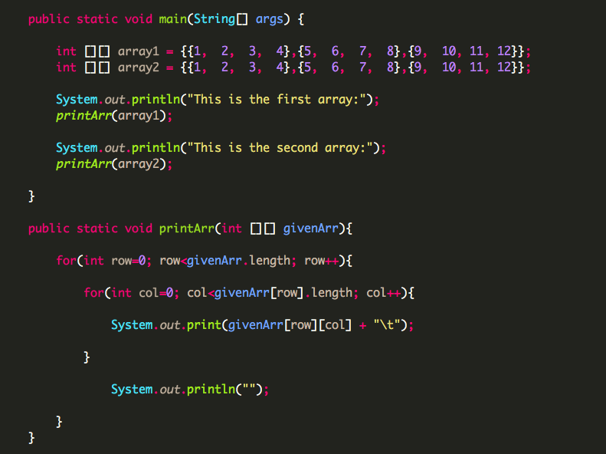
Answer

