Slide 1
Problem Statements & Assignment Planing
NGUYEN HUU LIEM

Slide 2
Stakeholders: Schuster is a multinational retail company dealing in sports goods and accessories. Business Requirements: Identify Late Payment invoices Data Analyst Requirements: build a model with the primary objective of identifying important predictor attributes that will help the business understand indicators of late payment. Model Requirements: Classification Model, Regression Model, with Evaluation, and able to predict Open Invoices Data.
Problem Statement

Slide 3
Data Preparation and EDA
NGUYEN HUU LIEM

Slide 4
- Remove unecessary columns based on the Data Dictionary- Drop cols with just a single variable - format date variables - calculate TARGET variable - Calculate Payment Term in days - Identify and remove Outliers from “USD Amount” and “PAYMENT_TERM_DAYS” using percentiles. Removing outliers will provide a better Scaler later on.
Data Preparation

Slide 5
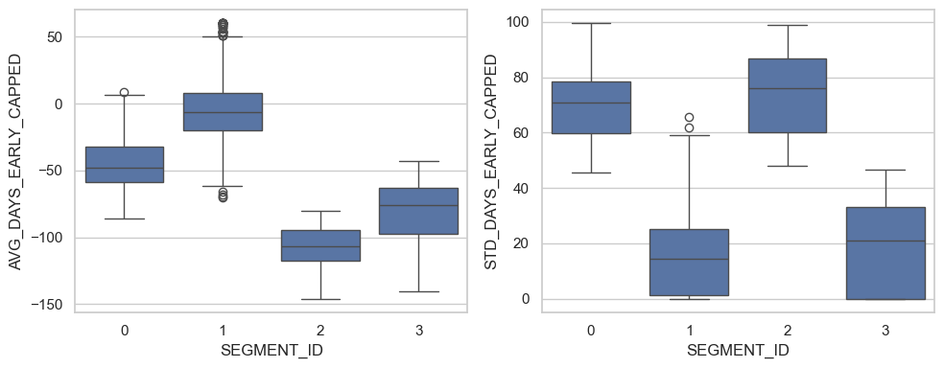
Customers Segmentaion
We have ourselve 4 customers segments with different characteristics:
- `SEGMENT_ID` 0 : Customers who make very late payments, with inconsistent late payment durations.
- `SEGMENT_ID` 1 : Customers who consistently make on-time payments.
- `SEGMENT_ID` 2 : Customers who are kinda late, and have inconsistent late payment durations.
- `SEGMENT_ID` 3 : Customers who consistently make late payments.

Slide 6
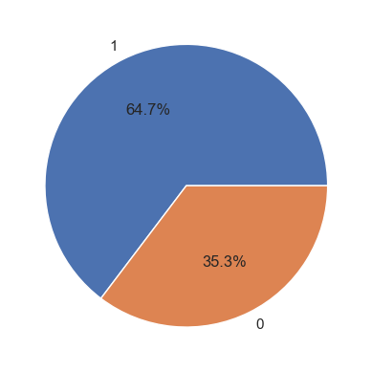
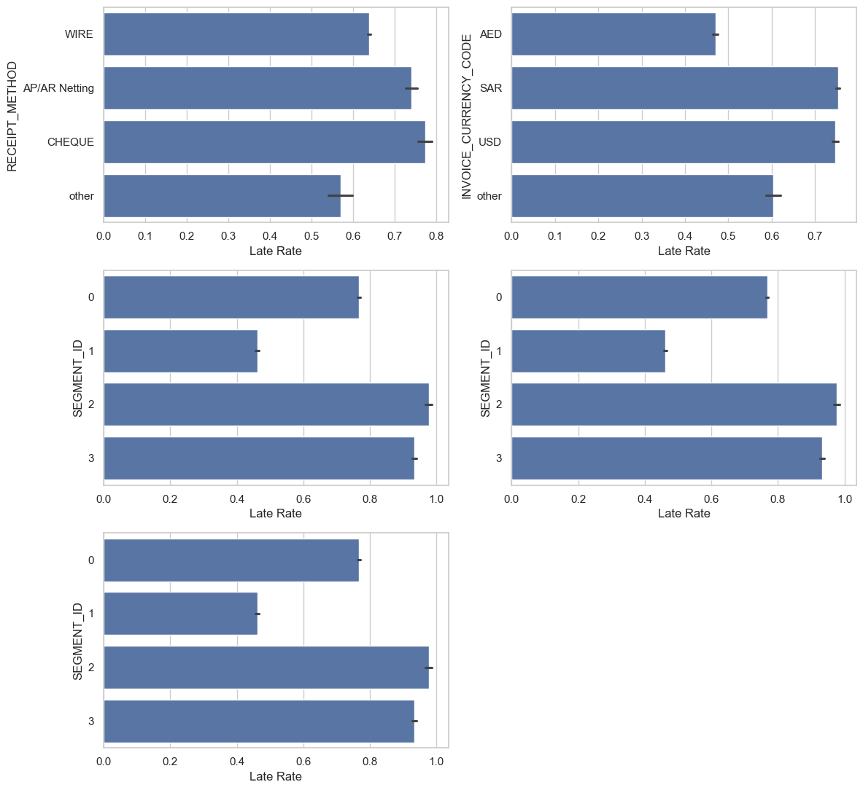
- About 2/3 payments are Late!
EDA
Insights on the Categoricals Variables Analysis:
- Payments with "Cheque" payment method have the highest chance of being late.
- Invoice's currency with "USD" and "SAR" currency have much higher change of being late, compared to "AED" and "other".
- Customers in SEGMENT_ID "3" have very high chance of paying late, while customers in SEGMENT_ID "1" are less likely to.

Slide 7
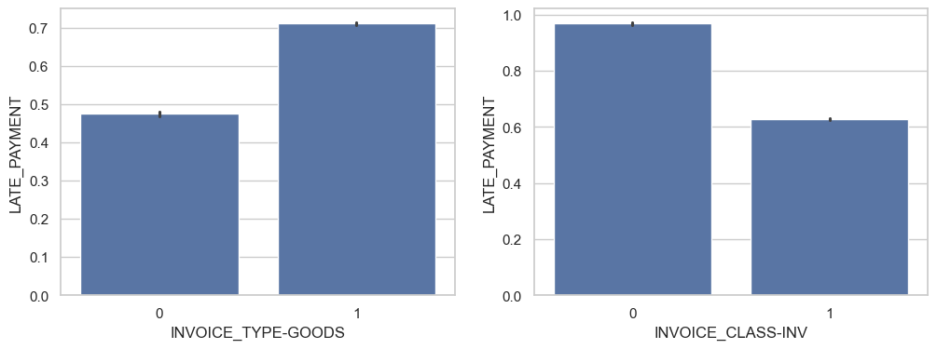
EDA
Insights on the binary variables:
- With Invoice type created for "physical goods", the change of getting a late payment is higher than Invoice created for "services"
- Invoice classes "Invoice" have lower change of a late payment, compared to "other" classes

Slide 8
Model building & Evaluation
NGUYEN HUU LIEM

Slide 9
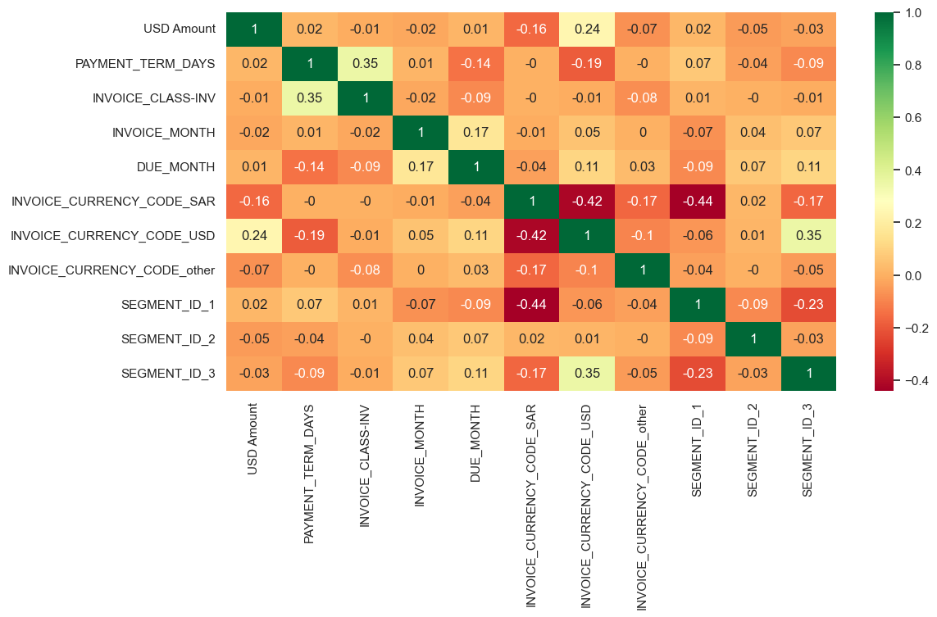
Test-train split and scaling

Slide 10
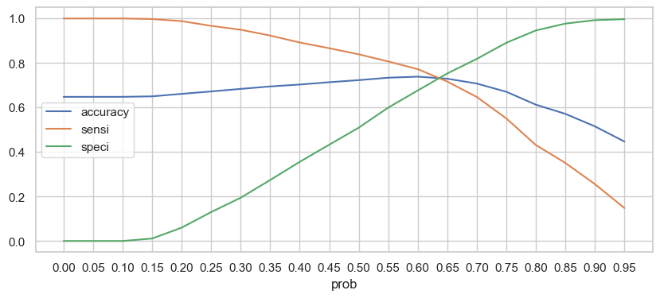
- The logistic regression model reach 0.73 accuracy, sensitivity, specificity - This will be the benchmark for our next models
Logistic Regression

Slide 11
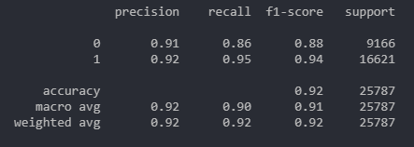
The Random Forest Classifier is built with the score of 0.92, and the params as follow: - max_depth: 23 - max_features: 5 - min_samples_leaf: 1 - min_samples_split: 2 - n_estimators: 150
Random Forest
- Good performance on class 1 (Late Payment) with high recall and F1-score. This means that our model can predict most of the late payments.
- High accuracy score on both train and test set, indicates a stable model have been built.

Slide 12
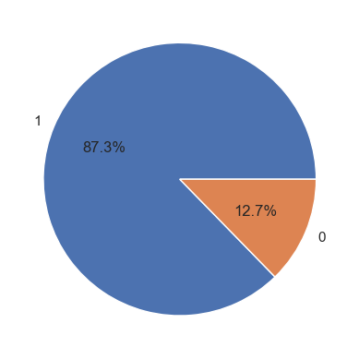
Out of ~60k Invoices predicted, there are 87% of Invoices that predicted as will be late.
Prediction on Open Invoices

Slide 13
Thank You!

