Slide 1
Option II - E-Commerce & Retail B2B Case Study
NGUYEN HUU LIEM

Slide 2
Problem Statements & Assignment Planing
NGUYEN HUU LIEM

Slide 3
Stakeholders: Schuster is a multinational retail company dealing in sports goods and accessories. Business Requirements: Identify Late Payment invoices Data Analyst Requirements: build a model with the primary objective of identifying important predictor attributes that will help the business understand indicators of late payment. Model Requirements: Classification Model, Regression Model, with Evaluation, and able to predict Open Invoices Data.
Problem Statement

Slide 4
Data Preparation and EDA
NGUYEN HUU LIEM

Slide 5
- Remove unnecessary columns based on the Data Dictionary - Drop cols with just a single variable - Format date variables - Calculate TARGET variable - Calculate Payment Term in days - Identify and remove Outliers from “USD Amount” and “PAYMENT_TERM_DAYS” using percentiles. Removing outliers will provide a better Scaler later on.
Data Preparation

Slide 6
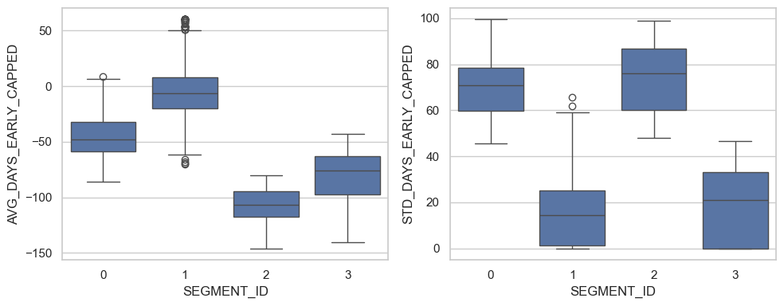
Customers Segmentaion
We have ourselves 4 customers segments with different characteristics:
- `SEGMENT_ID` 0 : Customers who make very late payments, with inconsistent late payment durations.
- `SEGMENT_ID` 1 : Customers who consistently make on-time payments.
- `SEGMENT_ID` 2 : Customers who are kinda late, and have inconsistent late payment durations.
- `SEGMENT_ID` 3 : Customers who consistently make late payments.

Slide 7
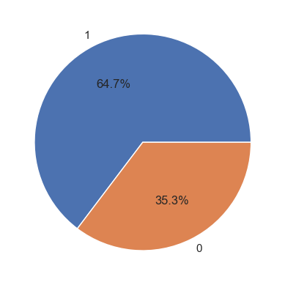
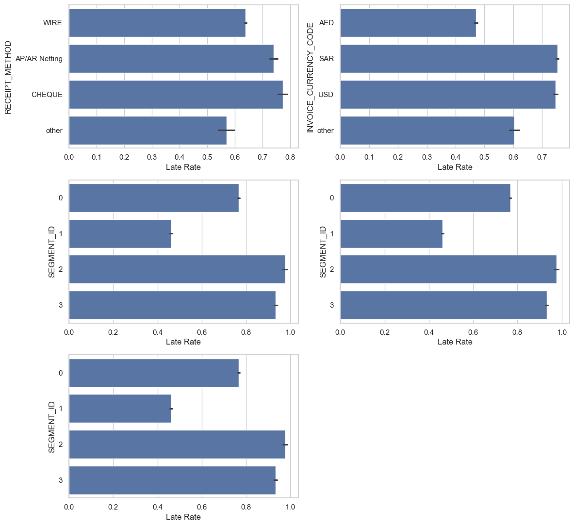
- About 2/3 payments are Late!
EDA
Insights on the Categoricals Variables Analysis:
- Payments with "Cheque" payment method have the highest chance of being late.
- Invoice's currency with "USD" and "SAR" currency have much higher change of being late, compared to "AED" and "other".
- Customers in SEGMENT_ID "3" have very high chance of paying late, while customers in SEGMENT_ID "1" are less likely to.

Slide 8
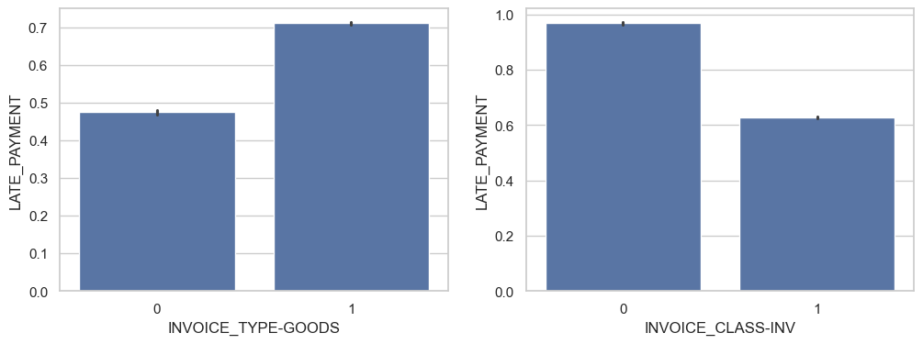
EDA
Insights on the binary variables:
- With Invoice type created for "physical goods", the change of getting a late payment is higher than Invoice created for "services"
- Invoice classes "Invoice" have lower change of a late payment, compared to "other" classes

Slide 9
Model building & Evaluation
NGUYEN HUU LIEM

Slide 10
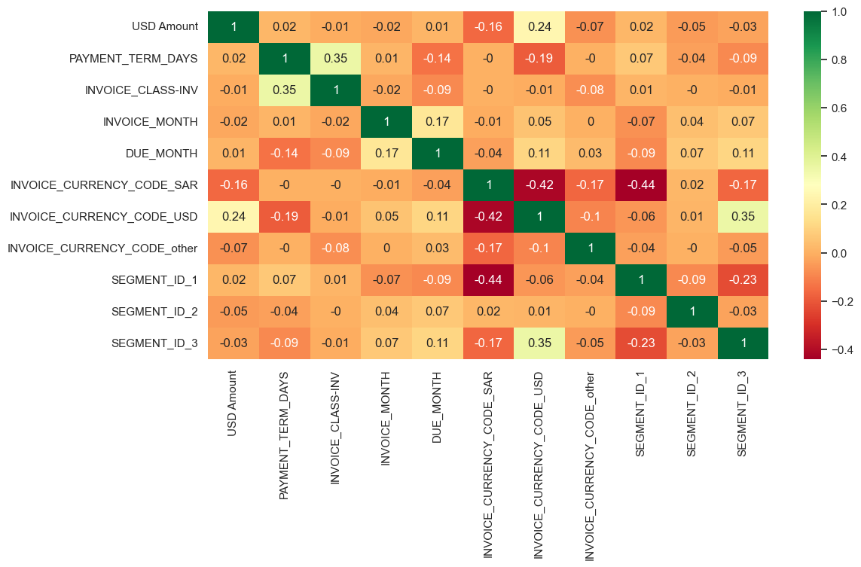
Test-train split and scaling

Slide 11
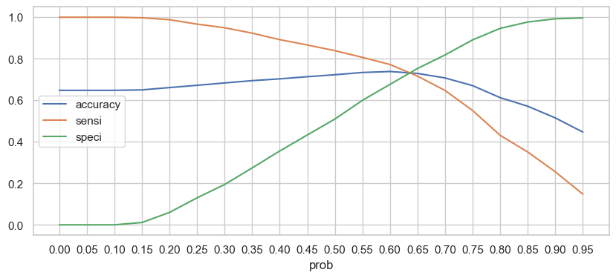
- The logistic regression model reach 0.73 accuracy, sensitivity, specificity - This will be the benchmark for our next models
Logistic Regression

Slide 12
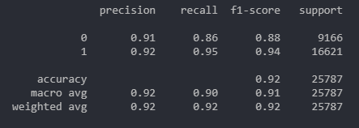
The Random Forest Classifier is built with the score of 0.92, and the params as follow: - max_depth: 23 - max_features: 5 - min_samples_leaf: 1 - min_samples_split: 2 - n_estimators: 150
Random Forest
- Good performance on class 1 (Late Payment) with high recall and F1-score. This means that our model can predict most of the late payments.
- High accuracy score on both train and test set, indicates a stable model have been built.

Slide 13
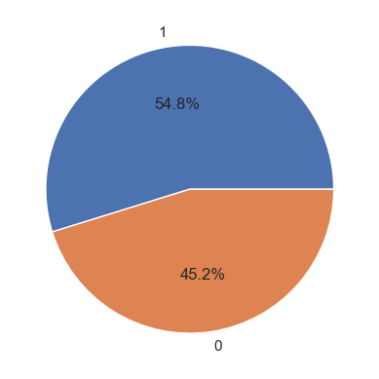
Out of ~28k Invoices predicted, there are 55% of Invoices were predicted as will be late.
Prediction on Open Invoices

Slide 14
Schuster should actively push and chase vendors with the following characteristics: 1. The currency they used for transaction are SAR or USD. 2. Vendors who belong to segment id 2 or 3. 3. Have invoices with payment terms below 40~50 days since the invoice is issued. 4. Have invoices issued during Autumn period (or Due during Winter period). 5. Have invoices classes other than “INV”. 6. Have invoices predicted as late payment in the ‘open_pred_df’ dataframe.
Recommendations

Slide 15
Thank You!

