Slide 1
Capstone Project
Segmenting and Clustering
Affordable Rental Project
in San Francisco

Slide 2
Content Page
1 - Introduction: Business Problem
2 - Data
2.1 - Source of Data
2.2 - Download and Explore Dataset

Slide 3
1. Introduction Business problem
Let assume that your boss request you to have a business trip at San Francisco for 3 month with a limited budget.
There would be a thousand rental house in San Francisco is waiting for you. There for your have a look to the listed affordable rental house published by Mayor's Office of Housing and Community Development Affordable Rental.
You need to choose the right one which have an affordable payment and nearest the living facility that make you save more money from transportation and movement times.
In this project, I will try to find a category of optimal affordable rental projects with better living facilities. This report will be targeted to individuals who want to travel to San Francisco for business or holiday with a limit budget.

Slide 4
2. Data 2.1 Source of Data
Based on the business problem, factors that will influence visitor to choose are:
Number of existing facilities around each project
Type of existing facilities around each project
Following data sources will be needed to generate the proper decision:
Basic information (project name/location/ Year Affordability Began ) of all the affordable rental programs, which can be get from open data website of San Francisco GOV (https://data.sfgov.org/)
Number of existing facilities and their type and location in every neighborhood will be obtained using Foursquare API

Slide 5
2. Data 2.2 Download and Explore Dataset
Datasets include some NaN value in Longitude and Latitude, we need to drop the rows which not clear Longitude and Latitude
The house too old include many risk and low quality so we only choose the rental house which have constructed year after 2005
Below is basic information data of Rental Project and Visualization using Folium to help use easy to observe the distribute on the San Francisco map

Slide 6
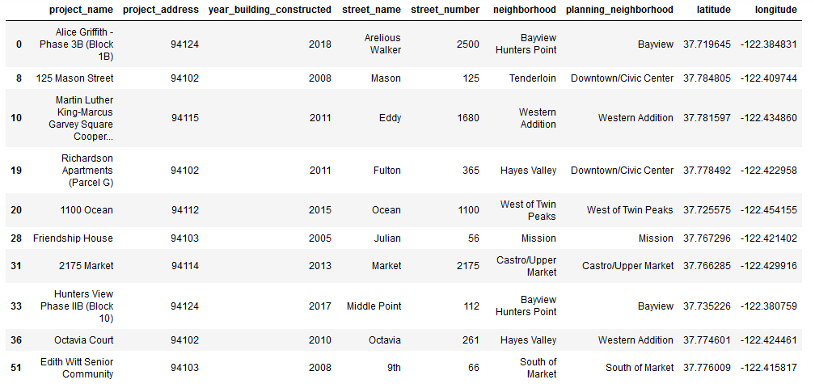
2. Data 2.2 Download and Explore Dataset

Slide 7
