Slide 1
Capstone Project
Segmenting and Clustering
Affordable Rental Project
in San Francisco

Slide 2
Content Page
1 - Introduction: Business Problem
2 - Data
2.1 - Source of Data
2.2 - Download and Explore Dataset

Slide 3
1. Introduction Business problem
Let assume that your boss request you to have a business trip at San Francisco for 3 month with a limited budget.
There would be a thousand rental house in San Francisco is waiting for you. There for your have a look to the listed affordable rental house published by Mayor's Office of Housing and Community Development Affordable Rental.
You need to choose the right one which have an affordable payment and nearest the living facility that make you save more money from transportation and movement times.
In this project, I will try to find a category of optimal affordable rental projects with better living facilities. This report will be targeted to individuals who want to travel to San Francisco for business or holiday with a limit budget.

Slide 4
2. Data 2.1 Source of Data
Based on the business problem, factors that will influence visitor to choose are:
Number of existing facilities around each project
Type of existing facilities around each project
Following data sources will be needed to generate the proper decision:
Basic information (project name/location/ Year Affordability Began ) of all the affordable rental programs, which can be get from open data website of San Francisco GOV (https://data.sfgov.org/)
Number of existing facilities and their type and location in every neighborhood will be obtained using Foursquare API

Slide 5
2. Data 2.2 Download and Explore Dataset
Datasets include some NaN value in Longitude and Latitude, we need to drop the rows which not clear Longitude and Latitude
The house too old include many risk and low quality so we only choose the rental house which have constructed year after 2005
Below is basic information data of Rental Project and Visualization using Folium to help use easy to observe the distribute on the San Francisco map

Slide 6
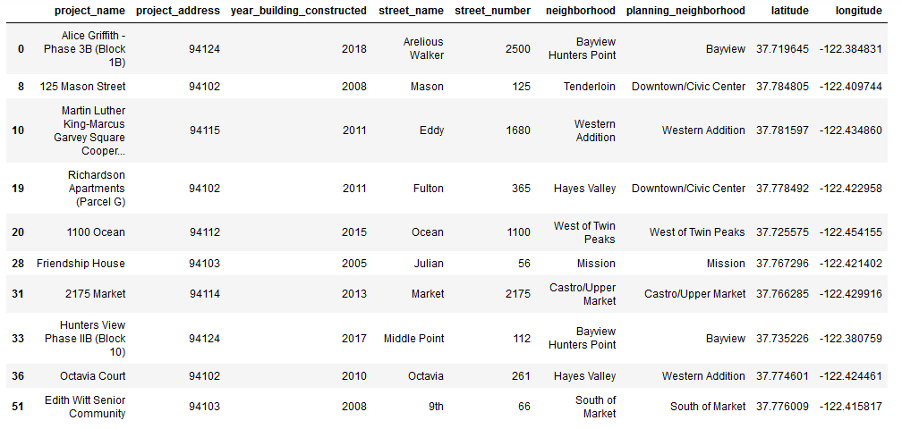
2. Data 2.2 Download and Explore Dataset

Slide 7
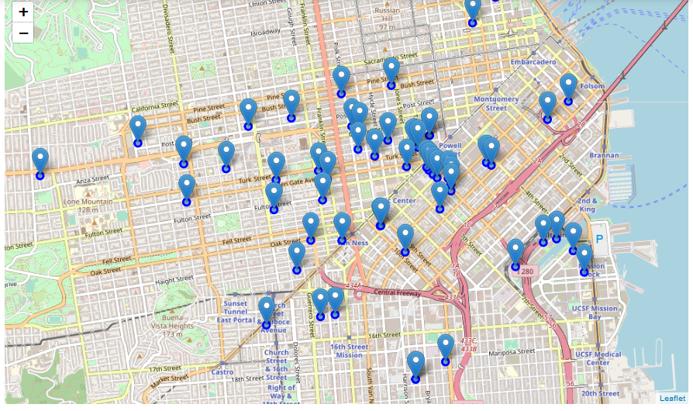

Slide 8
3. Methodology
The first step should be defined the business problem, we already have done that in Introduction
The second step should be downloaded the data and explore it, as we have done in Data
The Third step is to explore neighborhoods of each affordable housing projects in San Francisco with Foursquare API
The final step, cluster the all the affordable housing projects with K-means & visualize geographic details of each cluster

Slide 9
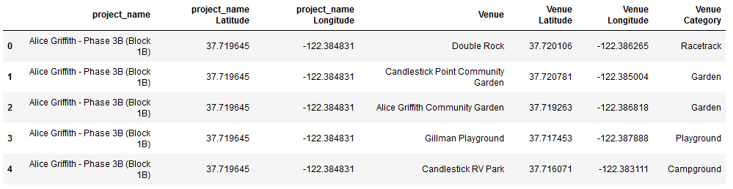
4. Analysis 4.1 Analyze Each Project Venues around ‘Affordable Rental Projects’

Slide 10
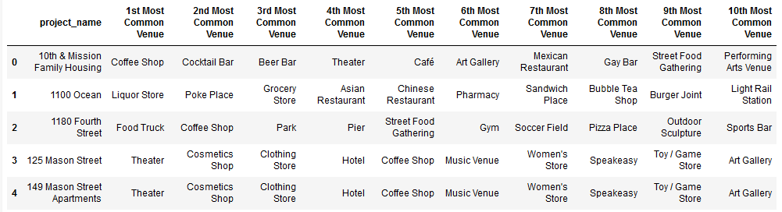
4. Analysis 4.1 Analyze Each Project Most common venues around each project

Slide 11
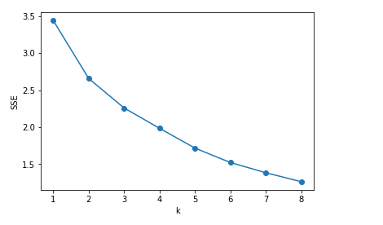
4. Analysis 4.2 Cluster Project
Best K with Elbow criterion

Slide 12
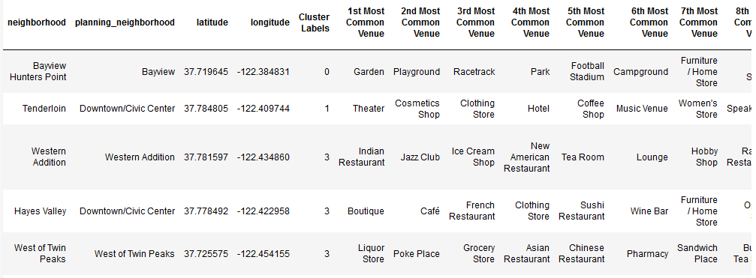
4. Analysis 4.2 Cluster Project
Merged table with cluster labels

Slide 13
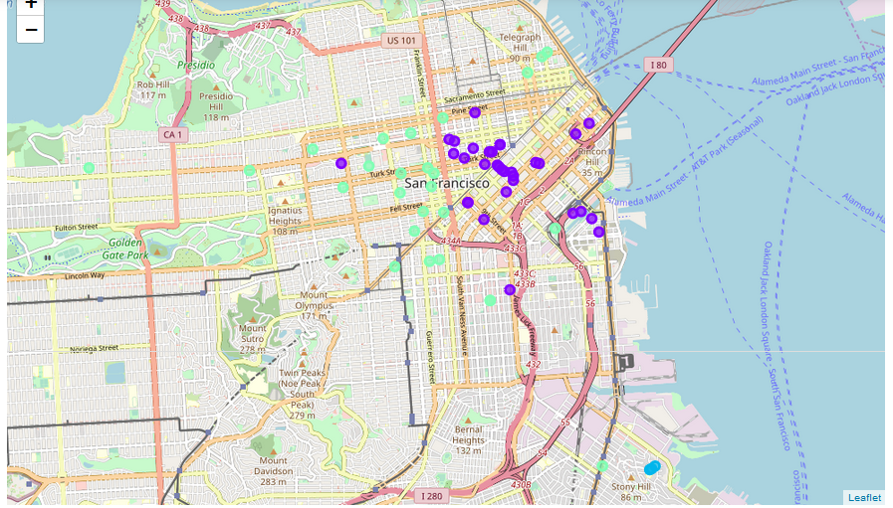
4. Analysis 4.2 Cluster Project
Geographic details of each cluster

Slide 14
5. Results and Discussion
Cluster 1 contains 3 affordable rental projects, top 10 Most Common Venue mainly contains Playground/ Racetrack /Park /Football Stadium /Campground /Furniture / Home Store /Yoga Studio /Donut Shop /Dive Shop, if the individual would like to have a fresh air and some quiet place for relax, these areas will be quite good.
Cluster 2 contains 33 affordable rental projects, this cluster contains most projects, top 10 Most Common Venue mainly contains Coffee Shop /Cocktail Bar /Nightclub /Gay Bar /Food Truck /Café /Motorcycle Shop /Thai Restaurant /Art Gallery /Furniture / Home Store etc.., almost cover every aspect of our daily life, obviously, it will be very convenient to live in these areas.
Cluster 3 contains 3 affordable rental projects, top 10 Most Common Venue mainly contains Park /Skate Park /Bookstore /Brewery /Event Space /Donut Shop /Dumpling Restaurant /Electronics Store /English Restaurant /Ethiopian Restaurant, it seems like these are community areas, living facilities are too simple here, but it may be good for those who work here.
Cluster 4 contains 32 affordable rental projects, top 10 Most Common Venue mainly contains Art Coffee Shop /Gay Bar /Gym /Sushi Restaurant /Grocery Store /Asian Restaurant /Sandwich Place /Café /Pet Store, it look like this cluster is a food areas which suitable for teenage. Their can try new food here and explore new culture such as Gay Bar or some Art Coffee Shop
Cluster 5 contains 1 affordable rental projects, this cluster contains most projects, top 10 Most Common Venue mainly contains Playground /Mountain Park /Yoga Studio /English Restaurant /Doctor's Office /Dog Run /Donut Shop /Dumpling Restaurant /Electronics Store etc.., living facilities are too simple here, but it may be good for those who work here.

Slide 15
5. Conclusion
Purpose of this project is try to find a category of optimal affordable Rental projects with better living facilities. Target to individuals who want to travel to San Francisco for business or holiday with a limit budget. As it is widely believed that a most of residential areas should be equipped with a range of living facilities, such as restaurants/gyms/markets/hospitals etc...
The Foursquare location data was leveraged to compare each project to provide reliable suggestions for individuals who want to choose some place with better living facilities.
With unsupervised learning K-means algorithm, all the affordable Rental projects were clustered in to 5 categories, the advantages of each category was expressed to help individuals choose their best one
This Project simply processed the Rental affordable housing programs data, and cluster them into 5 categories based one the living facilities data, the results can only help individuals choose the place they want to rent with affordable price and better living facilities. Further analysis can be done base on these 5 clusters, which can help provide more detail information to clarify the advantages of each category.

