Slide 1
BECODE × BANKING COMMUNICATION RESEARCH
Banking campaigns comparator
From public product pages to evidence-backed comparisons
A reusable research workflow
Built for human review
Capture evidence. Structure observations.
Review automatic suggestions. Compare like with like.
Business question: what can ING learn from how other banks present similar products?
React + FastAPI + PostgreSQL
Playwright page capture
Rule-based assistance
No AI model required
Project review · 24 September 2026
01
Notes:
Introduce the team. This is a research POC for comparing communication, not a production marketing platform. The deck assesses the current repository against the two stakeholder briefs.
Evidence: Project review · 24 September 2026

Slide 2
01 / WHY THIS PROJECT
The brief asks for evidence, not a bank ranking
A focused, reproducible POC for business and data stakeholders.
Compare consistently
Explain differences
Make it reusable
Same product category
Clear feature definitions
Explicit sample and language
Text and messaging
Visual design and structure
Calls to action and value
Preserve original evidence
Save structured labels
Document limits and assumptions
ING presentation pp. 19–22; use-case: Objective, MVP, Expected Outputs
02
Notes:
The stakeholder presentation illustrates differences in imagery, text and layout. These are starting hypotheses, not findings produced by our app. The use case explicitly says this is not a modelling exercise. Our scope is public product pages; we do not measure campaign conversion or CTR.
Evidence: ING presentation pp. 19–22; use-case: Objective, MVP, Expected Outputs

Slide 3
02 / DELIVERY AGAINST THE BRIEF
The research workflow is implemented
Business conclusions still depend on a reviewed, comparable sample.
Implemented
Partially addressed
Still to demonstrate
Page capture and history
Structured feature framework
Automatic draft suggestions
Manual review and completion
Category-based comparison
Limited registered auto cases
Visual dimensions: manual
Keyword method calibration
Sitemap discovery tooling
Research sample completion
ING market positioning
Traditional vs neobank patterns
Evidence-backed improvements
Cross-reviewer agreement
Business impact validation
Use-case: Feature Extraction, Expected Outputs; code evidence in presentation notes
03
Notes:
Implemented evidence: scraping/page_scrapers.py, capture.py, schemas/features.py, api/features.py, services/compare.py and frontend Compare.tsx. Partial: broad bank/language coverage and visual automation. Not established: ING positioning and validated recommendations. Do not claim a POC automatically proves business impact.
Evidence: Use-case: Feature Extraction, Expected Outputs; code evidence in presentation notes

Slide 4
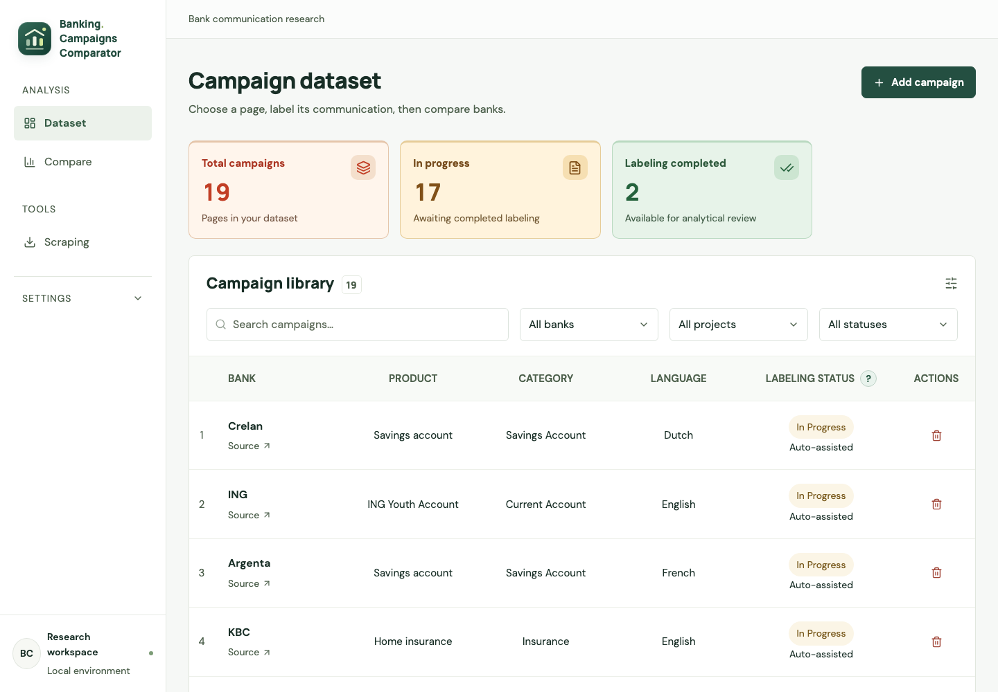
03 / PRODUCT WALKTHROUGH
One workspace for the research team
Actual local app snapshot: 19 campaigns, 2 completed; 17 awaiting completion.
Four working areas
Scraping sources
Dataset and filters
Product review / labeling
Comparison workspace
Local Dataset UI captured 24 September 2026; frontend/src/pages/Dashboard.tsx
04
Notes:
These are current UI counts, not a market sample claim. Completed status can include acknowledged missing fields. The screenshot documents application state and should not be presented as audited source authenticity or complete research coverage.
Evidence: Local Dataset UI captured 24 September 2026; frontend/src/pages/Dashboard.tsx

Slide 5
BANKING CAMPAIGNS COMPARATOR
Project architecture & data flow
Current implementation • Public webpages • Rule-based assistance • Human review
INTERFACE
Scraping Sources
Dataset & Labeling
Compare workspace
React
Add URL / choose action
Review evidence and labels
Charts, tables, observations
Evidence
PROCESSING
Auto-label
path only
FastAPI / Python
Source API
Support registry
Playwright capture
Feature extraction
Comparison API
Import / add sources
Select capture mode
Exact bank / category
product / language
Render public page
Save original evidence
Text / message / CTA
Registered auto cases
Same product category
Saved feature values
Review
& save
Every successful capture
First auto draft
DATA
Sources
Capture history
Feature records
Research context
PostgreSQL + files
user_sources / imports
Configured JSON input
PageCapture in database
Screenshot + dom.json files
CampaignFeature
Notes and review status
Campaign / bank / category
Stored in PostgreSQL
ACTION RULES
First + supported: Scrape & Auto-label | First + unsupported: Capture page | Already captured: Capture only
Solid arrows: data flow
Dashed arrows: user / control trigger
Recapture adds evidence and preserves saved labels.
Code: api/scraping.py · services/collection.py · scraping/* · services/compare.py | 24 September 2026
Notes:
Architecture of the implemented local app. Solid arrows show data; dashed arrows show triggers. Configured JSON sources are imported on list load. Only the first supported auto-label action saves automatic labels. All capture modes save evidence. Human review edits saved feature records. Compare reads those records within a single product category. No cloud AI, email, hash-based change detection or automatic website-difference engine is implied.

Slide 6
05 / PIPELINE
Three actions, chosen by source state
Exact automatic support: bank + category + product + language.
Product URL → Source in database → Successful capture already exists?
No + auto supported
No + no auto support
Yes: already captured
Scrape & Auto-label
Evidence + automatic draft
Capture page
Evidence; labels stay manual
Capture only
New evidence; labels preserved
↓
↓
↓
PageCapture history → Human review → Saved features → Compare
scraping/dispatcher.py; scraping_config.py; services/collection.py; pages/Scraping.tsx
06
Notes:
Sources come from UI additions or configured JSON imported into user_sources on list load. For a first capture, supported sources offer Scrape & Auto-label; unsupported sources offer Capture page. After a successful capture both paths offer only Capture only. Failed first attempts retain the original action. Recapture preserves labels.
Evidence: scraping/dispatcher.py; scraping_config.py; services/collection.py; pages/Scraping.tsx

Slide 7
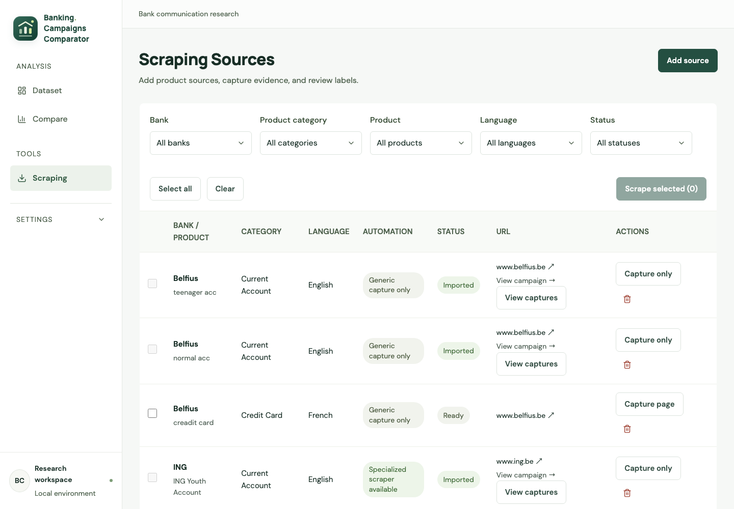
06 / EVIDENCE COLLECTION
Capture the page before analysing it
Screenshot, DOM and extracted content stay available for review.
Evidence saved
Full-page screenshot
DOM / shadow-root data
Text and headings
Paragraphs, lists, tables
Timestamp and warnings
scraping/capture.py; page_scrapers.py; message_scraper.py; components/CaptureViewer.tsx
07
Notes:
Capture evidence is saved before destructive text cleanup. Each capture is a historical record. Generic capture works without creating automatic labels. Dynamic pages, banners and hidden content can still affect coverage. Source URL and timestamps enable traceability; database and artifacts must be backed up together.
Evidence: scraping/capture.py; page_scrapers.py; message_scraper.py; components/CaptureViewer.tsx

Slide 8
07 / FEATURE FRAMEWORK
68 fields across 8 analytical sections
Plus campaign observations and labeling notes for research context.
01 / 4 fields
02 / 9 fields
03 / 9 fields
04 / 12 fields
Identification & Metadata
Text & Content
Messaging & Tone
Images & Visuals
05 / 7 fields
06 / 10 fields
07 / 6 fields
08 / 11 fields
Colour & Design
Layout & Page Structure
Call to Action
Product & Value Proposition
frontend/src/api/features.ts; backend/app/schemas/features.py; pages/Label.tsx
08
Notes:
Counts are derived from the current frontend feature definitions. The UI also has a ninth group for additional campaign observations. Having fields available does not mean all are automatically populated. Most visual/design fields require manual annotation.
Evidence: frontend/src/api/features.ts; backend/app/schemas/features.py; pages/Label.tsx

Slide 9
08 / AUTOMATED ASSISTANCE
Measurements and heuristics produce a draft
Automation supports reviewers; it does not determine effectiveness.
Text measurements
Message and tone
CTA analysis
Word and heading counts
Paragraph and bullet counts
Headline length
Case-specific text heuristics
Feature vs benefit focus
Emotional vs rational
Formality and friendliness
Keyword-based scale scores
Count and primary text
Above-fold placement
Repeated primary CTA
Prominence (1–5) and type
feature_labels.py; message_analysis.py; message_analysis_config.py; cta_analysis.py
09
Notes:
Supported cases share code but coverage is explicitly registered. Message scoring requires at least 50 words. Keyword-based scores need language and product calibration. CTA uses visible candidates, keyword/class rules, deduplication and ranking. No trained AI model is used. Six CTA fields are persisted via the existing feature schema.
Evidence: feature_labels.py; message_analysis.py; message_analysis_config.py; cta_analysis.py

Slide 10
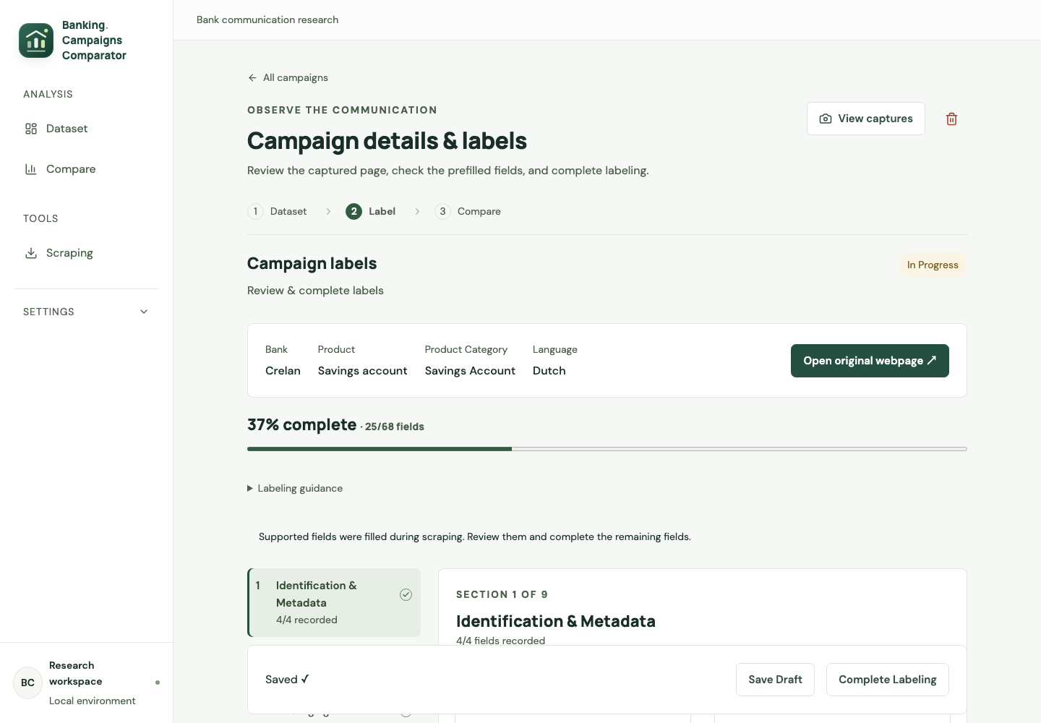
09 / HUMAN REVIEW
Keep the analyst in control
Not Started → In Progress → Completed
Reviewer decisions
Check captured evidence
Correct suggested values
Label visual dimensions
Record notes and context
Complete the review
pages/Label.tsx; api/features.py; components/FeatureControls.tsx
10
Notes:
Show the product details screen. Explain the difference between automatic provenance and review status. Completion may acknowledge missing fields, so it is not a promise of 100 percent completeness. Recapture updates evidence without overwriting reviewed labels.
Evidence: pages/Label.tsx; api/features.py; components/FeatureControls.tsx

Slide 11
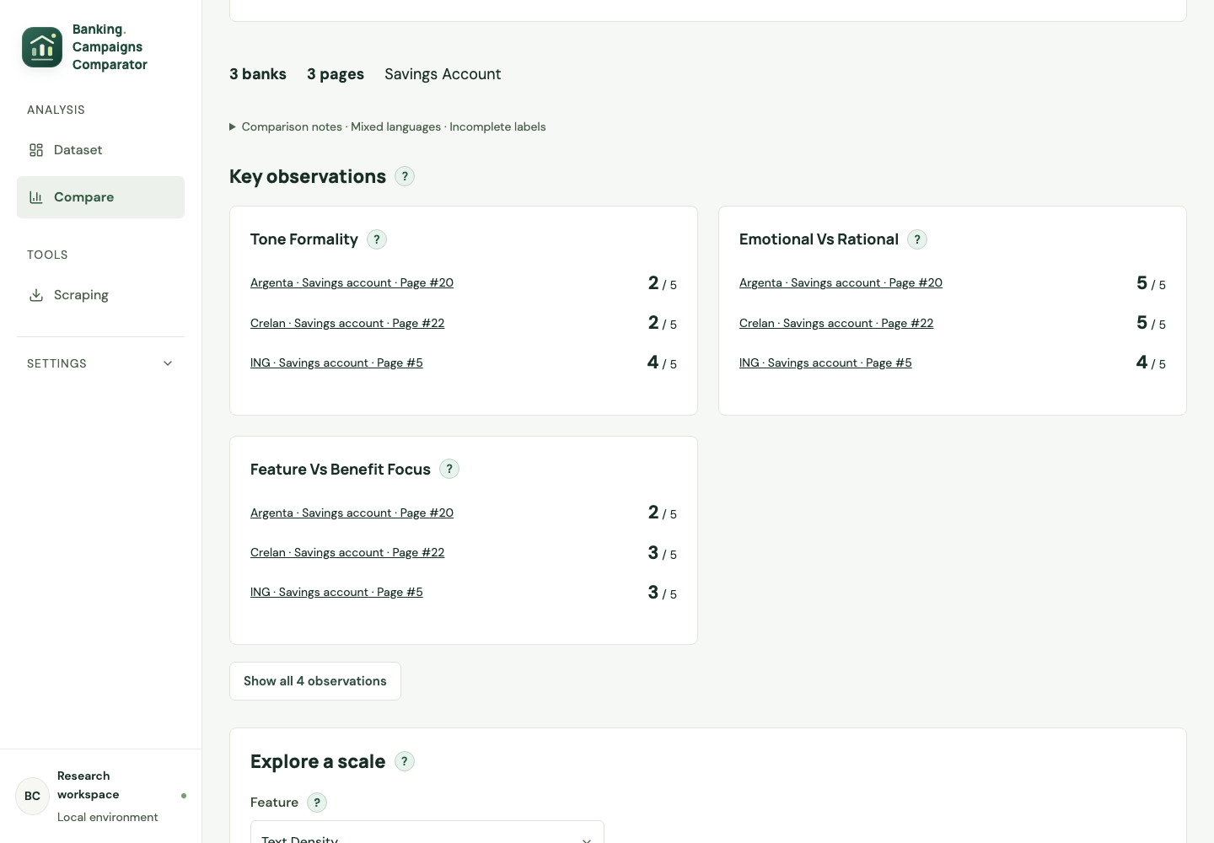
10 / COMPARISON
Compare recorded page characteristics
One category at a time; each page remains a separate observation.
What the views show
Selected-page feature tables
Descriptive 1–5 charts
Ranges and coverage
Missing-data warnings
Links back to product review
services/compare.py; ComparisonChart.tsx; ComparisonFindings.tsx; ComparisonTable.tsx
11
Notes:
Observations describe ranges or equal scores in the selected sample. They are deterministic summaries, not AI insights. Missing values stay missing and higher values do not necessarily mean better. There are no bank averages or effectiveness measurements. Screenshot selection is illustrative and may include drafts.
Evidence: services/compare.py; ComparisonChart.tsx; ComparisonFindings.tsx; ComparisonTable.tsx

Slide 12
11 / QUALITY AND LIMITATIONS
Useful POC; validation is still essential
Technical checks and research validity answer different questions.
Engineering evidence
Methodology risks
Collection boundaries
192 tests passed in the last run
CTA browser fixture checks
Saved feature / recapture tests
Generic and supported paths
No production-readiness claim
Vocabulary and language bias
Page length and text scope
Cookie / dynamic content
Manual reviewer differences
Small, incomplete sample
Public-page collection only
URL validation in generic flow
Sitemap discovery available
Review website permissions
No claim of universal access
tests/test_cta.py; test_source_workflow.py; test_message_integration.py; crawling/crawling.py
12
Notes:
The last completed backend run during implementation reported 192 passed; it was not rerun for this presentation. Tests cover implementation, not accuracy of bank labels. Sitemap discovery reads robots.txt for sitemap locations; that is not evidence that every fetch enforces robots rules. Site permission review remains a team responsibility.
Evidence: tests/test_cta.py; test_source_workflow.py; test_message_integration.py; crawling/crawling.py

Slide 13
12 / BUSINESS HANDOFF
What ING can use — and what comes next
A repeatable comparison process is delivered; conclusions need reviewed evidence.
Value delivered
Before final conclusions
Next business output
Less fragmented evidence
A common feature vocabulary
Traceable review decisions
Repeatable comparison views
Match category and language
Include relevant competitors
Complete and double-review
Validate keyword scores
Explain 2–3 real differences
Show evidence for each claim
Position ING within the sample
Propose testable improvements
Use-case: Expected Outputs, Goal; ING presentation pp. 21–22
13
Notes:
Do not invent a conclusion such as ING being more rational than competitors. Next choose a defensible matched sample, double-review labels, show a few concrete differences with screenshots and then formulate improvement hypotheses. Testing those hypotheses would be separate work.
Evidence: Use-case: Expected Outputs, Goal; ING presentation pp. 21–22

Slide 14
13 / LIVE DEMO & DISCUSSION
Show the full loop in three minutes
Source → Capture evidence → Review labels → Compare
01 Source
02 Evidence
03 Review
04 Compare
Show support and action state
Open screenshot and DOM history
Explain a CTA value and its provenance
Read a difference and its coverage
Discussion: which comparable sample should we validate next?
Demo uses existing records; no live scraping dependency required
14
Notes:
Suggested team split: presenter 1 covers problem and scope; presenter 2 architecture and pipeline; presenter 3 framework, automation and review; presenter 4 comparison, limitations and next steps. Adapt to team size. Use a previously captured product to avoid waiting for external sites during the demo.
Evidence: Demo uses existing records; no live scraping dependency required

Slide 15
APPENDIX / TRACEABILITY
Evidence behind this presentation
Requirement sources and implementation references for Q&A.
Stakeholder requirements
Implementation evidence
20260914_ProjectPresentation-compressed.pdf
Pages 19–22: comparisons, scope and POC
use_case_description_beCode_campaign_comparator.docx
Objectives, features and expected outputs
scraping/README.md and scraping modules
services/collection.py and services/compare.py
models/features.py and frontend/api/features.ts
Scraping, Label and Compare screens
Backend tests and frontend/styles.css
Repository review and local screenshots · 24 September 2026
15
Notes:
Some narrative documentation in the repository is outdated; implementation checks and current UI were prioritised. No external market research or database content changes were performed for this deck. Screenshots are local, dated observations. Fonts follow frontend CSS and may substitute if unavailable on the receiving computer.
Evidence: Repository review and local screenshots · 24 September 2026

