Slide 1
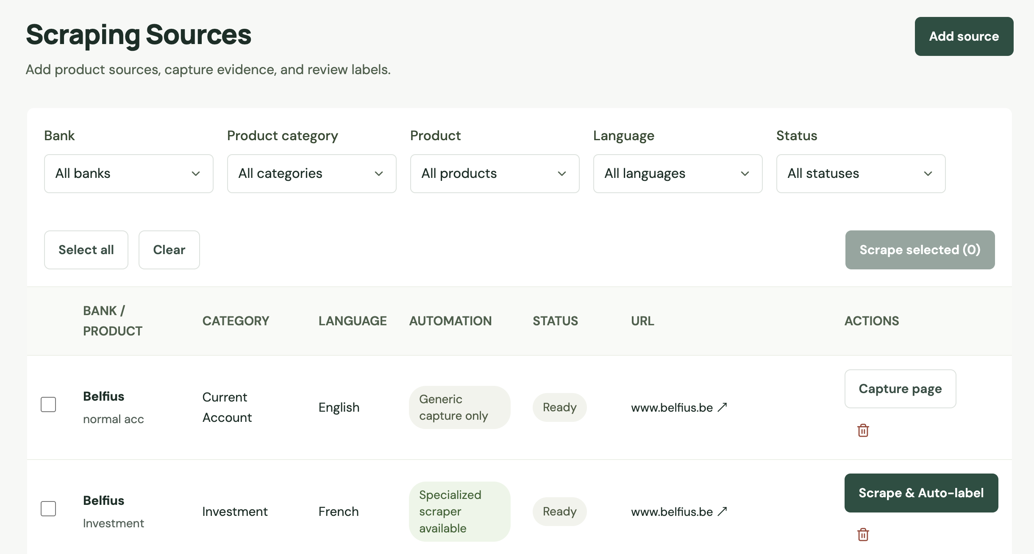
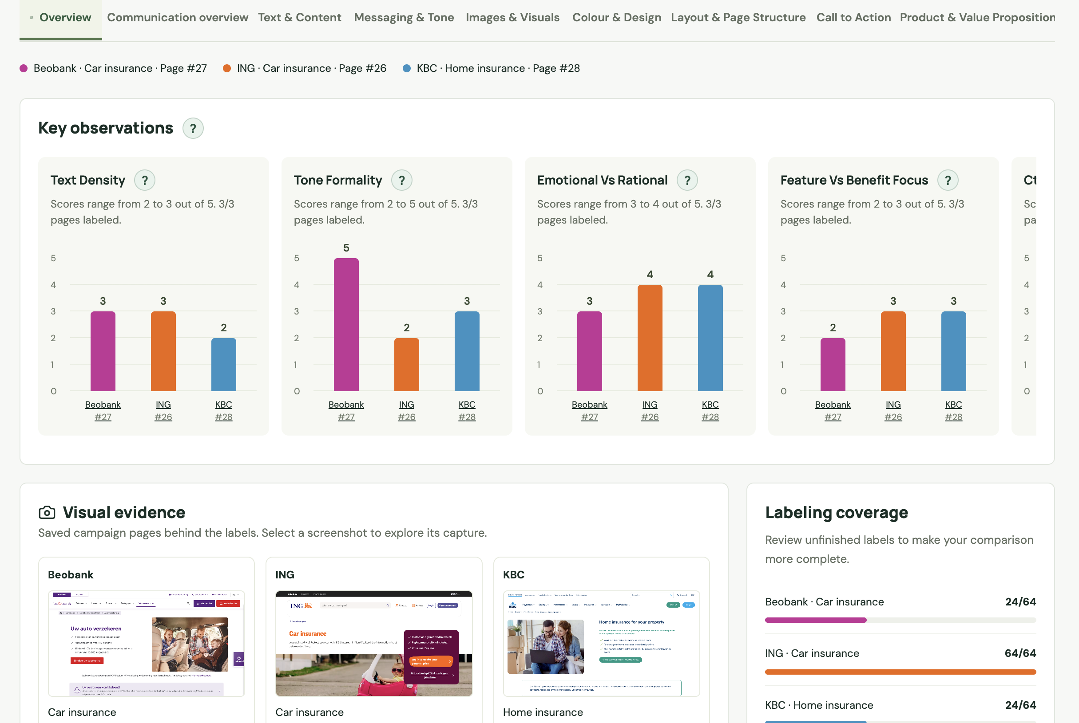
PROJECT / TEAM
Different banks.
One way to compare.
Banking Campaigns Comparator
A research workspace to capture public product pages,
review their features and compare how banks communicate.
Lien - Team lead
Gaetan - Data scientist
Hussein - Data scientist & new father
BANKING CAMPAIGNS COMPARATOR / RESEARCH PROTOTYPE
01 / 08
Notes:
Hello, we are presenting Banking Campaigns Comparator. Our question is simple: when banks offer similar products, how differently do they communicate them? One page may emphasize price, another convenience, and another visual storytelling. We built a workspace that makes those differences easier to examine using the same criteria. Liên KIM leads the team, develops the backend and frontend, and integrates the automation labeling functions contributed by Gaetan and Hussein. The goal is a traceable comparison of communication, rather than a claim about which bank performs best.
Presenter cue: Presenter 1 · 60 seconds. Introduce the contributors; the two speaking roles do not represent the number of team members.

Slide 2
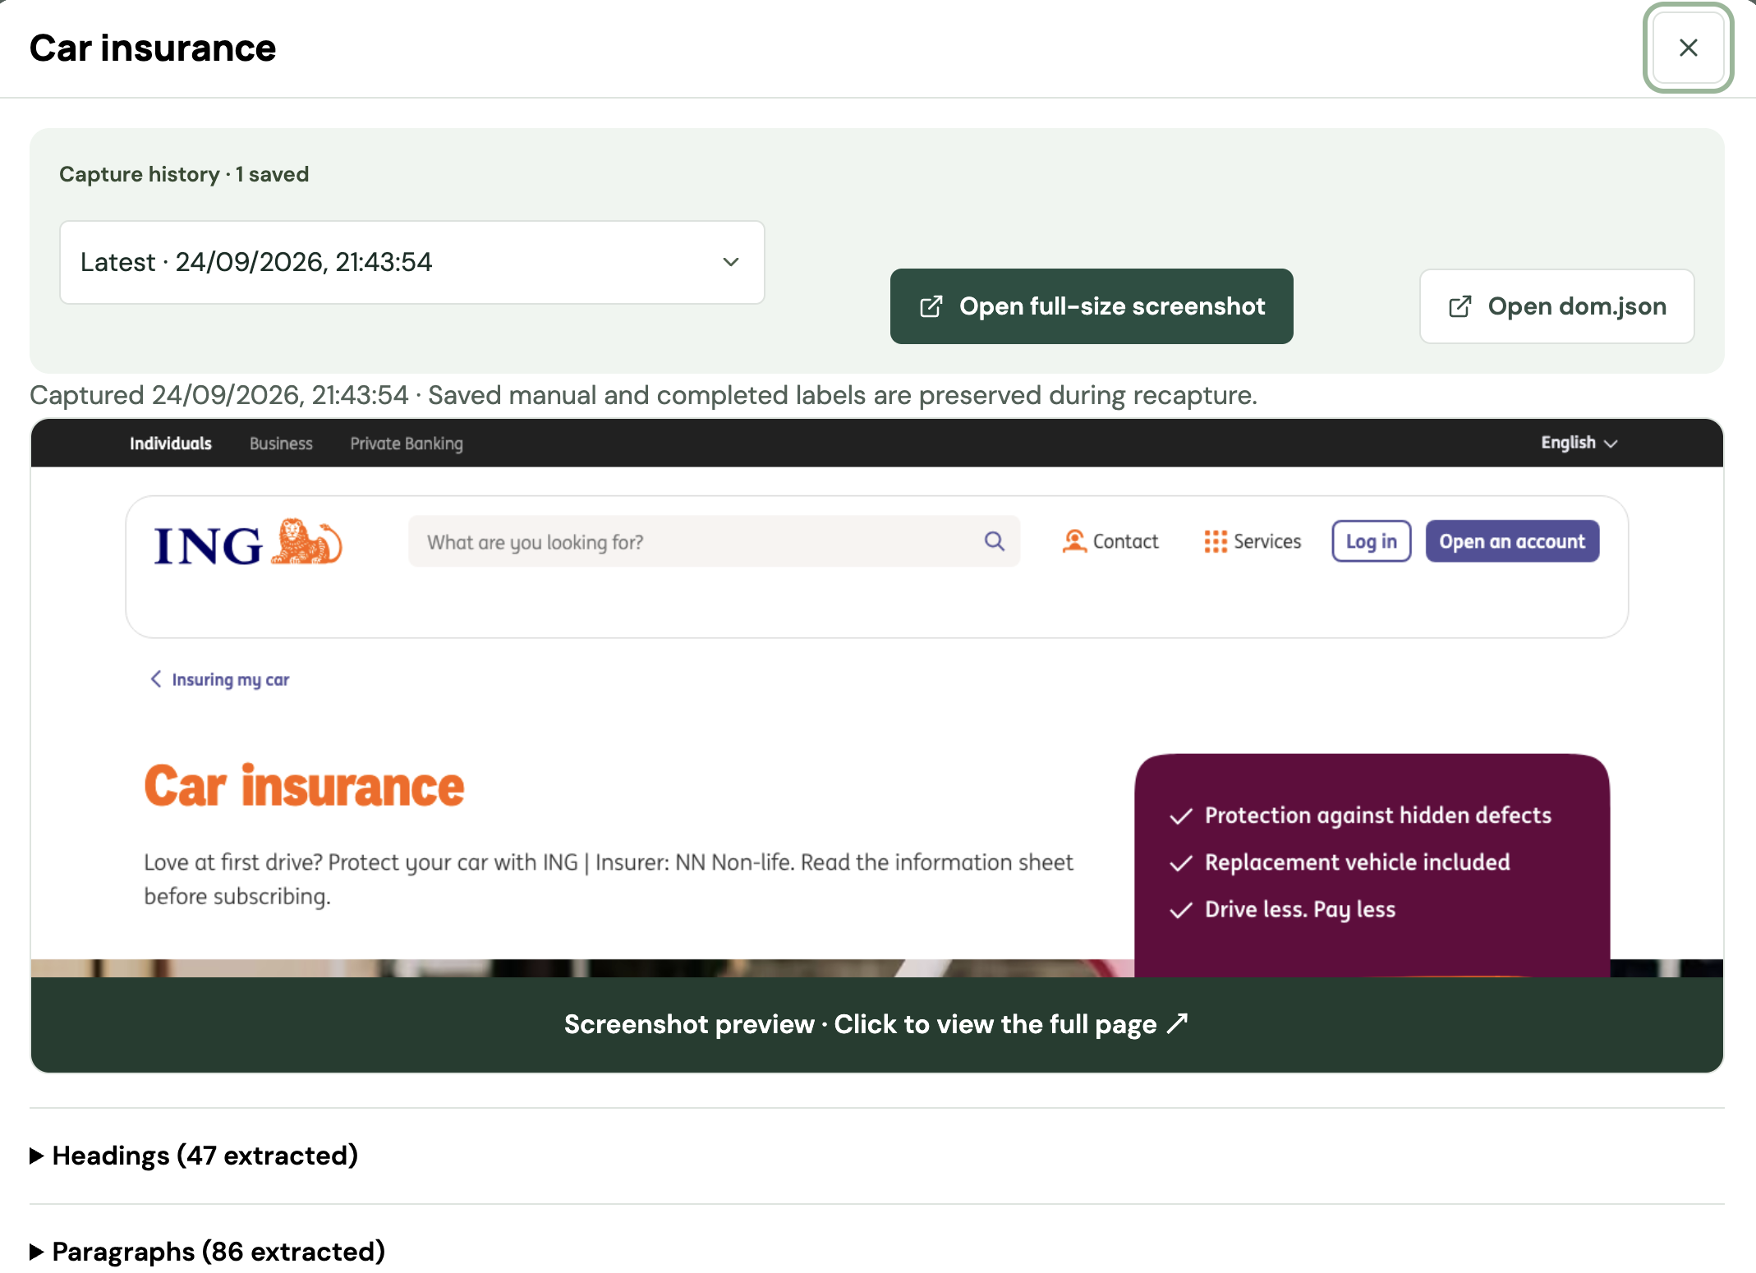
01 / THE IDEA
One workflow. From page to comparison.
The same evidence follows the page through capture, review and comparison.
01
CAPTURE
02
LABEL
03
COMPARE
Text & Content
Automation
Messaging & Tone
Automation
Images & Visuals
Human review
Layout & Page Structure
Human review
Colour & Design
Human review
Call to Action
Automation
Human review
Product & Value Proposition
Save what the visitor sees
(text + image)
Explore differences across pages.
Describe it with shared criteria.
Why it matters: one framework replaces scattered screenshots and inconsistent notes.
BANKING CAMPAIGNS COMPARATOR / RESEARCH PROTOTYPE
02 / 08
Notes:
Imagine comparing three current-account pages. If we simply browse them, each person may notice different things and keep different notes. Our workflow creates a common basis. First, capture the page and its source context. Second, record the same features for each page, using automatic drafts where supported and human review where needed. Third, compare those saved values and return to the evidence whenever something needs explanation. Each step produces something the next step can use. That connection is the main value of the application.
Presenter cue: Presenter 1 · 60 seconds. Follow the three visual objects from left to right. The bars are schematic, not bank findings.

Slide 3
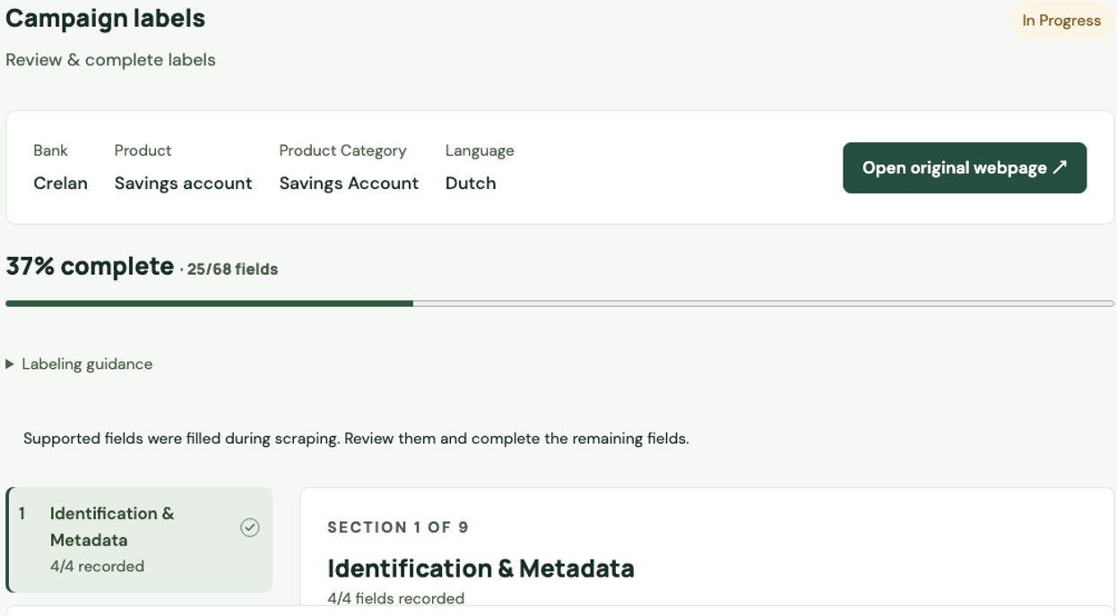
05 / LIVE DEMO
Let’s follow one page through the app.
A 90-second walkthrough using saved evidence, so we can focus on the research process.
01
Open its capture
What did we collect?
02
Review a label
What does this value mean?
03
Compare two pages
Where do they differ?
Demo route: Dataset → Page details → Labels → Compare
BANKING CAMPAIGNS COMPARATOR / RESEARCH PROTOTYPE
03 / 08
Notes:
Let us show that journey in the application. First, we open an existing page and its saved capture. This is the evidence behind the labels. Next, we open the labeling screen and explain one field, including whether it was automatically drafted or manually reviewed. Finally, we choose another comparable page, open Compare and switch the feature dropdown. We can expand a detailed group and return to the capture if we need more context. The important point is that the evidence, labels and comparison remain connected.
Presenter cue: Presenter 2 speaks; Presenter 1 can navigate. Prepare two existing pages in the same category. Do not rely on live scraping. If the app is unavailable, use this earlier repository screenshot as a fallback; it is not a current dataset count.

Slide 4
02 / CATEGORIZE BANKS URLS
Retrieve automatically product urls
For each bank, we first need to automatically find the urls of the different product categories.
1. Crawling
2. Scraping
3. Categorize
4. Retrieve urls
Returns a list of all urls of a bank by reading sitemap (+1000 / bank)
Reads the text of the web pages and cleans it
Finds the product category related to the web page using NLP
Retrieve urls with highest score for each product category
NLP (Natural Language Processing)
Returns a score for each predefined category
Light and pre-trained machine learning model
Runs locally (no key, no quota)
Still takes hours on our machine
Predefined list of product categories (current account, savings account, mortgage loan, family insurance, ...)
Computes a score (0-1) = match with the categories
BANKING CAMPAIGNS COMPARATOR / RESEARCH PROTOTYPE
04 / 08
Notes:
The pipeline starts with a source: its bank, product, language and URL. The backend selects the registered scraper for a supported case, or uses generic capture. Playwright renders the page, and the pipeline collects screenshots, DOM and extracted content with the capture date. Records are stored in PostgreSQL, while capture artifacts are stored as files. A registered labeling function can turn this evidence into an automatic draft. If no label function is available, the evidence is still useful for manual review. Recapture creates new evidence while preserving existing labels. I will now hand over to Presenter 2 to show what review and comparison look like.
Presenter cue: Presenter 1 · 75 seconds. Trace the pipeline, then the two branches. Explain DOM as page structure if the audience is nontechnical.

Slide 5
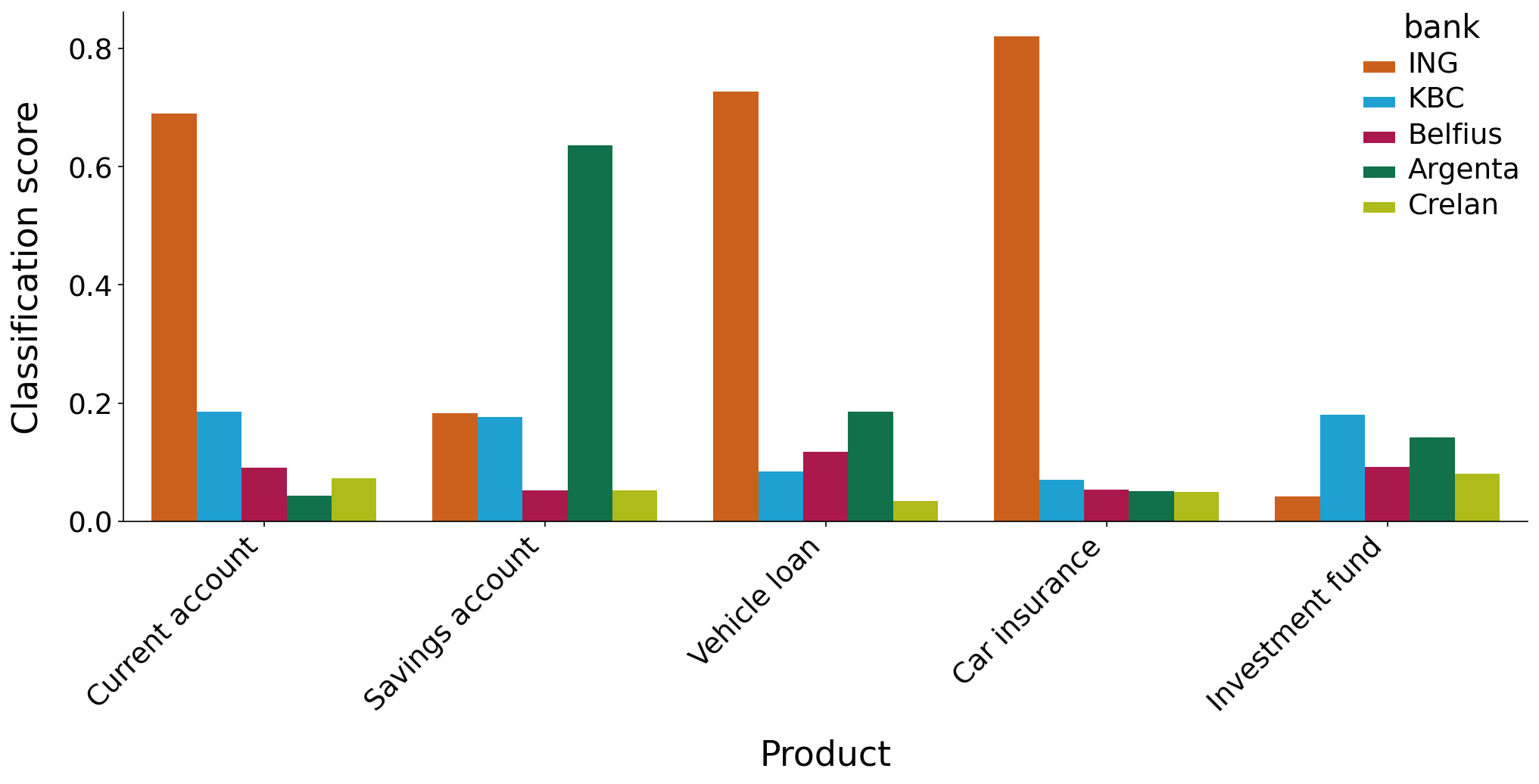
02 / CATEGORIZE BANKS URLS
Test categorization
Subset of urls : 5 banks, 5 products, compute matching score with NLP
Importance of a good matching
SEO (search engine optimization) : google search
GEO (generative engine optimization) : what LLMs thinks about your product
​ based on your website, customer rating on forums, and coherence
BANKING CAMPAIGNS COMPARATOR / RESEARCH PROTOTYPE
05 / 08
Notes:
The pipeline starts with a source: its bank, product, language and URL. The backend selects the registered scraper for a supported case, or uses generic capture. Playwright renders the page, and the pipeline collects screenshots, DOM and extracted content with the capture date. Records are stored in PostgreSQL, while capture artifacts are stored as files. A registered labeling function can turn this evidence into an automatic draft. If no label function is available, the evidence is still useful for manual review. Recapture creates new evidence while preserving existing labels. I will now hand over to Presenter 2 to show what review and comparison look like.
Presenter cue: Presenter 1 · 75 seconds. Trace the pipeline, then the two branches. Explain DOM as page structure if the audience is nontechnical.

Slide 6
03 / SCRAPING AND LABELING PIPELINE
Analyze objectively a webpage.
Capture web pages and label their content to further compare them.
1. Select source
2. Scrape page
3. Compute data
4. Store data
URL, filter by bank, product, language
Read text
Extract images
Compute labels based on several metrics
Store in database for comparison
Text
Image
Low level : length, complexity of vocabulary, tone, call to action (CTA)
Low level : size, colors
High level (with LLM) : feeling, description
BANKING CAMPAIGNS COMPARATOR / RESEARCH PROTOTYPE
06/ 08
Notes:
The pipeline starts with a source: its bank, product, language and URL. The backend selects the registered scraper for a supported case, or uses generic capture. Playwright renders the page, and the pipeline collects screenshots, DOM and extracted content with the capture date. Records are stored in PostgreSQL, while capture artifacts are stored as files. A registered labeling function can turn this evidence into an automatic draft. If no label function is available, the evidence is still useful for manual review. Recapture creates new evidence while preserving existing labels. I will now hand over to Presenter 2 to show what review and comparison look like.
Presenter cue: Presenter 1 · 75 seconds. Trace the pipeline, then the two branches. Explain DOM as page structure if the audience is nontechnical.

Slide 7
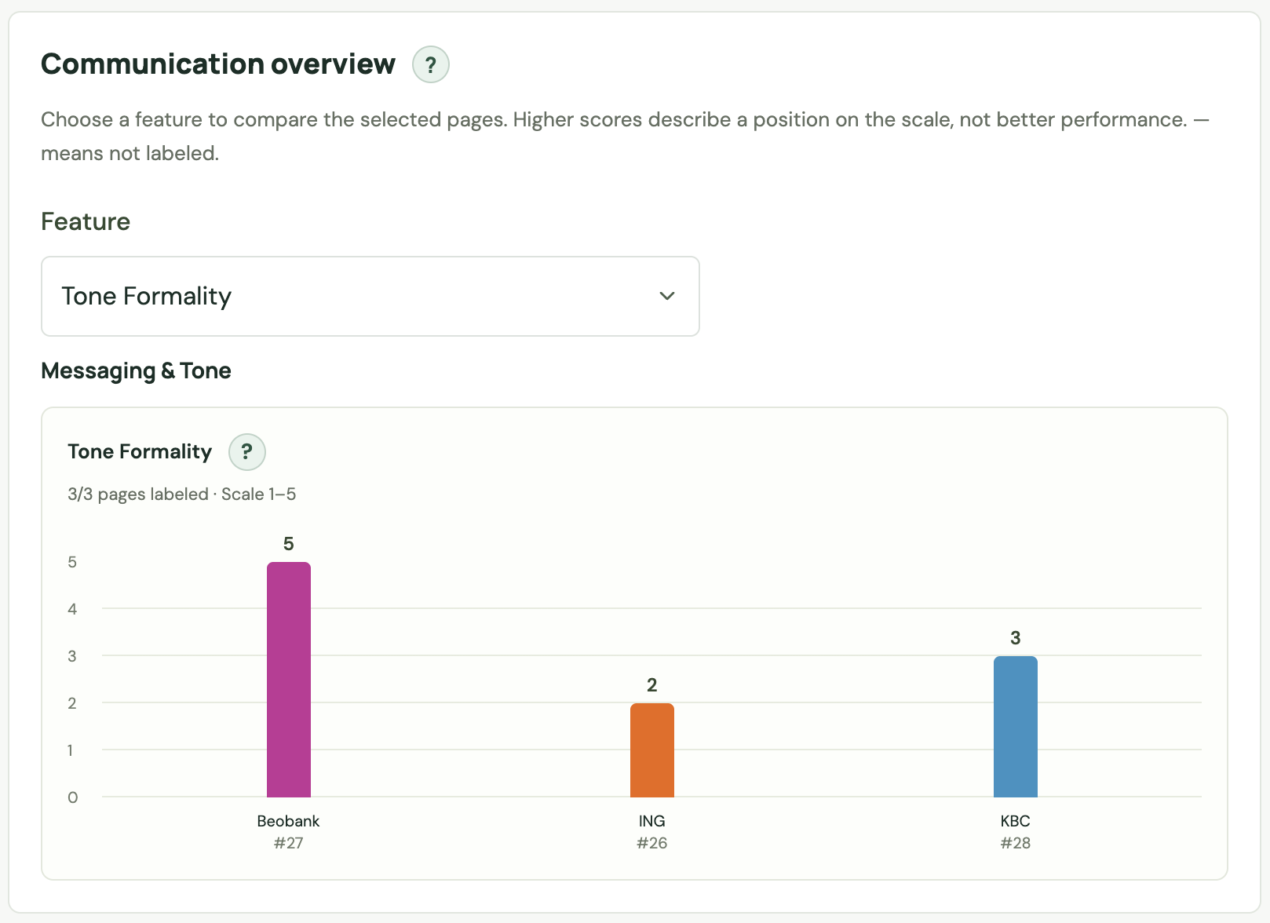
04 / COMPARISON
Spot a difference. Then explain it.
Select comparable pages, choose a feature, and inspect the values behind the chart.
01
Read the chart
A higher score describes the scale;
it does not mean better performance.
02
Open the details
Compare exact labels and see
which values are still missing.
03
Check the capture
Return to the page before drawing
a research conclusion.
The product shows you numbers, but does not tell you which is better.
You should draw your conclusions based on your own strategy.
BANKING CAMPAIGNS COMPARATOR / RESEARCH PROTOTYPE
07 / 08
Notes:
Suppose we want to compare tone formality. We select suitable pages and choose that feature in the dropdown. The chart shows one bar per page; ING products use shades of orange. In this teaching example, a value of four means more formal than a value of two. It does not mean better communication. Next, we open the detailed comparison to inspect stored values and missing labels. Finally, we return to the capture to understand the context. These example scores are illustrative, not actual bank findings. The app makes differences visible, but a defensible conclusion still depends on comparable pages and reviewed labels.
Presenter cue: Presenter 2 · 75 seconds. Explain one difference between 4 and 2, then follow the three numbered actions.

Slide 8
05 / AUTOMATION SCOPE
What is automated — and what stays human?
The next step is broader coverage and better validation, not removing the reviewer.
AVAILABLE NOW
NEXT DEVELOPMENT
HUMAN REVIEW
Capture & store labels
More sources
Visual clarity and meaning
Automatic labeling features:
Text & content
Messaging & tone
Images & visuals
CTA
Calibrate scoring rules
Ambiguous messaging
Validate with marketing team
Final research conclusions
Increase list of computed labels
BANKING CAMPAIGNS COMPARATOR / RESEARCH PROTOTYPE
08 / 08
Notes:
We already have the capture flow and measured text fields. Supported cases also provide draft messaging and CTA labels integrated into the application. That support is configured by source case; it is not universal. The next development direction is to cover more cases, calibrate the rules and compare the drafts against human annotations. We present these as proposed next steps because the active workstream has not been confirmed. Visual clarity, image meaning and ambiguous messaging should remain under human review. Final conclusions also need a person who understands the research question. Automation helps us work consistently and faster, while the analyst remains responsible for interpretation.
Presenter cue: Presenter 2 · 75 seconds. Separate implemented support from proposed continuation. Do not claim fully automatic visual analysis or validated business recommendations.

Slide 9
DISCUSSION
Questions
& answers
?
BANKING CAMPAIGNS COMPARATOR / RESEARCH PROTOTYPE
Notes:
To close, we started with scattered public webpages and built a shared research workflow. We can keep the evidence, apply the same labeling framework and explore communication differences in one place. The application supports the analysis; it does not turn a chart into a business conclusion on its own. Thank you. We are happy to discuss the scraping pipeline, automation boundaries, labeling choices or how to interpret a comparison.
Presenter cue: Both presenters · Q&A. Liên can cover app architecture and integration. Attribute the labeling-function contributions to Gaetan and Hussein without inventing individual feature ownership.

