Slide 1
ORANGE BUSINESS
Opportunity Spaces Innovation Radar
A regularly refreshed view of specific innovation opportunities — each scored on how attractive it is, how urgent the window is, and how strong Orange's right to win is.
MVP walkthrough · concepts · functionality · architecture

Slide 2
WHY
The problem is not a shortage of information
The available information about technology is generic, undated, unsourced — and disconnected from what Orange can actually sell.
REJECTED AS TOPICS
"AI"
"Cloud"
"Cybersecurity"
The radar's value is the join between an external signal and an internal asset, expressed at a level of specificity a salesperson can use in a meeting on Thursday.
"Digital transformation in retail"
WHAT A TOPIC MUST LOOK LIKE
Private 5G plus edge vision for safety compliance in mining
Orange Business · Opportunity Spaces / Innovation Radar
2

Slide 3
CONCEPT
An opportunity space is a triple
Identity is the triple. The statement is a rendering of it — both are stored.
VERTICAL
USE CASE
TECHNOLOGY
Manufacturing
×
OT / ICS security
×
SIEM and SOAR
SIEM/SOAR-based OT security analytics for legacy SCADA and ICS in brownfield manufacturing sites.
The triple gives deduplication and filtering. The statement gives the specificity a salesperson needs. A candidate that does not resolve to exactly one of each fails validation.
Orange Business · Opportunity Spaces / Innovation Radar
3

Slide 4
CONCEPT
Two scores, never one
They answer different questions and are owned by different people.
ATTRACTIVENESS
RIGHT TO WIN
CONVICTION
Is the world moving?
Can we play, can we win?
Do our own people believe it?
Market signal strength · Source diversity · Evidence quality · Novelty and momentum · Strategic relevance
Offer match · Reference density · Partner coverage · Compliance fit · Capability depth · Analyst recognition · Technology ownership
Strategic fit (strategy) · Customer demand (sales) · Deliverability (presales)
Computed from external evidence only.
Computed from the Orange Business Graph as named query results — never asserted by a model.
Adjusts what surfaces first for each role. Never alters the other two.
Collapsing them destroys the information the strategist needs: a topic can be excellent for a strategist (large, early, no proof points) and useless for a salesperson (nothing to show).
Orange Business · Opportunity Spaces / Innovation Radar
4

Slide 5
CONCEPT
Evidence before generation
The model never invents a topic from its own knowledge. It reorganises retrieved, dated, attributable evidence.
1 · Evidence binding
Every claim cites signal ids that must exist in the cluster that produced the candidate. Uncited claims are stripped, not rewritten.
PLUS AN ADVERSARIAL CRITIC
A separate critic prompt scores 1–5 as the MINIMUM across five tests, so one failure caps the whole score. In the live run it rejected 345 of 644 candidates — with specific, written reasons.
2 · Closed vocabulary
Taxonomy values are validated against the enumerations. A recognised synonym is repaired once; anything else is dropped.
3 · No generated numbers
Market sizes, growth rates and percentages are looked up and attributed, or they are absent. Backstopped by a regex.
4 · Entailment check
A second model pass verifies each claim is actually entailed by the span it cites.
Orange Business · Opportunity Spaces / Innovation Radar
5

Slide 6
CONCEPT
Portfolio distance decides whose conversation it is
The shortest path from a topic to a configuration Orange could actually deliver.
L0
Direct
An existing offer addresses it as it stands
Sales — sell it
L1
Bundle
Two or more existing offers combined
Presales — package it
L2
Partner-dependent
Needs a capability a partner already holds
Presales / alliances — assemble it
L3
Adjacent
Needs one capability built; nearby assets exist
Strategy — study it
L4
White space
No plausible path from the current portfolio
Strategy — watch or reject
This is what drives the role modes — they are not arbitrary presets. A high-attractiveness L4 topic is exactly the strategist's innovation agenda, and exactly what a salesperson should never be shown.
Orange Business · Opportunity Spaces / Innovation Radar
6

Slide 7
STATUS
What the MVP has actually produced
Every figure below is read from the live database, not typed into this deck.
174
4,658
18
2,007
12.3
OPPORTUNITY SPACES
SIGNALS INGESTED
LIVE SOURCES
ASSET LINKS
SIGNALS PER TOPIC
14/15 verticals covered
2,064 passed the gate
19 of 25 catalogued
181 graph nodes
evidence depth after enrichment
Coverage of the evidenced grid
37 of 59 use cases and 28 of 38 technologies appear in at least one topic — the grid is deliberately sparse; most cells should stay empty.
3,422 tier-1 signals from regulators, procurement portals, standards bodies and official statistics.
508 French-language signals so the anglophone bias named as a principal risk is measured, not assumed.
174 sized · 174 competition-scored · 62 with a sales brief each carrying its method and confidence, not a quoted headline figure.
Orange Business · Opportunity Spaces / Innovation Radar
7

Slide 8
CONCEPT
Sizing and competition, with the working shown
Two questions a topic cannot be acted on without: how big is it, and who else is already there?
MARKET SIZE — BOTTOM UP, NOT QUOTED
COMPETITIVE INTENSITY
Headline market figures in press coverage originate from paid research, are quoted without methodology, and frequently conflict by an order of magnitude. So the radar builds its own: enterprise counts by sector and size class, times an observed adoption rate, times a plausible contract value. Every estimate carries its method, its inputs and a confidence label — and can be rejected on its arithmetic.
Scored from a versioned competitor register against the evidence actually collected — who is visibly playing here. A crowded field is not a reason to walk away; it is a reason to win on a specific differentiator. And 'no competitor found' is reported as unverified rather than as empty, because it may only mean the register has a gap.
Both are filterable and sortable, because a number the radar computes but cannot be sorted on is a number a strategist has to eyeball across a hundred and forty-eight rows.
Orange Business · Opportunity Spaces / Innovation Radar
8

Slide 9
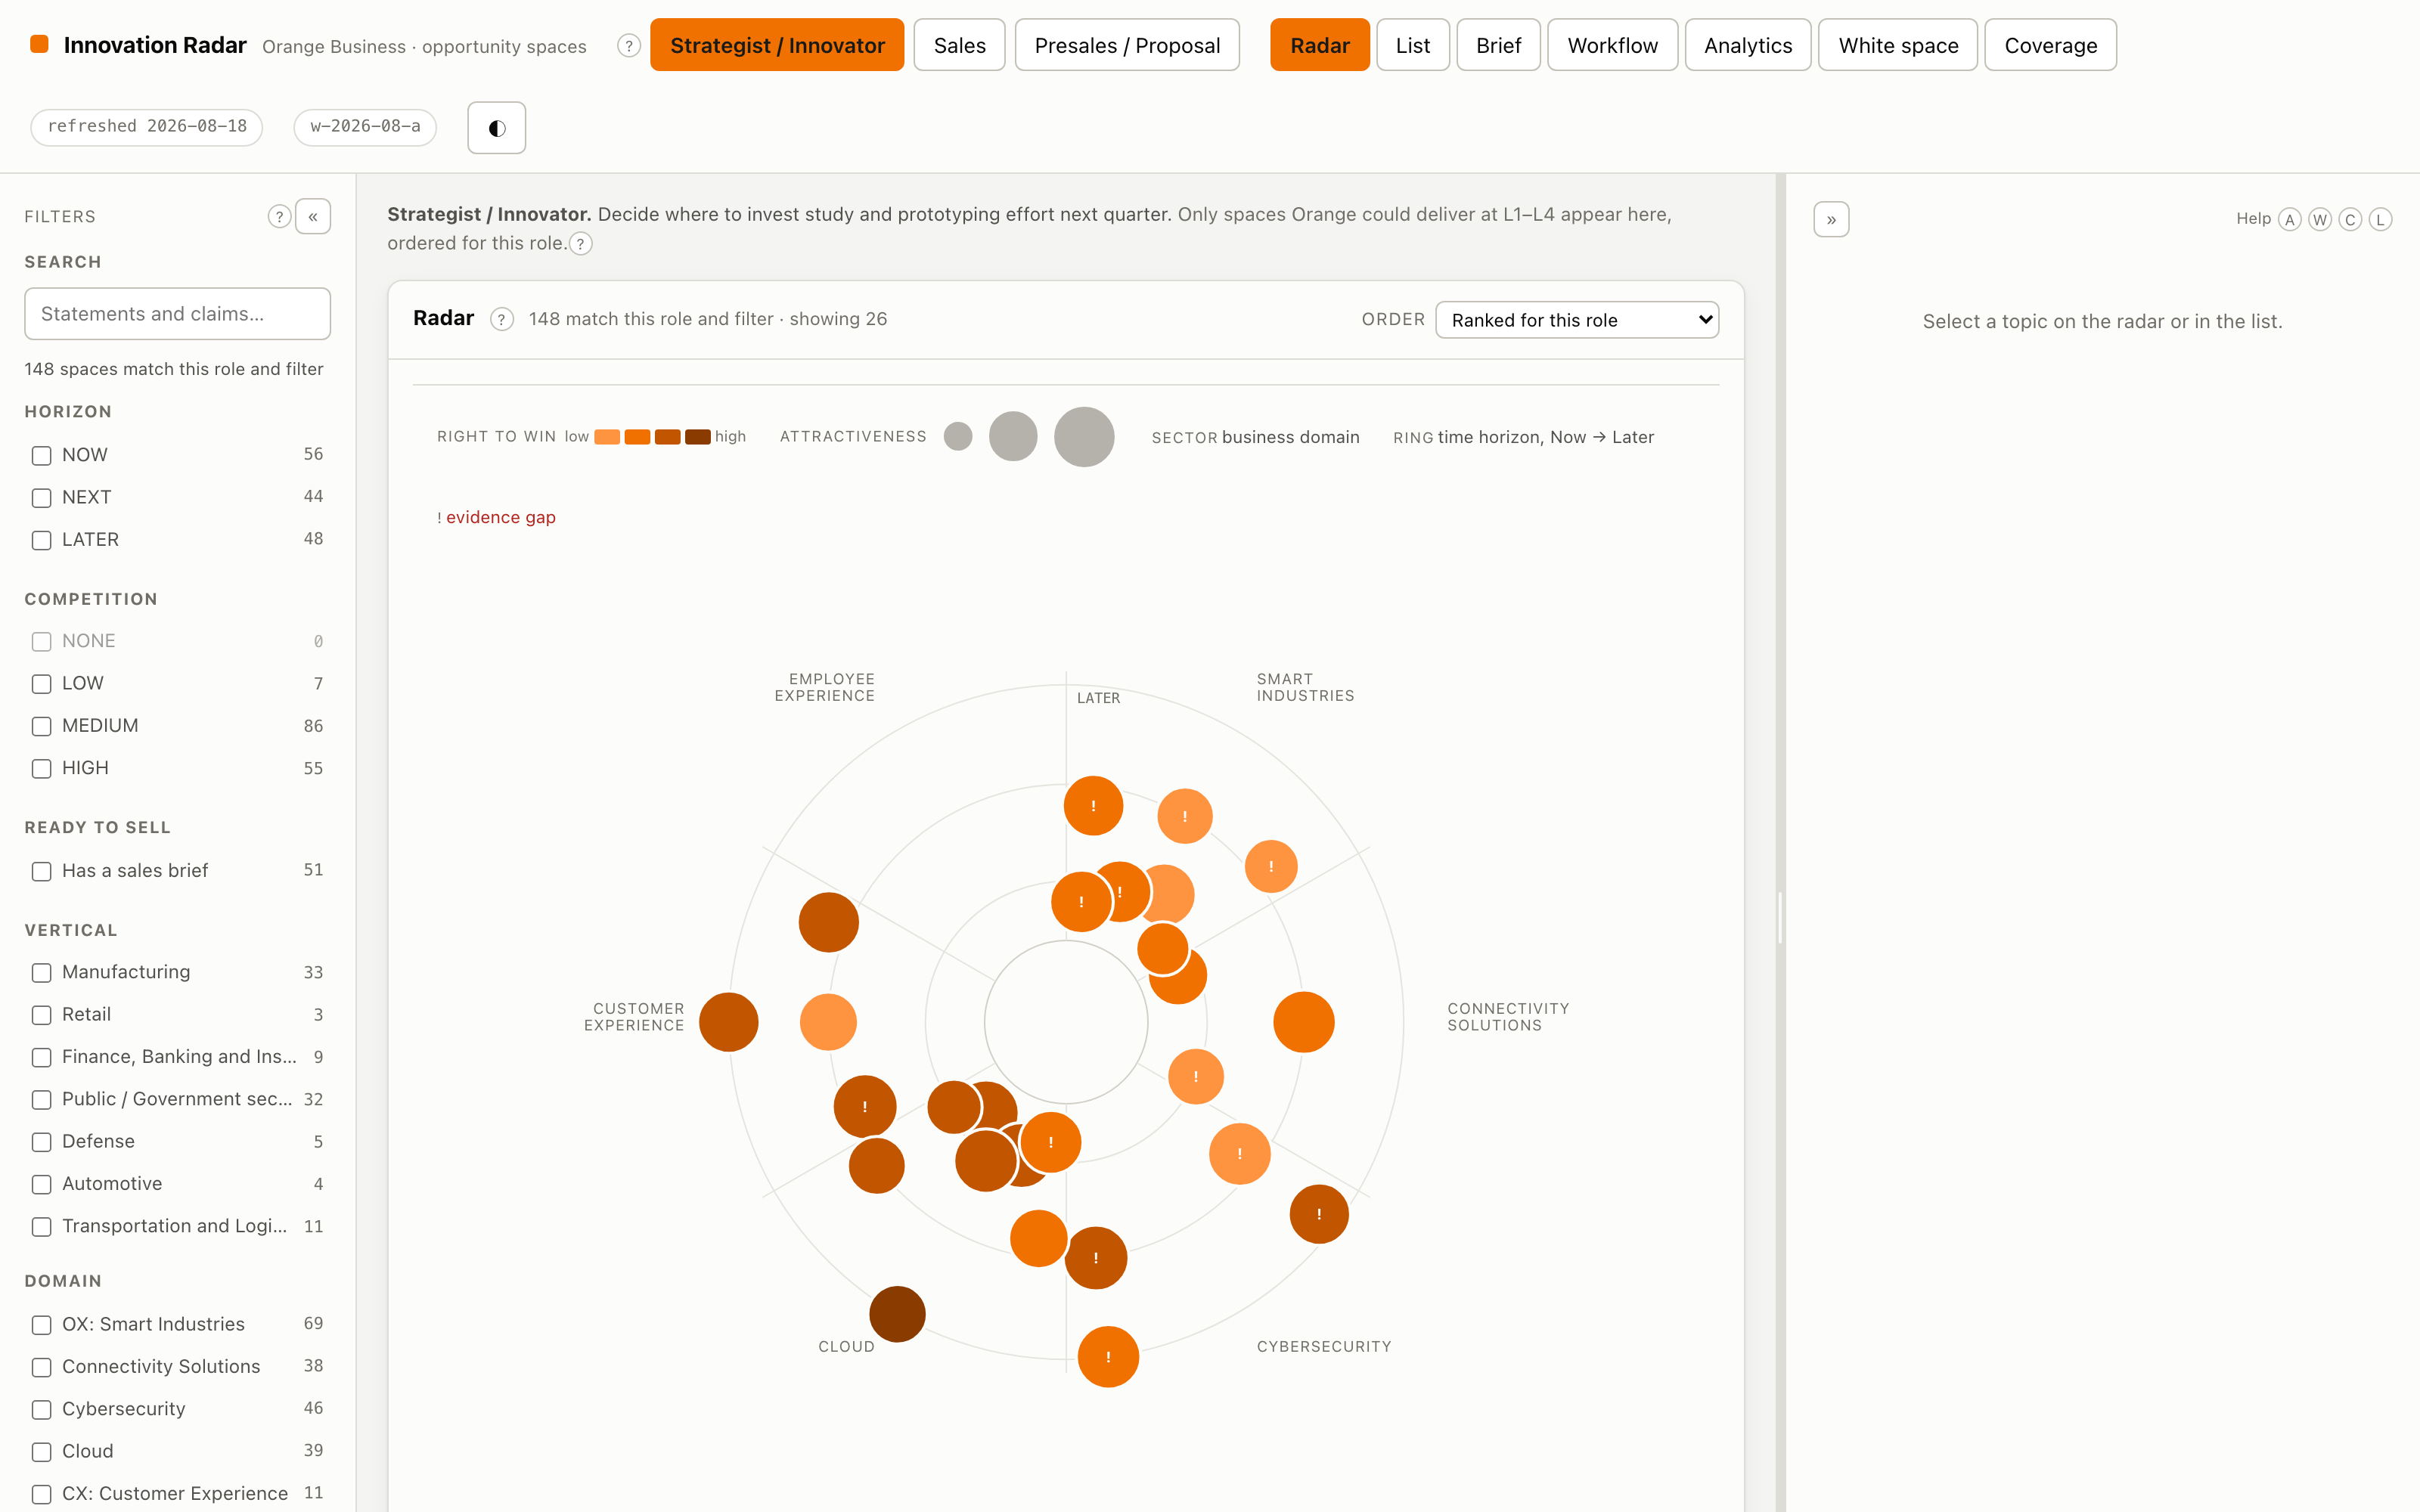
FUNCTIONALITY
The radar view
Four dimensions without a legend anyone has to study
Angular sector is the business domain. Distance from the centre is the time horizon — Now at the middle, Later at the rim. Marker size is attractiveness; marker colour is right to win. Position carries identity, so colour is free to encode a quantity. A ! inside a marker means an evidence gap.
Orange Business · Opportunity Spaces / Innovation Radar
9

Slide 10
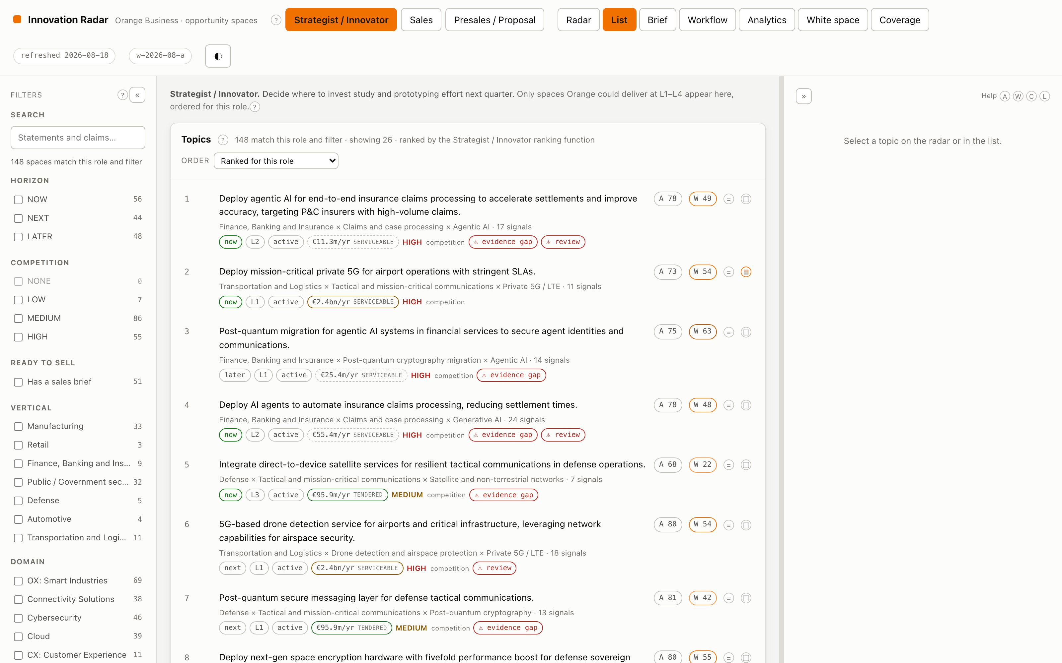
FUNCTIONALITY
Role-ranked list
The same data, three genuinely different rankings
Strategist ranks on attractiveness and novelty and ignores right-to-win. Sales ranks on right-to-win and proof-point density, and only sees topics with a delivery path, a published reference in the vertical, and no evidence gap. Presales ranks on differentiation.
Orange Business · Opportunity Spaces / Innovation Radar
10

Slide 11
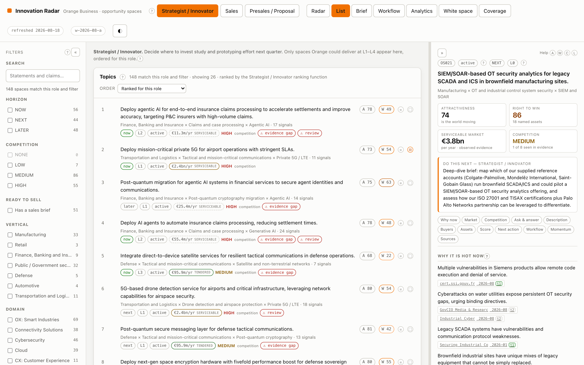
FUNCTIONALITY
Topic detail
Every claim traceable to a dated source
One page in the order the user's questions arrive: the statement, why it is hot now with each claim linked to its signals, where it delivers value and for whom, can-we-play/can-we-win itemised against named Orange assets, the score breakdown expanded, and the next action for the current role.
Orange Business · Opportunity Spaces / Innovation Radar
11

Slide 12
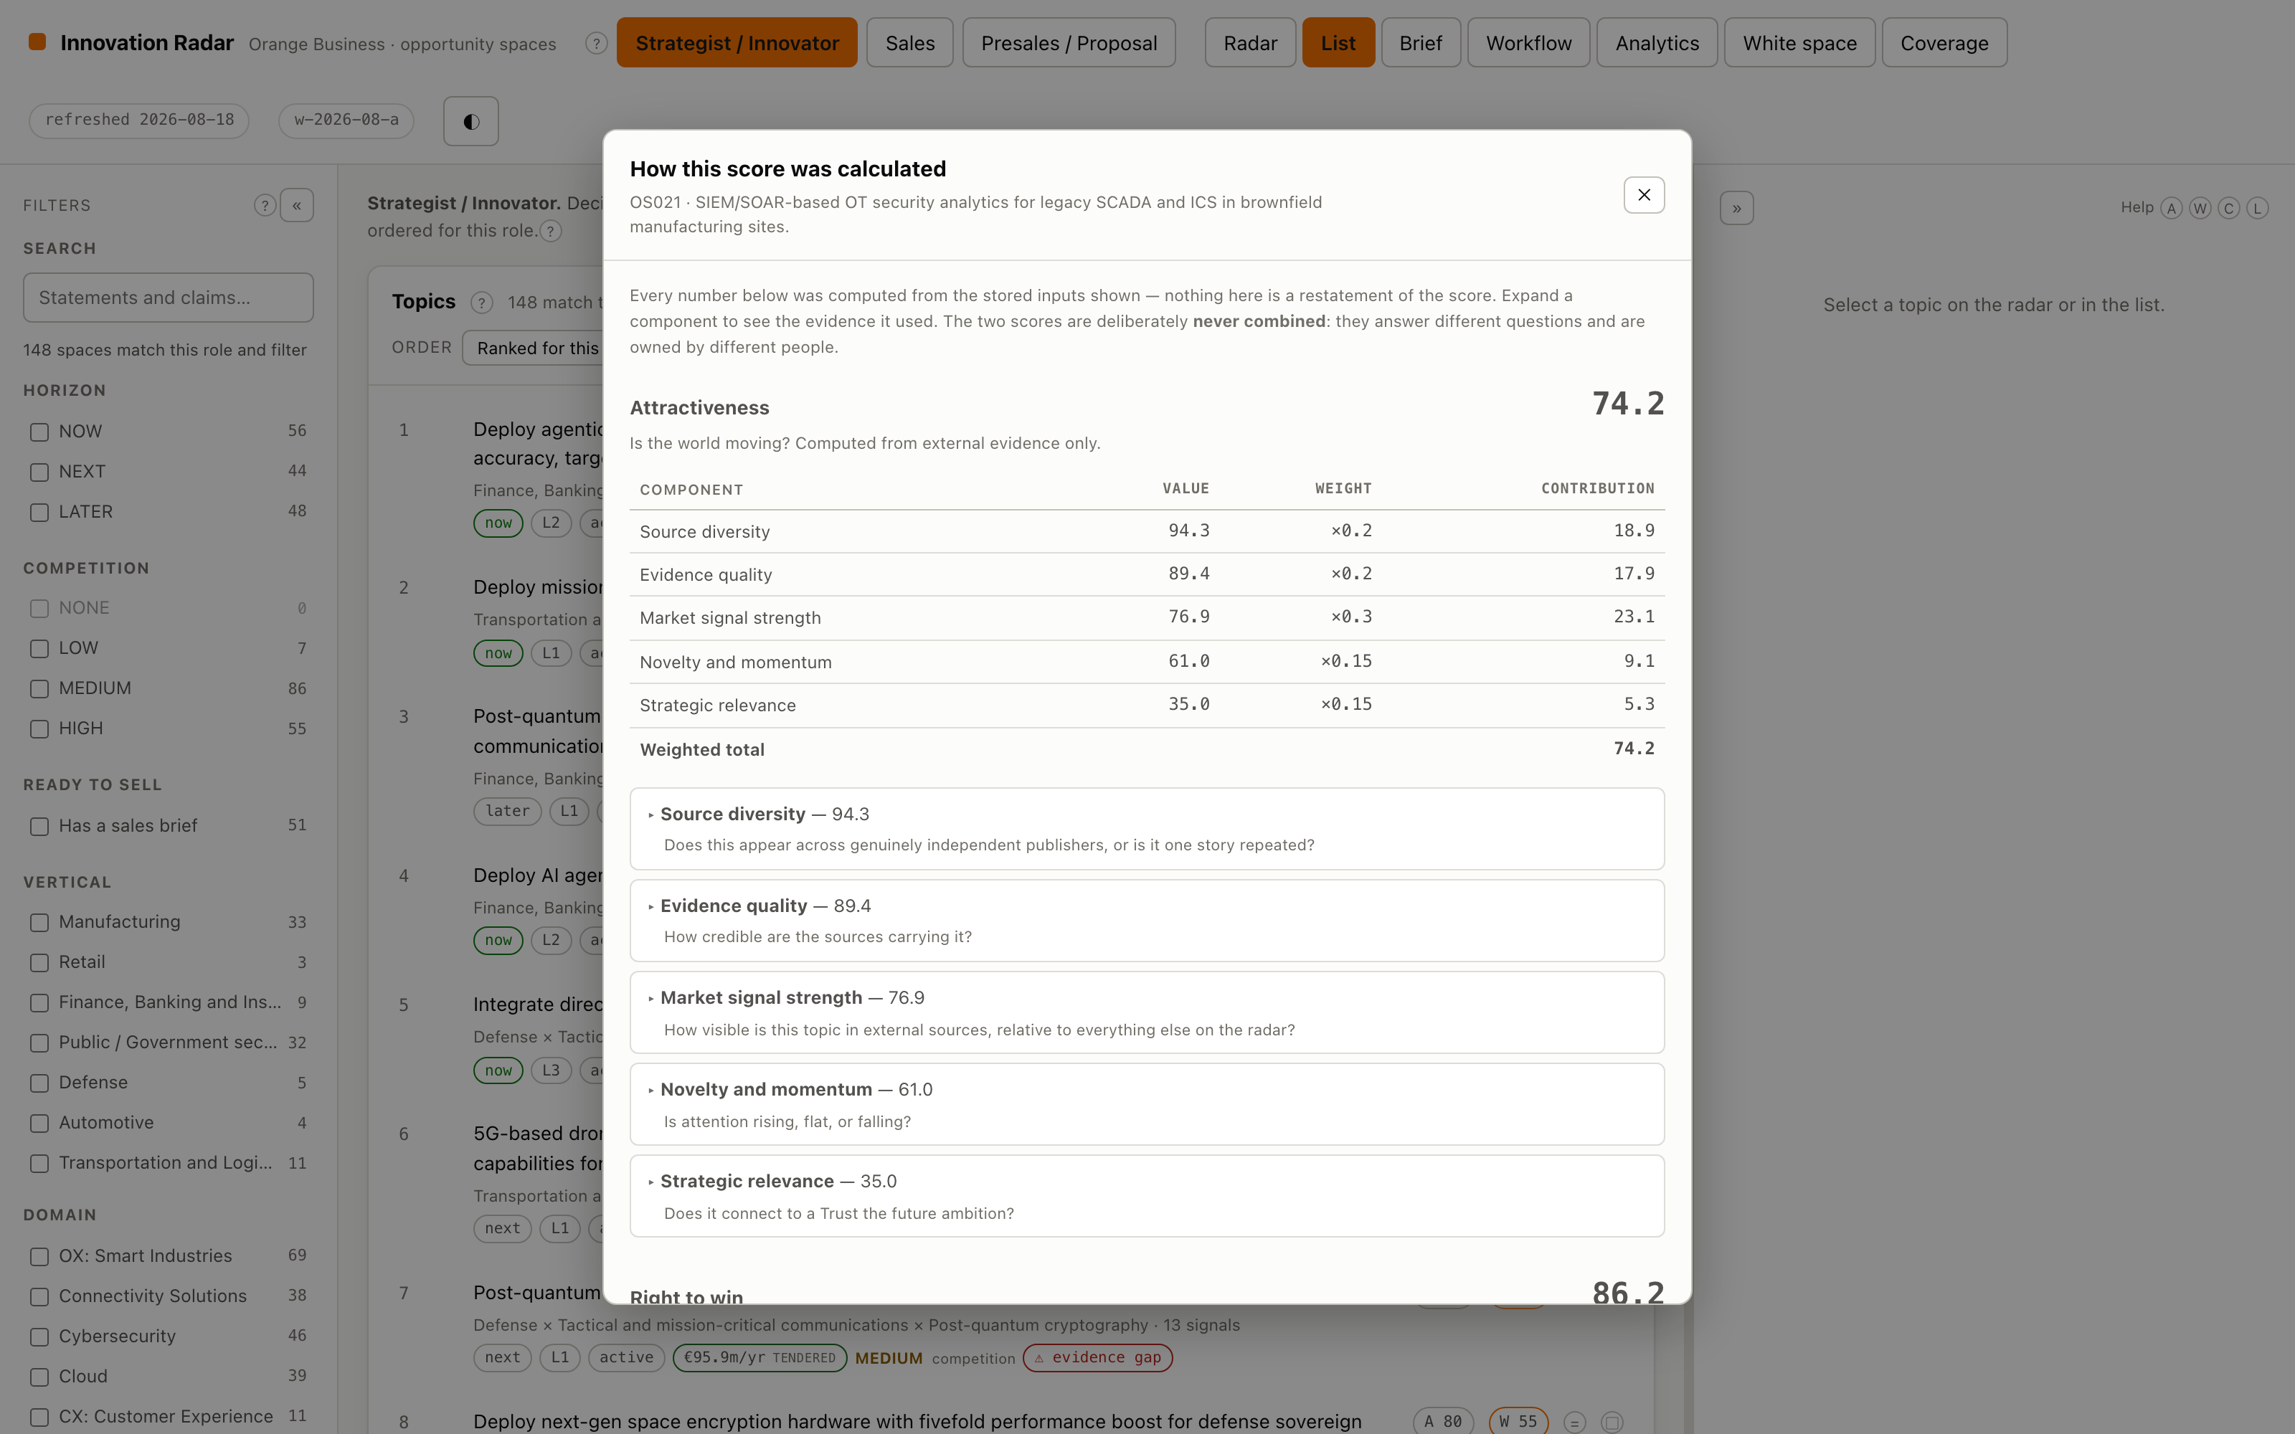
FUNCTIONALITY
How this score was calculated
Explainability made checkable rather than asserted
Every component shows the stored inputs and the arithmetic: publisher entropy and the publishers counted, the tier distribution, the per-period buckets the momentum slope was fitted to, the rubric level and its rationale. A reviewer outside the project can reconstruct why any topic holds its rank.
Orange Business · Opportunity Spaces / Innovation Radar
12

Slide 13
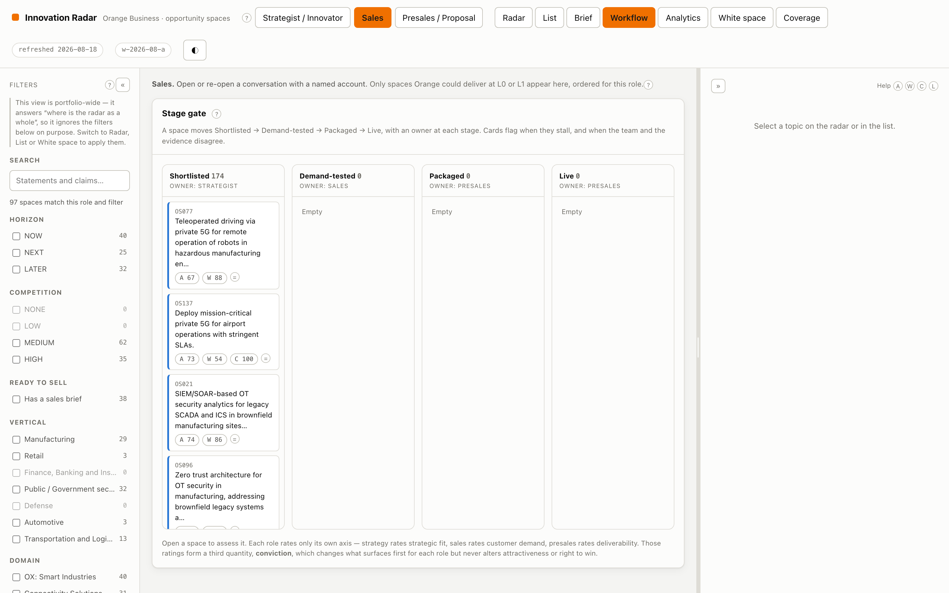
FUNCTIONALITY
Stage gate and role assessment
Shortlisted → Demand-tested → Packaged → Live
Ownership follows the stage, and stalled cards are flagged because latency is the known weakness of a stage gate. Each role rates only the axis it owns, on a 0–5 scale with written anchors. Those ratings form conviction — a third quantity that changes ranking only.
Orange Business · Opportunity Spaces / Innovation Radar
13

Slide 14
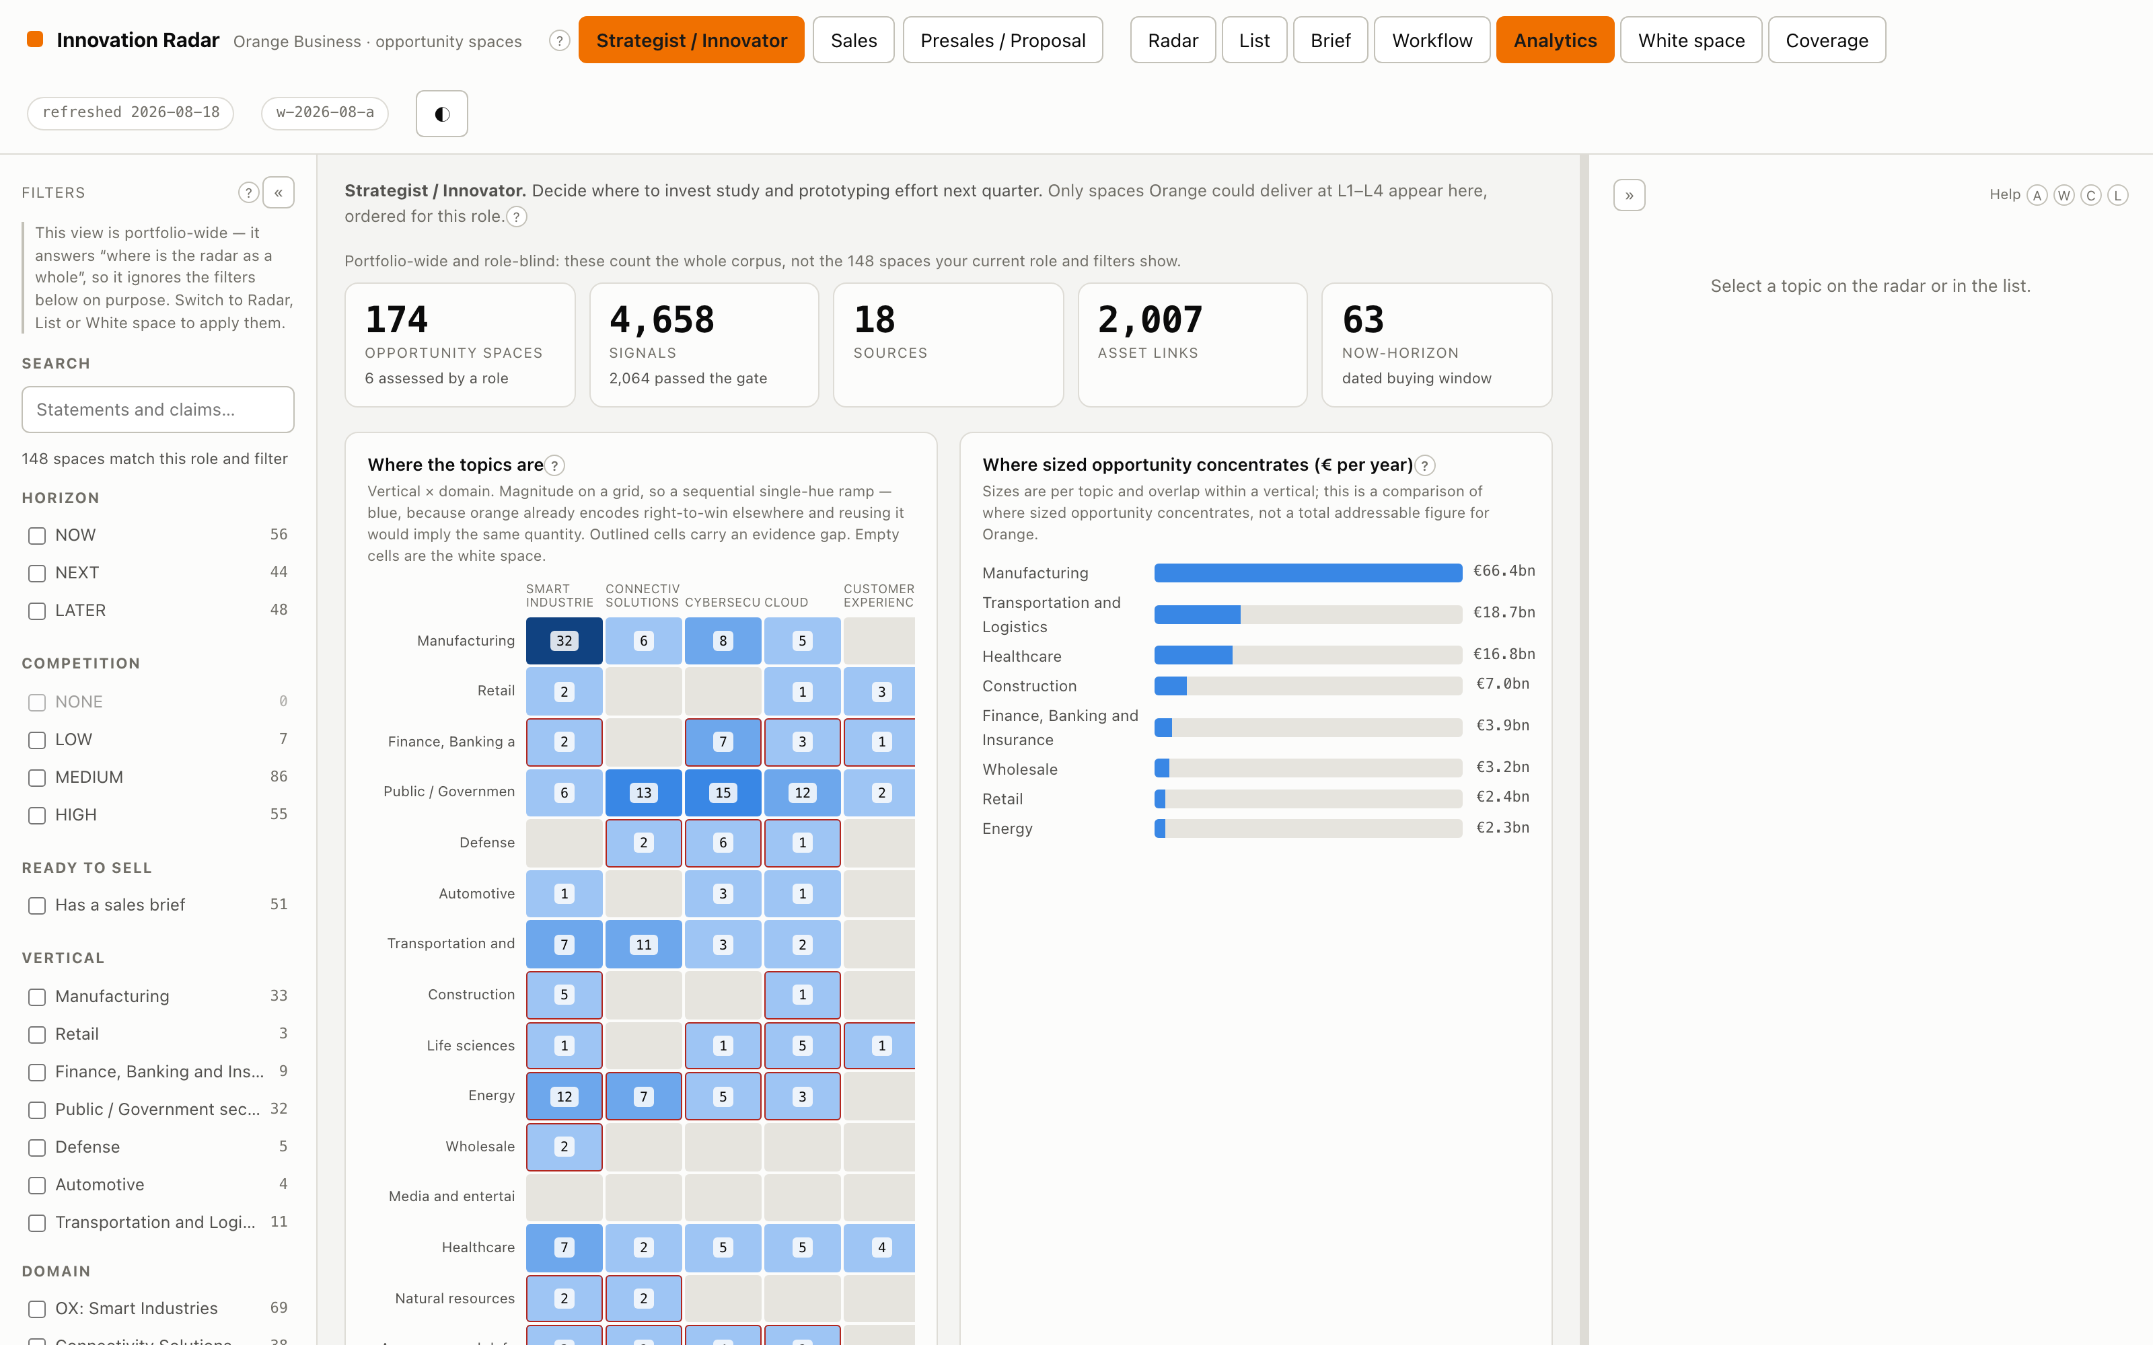
FUNCTIONALITY
Analytics
Charts chosen by the job the data does
The vertical × domain heatmap is magnitude on a grid, so sequential. Conviction versus evidence is polarity, so diverging with a neutral midpoint — agreement reads as nothing. The stage funnel is an ordered sequence, so ordinal. Only the signal-type mix is categorical, and it ships a legend and a table.
Orange Business · Opportunity Spaces / Innovation Radar
14

Slide 15
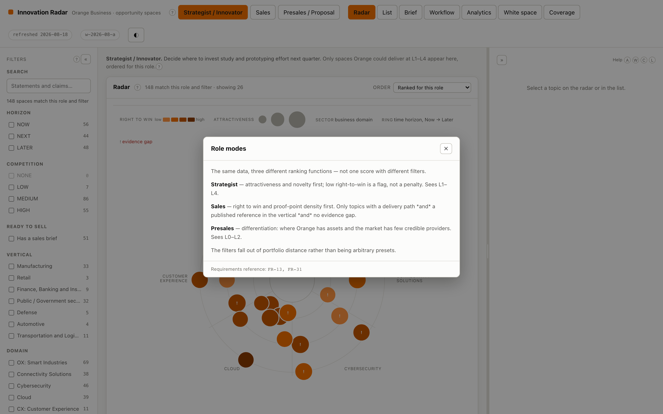
FUNCTIONALITY
Contextual help
Every dense concept explains itself
Portfolio distance, conviction, divergence, evidence gaps, source tiers, horizons, the lifecycle, the exploration slot. Each entry says what the thing is, why it works that way, and which requirement it comes from — so the answer is checkable rather than merely confident.
Orange Business · Opportunity Spaces / Innovation Radar
15

Slide 16
ARCHITECTURE
Seven pipeline stages, each with a contract
Stages can be developed, tested and replaced independently.
1 Collect
2 Normalise
3 Classify
4 Themes
5 Synthesise
5b Enrich
6 Score
7 Serve
connectors
ingest
ingest
themes
synthesis
enrich
graph + scoring
readmodel + api
source config → raw items
raw items → signal records
→ typed, tiered signals
→ theme clusters
→ candidate spaces
→ more evidence per topic
→ ranked spaces
→ radar, briefs, API
A parallel, slower path maintains the Orange Business Graph
Offers, references, partners with tiers, certifications, analyst positions, capability pools and research assets. It joins at stage 6, so right-to-win can be improved without re-running discovery. Links are typed L0–L4 and carry the evidence that justified them.
Collection runs in parallel — twelve sources in about forty-five seconds — while database writes stay serial, because deduplication is a read-modify-write over the whole signal table.
Orange Business · Opportunity Spaces / Innovation Radar
16

Slide 17
ARCHITECTURE
Stack and separation of concerns
INGESTION
INTELLIGENCE
SERVING
19 connectors: TED, BOAMP, UK Contracts, EUR-Lex SPARQL, Have-your-say, GDELT, news RSS (EN/FR), Hacker News, OpenAlex, Crossref, arXiv, CORDIS, NIST, CERT-FR Parallel fetch · circuit breaker · per-host pacing · replay-safe dates
DeepSeek behind a provider-agnostic client (swap to Ollama via .env alone) Local sentence-transformers for embeddings and clustering Deterministic where possible, generative only where it earns its place
SQLite — the graph is thousands of nodes, not millions FastAPI read API React + Vite + TypeScript Hand-drawn SVG radar, no chart library
Taxonomies, weights, thresholds, sources, the business graph and the crosswalks are all configuration, not code — and are validated at load time, so a dangling id is a startup error rather than a wrong number three stages later.
Orange Business · Opportunity Spaces / Innovation Radar
17

Slide 18
ARCHITECTURE
What makes the numbers defensible
The governing constraint: if a user cannot explain why a topic is ranked where it is, the scoring is not good enough.
Decomposable
Reproducible
Every displayed number breaks into named components; no opaque scores.
Every component stores the inputs used to compute it, so any number can be re-derived.
Traceable
Versioned
Full lineage from a displayed claim back to the raw ingested item, including prompt and model version.
Every score records its weight set. Trajectories are never plotted across a boundary silently.
Auditable
Bounded
A reviewer outside the project can reconstruct why any topic holds its rank.
Counting, diversity, recency and momentum are arithmetic — never a model. A model asked to count is unverifiable.
Orange Business · Opportunity Spaces / Innovation Radar
18

Slide 19
STATUS
What is deliberately not built — and what needs a decision
NOT BUILT, WITH THE REASON
NEEDS A DECISION FROM ORANGE
CRM integration deferred; public assets give a sufficient right-to-win proxy
Who is the curator? 2,007 links are machine-proposed and unconfirmed
Learned scoring models no labels exist on day one; the capture and replay harness ships instead
No agriculture vertical agri topics are being forced into four other verticals
Patent connector needs EPO registration; technology ownership uses a portfolio-level prior
Terms of use unconfirmed for ten enabled sources — a Sprint 0 blocker
Learned ranking per role needs 300-600 expert comparisons; the capture widget ships first
Refresh cadence drives connector design and cost more than any other choice
The radar reports its own gaps rather than hiding them: evidence-gap warnings, language coverage, unconfirmed links and skipped sources are all surfaced in the interface.
Orange Business · Opportunity Spaces / Innovation Radar
19

Slide 20
The join is the product
Without it the radar is a competent trend feed, and trend feeds already exist. With it, the radar answers a question nobody else can answer for Orange.
174 opportunity spaces · 4,658 signals · 18 live sources · 2,007 named asset links

